Slide 1


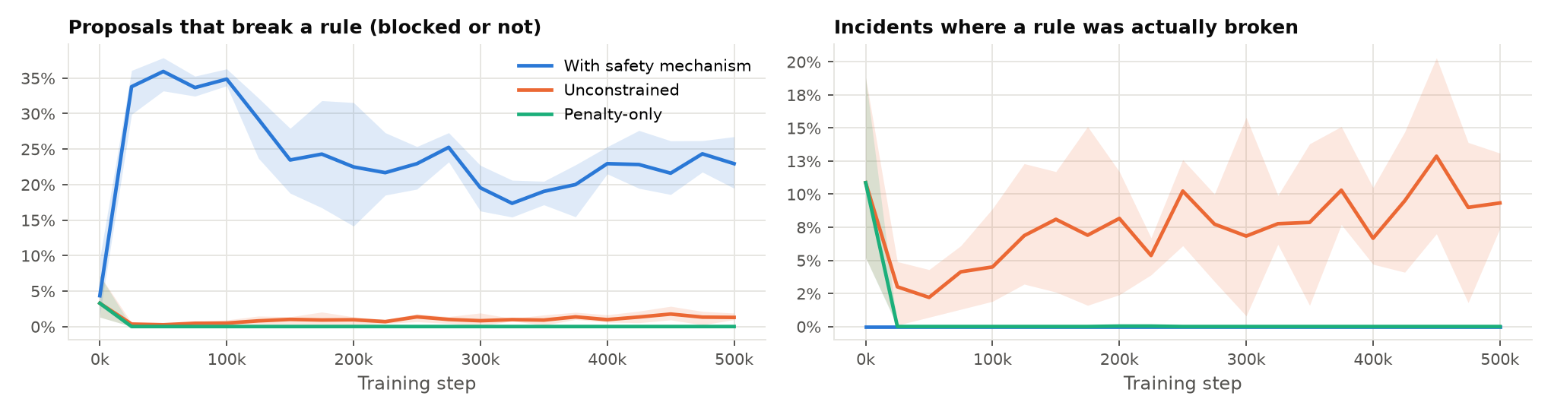
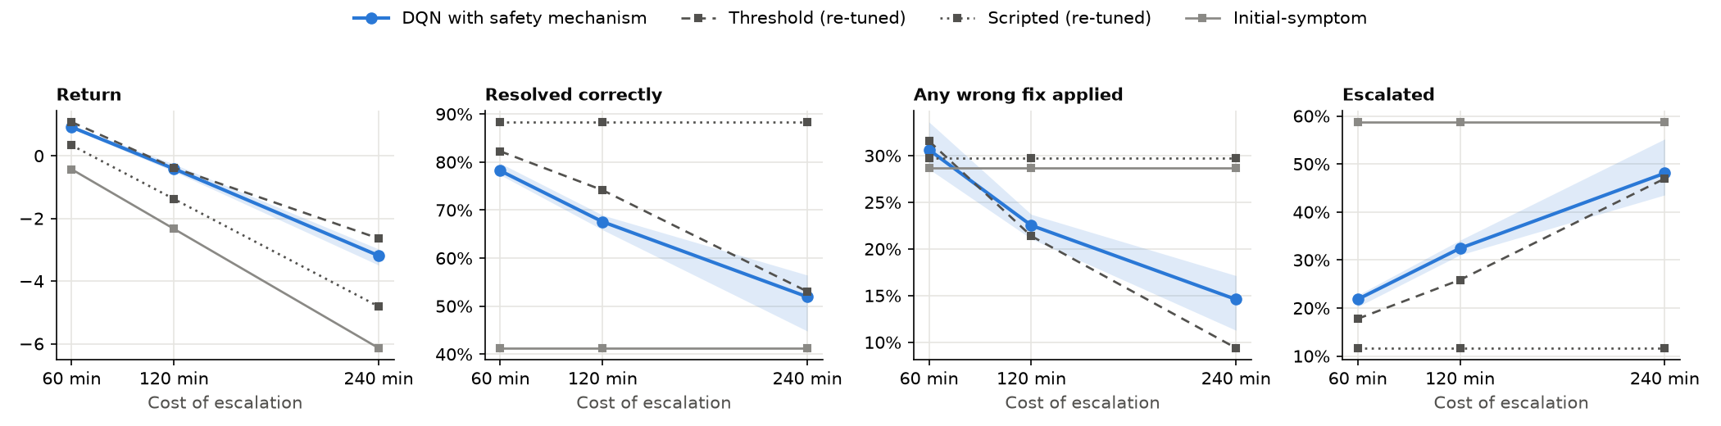
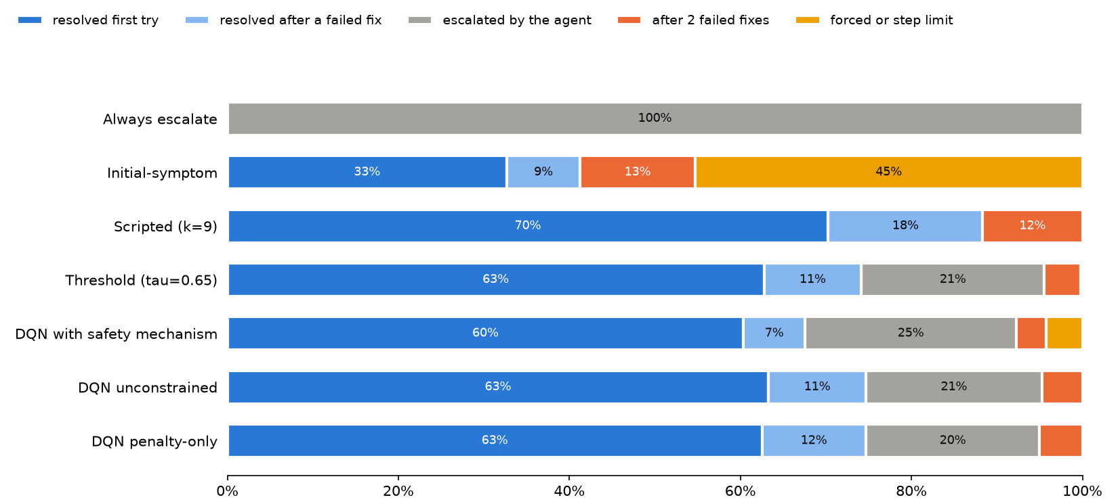
Investigate, Fix or Escalate: A Rule-Constrained Reinforcement
Learning Agent for IT Incident Triage under Ambiguous Evidence
OPOL CHARIS | S24B23/003 | B29654 | BSc Computer Science | Pilot Experiment Results
Uganda Christian University | Department of Computing & Technology | Faculty of Engineering, Design & Technology
Introduction
Implementation
Challenges
Hypotheses: Pilot Readings
When an IT incident is reported, staff must act before they know its cause: investigate further, apply a fix, or hand the incident to someone better placed. Most AI tools for IT operations treat triage as a single prediction from the ticket: they cannot ask for more evidence, say that they are unsure, or check their actions against the organisation's operating rules.
This pilot tests the method end to end before the main study with the Directorate of University ICT Services (UIS).
Scenario model: 8 causes, 11 checks (one, D11, delegated to a language model), 4 symptoms and 5 rules, from a UIS developer's Part 1 and Part 2 workbooks.
Environment: Gymnasium, one incident per episode, with noise, missing-check and overlap controls. Fix with verification: a failed fix costs its harm and is flagged; after two failed fixes a person takes over.
Safety mechanism: checks every proposal against the rules; a blocked proposal is returned once, a second block in a row escalates.
Agents: masked Double DQN (2 × 128 units, 500k steps) with the mechanism, unconstrained, and penalty-only (−10 per violation).
Evaluation: four baselines (always escalate, initial-symptom, scripted checklist, confidence threshold) on the same 5,000 unseen incidents; escalation 120 min, wrong fix 5× escalation; 95% bootstrap intervals.
The safety mechanism guarantees compliance but does not teach it. In the pilot a blocked proposal costs only a step, so the agent behind the mechanism keeps proposing rule-breaking fixes and lets the mechanism send them back.
Hypothesis | Pilot result | Reading
H1: beats simple baselines | 67.6% vs 88.3% (scripted) | Not supported
H2: best compliant success | 67.6% vs 74.7% (penalty) | Not supported
Zero executed violations | 0 of 15,000 | Holds
Blocked proposals fall | 35% → 20–25% | Partly
H3: ambiguity (Exp. 4) | Not run in pilot | –
Problem Statement and Objectives
Rule compliance over training (3 seeds per agent)
Conclusions & Next Steps
Problem Statement: in 34 reviewed studies (PRISMA 2020), no evaluated agent for IT incidents learns when to investigate, apply a permitted fix, or hand the incident to a person. The cause is hidden, and every action carried out must be permitted by the rules.
Pilot objectives
Build a scenario model and simulator from a UIS developer's workbooks: ACHIEVED.
Train agents that check, fix or escalate, with zero executed rule violations behind the mechanism: ACHIEVED (0 of 15,000 incidents).
Beat the baselines (H1) and the other agents on compliant success (H2): NOT SUPPORTED in this pilot, each for an identifiable cause.
A prototype that reads a ticket and logs and acts on a repository: ACHIEVED (6 of 8 cases).
Blocked proposals rise to ~35% early in training and settle at 20–25%; 4% of the agent's incidents end in a forced escalation.
Unconstrained: proposes few violations (~1%), but each one executes – a rule broken in 7.6% of incidents.
Verification changes what “good” means: the scripted checklist resolves the most (88%) by retrying fixes, at 9 checks and a wrong fix in 30% of incidents.
A qualified yes. The method works end to end: the agent learns a sensible three-way policy, reaches the strongest baseline on return, responds to the cost of escalation in the expected direction, and never executes a forbidden action behind the mechanism.
Two design choices decide the hypotheses: judging on resolution alone rewards repeated fixes (H1); a free block lets the agent lean on the mechanism (H2).
Next: take the results to UIS and request a Part 3 workbook (remedy times and harms); charge a block as an ablation; revisit the H1 criterion; run Experiment 4 (missing checks, noise); score the reader on 20 sample tickets.
0
15
6 of 8
Rule violations executed behind the mechanism (of 15,000)
Training runs, 500k steps, 3 seeds each
Prototype cases that end as intended
Areas of Improvement
Results
Charge a block (its cost is zero in the pilot) so that the agent learns to check before proposing; report it as an ablation of the mechanism.
Judge H1 on return and wrong-fix rate, not resolution alone: a checklist that retries fix after fix resolves a lot at a high cost.
The penalty only teaches where it was trained: in Phase 5 it broke rules in 4–7% of incidents once checks went missing; the mechanism stayed at zero.
Experiments 1 and 2: every policy on the same 5,000 incidents, escalation 120 min (agents: mean of 3 seeds):
National & Global Alignment
Policy | Return (h) | Resolved | Wrong fix | Escal. | Checks | Rule broken
Always escalate | −2.00 | 0% | 0% | 100% | 0.0 | 0%
Initial-symptom | −2.33 | 41.3% | 28.6% | 58.7% | 0.0 | 0%
Scripted (9 checks) | −1.38 | 88.3% | 29.7% | 11.7% | 9.0 | 0%
Threshold (0.65) | −0.38 | 74.1% | 21.4% | 25.9% | 4.7 | 0%
DQN + safety mech. | −0.41 | 67.6% | 22.5% | 32.4% | 5.7 | 0%
DQN unconstrained | −0.28 | 74.7% | 24.9% | 25.3% | 6.0 | 7.6%
DQN penalty-only | −0.24 | 74.7% | 25.4% | 25.3% | 5.0 | 0%
AI & Robotics Specialisation: deep reinforcement learning, decision-making under uncertainty and safe RL.
SDG 9 – Industry, Innovation & Infrastructure: reliable, rule-governed automation of the digital services that infrastructure depends on (Target 9.5).
NDP IV: supports the Digital Transformation Programme through reliable digital services and local AI skills.
Uganda Vision 2040: locally developed AI expertise, with ICT as a foundation of national transformation.
System Architecture
Ticket + logs
the incident as reported
Reader
LLM or keywords → fixed evidence form
Simulator
Gymnasium, training only
trains
DQN agent
proposes: run a check, fix, or escalate
Sensitivity to the cost of escalation (60, 120, 240 min)
Routed escalation
to the owner of the likely cause
escalate or 2nd block
proposal
returned once
Prototype
Safety mechanism
permit, return once, or escalate
Other information
Draft PR or fix order
never merged, never sent
permitted fix
Six of eight example cases end as intended (four with the earlier agent). In the ambiguous vague_slow case the agent's wrong guess failed on staging and was escalated, not shipped. The language model only reads the ticket; the trained agent decides; the rule checker stays independent.
Contacts
Email: charisopol@gmail.com Phone: 0765821211
Key References
1. Z. Chen et al., “Towards intelligent incident management: Why we need it and how we make it,” ESEC/FSE, 2020.
2. M. Alshiekh et al., “Safe reinforcement learning via shielding,” AAAI, 2018.
3. H. van Hasselt, A. Guez and D. Silver, “Deep reinforcement learning with double Q-learning,” AAAI, 2016.
Limits of the pilot
One UIS developer, not the Directorate; several researcher-set values.
Three seeds (ten planned); base ambiguity level only.
Block cost of zero; verification assumed reliable.
These are pilot readings, not thesis findings.
2 failed
Verification on staging
reproduction test passes, nothing breaks
verified
KEY: BLUE – input PINK – learning YELLOW – rules and verification GREEN – actions
Example case | Agent decision | Example case | Agent decision
results_approval | Fix, verified | fees_release | Escalate ✗
sign_in | Fix, verified | payment_gateway | Escalate ✗
transcript_dup. | Fix, verified | vague_slow | Fix failed, escalate
class_results_slow | Fix, verified | profile_cache | Fix, verified
Workflow: How the System Works
How each incident ended, by policy
1. Report comes in
2. Facts picked out
3. Agent chooses a step
4. Rulebook check
5. Act and record
The agents reach the strongest baseline. Penalty-only (−0.24 h) and unconstrained (−0.28 h) edge past the threshold policy (−0.38 h), which is given the likelihood model; the agent behind the mechanism is level (−0.41 h). Intervals overlap.
Every agent is far ahead of the scripted, initial-symptom and always-escalate baselines on return, at every escalation cost tested.
Behaviour follows cost: at 60, 120 and 240 min escalation rises 22% → 32% → 48% and wrong fixes fall 31% → 23% → 15%.
1. Someone reports a fault; the system's log is attached.
2. Each fact is copied word for word from the report or log, so a person can check it.
3. Look into it further, try a fix, or hand it to a person.
4. Steps the team's rules forbid are blocked; blocked twice, a person takes over.
5. Fixes are tested first and wait for a person's approval; every outcome is written down.
✗ = not the intended decision (fix C06 / fix C01). Cases written by the researcher: they show the pipeline works, not its accuracy.
Live incidents: a hidden fault is drawn from the scenario model and a fresh ticket and log are written; nobody sees the cause until the reveal.
Checks and fixes: a check missing from the log is answered by a live probe; a fix is verified against the hidden fault.

