Slide 1


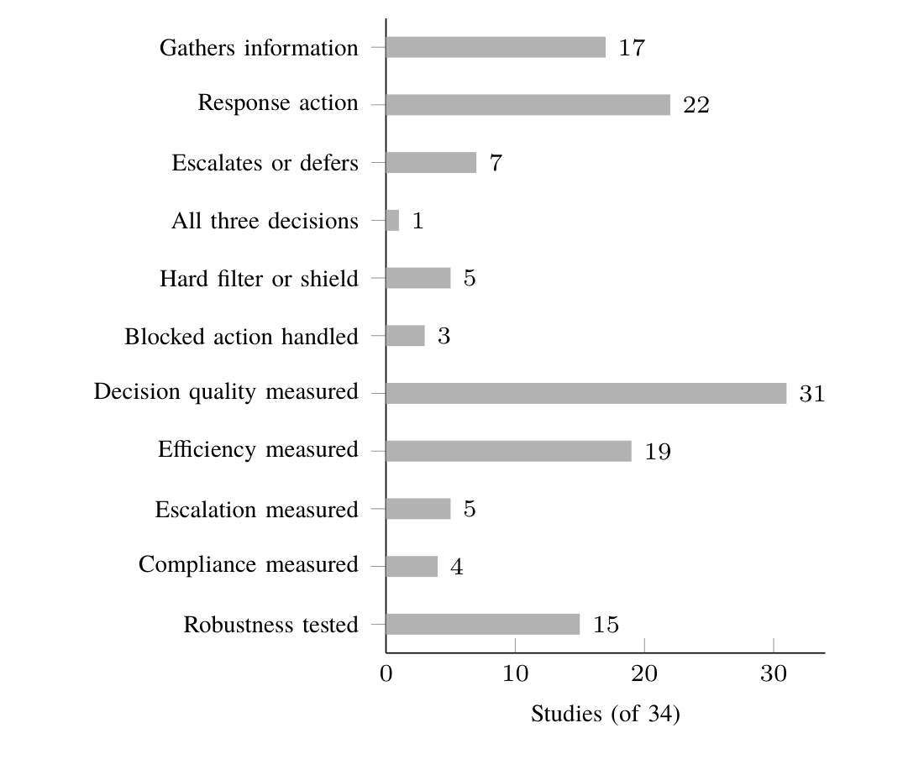
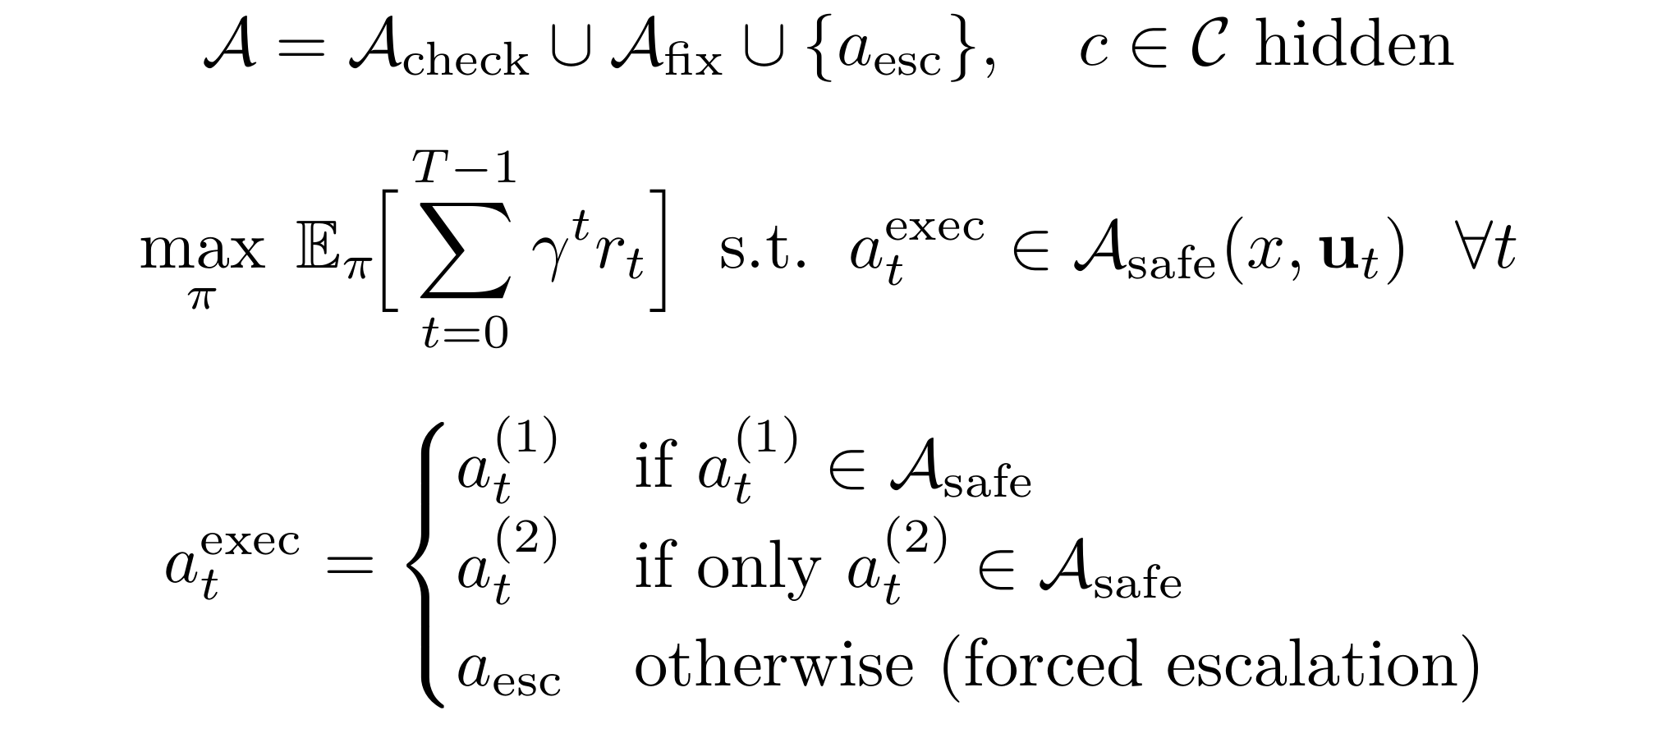
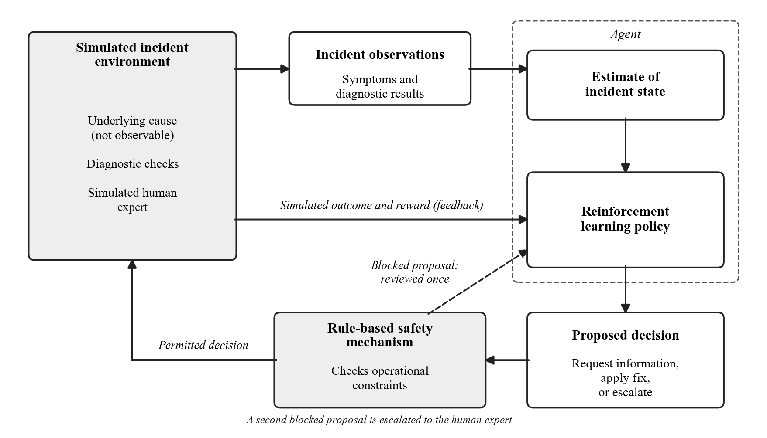
Investigate, Fix or Escalate: A Rule-Constrained Reinforcement
Learning Agent for IT Incident Triage under Ambiguous Evidence
OPOL CHARIS | S24B23/003 | B29654 | BSc Computer Science | Research Status, November 2026
Uganda Christian University | Department of Computing & Technology | Faculty of Engineering, Design & Technology
1. Introduction
4. What the 34 Studies Show
7. From Review to Pipeline
10. Methodology
When an IT incident is reported, staff must decide what to do before they know its cause: investigate further, apply a likely fix, or pass the incident to someone better placed. The first evidence is often incomplete, unreliable or consistent with several causes.
Most automated triage tools make a single prediction from the ticket. They cannot ask for more evidence, cannot say that they are unsure, and do not check their actions against an organisation's operational rules.
This research designs and evaluates a reinforcement learning agent that learns when to investigate, apply a permitted fix, or escalate, with an independent rule-based safety mechanism, for the Directorate of University ICT Services (UIS).
Reinforcement learning for IT and security incidents: each part of the planned agent appears somewhere, but never all together.
The review found | So this research
Unclear evidence rarely varied | Varies missing, wrong and overlapping evidence separately
Passing on seldom learned | Makes escalation a learned choice with a cost
Blocked actions unreported | Logs every block: one retry, then a person
Escalation and rule-keeping rarely measured | Reports four groups of measures together
Weak baselines, single runs | Six baselines; ten seeds; 95% intervals
Problem: triage of one incident is a partially observable decision problem, solved entirely in simulation: the cause is hidden and every executed action must be permitted.
Objective under the rules, and the two-proposal mechanism
Agent: masked deep Q-network (two layers of 128 units); PPO as a second learner.
Safety mechanism: checks each proposal; a blocked proposal is returned once, a second block escalates.
Compared with: four fixed policies and two agents without the mechanism (unconstrained, penalty-only).
Four experiments: baselines, rule mechanism, choices removed, worse evidence; ten seeds, 95% bootstrap intervals.
2. Objectives
Studies (of 34) containing each element
Build: a simulator from about 15 causes, 20 checks and 10 rules elicited from UIS, with missing, unreliable and overlapping evidence each controlled.
Train: a deep Q-network that requests checks, applies permitted fixes or escalates, under the safety mechanism; PPO as a robustness check.
Evaluate: against six baselines on decision quality, investigation cost, escalation and rule compliance, across levels of ambiguity.
Hidden cause: only 4 studies track what might be wrong.
Decisions: 17 gather information, 7 pass to a person, only 1 does all three.
Rules: 5 use a hard block; only 3 say what happens to a blocked action, and none lets the agent propose again.
Measures: decision quality in 31, escalation in 5, rule-keeping in 4.
8. Research Pipeline
11. Dataset
No tickets or personal data in training: a scenario model of causes, checks, symptoms and rules, filled in by IT staff.
Pilot: 8 causes, 11 checks, 4 symptoms and 5 rules from one UIS developer.
Planned: about 15 causes, 20 checks and 10 rules from the Directorate.
Tests: 5,000 simulated incidents never seen in training.
Prototype: 8 fictional tickets; 20 sample tickets kept private.
5. Research Gap
3. Literature Review: Method
The gap
No reviewed study learns one policy that investigates, fixes or escalates IT service incidents under explicit operational rules, or reports how such an agent behaves as the evidence becomes more ambiguous.
Databases: Scopus, IEEE Xplore (open access), ACM Digital Library; 23 Oct 2026.
Method: PRISMA 2020 and the Kitchenham and Charters procedure.
Appraisal: eight-item quality checklist; synthesis around five questions.
Limits: one AI-assisted screener; no citation searching yet.
The agent proposes; the rule mechanism permits, returns once or escalates
RQ1: How can ambiguous UIS incidents be simulated with controllable missing, unreliable and overlapping evidence?
RQ2: How well can an agent learn when to investigate, fix or escalate?
RQ3: How does the rule mechanism affect compliant success and decisions?
RQ4: How does the agent compare with baselines as evidence becomes more ambiguous?
9. Workflow: How the System Works
1. A problem report comes in
2. Key facts are picked out
3. The assistant chooses a step
4. Rulebook check
5. Action is taken and recorded
12. Status and Next Steps
4,399 records found
Done: review; pilot simulator, rule mechanism and agents; Experiments 1–2 (3 seeds); working prototype.
Pilot reading: 0 rule violations executed in 15,000 incidents behind the mechanism; the agents reach the strongest baseline.
Next: full scenario model with UIS; 10 seeds; Experiments 3–4; reader accuracy on the 20 sample tickets.
73 duplicates and 4,195 removed by filters
1. Someone reports a fault; the system's log is attached.
2. Each fact is copied word for word from the report or log, so a person can check it.
3. Look into it further, try a fix, or hand it to a person.
4. Steps the team's rules forbid are blocked; blocked twice, a person takes over.
5. Fixes are tested first and wait for a person's approval; every outcome is written down.
131 screened
84 excluded on title and abstract
47 sought in full
7 not retrieved
6. Hypotheses
H1: the agent resolves more incidents correctly than the simple baselines, at no higher investigation cost than the scripted checklist.
H2: with the rule mechanism it achieves a higher compliant success rate than the unconstrained and penalty-only agents.
H3: missing evidence brings more escalation; unreliable evidence more checks; overlapping evidence more checks and escalation.
13. Contacts & Key References
40 read in full
6 excluded
Email: charisopol@gmail.com Phone: 0765821211
1. M. J. Page et al., “The PRISMA 2020 statement,” BMJ, 2021.
2. B. Kitchenham and S. Charters, EBSE-2007-01, 2007.
3. Z. Chen et al., “Towards intelligent incident management,” ESEC/FSE, 2020.
4. M. Alshiekh et al., “Safe reinforcement learning via shielding,” AAAI, 2018.
34 included
published 2020–2026
Example: a fictional sign-in ticket
Report: “Students cannot log in to the portal” (production).
Facts: the log shows a lock on the users row during a token update.
Step: fix C08, move the token write off the sign-in path; the rulebook permits it.
Action: its test passes on staging, so a draft pull request awaits a person.
Study selection (PRISMA 2020), searched 23 Oct 2026

