Slide 1
Introduction
to
Kubernetes

Slide 2
Recap on Day 3
Linux Dockerfile best practices (layers, caching, .dockerignore)
Advanced concepts: volumes, networking, Dockerfile optimization
Docker Compose concepts: multi-container orchestration
Understanding Docker Compose ( services, YAML configuration, and container scaling)

Slide 3
Today
Kubernetes fundamentals: Pods, Nodes, Deployments
Introduction to kubectl commands and Kubernetes cluster architecture
Core objects (ConfigMaps, Secrets, Persistent Volumes, Namespaces)
Minikube vs Kind vs Cloud clusters

Slide 4
Kubernetes fundamentals
Pods run your containerized applications.
Nodes provide the underlying infrastructure to host these Pods.
Deployments manage and orchestrate the creation, scaling, and updates of Pods, ensuring the application's desired state is maintained across the cluster of Nodes.
This layered approach allows for robust, scalable, and self-healing application deployments in a Kubernetes environment.

Slide 5
Kubernetes fundamentals
Kubernetes Manager
Node
Node
Pod
Pod
Pod
pod
Containers
Containers

Slide 6
Kubernetes fundamentals
Pods are the smallest deployable units in Kubernetes.
A Pod represents a single instance of an application and typically encapsulates one or more containers that are tightly coupled and share resources like network and storage.
All containers within a Pod share the same network namespace and can communicate with each other via localhost.
Pods are ephemeral; if a Pod fails or is terminated, Kubernetes will create a new one to maintain the desired state.

Slide 7
Kubernetes fundamentals
Nodes are the worker machines in a Kubernetes cluster where Pods are scheduled and run.
A Node can be a physical or virtual machine and contains the necessary components to execute and manage Pods, including a container runtime (like Docker or containerd), the kubelet (an agent that communicates with the Kubernetes control plane), and kube-proxy (which handles network proxying for services).
The Kubernetes control plane automatically schedules Pods across available Nodes based on resource requirements and other scheduling policies.

Slide 8
Kubernetes fundamentals
Deployments are a higher-level abstraction that manage the lifecycle of Pods.
A Deployment defines the desired state for a set of replica Pods, ensuring that a specified number of Pod replicas are always running and available.

Slide 9
Kubernetes fundamentals
Deployments handle tasks such as creating and updating Pods, performing rolling updates without downtime, and automatically recovering from Pod failures by recreating them.
When a Deployment is updated, it intelligently manages the transition to the new version, rolling back if necessary.

Slide 10
Introduction to kubectl commands and Kubernetes cluster architecture
kubectl is the remote control for Kubernetes.
kubectl is the command-line tool for interacting with a Kubernetes cluster.
It allows users to run commands against Kubernetes clusters, deploy applications, inspect and manage cluster resources, and view logs.

Slide 11
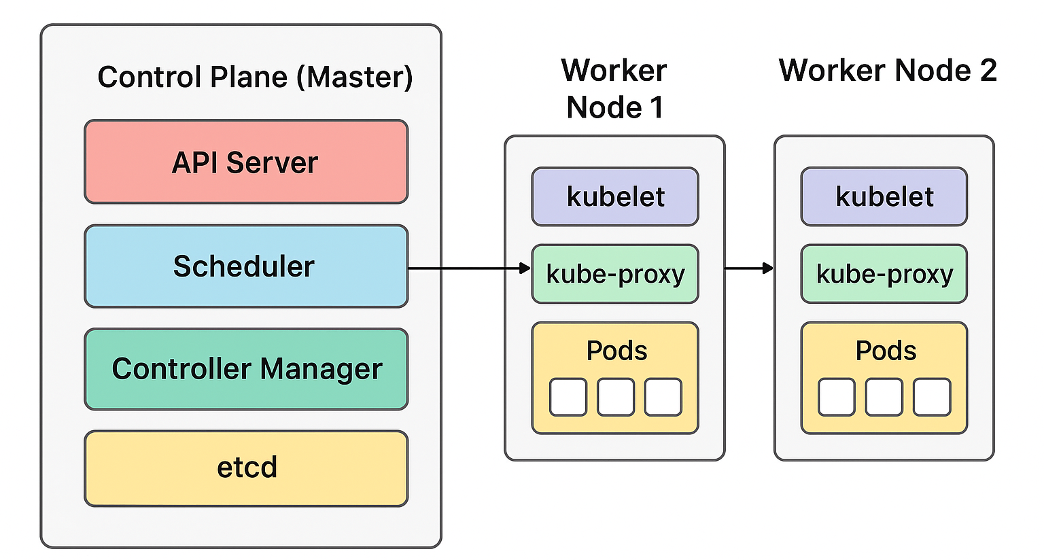
Introduction to kubectl commands and Kubernetes cluster architecture

Slide 12
Introduction to kubectl commands and Kubernetes cluster architecture
kubectl ---> API Server ---> etcd (store state)
|
v
Controller Manager
|
v
Scheduler
|
v
kubelet (on Node)
|
v
Container runtime
|
v
Pod running!

Slide 13
Kubectl commands
Command | Purpose | Easy Analogy
kubectl get nodes | Shows all machines (nodes) in the cluster | Checking how many chefs are available in the kitchen
kubectl get pods | Lists all running Pods | Seeing what dishes are currently being cooked
kubectl describe pod <pod-name> | Detailed info about a Pod | Inspecting a dish closely
kubectl logs <pod-name> | View app logs | Looking at the recipe notes to see what went wrong

Slide 14
Kubectl commands
Command | Purpose | Easy Analogy
kubectl exec -it <pod-name> -- sh | Open shell inside a Pod | Walking into the kitchen to see what’s happening
kubectl apply -f <file>.yaml | Deploy resources defined in YAML | Handing the manager a new recipe card
kubectl delete pod <pod-name> | Remove a pod | Throwing away a burnt dish (Kubernetes will make a new one if part of a Deployment)
kubectl scale deployment myapp --replicas=3 | Increase/decrease Pods | Asking for more dishes to be cooked

Slide 15
Core objects (ConfigMaps, Secrets, Persistent Volumes, Namespaces)
Kubernetes lets you separate application code from configuration, secrets, and storage.
That way, you don’t rebuild your container image every time you change a setting, and you can keep sensitive data safe.
Kubernetes employs several core objects to manage and orchestrate containerized applications.
Among these, ConfigMaps, Secrets, Persistent Volumes, and Namespaces are fundamental for configuration, security, storage, and resource organization.

Slide 16
Core objects
ConfigMaps is a configuration file cabinet that apps can read from.
Secret helps to keep sensitive data out of your source code.
Persistent Volumes represent abstract pieces of storage in a Kubernetes cluster, provisioned either statically by an administrator or dynamically through a StorageClass.
PVs are independent of the Pod lifecycle, meaning the data they hold persists even if the Pod that uses them is terminated.

Slide 17
Core Objects
Namespaces provide a mechanism for isolating resources within a single Kubernetes cluster.
They are used to logically divide cluster resources, enabling multi-tenancy and better organization.
Namespaces allow for resource quotas, access control policies, and prevent naming collisions between different teams or applications within the same cluster.
Kubernetes starts with several default namespaces, including default, kube-system, kube-public, and kube-node-lease.

Slide 18
Minikube
vs
Kind
vs
Cloud clusters

Slide 19
Minikube
Minikube is a widely adopted tool designed to run a single-node Kubernetes cluster on various operating systems, including macOS, Linux, and Windows.
It provides a simple way for developers to run Kubernetes locally and is ideal for testing applications in a controlled environment.
Minikube supports multiple hypervisors such as VirtualBox, VMware, and HyperKit, making it flexible for different infrastructures.

Slide 20
Minikube
Additionally, it offers features like the ability to enable or disable specific Kubernetes components, which allows developers to tailor their environment to closely match production settings.
This flexibility is crucial for debugging and ensuring that applications behave as expected before deployment.

Slide 21
Kind
Kind, short for Kubernetes in Docker, is another option that allows users to create Kubernetes clusters using Docker containers as nodes.
This approach adheres to containerization principles, enabling quick setup and teardown of clusters.
Kind is particularly useful for testing Kubernetes itself and is favored by CI/CD pipelines.

Slide 22
Kind
Its ability to run clusters in Docker means that developers can easily replicate their production environments in a lightweight manner, making it an excellent choice for continuous integration workflows.
Furthermore, Kind supports multi-node clusters, which can be beneficial for simulating more complex scenarios that developers may encounter in real-world applications.

Slide 23
Cloud Cluster
Fully managed Kubernetes clusters offered by cloud providers (Google, AWS, Azure).
Provider runs and maintains the control plane you just create worker nodes and deploy apps
Highly scalable, reliable, production-grade
No need to manage master nodes
Integrates with cloud storage, load balancers
Cost money (pay for nodes and cloud resources)
Slightly more complex to set up for beginners

Slide 24
Practical
Session

