Slide 1
Digital sales trends exploration
By team Data Pioneers
Pranathi Patlolla-S559285
Puruhuthika Yerragunta – S560279
Naveen Manne-S563087
Charishma Chowdary Bandaru- S559159

Slide 2
Agenda
Project Objective and Technologies
Data Acquisition and Cleaning
Goals Achieved
Conclusion

Slide 3
The objective of the project is to Leverage the Global Superstore dataset to uncover patterns in customer purchasing decisions, analyzing attributes like discounts and shipping modes to optimize sales strategies and enhance the overall shopping experience. Technologies: Pyspark, Tableau.
Project Objective

Slide 4
ABOUT DATASET
Number of rows : 51290
Number of columns : 23
Data cleaning and preparation : Tableau prep & Excel
Visualization : Tableau Desktop, Jupyter Notebook
Notes:
we processed a dataset comprising 52,417 rows and 9 columns using Tableau Prep and Excel for thorough data cleaning and preparation. Subsequently, we employed Tableau Desktop for intuitive visualizations and Jupyter Notebook for additional exploratory analyses. This comprehensive approach ensured a meticulous understanding of the data and facilitated compelling visual representations for effective presentation.

Slide 5
Project overview
The Global Superstore dataset comprises 23 columns and 51,290 rows of sales and order data, offering insights into global retail operations.
Using tools like PySpark, Tableau Prep, and Tableau, the data is ingested, cleaned, and visualized for efficient analysis.
Specific goals include analyzing sales by country, profits by region, shipping costs by segment, customer distribution by market, and more.
By assessing data completeness, accuracy, and relevance, businesses can optimize strategies, improve performance, and drive profitability.

Slide 6
CLEANING AND PROCESSING DATA
Handle missing data
Checking data types
Remove duplicates
Notes:
In addressing data quality, we meticulously handled missing values, verified data types for consistency, and eliminated duplicates to ensure a clean and robust dataset. This data preprocessing stage laid a strong foundation for our analysis, enhancing the reliability and accuracy of our findings.

Slide 7
Goals
To find out total number of sales in each country
To find out average profits in each region.
To determine how much does shipping cost total for each segment
To determine how many number of customers ordering from each Market
To find out the Maximum number of orders for each sub-category
To determine the sum of quantity based on order priority
To analyze the Shipping Cost by Ship Mode and Region
To determine and analyze the number of unique customers per year

Slide 8
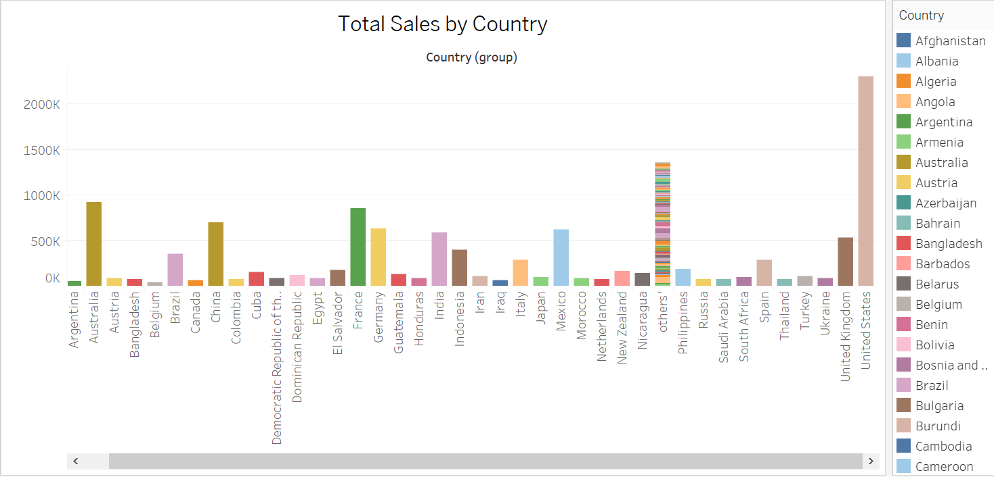
Goal 1
To find out total number of sales in each country

Slide 9
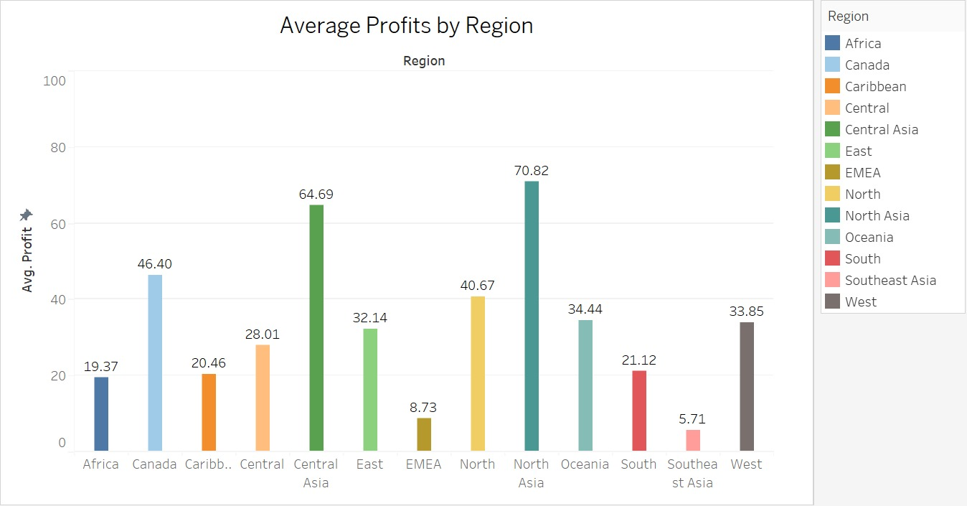
Goal 2
To find out average profits in each region.

Slide 10
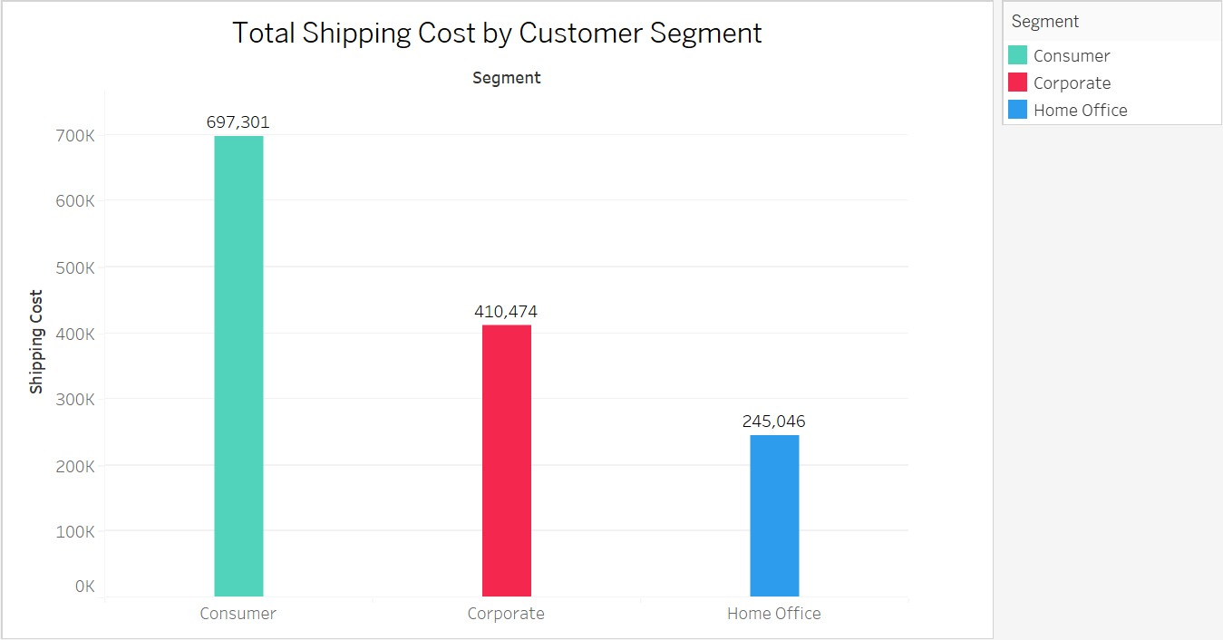
Goal 3
To determine how much does shipping cost total for each segment

Slide 11
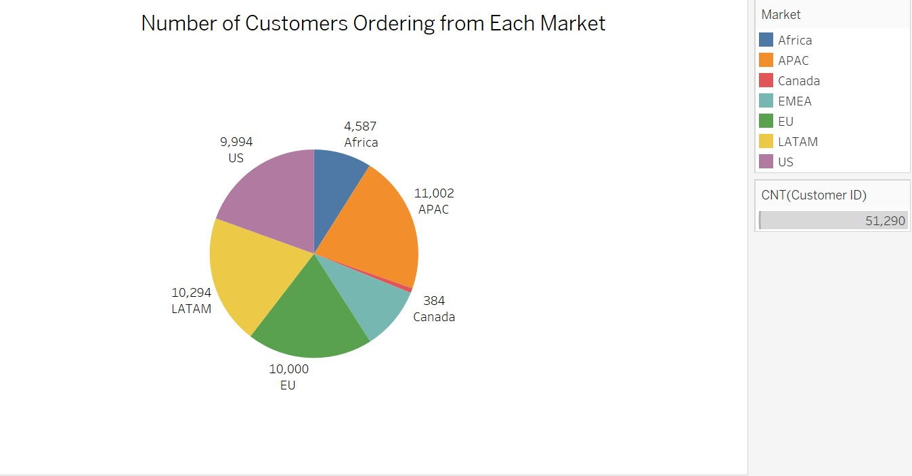
Goal 4
To determine how many number of customers ordering from each Market
.

Slide 12
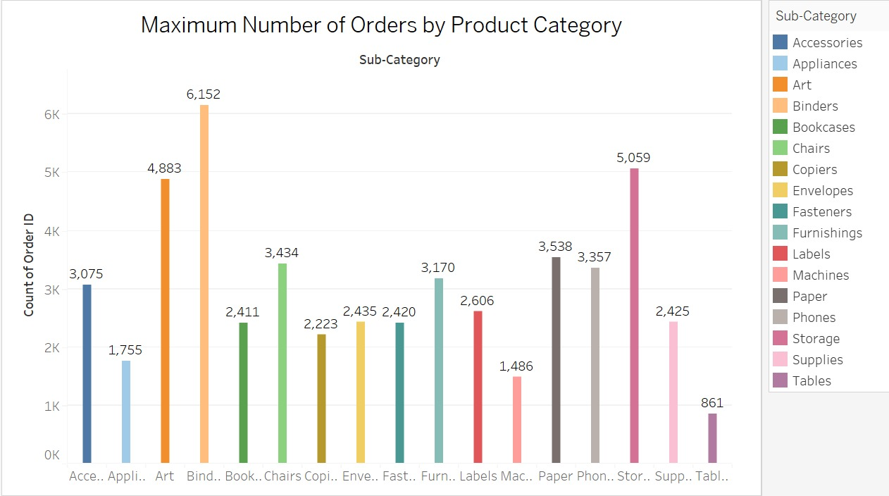
Goal 5
To find out the Maximum number of orders for each sub-category.

Slide 13
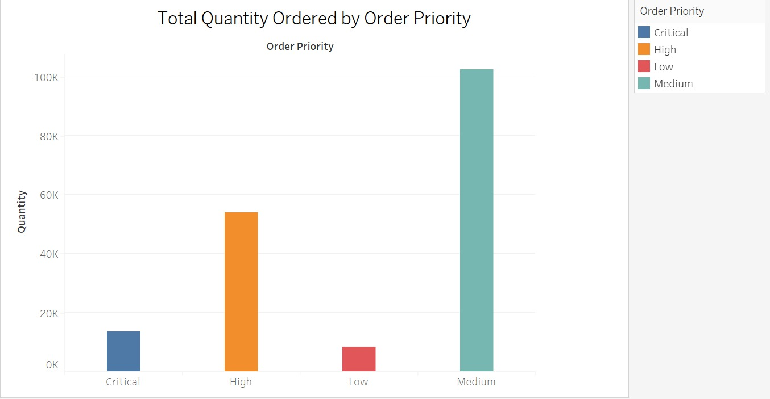
Goal 6
To determine the sum of quantity based on order priority.

Slide 14
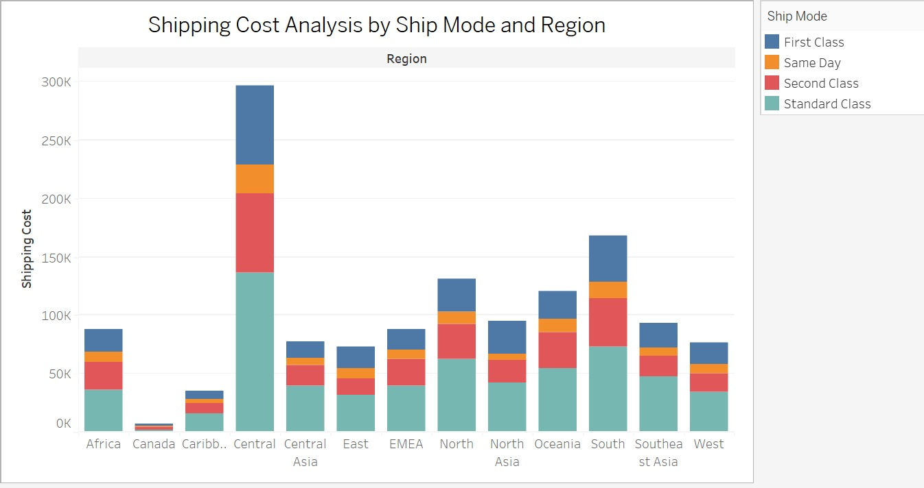
Goal 7
To analyze the Shipping Cost by Ship Mode and Region

Slide 15
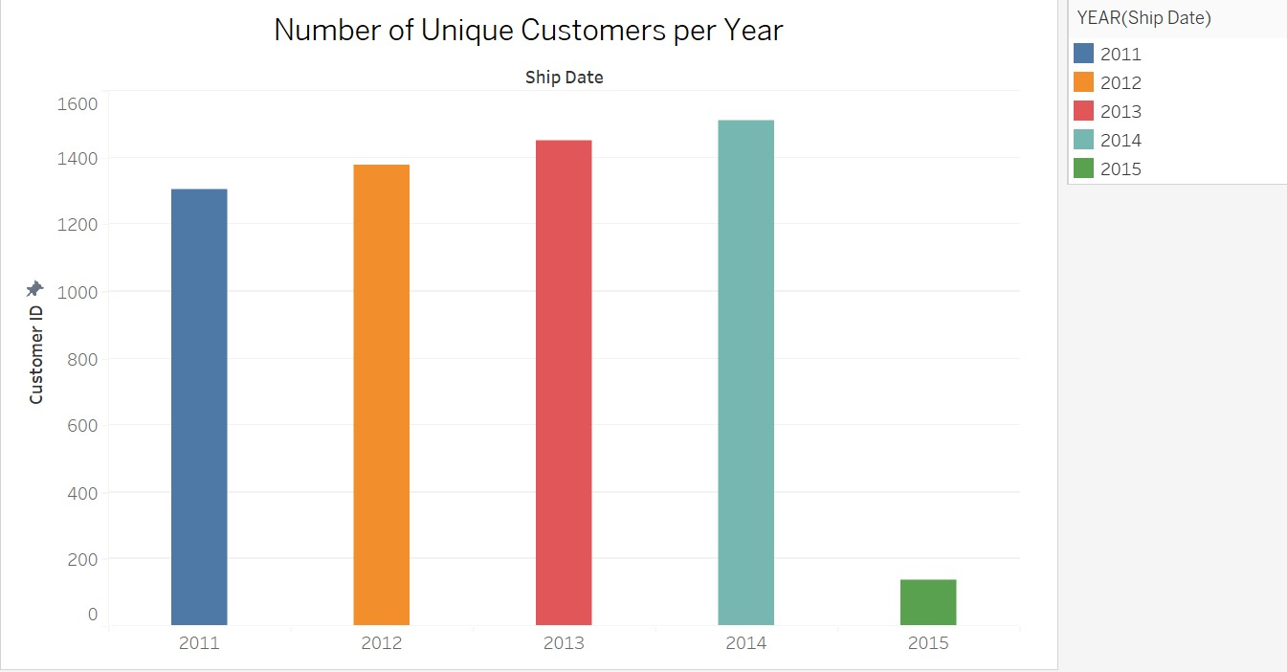
Goal 8
To determine and analyze the number of unique customers per year

Slide 16
CONCLUSION
Captures diverse transactions across products, cities, and customer.
Utilized Tableau Prep for accurate data cleaning.
Unveils purchasing patterns, shipping preferences, and discount engagement
Offers valuable insights for strategic decision-making

Slide 17
Thank you

