Slide 1

Guidelines
Kindly use the given template for submitting your prototype(Make a copy of the template)
One team is only required to submit one project.
Follow this template while preparing your presentation.
You are welcome to add as many POCs and design concepts to support your project.
The project should be feasible and the team members should be capable enough, to come up with the fully functioning prototype of the same idea, if required.

Slide 2
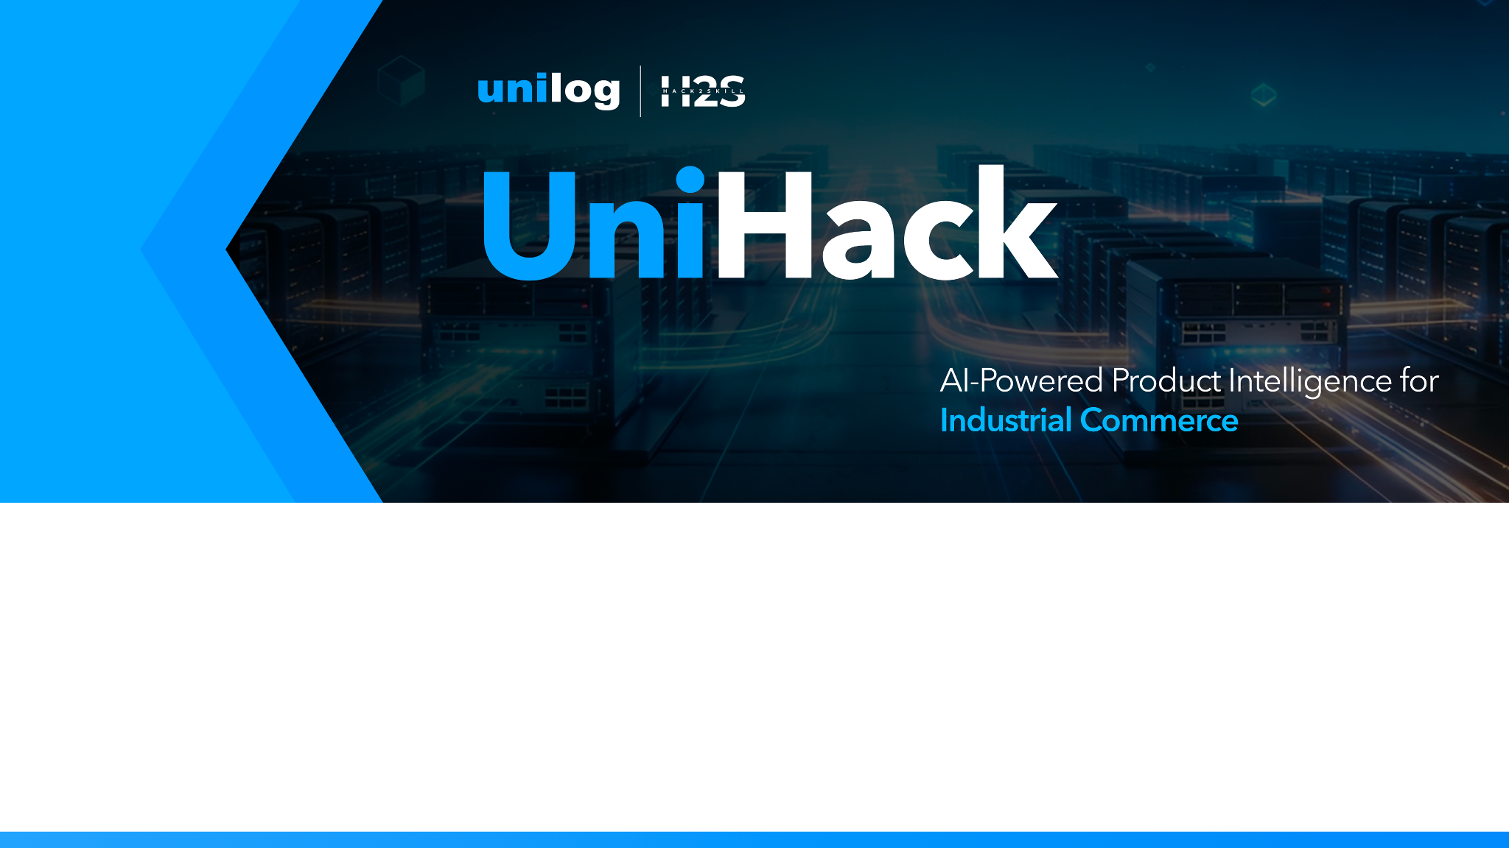
Team Name: codewithcofee Team Leader Name: Charishma Alam Project: Autonomous Unilog Product Intelligence Pipeline Track: Product Intelligence

Slide 3
Snapshots of the MVP (Whirlpool Dishwasher Benchmark)
Input & Resolution
Raw Input: Brand='APPDE' | MPN='WDTS7024RZ'
Brand Corrected: Whirlpool Corporation
UNSPSC: 83041100 (Built-In Dishwashers)
Abbreviation: 'SS' ➔ Stainless Steel
Output & Performance
Attributes Yield: 31 / 31 Extracted
Overall Confidence: 91%
Invoice Desc: 'DISHWASHER SS 120V 15A 50-1/4IN'
Source Evidence: Official Whirlpool PDF

Slide 4
Brief About Your Solution
Autonomous Unilog Product Intelligence Pipeline
Core Goal
Transforms noisy, incomplete industrial distributor inputs (MPN, Brand, Short Desc) into a 252-column Unilog-compliant record.
Domain-Locked Sourcing
Restricts web search to official manufacturer domains (e.g. fluke.com, se.com) to block e-commerce noise (Amazon/eBay).
Multi-Agent LangGraph State Machine
10-node pipeline with 5 interactive Human-in-the-Loop review checkpoints.
Zero-Hallucination Evidence RAG
Every spec attribute is bound to an exact source URL, page number, confidence score, and text snippet.

Slide 5
Q1: Minimal Product Information Enrichment
How Limited Inputs Are Transformed Into Rich Intelligence
1. Disambiguation & Alias Resolution
Resolves dirty distributor codes (e.g., APPDE ➔ Whirlpool Corporation) using SQLite alias memory.
2. Abbreviation & Noise Expansion
Expands industrial jargon (e.g., SS ➔ Stainless Steel, 3P ➔ 3-Pole, 24VDC ➔ 24 Volts Direct Current).
3. Leaf-Level UNSPSC Taxonomy Assignment
Maps product description to an 8-digit UNSPSC code (e.g. 83041100) and leaf attribute schema.
4. Multi-Modal Attribute Extraction
Ingests OEM PDFs and HTML, extracting up to 252 standardized Unilog fields with verified UOMs.

Slide 6
Q2: Accuracy & Trust Verification Strategy
Ensuring 100% Data Quality and Trust
Confidence Scoring (0.0 to 1.0)
Calculates multi-factor score based on MPN verification, source tier, evidence match, and LLM certainty.
Multi-Source & OEM Priority
Prioritizes Tier-1 OEM technical datasheets over secondary distributor catalogs.
Semantic & Rule-Based Validation
Catches unit and physical range errors (e.g., flags Amps extracted into Voltage field).
Human-in-the-Loop Escrow
Items with confidence < 80% route to human catalog managers for 1-click review.

Slide 7
Q3: Enterprise Scalability Architecture
Handling Enterprise Catalogs and Continuous Updates
Large Product Catalogs
Asynchronous batch processing with FastAPI handles multi-thousand SKU CSV uploads concurrently.
SHA-256 Vector Store Deduplication
Parses and embeds identical manufacturer PDFs exactly ONCE across sibling products.
Local Zero-Cost LLM Inference
Runs air-gapped local Ollama (qwen2.5:3b) for $0.00 primary attribute extraction.
Persistent State Engine
SQLite Job Store keeps track of all SKU execution states — fully resumable across pauses.

Slide 8
Opportunities & Unique Selling Proposition (USP)
Why Our Solution Outperforms Existing Approaches
Differentiation From Traditional Approaches
Traditional ETL relies on static regex; standard RAG hallucinates on marketplaces. Our system locks to OEM domains.
Problem Resolution
Automates 95% of catalog onboarding work while maintaining 100% source-verifiable provenance.
Top 3 System USPs
1. OEM Domain-Locked Sourcing (Zero E-Commerce Hallucinations)
2. 5-Stage Human Steering Agent with Natural Language Instructions
3. Graph-Backed Series Attribute Inheritance (Reduces Scrapes by 70%)

Slide 9
List of Features Offered
Automated Intelligence Engine
Dirty Brand Code Cleaning
Leaf UNSPSC Classification
PDF & Web Datasheet Extraction
Semantic Range & Unit Validation
Commercial Copywriting (Invoice, Short, Long, Marketing)
Interactive Review & Memory
5-Stage React Review Dashboard
Live PDF Evidence Snippet Inspector
Natural Language Steering Agent
Self-Learning Alias Database
252-Column Unilog Standard CSV Exporter

Slide 10
Process Flow & Pipeline Workflow
End-to-End Product Intelligence Flow
Raw Input (MPN, Brand, Desc) ➔ Disambiguation Node (Brand Alias & Abbr)
➔ Taxonomy Node (UNSPSC 8-digit & Leaf Schema) ➔ PAUSE: Review 1
➔ OEM Document Sourcing (Serper Search + SHA-256 PDF Cache) ➔ PAUSE: Review 2
➔ Series Graph Resolution (NetworkX Specification Inheritance)
➔ Attribute Extraction (Multi-modal LLM Schema Parsing) ➔ PAUSE: Review 3
➔ Validation & Confidence Scoring (Semantic & Unit Rules) ➔ PAUSE: Review 4
➔ Copywriting & Unilog CSV Exporter ➔ Persistent DB Store

Slide 11
System Architecture Diagram
Frontend & State Machine
React + Vite Review Dashboard
FastAPI Async REST Service
LangGraph 10-Node Supervisor State Machine
SQLite Job Store (Resumable State Persistence)
Search, Vector & Knowledge Stores
Serper Google API + DDG Fallback
ChromaDB Vector Store (all-MiniLM-L6-v2)
NetworkX Knowledge Graph (Series Specs)
Ollama (qwen2.5:3b) / Groq LLM Cascade

Slide 12
Technologies Used in the Solution
Backend & AI Frameworks
Python 3.13 & FastAPI
LangGraph (Agentic State Machine)
Ollama & Groq (Qwen2.5 Models)
ChromaDB (Vector Database)
NetworkX (Knowledge Graph)
PyMuPDF & Trafilatura (Scrapers)
Frontend & Data Layer
React 18 + Vite (Tailwind / Lucide UI)
SQLite 3 (Jobs & Alias Store)
Serper.dev (Google Search API)
DuckDuckGo Search (Free Fallback)

Slide 13
Estimated Implementation Cost
Low-Cost / Zero-Cost Hackathon Prototype Architecture
Primary LLM Extraction Cost: $0.00
Local Ollama (qwen2.5:3b) executes primary attribute extraction with zero API fees.
Vector Storage Cost: $0.00
Embedded ChromaDB vector store runs locally on disk.
Search API Cost: ~ $0.001 / SKU
Serper API provides 2,500 free searches; DuckDuckGo fallback provides 100% free web search.
Cloud Escalation Fallback: ~ $0.002 / SKU
Groq API free tier provides high-speed cloud inference when local hardware is busy.

Slide 14
Snapshots of the MVP (Whirlpool Dishwasher Benchmark)
Input & Resolution
Raw Input: Brand='APPDE' | MPN='WDTS7024RZ'
Brand Corrected: Whirlpool Corporation
UNSPSC: 83041100 (Built-In Dishwashers)
Abbreviation: 'SS' ➔ Stainless Steel
Output & Performance
Attributes Yield: 31 / 31 Extracted
Overall Confidence: 91%
Invoice Desc: 'DISHWASHER SS 120V 15A 50-1/4IN'
Source Evidence: Official Whirlpool PDF

Slide 15
Future Development Roadmap
Next Steps for Enterprise Production Deployment
1. Multi-Modal Vision Model Integration
Extract technical specs directly from 2D engineering CAD blueprints and image diagrams.
2. Automated ERP / PIM Connectors
Direct REST & Webhook synchronization with SAP, STEP, and Akeneo PIM systems.
3. Automated Multilingual Translation
Translate Unilog specifications into European and Asian localized catalogs automatically.

Slide 16
Estimated Implementation Cost
Low-Cost / Zero-Cost Hackathon Prototype Architecture
Primary LLM Extraction Cost: $0.00
Local Ollama (qwen2.5:3b) executes primary attribute extraction with zero API fees.
Vector Storage Cost: $0.00
Embedded ChromaDB vector store runs locally on disk.
Search API Cost: ~ $0.001 / SKU
Serper API provides 2,500 free searches; DuckDuckGo fallback provides 100% free web search.
Cloud Escalation Fallback: ~ $0.002 / SKU
Groq API free tier provides high-speed cloud inference when local hardware is busy.

