Slide 1
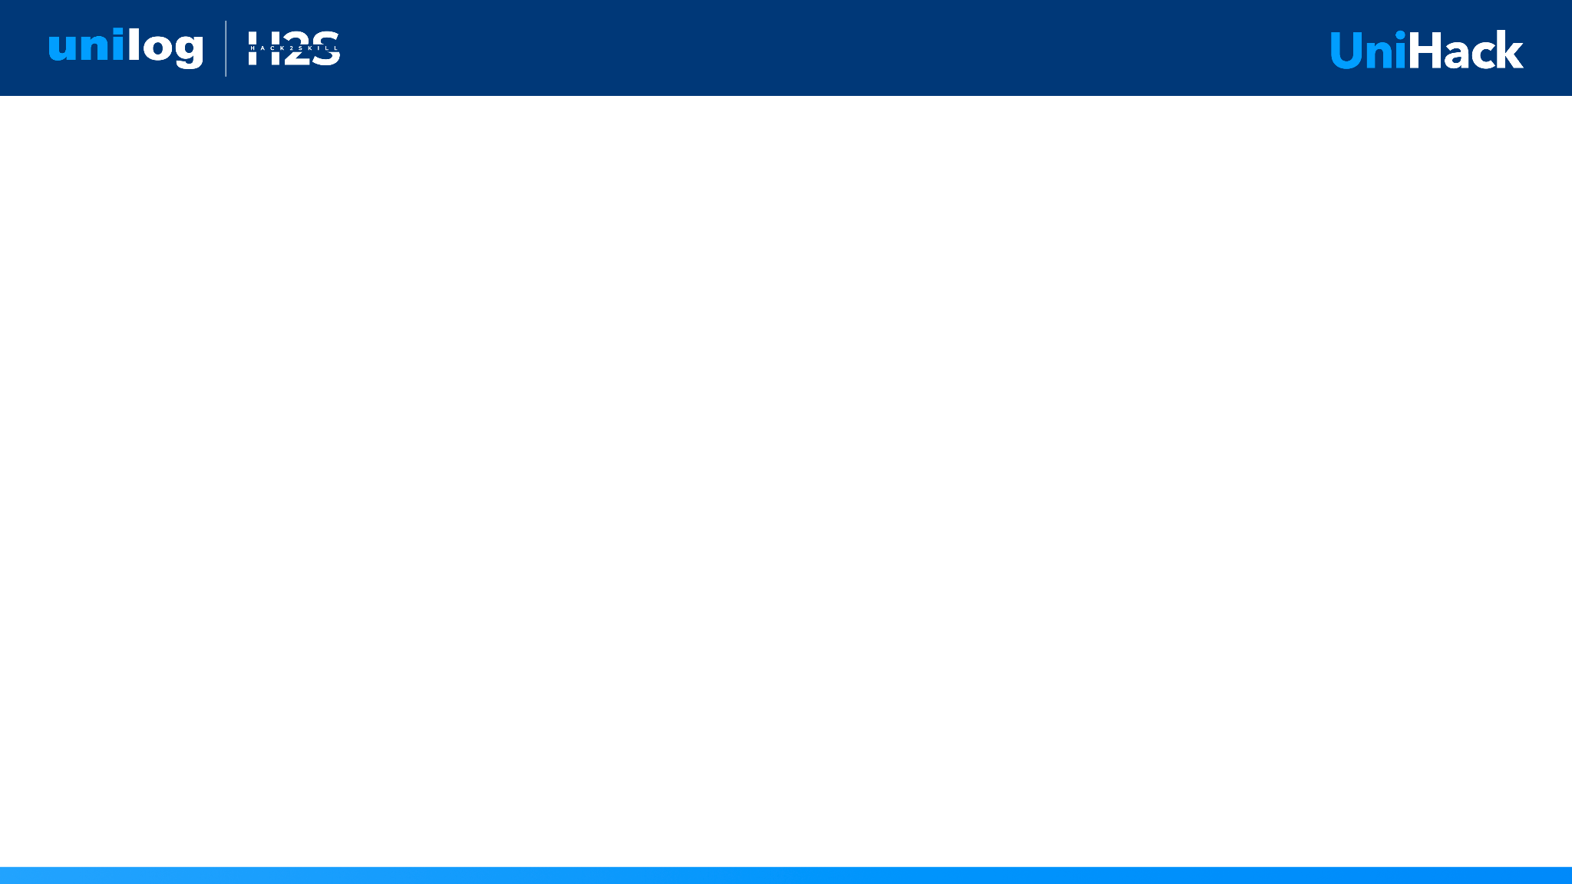
Guidelines
Kindly use the given template for submitting your prototype(Make a copy of the template)
One team is only required to submit one project.
Follow this template while preparing your presentation.
You are welcome to add as many POCs and design concepts to support your project.
The project should be feasible and the team members should be capable enough, to come up with the fully functioning prototype of the same idea, if required.

Slide 2

Team name: codewithcofee
Team leader name: charishma alam

Slide 3
Our solution is an intelligent, agentic pipeline built on LangGraph that transforms sparse, messy industrial product data into structured, commerce-ready catalogs. By mimicking a human catalog engineer, it utilizes dual-layer RAG, exact Manufacturer Part Number (MPN) verification, and series-level knowledge caching to ensure zero hallucinations and maximum system efficiency.

Slide 4
1. How does your solution enrich minimal product information?
Briefly explain how your solution transforms limited inputs (e.g., Part Number, Brand, Short Description) into rich product intelligence.
2. How does your solution ensure accuracy and trust in the generated product data?
Describe your validation strategy. This may include:
(Confidence scoring, Multi-source verification, Human review, Rule-based validation, AI validation, Other approaches)
3. What makes your solution scalable for enterprise product catalogs?
Describe how your solution would handle: Large product catalogs, New manufacturers, Different document formats, Continuous product updates

Slide 5
How different is it?
Unlike basic LLM wrappers, our solution is a self-learning orchestrator. When a human reviewer corrects an abbreviation (e.g., BRS to Brass), the system saves it to a persistent database, automatically applying this knowledge to all future ingestion runs.
How will it solve the problem?
It directly addresses the 'sparse data' problem by treating data enrichment as an autonomous research task—finding the exact spec sheet, verifying the part number, and systematically extracting fields without making assumptions.

Slide 6
- Exact MPN Verification on Manufacturer PDFs
- Series Knowledge Inheritance
- Document Hash Caching
- Self-Learning HITL Review Feedback Loop
- Zero-Hallucination Provenance Tracking
- Commerce-Ready 250-Column Export

Slide 7
(Please paste the Mermaid Process Flow diagram from the markdown artifact here)

Slide 8
(Please paste screenshots of the React Dashboard here)

Slide 9
(Please paste the Mermaid Architecture diagram from the markdown artifact here)

Slide 10
- Orchestration: LangGraph, LangChain
- Backend: Python, FastAPI
- Frontend: React, Vite, CSS3
- Data: SQLite, ChromaDB
- Models: Gemini (Reasoning), Qwen2.5/Llama3 (Extraction)
- Parsing: Serper API, DuckDuckGo, PyMuPDF

Slide 11
- Lightweight enough to run core extraction on local hardware.
- Leveraging fast, efficient models (Gemini Flash) brings API orchestration costs down to approx $0.002 - $0.005 per product.
- Document hashing and series caching reduce external API calls by up to 60-80%.

Slide 12
(Please paste high-quality screenshots of the working product here)

Slide 13
- Intelligent Table Parsing: Upgrading PDF extraction to seamlessly parse complex data tables using vision-language models.
- Vision-Based Extraction: Processing product images to automatically infer physical dimensions and finishes.
- Direct Distributor Integrations: Automated API connections to ERP databases for real-time syncing.

Slide 14
Provide links to your:
GitHub Public Repository
Demo Video Link (3 Minutes)
Working Prototype Link

Slide 15


