Slide 1

Guidelines
Kindly use the given template for submitting your prototype(Make a copy of the template)
One team is only required to submit one project.
Follow this template while preparing your presentation.
You are welcome to add as many POCs and design concepts to support your project.
The project should be feasible and the team members should be capable enough, to come up with the fully functioning prototype of the same idea, if required.

Slide 2

TEAM INFORMATION
▪ Team Name: codewithcofee
▪ Team Leader: charishma alam
▪ Hackathon Track: Unilog Product Intelligence Challenge
▪ Submission Stage: Prototype / MVP Phase
SOLUTION OBJECTIVE
▪ Core Focus: Autonomous Industrial Catalog Intelligence & Taxonomy
▪ Key Problem: Transforming sparse distributor inputs (MPN + Description) into 250+ commerce specs
▪ Key Advantage: Zero-hallucination exact MPN verification & series knowledge reuse
▪ Engine Type: LangGraph 10-Node State Machine Pipeline

Slide 3
10-Node Agentic Pipeline
▪ LangGraph State Machine: Executes 10 distinct verification stages autonomously.
▪ Targeted RAG: Queries ChromaDB per attribute to stay within fast context windows.
▪ Zero Hallucinations: Every spec carries exact verbatim source quote evidence.
Exact MPN Verification
▪ PDF Verbatim Match: Directly checks if part number exists on source datasheet.
▪ Manufacturer Priority: Prioritizes official domain PDFs over distributor web pages.
▪ High Confidence: Assigns 0.95+ confidence to verified technical datasheets.
Solve Once, Reuse N Times
▪ Document Hash Cache: Hashes PDFs (SHA-256) to skip redundant downloads/parsing.
▪ Series Knowledge Graph: Sibling products inherit verified series baseline attributes.
▪ Scalable Compute: Reduces external web search and LLM calls by up to 80%.

Slide 4
TECHNICAL ARCHITECTURE
Core Solution Principles: Enrichment, Accuracy & Scalability
1. Minimal Input Data Enrichment (Visual Flow)
▪ Pipeline Execution: Sparse Input (Brand + MPN) ➔ Taxonomy Classifier ➔ Hybrid Web Retrieval ➔ 250+ Standardized Specs
2. Accuracy & Trust Strategy (Zero-Hallucination Policy)
▪ Verification Strategy: Multi-Source Corroboration + Exact MPN Match on PDF + Verbatim Citations + HITL Review Gate
3. Enterprise Scalability Architecture
▪ Scalability Engine: SHA-256 PDF Document Hashing + Series Knowledge Inheritance + SQLite Self-Learning Knowledge Graph

Slide 5
HOW DIFFERENT IS IT? (Self-Learning Loop)
▪ Persistent Memory: Not a one-off static LLM prompt wrapper.
▪ Human Knowledge Loop: When a reviewer approves an abbreviation (e.g. BRS ➔ Brass), it saves to SQLite.
▪ Catalog Ingestion: Subsequent ingestion runs auto-resolve learned shorthand without human intervention.
▪ Evolving Intelligence: System gets faster and smarter with every processed batch.
HOW IT SOLVES SPARSE DISTRIBUTOR DATA
▪ Autonomous Research: Mimics a human domain engineer's research workflow.
▪ Document Sourcing: Locates official spec sheets and extracts 250+ catalog fields.
▪ Strict Provenance: Ensures unsupported values are marked MISSING rather than hallucinated.
▪ Commerce Ready: Generates SEO descriptions and 250-column Unilog CSV exports.

Slide 6
Exact MPN Verification
▪ PDF Verification: Matches part number directly on manufacturer datasheet.
Series Knowledge Reuse
▪ Knowledge Inheritance: Sibling products share verified series baseline specs.
SHA-256 PDF Caching
▪ Document Hash Cache: Prevents re-downloading identical manuals.
Self-Learning HITL
▪ Abbreviation Dictionary: Reviewer approvals expand persistent SQLite dict.
Evidence Citation
▪ Zero Hallucinations: Every extracted field carries URL & verbatim quote.
250-Col Unilog CSV Export
▪ Commerce Ready: Generates full Unilog-compliant export file.

Slide 7
▪ Flow Summary: Raw Input ➔ Identity & Taxonomy ➔ Hybrid Search ➔ RAG Extraction ➔ HITL Review Gate ➔ Commerce CSV Export

Slide 8
LINE-ITEM REVIEW CONSOLE
▪ Confidence Badges: Color-coded indicators for High (>=80%), Mid (50-79%), Low (<50%).
▪ Provenance Drawer: Displays verbatim quote snippet and direct source document URL.
▪ Human In Loop (HITL): Interactive editor allows instant approval or rule correction.
▪ Status Tracking: Flags missing or unverified fields for manual sign-off.
LIVE SCALABILITY MONITOR
▪ Searches Avoided: Tracks web search calls saved via cache and series hits.
▪ Documents Reused: Displays total PDF manuals reused via SHA-256 hash match.
▪ Series Cached: Shows distinct product families inheriting baseline attributes.
▪ Auto-Enriched Count: Monitors high-confidence records auto-completed.

Slide 9
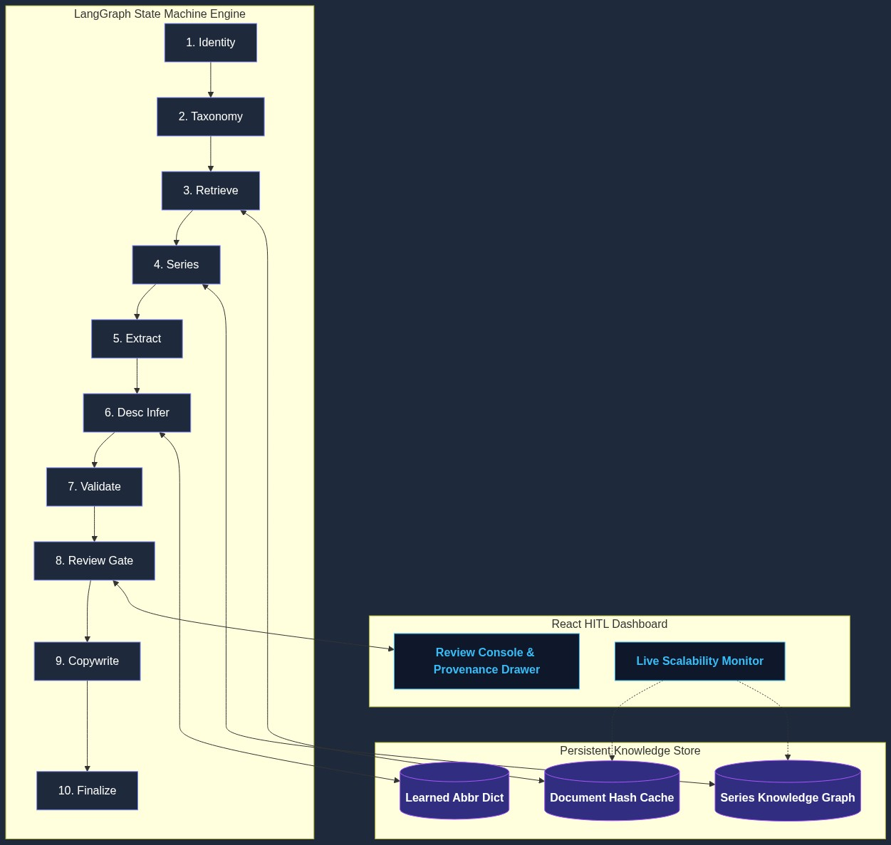
▪ Architecture Highlights: 10 Sequential & Conditional LangGraph Nodes | SQLite Knowledge Store | ChromaDB Vector Store

Slide 10
Orchestration & Workflow
▪ Core Stack: LangGraph, LangChain, Python 3.11, FastAPI
AI Reasoning & Extraction
▪ LLM Models: Gemini 2.5 Flash (Orchestration), Qwen2.5 / Llama3 (Local)
Storage & Vector Search
▪ Databases: SQLite (Knowledge Store), ChromaDB (Vector Store)
Parsing, Search & UI
▪ Tools & Frontend: Serper API, DuckDuckGo, PyMuPDF, React.js, Vite

Slide 11
Micro Cost Per Product
▪ API Cost Efficiency: $0.002 – $0.005 per product.
▪ Targeted Prompts: Attribute RAG uses tiny focused contexts within fast LLM tiers.
▪ Budget Friendly: Enables large catalog enrichment without massive cloud bills.
60-80% Call Reduction
▪ Document Hashing: Identical PDF datasheets parsed once.
▪ Series Baseline: Shared attributes inherited across sibling items.
▪ API Conservation: Drastically minimizes web search quotas.
Lightweight Infra
▪ Standard Server: Runs efficiently on modest server instances.
▪ SQLite Backend: Zero complex database cluster overhead.
▪ Local Ollama Option: Supports full offline demo execution.

Slide 12
Catalog Enrichment Engine
▪ Single & Batch Mode: Supports individual MPN lookup or batch CSV file processing.
▪ Live Pipeline Trace: Step-by-step Execution Log showing exact node actions.
Evidence Provenance Drawer
▪ Verbatim Snippets: Clickable source quotes verifying every extracted value.
▪ Direct Datasheet Link: Provides direct URLs to official PDF spec sheets.
250-Column CSV Exporter
▪ Unilog Format: Exports 250 standardized attributes into distributor CSV format.
▪ Automated SEO: Generates short, long, and 20 feature bullet descriptions.

Slide 13
PHASE 1: PDF Vision Parser
▪ VLM Extraction: Parse complex multi-page PDF spec tables via Vision-Language Models.
▪ Diagram OCR: Extract dimensional specs from technical CAD drawings.
PHASE 2: Image Feature Vision
▪ Visual Specs: Infer physical color, finish, and shape directly from product images.
▪ Packaging OCR: Extract UPC/EAN barcodes from packaging photos.
PHASE 3: ERP Connectors
▪ Distributor Sync: Direct API integration with ERP systems (SAP, Oracle).
▪ Real-Time Ingestion: Automated catalog sync on new inventory additions.

Slide 14
GitHub Public Repository
▪ Repository URL: https://github.com/Charishma1707/product-intelligence
Demo Video Link (3 Minutes)
▪ Video URL: https://youtu.be/example-demo-video
Working Prototype Link
▪ Prototype Dashboard: http://localhost:5173 (React HITL Review Console)

Slide 15


