Slide 1
Railway Reservation System
TEAM MEMBERS
A25126510016 - gullipalli bindu shalini
A25126510026 - kothimera princy
A25126510028 - metta tejaswini
A25126510046 - reesu lakshmi charishma

Slide 2
PROBLEM STATEMENT
This system simulates railway ticket booking operations.It manages train schedules,seat availability, and passenger details.The system ensures efficient booking and cancellation processes.File handling is used for storing data.It demonstrates OOP cocepts and system design. The system reduces manual workload and improves accuracy.It supports searching for trains and booking tickets. It can be extended with real-time updates and payment systems.It is useful for understanding large-scale reservation systems.

Slide 3
OBJECTIVES
To simulate railway booking
To manage train schedules
To track seat availability
To store passenger data
To ensure efficient booking

Slide 4
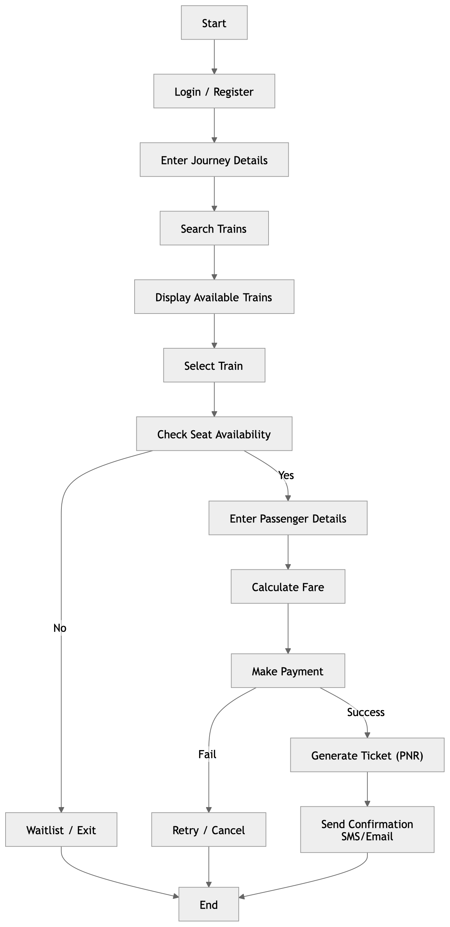
SYSTEM DESIGN
(FLOWCHART /
ALGORITHM)

Slide 5
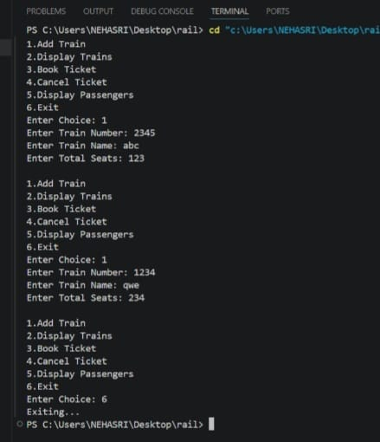
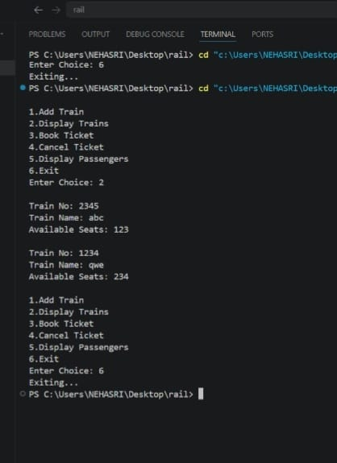
IMPLEMENTATION
FRONTEND: console / Terminal interface
BACKEND: classes, file handling, booking / cancel logic
1.ADD TRAIN: 2.DISPLAY TRAIN:

Slide 6
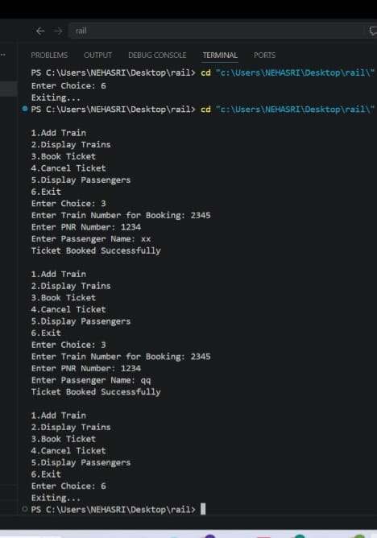
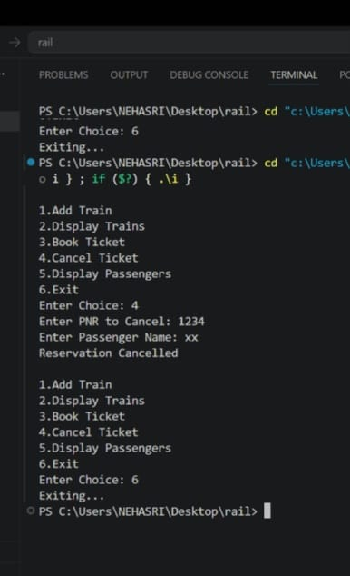
3.BOOK TICKET: 4.CANCEL TICKET:

Slide 7
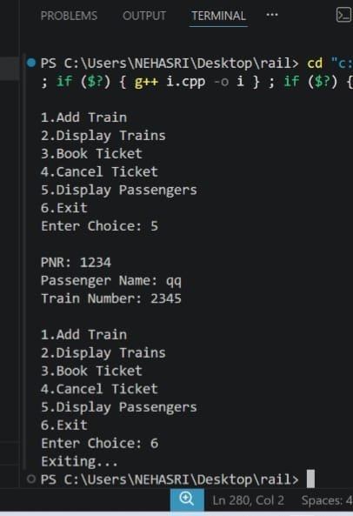
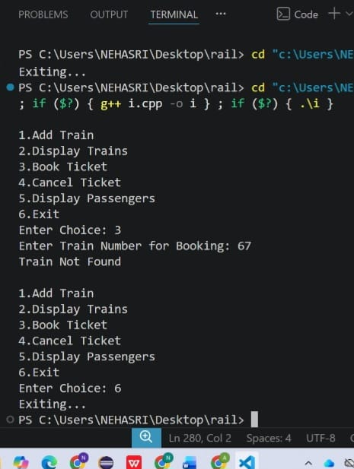
5.DISPLAY PASSENGER: 6.EXIT:

Slide 8
RESULTS AND DISCUSSION
Successfully performs the main railway operations such as displaying available trains, booking tickets, generating passenger ticket, cancelling tickets.
The system reduces manual work and gives fast results through a menu-driven interface.
The use of OOPs makes the code modular and easy to understand.
The system stores train and passenger data using binary file handling.

Slide 9
CONCLUSION
The railway reservation system efficiently automates basic railway operations.
It demonstrates the combined use of OOPs concepts and file handling to store and manage data permanently.
Future scope: online payments integration, database connectivity, GUI or web application interface.

