Slide 1

Unveiling the Depths: Exploring Suicide Rates - Statistical Analysis and Insights
Presented by: Presented to: Balasubramanian, Sangeeth (100890482) Prof. Thomas Francescutti Ganesan, Yogaraj (100897419) Gunasekaran, Praveen Raju (100896126) Kondamuri, Charishma (100899582) Parasur Venkataraman, Jayasurya (100897383) Jasthi, Bala Sai Tejaswini (100905288) Pudota, Ignatius (100903994)

Slide 2

Background of organization/problem addressed
Background:
Global Public Health Research Institute
Collaborates with governments, academic institutions, NGOs
Problem Addressed:
Global suicide rates
Understanding the causes , patterns and trends

Slide 3
Business problem/opportunity
Business Problem/Opportunity:
Governments and Policy Makers
Healthcare Professionals
Non-profit Organizations and Advocacy Groups
Challenge/Opportunity:
Data Availability and Reliability
Understanding Complex Factors
Tailoring Interventions to Vulnerable Populations
Cultural Sensitivity and Stigma
Humanity Considerations:
Affects individuals, families, and communities
Advocate for improved mental health services

Slide 4
Data mining problem
Supervised/Unsupervised Learning: It relies on descriptive statistics, visualizations, and linear regression analysis. Therefore, the problem is more descriptive (unsupervised/explanatory) rather than a supervised predictive modeling task.
Explanatory/Predictive Analysis: The focus of the analysis is primarily explanatory, aimed at understanding suicide trends, patterns, and relationships within the dataset. The analysis aims to explain rather than predict future suicide rates.
Deployment: Given that the analysis is primarily descriptive and explanatory, its deployment may involve:
Public Awareness Campaigns
Policy Formulation
Resource Allocation
Research and Collaboration

Slide 5
Columns in Dataset
Country
Year
Sex
Age
Suicides_no
Population
Suicides/100k pop
Country-year
HDI for year
GDP for year
GDP per capita
Generation

Slide 6
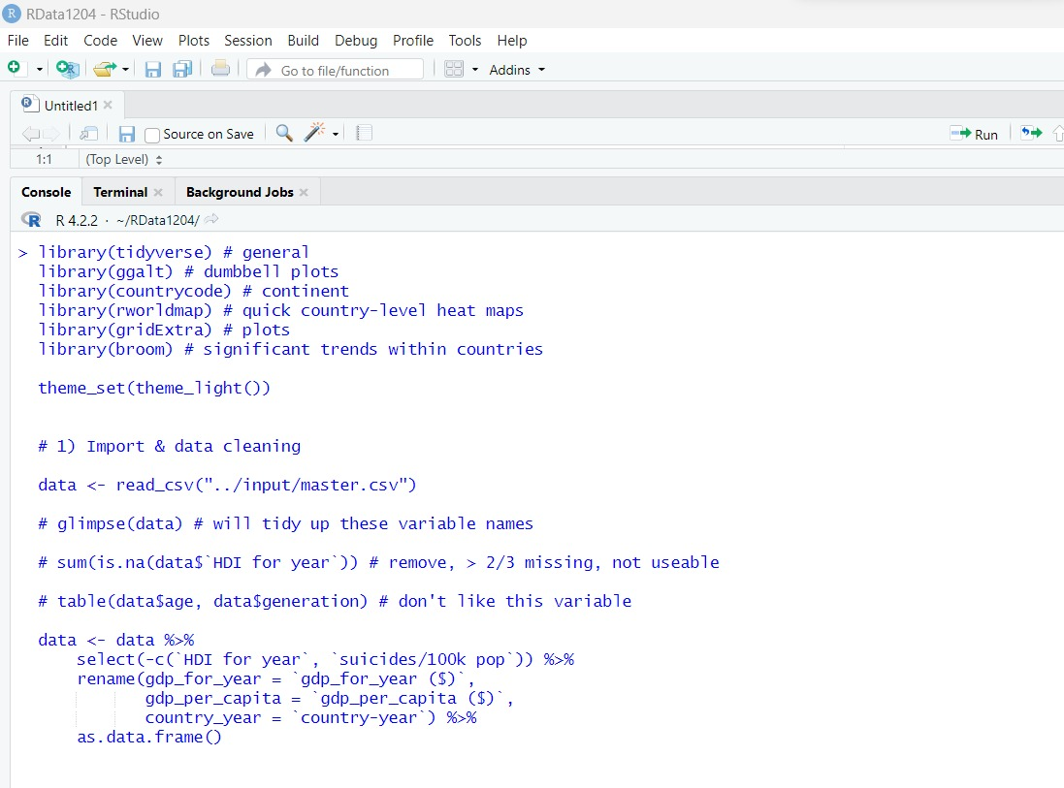
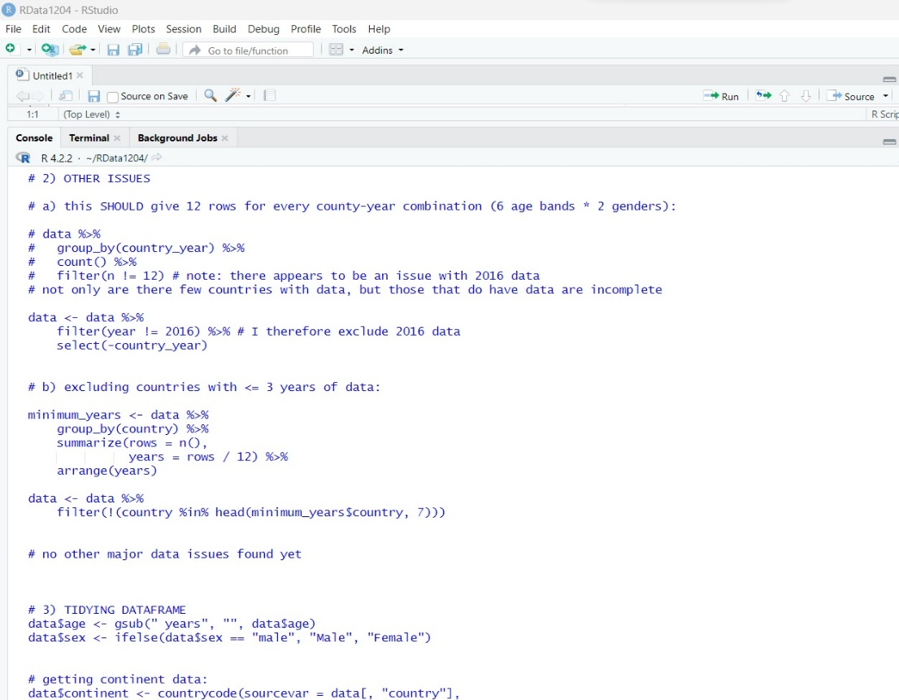
Data cleansing, if needed – steps taken – what were the challenges with the data and steps taken to cleanse bring it to usable format (ETL – extract, transform, load steps). Technology/tools used for cleansing/analysis
Removed 7 Countries:
Excluded countries with <= 3 years of data.
Ensured meaningful analysis by focusing on countries with sufficient data.
Excluded 2016 Data:
Removed 2016 data from the dataset.
Due to limited data and missing entries in some countries.
Removed HDI Variable:
Eliminated "HDI for year" due to > 2/3 missing data.
Ensured the use of complete and reliable variables.
Addressed Generation Variable Issues:
Rectified problems with the "generation" variable (2.11).
Cleaned and transformed the variable for accurate analysis.

Slide 7
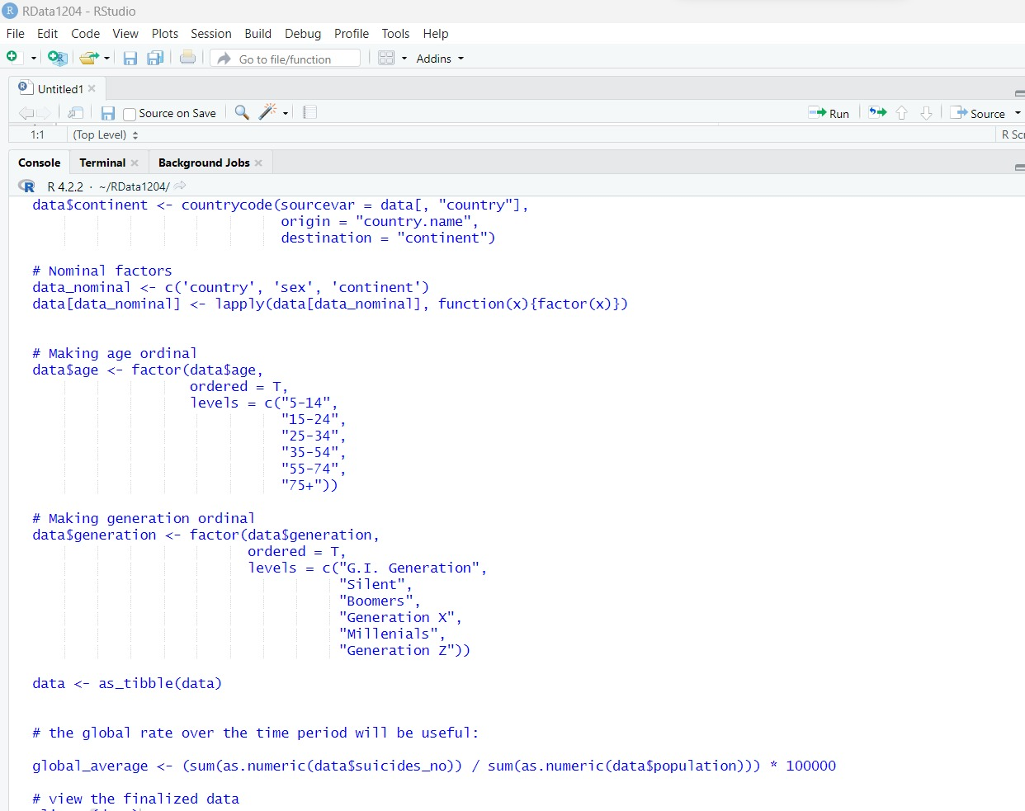
Data cleansing, if needed – steps taken – what were the challenges with the data and steps taken to cleanse bring it to usable format (ETL – extract, transform, load steps). Technology/tools used for cleansing/analysis
Added Continent Information:
Utilized the countrycode package to add "continent" data.
Enhanced analysis by grouping countries based on continents.
Addressed Limited African Data:
Acknowledged limited suicide data from African countries.
Included available data while highlighting the need for further collection.
Technology/Tools Used:
Utilized R, tidyverse, countrycode package, and more.
Efficiently processed and analyzed data for insights.

Slide 8
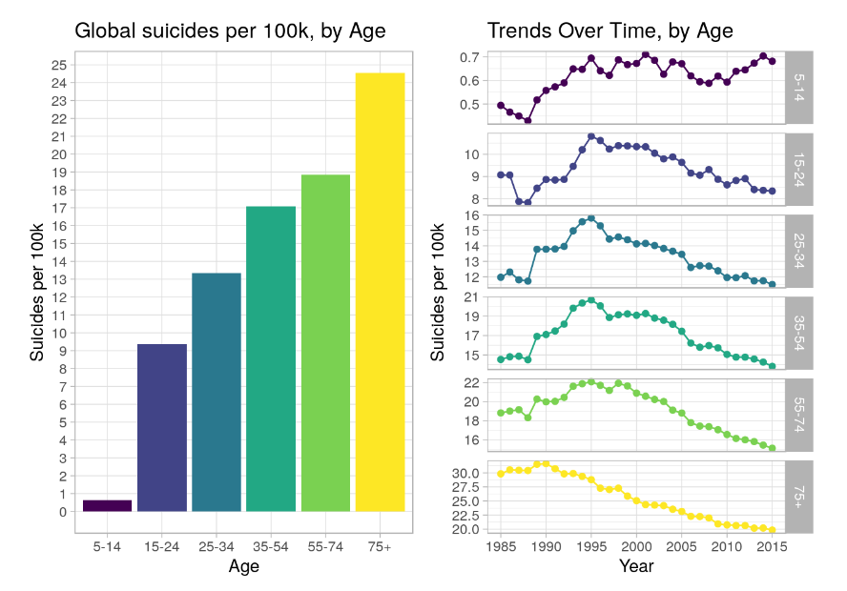
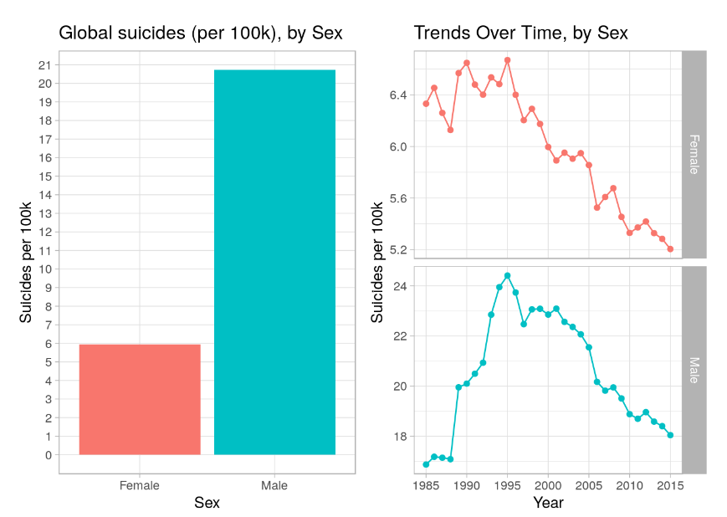
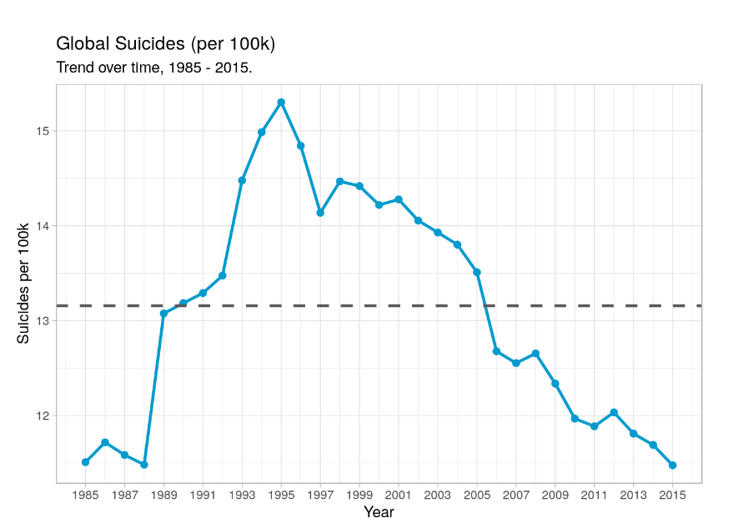
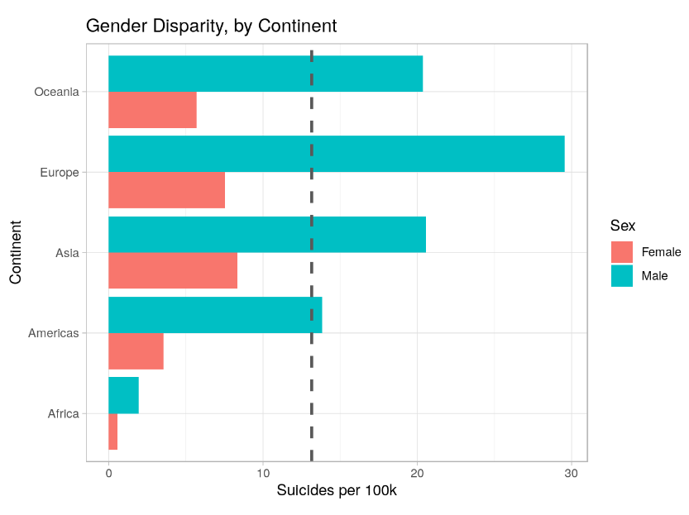
Overall Suicide Trends (Line Plot):
Data from "Year" and "Suicides/100k pop" columns.
Aggregated average suicide rate per year.
Inference: Decreasing trend in global suicide rates, suggesting the impact of prevention efforts.
Geographic Variations (Choropleth Map):
Data from "Country," "Year," and "Suicides/100k pop" columns.
Filtered for specific year or aggregated across all years.
Inference: Geographic differences in suicide rates, guiding targeted interventions.
Gender Differences (Bar Plot):
Data from "Year," "Sex," and "Suicides/100k pop" columns.
Aggregated average suicide rate for males and females.
Inference: Higher suicide rates among males globally, requiring gender-specific interventions.
Age Patterns (Stacked Bar Plot):
Data from "Year," "Age," and "Suicides/100k pop" columns.
Aggregated average suicide rate for different age groups.
Inference: Tailoring prevention strategies to specific age groups based on age-related patterns
Methods Used:

Slide 9
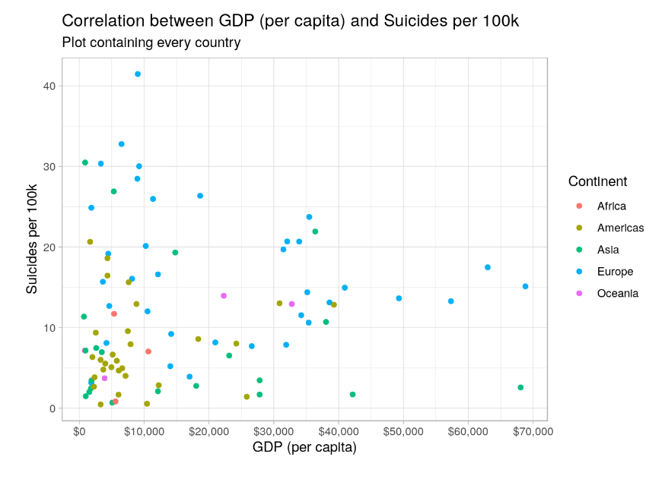
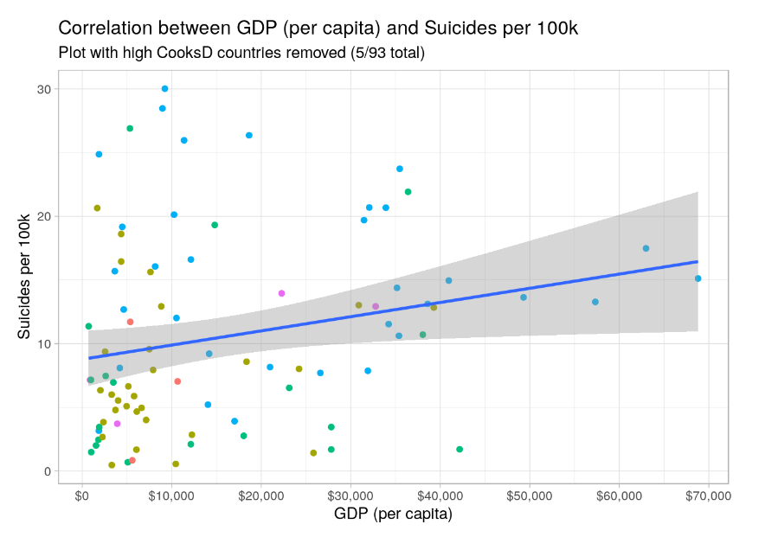
Suicide Rates vs. Human Development Index (HDI) and GDP per Capita
Scatter Plot 1: Suicide Rates vs. HDI
Method: Data from "HDI for the year" and "Suicides/100k pop" columns.
Inference: Weak positive correlation between HDI and suicide rates. Wealthier countries tend to have marginally higher suicide rates, but correlation is not substantial.
Scatter Plot 2: Suicide Rates vs. GDP per Capita
Method: Data from "Gdp_per_capita ($)" and "Suicides/100k pop" columns.
Inference: Faint positive correlation between GDP per Capita and suicide rates. Richer countries tend to have slightly higher suicide rates, but correlation is not strong.

Slide 10
Data Analysis Methods for Global Suicide Rates
Data Collection and Preprocessing:
Collected diverse dataset from reliable sources (WHO, CDC, national health agencies).
Addressed challenges (missing data, inconsistent reporting, data format variations).
Preprocessed data (cleaning, handling missing values, removing duplicates, normalization).
Exploratory Data Analysis (EDA):
Overview: Summarized statistics and identified distributions.
Visualizations: Histograms, box plots, and correlation matrices.
Time Series Analysis:
Studied trends and seasonality patterns using line and area charts.
Geographic Analysis:
Examined suicide rates across countries with choropleth maps and bubble charts.
Correlation Analysis:
Identified relationships between suicide rates and factors using scatter plots and heat maps.
Clustering:
Grouped countries with similar suicide rate patterns using K-means clustering and cluster maps.
Time Intelligence Functions (DAX):
Performed date-related calculations like year-to-date totals and period-over-period growth.
Custom Columns and Functions (M Language):
Transformed data with M language in Power Query beyond standard functions.
What-If Analysis:
Explored impact of different factors on suicide rates using What-If parameters.

Slide 11
Benchmarking and Comparison in Global Suicide Rates Analysis
Benchmark:
Global Average Suicide Rate:
Used as a reference to compare individual country or regional suicide rates.
Previous Studies:
Compared findings with existing research to validate analysis and assess insights consistency.
Comparison:
Regional Comparison: Analyzed suicide rates across different regions or continents to identify variations and disparities.
Demographic Comparison:
Compared suicide rates among age groups and genders to understand vulnerability differences.
Correlation Analysis:
Investigated correlation coefficients between suicide rates and factors like mental health indicators and economic conditions.
Clustering Comparison:
Compared characteristics and distribution of countries or regions within each cluster to understand patterns.
What-If Analysis Comparison:
Conducted multiple scenarios to compare the impact of different factors on suicide rates.

Slide 12
Implications of Data Analysis on Suicide Rates
Actionable Steps for Businesses and Organizations:
Targeted Interventions: Implement suicide prevention programs based on identified risk factors.
Seasonal Awareness Campaigns: Run campaigns during high-risk periods to promote mental health support.
Training and Education: Provide workshops to identify distress signs and offer appropriate support.
Crisis Helplines and Support Services: Establish accessible helplines for individuals in distress.
Long-Term Policy Development: Develop sustainable mental health policies based on longitudinal trends.
Public Awareness Initiatives: Launch campaigns to reduce mental health stigma.

Slide 13
Recommendations, considerations, challenges, and suggestions:
Data Quality and Bias
Ethical Considerations
Cultural and Regional Variations
Correlation vs. Causation:
Feature Selection
Imbalanced Data
Longitudinal Data
Domain Expertise
Interpretability
Validation and Reproducibility
Consider Long-term Impact
Continual Learning

Slide 14


THANK YOU
THANK YOU

