Slide 1
AMBSAFE
EMERGENCY AMBULANCE TRACKING SYSTEM
Every year, thousands of lives are lost in road accidents due to delayed ambulance response.
Ambsafe is a revolutionary tracking system that ensures fast and efficient emergency medical services.

Slide 2
STUDENT DETAILS
Name of the Student | Roll Number | Branch | Mobile Number
TAMMANA NAGA SAI CHARISHMA | 21951A3323 | CSIT | 8096775740
THAMMALI NIKITHA | 21951A3326 | CSIT | 9515177831

Slide 3
The Solution Proposed
In order to solve the above problems, we have come up with an idea to implement real-time projects using computer science as the based on the application, web and sensor development.
To address the problem, we are going to implement an ambulance tracking technology using android application development, web development and a sensor.
With the help of android, the nearest ambulance drivers would get an alert after an emergency we make sure that the Ambulance reach the accident spot as quickly as possible by providing shortest route to the hospital.
Ambsafe has a sensor which changes the traffic signal to green till the ambulance passes the signal region enabling the ambulance reach the hospital quickly without getting stuck in the traffic.
With the help of Web application, the traffic authority can monitor the passage of vehicles and track them easily

Slide 4
Solution Offerings
Find the nearest ambulance to the emergency location.
Locate the nearest hospital from the ambulance.
The shortest route to the accident spot is displayed
The central server tracks the vehicles location
Sensor switches the Traffic signal when the ambulance is nearing the traffic lights.
Cut response times in the “GOLDEN HOURS”.

Slide 5
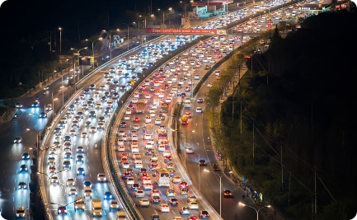
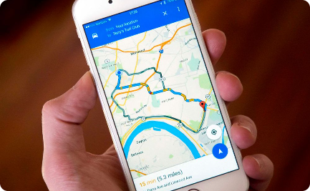

Avoids Traffic Jams
Time is crucial
Traffic signal control
Smartphone integration
Ambsafe identifies the shortest route in real-time, helping ambulances avoid traffic congestion and reach patients faster.
Integrated with smartphones, this system guides drivers with turn-by-turn navigation, ensuring they always take the fastest route.
Ambsafe's central server communicates with traffic lights, ensuring they turn green when an ambulance approaches, clearing the way ahead.

Slide 6
Efficient Traffic Management
Real-time tracking
Reduced congestion
The central server continuously tracks the location of ambulances, enabling better coordination with traffic authorities.
By rerouting ambulances away from congested areas, Ambsafe helps reduce overall traffic congestion.
Emergency priorities
Traffic signals are adjusted in real-time based on the proximity of ambulances, giving priority to emergency vehicles and saving critical time.

Slide 7
User-Friendly Interface
1
Intuitive design
The user interface of Ambsafe is user-friendly and requires minimal training to use, ensuring quick adoption and ease of use for emergency responders.
2
Real-time updates
Dispatchers and drivers can see real-time updates on the ambulance location, traffic conditions, and estimated arrival time, enabling efficient decision-making.
3
Seamless integration
Ambsafe seamlessly integrates with existing ambulance management systems, making it easy to implement and cost-effective.

Slide 8
Improved Response Time
Before Ambsafe
After Ambsafe
An average response time of 15 minutes
An average response time of 8 minutes
Delays due to traffic jams and inefficient route planning
Efficient routing and traffic signal control for faster response
Increase in patient mortality rates
Potential to reduce patient mortality rates significantly

Slide 9

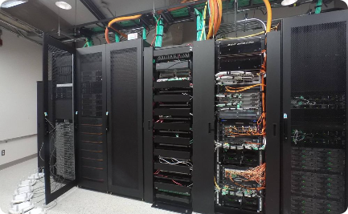
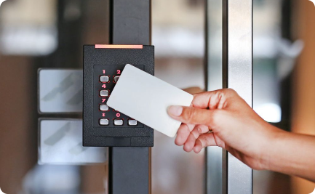
Reliable and Secure
Secure data transmission
Robust server infrastructure
Access control measures
Ambsafe uses encrypted communication protocols, ensuring the privacy and security of patient data during transmission.
With a redundant server setup, Ambsafe ensures uninterrupted service and zero downtime, guaranteeing the system is always available when needed.
Ambsafe incorporates strict access controls and user authentication protocols, preventing unauthorized access and ensuring data integrity.

Slide 10
Enhancements
Real-time traffic updates
Automated emergency vehicle detection
Elevation mapping
Adding elevation data to the routing algorithm will allow Ambsafe to consider gradients and inclines for even more accurate route optimization.
The ability to obtain real-time traffic updates will enable Ambsafe to dynamically choose the fastest and most efficient route.
By integrating with traffic cameras and sensors, Ambsafe can automatically detect approaching emergency vehicles and provide them with unobstructed passage.

Slide 11
Cost-Efficient Solution
1
Reduces fuel consumption
2
Lower maintenance expenses
By optimizing routes, Ambsafe helps reduce fuel consumption and lowers operational costs for ambulance services.
The faster response times enabled by Ambsafe reduce wear and tear on ambulances, resulting in reduced maintenance expenses.
3
Saves lives
Ultimately, the lives saved by Ambsafe outweigh the initial investment, making it a cost-efficient solution for emergency response services.

Slide 12
The Uniqueness and distinctive features of the solution
If the solutions are implemented well, then it will be a benefit to the society.
UNIQUE FEATURES
Registration
Sign in
Location sharing
USER INTERFACE
Request
Retrieve
Trace the availability
Collaboration with Hospital

Slide 13
How the proposed / developed (product / process / service) solution is different from similar kind of product by the competitors
The proposed solution is different from similar kinds of products in the market which have features like the Location of the ambulance but we are going to differ from the present products with the following features:
Can also SEND ALERT to the traffic authority about the scenario.
Sensors can control the traffic light into green till the ambulance reach the desired hospital.
Suggest the shortest distance to the ambulance with can help the ambulance to reach within the golden hours.
Login access to the Driver and track the patient details number of patients, no of trips, etc.

Slide 14
Scalability:
We can increase the market potential by creating a new application with the above-mentioned features and selling it to the required customers especially government. Some of the major application areas for the global market include fields such as
Healthcare
Transportation
Services
Target user / Customers are all the Emergency patients and government and private medical emergency services /NGOs.

Slide 15
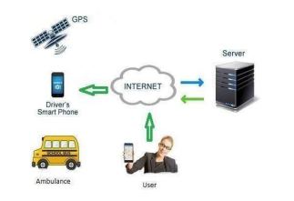
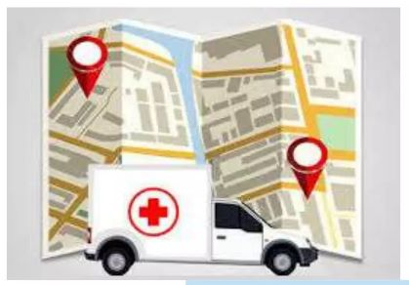
IMAGES

Slide 16
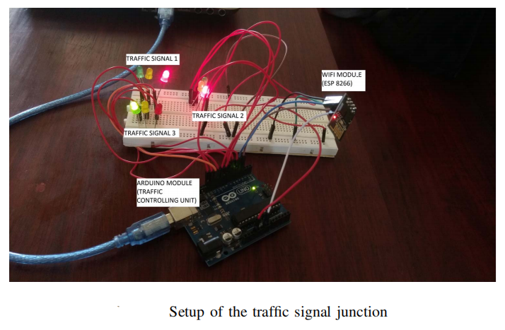
IMAGES
Sample Setup of the traffic signal junction

Slide 17
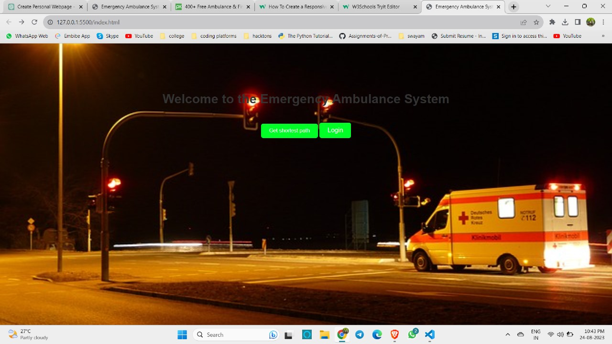
PROTOTYPE IMAGES

Slide 18


