Slide 1
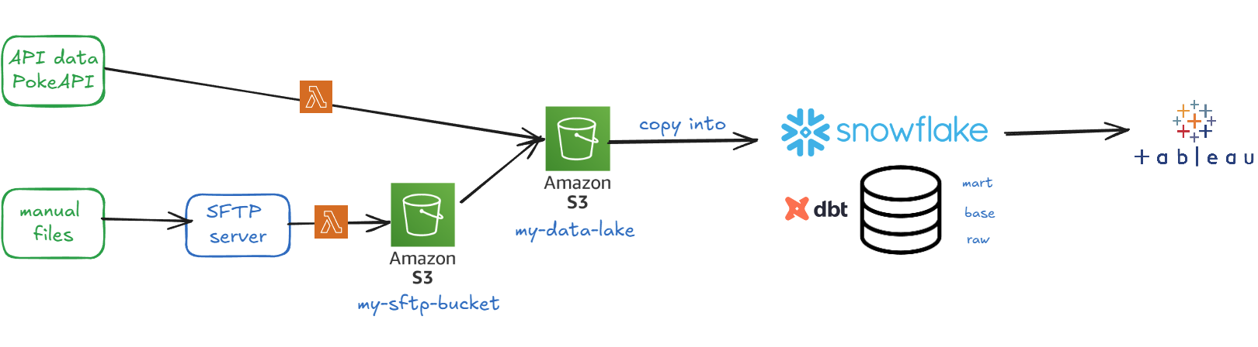
DATA PIPELINE / ARCHITECTURE DIAGRAM

Slide 2
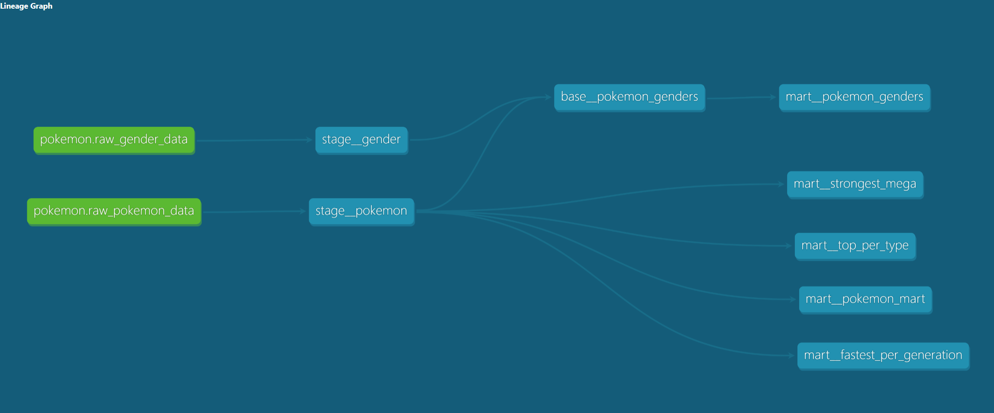
DBT LINEAGE

