Slide 1
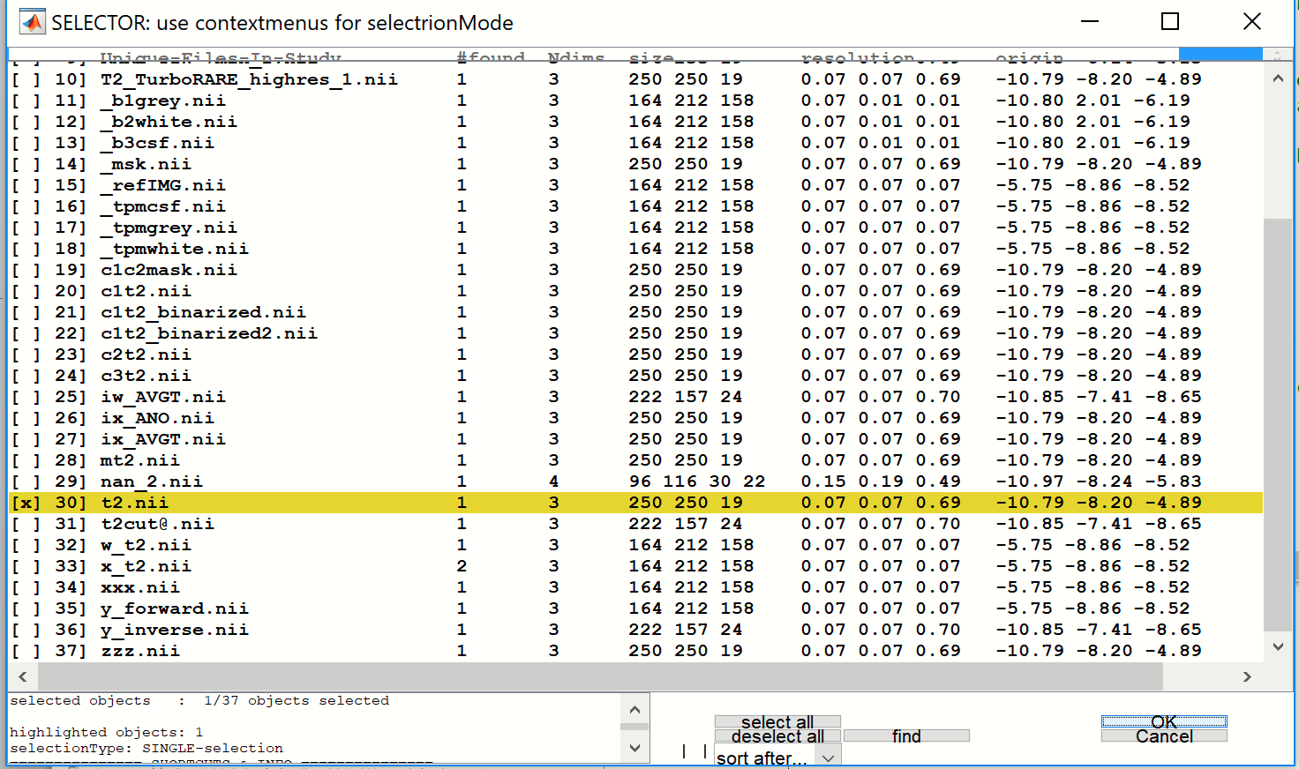
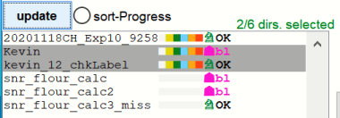
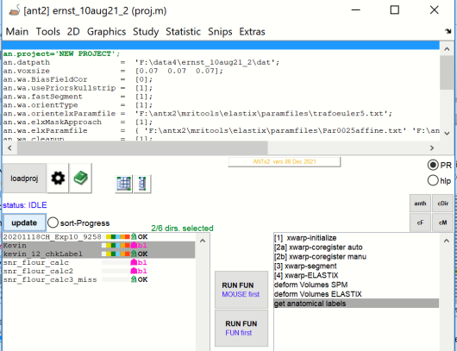
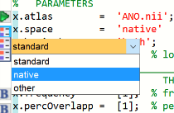
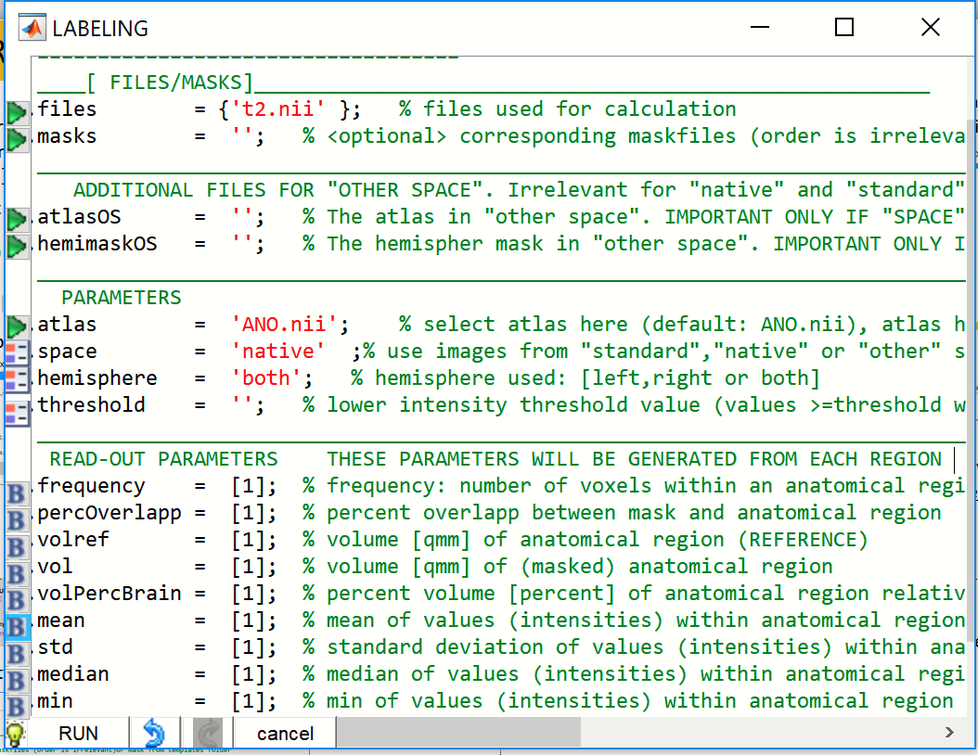
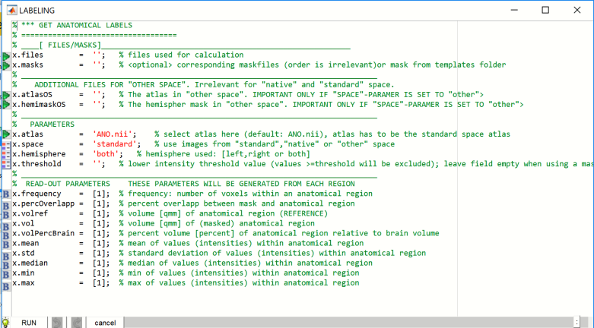
Regionwise read-out in Native Space (NS)
1
-start ANT-gui: type ‚ant‘
-go to study-folder: use cd… or use matlab-path edit box or matlab‘s browse
-to-folder-icon : ..example: cd F:\data4\ernst_10aug21_2
-load project: via [loadproj]-button and select your project (m-file)
6
In the file selector window select the „t2.nii“ -image. The t2.nii-file is in the animal‘s
native space, and we want to extract region-weise parameter here. Hit [OK]
2
Select animals in the left listbox: ..here I selected two animals
Prerequisite: It is assumed here that the selected animals are already registered to standard space (template-space)…this is
also mandatory im image paramter are extracted from NS
3
Select „get anatomical labels“ from the right listbox:
7
IMPORTANT:
-here we do not use additional masks,…leave x.masks empty
- now the input image is in native space. DO not change the ATLAS (keep
„ANO.nii“ for x.atlas)!
-change x.space to „native“via left icon
(because the image is in NS)
-extract paramter from both hemispheres together: thus, keep x.hemisphers=‚both‘
8
The parameter window should now look as follows:
4
Hit lower [RUN FUN] -button..The parameter window will pop-up.
Hit the „bulb“-icon to get further help
5
Click [green icon ] left to ‚x-files‘…to open the file selector window…
Hit [RUN]

Slide 2
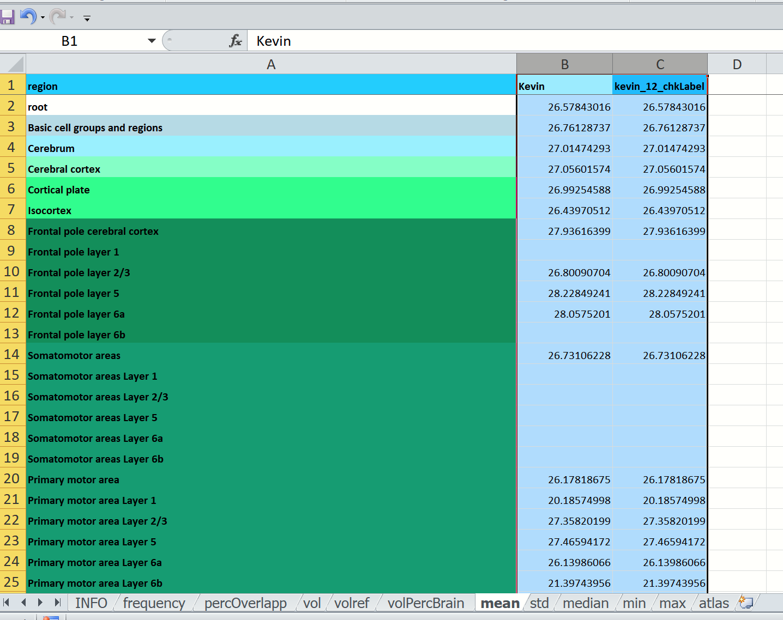
9
When done…Matlab‘s comand window should show a hyperlink to open the
Exelfile or open the explorer and highlight the file in the results-folder
Open the document and select the „mean“-sheet. This sheet shows you the
mean value for each region (rows) and each animal. Note here that the dataset of the 2nd
Animal was just copied thus from the first animal…thus the values are identical!
Please inspect the info-sheet to obtain information about the document and sheets
Use also the bulb-icon to obtain help for the paramter-window or type „uhelp xgetlabels4“ in the command window

Slide 3
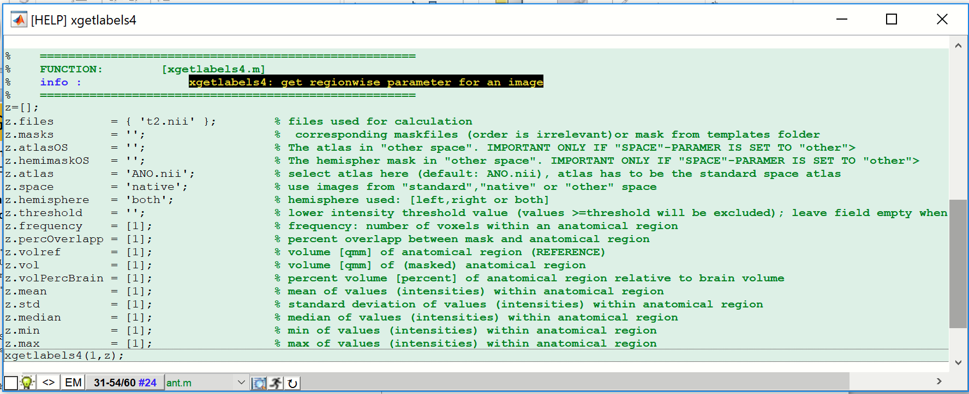
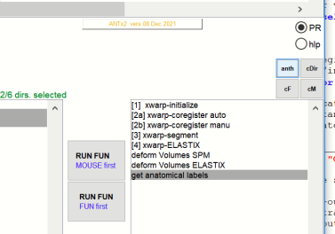
Get the code
Type „char(anth)“ in the matlab command window or click
[anth]-icon or type „uhelp anth“ to obtain the latest function-
Related code
-you may rerun/modify+rerun the code for same/other animals
(don‘t forget to select them in the left listbox)
% % =====================================================
% % #g FUNCTION: [xgetlabels4.m]
% % #b info : #yk xgetlabels4: get regionwise parameter for an image
% % =====================================================
z=[];
z.files = { 't2.nii' }; % % files used for calculation
z.masks = ''; % % <optional> corresponding maskfiles (order is irrelevant)or mask from templates folder
z.atlasOS = ''; % % The atlas in "other space". IMPORTANT ONLY IF "SPACE"-PARAMER IS SET TO "other">
z.hemimaskOS = ''; % % The hemispher mask in "other space". IMPORTANT ONLY IF "SPACE"-PARAMER IS SET TO "other">
z.atlas = 'ANO.nii'; % % select atlas here (default: ANO.nii), atlas has to be the standard space atlas
z.space = 'native'; % % use images from "standard","native" or "other" space
z.hemisphere = 'both'; % % hemisphere used: [left,right or both]
z.threshold = ''; % % lower intensity threshold value (values >=threshold will be excluded); leave field empty when using a mask
z.frequency = [1]; % % frequency: number of voxels within an anatomical region
z.percOverlapp = [1]; % % percent overlapp between mask and anatomical region
z.volref = [1]; % % volume [qmm] of anatomical region (REFERENCE)
z.vol = [1]; % % volume [qmm] of (masked) anatomical region
z.volPercBrain = [1]; % % percent volume [percent] of anatomical region relative to brain volume
z.mean = [1]; % % mean of values (intensities) within anatomical region
z.std = [1]; % % standard deviation of values (intensities) within anatomical region
z.median = [1]; % % median of values (intensities) within anatomical region
z.min = [1]; % % min of values (intensities) within anatomical region
z.max = [1]; % % max of values (intensities) within anatomical region
xgetlabels4(1,z);
Obtain history/code via button

