Slide 1
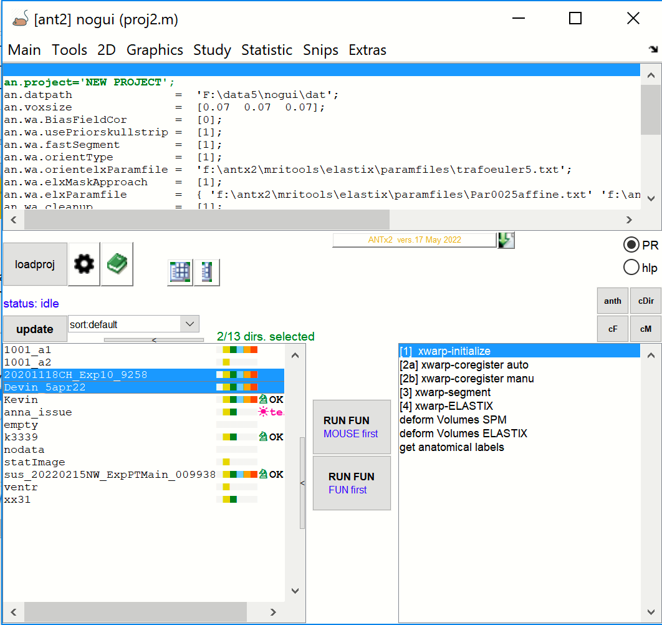
ANTx – Main GUI
Current ANTx version
(show changes)
Study name
(Folder name)
Project-name
(m-file)
Show case-file matrix
of all animals
Show case-file matrix
of sellected animals
Update ANTx from Github
Show HTML report
During template registration
Obtain help when hovering
over menu items
setting of the project
Show ANTx history
(obtian batch) of last
functions
Open history of prev. projects
Change setting of the project
Close all open directories
Load an ANTx project
(proj.m/m-file)
Status message
Sort animals
Close all Mricron
instances
Update animal listbox
Number of selected animals
Close all figures
Selected animals
Function listbox:
Functions for
Template registration
Animal listbox
(each item is an animal-folder)
Run selected function(s) from function listbox across Selected animals via Parallel processing
Resize animal listbox
Run selected function(s) from function listbox across Selected animals

