Slide 1
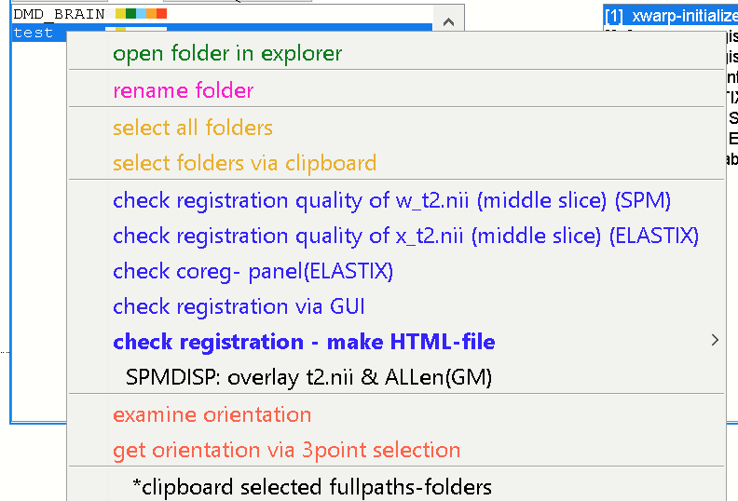
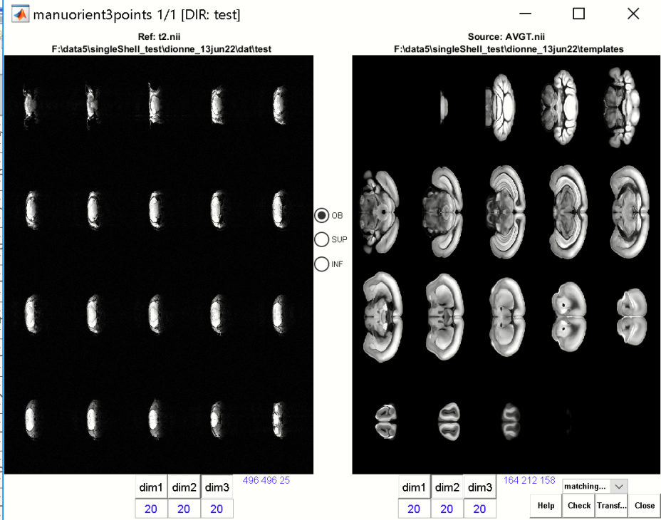
Obtain orientation via „get orientation via 3point selection „
-use this method if the method „examine orientation“ from animal‘s listbox does not work!
For example if the „t2.nii“ image is to small to examine the best orientation type via „examine orientation“
The orientation type has to be examined and checked before performing the registration to standard-space!
Hopefully all animals of the same study are roughly oriented in same the way…
In this case the definition of the orientType has to be done only once per study!
-Select one animal from the left animal listbox
-click right context-menu: select: get orientation via 3point selection
-use [dim1/2/3]-buttons of reference and source-image to obtain the coronal view of both images

Slide 2
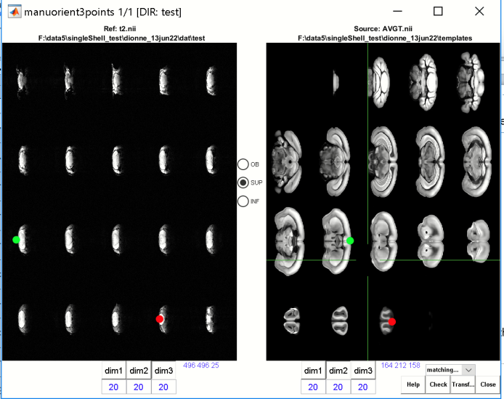
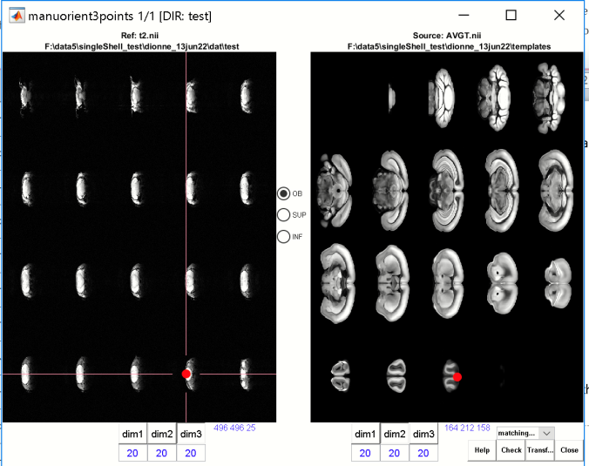
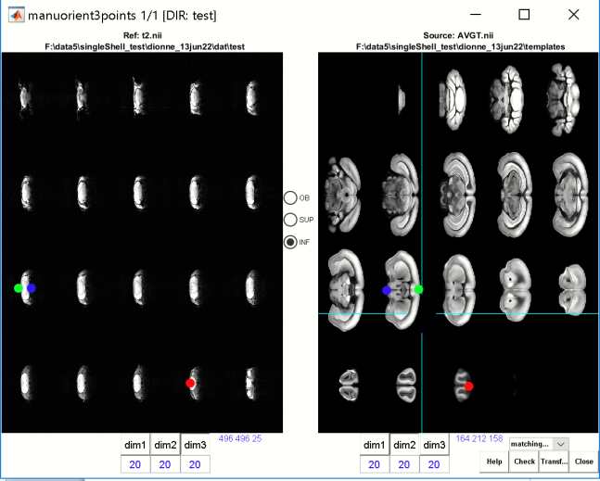
Set pairwise points
1) select the radio-[OB]
-click to mark the upper/anteriror olfact location or a
frontal brain location in both images
(close to the brain-boundary) (red dot)
2) select the radio-[SUP]
- click to mark the upper/superor brain location in one of the midbrain slices (close to the brain-boundary) in both images (green dot)
3) select the radio-[INF]
- click to mark the inferor brain location in the same slice as used for SUP, (close to the brain-boundary) in both images (blue dot)
Now we have defined 3 pairwise points and the idea is to estimate the rotations to bring the locations A & A‘, B & B‘ and C and C‘ of the reference and source image as close as possible

Slide 3
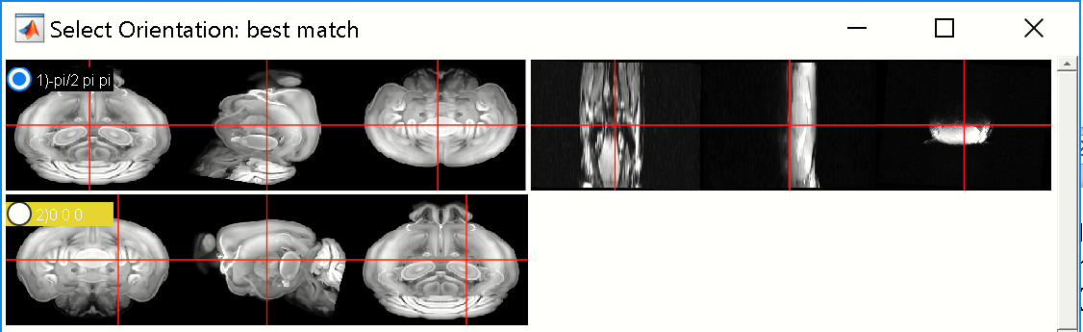
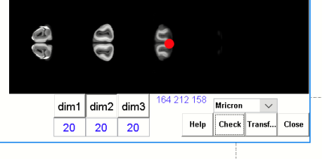
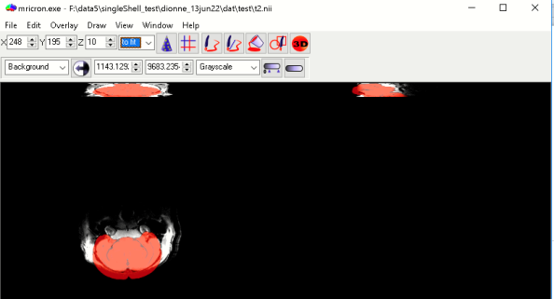
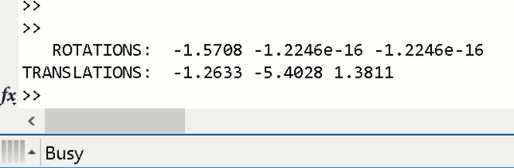
Hit [check]-button
The first panel will show the rough match (left: template; right: t2.nii) when considering the rotations defined by the three pairwise locations
-The lower panel shows the unrotated reference image
- If the visualization is suboptimal to inspect (low resolution) select „MRicron“-from dropdown list and hit the [check]-button again.
Mricron: overlay of the two images when considering the three rotations
-note that we are only interested in a rough orientation, thus aproximate rotations are sufficient!
-when hitting the [check]-button, the rotations are displayed in the CMD-window:
Note that the 2nd & 3rd rotations are close to zero
Hit [Close]-button to close UI

Slide 4

-copy the rotation paramters from the CMD-window to clipboard
-open the parameter settings via [settings]-button → gear-icon
For „x.wa.orientType“ we now insert the rotaton as string.
Note that the 2nd & 3rd rotation angles are close to zero …thus we use zeros there:
x.wa.orientType = '-1.5708 0 0'; % index …
Define here as string!
- Hit [OK] and overwrite this setting (proj-file)
Now the orientation is defined for this animal.
Hopefully all animals of the same study are roughly oriented in same the way…
In this case the definition of the orientType has to be done only once per study!
Now, we can register the „t2.nii“-image of this animal or all other animals to standard-space!

