Slide 1



Amaravati Quantum Valley Hackathon 2025
TITLE PAGE
Problem Statement ID – AQVH910
Problem Statement Title- Quantum Random Number Generator for Secure Applications
Theme- Quantum Computing & Cybersecurity
PS Category- Software
Team ID- C-27674
Team Name- SKY HIGH CODERS

Slide 2
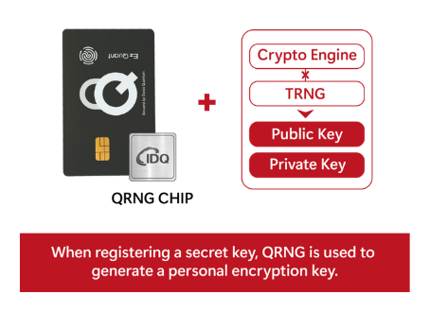
IDEA TITLE
Quantum Random Number Generator (QRNG) with Bias Reduction & Randomness Testing
Building a Quantum RNG using Qiskit (Hadamard gates).
Apply extractors (e.g., Von Neumann) to remove bias.
Perform NIST-inspired statistical randomness tests.
Provide a secure key generator (256-bit) for encryption.
Interactive React dashboard for visualization & usability.
Innovation & Uniqueness:
Combines quantum entropy with real-time bias correction.
Integrated test suite + visual analytics in one tool.
Ready for practical use in cryptography & secure apps.

Slide 3
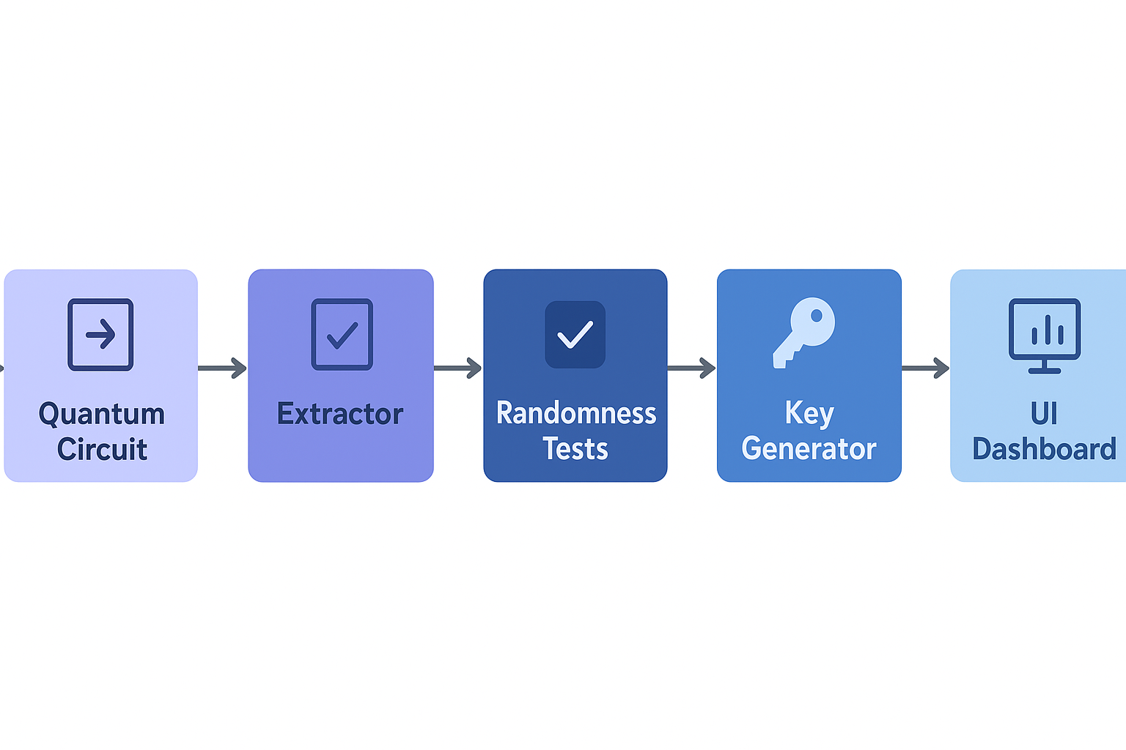
TECHNICAL APPROACH
Languages/Frameworks:
Backend → Fast API, Python packages(NumPy, SciPy, Qiskit)
Frontend → React + Vite + JavaScript
Prototype Flow

Slide 4
ADVANTAGES & DISADVANTAGES
Advantages
Disadvantages
Truly random – cannot be predicted or reproduced
Full security – no algorithm, no patterns
Open source – can integrate into any platform
Bias-free randomness for reliable results
Future-ready for AI, IoT, blockchain
Time consuming to generate fully secure random numbers
May depend on specialized quantum hardware
Scalability challenges for large-scale use
Higher cost compared to free PRNGs
Still not widely standardized or adopted

Slide 5
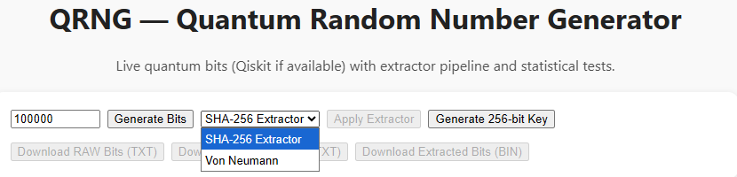
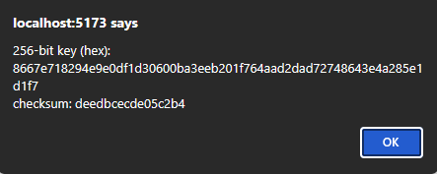
FEASIBILITY AND VIABILITY
Feasibility
Works on simulators (Qiskit Aer) or real IBMQ hardware.
Lightweight deployment (Python + Node).
Challenges
Large bit generation → time-consuming.
Limited access to quantum hardware.
Statistical test false negatives.
Mitigation
Use efficient simulators for hackathon demo.
Allow configurable sample sizes.
Apply extractor + multiple tests to ensure quality.
USER INTERFACE OF QRNG
Randomly generated 256-bit key

Slide 6
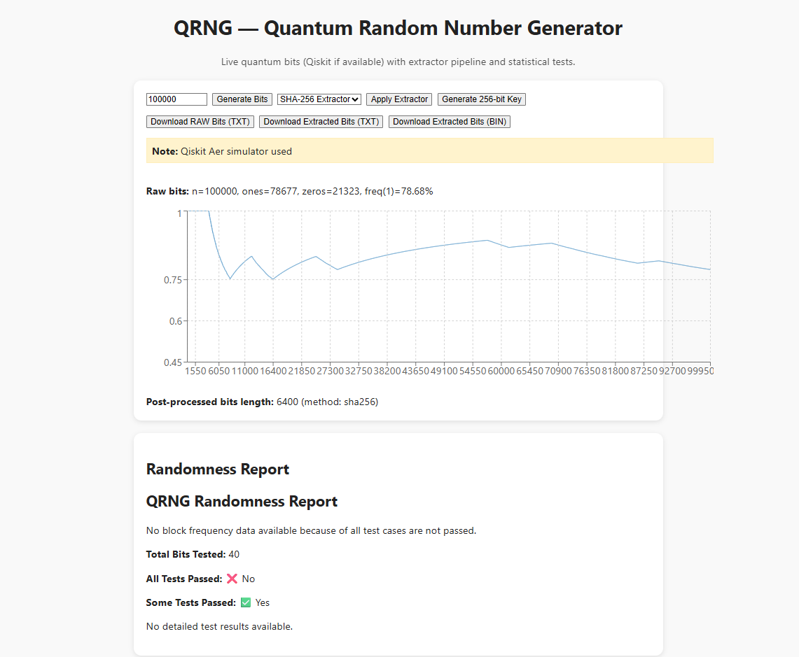
IMPACT AND BENEFITS
Target Audience: Cybersecurity, FinTech, AI, Research.
Benefits:
Security: Provides true randomness → stronger cryptography.
Transparency: Users can visualize and test randomness.
Scalability: Can integrate into existing apps via API.
Educational: Teaches quantum randomness & bias correction.
Sample screenshot of the application usage

Slide 7
WHAT THE GRAPH DESCRIBING
The graph is showing the “block frequency test” results.
In randomness testing, your sequence of bits (like 010101...) is split into blocks of fixed size (here block_size: 128 bits).
It counts how many 1s and 0s appear.
It computes the balance (ratio of 1s vs block size).
If the block has exactly half 1s and half 0s, the balance is 0.5.
If it’s skewed more towards 1s, balance > 0.5.
If it’s skewed more towards 0s, balance < 0.5.
Sample screenshot of the application usage

Slide 8
RESEARCH AND REFERENCES
📚 Key Points from References
🔹 Qiskit Documentation (https://qiskit.org)
Open-source quantum computing framework by IBM.
Provides libraries to simulate and run quantum circuits.
Supports QRNG experiments using quantum measurement outcomes.
Easy integration with Python for randomness analysis.
🔹 NIST SP 800-22 Statistical Test Suite (https://csrc.nist.gov)
Standard benchmark for testing randomness quality.
Includes 15+ statistical tests (Frequency, Runs, FFT, etc.).
Ensures random numbers are unbiased and unpredictable.
Widely accepted in cryptography and security validation.

Slide 9
RESEARCH AND REFERENCES
📚 Key Points from References
🔹 Quantum Random Number Generation – Review Papers (Nature, IEEE)
QRNG leverages quantum uncertainty (superposition/measurement).
Provides true randomness vs. algorithmic PRNGs.
Applications in cryptography, secure communications, and simulations.
Highlighted as a future-proof solution for cybersecurity.
🔹 GitHub – Randomness Extractors & Open-Source RNGs
Open-source projects for randomness extraction and testing.
Helps remove bias/noise from raw quantum data.
Useful for integrating QRNG into real-world applications.
Demonstrates community-driven implementations and validation.

Slide 10

---FROM
SKY HIGH CODERS

