Slide 1
Book Library Tracker
Presented by:-
SHIVAMANI.B
SHREYAS PAUL
SRIRAMA ARAVIND
T CHARITHA YADAV
T PRIYANKA

Slide 2
PROBLEM STATEMENT
Book Library Tracker
Construct a Library system managing multiple Book entries and registered Users. Users can borrow and return books. Implement logic to update the availability status of each book and prevent borrowing if unavailable. Track borrowing history per user.

Slide 3
INTRODUCTION
Organized Cataloging: The Book Library Tracker helps manage and catalog books efficiently, allowing users to sort by title, author, genre, status (read/unread), and more.
Reading Progress Monitoring: Users can track their reading status, set goals, and log completion dates to monitor their reading habits and progress over time.
Personalized Library Experience: It provides customizable features such as wishlists, ratings, notes, and recommendations to enhance the personal reading experience.

Slide 4
REQUIREMENT ANALYSIS
1. **User Management:
* Ability to create and manage user accounts (optional for personal use).
* Support for login/logout, user preferences, and data privacy.
2. Book Cataloging System:
* Add, edit, delete, and search books with fields like title, author, genre, publication year, ISBN, and cover image.
* Support for tagging books as “read,” “unread,” “currently reading,” or “wishlist.”
3. Reading Progress & History Tracking:
* Track start and finish dates, page progress, and notes per book.
* Visual indicators for reading goals and completion stats.
4. Search, Filter, and Sort Functionality:
* Efficient search by title, author, or genre.
* Filtering options based on status, rating, or custom tags.
* Sorting options (A–Z, recently added, progress level, etc.).

Slide 5
[Start]
| FLOW CHART
[User Login / Register
|
[Dashboard]
|
+-------------+-------------+-------------+-------------+
| | | | |
[Add Book] [Edit/Delete Book] [View Books] [Search/Filter] [Export/Import]
| | | |
[Enter Details] [List View] [By Title, etc.] [CSV/JSON]
(Title, Author, ...) |
+-------------+-------------+
| |
[Track Reading Progress] [Add Notes / Ratings]
|
+---------------+---------------+
| | |
[Start Date] [Current Page] [End Date]
|
[Mark as:]
[Read] [Unread] [Currently Reading]
|
[Logout]

Slide 6
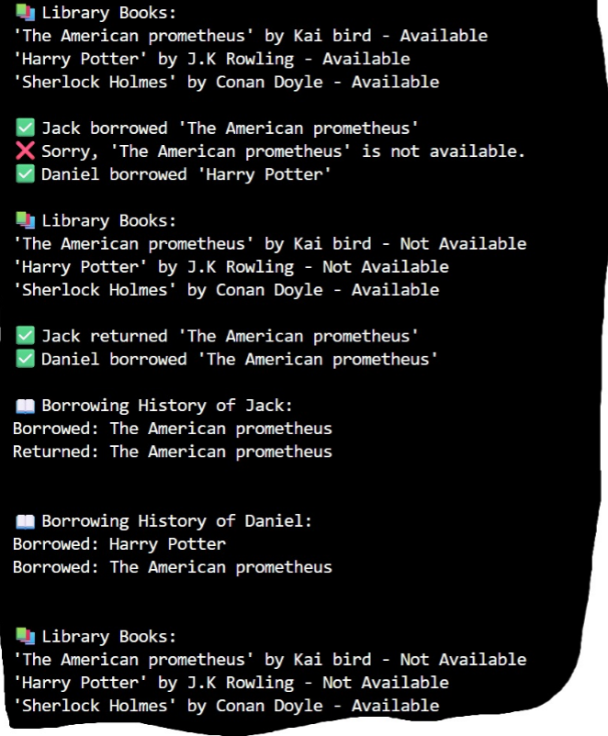
FUNCTIONS

Slide 7
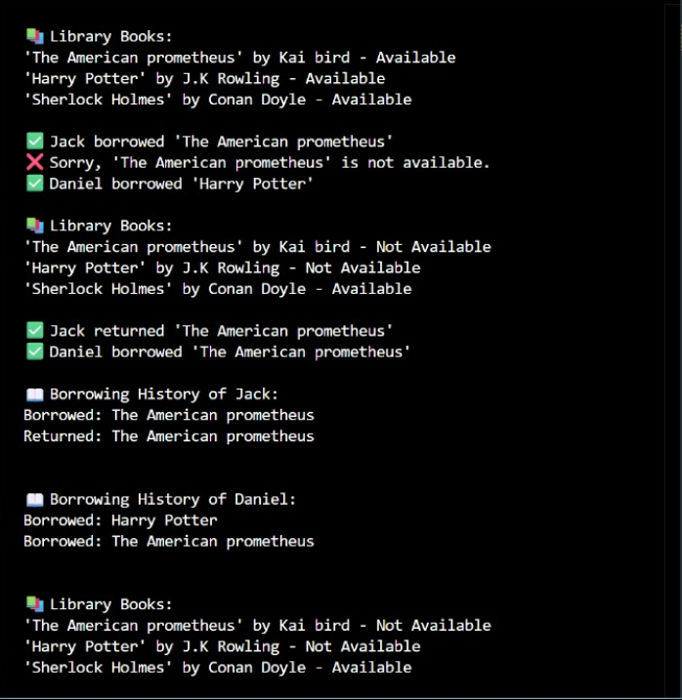

Slide 8
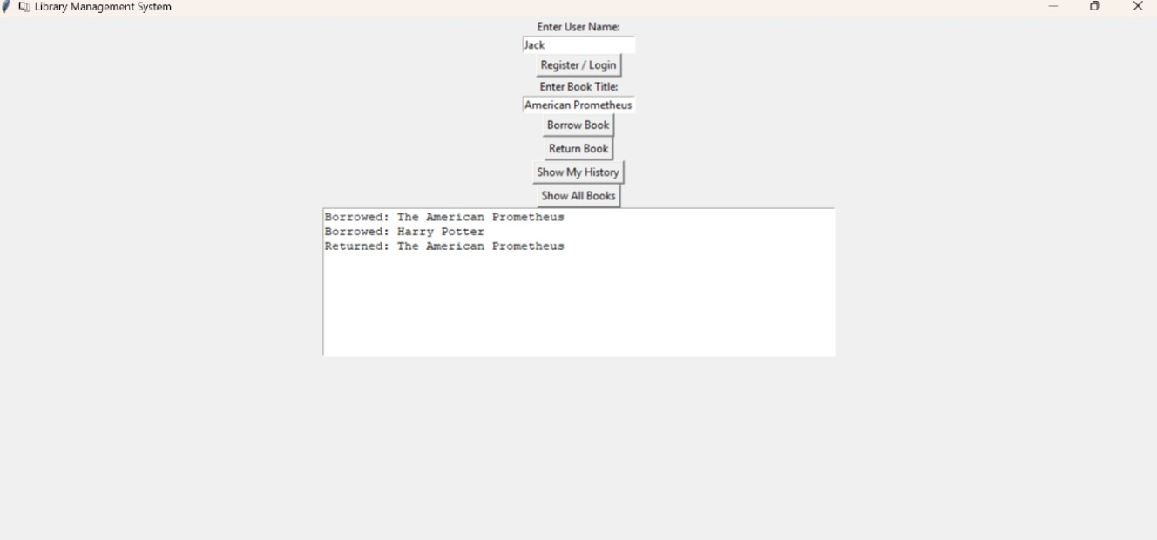
OUTPUTS

Slide 9
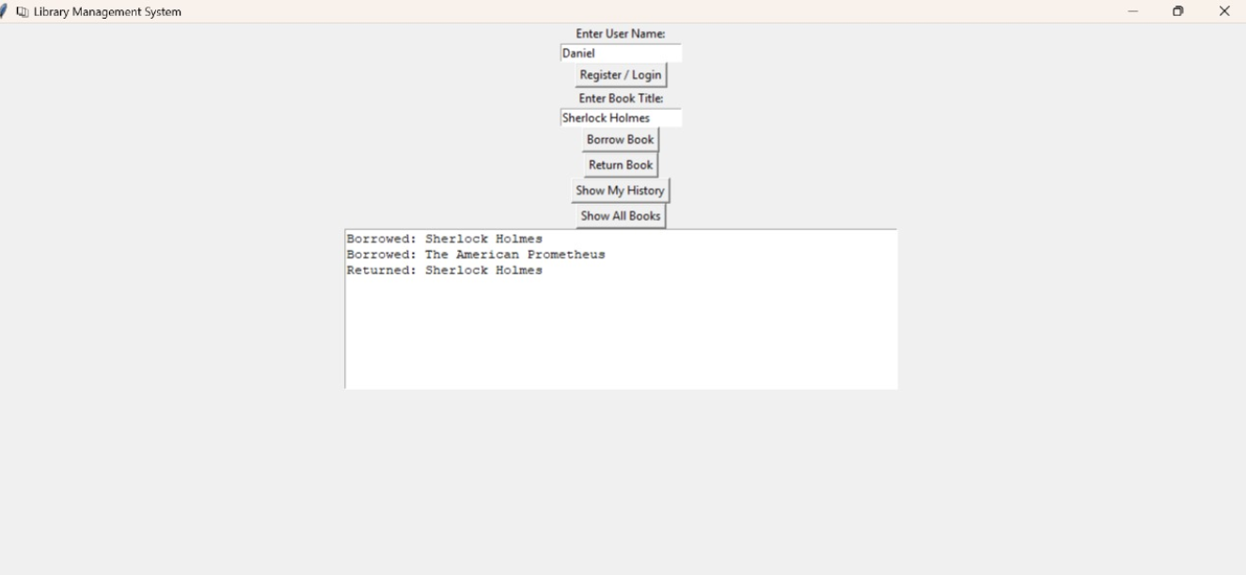
OUTPUTS

Slide 10
CHALLENGES
Data Management & Accuracy:
Ensuring accurate and consistent data entry for books (e.g., title, author, ISBN) can be difficult, especially when users input information manually or import from multiple sources.
User Experience & Interface Design:
Designing a user-friendly interface that accommodates various features like search, filter, tracking, and customization without overwhelming the user is a major challenge.
Scalability & Integration:
As the library grows, performance can suffer. Integrating with external APIs (like Google Books or Goodreads) for book details and handling large datasets requires thoughtful backend design.

Slide 11
CONCLUSION
Efficient Book Organization:
A Book Library Tracker simplifies the management of personal or institutional book collections, making it easier to organize, access, and update book records.
Enhanced Reading Experience:
By tracking reading progress, goals, and preferences, users can stay motivated, reflect on their reading habits, and make informed choices for future reads.
Scalable and Customizable Tool:
With proper design and integration, the system can be adapted to suit individual users, schools, or libraries, offering a flexible and scalable solution for long-term use.

Slide 12
FUTURE SCOPE
AI-Powered Recommendations:
Integration of machine learning algorithms to analyze user reading habits and suggest personalized book recommendations based on preferences and history.
Cloud-Based Multi-Device Access:
Expanding to cloud storage and synchronization, allowing users to access and manage their library seamlessly across devices (mobile, tablet, desktop).
Community and Social Features:
Adding social features like user reviews, reading groups, book discussions, and sharing libraries or reading lists with friends to build a reading community.

Slide 13
THANK YOU

