Slide 1



Department of Computer Science Engineering (Data Science)
A Mini-Project Phase-1 Presentation on
“Centralised Digital Platform for Comprehensive Student Activity Record in HEIs”
Presented by :
T.charitha 3BR23CD094
K.Tanmay 3BR23CD099
U.Bheemesh 3BR23CD100
U.Phanikumar 3BR23CD101
Under the Guidance of
Dr. Jagadish R.M
Project Coordinator
Dept. of CSE-DS
Mrs.KAVYASHREE
Project Guide
Dept. of CSE-DS
Dr. Aradhana D
Head of Department
Dept. of CSE-DS

Slide 2
CONTENTS:
Abstract
Objectives
Literature Survey
Problem Statement
Scope of the Project
Software and Hardware Requirements
Functional and Non-Functional Requirements
Description of Modules
Design
Work Done So Far
Individual Contribution
Conclusion
References

Slide 3
ABSTRACT:
centralized digital hub designed to store and manage student academic and activity records. It combines web and mobile platforms to provide seamless access for both students and faculty. The system aims to make student achievements visible, verified, and easily shareable. Furthermore, it supports educational institutions in their audits, accreditations, and performance monitoring processes.

Slide 4
OBJECTIVES:
• To create a single platform for managing all student academic and non-academic data.
• To provide real-time dashboards and analytics for students and faculty.
• To automate the validation and approval of student activities.
• To reduce paperwork and make institutional processes more efficient.

Slide 5
PROBLEM STATEMENT:
Centralised Digital Platform for Comprehensive Student Activity Records in Higher Education and Dropout Prevention

Slide 6
SCOPE OF PROJECT:
• Designed for Higher Education Institutions (HEIs) of all sizes.
• Web + Mobile access for students, faculty, and administrators.
• Covers academic, co-curricular, and extracurricular achievements.
• Scalable to integrate with other educational platforms (LMS/ERP).

Slide 7
SOFTWARE & HARDWARE REQUIREMENTS:
Software Requirements:
· Frontend: React.js / Flutter / Angular
· Backend: Node.js / Python (Django/Flask) / Java (Spring Boot)
· Database: MongoDB / PostgreSQL / MySQL
· Mobile Framework: Flutter / React Native
· Reporting Tool: A library like JasperReports, pdfmake, or a charting library for analytics.
Hardware Requirements:
Server: A cloud server instance (e.g., AWS EC2, Azure VM) with adequate RAM and storage.

Slide 8
Functional & Non-Functional Requirements:
• Functional: User login, activity uploading, dashboard, portfolio generation.
• Functional: Faculty approval and analytics.
• Non-Functional: Secure, scalable, reliable, easy to use.
• Non-Functional: Fast performance and high availability.

Slide 9
DESCRIPTION OF MODULES:
• Student Module: Upload activities, view performance, download portfolio.
• Faculty Module: Verify and approve student records.
• Admin Module: Manage users, generate reports, integrate systems.
• Analytics Module: Generate insights for NAAC/NIRF/AICTE reporting

Slide 10
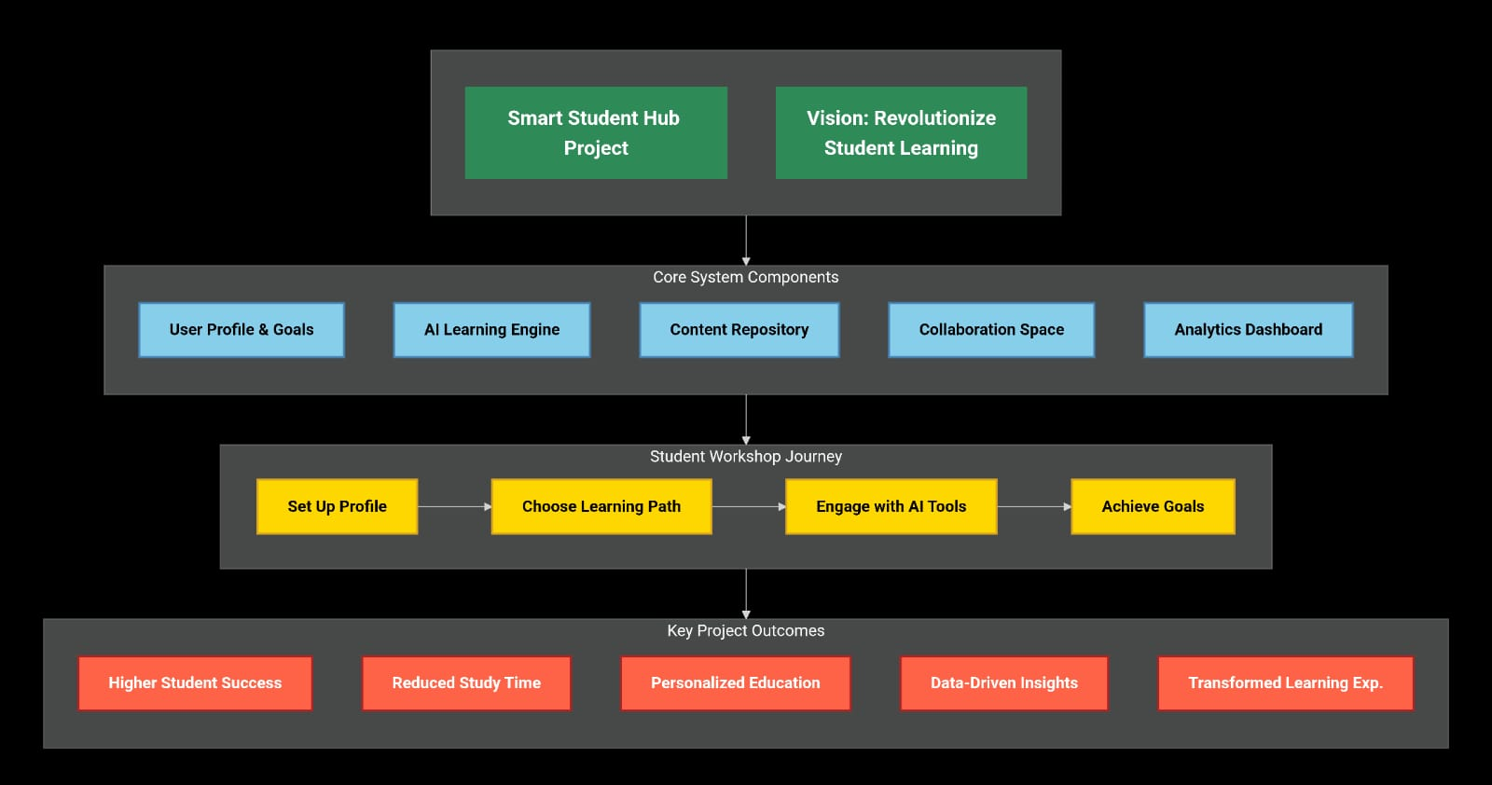
DESIGN:

Slide 11
WORK DONE SO FAR:
• Requirement analysis and problem definition completed.
• Finalized technology stack and basic UI wireframes.
• Draft architecture and database schema designed.
• Initial login and dashboard prototype started.

Slide 12
INDIVIDUAL CONTRIBUTION:
• Team Member 1: UI/UX Design and frontend development.
• Team Member 2: Backend API and database setup.
• Team Member 3: Analytics and report generation module.
• Team Member 4: Integration, testing, and documentation.

Slide 13
Literature Survey
Yang (2024) | E-Portfolio implementation in Higher Education | Systematic review | Portfolios help track academic growth but need proper design and faculty support | Use e-portfolio module, training, and flexible templates
Lu (2023) | Benefits of e-portfolios | Literature review | Portfolios improve employability and learning engagement | Add export & sharing options for verified achievements
Zhang (2024) | E-Portfolio during pandemic | Review & analysis | Enabled remote collaboration and evidence collection | Add online/offline sync and collaboration tools
Acreditta (2024) | Digital credentials | Technical overview | Enables secure verification & storage | Add verifiable credentials & API

Slide 14
CONCLUSION:
Centralized platforms simplify student data management in HEIs.
They enable personalized academic support and tracking.
Transparency improves student evaluation and recognition.
Digital systems prepare institutions for scalable growth.

Slide 15
REFERENCES:
• AICTE, NAAC, NIRF official documentation.
• Research papers on student activity management systems.
• Open-source ERP/LMS platform architecture.
• Online tutorials and documentation of React, Node.js, and MongoDB.

Slide 16
Thank you

