Slide 1

KHP Protocol (Pwn)
Group – 8 :
Shajith Vignesh Ananthaneni Venkata Chaitanya Reddy Koppolu Sai Charitha Bandaru Tharun Gunishetti

Slide 2
Introduction & Project Motivation
Heap-based buffer overflows remain a powerful attack vector in binary exploitation.
KHP Server (Keys Holder Protocol) mimics real-world key management systems.
Project Goal: Identify and exploit a vulnerability in the server’s key handling to gain unauthorized shell access.
Learn heap layout manipulation, memory corruption, and privilege escalation techniques.

Slide 3
Binary Analysis: Ghidra – Reverse engineering to explore khp_server behavior
Exploit Development: Python + pwntools – Automates the exploit chain
Heap Debugging: GDB with custom heap visualization.
Testing Platform: Kali Linux & Parrot
Additional Tools: netcat for manual command tests, hexdump for payload crafting
Environment
&
Tools

Slide 4
KHP Server Architecture
C-based server that spawns threads per client.
Uses custom commands over TCP to manage authentication keys.
Vulnerable function: REKE → processes user input without bounds checking.
Key Commands:
REKE: Register key (username:role password)
DEKE: Delete key (by ID)
RLDB: List keys
AUTH: Authenticate using a key
EXEC: Execute command (post-authentication)

Slide 5
Understanding Heap Behavior & Heap Layout Manipulation
Heap Basics: Dynamic memory is allocated via malloc() and reused.
Memory is not zeroed on free → stale data remains exploitable.
Corrupting metadata of freed chunks can lead to control over future allocations.
Target: overwrite key structure used during AUTH command.
Register 3 keys using REKE
Reloading the DB using RLDB
Delete 3rd key with DEKE(3) – creates free chunk.
Overflow from a new REKE call into this freed region.
Injects fake username/role data that server interprets as a real key.

Slide 6
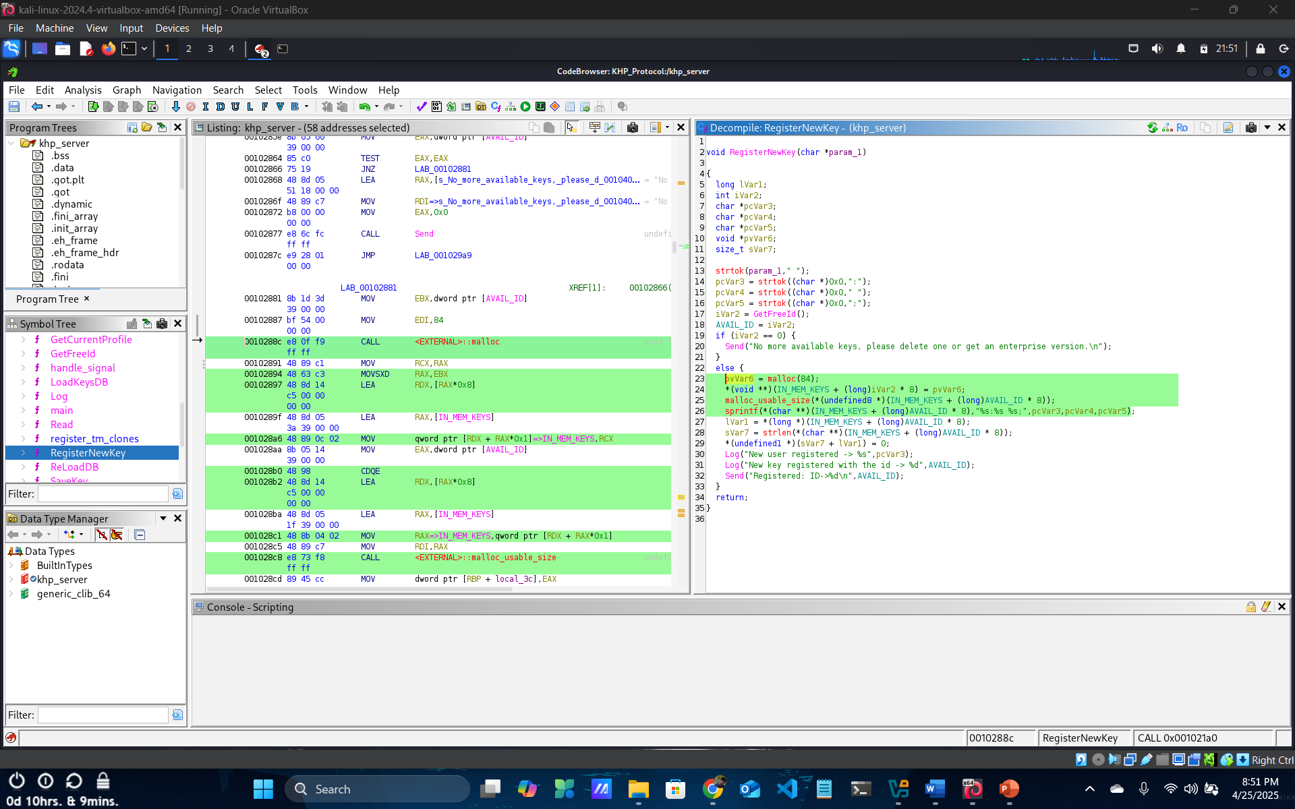
RegisterNewKey Function

Slide 7
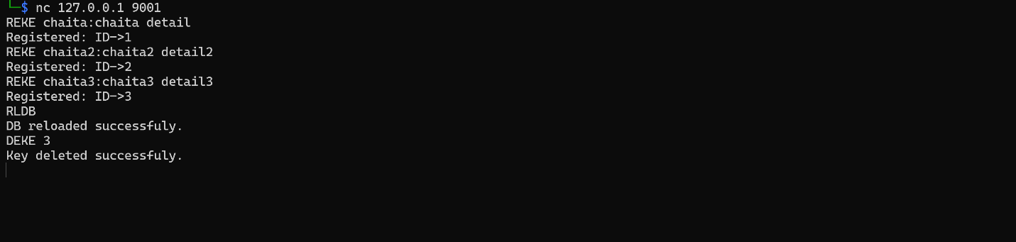
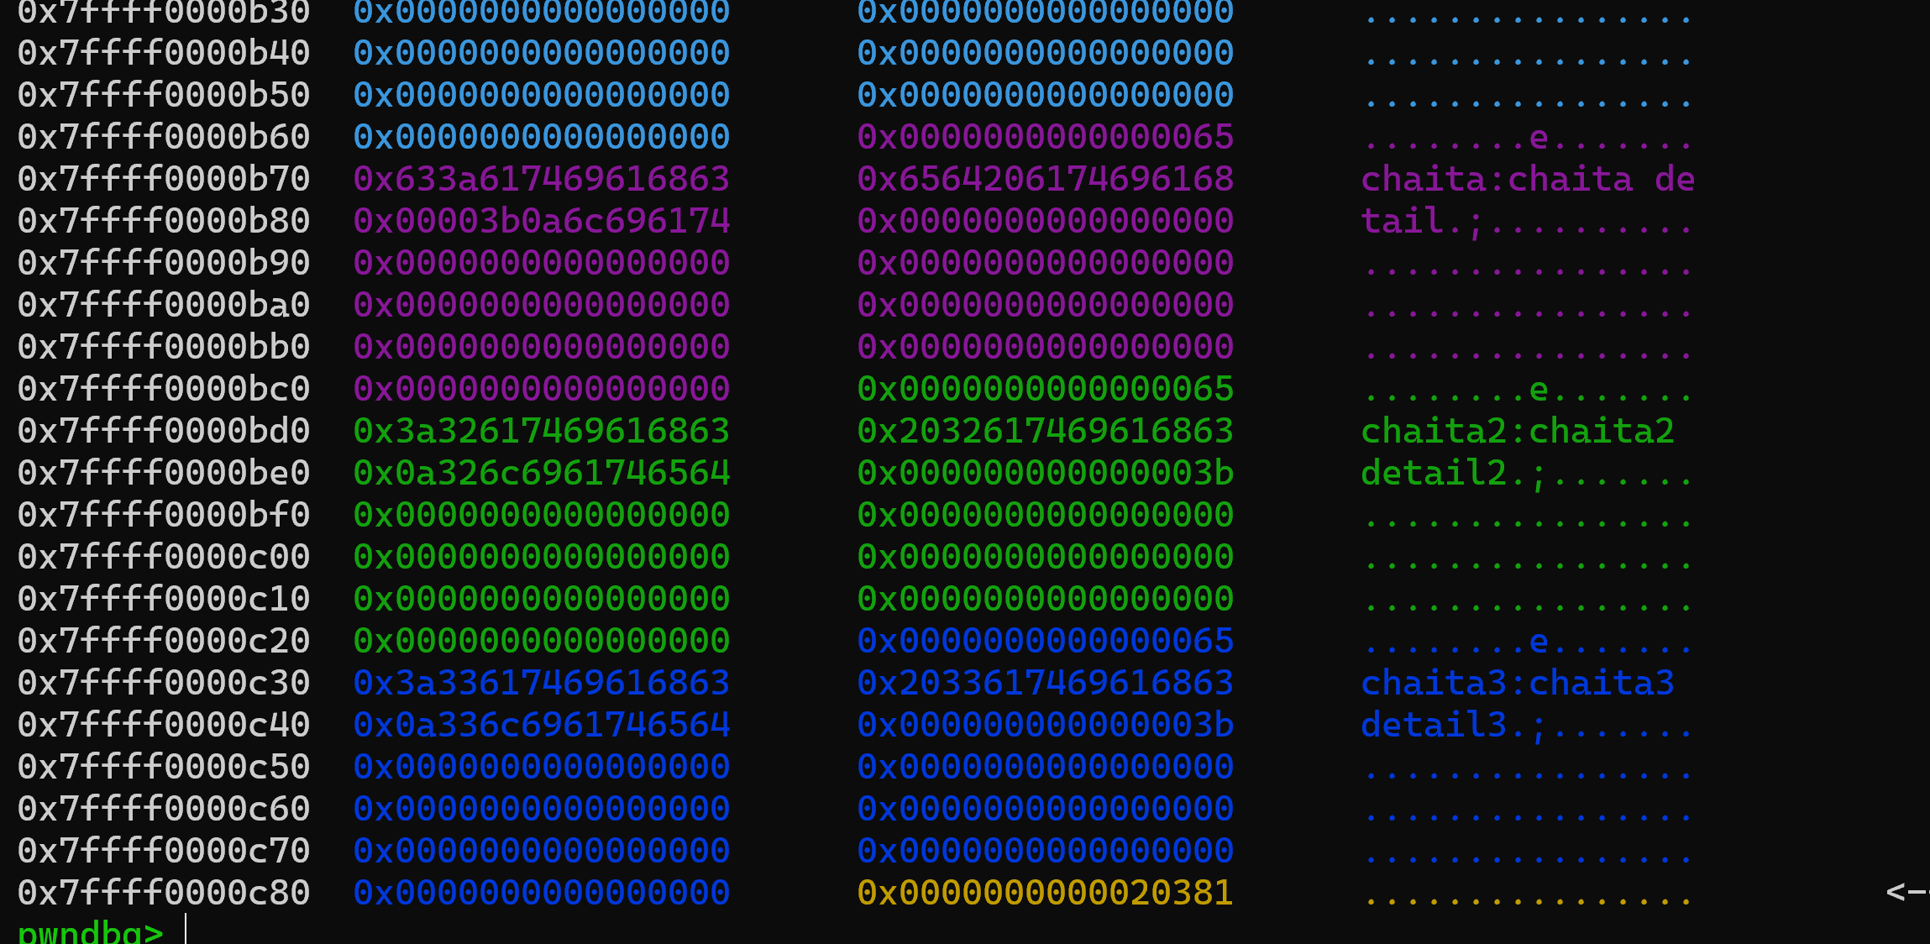
Connecting to Sever
Viewing Heap

Slide 8

Vulnerability Discovery
Discovered through static analysis in Ghidra:
sprintf() or similar unsafe memory copy with user-controlled input.
Vulnerability in how REKE copies data into a heap-allocated buffer.
No boundary check = heap overflow.
Adjacent heap chunks can be corrupted (use-after-free, fake object injection).

Slide 9
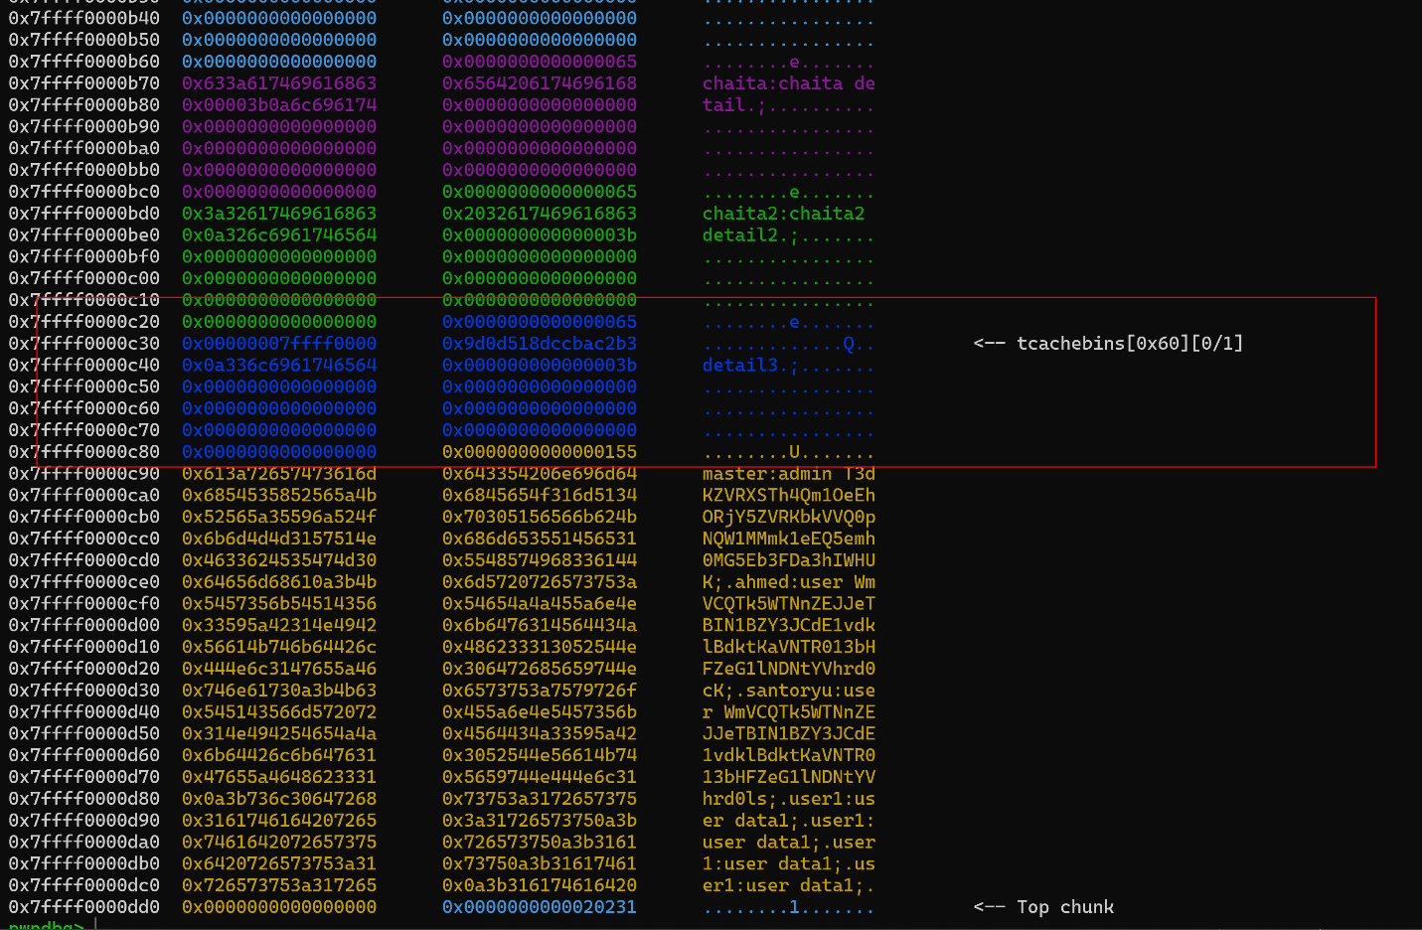
Deleted Entry

Slide 10
Crafting the Exploit Payload
Exploit string: REKE('CHA', ‘ITA', b'\x01'*0x70 + b'chaita:admin abcdef’)
\x01 padding causes the overflow.
Embedded string simulates a valid key in adjacent memory.
Payload length calculated based on Ghidra's analysis of buffer sizes and struct layout.

Slide 11
Establish TCP connection to the server.
Register 3 normal keys.
Delete 3rd key → creates hole in heap.
Send crafted overflow payload with fake metadata.
Authenticate using corrupted key ID (often key 1).
If successful, send EXEC to obtain interactive shell.
Exploit
Chain Walkthrough

Slide 12
Code Structure & Debugging the Heap
KeyExploiter class includes:
register_key(), delete_key(), authorize(), execute_command()
prepare_exploit() orchestrates the full attack.
Uses pwntools’ remote() for low-level control of TCP socket.
Built-in logging for debugging and output tracing.
GDB Insights
Set breakpoints after DEKE and REKE.
Visualized heap before and after overflow.
Confirmed that overwritten chunk data matches injected payload.
Observed successful memory corruption that bypasses auth check.

Slide 13
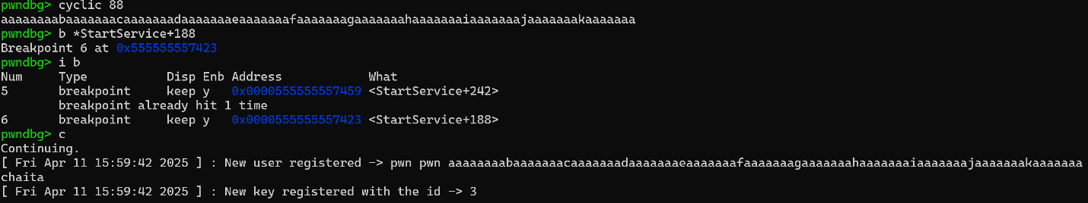
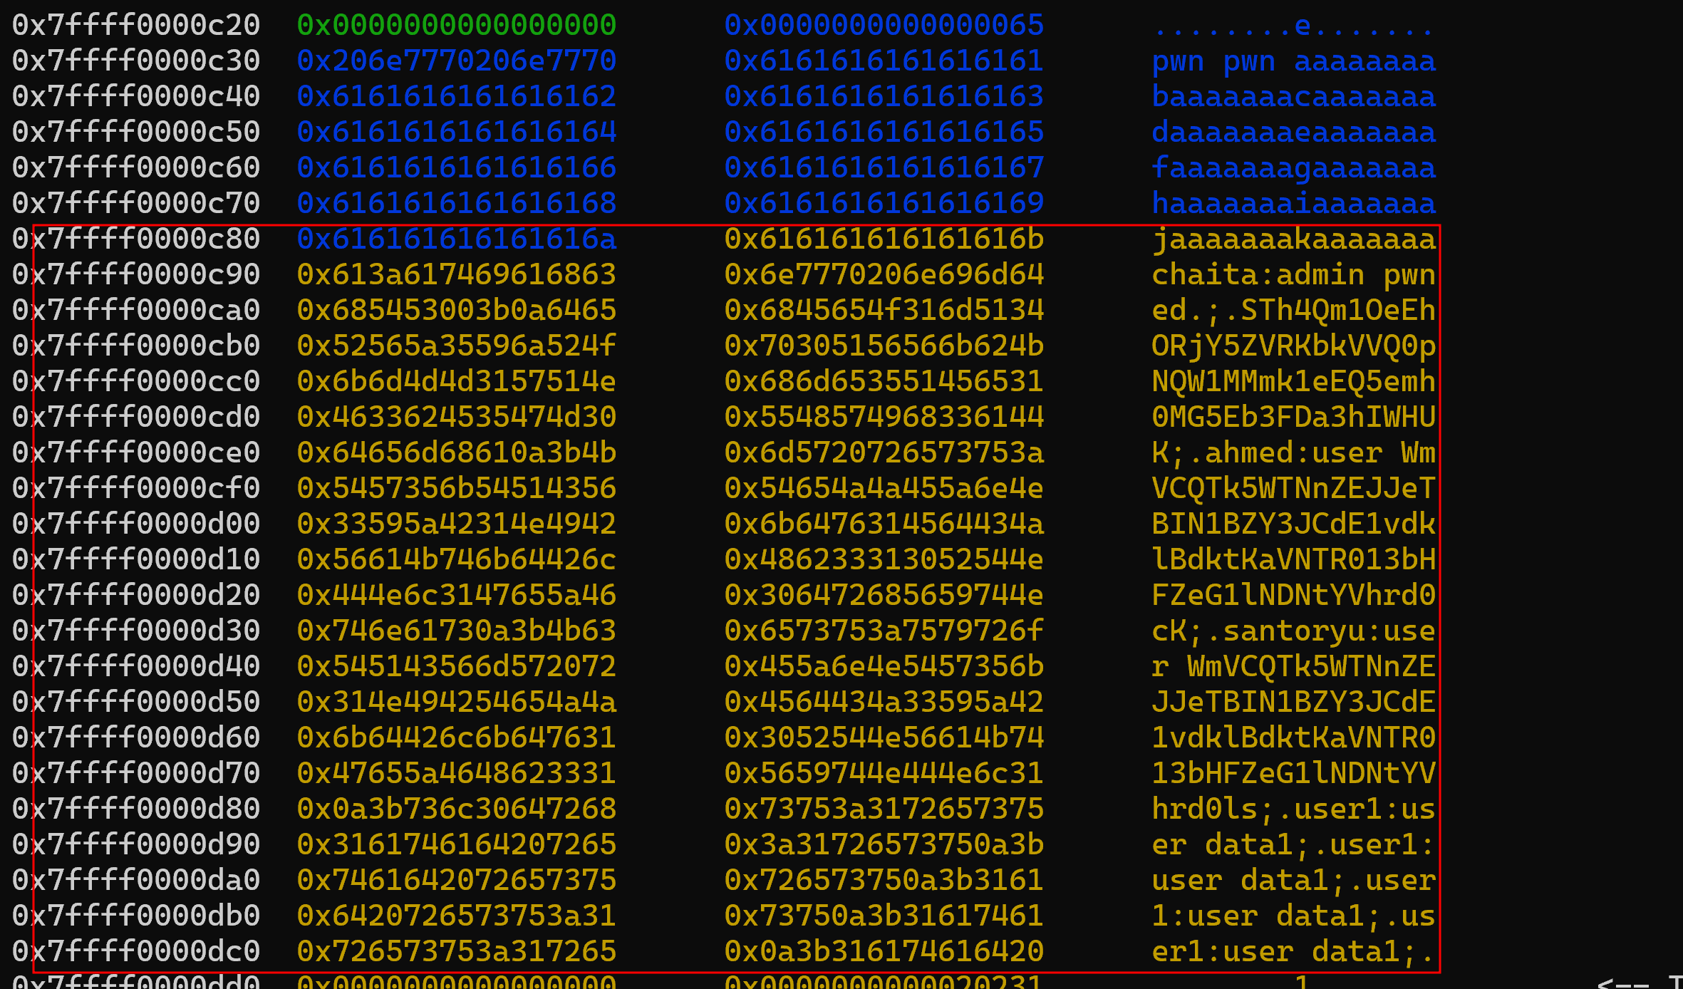
Breakpoints after DEKE and REKE
Overflow into adjacent chunk.

Slide 14
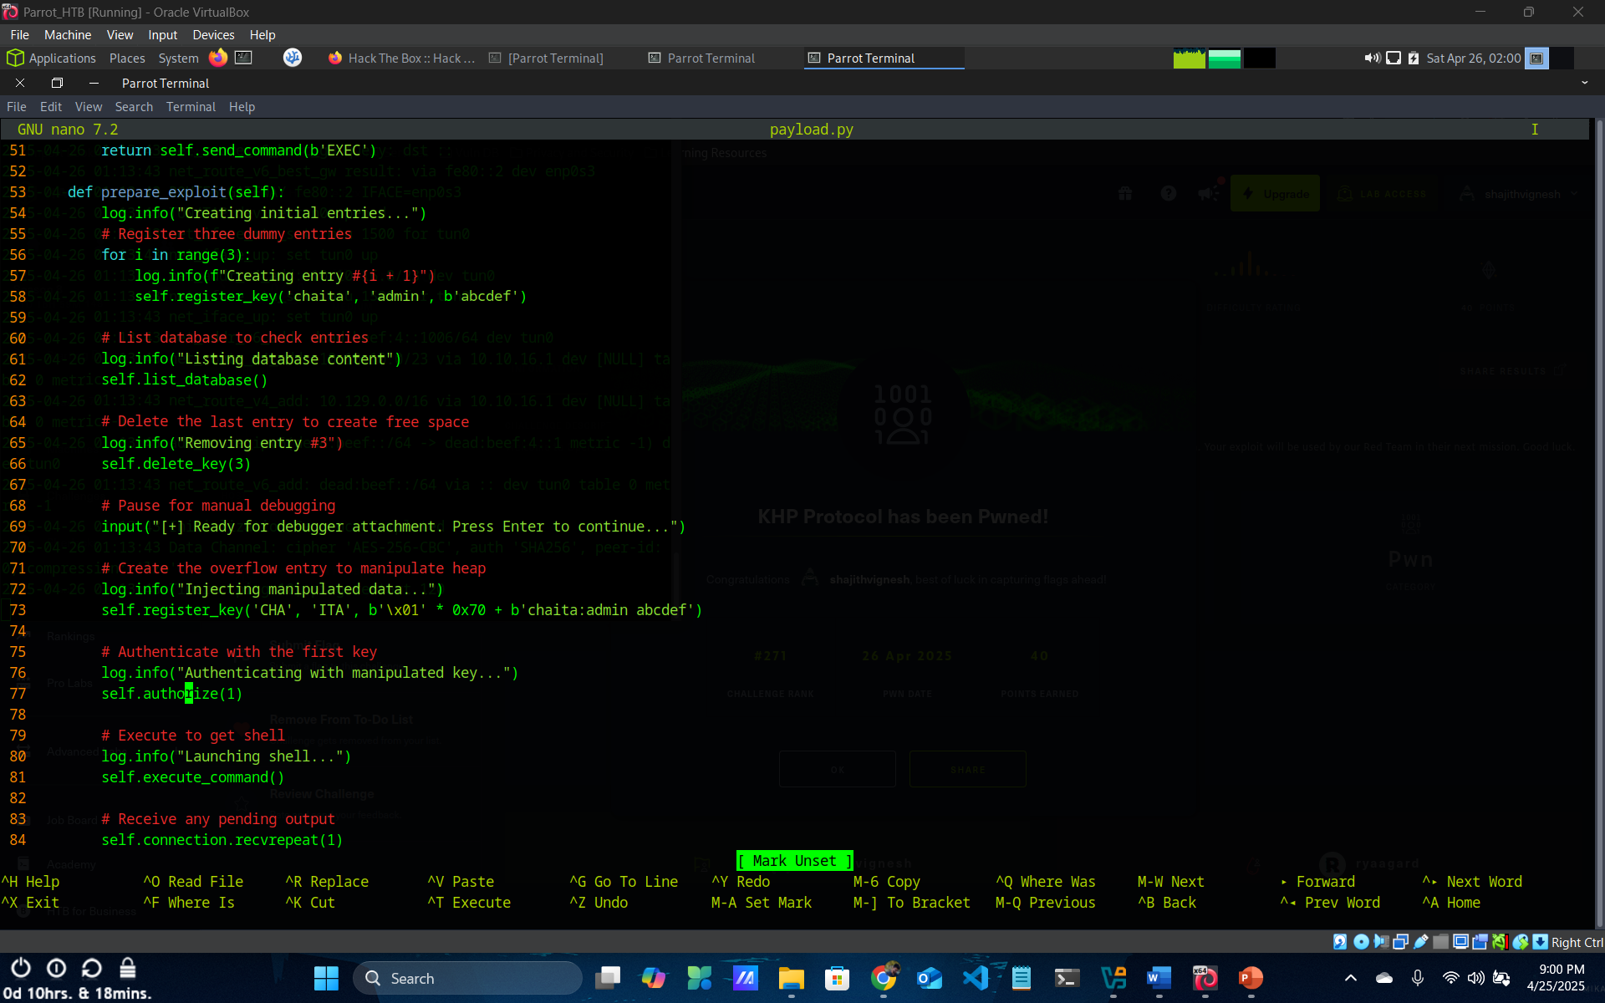
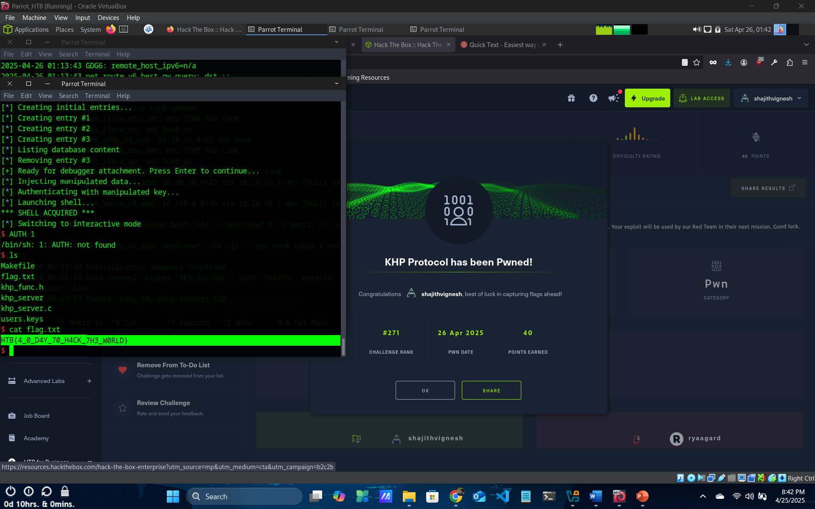
Payload Execution & Flag
Flag.txt: HTB{4_0_D4Y_70_H4CK_7H3_W0RLD}

Slide 15
Impact & Exploit Success
Achieved remote code execution through EXEC command.
Corrupted key structure is recognized as valid → authentication bypass.
Shell spawned with elevated privileges.
Mimics real-world remote attack scenarios (CVE-style exploit).

Slide 16
Security Implications & Preventive Measures
Demonstrates critical importance of:
Input validation
Memory safety
Secure coding practices in C/C++
Lack of bounds checking → complete compromise of server.
Replace unsafe functions (strcpy, sprintf) with safer alternatives (strncpy, snprintf).
Add bounds checks in all input handlers.
Use modern heap protection techniques:
ASLR, DEP, Safe unlinking, Canaries
Prefer memory-safe languages when possible (Rust, Go).

Slide 17
Summary
Classic heap overflow exploit adapted for modern usage.
Full control over server memory through crafted REKE input.
Exploit chain required:
Static analysis
Heap manipulation
Runtime debugging
Payload construction
Successfully demonstrated a practical memory corruption exploit.

Slide 18
Thank you

