Slide 1
Silica concentrate prediction in mining process
By
Charitha BV | IIS20012
19AI716 | Cloud And Big Data Analytics
M.Tech IIS | Amrita Vishwa Vidyapeetham

Slide 2
Contents
Introduction
Dataset Description
Existing Work
Objective
Data Preprocessing
Exploratory Data Analysis
Spark – ML
Spark – Streaming
Dataproc
Big Query
Pub/Sub
Automl

Slide 3
introduction
Iron ores are rocks and minerals from which metallic iron can be economically extracted.
In steel manufacturing industries, the high-grade iron ores plays a vital role in the steel manufacturing process.
If the impurities are high in iron ores, the efficiency and performance of the kiln are reduced.
The common impurity present in the Iron ore is silica.
The typical magnetite iron-ore concentrate contains impurity of 3–7% of silica.
Therefore predicting the percentage of silica concentrate present in the Iron ore is essential.

Slide 4
DATASET Description
Duration : 6 months (March - September 2017)
Measurements are taken for every 20 seconds
The dataset has 7,37,453 samples and 24 attributes

Slide 5
Dataset Description (cont.)
Independent Variables : [ '% Iron Feed', '% Silica Feed', 'Starch Flow', 'Amina Flow', 'Ore Pulp Flow', 'Ore Pulp pH', 'Ore Pulp Density', 'Flotation Column 01 Air Flow', 'Flotation Column 02 Air Flow', 'Flotation Column 03 Air Flow', 'Flotation Column 04 Air Flow', 'Flotation Column 05 Air Flow', 'Flotation Column 06 Air Flow', 'Flotation Column 07 Air Flow', 'Flotation Column 01 Level', 'Flotation Column 02 Level', 'Flotation Column 03 Level', 'Flotation Column 04 Level', 'Flotation Column 05 Level', 'Flotation Column 06 Level', 'Flotation Column 07 Level', '% Iron Concentrate']
Dependent Variable : [‘ % Silica Concentrate’]

Slide 6
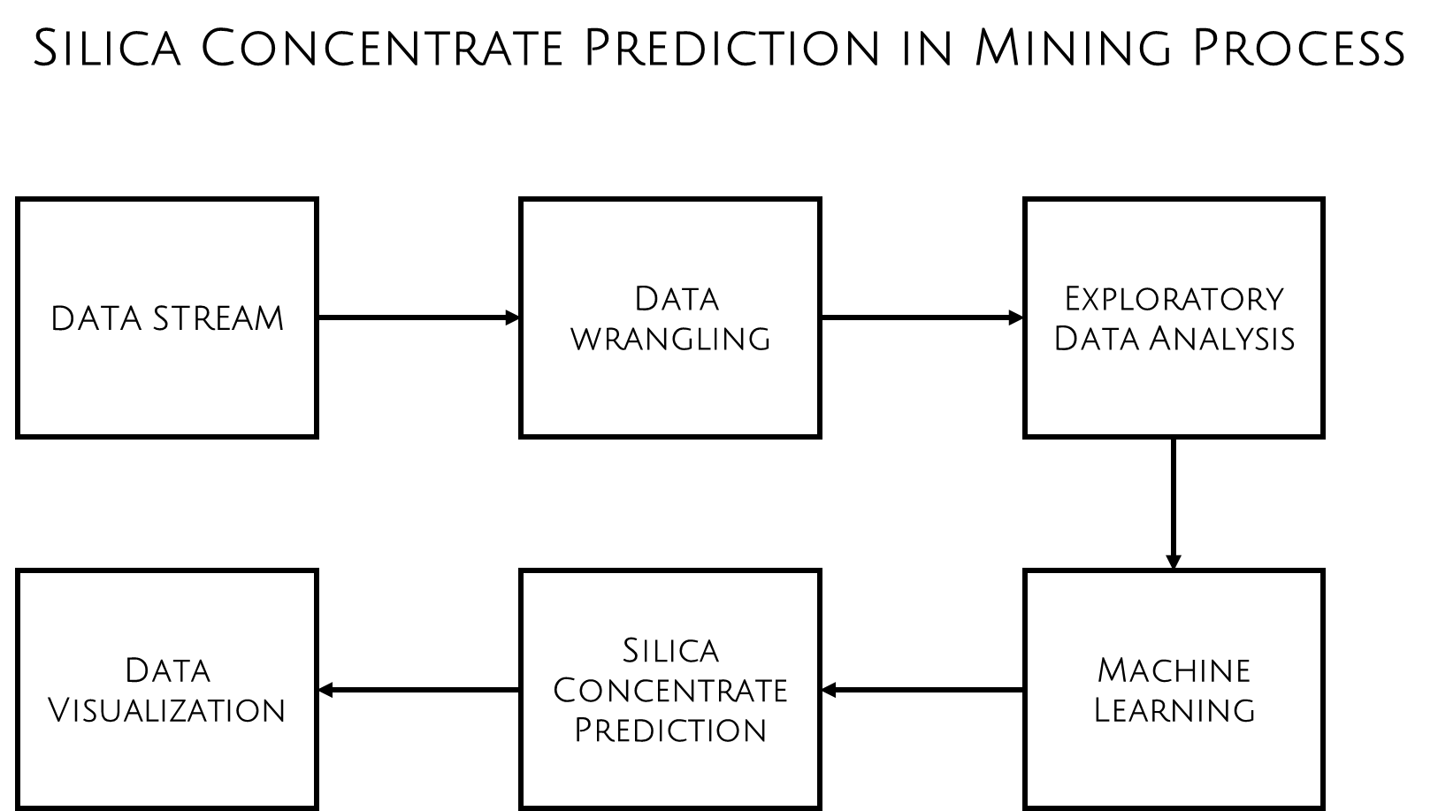
Overview of data analytics

Slide 7
Existing Work
The percentage of Iron and silica concentrate is predicted.
Multi-Target Regression is used (% Iron and Silica concentrate)
Machine Learning Algorithms like ADAboost, Random Forest,
Decision tree, XGboost, Ridge are used.
MODEL | R2 Score | RMSE
ADA BOOST | 0.9745449 | 0.0320345
RANDOM FOREST | 0.9404630 | 0.0749937
DECISION TREE | 0.9036198 | 0.1243733
XBOOST | 0.7750269 | 0.2641687
RIDGE | 0.1457070 | 1.0722436

Slide 8
Objective
To predict the percentage of silica concentrate from Mining process database
  To find a suitable Machine Learning algorithm
  To stream real-time data and perform prediction
  To deploy the solution in Google Cloud Platform

Slide 9
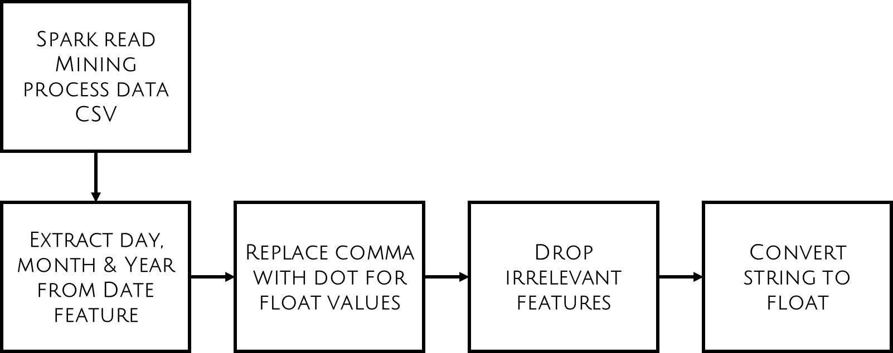
Data Preprocessing

Slide 10
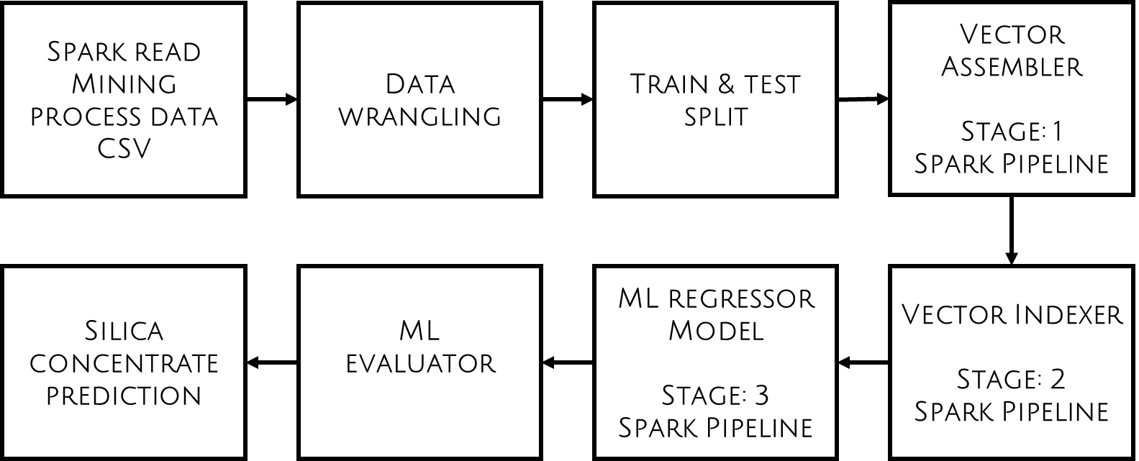
Prediction using Pyspark

Slide 11

Prediction using Pyspark (cont.)
Train & test split
Vector Assembler & Vector Indexer

Slide 12
Spark ML
Machine Learning Algorithms used
          Linear Regression
      Decision Tree
      Random Forest
      Gradient Boost Trees

Slide 13
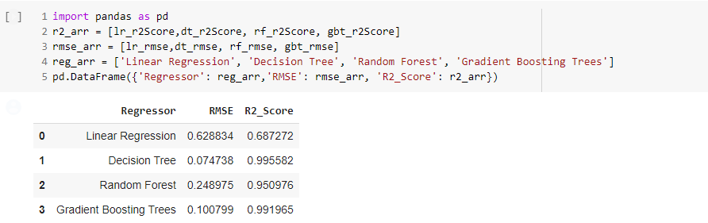
ML : Results
Comparison of Evaluation Metrics

Slide 14
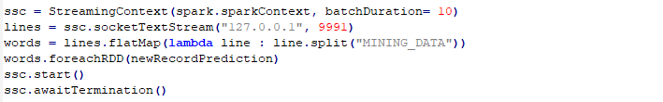
Spark - Streaming
Pyspark Streaming

Slide 15
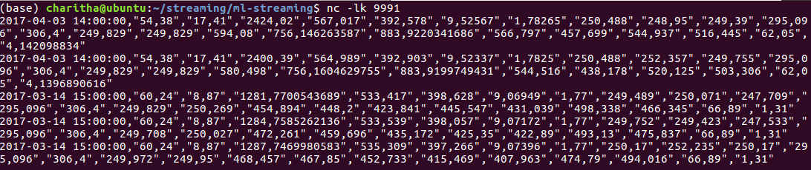
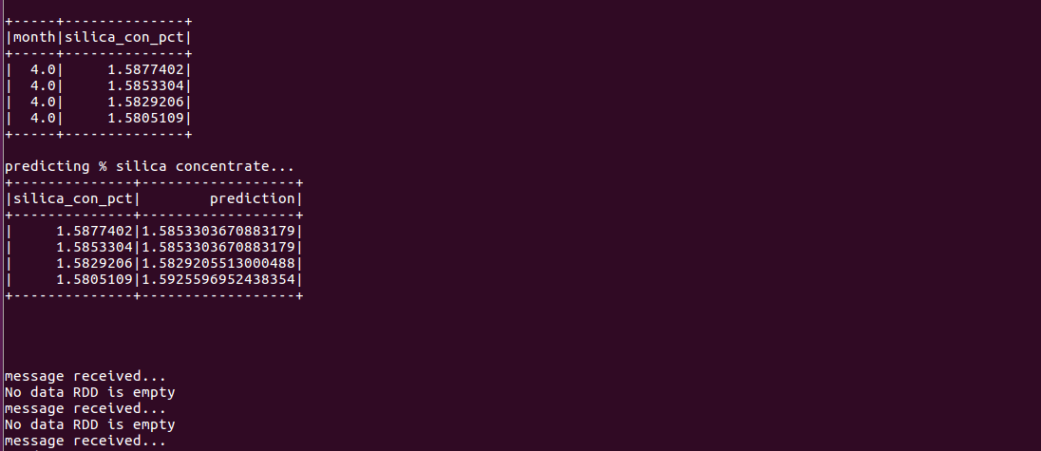
Spark – Streaming (Cont.)
Netcat
Streaming - Prediction Results

Slide 16
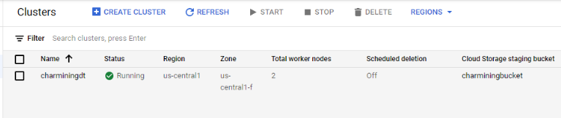
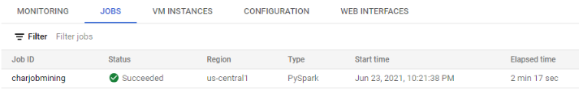
Dataproc
Cluster
Job

Slide 17
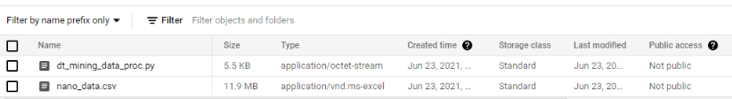
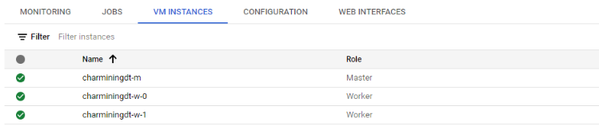
Dataproc (Cont.)
Files in the bucket
Master and Worker Nodes

Slide 18
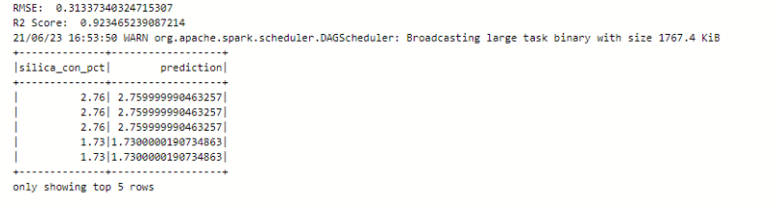
Dataproc (Cont.)
Decision Tree Regressor
Decision Tree dataproc Prediction

Slide 19
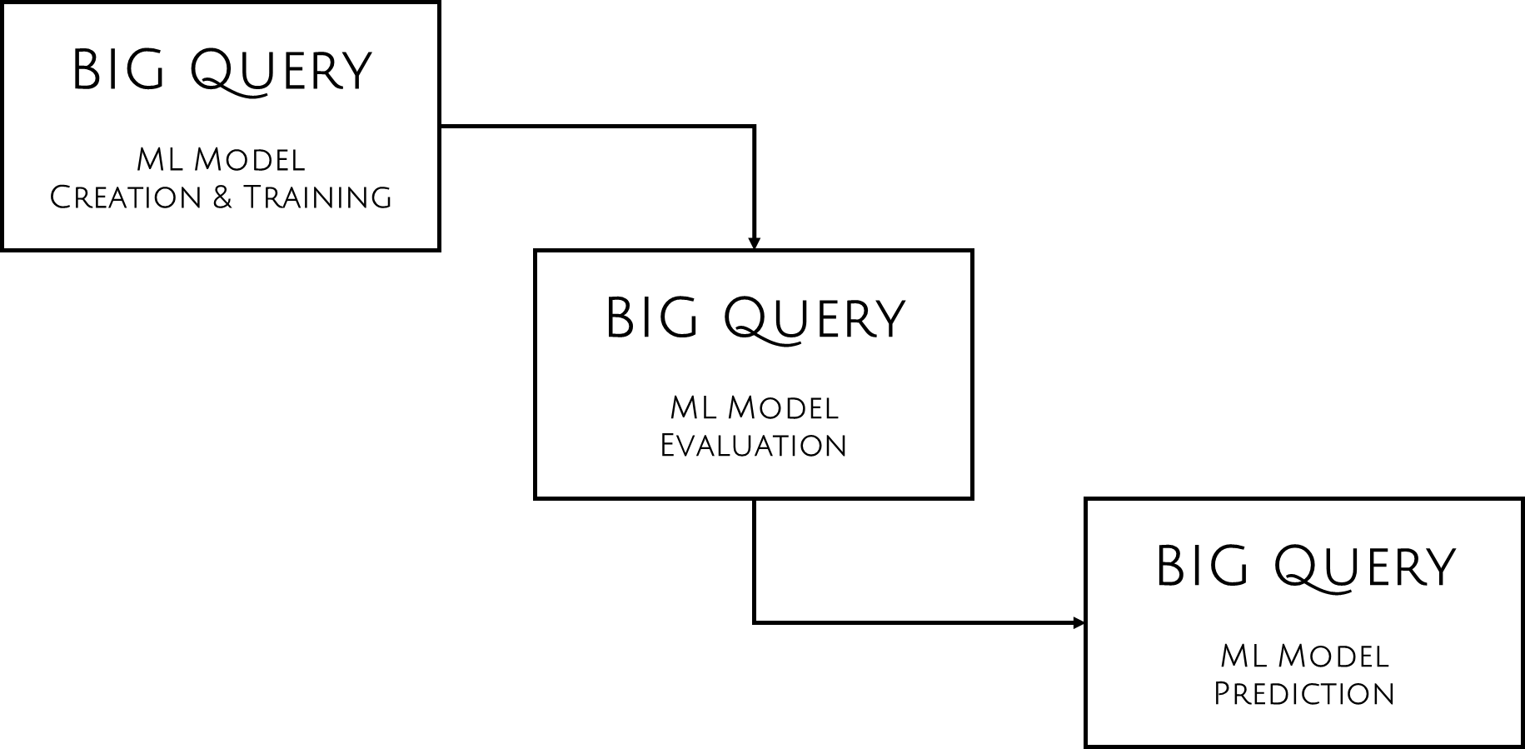
Big query

Slide 20


Big query - Results
Evaluation Metrics
Prediction of % silica concentrate

Slide 21
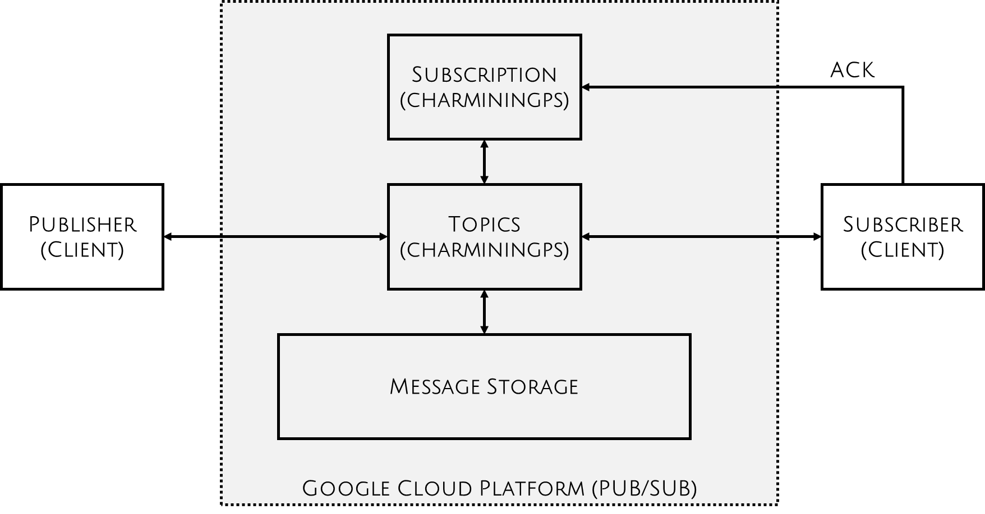
Pub/Sub

Slide 22
Pub/Sub (Cont.)
Installations
Virtual Environment
Google Cloud Pub/Sub library
Google Cloud Big query library

Slide 23
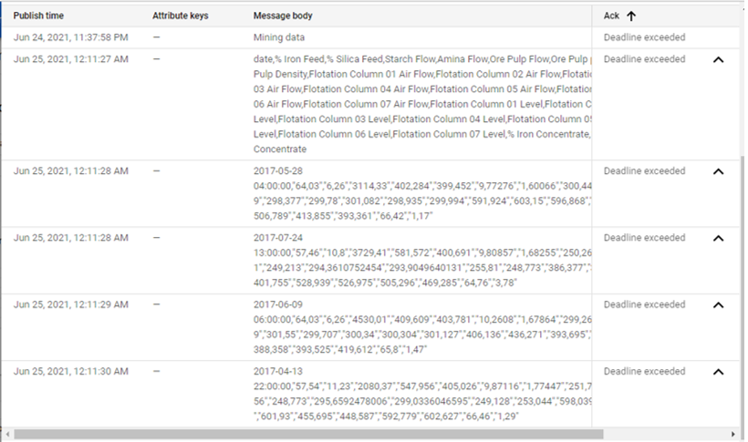
Pub/Sub (Cont.)
Verification of the published Messages on GCP-subscriptions

Slide 24
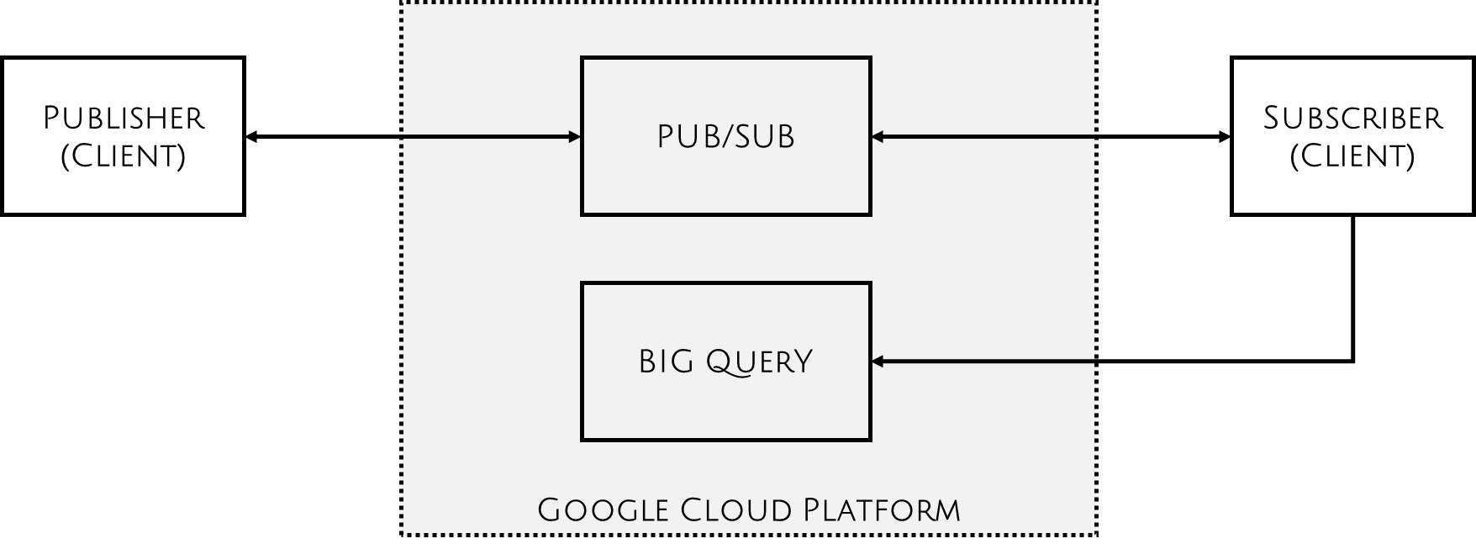
Big Query

Slide 25
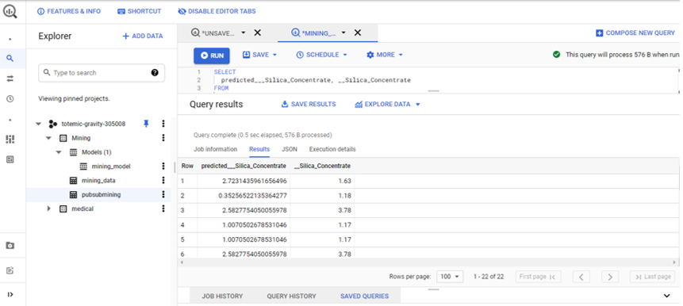
Big Query (Cont.)
Predicted results of newly created big query table

Slide 26
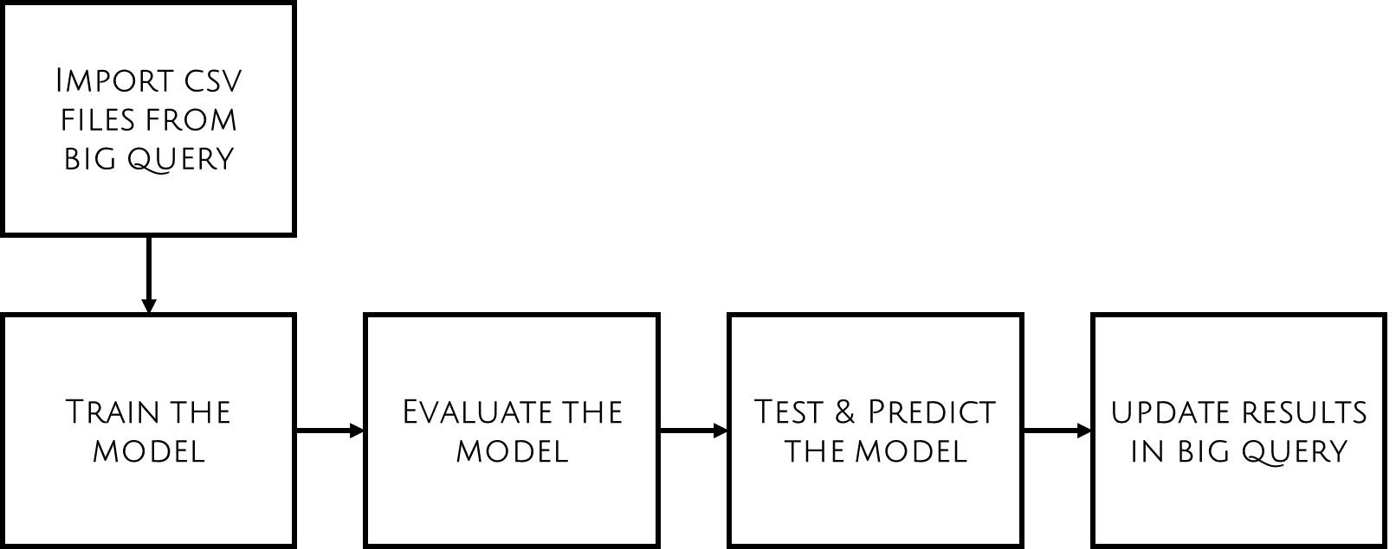
Automl

Slide 27
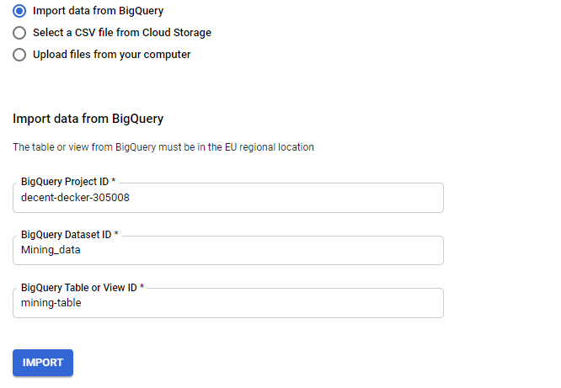
Automl (Cont.)
Importing data from Big query

Slide 28
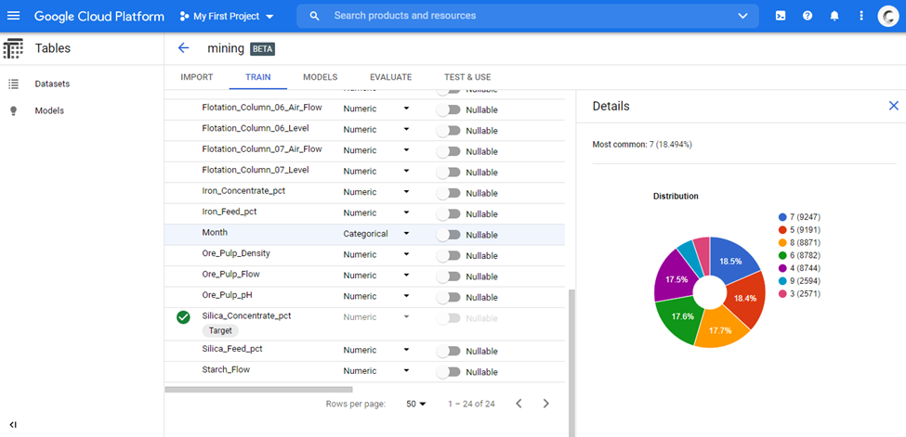
Automl (Cont.)
Distribution of data

Slide 29
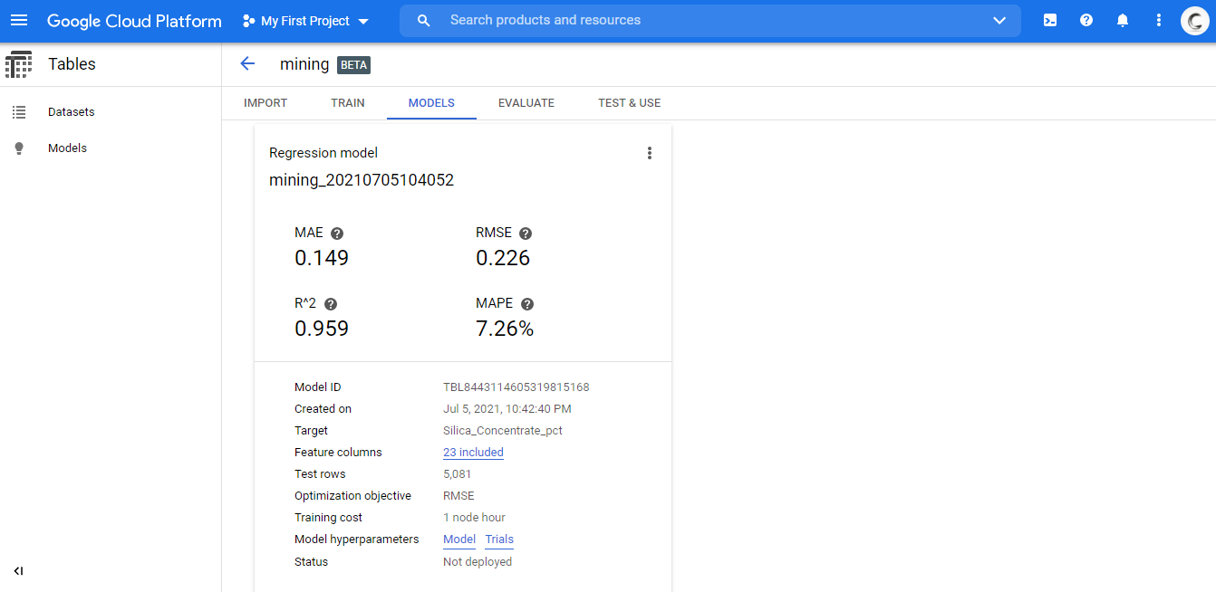
Automl (Cont.)
Training Model

Slide 30
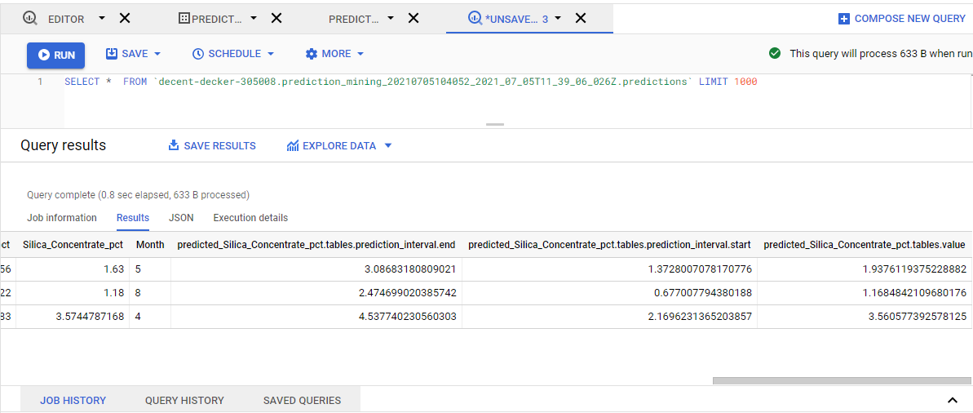
Automl (Cont.)
Predicted Results in Big query

Slide 31
Thank You

