Slide 1
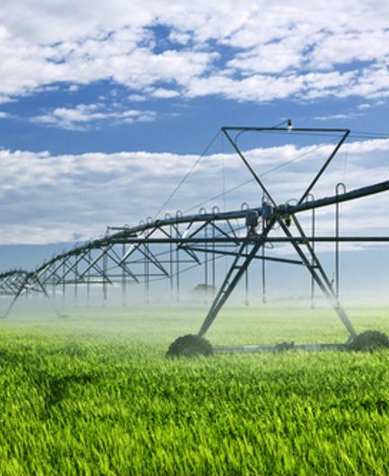
Cyber-physical intelligent agents For Irrigation scheduling
BY
Charitha BV– IIS20012
M.Tech (Industrial Intelligent Systems)
Amrita Vishwa Vidyapeetham, Coimbatore

Slide 2
CONTENTS
Introduction
Cyber-physical intelligent agent for irrigation scheduling
Objective
Implementation of Cyber-physical intelligent agent
Agent central station (ACS)
Decision system (Logic-Based architecture)
Yield Prediction
Results

Slide 3

Introduction
Irrigation scheduling is a process of supplying the exact amount of water to the crops and to determine appropriate irrigation time.
The strategy to improve the performance of automatic irrigation systems is the usage of intelligent agents with rational behavior along with Internet of Things.
Precision agriculture is the implementation of new technologies to measure, monitor and control the application of agricultural inputs in the right place and quantity.
Cyber Physical System is basically the combination of technologies such as agent systems, Internet of Things, cloud computing, big data and machine learning etc.
Intelligent agents together with CPSs can enhance them with several capabilities to achieve complexity management, intelligence and adaptation.

Slide 4
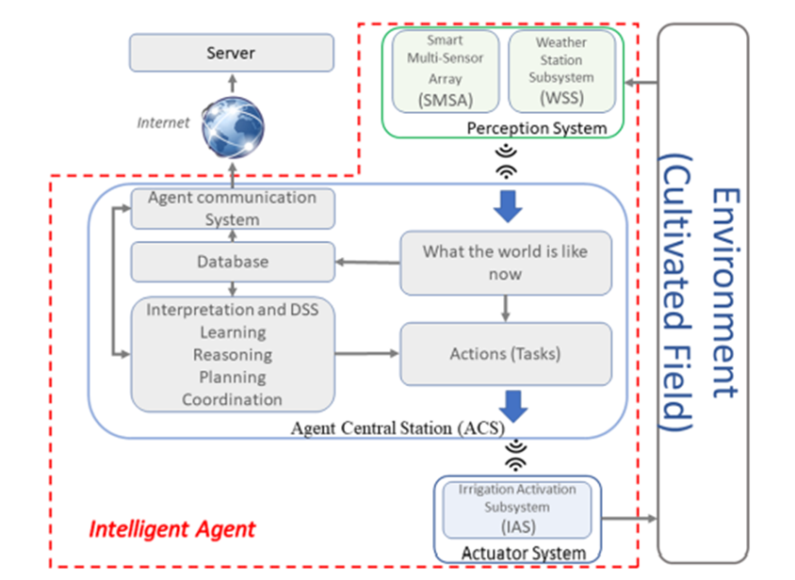
Cyber-physical intelligent agent
The CPS principle follows the concept of an intelligent agent which integrates several subsystems.
The intelligent agent consists of a smart multi-sensor array (SMSA) which is located in the field and a weather station subsystem (WSS) that is used to monitor the function of perception system.
The agent actions are performed in the field by an Irrigation activation subsystem (IAS).
The web server databases can be integrated with other systems for monitoring tasks in decision support activities.
Cyber-physical intelligent agent architecture for irrigation scheduling [1]

Slide 5
Objective
The main objective is to design and implement a cyber-physical crop irrigation system with intelligent agents.
  This system provides the acquisition of field information through sensors, the usage of water according to a decision system and activation of solenoid valves.

Slide 6
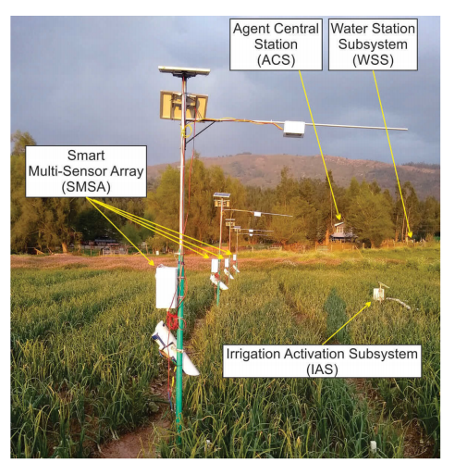
Implementation
The cyber-physical intelligent agent is implemented in the study field
Each SMSA node has a Raspberry-Pi and a digital camera for acquiring images from the field that can be used for crop allometric analysis [2]
The SMSA web server application was developed for the acquisition of parameters measured in the field.
Four treatments were monitored
The SMSA web database contains data of user, treatment, longitude, latitude, soil moisture 1, soil moisture 2, soil moisture 3, environmental temperature, relative humidity, object canopy temperature, sensor canopy temperature, irrigation prescription time and irrigation prescription rate
Implementation of Cyber-physical intelligent agent [1]

Slide 7
Agent central station (ACS)
The ACS is installed in the farmer house. Two power supply systems can be used in this development
  The house power supply using an adaptor
  A photovoltaic power supply using a solar panel
Historical data and crop modelling are used for prediction algorithms and for evaluating irrigation prescriptions.
The intelligent agent has several abilities such as autonomy, proactivity and reasoning.
The intelligent agent can perform three possible actions,
  Turn on - sends positive pulse to the solenoid valve
  Turn off - sends negative pulse to the solenoid valve
  Reset - sending positive pulse followed by a negative pulse to the solenoid valve
The goal is to apply irrigation prescriptions according to amounts and times specified by the decision system

Slide 8
Decision system (Logic-Based architecture)
The Logic-Based architecture also known as “symbolic AI” gives a symbolic representation to the irrigation agent of its desired behavior and the crop field to work with it
The irrigation agent model has an internal database, which is the representation of the information that the irrigation agent has about the crop field (belief) in a symbolic form
These databases consists of data obtained from the perception system, historical data, crop status and constraints.
The decision-making process of the irrigation agent is modelled through a set of decision rules, which are simply inference rules for the logic.

Slide 9
Decision system (Cont.)
The Percepts, Actions, Goal and Environment is given by,
Percept (P)
Regional Weather Data - Weather station: Rain (R), air temperature (T), relative humidity (RH), wind direction (WD), wind speed (WS), radiation (Rad), evapotranspiration (ETo).
Sensor Station - Soil moisture sensor (SM), canopy temperature sensor (CT), temperature (Tss), relative humidity (RHss)
Flow Sensor (Q)
Warnings and orders - District irrigation: No irrigation available (NIA), Farmer: Stop irrigation (SI)
Actions (A)
Turn-on irrigation actuator, wait ITi and turn-off irrigation actuator
Stop irrigation system - Reset solenoid (IrrRes)
Goal (G)
Applying irrigation according to prescription (time and amount)
Environment (E)
Field: Crop + Soil + Climate

Slide 10
Yield Prediction
The yield prediction is calculated using the Aqua crop software developed by the Food and Agriculture Organization (FAO) for simulating the yield response of crops to water.
The selection of the best irrigation prescription is evaluated using the irrigation water use efficiency (IWUE) as performance measurement using equation.
IWUE = crop yield / total irrigation applied
Soil parameters correspond to the values obtained from the soil samples in the field.
Climatic values are obtained using the WSS and historical regional weather data.
Plant characteristics were defined using Aqua crop models.

Slide 11
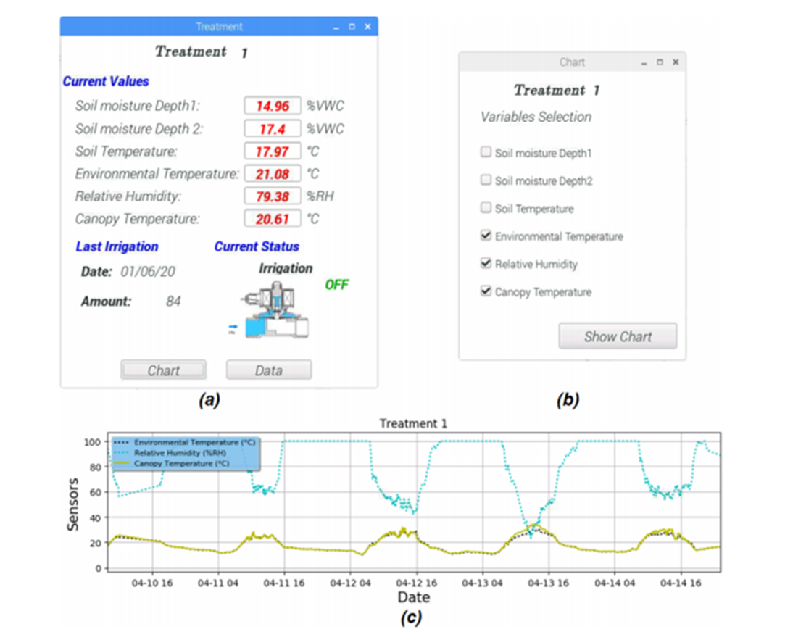
Results
(a) Monitoring in real time (b) Selection of variables (c) Interactive chart [1]

Slide 12
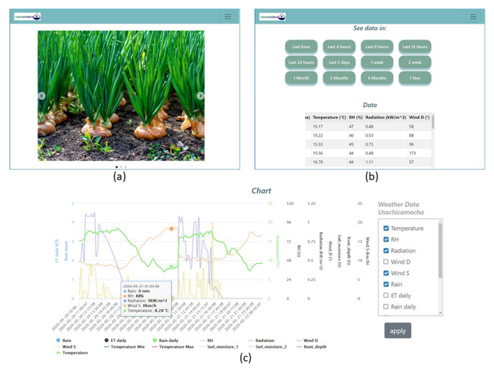
Results (Cont.)
Web application (a) Home Page (b) Data visualization using Tables (c) Chart visualization [1]

Slide 13
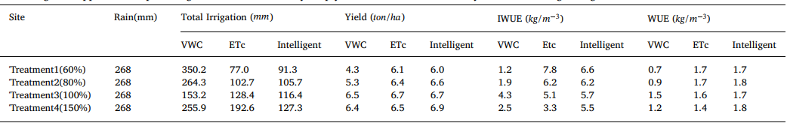
Results (Cont.)
Table - Total irrigation application depth along with the simulated dry crop yield and water use efficiency [1]
Irrigation scheduling using Soil moisture Sensors (VWC), soil water balance equation (ETc) and the intelligent system

Slide 14
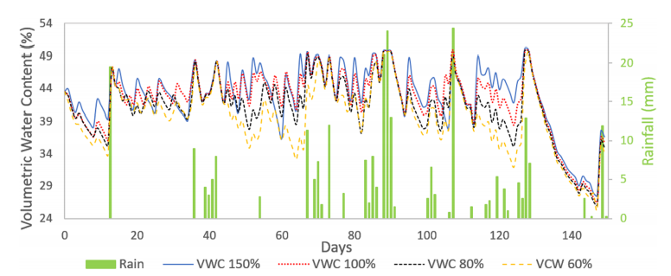
Results (Cont.)
Volumetric Water Content of Treatments during the crop growing season [1]

Slide 15
CONCLUSION
A cyber-physical intelligent agent based on the concept of a rational agent was designed and implemented for irrigation scheduling.
Raw data was collected and processed using a central station and irrigation prescriptions were defined using a reasoning system based on a heuristic based on yield and water use efficiency parameters.
The intelligent agent sends activation messages to an actuator system that energizes solenoid valves in the field.
Results confirm that the irrigation scheduling system using the intelligent agent in the prediction of yield and WUE is suitable for irrigation scheduling and is able to improve water conservation.

Slide 16
Future work
The cyber-physical intelligent agent can be further extended to include irrigation prescriptions using digital images for defining root depths, crop coefficients and temperature sensors
The system can be adapted for various types of crops, soils and irrigation infrastructure by changing few inputs parameters in the central station software application

Slide 17
References
[1] Andres-F Jimenez, Pedro-F Cardenas, Fabian Jimenez, Antonio Ruiz-Canales, Angel López, “A cyber-physical intelligent agent for irrigation scheduling in horticultural crops,” Computers and Electronics in Agriculture, Volume 178, 2020.
[2] Lemaire, G., Sinclair, T., Sadras, V. et al. “Allometric approach to crop nutrition and implications for crop diagnosis and phenotyping.” A review. Agron. Sustain. Dev. 39, 27 (2019).
[3] Jimenez, Andres & Cardenas, Pedro-F & Canales, Antonio & Jiménez L., Fabián & Portacio, Alfonso. (2020). A survey on intelligent agents and multi-agents for irrigation scheduling. Computers and Electronics in Agriculture. 176. 105474. 10.1016/j.compag.2020.105474.

Slide 18
Thank you

