Slide 1
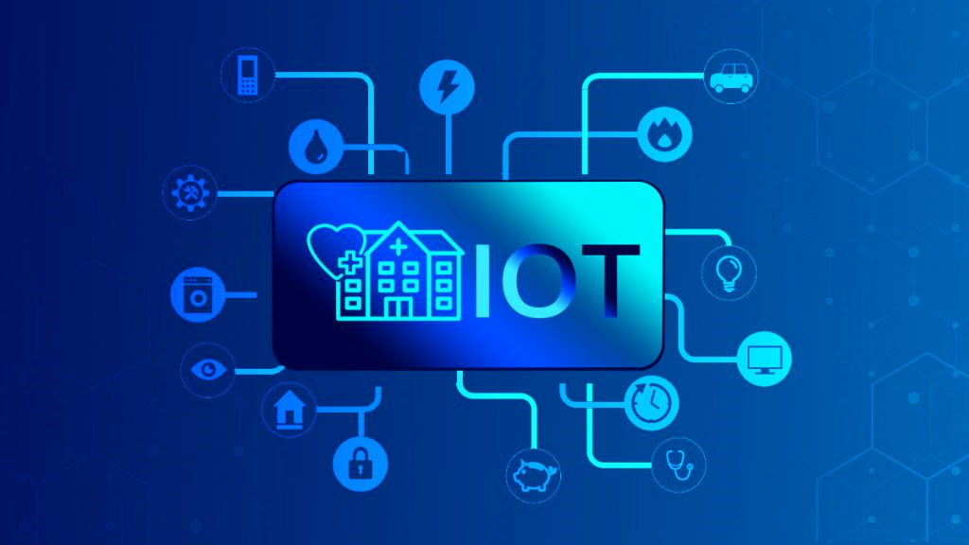
Security and Privacy of IOT Devices in Smart HealthCare
By
Charitha BV – IIS20012
M.Tech – Industrial Intelligent Systems
Amrita Vishwa Vidyapeetham - Coimbatore

Slide 2
Motivation
1
The integration of medical “things” - devices, smart sensors, mHealth apps, artificial intelligence (AI) etc. had increased the usage of IoT devices
2
This has urged the demand for various medical wearable devices globally as people can easily access and monitor their health at any given time
3
The hospitals segment held a global internet of things (IoT) in healthcare market share of about 34.6% in 2020
4
Medical devices pose a unique cybersecurity risk in that attacks or hacks can directly endanger patient privacy and safety
5
Identify the open-research challenges in security and privacy of Smart HealthCare System

Slide 3
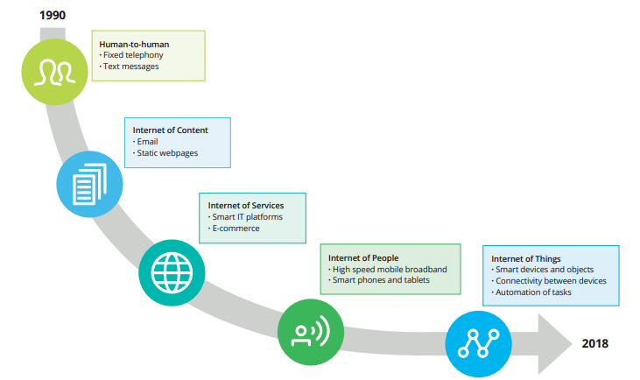
Introduction
Fig. 1. Technological and cultural changes enabling the development of the Internet of Things

Slide 4
Introduction (Cont.)
The Internet of Things (IoT) consists of Subsets,
The Internet of Healthcare Things (IoHT) is the convergence and integration of sensor data collected by medical devices and mobile technologies and applied in Healthcare
Devices linked to cloud platforms on which captured data is stored and analyzed has come to be known as the Internet of Medical Things (IoMT)
Most of the connected medical devices can only send information or can send and receive data.
The US Food and Drug Administration (FDA) was made aware of 11 cybersecurity vulnerabilities that, if exploited by a remote attacker, could put critical medical devices and networks at risk.

Slide 5
Literature Survey
In the [3], the author discusses the importance of Iot in HealthCare and how the devices are subjected to Cyber attacks.
DDos attacks in IOT devices
Integration of Various Devices
Medjacking – Hacking of Medical Devices.
  In June 2015 – TrapX revealed Medjacking
  In the first case, a blood gas analyzer infected with two different types of malware was used to steal passwords for other hospital systems and confidential data
  At another hospital, the radiology department’s image storage system was used to gain access to the main network, sensitive data was retrieved and sent to a location in China.
  Stolen medical identities are much more valuable than the price of a stolen credit card number.

Slide 6
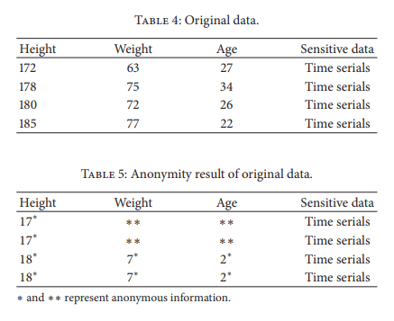
Literature Survey
The Data Encryption technology - Cryptography is a security technology for information exchange and communication. [4]
Privacy Disclosure of the original data
Data Search
  Searchable Symmetric Encryption (SSE)
  public-key encryption with keyword search (PEKS)
Privacy Disclosure [4]

Slide 7
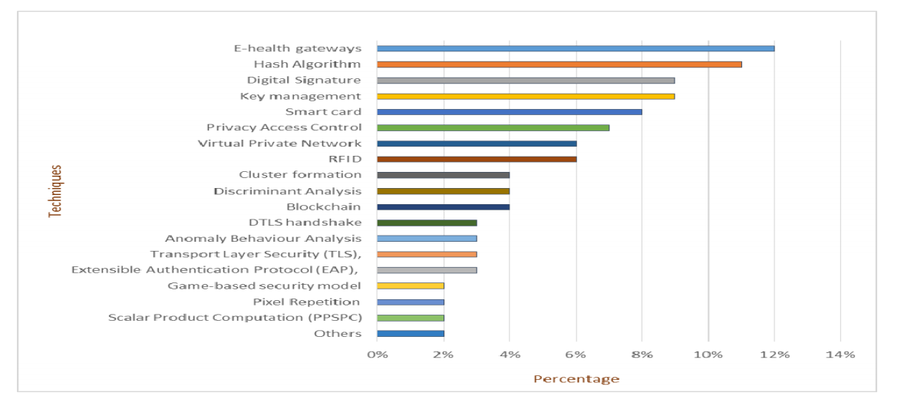
Literature Survey
Fig. 2. Classification by security techniques [1]

Slide 8
Current Status
In Pune, India, June 07, 2021 (GLOBE NEWSWIRE) - The global internet of things (IoT) in healthcare market size is expected to experience significant growth by reaching $ 446.52 billion by 2028 while exhibiting the Compound Annual Growth Rate (CAGR) of 25.9% between 2021 and 2028.
Cisco Blog - On an average a hospital has 15 to 20 IoMT devices which could be in the form of a smart bed, an IV pump, an MRI machine, a ventilator, a monitor and other health tech devices.

Slide 9
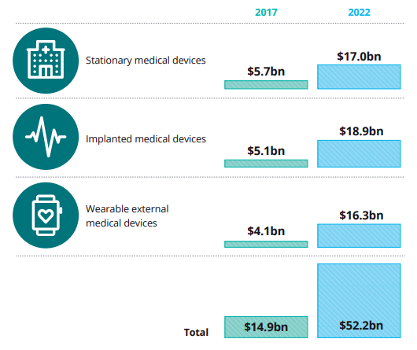
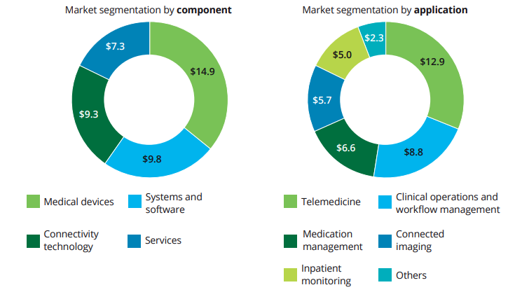
Current Status
Fig. 3. IoMT market segmentation
Fig. 4.The market for connected medical devices
Source: Deloitte

Slide 10
Current Status
The Role of Firmware in Attacking IoMT Devices – A WRECK bug firmware that gives the cyber criminals an easy pass to control the medical devices even without the internet
Few steps to protect internet-connected equipment s from Cyberattacks are
IT teams should be knowledgeable about IoMT devices
Strong Passwords
Network Segmentation
Active Monitoring of Network Traffic
-- TECH TIMES

Slide 11
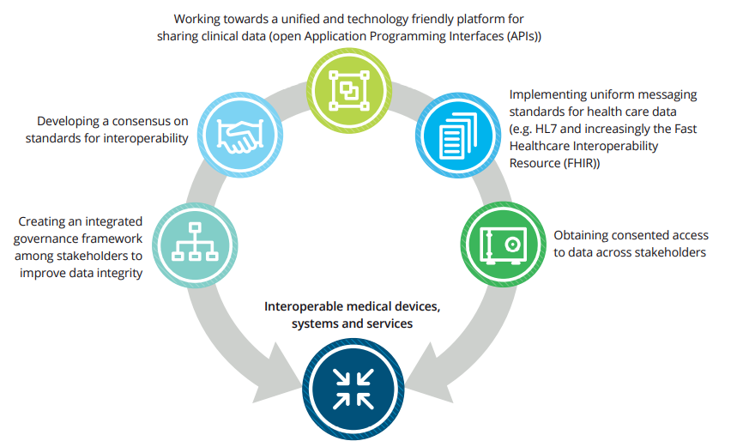
Implementation
Fig. 5. Key actions life sciences and health care stakeholders when tackling the interoperability challenge
Source: Deloitte LLP, 2018

Slide 12
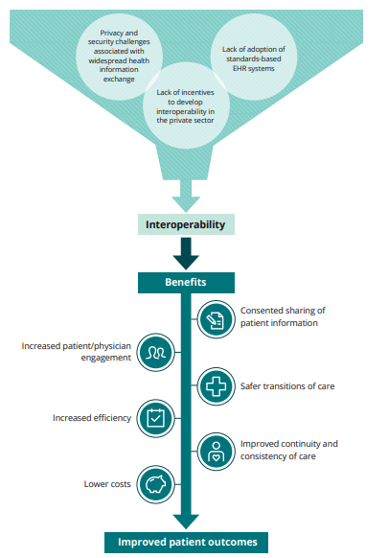
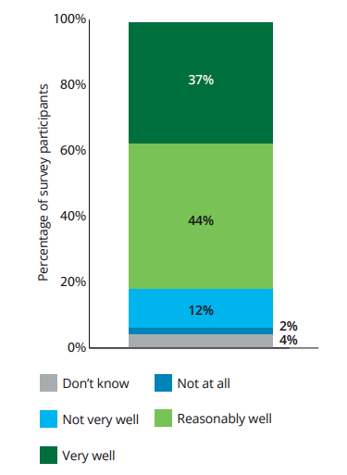
Implementation
Fig. 7. Preparedness of medtech companies maintaining the cybersecurity of connected medical devices
Fig. 6. Barriers to and benefits of interoperability

Slide 13
Implementation
IBM introduces Cognitive IOT devices as a part of Security in Medical devices by introducing wearables
Instrumented and Interconnected - Integrating structured data with unstructured data (e.g. social media, text, email, voice)
Intelligent - Applying adaptable machine learning techniques to interconnected physical device data patterns and Trends
In Real-time - Responding dynamically to chronic, multi-dimensional and/or time sensitive problems
In Context Data - Creating a personal and consumable experience by understanding the human element in the context of both structured and unstructured data
Source: IBM MD&I

Slide 14
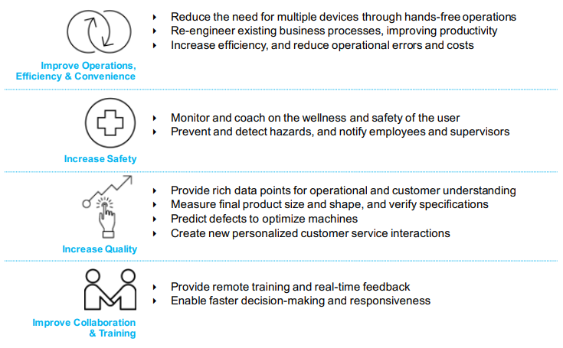
Implementation
Source: IBM MD&I

Slide 15
Conclusion
Making these Wearables interoperable can enhance the existing methodologies
The wearable devices through their hospital or prescribed from the doctor are recommended to minimize Cyber attacks
Usage of BYOD should be minimized

Slide 16
Future Work
Providing data security and privacy at all stages of data is essential
IT teams should be knowledgeable about IoMT devices
Active Monitoring of Network Traffic
Device Patching

Slide 17
References
[1] A. Algarni, "A Survey and Classification of Security and Privacy Research in Smart Healthcare Systems," in IEEE Access, vol. 7, pp. 101879-101894, 2019, doi: 10.1109/ACCESS.2019.2930962.
[2] F. Alsubaei, A. Abuhussein and S. Shiva, "Security and Privacy in the Internet of Medical Things: Taxonomy and Risk Assessment," 2017 IEEE 42nd Conference on Local Computer Networks Workshops (LCN Workshops), 2017, pp. 112-120, doi: 10.1109/LCN.Workshops.2017.72.
[3] Anil Chacko, Thaier Hayajneh, “Security and Privacy Issues with IoT in Healthcare” Fordham Center for Cybersecurity, Fordham University, New York, NY, USA
[4] Wencheng Sun, Zhiping Cai, Yangyang Li, Fang Liu, Shengqun Fang, Guoyan Wang, "Security and Privacy in the Medical Internet of Things: A Review", Security and Communication Networks, vol. 2018, Article ID 5978636, 9 pages, 2018. https://doi.org/10.1155/2018/5978636

Slide 18
References
Reference links
Deolitte
https://www2.deloitte.com/content/dam/Deloitte/global/Documents/Life-Sciences-Health-Care/gx-lshc-medtech-iomt-brochure.pdf
TechTimes
https://www.techtimes.com/articles/262653/20210709/iomt-devices-healthcare-systems-aware-vulnerabilities-heres-protect.htm
IBM MD&I
https://www.ibm.com/downloads/cas/O50QV9NK
https://www.ibm.com/thought-leadership/institute-business-value/report/medical-device-security#
Cisco Blog
https://blogs.cisco.com/healthcare/securing-internet-connected-devices-in-the-new-era-of-healthcare?dtid=osscdc000283

Slide 19
References
Reference links
IOMT Devices
https://www.qrcsolutionz.com/blog/cybersecurity-challenges-using-iot-iomt-in-healthcare
IoT HealthCare – Benefits, Challenges and Applications
https://www.valuecoders.com/blog/technology-and-apps/iot-in-healthcare-benefits-challenges-and-applications/
https://www.globenewswire.com/en/news-release/2021/06/07/2242429/0/en/Internet-of-things-IoT-in-Healthcare-Market-to-Exhibit-Astonishing-25-9-CAGR-by-2028-Stoked-by-Increasing-Demand-for-Medical-Wearable-Devices-Worldwide-says-Fortune-Business-Insigh.html
https://www.optum.in/thought-leadership/library/internet-healthcare-things.html

Slide 20
Thank You

