Slide 1

Music Genre Classification
CHARITHA BV – IIS20012

Slide 2
References
http://marsyas.info/downloads/datasets.html (Dataset -Audio Files)
http://cs229.stanford.edu/proj2019spr/report/3.pdf (Feature Extraction)
https://www.irjet.net/archives/V6/i5/IRJET-V6I5174.pdf (Feature Extraction)
https://medium.com/@sdoshi579/classification-of-music-into-different-genres-using-keras-82ab5339efe0 (Code Reference)

Slide 3
Problem Formulation
Objective: Classification of Music genres (10 different genres)
Dataset details:
http://marsyas.info/downloads/datasets.html
The dataset considered here is GTZAN genre collection. It consists of 10 different genres and each consisting of 100 audio clips which plays for 30 seconds.
Assumptions:
From each music genre, 10 samples are considered

Slide 4
Feature Extraction
The librosa API is used to extract wave files(.wav)
Here, two librosa methods are used to extract raw data from the wave files.
MFCC (Mel-Frequency Cepstral Coefficients)
Chromagram

Slide 5
PCA –Comparison of Sum of the upper triangular matrices
The value of upper triangular matrices before applying PCA is -173.79940991701517
The value of upper triangular matrices after applying PCA is 4.937684067143513e-12
These values shows that after applying PCA the features are independent

Slide 6
(Theory) GMM EM
Gaussian Mixture Models (GMMs) assume that there are a certain number of Gaussian distributions , and each of these distributions represent a cluster .
Gaussian Mixture Model tends to group the data points belonging to a single distribution together.
Gaussian Mixture Models are probabilistic models and use the soft clustering approach for distributing the points in different clusters

Slide 7
(Theory) GMM EM
EM algorithm models the data as being generated by mixture of Gaussians.
The EM algorithm estimates the parameters of (mean and covariance matrix) of each Gaussian.
Each Gaussian defines a single cluster of data.
EM is an iterative algorithm which is used to find the maximum likelihood when there are hidden variables

Slide 8
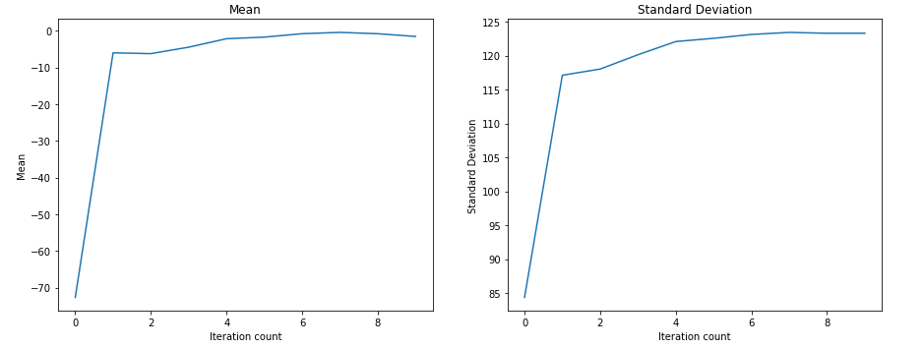
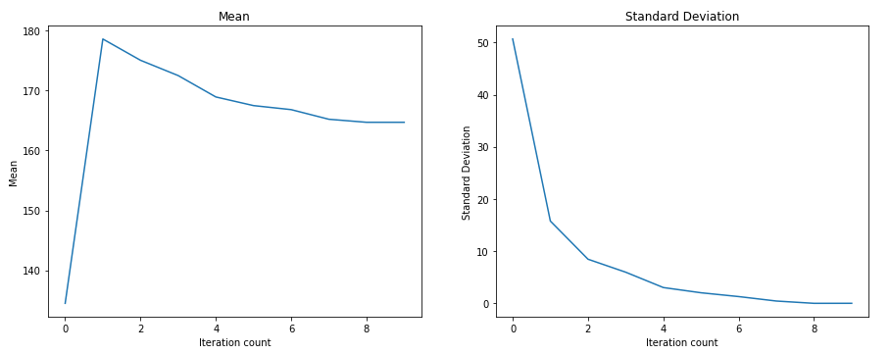
GMM EM application (100 samples)

Slide 9
Inference
How many features (columns) you played with?
Two features
How to select initial values?
Initial values are selected at random.
How many iterations?
10 iterations were executed.
How to choose number of Gaussians?
Using Maximum Likelihood Estimate

Slide 10
(Theory) Logistic regression
Logistic Regression is used when the dependent variable(target) is categorical.
For example,
To predict whether an email is spam (1) or (0)
Reference
https://towardsdatascience.com/logistic-regression-detailed-overview-46c4da4303bc - Logistic Regression

Slide 11
(Theory) Logistic regression
Training 80% of data - 160 samples
Testing remaining 20% of data – 40 samples
Classification – Two classes are considered
Class 1 – ‘blues’
Class 2 – ‘classical’

Slide 12
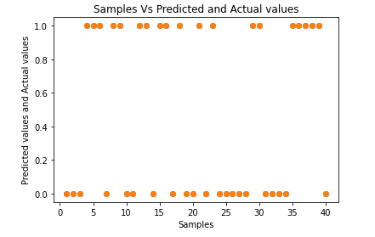
Inference
The prediction Accuracy is 100%

Slide 13
Inference
How many features (columns) you played with? What is R² values in each case? Plot the graph Y axis is R² values
R square value = 1.0 for the features 3,4,5 and 7. And this is indicates the perfect fit
It is observed that if number of features increases R square value decreases.

Slide 14
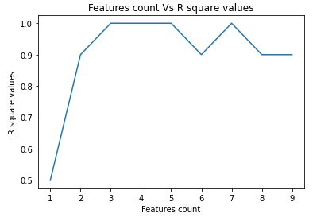
Inference

Slide 15
Inference
What is the order of polynomial you have selected? ? What is R² values in each case? Plot the graph. Y axis is R² values
As the order of polynomial increases, R square values decreases
The maximum R square value is 0.4987 when the order of polynomials are 2, 4, 5, 6, 7, 8.

Slide 16
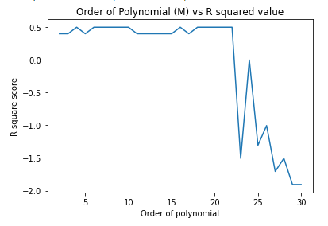
Inference

Slide 17
References
K-means Clustering
https://www.analyticsvidhya.com/blog/2019/08/comprehensive-guide-k-means-clustering/

Slide 18
(Theory) k-means Clustering
K-means clustering is an algorithm which tries to minimize the distance of the points in a cluster with their centroid.
The main objective of the K-Means algorithm is to minimize the sum of distances between the points and their respective cluster centroid.

Slide 19
(Theory) K-means Algorithm
Step 1: Choose the number of clusters k
Step 2: Select k random points from the data as centroids
Step 3: Compute the distances for each data point and cluster centroid
Step 4 : Assign all the points to the closest cluster centroid
Step 5: Recompute the centroids of newly formed clusters
Step 6: Repeat the steps 3 to 5 until the convergence is achieved.
Convergence criteria
The termination conditions are
Number of maximum iteration permissible.
No change of centroid values in any cluster.
No significant movements of sample from one cluster to another.

Slide 20
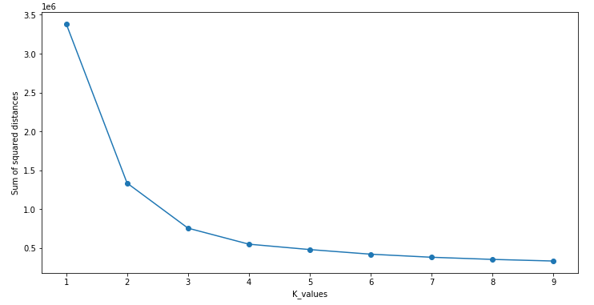
Inference

Slide 21
Inference
Use features of your dataset for clustering into n clusters. Where n must be learnt by elbow method.
The optimal number of clusters is given by the sharp turn in the Elbow graph.
Here, the optimal cluster is 3.

Slide 22
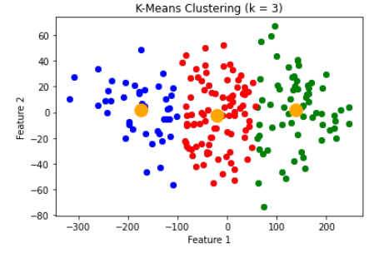
Inference
The yellow dots represent cluster centers

Slide 23
(Theory) Neural Network
Neural networks, also known as artificial or simulated neural networks (ANNs/SNNs) are a subset of machine learning and are at the heart of deep learning algorithms.
Their name and structure are inspired by the human brain, mimicking the way that biological neurons signal to one another.
Artificial neural networks (ANNs) are comprised of a node layers, containing an input layer, one or more hidden layers, and an output layer.
Each node or artificial neuron connects to another and has an associated weight and threshold.

Slide 24
(Theory) Neural Network
If the output of any individual node is above the specified threshold value, that node is activated, sending data to the next layer of the network.
Otherwise, no data is passed along to the next layer of the network.
Neural networks rely on training data to learn and improve their accuracy over time.
Types of neural networks
Feedforward neural networks or multi-layer perceptrons (MLPs)
Recurrent neural networks (RNNs)

Slide 25
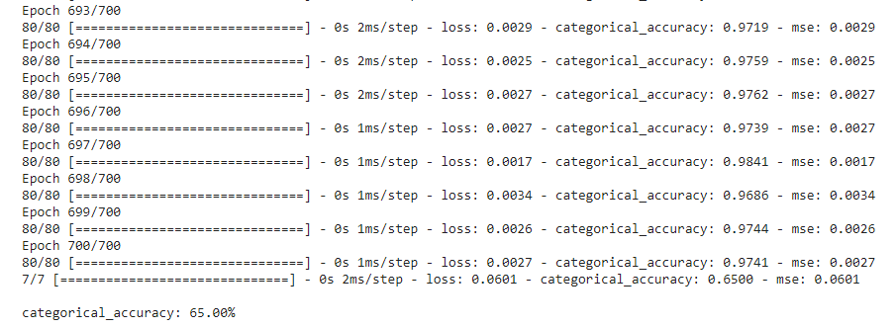
Inference
Sigmoid layer network
The number of epochs given is 700 and the accuracy achieved is 65%

Slide 26
Inference
RADIAL BASIS network.
The number of epochs given is 100 and the accuracy achieved is 6.5%
Results show that Radial basis function(NN) with single hidden layer is not suitable for Classification of Music genres

Slide 27
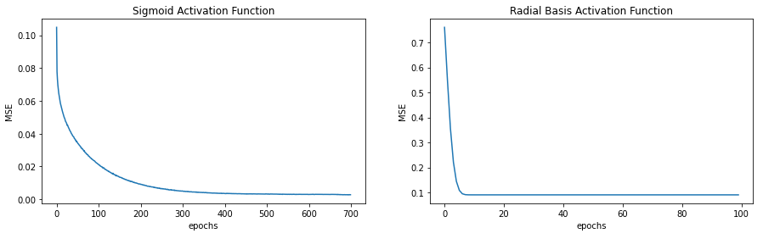
Plots – Epochs Vs MSE

Slide 28
References
https://www.datacamp.com/community/tutorials/svm-classification-scikit-learn-python - SVM

Slide 29
(Theory) SVM,SVC
SVM offers very high accuracy compared to other classifiers.
The classifier separates data points using a hyperplane with the largest amount of margin and is also known as a discriminative classifier.
SVM finds an optimal hyperplane which helps in classifying new data points.
SVM constructs a hyperplane in multidimensional space to separate different classes and generates optimal hyperplane in an iterative manner, which is used to minimize an error.
The core idea of SVM is to find a maximum marginal hyperplane(MMH) that best divides the dataset into classes.

Slide 30
(Theory) SVM,SVC
SVM Kernels
The SVM algorithm is implemented in practice using a kernel.
Linear Kernel - Used as normal dot product any two given observations.
Radial Basis Function Kernel - RBF can map an input space in infinite dimensional space.
Polynomial Kernel - Distinguishes curved or nonlinear input space.
gamma is a parameter, which ranges from 0 to 1. A higher value of gamma will perfectly fit the training dataset, which causes over-fitting. gamma = 0.1 is considered to be a good default value. The value of gamma needs to be manually specified in the learning algorithm.

Slide 31

Inference
SVC algorithm with polynomial kernel gives the highest accuracy score of 60.5%
SVC algorithm with RBF kernel performs poorly for Music genre classification
Accuracy Score

Slide 32
References
https://www.analyticsvidhya.com/blog/2021/04/beginners-guide-to-decision-tree-classification-using-python/
https://medium.com/swlh/decision-tree-classification-de64fc4d5aac

Slide 33
(Theory) Classification Tree
Decision Tree is a Supervised learning technique that can be used for both classification and Regression problems, but it is preferred for solving Classification problems.
It is a tree-structured classifier, where internal nodes represent the features of a dataset, branches represent the decision rules and each leaf node represents the outcome.
It is a graphical representation for getting all the possible solutions to a problem/decision based on given conditions.
The two popular techniques for Attribute Selection Methods are:
Information Gain (Entropy)
Gini Index

Slide 34
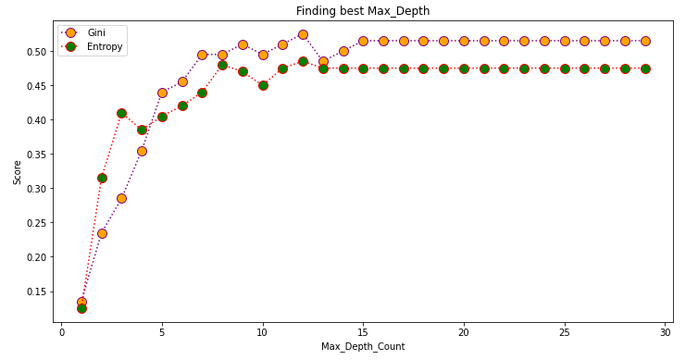
Inference – DT Classification
Comparison of Gini Index and Entropy Criteria
Max accuracy (max_depth = 12)
12

Slide 35
Inference
From the above plot,
When the max_depth is 12, the accuracy of the Model (criterion as Gini index) : 52.5%
When the max_depth is 12 ,the accuracy of the Model (criterion as Entropy) : 48.5%
The Gini Index works better than Entropy for Music Genre Classification

Slide 36
References
Random Forest Algorithm
https://www.askpython.com/python/examples/random-forest-regression
https://machinelearningmastery.com/random-forest-ensemble-in-python/

Slide 37
(Theory) Random Forests
Random forest is an ensemble of decision tree algorithms.
It is an extension of bootstrap aggregation (bagging) of decision trees and can be used for classification and regression problems.
In bagging, a number of decision trees are created where each tree is created from a different bootstrap sample of the training dataset.
A bootstrap sample is a sample of the training dataset where a sample may appear more than once in the sample, referred to as sampling with replacement.
Bagging is an effective ensemble algorithm as each decision tree is fit on a slightly different training dataset, and in turn, has a slightly different performance.

Slide 38
(Theory) Random Forests
Steps to perform the random forest regression
Pick a random K data points from the training set.
Build the decision tree associated to these K data points.
Choose the number N tree of trees you want to build and repeat steps 1 and 2.
For a new data point, make each one of your Ntree trees predict the value of Y for the data point in the question, and assign the new data point the average across all of the predicted Y values.

Slide 39
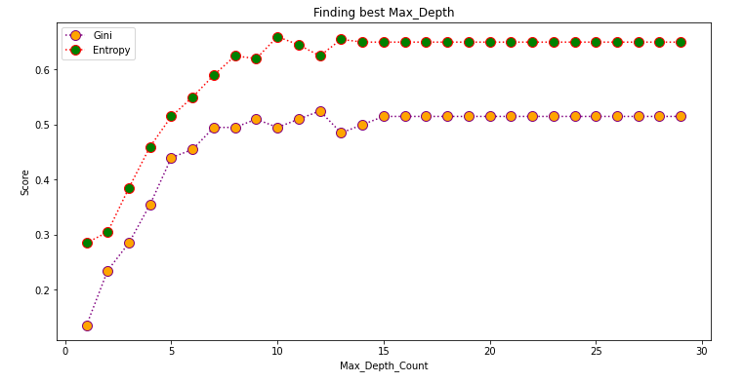
Inference
Comparison of Gini Index and Entropy Criteria
Max accuracy
(entropy, max_depth = 10)
Max accuracy (gini_index, max_depth = 12)

Slide 40
Inference
Comparing the models (Gini-index and entropy) of Decision tree and Random Forest algorithms
The maximum accuracy score for Music genre classification is 66 % (at max_depth = 10) and it is achieved using “Random Forest algorithm”
Algorithms | Gini _index |  | Entropy
 | Max accuracy | Max depth | Max accuracy | Max depth
Decision Tree | 52.5 % | 12 | 48.5 % | 12
Random Forest | 52.5 % | 12 | 66 % | 10

