Slide 1

Hybrid Neuro-Fuzzy Systems
By
Charitha BV (IIS20012)
M.Tech (Industrial Intelligent Systems)
Amrita Vishwa Vidyapeetham, Coimbatore

Slide 2
Summary
Neuro-Fuzzy Systems
Structures of Neuro-Fuzzy Systems
Case study : FDI OF AN ELECTRO - PNEUMATIC VALVE ACTUATOR

Slide 3

Neuro-Fuzzy Systems
Neural Network training techniques handles information retrieval from data using optimization techniques
Fuzzy system provides the intuitive understanding of the resulting system and establishes the possibility of integrating expert knowledge
Neuro-Fuzzy Systems is a combination of “Human experts and Experimental data”
It can generate new rules from the data and also refine the existing rules by adapting parameters within them

Slide 4
Control - Approximate the non-linear functions in modelling and system identification
01
Decision making – Ability to build decision support systems is important
02
Application Areas

Slide 5
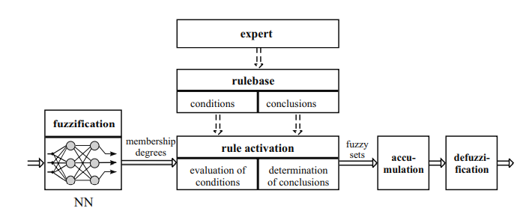
General Structure of Neuro-Fuzzy Model
Neuro-Fuzzy System

Slide 6
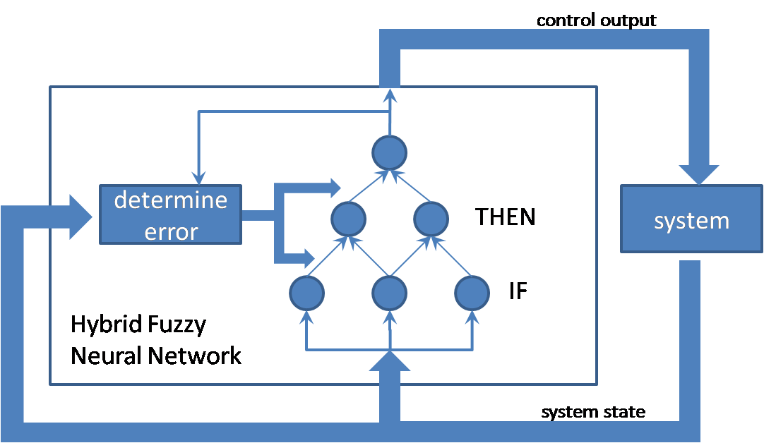
General Structure of Neuro-Fuzzy Model
Neuro-Fuzzy System

Slide 7
Structures of Neuro-Fuzzy model
01
02
03
Generic hybrid model
Mamdani and Singleton model
Takagi and Sugeno model

Slide 8
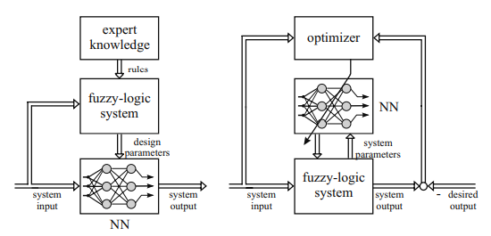
Generic Hybrid Neuro-Fuzzy Model
Serial and Parallel networks of general neuro-fuzzy systems

Slide 9
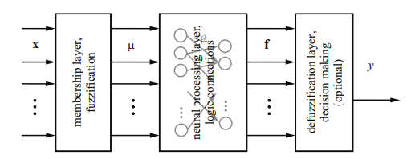
Generic Hybrid Neuro-Fuzzy Model
Hybrid neuro-fuzzy network consists of the same components as fuzzy inference engine
Fuzzification layer
Neural processing unit
Defuzzification layer
Generic neuro-fuzzy structure (decision making)

Slide 10
Classification
The classification problems maps the continuous, discrete or mixed input domains to the discrete output domain (0 and 1) - classes
In the application of fault diagnosis, the inputs are
Inputs (Symptoms– s_{i} )
Outputs (fault measures - f_{j})
R_{l} = IF …… THEN class1
In Classification, output fuzzy attributes do not exist.
The maximum decision will directly act on activation of rule premises, the conclusion of the rule with strongest activation will be the classification statement

Slide 11
Regression
A regression problem is the approximation of usually continuous valued one or higher dimensional function
For 1-D, it refers to y = f (x) where y assumes any value in continuous output domain
Regression neural network usually possess a defuzzification with output member functions or singletons and network elements that perform a weighted sum, which in case of singletons is equivalent to a center of gravity defuzzification
R_{l} = IF …… THEN y is large

Slide 12
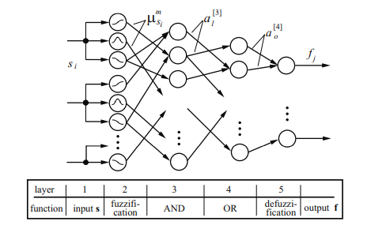
Mamdani and singleton neuro-fuzzy Systems
The typical hybrid neuro-fuzzy systems is the structure suggested by Fuzzy Adaptive Learning Control/Decision Network (FALCON)
Fuzzy Adaptive Learning Control/Decision Network (FALCON)

Slide 13
Mamdani and singleton neuro-fuzzy Systems
The network structure maps Mamdani-type fuzzy rules like,
R_{j} : IF s₁ is A₁ AND s₂ is A₂… AND s_{n} is A_{n} THEN yk is B₁
Triangular Membership functions are used in their Neuro-Fuzzy Classification System (NEFCLASS)
Here, The inference involves Min-Max operators
A different network structure called System Adaptive Rule Acquisition with Hebbian Learning (SARAH) which is also called as ANDOR neuron model.

Slide 14
Mamdani and singleton neuro-fuzzy Systems
This represents both t-norm (parametric composite of bounded difference operator) and t-conorm (parametric composite of bounded sum operator)
The resulting neuron resembles a standard sigmoidal perceptron
The input is fuzzified by Gaussian membership functions in the antecedent layer of SARAH structure
The rule activation scales the associated output singletons within the output layer
This yields a Crisp output value

Slide 15
Takagi-Sugeno neuro-fuzzy Systems
In Takagi-Sugeno structure the consequence is given as linear or nonlinear function of the inputs.
R_{l} : IF s₁ is A₁ AND s₂ is A₂ … AND S_{ns} is A_{na} THEN f_{j} = F_{l,j} (s)
The linear function in the consequence is,
R_{l} : IF s₁ is A₁ AND s₂ is A₂ … AND s_{ns} is A_{na} THEN f_{l , j} = w₀ + w₁s₁ + w₂s₂ + … + w_{ns}s_{ns}
The overall output is then determined as the weighted sum over all consequences

Slide 16
Takagi-Sugeno neuro-fuzzy Systems
Learning Algorithms:
The Adaptive-Network-based Fuzzy Inference System (ANFIS) is used.
Inputs are used twice : Inputs of fuzzification layer and the inputs of consequences
TS-fuzzy systems are used for the approximation of non-linear functions
Adaptive-Network-based Fuzzy Inference System (ANFIS)
IF s1 is large THEN fault F2
ELSE IF s2 small THEN fault F1
ELSE fault F3
Local Linear Model Tree (LOLIMOT) – Approximation of Non-linear systems and Pattern recognition

Slide 17
Case Study
FDI OF AN ELECTRO - PNEUMATIC VALVE ACTUATOR
The valve considered for FDI is an electro-pneumatic flow controller in evaporization stage
The model is then used to generate faulty/ fault-free data to evaluate the Neuro-fuzzy based fault isolation schemes

Slide 18
Conclusion
Neuro-fuzzy systems not only have powerful approximation abilities for modelling unknown dynamic non-linear systems, but a high level description of the system can also be obtained.
The transparent structure of NF is very useful to study the effect of faults on system characteristics

Slide 19
References
R. J. Patton, J. Chen, & H. Benkhedda, A study on neuro‐fuzzy systems for fault diagnosis, Int. J. of Syst Sci., Vol.31, No.11, 2000
Faisel J Uppal, Ron J Patton and Vasile Palade, NEURO-FUZZY BASED FAULT DIAGNOSIS APPLIED TO AN ELECTRO-PNEUMATIC VALVE, Control & Intelligent Systems Engineering, University of Hull, HU6 7RX United Kingdom – Case Study
https://www.researchgate.net/publication/242073375
https://www.researchgate.net/publication/264923989

Slide 20
THANK YOU

