Slide 1
Parking slot allocation using rfid technology
20RM600 RESEARCH METHODOLOGY
BY
Charitha BV (IIS20012)
M.Tech (Industrial Intelligent Systems)
Amrita Vishwa Vidyapeetham, Coimbatore

Slide 2
Introduction
One of the most popularly encountered problems in recent days is parking the vehicles
The parking lot area has many lanes/slots. Moreover, this involves a lot of manual labor.
Conventional parking systems do not have any intelligent monitoring systems.
Here, an efficient parking management system is proposed using RFID Technology to bring down the waiting time.

Slide 3
Radio
Frequency
Identification
(RFID)
Cost effective
Passive RFID card – High durability
Complex encryption algorithms
Dustproof & Waterproof

Slide 4

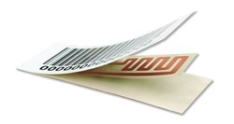
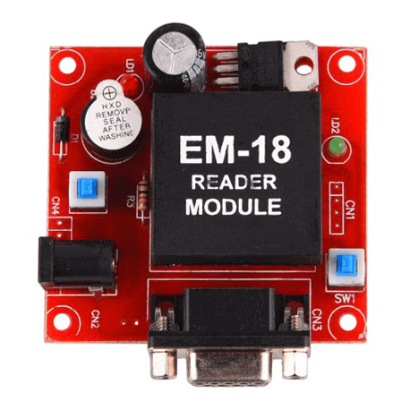
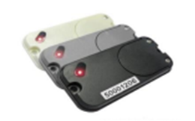
Literature Survey
RFID & GSM Feature
Pre-booking the slot by application with OTP [2][5][7].
Usage of RFID Tags and RFID Reader
RFID Passive TAG
RFID Reader Module
RFID Active TAG
Source: Google

Slide 5
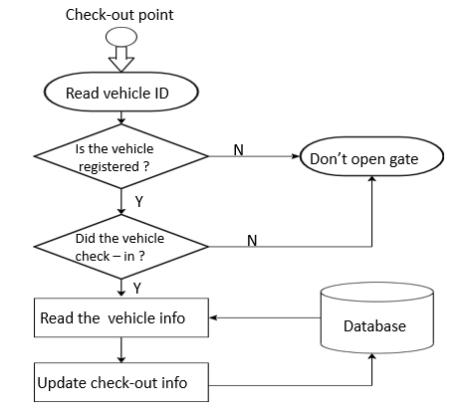
Literature Survey
Security
Check-ins and check-outs are controlled by the software on the basis of smart card [4][8].
Parking lot check-out process [1]

Slide 6
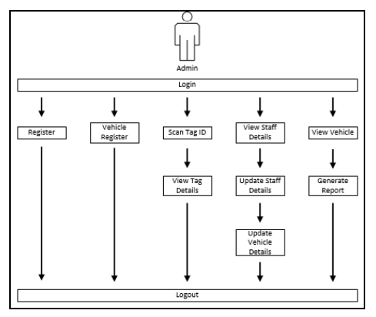
Literature Survey
Registration Process in User Interface
Block diagram of Registration Process [4]

Slide 7
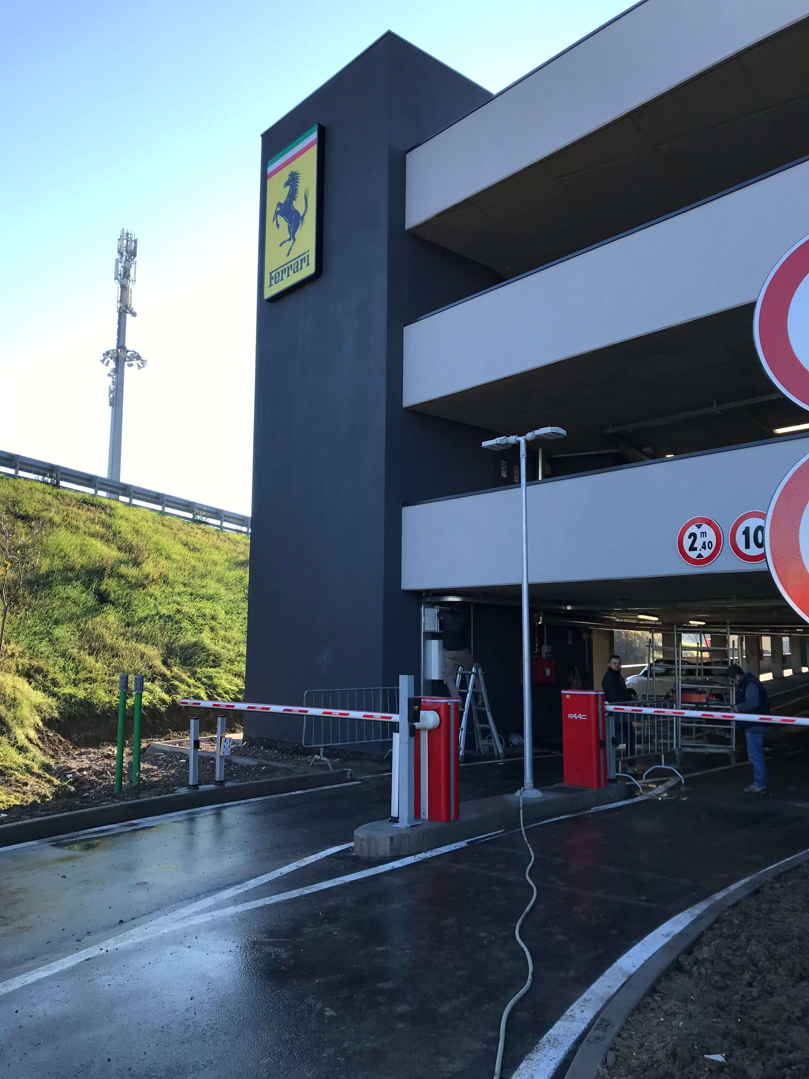
Literature Survey
Parking Charges
Deducts the charges at the exit [6].
The real-time detection of improper parking and automatic collection of parking charges are developed using E-parking
system [3][10].
Exit Gate of the Parking Lot
Source: Google

Slide 8
Research Gap
  Notifying the user about the details of parked vehicles
  The Management Costs can be decreased by automating the parking management system
  Payments and POS can be integrated
  The parking solution can be optimized by managing the traffic and there by reducing pollution

Slide 9
Objectives
To build a smart parking prototype using RFID Technology
  To find the empty slots in parking lot
  To notify the user about the allocated slot via SMS
  To deduct the charges of parked vehicles at the exit

Slide 10
Methodology
IR sensor 1
HT12E
Encoder
BIT 0
434 MHz
RF Transmitter
IR sensor 2
BIT 1
DOUT
BIT 2
IR sensor 3
BIT 3
IR sensor 4
Pin diagram of Transmitter Circuit

Slide 11
Methodology (Cont’d)
HT12D
Decoder
Arduino UNO
16 x 2
LCD Display
434 MHz
RF Receiver
BIT 0
D0
D8
D4
BIT 1
D1
D9
D5
DIN
BIT 2
D2
D10
D6
BIT 3
D3
D11
D7
Pin diagram of Receiver Circuit

Slide 12
Methodology (Cont’d)
PC
Arduino UNO
UART to USB
Adapter
C# .NET Application
MySQL
Database
Database Interface Block Diagram

Slide 13
Software Implementation
Serial_Port_Communicator
Port : string
Rthreshold : bool
Baud Rate : int
Data Bits : int
Parity : int
Stop Bit : bool
NullDiscard : bool
Adapter()
Process_Data()
Filter()
Settings()
Status_SMS
Parking_Full()
No_of_Free_Slots()
Free_Slot_Viewer
Data Encoding
Message Type
SMS Service
Network Service
Status_SMS()
Send_Message()
Parking_Slot
Serial_Port_Communicator()
Free_Slot_Checker()
Free_Slot_Viewer()
Free_Slot_Checker
Vehicle Count
Reset Slot
Vehicle_Counter()
Slots_Occupied()
Slots_Updation()
Send_Message
SMS_Open()
SMS_SendMessage()
SMS_Close()
Class diagram for parking slot allocation system

Slide 14
Software Implementation(Cont’d)
Parking_Slot
Serial_Port_Communicator ()
Free_Slot_Checker()
Free_Slot_Viewer ()
Adapter()
Status_SMS()
  Parking_Full()
  No_of_Free_Slots()
Vehicle_Counter()
Process_Data()
Slots_Occupied()
Send_Message()
  SMS_Open()
  SMS_SendMessage()
  SMS_Close()
Filter()
Slots_Updation()
Settings()
Workflow of Class diagram

Slide 15
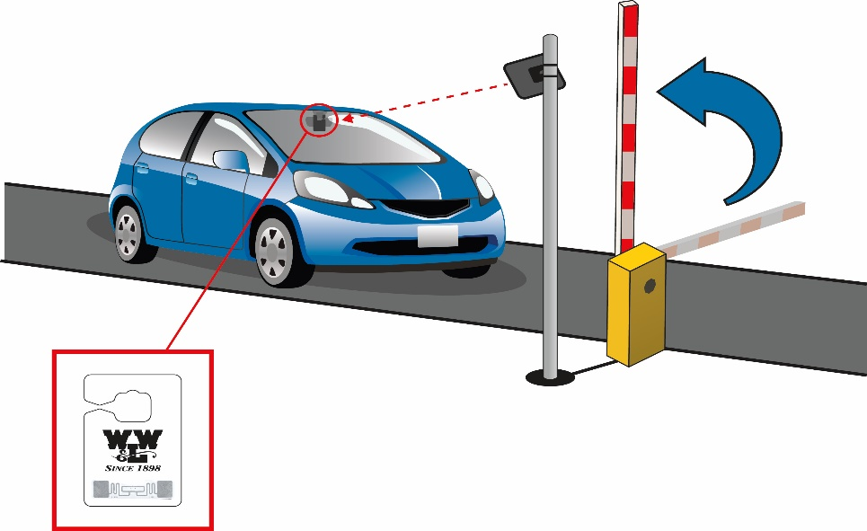
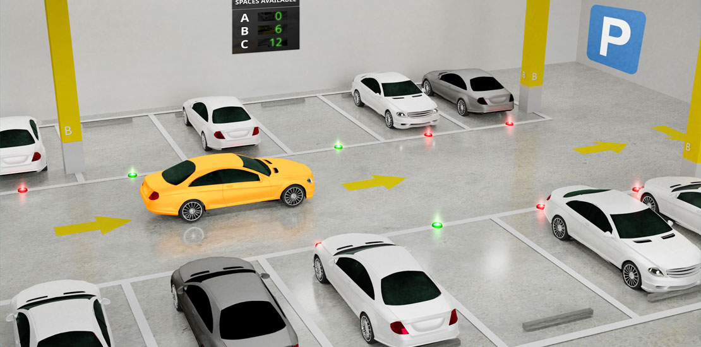
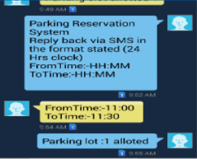

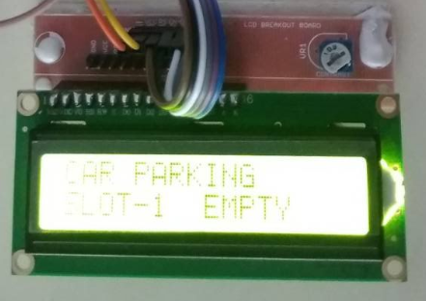
Overview of Smart Parking System
Overview of the system
Source: Google

Slide 16
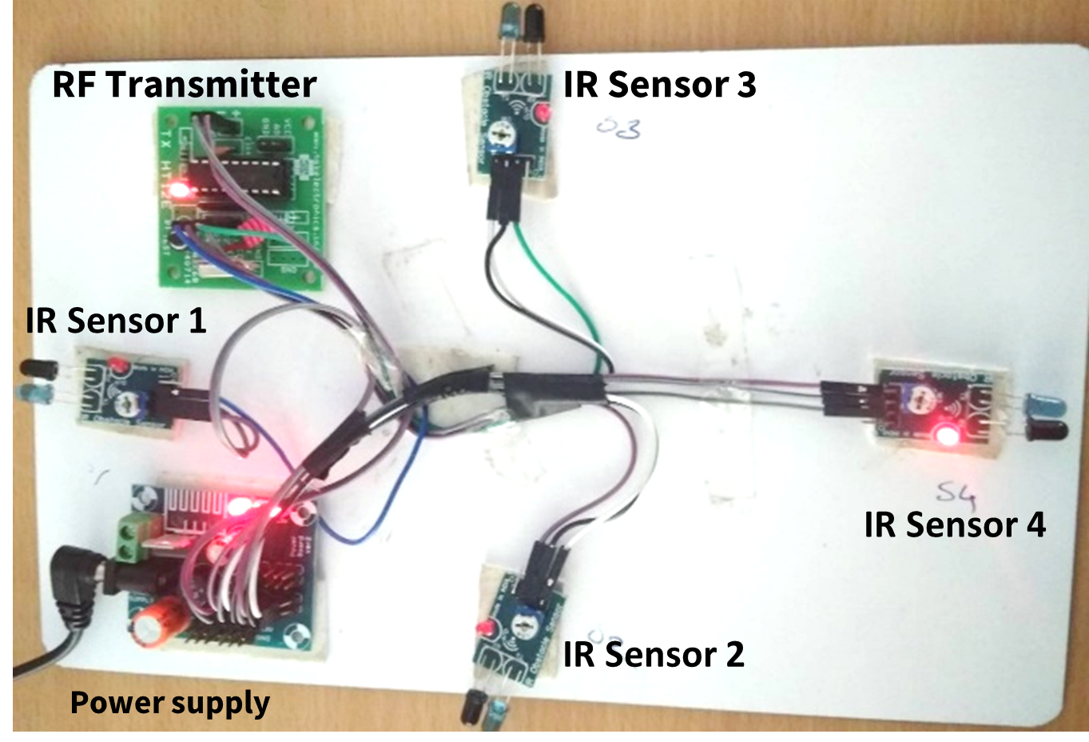
Results
Parked status transmission System

Slide 17
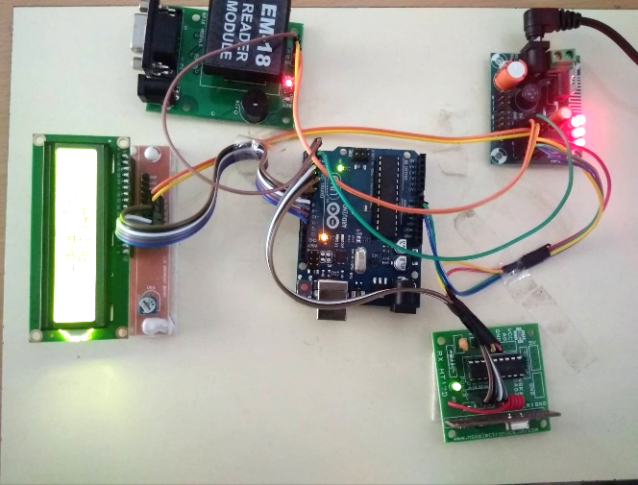
Results (Cont’d)
RFID Reader
Power supply
Arduino UNO
LCD Display
RF Receiver
Parking lot Management System

Slide 18
Conclusion
The prototype of RFID-based Smart parking system is successfully built
The prototype mimics the small smart parking scenario
Finding and allocating the empty slots in parking lot
User is notified about the parked vehicle details via SMS

Slide 19
Future Work
This work can be further carried out by calculating and deducting the charges of the parked vehicles at the exit of the parking lot
Connect all parking areas in a city using a single web server
Promote the use of autonomous, smart and non-polluting vehicles to reduce traffic and pollution.

Slide 20
References
[1] Z. Pala and N. Inanc, “Smart Parking Applications Using RFID Technology,” 2007 1st Annual RFID Eurasia, 2007, pp. 1-3, doi: 10.1109/RFIDEURASIA.2007.4368108
[2] K. Ganesan and K. Vignesh, "Automated parking slot allocation using RFID technology," 2007 9th International Symposium on Signal Processing and Its Applications, 2007, pp. 1-4, doi: 10.1109/ISSPA.2007.4555296
[3] H.Tanti , Pratik Kasodariya , Shikha Patel , Dhaval H Rangrej, 2020, Smart Parking System based on IOT, International Journal Of Engineering Research & Technology (IJERT) Volume 09, Issue 05 (May 2020).
[4] Mazlan, Muhammad & A Hamid, isredza rahmi & Kamaludin, Hazalila. (2018). Radio Frequency Identification (RFID) Based Car Parking System. JOIV : International Journal on Informatics Visualization. 2. 10.30630/joiv.2.4-2.173.
[5] Zala, Yuvraj & Patel, Akash & Makwana, Deval & Botta, Ravi. (2017). Implementation of cost-effective RFID based smart parking management system with enabled GSM feature.(ICCMIT 2017) Warsaw, Poland.

Slide 21
References
[6] Sadhukhan, Pampa. (2017). An IoT-based E-Parking System for Smart Cities. 10.1109/ICACCI.2017.8125982.
[7] Sahil Kalpesh Desai “Smart Car Parking System” International Advanced Research Journal in Science, Engineering and Technology .Vol. 7, Issue 1, January 2020.
[8] L. Kumar, M. H. Khan and M. S. Umar, "Smart parking system using RFID and GSM technology," 2017 International Conference on Multimedia, Signal Processing and Communication Technologies (IMPACT), 2017, pp. 180-184, doi: 10.1109/MSPCT.2017.8364000.
[9] E. h. ROUAN, S. SAFI and A. BOUMEZZOUGH, "An automated parking access control system based on RFID technology," 2020 15th Design & Technology of Integrated Systems in Nanoscale Era (DTIS), 2020, pp. 1-2, doi: 10.1109/DTIS48698.2020.9080913.
[10] Mudaliar, Shruthi & Agali, Shreya & Mudhol, Sujay & Jambotkar, Chaitanya. IoT Based Smart Car Parking System. IJSART - Volume 5 Issue 1 – Jan 2019

Slide 22
THANK YOU

