Slide 1
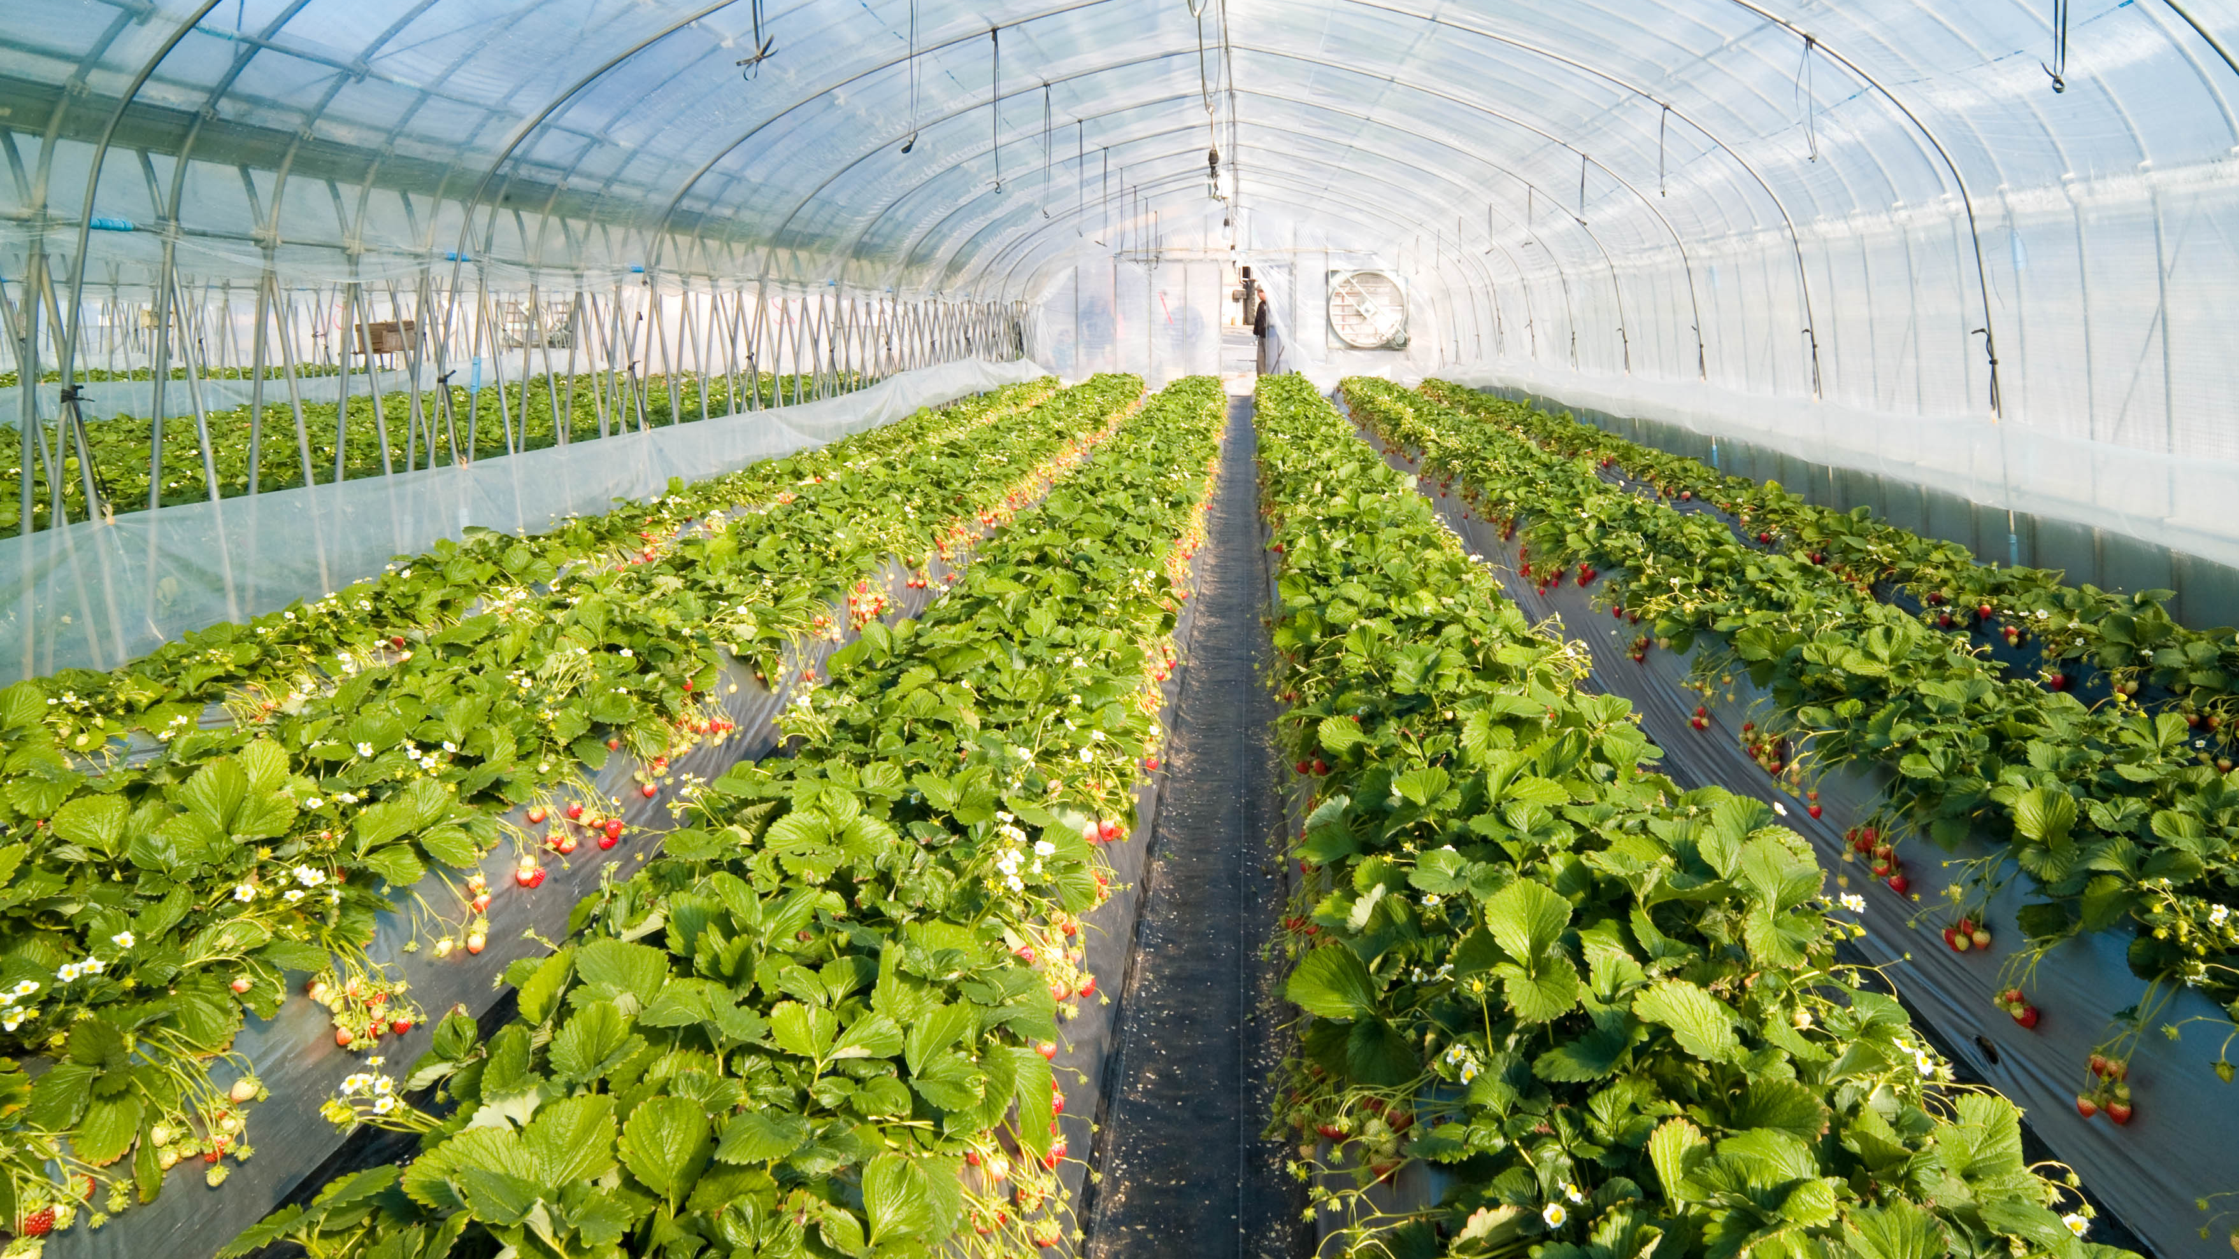
GREENHOUSE AUTOMATION
CHARITHA BV - CB.EN.P2IIS20012
Notes:
We designed this template so that each member of the project team has a set of slides with its own theme. Members, here’s how you add a new slide to just your set:
Mark where you want to add the slide: Select an existing one in the Thumbnails pane, click the New Slide button, then choose a layout. The new slide gets the same theme as the other slides in your set.
Careful! Don’t annoy your fellow presenters by accidentally changing their themes. That can happen if you choose a different theme from the Design tab, which changes all of the slides in the presentation to that look.

Slide 2
EXISTING SYSTEM
Automation is carried out with Monitoring and Controlling Techniques
Unit has an automated system that controls air conditioning, soil conditions and irrigation.
Control Sub sytems are not Integrated.

Slide 3

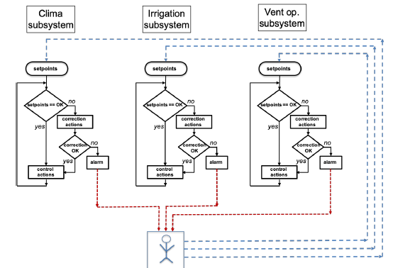
APPLIED TECHNOLOGIES
Precision Agriculture -Automation in Agriculture
Information and Communication Technologies(ICT)
Sub – systems are connected to Artificial Intelligence Platform “Smarter Environments”

Slide 4
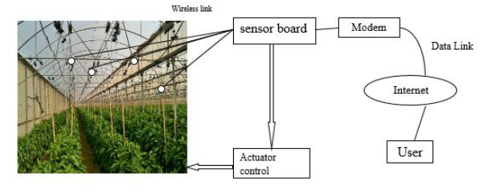
SENSOR NODES
The main objective of the WSN system for greenhouse is to control the climatic conditions
The sensor is designed for collecting information about climate of agriculture greenhouse like temp, pressure, light, humidity, CO2, wind speed and wind direction.

Slide 5
SMART GREENHOUSE REQUIREMENTS
Crop – Sensors with data are considered as inputs
Soil - Soil moisture, disease control should be treated
Climate - Humidity and temperatures
Water and Nutrients - Water Temperature, pH are variables
Energy - Energy consumption and renewable generation
User interfaces
Events detection

Slide 6
SMART GREENHOUSE MODEL
HARDWARE
SOFTWARE
Hardware Platform uses embedded devices to integrate greenhouses automated subsystems (climate, crop irrigation, vent openers and renewable energy generation)
Software platform with artificial intelligence paradigms perform prediction and classification tasks to automate new actions.

Slide 7
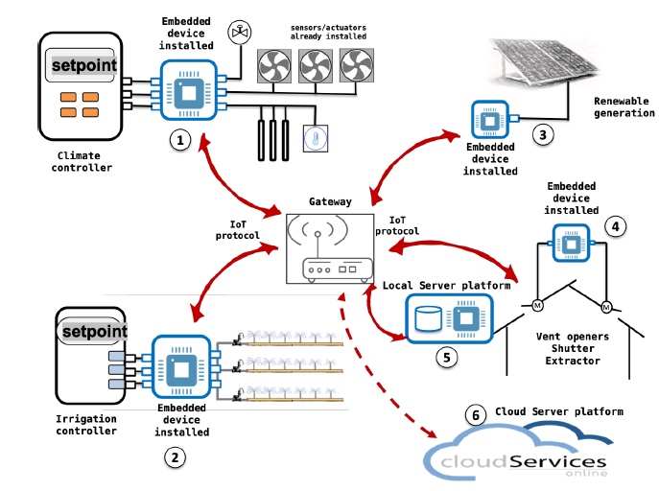
SMART GREENHOUSE DESIGN
Climate Controller
Renewable Energy Generation
Vent Openers Shutter
Cloud Server Platform
Irrigation Controller
Local Server Platform

Slide 8
LEVELS OF SMART GREENHOUSE DESIGN
First level – Formed by control nodes 1,2,3,4
The controllers connect to each other and to the local network, managed by a gateway
Second level – Formed by control Nodes 5 and 6
The controlling nodes communicate with the network management servers using IoT protocols
IoT Communication
Processing Capacity

Slide 9
IOT COMMUNICATION
CC2530 - Processing chip of the wireless sensor nodes
The ZigBee technology is adopted in wireless communication, the gateway uses the processor and Linux operating system as the core.

Slide 10
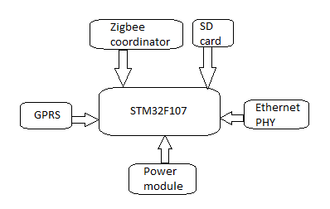
DESIGN OF IOT GATEWAY

Slide 11
AI IN GREENHOUSE AUTOMATION
Algorithms that implement AI models are installed in embedded devices with multi-threaded operating system
The programming language used is Python
The set points are defined in hourly sections depending on the crop and the expected climatic conditions.

Slide 12
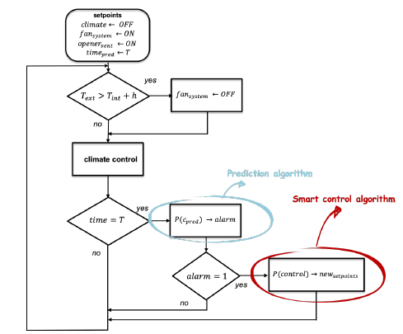
PREDICTION INTEGRATION AND SMART CONTROL
A new prediction algorithm has been developed
The User Centered Design(UCD) method is followed where both the agronomist and the ICT technician participate in this development, services are designed, implemented and validated

Slide 13
RANDOM FOREST REGRESSION
The agronomist schedules the conditions of each of them manually, using a web interface.
The algorithm predicts the expected temperature for every 15 minutes, With this prediction the system can act and make control decisions.
The results of temperature prediction obtained with the model proposed are given by RF (Random Forest) Algorithm.

Slide 14
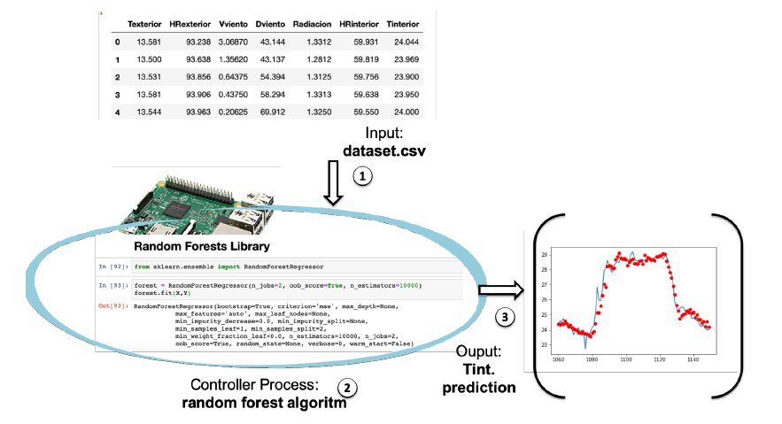
Results of RF Algorithm

Slide 15
CONCLUSION
The current state of the technologies in greenhouse automation is revised
Expert agronomist knows the operation rules, ICT technologies, such as embedded hardware, communication protocols (IoT), algorithm processing with high-level languages (Python) and artificial intelligence models (random forest regression)
“Convert greenhouses into Smart environments”

Slide 16
REFERENCES
Francisco Javier Ferrández-Pastor , Sara Alcañiz-Lucas, Juan Manuel García-Chamizo and Manuel Platero-Horcajadas - Smart Environments Design on Industrial Automated Greenhouses
Ferrández-Pastor, F.J.; García-Chamizo, J.M.; Nieto-Hidalgo, M.; Mora-Martínez, J. Precision Agriculture Design Method Using a Distributed Computing Architecture on Internet of Things Contex. Sensors 2018, 19,603. doi:10.3390/s18061731
Harshada D Thite, S V. Athawale T.E. - An IoT based Greenhouse System using ZigBee Technology

Slide 17
THANK YOU

