Slide 1
THERMAL IMAGING-BASED FAULT DETECTION
IN AN INDUCTION MOTOR
USING MACHINE LEARNING TECHNIQUES
Dissertation 20IS799
17-June-22
Presented By: Charitha BV
CB.EN.P2IIS20012
M.Tech, Industrial Intelligent Systems
Guided By: Dr. T. Ananthan
Assistant Professor
Department of Electrical And Electronics Engineering
Department Of Electrical And Electronics Engineering
Amrita School Of Engineering, Coimbatore

Slide 2
Introduction
Infrared ray is an electromagnetic wave and the range of infrared rays lies between human eyes perception and portions of the microwaves of an electromagnetic spectrum
Infrared Thermography (IRT) is a method of measuring the temperature of an object by detecting the infrared radiations emitted from the object’s surface
In thermal imaging, thermal cameras convert these infrared radiations into the visible Images
Thermal Imaging is used to detect these temperature differences
As components wear away, their resistance increases, causing an increase in heat, and hence faults occur
Forward Looking InfraRed (FLIR) thermal cameras are mostly used for capturing thermal images

Slide 3
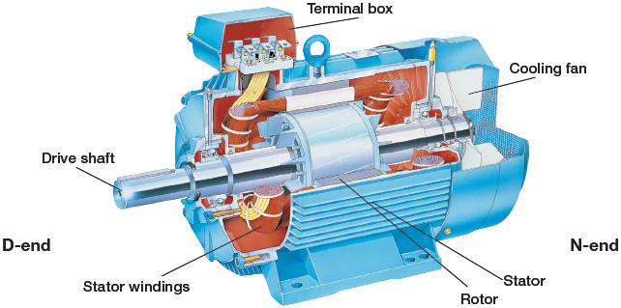
Introduction (Cont’d)
In electrical equipment detecting the external faults is easier, but the internal faults of the equipment depend on the varying temperature
In an induction motor, several faults such as rotor fault, bearing fault, short circuit in stator windings, cooling fan failures, etc. can occur
All these faults can be found accurately with efficient usage of thermal images
This work mainly focuses on internal faults present in an induction motor and detecting the faults using machine learning classifiers
Image Source: Google

Slide 4
Literature review
Authors (Year) | Title of the paper | Key contributions /Inference
W. Yongqing et.al. (2017) | The temperature measurement technology of infrared thermal imaging and its applications review | Analysis of Objects using Infrared thermal thermometer (FLIR-T420) Used in Military medical, electric power, construction, agriculture, Industrial fields for detecting faults
A. Choudhary, et.al. (2018) | Bearing fault diagnosis of induction motor using Thermal imaging | Classification of Images is done using 2D-DWT, Mahalanobis distance and SVM Classifier for fault detection. Used in Three phase Induction Motor
Sambhi, Shilpa. (2018). | Thermal imaging technology for predictive maintenance of electrical installation in Manufacturing plant | Monitoring performance of electrical motor using Predictive Maintenance. Comparing the operating temperature of similar equipment to find out faulty ones
O. Janssens et.al. (2019) | Thermal imaging and vibration-based multi-sensor fault detection for rotating machinery | Two datasets containing vibration measurements and thermal imaging data , faults induced in a rotating setup and ML algorithms are used for preventive maintenance
J. Du et.al. (2019) | Application of infrared thermal imaging technology in fault diagnosis of mine car wheels | Images are Grayscaled and binarized. Region growing algorithm is used. Wheel faults in underground Mine cars

Slide 5
Literature review (Cont’d)
Authors (Year) | Title of the paper | Key contributions /Inference
M. Najafi et.al. (2020) | Fault diagnosis of electrical equipment through thermal imaging and interpretable machine learning applied on a newly-introduced dataset | Datasets consisting of thermal Images of an Induction Motor and Transformer and Classifying images based on hot and cold conditions Segmentation to find ROI and feature extraction and detecting faults using ML algorithms like Adaboost, Random forest and decision tree. Proposed Method gives the accuracy of 93.8%
A. A. Azeez et.al. (2020) | Thermal imaging fault detection for rolling element bearings | Video recording of 10 mins using FLIR thermal Imaging camera, MATLAB. Faults Considered are No fault, Line fault, small circle fault, double line fault and large circle fault in rolling element bearings
A. Choudhary et.al. (2021) | Convolutional neural network based bearing fault diagnosis of rotating machine using thermal images | Comparison based on classification performance using ANN and CNN. Rolling-element bearing in six conditions have been considered (one healthy and five faulty conditions)
A. Glowacz (2021) | Fault diagnosis of electric impact drills using thermal imaging | BCAoID (Binarized Common Areas of Image Differences), KNN, and Backpropagation NN. Fault Diagnosis of healthy Electric Impact Drills, EID with faulty fan EID with the damaged gear train

Slide 6
Literature review (Cont’d)
Authors (Year) | Title of the paper | Key contributions /Inference
A. Mehta et.al. (2021) | Machine learning-based fault diagnosis of self-aligning bearings for rotating machinery using infrared thermography | Comparison of deep learning approaches such as ANN and CNN was discussed Principal Component Analysis (PCA) was used to select the features. Linear Discriminant Analysis (LDA), k-nearest neighbors (KNN), and Support Vector Machines (SVM) were used to categorize the faults
E. Resendiz-Ochoa et.al. (2021) | Broken Rotor Bar Failures Diagnosis with Supervised Learning and Infrared Thermography | Three fault conditions are considered to find rotor bar faults using thermal images. (Half, One, and two) K-nearest neighbors (KNN) was used to detect and classify faults
R. Mehra (2022) | Thermal Imaging-Based Fault Diagnosis of Electronics Circuit Boards | Arduino Uno and Raspberry Pi Principal Component Analysis (PCA) for dimensionality reduction Support vector machine (SVM) for fault detection
T. Mian et.al. (2022) | Multi-Sensor Fault Diagnosis for Misalignment and Unbalance Detection Using Machine Learning | Misalignment and unbalanced detection in rotating machines Naive Bayes (NV), k-Nearest Neighbor (k-NN), and Support Vector Machine (SVM) for detecting faults

Slide 7
Objective
Using thermal imaging, the objective is to detect specific internal faults present in an induction motor by adopting machine learning classifiers

Slide 8
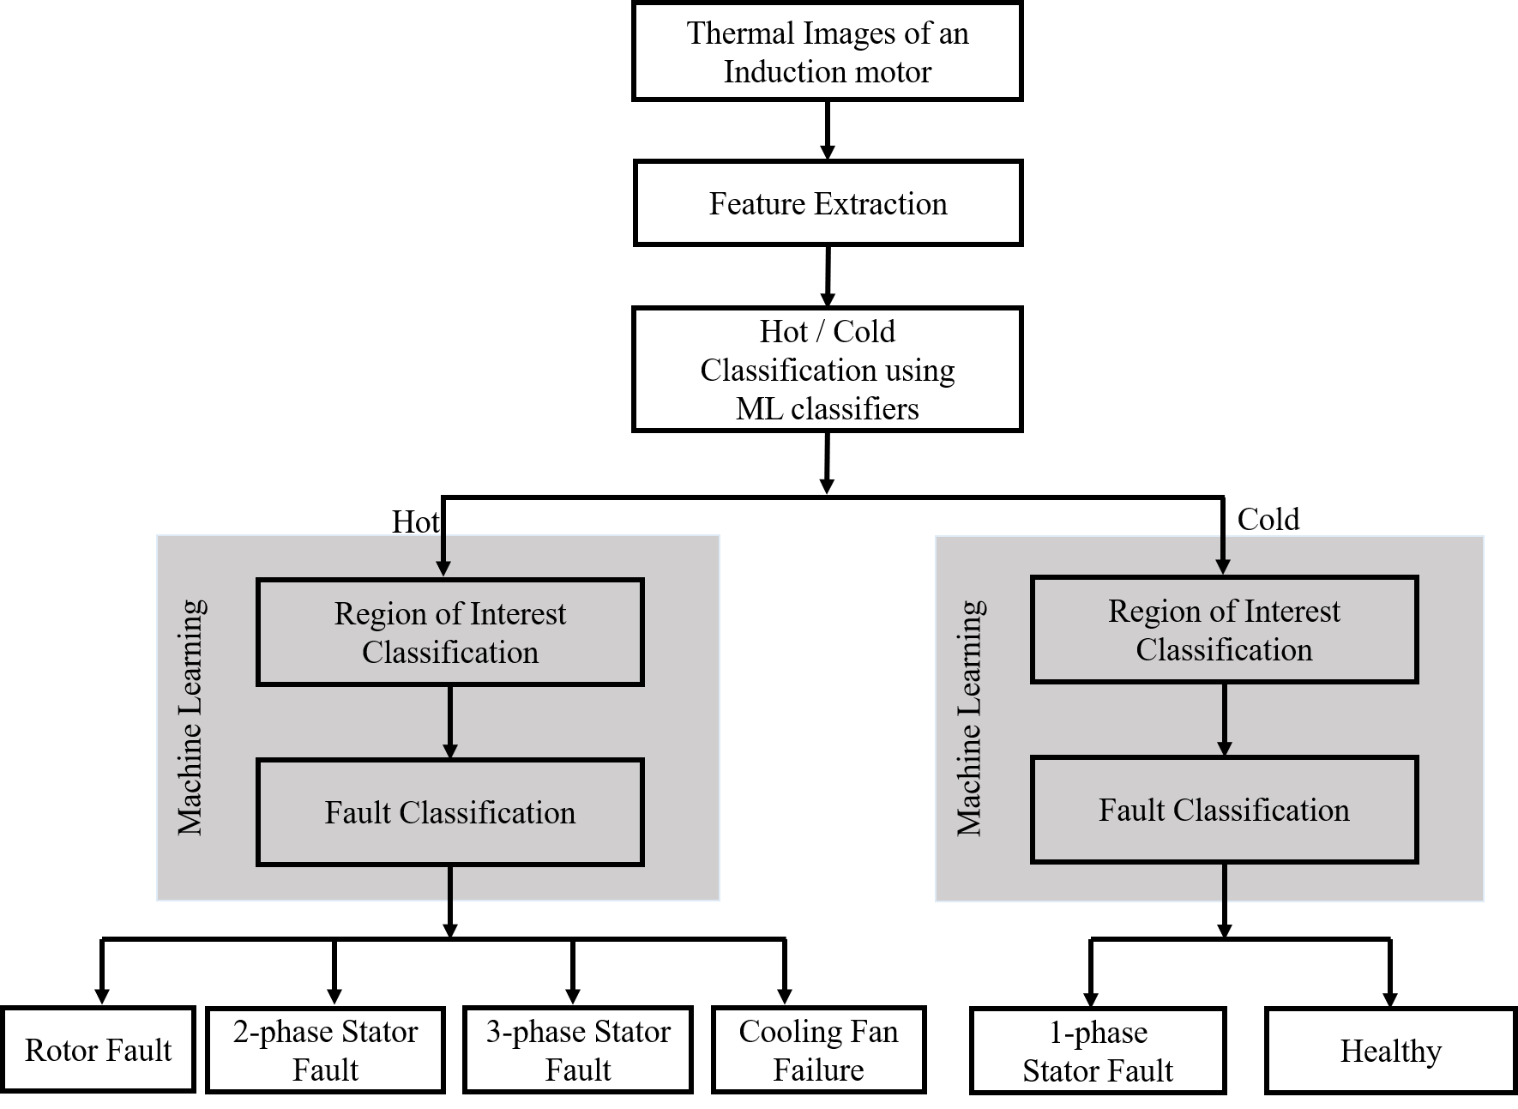
Proposed Methodology

Slide 9
Dataset
The Mendeley dataset [26] is used which comprises infrared thermal images of induction motor.
The thermal images comprise healthy and faulty conditions.
The dataset has a total of 540 thermal images which includes faults in short circuits in stator windings, rotor, cooling fan, and healthy conditions.
The healthy condition is treated as normal and the rest of the cases are treated as faulty
Data Augmentation techniques are used
  Horizontal flipping
  Vertical flipping
Specifications of an induction motor
Phase | 3 Phase
Frequency | 50 Hz
Power | 1.1 KW
Voltage | 220 / 380 V
Input Current | 5 A
Speed | 2800 RPM

Slide 10
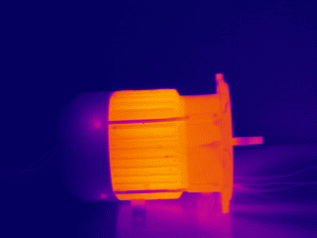
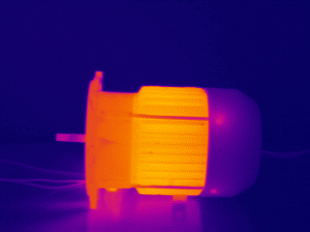
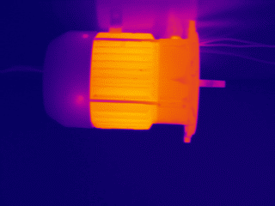
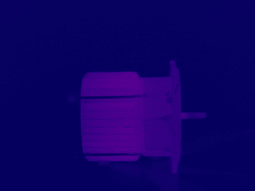
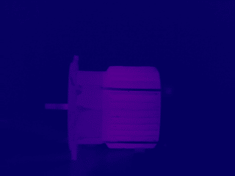
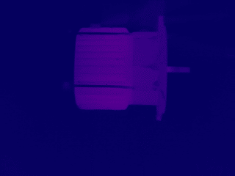
Dataset (Cont’d)
Sample thermal images
Usual
Horizontally Flipped
Vertically Flipped
Hot
Cold

Slide 11
Implementation
Image Details
The thermal Images present in the dataset are 3-D Images
Consists of RGB (Red, Green, Blue) colors
The dimensions of the Images are given by,
(Height * Width * No. of channels) = (240 * 320 * 3)
The datatype of the Images is “uint8”

Slide 12

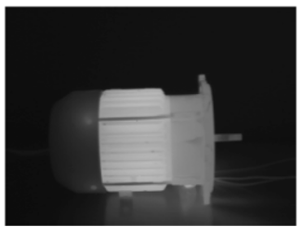
Implementation (Cont’d)
RGB to gray scale images
RGB → Gray Scale Images (3D → 2D)
Conversion to gray scale converts the image into single layer image

Slide 13
Implementation (Cont’d)
Feature Extraction
The histogram or first-order features and textural or second order gray level cooccurrence matrix (GLCM) features are as shown,
Histogram Features | Textural Features
Mean | Dissimilarity
Entropy | Correlation
Skewness | Energy
Gray scale pixel count | Homogeneity
 | Contrast
 | Angular Second Moment (ASM)

Slide 14
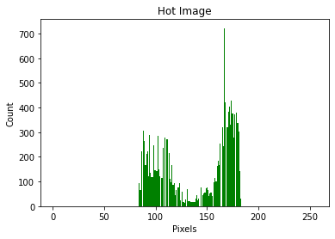
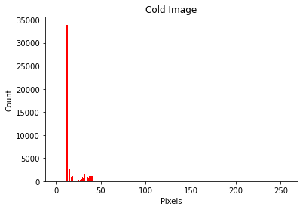
Implementation (Cont’d)
Feature Extraction
Distribution of gray pixels in an image

Slide 15
Implementation (Cont’d)
Machine Learning
Training 70% and Testing 30%
ML Classifiers | Evaluation Metrics
Decision Tree Classifier | Accuracy
Random Forest Classifier | Precision
Ada Boost Classifier | Recall
Gradient Boosting Trees Classifier | F1 Score

Slide 16
Implementation (Cont’d)
Hot or Cold classification
First-order feature extraction is used for hot and cold classification
Hence, gray color pixels are considered to be in the middle of the specified range and are considered as the region of interest
The rest of the pixels are converted to black, i.e. Zero
Here only the pixels of gray color is taken into consideration, which is a non-zero count
Otsu automatic thresholding function is used for optimal threshold value

Slide 17
Implementation (Cont’d)
Hot or Cold classification
The cold class is considered as 0 and the hot class is considered as 1.
 | Hot images | Cold images
Image Count | 360 | 180
Number of classes | 4 | 2
Classification | Multi-classification | Binary classification
Classes | Cooling fan failure | Stator fault (1-Phase)
 | Stator fault (3-Phase)
 | Stator fault (2-Phase) | Healthy
 | Rotor fault
Training (70%) | 252 | 108
Testing (30%) | 126 | 54

Slide 18
Implementation (Cont’d)
ROI Classification – Thresholding Functions
Otsu automatic thresholding function is used for finding ground truth
Distinguish the foreground from the background
Cluster-based image thresholding
ROI Classification – Ground truth
Accurate segmentation or partition of an image
Region of interest is enclosed with a rectangular bounding box based on ground truth

Slide 19
Implementation (Cont’d)
ROI Classification – Sliding Window Technique
The sliding window technique is used to find the region of interest in an image.
It consists of the window size, step size, also known as stride value.
The window size is considered as (9 x 16) and the stride value is chosen as 1
Ground truth is compared to all the obtained images from sliding window from which Region of interest is detected

Slide 20
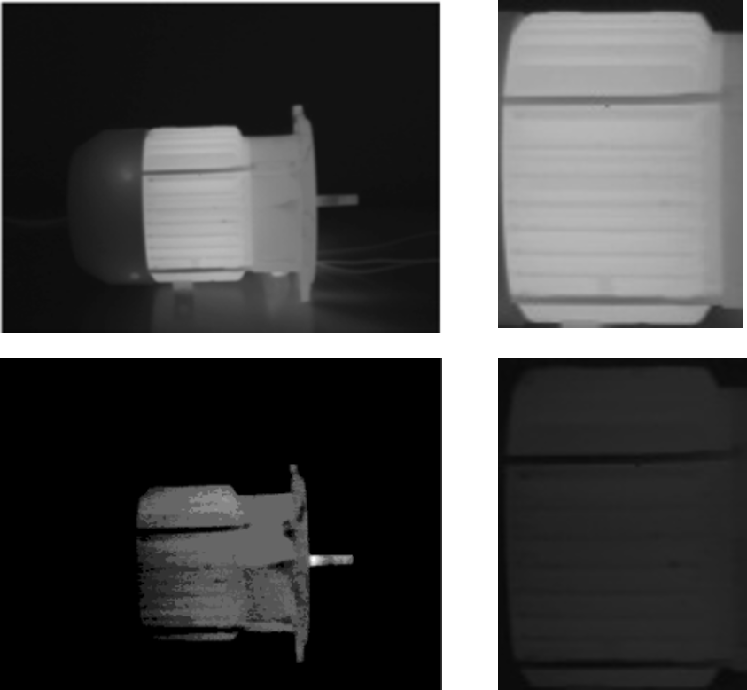
Implementation (Cont’d)
ROI – Hot and Cold Images

Slide 21
Implementation (Cont’d)
Fault Classification
The first and second-order features are extracted from predicted RoI images and faults are classified using previously trained models
Models are used to compare and evaluate the actual and predicted conditions of each image.
The prediction results are used to calculate overall accuracy.

Slide 22
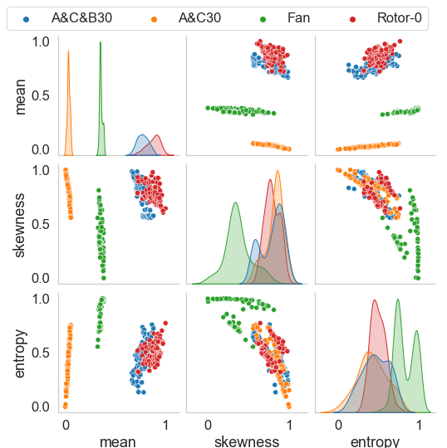
Results
Features of hot images
First-Order / Histogram features
Mean
Skewness
Entropy

Slide 23
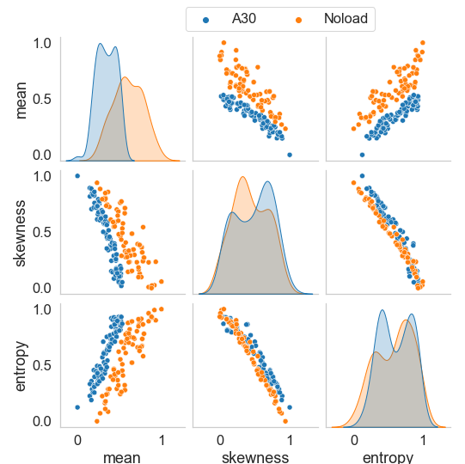
Results (Cont’d)
Features of cold images
First-Order / Histogram features
Mean
Skewness
Entropy

Slide 24
Results (Cont’d)
Hot or cold classification
ML Classifiers | Accuracy in Percentage (%) | F1 Score
Decision Tree Classifier | 100 | 1.00
Random Forest Classifier | 100 | 1.00
Ada Boost Classifier | 100 | 1.00
Gradient Boosting Trees Classifier | 100 | 1.00

Slide 25
Results (Cont’d)
Validation Set
A validation set includes unseen data and used data selected at random
180 hot images and 90 cold images are considered for analysis
Trained classification models are used for final fault detection

Slide 26
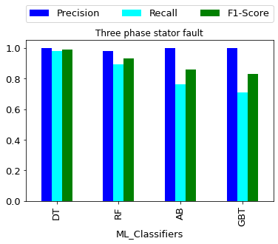
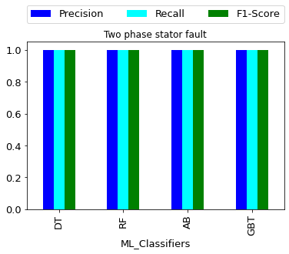
Results (Cont’d)
Evaluation Metrics – Hot

Slide 27
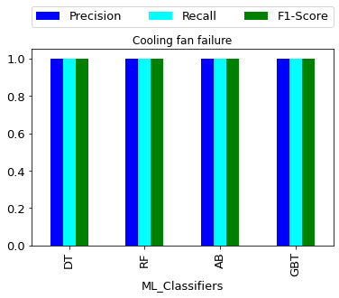
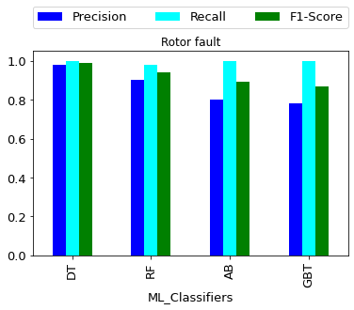
Results (Cont’d)
Evaluation Metrics – Hot

Slide 28
Results (Cont’d)
Evaluation metrics for hot class
ML Classifiers | Accuracy in Percentage (%) | F1 Score
Gradient Boosting Trees Classifier | 92.8 | 0.92
Ada Boost Classifier | 93.8 | 0.93
Decision Tree Classifier | 93.9 | 0.94
Random Forest Classifier | 97.2 | 0.97

Slide 29
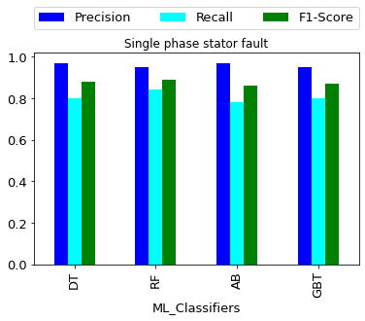
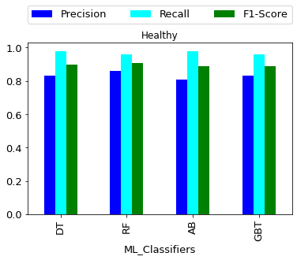
Results (Cont’d)
Evaluation Metrics – Cold

Slide 30
Results (Cont’d)
Evaluation metrics for cold class
ML Classifiers | Accuracy in (%) | Precision | Recall | F1 Score
Ada Boost Classifier | 87.8 | 0.97 | 0.81 | 0.89
Gradient Boosting Trees Classifier | 87.8 | 0.96 | 0.82 | 0.89
Decision Tree Classifier | 88.9 | 0.97 | 0.83 | 0.89
Random Forest Classifier | 90 | 0.96 | 0.86 | 0.90

Slide 31
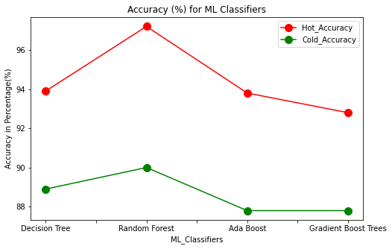
Results (Cont’d)
Overall accuracy for hot and cold classes

Slide 32
Conclusion
The project provides a condition monitoring system for fault detection in induction motor
The main focus is to detect the internal faults present in an induction motor using infrared thermal images
Classification of images into hot and cold helps in locating the specific faults
The region of interest is found accurately using a sliding window technique
Faults are classified with an overall accuracy of 97.2% for hot conditions and 90% for cold conditions

Slide 33
References
[1] | W. Yongqing, G. Zongqing, W. Shuonan, and H. Ping, “The temperature measurement technology of infrared thermal imaging and its applications review,” in 13th IEEE International Conference on Electronic Measurement \& Instruments (ICEMI). IEEE, 2017.
[2] | C. Qingsong, L. Yongxiang, L. Zhixiang, Z. Zhenyu, Z. Shen, and W. Zhiyuan, “Analysis of transformer abnormal heating based on infrared thermal imaging technology,” in 2nd IEEE Conference on Energy Internet and Energy System Integration (EI2). IEEE, 2018.
[3] | M. Bhadane and K. I. Ramachandran, "Bearing fault identification and classification with convolutional neural network," 2017 International Conference on Circuit ,Power and Computing Technologies (ICCPCT), 2017, pp. 1-5, doi: 10.1109/ICCPCT.2017.8074401.
[4] | A. Choudhary, S. Shimi, and A. Akula, “Bearing fault diagnosis of induction motor using thermal imaging,” in International Conference on Computing, Power and Communication Technologies (GUCON). IEEE, 2018.
[5] | S. Sambhi, “Thermal imaging technology for predictive maintenance of electrical installation in manufacturing plant—a literature review,” in 2nd IEEE International Conference on Power Electronics, Intelligent Control and Energy Systems (ICPEICES), 2018.
[6] | O. Janssens, M. Loccufier, and S. Van Hoecke, “Thermal imaging and vibration-based multisensor fault detection for rotating machinery,” IEEE Transactions on Industrial Informatics, vol. 15, no. 1, pp. 434–444, 2018.

Slide 34
References
[7] | R. Misra and A. Agarwal, “Improving motor reliability by thermal imaging,” in International Conference on Sustainable Energy, Electronics, and Computing Systems (SEEMS). IEEE, 2018.
[8] | S. Vigneshkumar, V. K. Shankar, P. N. Krishna and P. Supriya, "Fault Detection in Gearbox Using Motor Electrical Signature Analysis," 2018 9th International Conference on Computing, Communication and Networking Technologies (ICCCNT), 2018, pp. 1-6, doi: 10.1109/ICCCNT.2018.8494153.
[9] | J. Du, K. Chen, Q. Liu, and J. Wang, “Application of infrared thermal imaging technology in fault diagnosis of mine car wheels,” in IEEE 3rd Information Technology, Networking, Electronic and Automation Control Conference (ITNEC). IEEE, 2019.
[10] | R. Andoga, L. Fozo, M. Schrotter, M. Ceskovic, S. Szabo, R. Breda, Robert and M. Schreiner, “Intelligent thermal imaging-based diagnostics of turbojet engines,” Applied Sciences, vol. 9, no. 11, p. 2253, 2019.
[11] | M. Najafi, Y. Baleghi, S. A. Gholamian, and S. M. Mirimani, “Fault diagnosis of electrical equipment through thermal imaging and interpretable machine learning applied on a newly-introduced dataset,” in 2020 6th Iranian Conference on Signal Processing and Intelligent Systems (ICSPIS). IEEE, 2020.
[12] | A. A. Azeez, M. Alkhedher and M. S. Gadala, "Thermal Imaging Fault Detection for Rolling Element Bearings," 2020 Advances in Science and Engineering Technology International Conferences (ASET), 2020, pp. 1-5, doi: 10.1109/ASET48392.2020.9118361.
[13] | A. Choudhary, D. Goyal and S. S. Letha, "Infrared Thermography-Based Fault Diagnosis of Induction Motor Bearings Using Machine Learning," in IEEE Sensors Journal, vol. 21, no. 2, pp. 1727-1734, 15 Jan.15, 2021, doi: 10.1109/JSEN.2020.3015868.

Slide 35
References
[14] | B. Du, Y. He, Y. He, J. Duan and Y. Zhang, "Intelligent Classification of Silicon Photovoltaic Cell Defects Based on Eddy Current Thermography and Convolution Neural Network," in IEEE Transactions on Industrial Informatics, vol. 16, no. 10, pp. 6242-6251, Oct. 2020, doi: 10.1109/TII.2019.2952261.
[15] | A. Mehta, D. Goyal, A. Choudhary, B. Pabla, and S. Belghith, “Machine learning-based fault diagnosis of self-aligning bearings for rotating machinery using infrared thermography,” Mathematical Problems in Engineering, 2021.
[16] | A. Glowacz, “Fault diagnosis of electric impact drills using thermal imaging,” Measurement, vol. 171, p. 108815, 2021.
[17] | A. Choudhary, T. Mian, and S. Fatima, “Convolutional neural network-based bearing fault diagnosis of rotating machine using thermal images,” Measurement, vol. 176, p. 109196, 2021.
[18] | E. Resendiz-Ochoa, J. M. Enriquez-Ugalde, J. J. Saucedo-Dorantes and L. A. Morales-Hernandez, "Broken Rotor Bar Failures Diagnosis with Supervised Learning and Infrared Thermography," 2021 IEEE 13th International Symposium on Diagnostics for Electrical Machines, Power Electronics and Drives (SDEMPED), 2021, pp. 499-504, doi: 10.1109/SDEMPED51010.2021.9605504.
[19] | S. Badoni and R. K. Jarial, "Health Monitoring of three phase induction motor using infrared thermography," 2021 6th International Conference on Communication and Electronics Systems (ICCES), 2021, pp. 156-160, doi: 10.1109/ICCES51350.2021.9489095.
[20] | C. Schuss, K. Remes, K. Leppänen, B. Eichberger and T. Fabritius, "Thermography of Photovoltaic Panels and Defect Detection Under Outdoor Environmental Conditions," 2021 IEEE International Instrumentation and Measurement Technology Conference (I2MTC), 2021, pp. 1-6, doi: 10.1109/I2MTC50364.2021.9460099.

Slide 36
References
[21] | I. T V, S. K, S. Krishna and R. A. A S, "Effect of Co-Occurrence Filtering for Recognizing Abnormality from Breast Thermograms," 2021 Second International Conference on Electronics and Sustainable Communication Systems (ICESC), 2021, pp. 1170-1175, doi: 10.1109/ICESC51422.2021.9532846.
[22] | T. Mian, A. Choudhary and S. Fatima, "Multi-Sensor Fault Diagnosis for Misalignment and Unbalance Detection Using Machine Learning," 2022 IEEE International Conference on Power Electronics, Smart Grid, and Renewable Energy (PESGRE), 2022, pp. 1-6, doi: 10.1109/PESGRE52268.2022.9715938.
[23] | R. Mehra, "Thermal Imaging-Based Fault Diagnosis of Electronics Circuit Boards." Advances in Energy Technology. Springer, Singapore, 2022. 111-121.
[24] | A. I. Alvarado-Hernandez, I. Zamudio-Ramirez, J. A. Antonino-Daviu and R. A. Osornio-Rios, "Infrared thermography image processing for the electromechanical fault detection on the kinematic chain," IECON 2021 – 47th Annual Conference of the IEEE Industrial Electronics Society, 2021, pp. 1-6, doi: 10.1109/IECON48115.2021.9589542.
[25] | Z. Huo, M. Martínez-García, Y. Zhang and L. Shu, "A Multisensor Information Fusion Method for High-Reliability Fault Diagnosis of Rotating Machinery," in IEEE Transactions on Instrumentation and Measurement, vol. 71, pp. 1-12, 2022, Art no. 3500412, doi: 10.1109/TIM.2021.3132051.
[26] | M. Najafi, Y. Baleghi, S. A. Gholamian, and S. M. Mirimani, “Thermal image of equipment, Mendeley Data,” 2021. [Online]. Available:https://data.mendeley.com/datasets/m4sbt8hbvk/2

Slide 37
THANK YOU

