Slide 1



Process Control & Monitoring of Three-Tank System
By
Charitha BV – IIS20012
M.Tech - Industrial Intelligent Systems
Amrita Vishwa Vidyapeetham - Coimbatore

Slide 2
Introduction
The System consists of 3 tanks with non-linear behavior
The dynamics of hybrid systems is described by a mix of continuous and discrete-event variables
The three tank system resembles some of the industrial processes like Waste water treatment, stirred-tank reactor and refineries
The main goal is to provide a continuous water flow in the output pipe of the tank

Slide 3
Purpose of Three-Tank System
Investigation of the dynamic behavior of coupled tanks
Testing and validation of linearization techniques
Linear and nonlinear control strategies
Fault detection and diagnosis algorithms
Fault Isolation Strategies

Slide 4
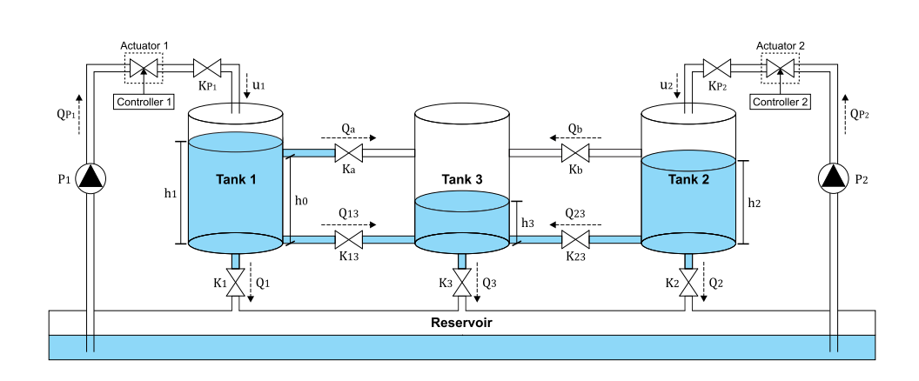
Three-Tank System
Three-tank System

Slide 5
Three-tank System Description
It consists of three cylindrical tanks connected by four pipes which allows the fluid exchange between the lateral tanks (tanks 1 and 2) and the central tank (tank 3)
It consists of 12 sensors – 3 level sensors and 9 flow sensors
The system has two servo-valves as actuators
  The first actuator regulates the input flow to the tank 1
  The second actuator regulates the input flow to the tank 2
The upper pipes and valves that connect the tanks 1 and 2 to the tank 3 are located at the same height h0 and are called transmission pipes and valves;
The lower pipes and valves that connect the tanks 1 and 2 to the tank 3 are aligned with the base of the tanks and are called connection pipes and valves.
At the bottom of each tank are the output pipes and valves
The dashed arrows indicate the reference direction of each flow

Slide 6
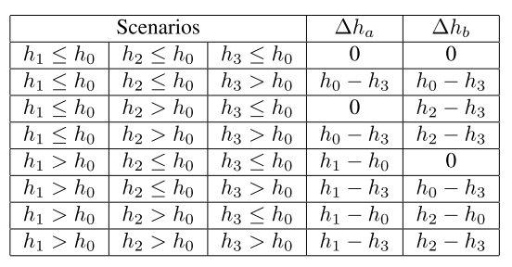
State Equations
The flow rates from the pumps P1 and P2 (i.e., QP1 and QP2) are inputs defined by the user, whereas the flows through the transmission, connection and output pipes can be determined

Slide 7
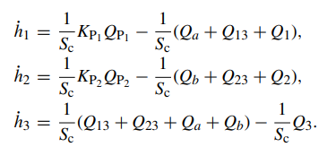
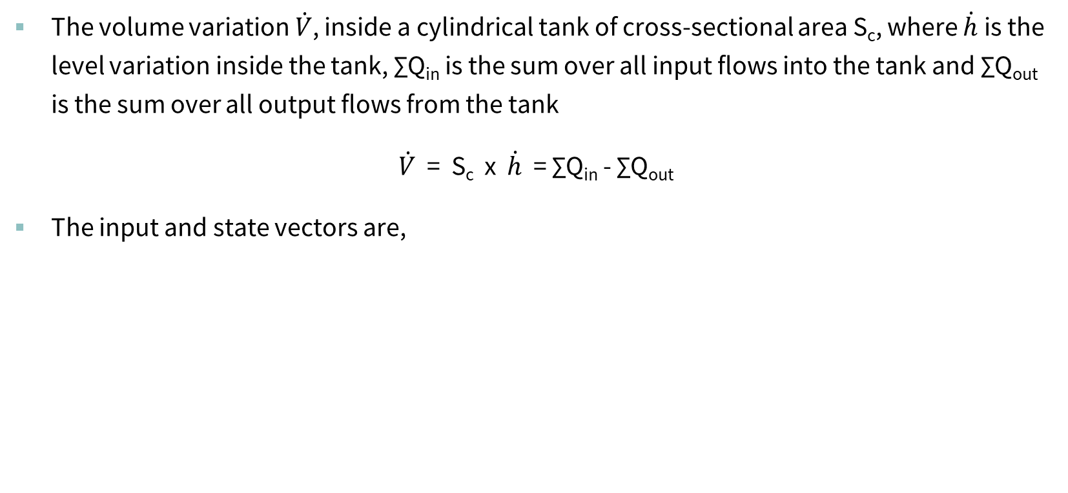
State Equations
The volume variation $\dot{V}$, inside a cylindrical tank of cross-sectional area S_{c}, where $\dot{h}$is the level variation inside the tank, ∑Q_{in} is the sum over all input flows into the tank and ∑Q_{out} is the sum over all output flows from the tank
$\dot{V}$ = S_{c} x $\dot{h}$ = ∑Q_{in} - ∑Q_{out}
The input and state vectors are,

Slide 8
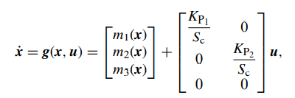
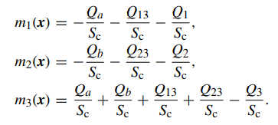
State Equations (cont.)
WW

Slide 9
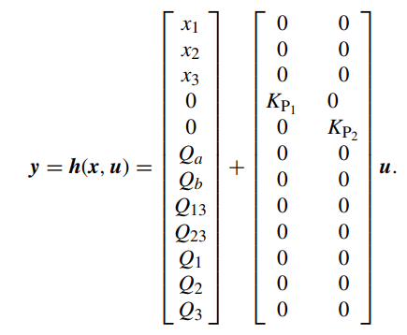
State Equations (cont.)
Output Equation

Slide 10
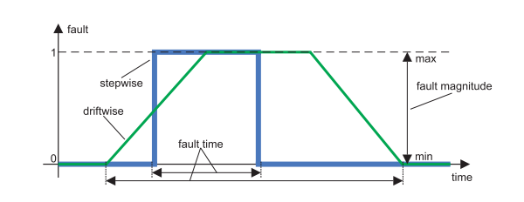
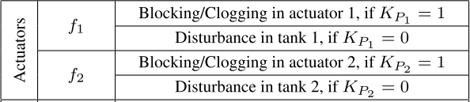
Fault Scenarios
Types of faults in Actuators

Slide 11
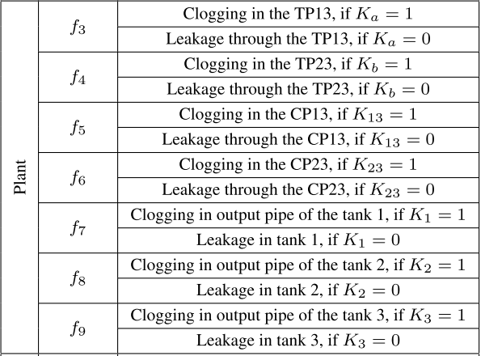
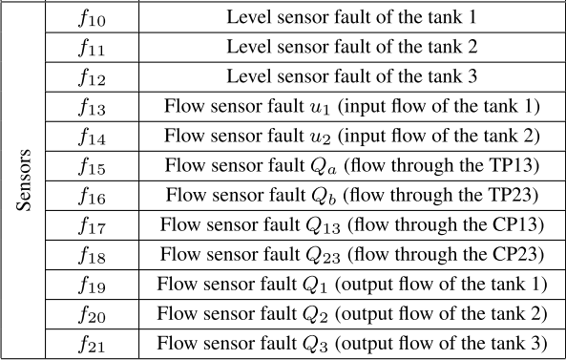
Fault Scenarios (Cont.)
Types of faults in Sensors and plant

Slide 12
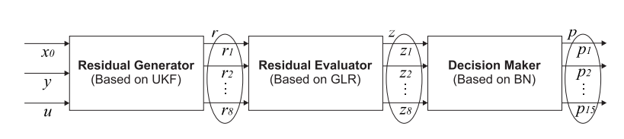
Fault Detection and Isolation
consists of a residual generator based
on unscented Kalman filter (UKF), a residual evaluator based
on generalized likelihood ratio (GLR), and a decision maker
based on Bayesian network (BN)
Architecture of FDI Strategy
The FDI strategy consists of,
A residual generator based on unscented Kalman filter (UKF)
A residual evaluator based on generalized likelihood ratio (GLR)
A decision maker based on Bayesian Network (BN)

Slide 13
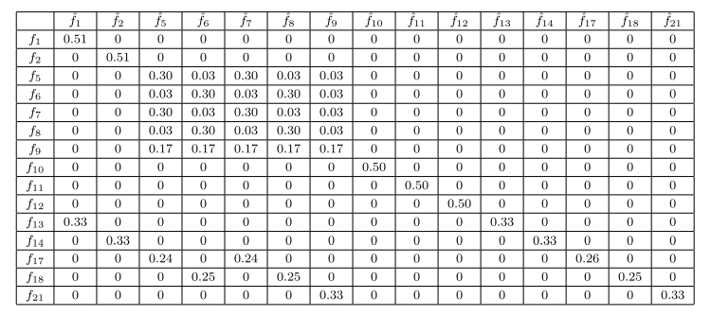
Fault Isolation Strategy
Confusion matrix for step-wise faults

Slide 14
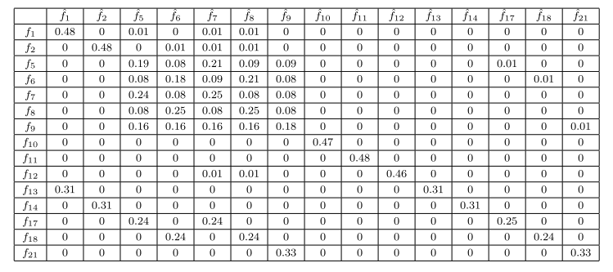
Fault Isolation Strategy
Confusion matrix for drift-wise faults

Slide 15
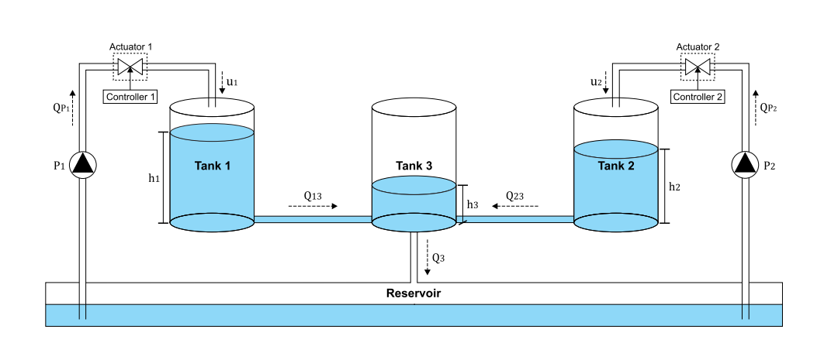
Test Scenario#1
Three-tank System

Slide 16
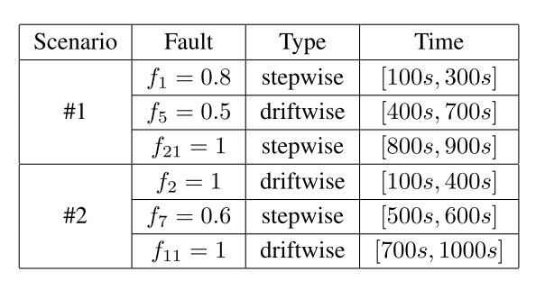
Fault Scenarios
Fault scenarios for the FDI strategy

Slide 17
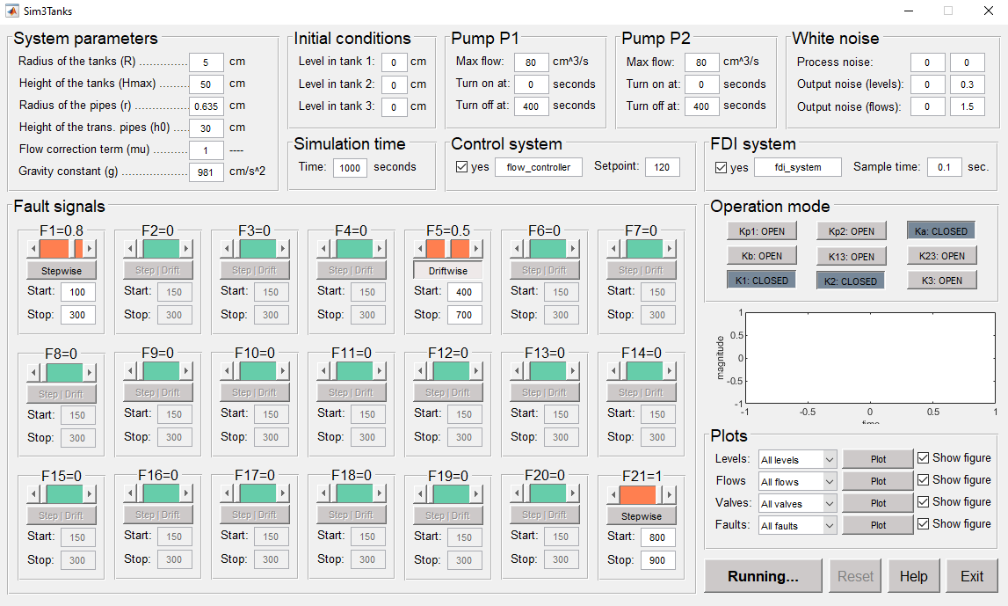
GUI Interface
GUI Interface of Three-tank System

Slide 18
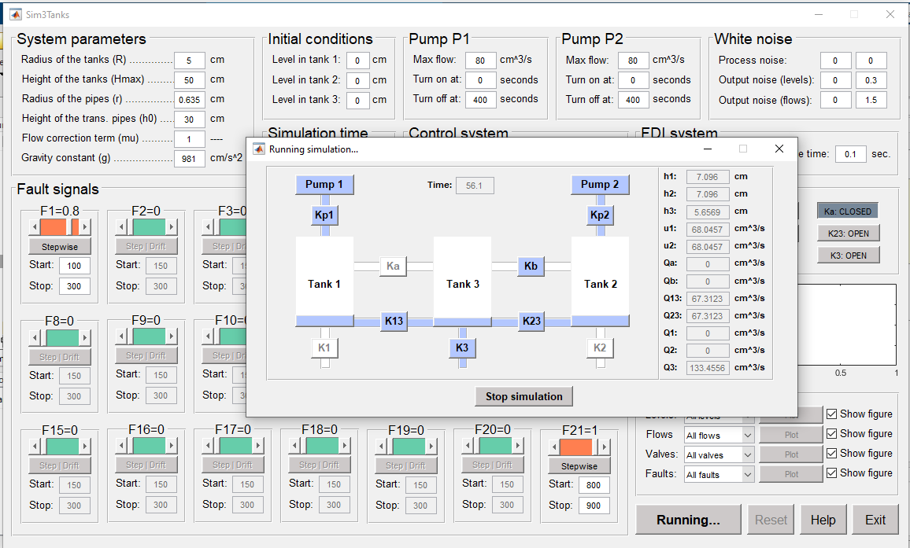
GUI Interface (Cont.)
GUI Interface of Three-tank System

Slide 19
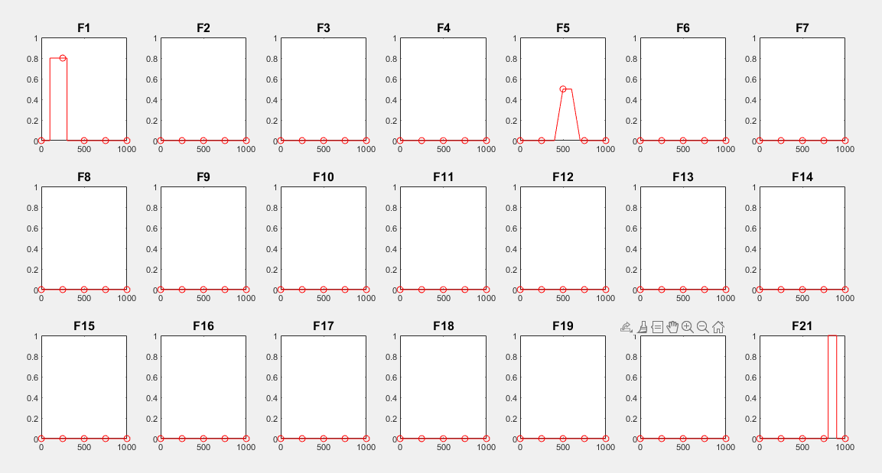
GUI Interface (Cont.)
Faults for scenarios for scenario#1

Slide 20
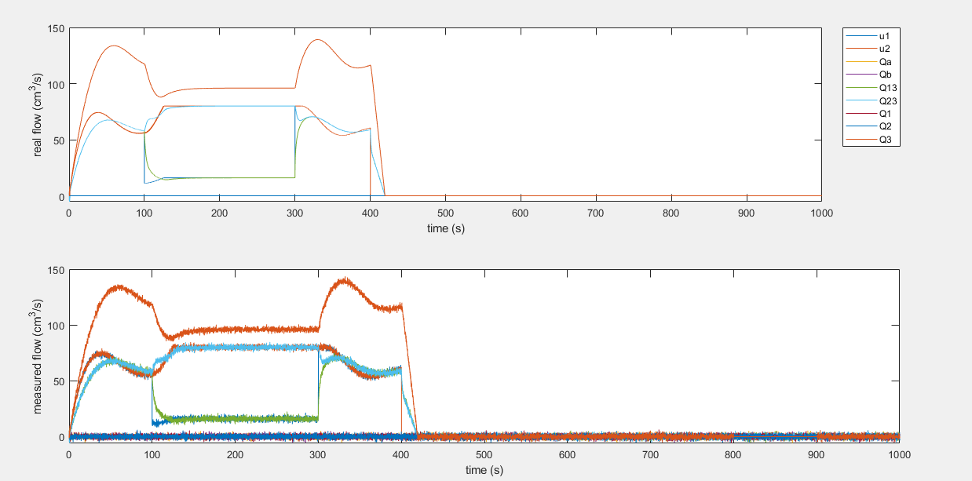
GUI Interface – Results
Fault scenarios of All flows

Slide 21
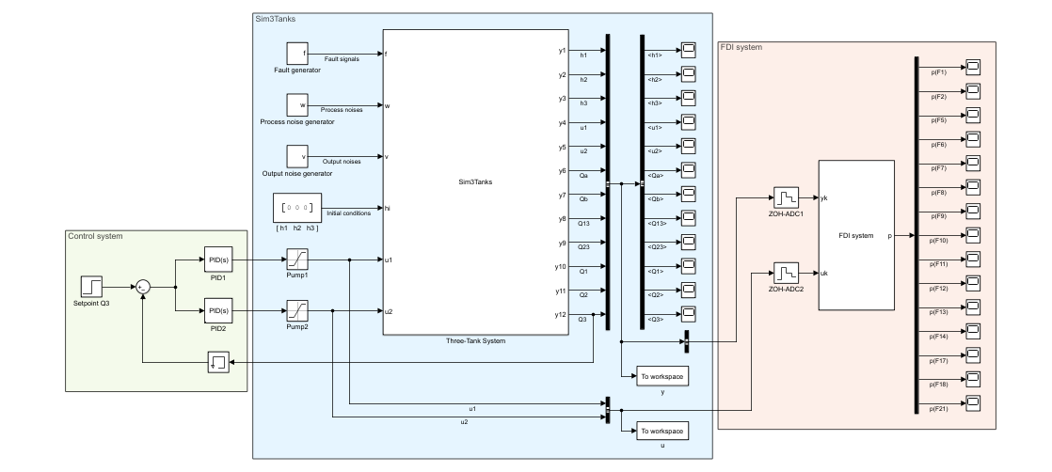
Simulink Model
Simulink model of Three-tank System

Slide 22
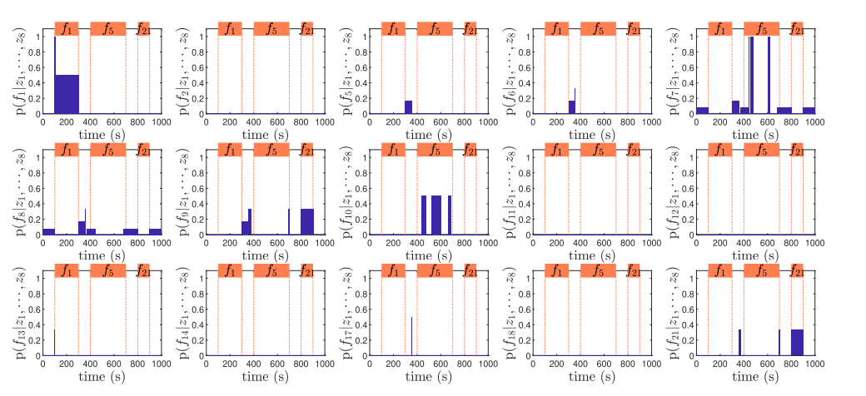
Simulation - Results
Fault probabilities computed by the Bayesian network for the fault scenario #1.
Fault probabilities computed by the Bayesian network for the fault scenario #1

Slide 23
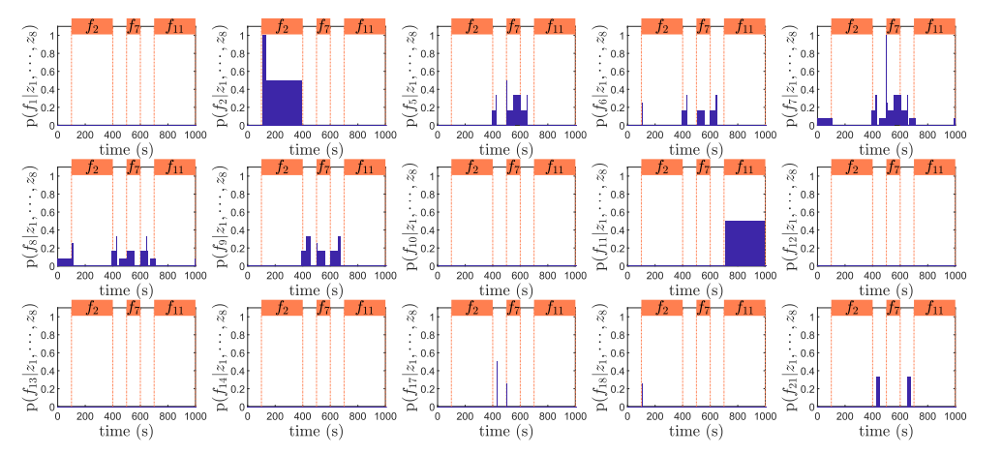
Simulation – Results (Cont.)
Fault probabilities computed by the Bayesian network for the fault scenario #2

Slide 24
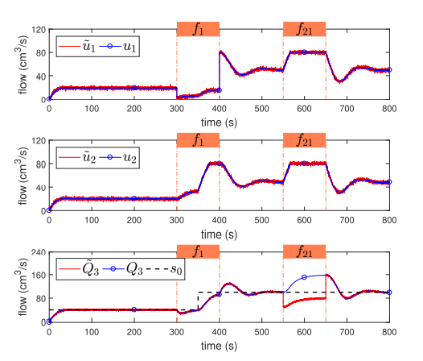
Simulation – Results (Cont.)
FDI Results for Scenario#1

Slide 25
Conclusion
The three-tank system implemented in Hybrid Tank System core presents some challenging dynamic aspects such as nonlinearities, actuator limitations, noises, and hybrid behavior
It is possible to simulate different kinds of faults (e.g., blocking or clogging of valves, leakage in tanks, and malfunction of sensors and pumps), thus allowing the user to evaluate and compare different fault detection and diagnosis and fault isolation strategies

Slide 26
References
[1] A. O. Farias, G. A. C. Queiroz, I. V. Bessa, R. L. P. Medeiros, L. C. Cordeiro and R. M. Palhares, "Sim3Tanks: A Benchmark Model Simulator for Process Control and Monitoring," in IEEE Access, vol. 6, pp. 62234-62254, 2018, doi: 10.1109/ACCESS.2018.2874752.
[2] Cordeiro, Lucas C., et al. “Survey on Automated Symbolic Verification and Its Application for Synthesising Cyber-Physical Systems.” IET Cyber-Physical Systems: Theory & Applications, vol. 5, no. 1, 2020, pp. 1–24.

Slide 27
THANK YOU

