Slide 1
VISTORA
Feature Engineering Using Snowflake and Feature Stores

Slide 2
OBJECTIVE
The objective of this assignment is to design and implement an end-to-end feature engineering pipeline using Snowflake and its Feature Store. The goal is to demonstrate the ability to ingest and clean raw data, engineer meaningful features, register them as reusable Feature Views, generate training datasets with point-in-time correctness, and train a machine learning model within the Snowflake ecosystem. This showcases practical skills in data preparation, feature store integration, and model readiness for real-world AI/ML applications.
PROBLEM STATEMENT
In modern machine learning projects, raw datasets often contain noise, missing values, and unstructured information that cannot be directly used for model training. To build accurate and reliable models, it is essential to transform this raw data into meaningful features through a structured feature engineering process. However, managing features across different teams and models becomes challenging without a centralized system.
A Feature Store addresses this challenge by serving as a centralized repository to register, store, and reuse features with point-in-time correctness. Using Snowflake’s Feature Store provides the added advantage of scalability, governance, and seamless integration with data pipelines, making it possible to automate feature generation, ensure consistency, and accelerate the end-to-end machine learning lifecycle.

Slide 3
Scope of Work
The scope of this assignment is to implement an end-to-end feature engineering and management
pipeline using Snowflake and its Feature Store.
The work covers the following key activities:
Setting up a Snowflake trial account and preparing the working environment.
Ingesting and exploring raw datasets, followed by data cleaning and preprocessing.
Designing and engineering meaningful features using SQL and Snowpark.
Registering entities and Feature Views in Snowflake Feature Store with proper versioning and metadata.
Generating training datasets with point-in-time correctness to ensure model reliability.
Training and evaluating a machine learning model using the engineered features.
Demonstrating feature refresh automation and production readiness through scheduling and governance features.
Preparing professional deliverables including a project report, code repository, presentation slides, and a video walkthrough.

Slide 4
Methodology
The project will be executed in a structured, step-by-step manner to ensure clarity, reproducibility, and professional
presentation.
The methodology followed is outlined below:
Environment Setup: Create a Snowflake trial account, configure the database, schema, and warehouse for project execution.
Data Ingestion: Import datasets either from Snowflake’s sample data or by uploading external files into stages and tables.
Data Cleaning & Preprocessing: Perform exploratory data analysis (EDA) to detect missing values, duplicates, and inconsistencies, followed by data normalization and transformation.
Feature Engineering: Design meaningful features using SQL and Snowpark, including aggregations, rolling statistics, categorical encodings, and interaction variables.
Feature Store Registration: Define entities, register Feature Views in Snowflake Feature Store, and configure refresh frequencies for automated updates.
Dataset Generation: Build training datasets with point-in-time correctness to ensure features align with the target variable during model training.
Model Training & Evaluation: Train a machine learning model within Snowflake, evaluate it using appropriate metrics, and highlight feature importance.
Production Readiness: Demonstrate automated refresh of features, governance, reproducibility, and monitoring through Snowflake’s integrated tools.
Deliverables Preparation: Compile a GitHub repository (code + documentation), presentation slides, and a video walkthrough with a professional explanation.

Slide 5
1. Introduction to Feature Engineering
1.1 Defination and Importance
Feature Engineering is the process of transforming raw data into meaningful inputs (features) that improve the
performance of machine learning (ML) models. It involves creating new variables, modifying existing ones, and selecting
the most relevant attributes so that models can learn patterns more effectively.
In machine learning, the quality of features is often more important than the choice of algorithm. Even advanced models
like neural networks or ensemble methods perform poorly if the input data is noisy, incomplete, or not well-represented.
By contrast, simple models can achieve high accuracy when provided with well-engineered features.
Importance of Feature Engineering in ML:
Improves Model Accuracy: Well-crafted features capture hidden patterns in the data, boosting predictive performance.
Reduces Overfitting: Properly designed features simplify the problem space, preventing models from memorizing noise.
Enables Reusability: Centralized and reusable features (via a Feature Store) allow consistency across multiple models and teams.
Ensures Point-in-Time Correctness: By aligning features with the correct timeline, feature engineering prevents data leakage during training.
Accelerates Development: Automated feature pipelines shorten the time from raw data to deployable models.

Slide 6
1.Introduction to Feature Engineering
1.2 Feature Engineering Techniques
1 Normalization and Standardization
Definition: These techniques adjust numerical values to a common scale without distorting differences between them.
Normalization: Rescales values to a range, typically [0,1]. Example: Transforming transaction amounts into a 0–1 scale to avoid dominance of large values.
Standardization: Rescales data so it has a mean of 0 and a standard deviation of 1. Example: Standardizing customer age values for algorithms like Logistic Regression or SVMs.
2 Encoding Categorical Variables
Label Encoding: Assigns integer values to categories. Example: Device type → {Mobile = 0, Desktop = 1, Tablet = 2}.
One-Hot Encoding: Creates binary columns for each category. Example: Payment method → {Credit Card = [1,0,0], UPI = [0,1,0], Net Banking = [0,0,1]}.
Target Encoding: Replaces categories with aggregated target statistics. Example: Replacing product categories with their average purchase amount.
3 Time-Based Feature Engineering
Lag Features: Previous values of a variable. Example: Number of logins in the past 7 days.
Rolling Statistics: Moving averages, sums, or counts over a time window. Example: Average transaction amount in the last 30 days.
Time-of-Day / Day-of-Week Features: Extracts temporal patterns. Example: Encoding whether a transaction occurred on a weekend vs. weekday

Slide 7
1.Introduction to Feature Engineering
1.2 Feature Engineering Techniques
4 Aggregations and Grouping
Definition: Summarizing data at a group level.
Examples:
Total purchase amount per user in the last month.
Average session duration per device type.
Count of transactions per product category.
5 Handling Missing Values
Imputation: Replacing missing values with mean, median, mode, or domain-specific defaults.
Indicator Variables: Adding a binary flag to indicate whether a value was missing.
6 Transformation and Interaction Features
Log Transformation: Reduces skewness in numerical data.
Polynomial / Interaction Features: Creating new features by combining existing ones. Example: Amount × Discount Rate to capture interaction effects.

Slide 8
2. Using Snowflake for Data Storage & Processing
2.1 How Snowflake is used for storing structured and semi-structured data.
Snowflake is a modern cloud-based data platform designed to store, process, and analyze large volumes of both structured and semi-structured data. It separates storage, compute, and services, allowing flexibility, scalability, and cost efficiency.
1-Storing Structured Data
Snowflake stores structured data (e.g., relational database tables) in a highly optimized columnar format.
Data is automatically compressed and partitioned for fast querying.
Examples : Transaction records , Customer profile ,Product catalogs
Benefits: Efficient storage , Easy indexing , High query performance
2-Storing Semi-Structured Data
Snowflake natively supports semi-structured formats such as JSON, Avro, ORC, Parquet, and XML.
These files can be ingested directly into snowflake tables using the VARIANT data type , which allows flexible schema –on-read
Querying semi structured data is done using built in functions like :key accessors or FLATTEN()
Example: Storing clickstream logs, IoT sensor data, or API responses in JSON format.

Slide 9
2. Using Snowflake for Data Storage & Processing
2.1 How Snowflake is used for storing structured and semi-structured data.
3 -Data Processing with Snowflake
SQL Processing: Analysts and engineers can use standard SQL for querying, aggregations, and transformations.
Snowpark: Developers can process data using Python, Java, or Scala directly inside Snowflake without moving data out.
Scalability: Snowflake’s compute clusters (called Virtual Warehouses) can scale up or down based on workload.
Semi-Structured Handling: Nested JSON or Parquet data can be parsed, filtered, and joined with structured tables seamlessly.
Automation: Tasks, Streams, and Dynamic Tables allow automated ETL/ELT workflows and incremental data processing.
4 -Advantages for ML Feature Engineering
Centralized storage for both structured (transactions, users) and semi-structured (logs, events) data.
Supports large-scale joins and aggregations required in feature engineering.
Ensures governance, security, and reproducibility through built-in RBAC and metadata management.

Slide 10
2. Using Snowflake for Data Storage & Processing
2.2- Example SQL Queries for Extraction & Preprocessing
Extract raw data:
SELECT customer_id,
product_category,
purchase_amount,
purchase_date
FROM sales_data
WHERE purchase_date >= '2025-01-01’;
2. Aggregation features per customer:
SELECT customer_id,
COUNT(*) AS total_purchases,
AVG(purchase_amount) AS avg_purchase_amount
FROM sales_data
WHERE purchase_date >= '2025-01-01’
GROUP BY customer_id;

Slide 11
3. Time-based feature engineering:
SELECT customer_id,
COUNT(*) AS purchases_last_7_days,
MAX(purchase_date) AS last_purchase_date
FROM sales_data
WHERE purchase_date >= DATEADD(day, -7, CURRENT_DATE)
GROUP BY customer_id;
4. Encoding categorical features (example using CASE statement):
SELECT customer_id,
CASE
WHEN product_category = 'Electronics' THEN 1
WHEN product_category = 'Clothing' THEN 2
WHEN product_category = 'Books' THEN 3
ELSE 0
END AS product_category_encoded
FROM sales_data;

Slide 12
2. Using Snowflake for Data Storage & Processing
2.3 -Integration of Snowflake with ML Pipelines
Snowflake seamlessly integrates with machine learning pipelines, enabling data engineers and data scientists to extract, transform, and serve features efficiently for model training and inference.
Key Integration Points:
Direct Feature Access: Snowflake allows ML models to access structured and semi-structured data directly through SQL queries, eliminating the need for separate ETL pipelines.
Integration with ML Platforms: Snowflake can connect to external ML platforms such as Databricks, AWS SageMaker, and Azure ML. Data can be exported or streamed from Snowflake into these platforms for model training.
Snowpark for In-Database ML: Snowpark enables developers to run Python, Java, or Scala code directly inside Snowflake. This allows feature engineering and even simple model training without moving data out of Snowflake, reducing latency and improving data security.
Batch & Real-Time Pipelines: Snowflake supports both batch and streaming data pipelines. Features can be precomputed in batches or updated in real time, enabling real-time ML predictions.
Consistency for Training & Inference: By serving features directly from Snowflake (or Snowflake Feature Store), models can access the same features during training and inference, ensuring consistency and reducing errors due to feature drift.

Slide 13
3. Feature Store Concepts
3.1 What is a Feature Store and Why is it Needed?
A Feature Store is a centralized repository that stores curated, preprocessed features for machine learning models. It acts as a single source of truth, allowing data scientists and ML engineers to consistently access features for both training and inference.
Why it is Needed:
1.Consistency Across Pipelines: Ensures that the same features used during model training are available during inference, reducing errors due to mismatched or stale data.
2.Reusability of Features: Features created once can be reused across multiple models and projects, saving time and effort in feature engineering.
3.Real-Time & Batch Feature Serving: Supports both batch and online pipelines, allowing ML models to access precomputed features for real-time predictions.
4.Governance and Documentation: Provides a structured way to store, document, and manage features, improving collaboration between teams and ensuring quality.
5.Simplified ML Workflow: Reduces duplication of work and makes the end-to-end ML pipeline more efficient by decoupling feature engineering from model training.

Slide 14
3.2 Comparison of Different Feature Stores
Feature Store | Key Features & Strengths | Limitations / Considerations
AWS SageMaker Feature Store | - Fully managed, scalable, and secure- Supports both online (real-time) and offline (batch) feature retrieval- Tight integration with SageMaker ML pipelines | - Limited to AWS ecosystem- Cost can increase with large-scale usage
Snowflake Feature Store | - Integrated with Snowflake SQL and Snowpark- Leverages Snowflake’s cloud data warehouse capabilities- Supports batch and streaming pipelines | - Limited native ML-specific tools- Real-time feature updates may require additional setup
Databricks Feature Store | - Strong integration with ML workflows in Databricks- Supports both batch and real-time feature serving- Feature versioning and lineage tracking | - Requires Databricks platform subscription- May have a steeper learning curve for new users

Slide 15
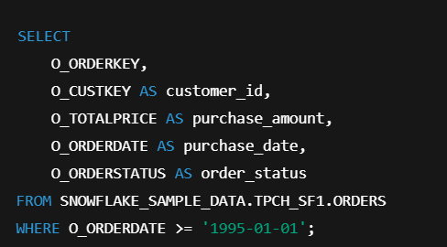
4. Implementing Feature Engineering with Snowflake & Feature Store
4.1 Extract: Use Snowflake SQL to fetch raw data.
The first step in feature engineering is to extract relevant raw data from Snowflake.
This step ensures that only the necessary data is retrieved, reducing processing time and improving efficiency.
Typical actions during extraction:
Selecting key columns needed for feature creation (e.g., customer ID, purchase amount, order date).
Filtering data based on relevant time periods or conditions.
Ensuring data quality by removing duplicates or irrelevant records.
Purpose:
To provide a clean, structured dataset ready for transformation.
High-quality extraction is critical because the features created later depend directly on the raw data.
Example:

Slide 16
4.2 Transform: Perform feature engineering (aggregations, encoding, etc.).
Explanation:
Transformation is the core of feature engineering, where raw data is converted into meaningful features that improve ML model performance.
This step involves aggregating, encoding, and deriving new features to capture patterns, trends, and behaviors in the data.
Common Transformations:
Aggregations:
Calculate metrics such as total purchases, total orders, and average order amount per customer.
Helps summarize raw transactional data into compact, informative features.
Recency / Date Features:
Derive features like the last order date or days since last order.
Captures how recently a customer interacted, which is important for predictive modeling.
Rolling Window Features:
Count orders in the last 30 days or last 7 days.
Captures recent trends in customer behavior.
Encoding / Flags:
Create binary flags such as active in last 7 days.
Convert categorical or boolean information into a format suitable for ML models.

Slide 17
Example:
SELECT
O_CUSTKEY AS customer_id,
COUNT(*) AS total_orders,
SUM(O_TOTALPRICE) AS total_spent,
AVG(O_TOTALPRICE) AS avg_order_amount,
MAX(O_ORDERDATE) AS last_order_date,
DATEDIFF(day, MAX(O_ORDERDATE), CURRENT_DATE) AS days_since_last_order,
SUM(CASE WHEN O_ORDERDATE >= DATEADD(day, -30, CURRENT_DATE) THEN 1 ELSE 0 END) AS orders_last_30_days,
CASE WHEN MAX(O_ORDERDATE) >= DATEADD(day, -7, CURRENT_DATE) THEN 1 ELSE 0 END AS active_last_7_days
FROM SNOWFLAKE_SAMPLE_DATA.TPCH_SF1.ORDERS
GROUP BY O_CUSTKEY;

Slide 18
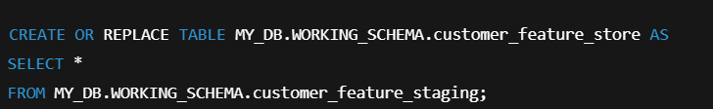
4.3 Load into Feature Store: Explain how features can be stored in a Feature Store
Explanation:
After feature transformation, the next step is to store the engineered features in a centralized Feature Store.
A Feature Store acts as a single source of truth for all features, making them accessible, consistent, and reusable for multiple ML models.
Key Actions in this Step:
Create a Database and Schema:
Organize the feature store in a dedicated database and schema within Snowflake.
Create Feature Store Table:
Store all transformed features in a structured table.
This table can include aggregates, recency metrics, rolling window features, and flags.
Ensure Reusability and Consistency:
Features in the store are versioned and documented, allowing ML models to reuse them without recalculation.
Maintains consistency between training and inference pipelines.

Slide 19
4.4 Access for ML: Retrieving Features from the Feature Store
Explanation:
Once features are stored in the feature store, ML models need to access them for training and inference.
The feature store ensures that the features are consistent, reusable, and up-to-date.
Key Methods of Access:
Batch Training:
Features are joined with labels to create a training dataset within Snowflake.
Allows models to train efficiently without recalculating features.
Real-Time / On-Demand Access:
Features can be fetched for individual records or small batches.
Supports real-time prediction pipelines.
Integration with ML Pipelines:
Snowflake connectors (Python, Spark, etc.) enable smooth feature retrieval in ML environments.
Ensures reproducibility, i.e., the same features are used during training and inference.
Why it matters for ML:
Prevents re-computation of feature logic.
Maintains consistency and reproducibility for all ML workflows.
Enhances pipeline efficiency, supporting large-scale ML operations.

Slide 20
Example:
import snowflake.connector
import pandas as pd
conn = snowflake.connector.connect(
user='YOUR_USERNAME',
password='YOUR_PASSWORD',
account='YOUR_ACCOUNT'
)
query = "SELECT * FROM MY_DB.WORKING_SCHEMA.customer_feature_store WHERE customer_id = 1001"
df_features = pd.read_sql(query, conn)
print(df_features)

Slide 21
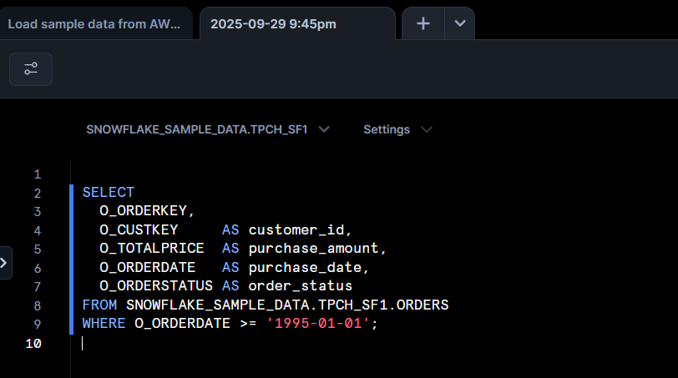
5. Implementing Feature Engineering with Snowflake & Feature Store
5.1 Extract: Use Snowflake SQL to fetch raw data . Query->

Slide 22
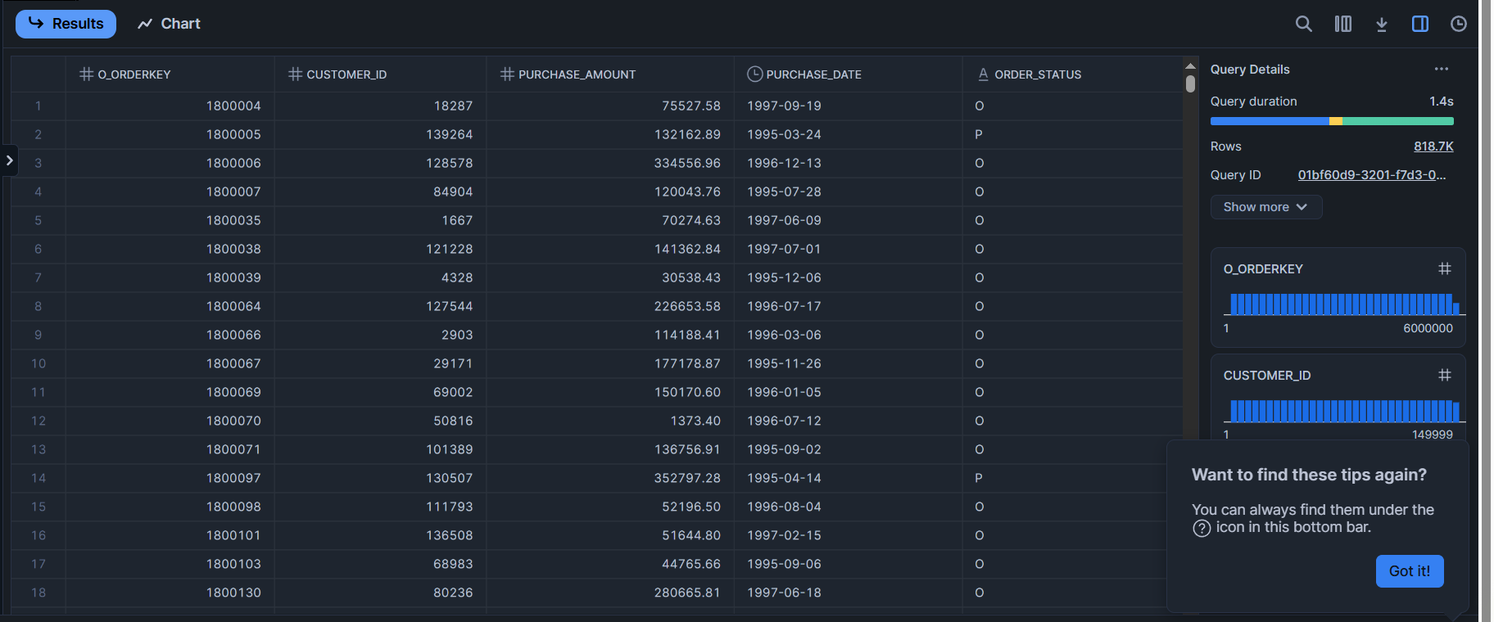
5.1 Result->

Slide 23
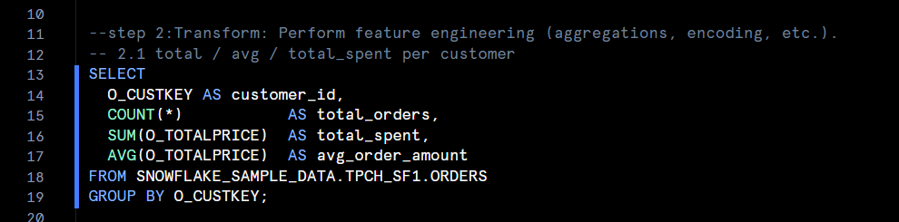
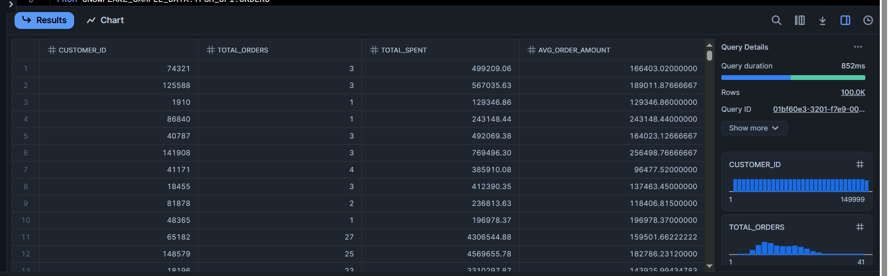
5.2 Transform: Perform feature engineering (aggregations, encoding, etc.).
5.2.1 Aggregates per customer ->Query
Result->

Slide 24
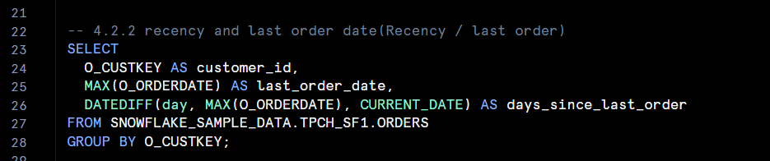
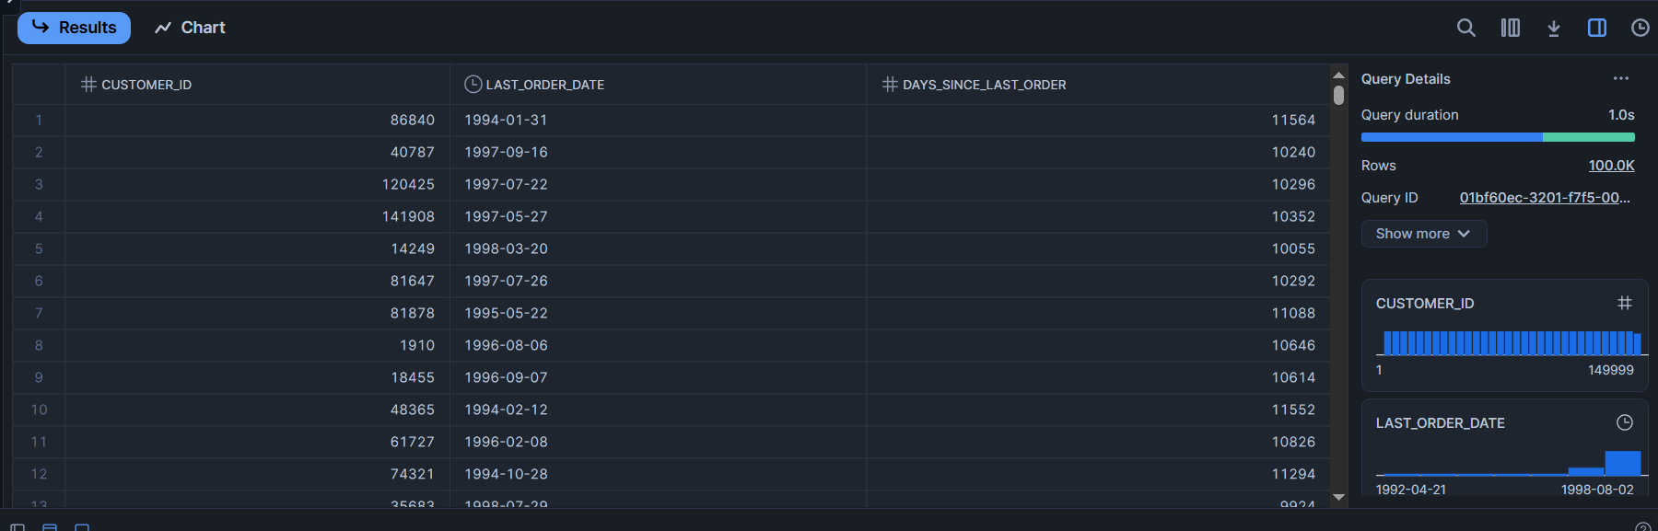
5.2.2- Recency / last order
Query->
Result->

Slide 25
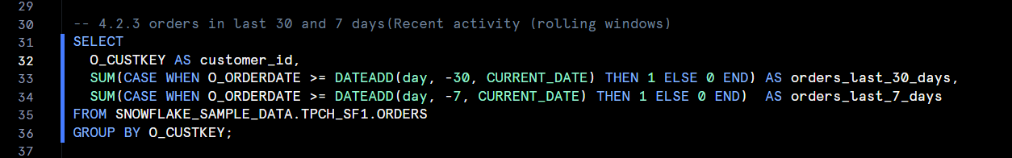
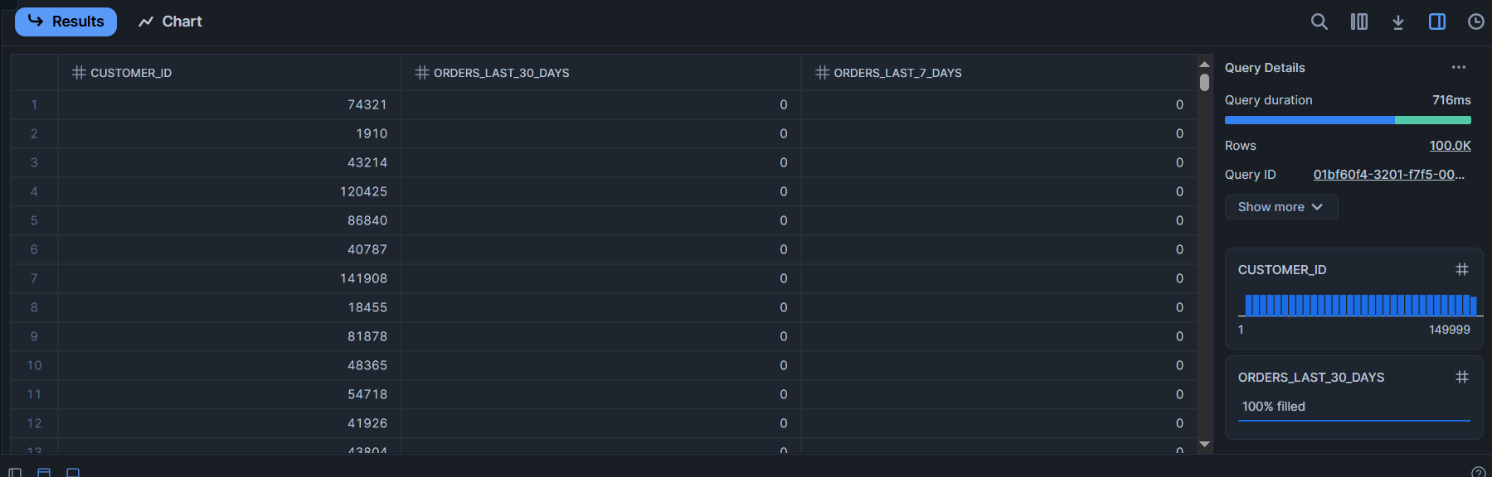
5.2.3 Recent activity (rolling windows)
Query->
Result->

Slide 26
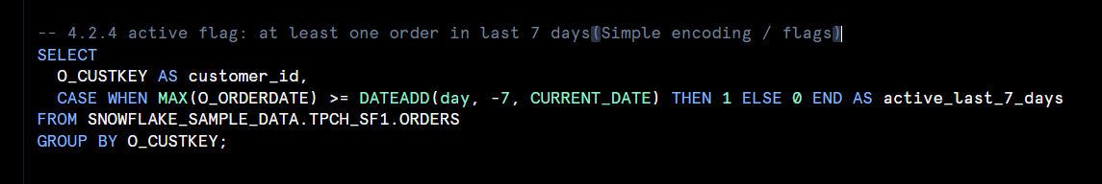
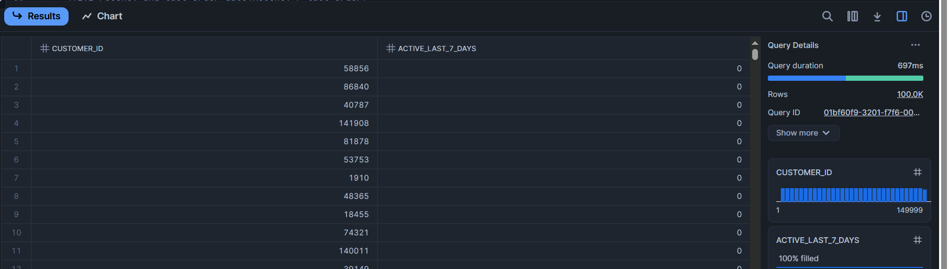
5.2.4 Simple encoding / flags
Query->
Result->

Slide 27
Objective: After performing feature engineering (aggregations, encoding, recency, etc.), the next step is to store the transformed features in a centralized table. This table acts as a feature store, which allows machine learning models to efficiently retrieve cleaned and preprocessed features without repeating computations.
Explanation:
->We first create a personal database (MY_DB) and a schema (WORKING_SCHEMA) to store our features. ->Using the CREATE OR REPLACE TABLE statement, we consolidate all transformed features (total orders, total spent, average order value, recency, rolling window activity, and active flags) into a single feature store table named customer_feature_store. ->This approach ensures that all features are centralized, consistent, and easily accessible for downstream ML pipelines. ->Storing features in a feature store avoids duplicate computations, improves reproducibility, and allows scalable access by multiple models or analysts.
5.3 LOAD into Feature Store — how to store engineered features

Slide 28
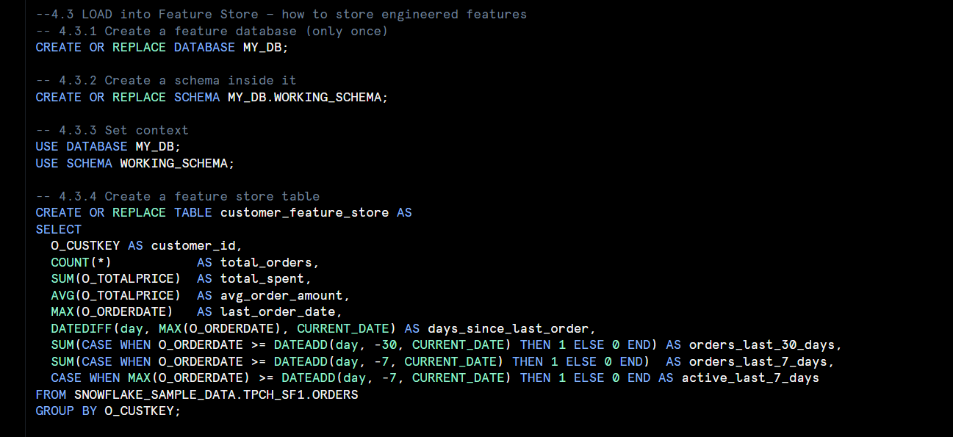
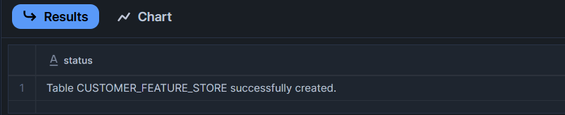
Query->
Result->

Slide 29
5.4 Access for ML: How can ML models retrieve features from the store?
Objective:
Once features are stored in a centralized feature store, machine learning models need to retrieve these features efficiently for training and inference. The goal is to ensure that models always use consistent, preprocessed, and up-to-date data.
Explanation:
The feature store acts as a single source of truth containing all engineered features.
ML pipelines can query this store directly using SQL (if using Snowflake for model training) or connect via Snowflake connectors from Python, Spark, or other ML environments.
This allows models to:
Fetch features on-demand for specific customers or time periods.
Avoid re-computation of the same feature logic.
Maintain reproducibility, ensuring training and inference use identical feature definitions.

Slide 30
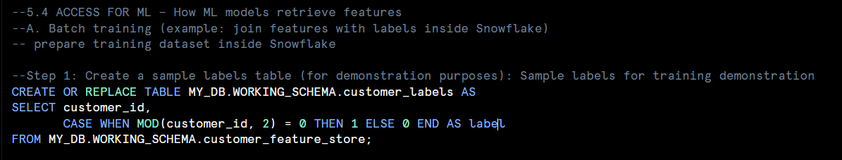
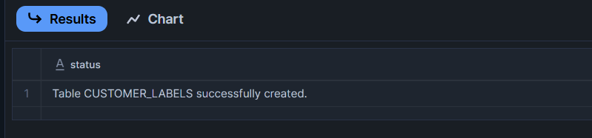
Two common use cases: (A) Batch training and (B) Online inference
A. Batch training (example: join features with labels inside Snowflake)

Slide 31
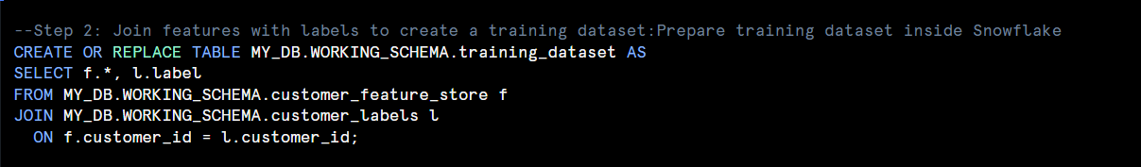
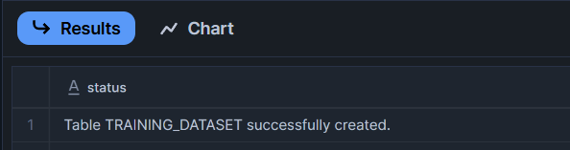

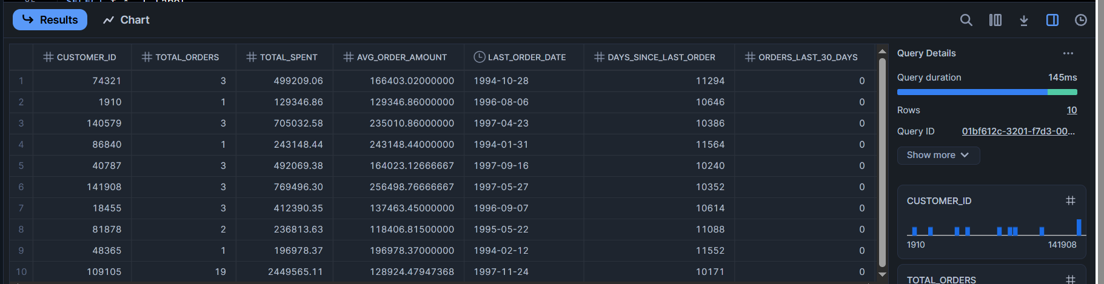

Slide 32
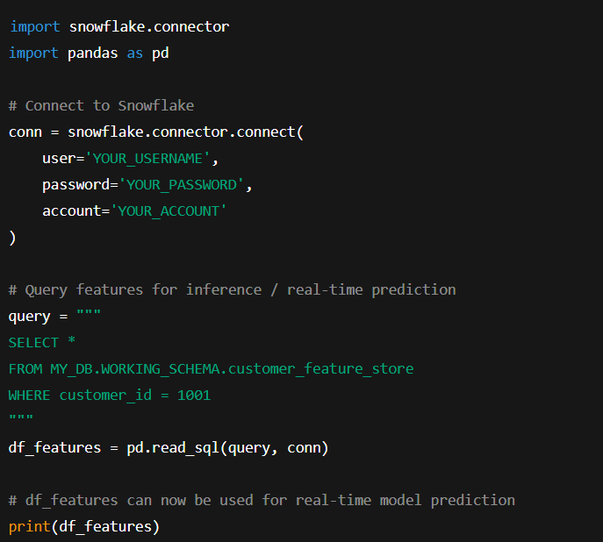
B. Real-Time Feature Access Example
Using Python Snowflake Connector:

