Slide 1

Small. Fast. Reliable. Choose any three
Keerthi Kumar
kk.creare@gmail.com

Slide 2
SQLite - Introduction
SQLite is a software library.
It is:
self-contained + Serverless + zero-configuration
transactional = SQL database engine.
Most widely deployed.
The source code(written in ANSI C) is in the public domain.

Slide 3





SQLite - Consortium

Slide 4
SQLite - Introduction
Self-contained:
Minimal support from external libraries or OS.
It makes minimal use of the standard C library.
Useful for embedded devices.
Serverless:
Process that access the database reads and writes directly from the database files on disk.

Slide 5
SQLite - Introduction
Zero-configuration:
No separate server process to install, setup, configure, initialize, manage, and troubleshoot.
Transactional:
All changes within a single transaction in SQLite either occur completely or not at all(ACID).

Slide 6
SQLite - Introduction
SQLite version 3.7.8 is less than 350KiB in size on x86 and less than 400KiB on x64.
SQLite uses dynamic typing i.e. the data type of a value is associated with the value itself, not with its container.
Is a popular choice as an Application File Format. i.e. no more fopen().

Slide 7
SQLite vs SQL
RIGHT and FULL OUTER JOIN | LEFT OUTER JOIN is implemented, but not RIGHT OUTER JOIN or FULL OUTER JOIN.
Complete ALTER TABLE support | Only the RENAME TABLE and ADD COLUMN variants of the ALTER TABLE command are supported. Other kinds of ALTER TABLE operations such as DROP COLUMN, ALTER COLUMN, ADD CONSTRAINT, and so forth are omitted.
Complete trigger support | FOR EACH ROW triggers are supported but not FOR EACH STATEMENT triggers.
Writing to VIEWs | VIEWs in SQLite are read-only. You may not execute a DELETE, INSERT, or UPDATE statement on a view. But you can create a trigger that fires on an attempt to DELETE, INSERT, or UPDATE a view and do what you need in the body of the trigger.
GRANT and REVOKE | Since SQLite reads and writes an ordinary disk file, the only access permissions that can be applied are the normal file access permissions of the underlying operating system. The GRANT and REVOKE commands commonly found on client/server RDBMSes are not implemented because they would be meaningless for an embedded database engine.
http://www.sqlite.org/omitted.html

Slide 8
SQLite – An example
android.database.sqlite
public class MySQLiteHelper extends SQLiteOpenHelper {
public static final String TABLE_COMMENTS = "comments";
public static final String COLUMN_ID = "_id";
public static final String COLUMN_COMMENT = "comment";
private static final String DATABASE_NAME = "commments.db";
private static final int DATABASE_VERSION = 1;
// Database creation sql statement
private static final String DATABASE_CREATE = "create table "
+ TABLE_COMMENTS + "(" + COLUMN_ID
+ " integer primary key autoincrement, " + COLUMN_COMMENT + " text not null);";
public MySQLiteHelper(Context context) {
super(context, DATABASE_NAME, null, DATABASE_VERSION);
}
….
http://www.vogella.com/articles/AndroidSQLite/article.html#overview_sqlite

Slide 9
SQLite – An example
@Override
public void onCreate(SQLiteDatabase database) {
database.execSQL(DATABASE_CREATE);
}
@Override
public void onUpgrade(SQLiteDatabase db, int oldVersion, int newVersion) {
Log.w(MySQLiteHelper.class.getName(),
"Upgrading database from version " + oldVersion + " to "
+ newVersion + ", which will destroy all old data");
db.execSQL("DROP TABLE IF EXISTS " + TABLE_COMMENTS);
onCreate(db);
}
}
http://www.vogella.com/articles/AndroidSQLite/article.html#overview_sqlite

Slide 10
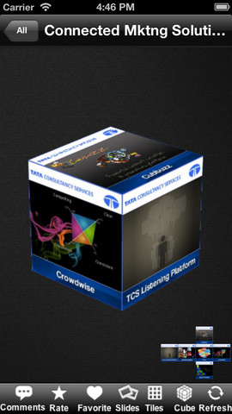
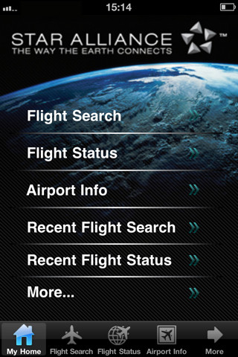




SQLite – Applications
Trademarks are the property of their respective owners

Slide 11
References
http://www.sqlite.org/
http://developer.android.com/training/basics/data-storage/databases.html

