Slide 1
Risk Factors and 10-Year
Probability of Stroke
Framingham Heart Study
Yunjing (Charlotte) Hong
Spring 2026
Notes:
Good morning everyone. Today I will be presenting our analysis of risk factors for stroke using data from the Framingham Heart Study. This is a classic dataset in cardiovascular epidemiology. Our goal was twofold: first, to identify which baseline risk factors predict 10-year stroke risk, and second, to compute predicted stroke probabilities for different patient profiles. The analysis was stratified by sex because we expected the risk factor associations might differ between men and women.

Slide 2
Research Question
Primary goal:
Identify important risk factors of stroke and compute the 10-year probability of stroke based on different risk profiles, stratified by sex (M/F). Baseline (Period 1) covariates only; follow-up restricted to 10 years.
Secondary aim:
Describe within-individual risk factor changes across 3 examination periods to inform whether time-varying covariate analysis is warranted.
Covariates:
A priori (forced in all models): age, diabetes, systolic BP
Candidates (to test): prevalent CHD, BP medications, current smoking, total cholesterol, BMI
Statistical hypotheses (tested separately for each sex):
H₀: After adjusting for age, diabetes, and SBP, none of the 5 candidate risk factors are associated with 10-year stroke risk (HR = 1)
Hₐ: At least one candidate risk factor is associated with 10-year stroke risk (HR ≠ 1)
Notes:
So the investigator asked us to address two questions. The primary goal was to identify which risk factors predict 10-year stroke and then use those models to compute predicted probabilities for clinically meaningful risk profiles — for example, what is the 10-year stroke risk for a 60-year-old diabetic man with high blood pressure versus an average-risk woman? We did this separately for men and women. The secondary aim was descriptive: the data include three examination periods spanning about 12 years, so we wanted to see how much risk factors actually change within the same individuals over time. This matters because if blood pressure is rising and smoking rates are dropping, then our baseline-only model might not capture the true risk exposure over the full 10 years of follow-up. Now, regarding covariates: three variables were forced into every model based on established clinical evidence — age, diabetes, and systolic blood pressure. These are well-known stroke risk factors and the investigator specified them a priori. The five candidate variables we were testing are prevalent CHD, BP medication use, current smoking, total cholesterol, and BMI. Our null hypothesis is that after adjusting for the three forced variables, none of these five candidates add predictive value for stroke.

Slide 3
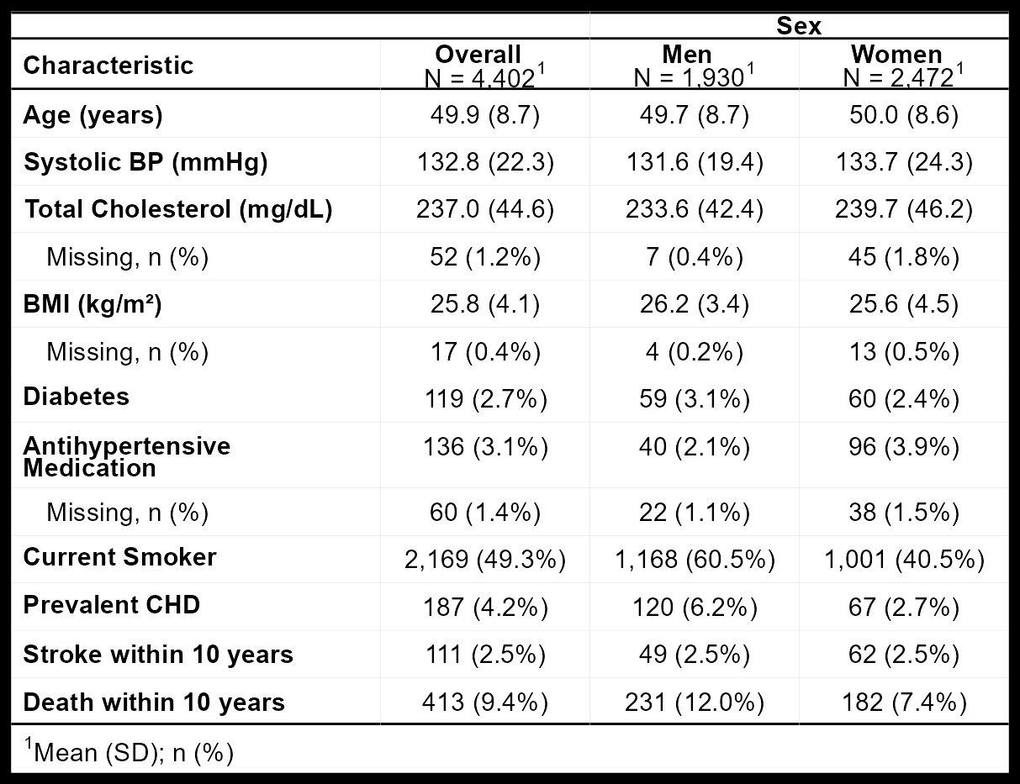
Data Overview
Framingham Heart Study: 4,434 participants, 3 exam periods (~1956–1968)
Analytic cohort: 4,402 baseline participants free of prevalent stroke (32 excluded)
1,930 men | 2,472 women
Stroke within 10 yrs: 49 men (2.5%), 62 women (2.5%)
Competing risk: 208 men (10.8%), 159 women (6.4%) died without stroke
Missing data: BPMEDS ~1–2%; all others <1%
Time censored at 3,652 days (~10 years)
Notes:
Our data come from the Framingham Heart Study, which enrolled over 5,000 participants starting in 1948. The subset we received includes 4,434 participants across three examination periods spanning roughly 1956 to 1968. We restricted our analytic cohort to the 4,402 participants who were stroke-free at baseline — Period 1 — excluding 32 with prevalent stroke. As you can see in Table 1 on the right, the cohort is split into 1,930 men and 2,472 women, with a mean age of about 50 in both groups. A few key differences between the sexes: men had much higher smoking prevalence at 60.5% versus 40.5% for women, and more prevalent CHD at 6.2% versus 2.7%. Women had slightly higher systolic blood pressure. Now, an important feature of this data: within 10 years, only about 2.5% in each sex experienced a stroke — so this is a relatively rare event with only 111 total cases. But critically, 208 men — over 10% — and 159 women — about 6.4% — died without having a stroke first. This death-without-stroke is a competing risk. Our Cox models treat these deaths as non-informative censoring, which could slightly overestimate stroke incidence. Missing data was minimal — BPMEDS had the most at about 1 to 2 percent — so we used complete-case analysis.

Slide 4
Analysis
Model: Cox proportional hazards, fitted separately for men and women
Outcome: time to first stroke within 10 years
A priori variables (forced): age, diabetes, systolic BP
Candidate variables: prevalent CHD, BP medications, current smoking, total cholesterol, BMI
Model selection: AIC-based stepwise (backward + forward)
Inference: Wald test on final model coefficients (α = 0.05, two-sided)
Diagnostics: Schoenfeld residuals (PH assumption); concordance index (discrimination)
Time-varying analysis: risk factor summaries computed on balanced cohort (participants in all 3 periods)
Within-individual paired changes (Period 3 minus Period 1) to capture person-level change
Balanced cohort avoids confounding period contrasts with differential attrition
Notes:
For our statistical approach, we used Cox proportional hazards models fitted separately for men and women. The outcome is time to first stroke, censored at 10 years. As I mentioned, three variables — age, diabetes, and systolic BP — were forced into every model. The five candidate variables were then evaluated for inclusion. For model selection, we used AIC-based stepwise selection, running it in both backward and forward directions. Backward elimination starts with all eight variables and iteratively removes the one whose removal most improves AIC. Forward selection starts with just the three forced variables and adds candidates one at a time. Running both directions lets us check whether they converge on the same model, which would give us confidence that the selection is robust. We preferred AIC over individual likelihood ratio tests for an important reason that the investigator specifically asked about: individual LRTs test each candidate against the base model one at a time, which means they can miss a variable that is only informative when adjusted for other covariates — a classic confounding or suppression scenario. AIC-based stepwise evaluates each variable in the context of whatever else is already in the model, so it can catch these cases. We also reported individual LRTs as a secondary check for comparison. For inference on the final model, we used the Wald test at alpha equals 0.05. We verified the proportional hazards assumption using Schoenfeld residuals, and assessed model discrimination with the concordance index.

Slide 5
Results
All three selection methods (backward AIC, forward AIC, individual LRT) converged on the same variable sets.
Men (C = 0.797)
Women (C = 0.796)
Age: HR = 1.066/yr (95% CI: 1.027–1.107, p<0.001)
Diabetes: HR = 4.807 (2.099–11.005, p<0.001)
Systolic BP: HR = 1.034/mmHg (1.022–1.046, p<0.001)
Current smoking: HR = 1.924 (1.036–3.573, p=0.038)
Age: HR = 1.073/yr (95% CI: 1.033–1.116, p<0.001)
Diabetes: HR = 1.767 (0.636–4.904, p=0.275)
Systolic BP: HR = 1.026/mmHg (1.018–1.034, p<0.001)
No candidate variable improved AIC
Diabetes HR increased from 3.54 (base) to 4.81 (final) in men after adjusting for smoking — confounding
PH assumption satisfied for both models (Schoenfeld p > 0.09 all terms)
Predicted 10-yr stroke: average-risk 60-yr-old man = 1.4%; high-risk (diabetic, SBP 160, smoker) = 22.3%
Notes:
Now for the results. First, a key finding on model selection: all three methods — backward AIC, forward AIC, and individual LRT — converged on exactly the same variable sets for both sexes. This is strong evidence that the selection is robust and we are not missing variables that would only appear with a different method. For men, the final model retained four variables with a C-index of 0.797. The strongest predictor was diabetes, with a hazard ratio of 4.807, meaning diabetic men had nearly five times the stroke hazard compared to non-diabetic men. Age and systolic BP were also highly significant. Current smoking had a hazard ratio of 1.924 — so about double the risk — and was the only candidate variable that improved the model. One interesting finding: the diabetes hazard ratio jumped from 3.535 in the base model to 4.807 after adjusting for smoking. This tells us smoking was partially confounding the diabetes-stroke association, attenuating it in the base model. For women, the picture was simpler. No candidate variable improved AIC, so the final model contained only the three a priori variables with a C-index of 0.796. Diabetes had a hazard ratio of 1.767 but was not significant at p equals 0.275 — this is likely a power issue since very few diabetic women experienced stroke events, not a true null association. The proportional hazards assumption was satisfied for both models. To give you a sense of the clinical implications: for a 60-year-old man, the predicted 10-year stroke probability ranges from just 1.4% for someone with no risk factors to 22.3% for a diabetic smoker with high blood pressure.

Slide 6
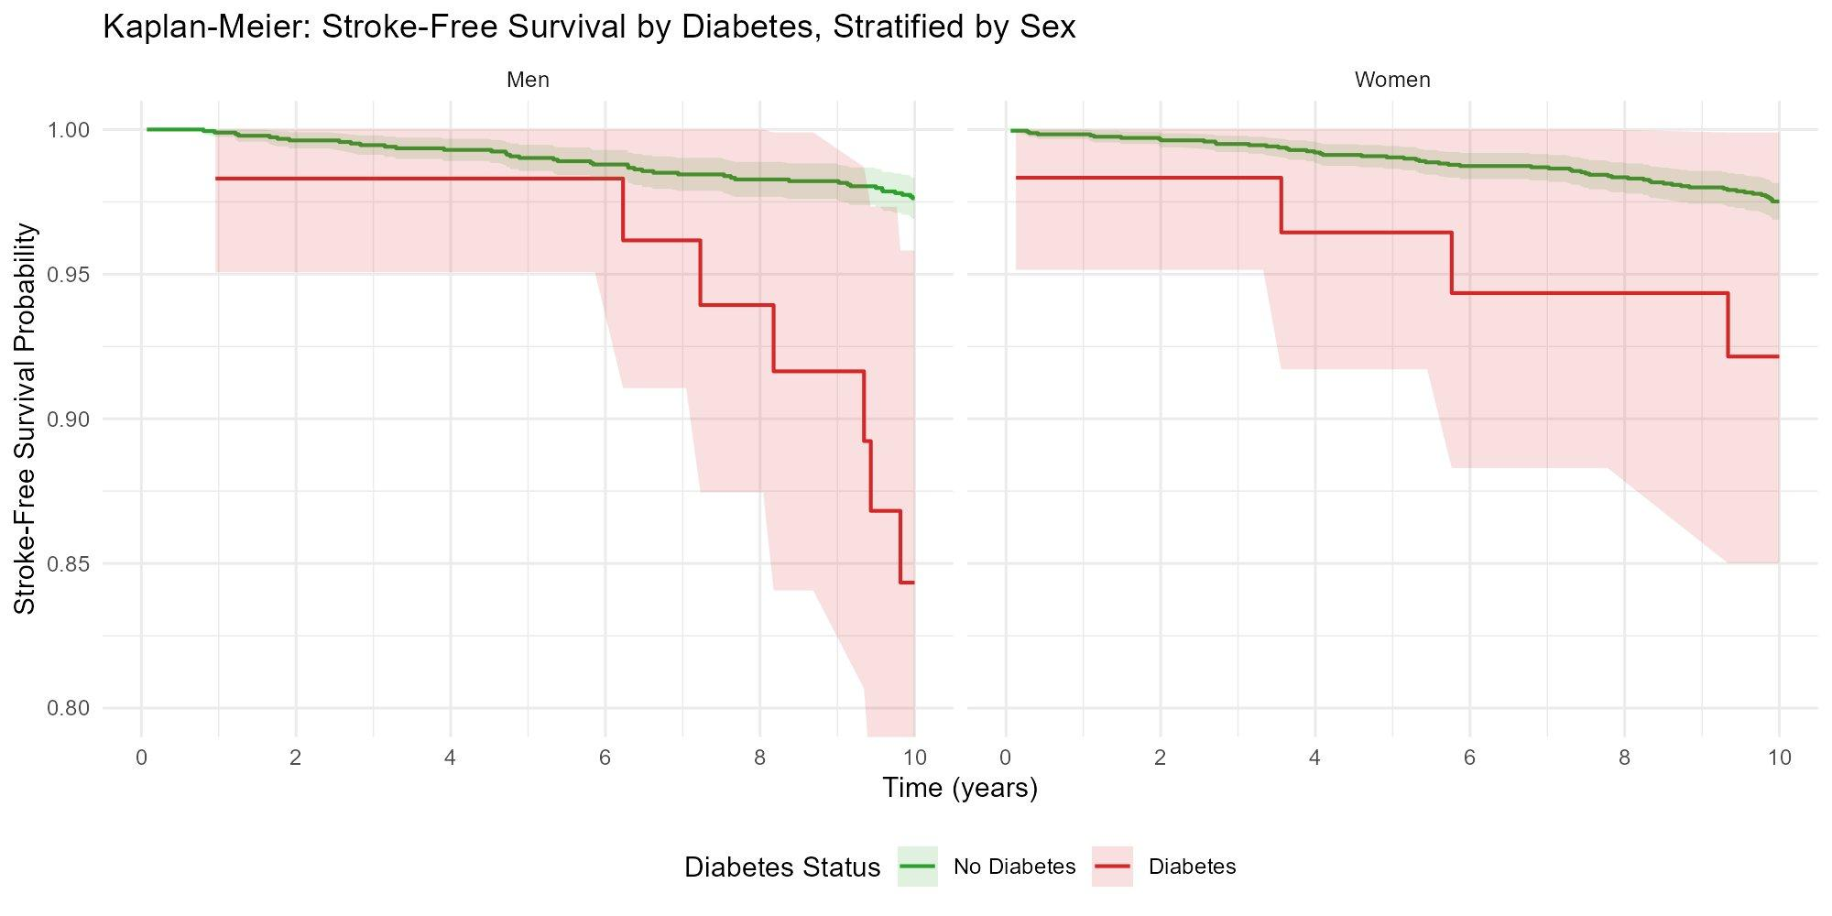
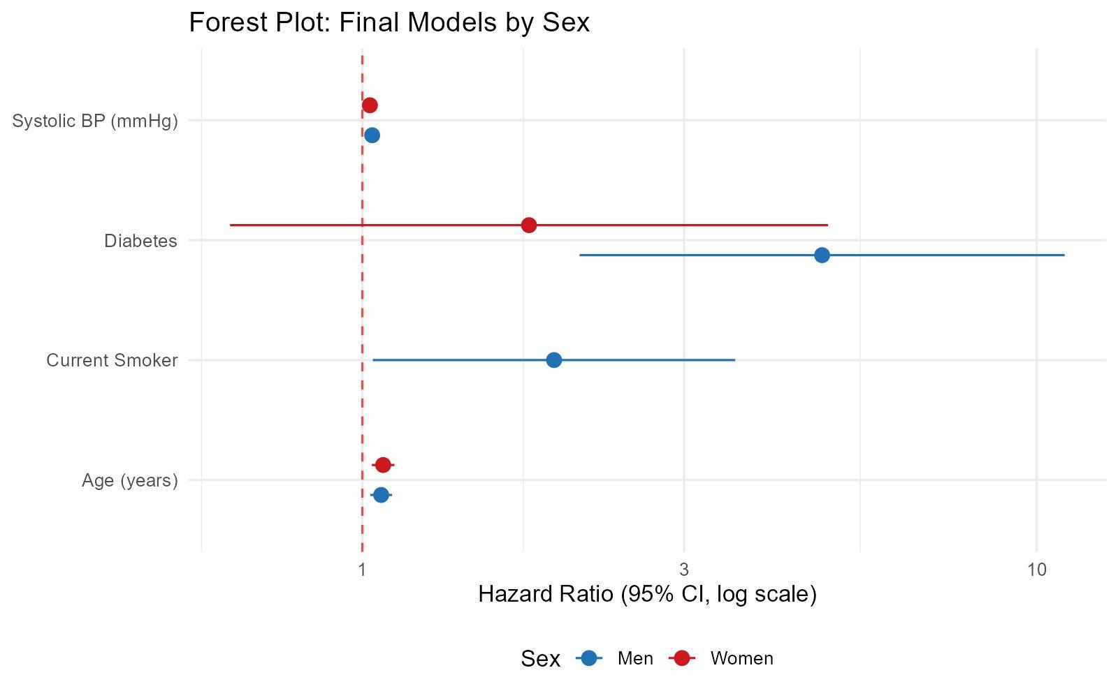
Results (continued)
KM: Stroke-free survival by diabetes, stratified by sex
Forest plot: hazard ratios from final models
Time-varying covariates (balanced cohort, n = 3,139):
SBP rose ~10 mmHg | Diabetes incidence: 6.6% (M), 5.6% (F) | 21.7% male smokers quit | 9.9% (M) / 14.7% (F) started BP meds
Baseline values increasingly misaligned with true exposure — time-varying analysis warranted
Notes:
These two figures illustrate the results visually. On the left is the Kaplan-Meier curve for stroke-free survival by diabetes status, stratified by sex. You can see that the green curves — non-diabetic participants — stay close to 1.0, while the red diabetes curves diverge downward, especially for men after about year 6. The confidence bands are wide because diabetes prevalence at baseline was only about 3%, so there are few diabetic participants, but the separation is clinically striking. On the right is the forest plot showing the hazard ratios from both final models side by side. Blue is men, red is women. The most striking feature is the diabetes point for men way out at 4.8 with a wide confidence interval extending past 10. Current smoking is the other notable sex difference — it appears for men at about HR 1.9 but was not even retained in the women's model. Age and systolic BP show consistent, similar-magnitude effects across both sexes. Now, at the bottom of this slide, I want to highlight our secondary analysis of within-individual risk factor changes. We restricted to a balanced cohort of 3,139 participants present in all three examination periods, so we are not confounding time trends with changes in who is observed. The results are striking: systolic BP rose about 10 mmHg on average, diabetes prevalence roughly quadrupled, over 20% of male smokers quit by Period 3, and BP medication use increased dramatically. These substantial changes mean that baseline values measured at Period 1 become increasingly misaligned with what participants are actually experiencing over the 10-year follow-up, which supports the investigator's intuition that a time-varying covariate analysis would be worth pursuing.

Slide 7
Discussion
Summary
Age, diabetes, and systolic BP are the primary determinants of 10-year stroke risk in both sexes
Current smoking adds independent risk in men only (HR = 1.92)
Substantial within-individual risk factor changes support future time-varying covariate analysis
Limitations
Deaths without stroke treated as non-informative censoring (may overestimate stroke incidence)
Baseline-only covariates become misaligned with true exposure over 10-year follow-up
Post-selection inference: p-values should be interpreted with caution (AIC partially mitigates)
Predominantly white Framingham cohort: generalizability may be limited
Notes:
To wrap up. Our analysis identified age, diabetes, and systolic blood pressure as the primary determinants of 10-year stroke risk in both sexes. Current smoking added independent risk in men with a hazard ratio of about 1.9, but was not retained for women. Both models achieved C-indices around 0.80, indicating reasonable discriminative ability — the models do a good job of ranking who is at higher versus lower risk. The convergence of all three selection methods on the same variables is reassuring: the investigator asked whether individual testing might miss jointly informative variables, and in this dataset it did not, though the stepwise approach remains the more defensible primary method. The within-individual changes we observed strongly support the investigator's suggestion that a time-varying covariate analysis could yield different and potentially more accurate results. For limitations: first, deaths without stroke are treated as non-informative censoring in standard Cox models, and given that over 10% of men died, this could overestimate stroke incidence. Second, our models rely on baseline-only covariates that, as we showed, become increasingly misaligned with true exposure. Third, p-values from the final model should be interpreted with some caution since we used the same data for selection and inference, though AIC-based selection partially mitigates this compared to p-value-based selection. Finally, the Framingham cohort is predominantly white, so generalizability to more diverse populations may be limited. Thank you very much. I am happy to take any questions.

