Slide 1
22/04/2021
NEW ROLE SCHOOLS
DATA SCIENTIST
Edition 4 | Group 2
PROJECT WORK PRESENTATION
YOUR WAY TO THE FUTURE

Slide 2
Agenda
1
Team Composition
2
How we worked together
3
Overview of the entire process and data insights obtained from it
4
Business action proposals based on findings
5
Annexes

Slide 3
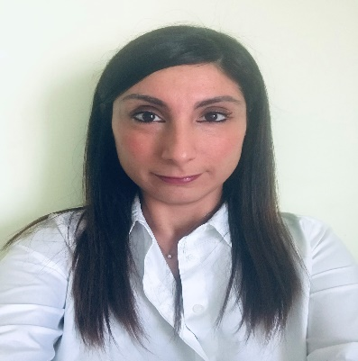




Team Composition
Team is the key element for turning ideas into profitable business
ADD PROFILE
PICTURE
ADD PROFILE
PICTURE
ADD PROFILE
PICTURE
ADD PROFILE
PICTURE
CHARL MARAIS
Role
Europ Assistance Holding
MADDALENA GIACOLLO
Role
Generali Italia
MARIUS KRAPF
Role
Generali Deutschland AG
SIMONA SANTOLOCE
Data Analyst
Generali Investment Holding
CHRISTOPH BEQUET
Role
Generali Shared Services
3

Slide 4
Agenda
1
Team Composition
2
How we worked together
3
Overview of the entire process and data insights obtained from it
4
Business action proposals based on findings
5
Annexes

Slide 5







How we worked together
Organization of meetings schedule & agendas, involvement of attendees
1
Data Wrangling
Optimization of datasets in terms of missing or incoherent values
3
Sentimental Analysis
5
Fine tuning and Delivery
TIMELINES AND MILESTONES
Discussion of approach, activities, datasets and interdependencies
Interpretation of twitters in terms of sentiment of words
4
Model Development
Award Ceremony
0
Project Kick-off
2
Exploratory Data Analysis
MICROSOFT TEAMS
GITHUB
OUTLOOK
WHATSAPP
Operative weekly check point
Sharing of documents
Definition of deadlines
Overall planning monitoring
1
2
3
4
SUPPORTING TOOLS
5

Slide 6
Agenda
1
Team Composition
2
How we worked together
3
Overview of the entire process and data insights obtained from it
4
Business action proposals based on findings
5
Annexes

Slide 7
7

Slide 8
Slide Title
8

Slide 9
Slide Title
9

Slide 10
Q&A
Thank you!

