Slide 1
Process 1 (Your Software)
Tarsim Client
Tarsim
Process 2 (Your Software)
Communication
Module
Kinematics
Engine
Tarsim Client
Configuration
Parser
GUI
Process n (Your Software)
Tarsim Client

Slide 2
Mate
Joint x
Joint y
Joint Transformation
Rigid Body j
Joint y
Joint x
Rigid Body i

Slide 3
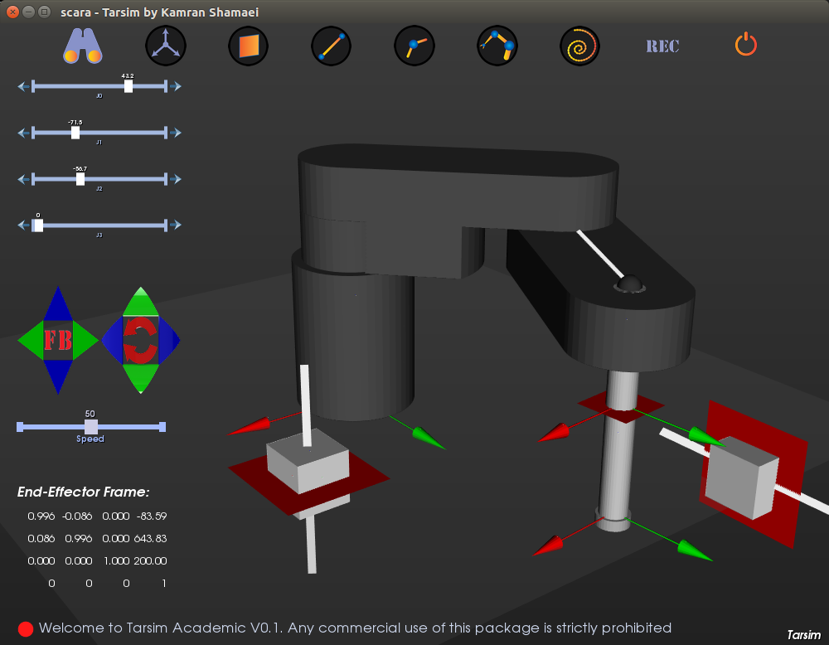
Buttons Scene
Joint Values
Scene
6-DOF
Command
Scene
Speed Scene
Fault Messages Scene

Slide 4
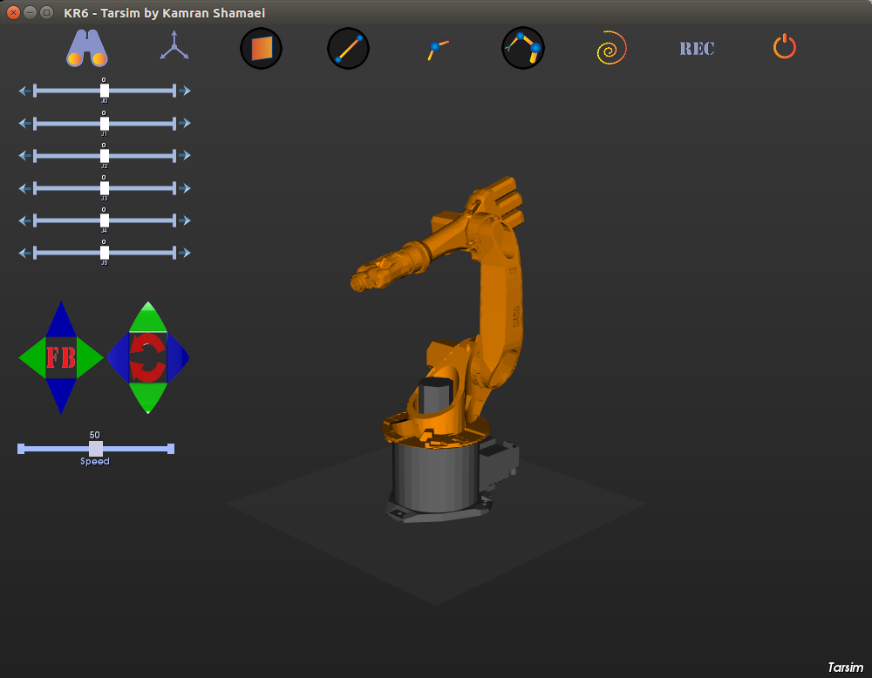
Your Qt Application
Qt Widget 1
Qt Widget 2
Qt Widget 3
Qt Widget 4
Qt Widget n

