Slide 1
Legion programming system
Regent [2]
(Legion language)
Sequential semantics, type system ensures program correctness
Lua/Terra metaprogramming
CPUs + GPUs (NV/AMD/INTEL)
Static optimizations
Pygion [3]
(Legion Python API)
OpenMP, no GPU
Dynamically type-checked
Optimizations partially supported
Can call external Python lib. (CuPy, Pytorch, …)
Cunumeric (Numpy drop-in replacement)
legate.sparse
(scipy.sparse drop-in replacement)
Legate [4]
Framework for building composable Legion libraries
Higher-level of abstraction (e.g. Legate Stores, Legate tasks, …)
Prof. Aiken (Stanford), Elliott Slaughter (SLAC), Sandia, LANL, …
Nvidia
High-level, compact
Legion [1] (C++ API)
(Implicit Task-based distributed computation)
Low-level, verbose
Realm
(Explicit Task-based distributed computation)
GASNet-EX
(Communication layer)
LBNL
[1] Bauer, M., et al., SC’12, IEEE, 2012
[2] Slaughter, E., et al., SC’15, IEEE, 2015
[3] Slaughter, E., et al., PAW-ATM, IEEE/ACM, 2019
[4] Bauer, M., Garland, M., SC’19, IEEE, 2019

Slide 2
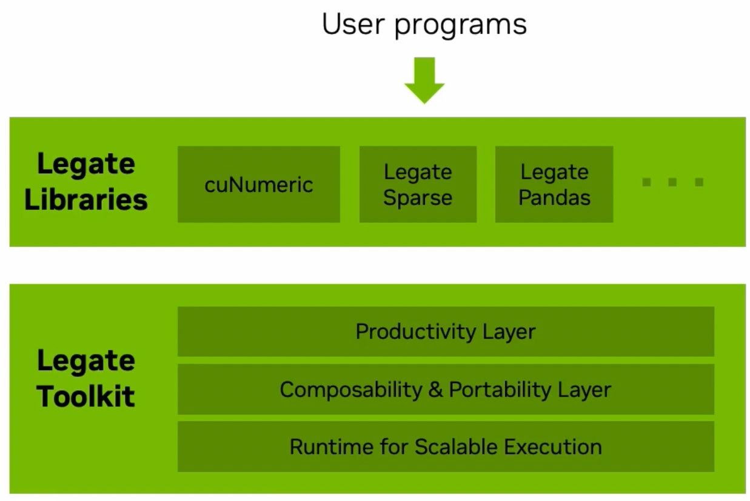
Legate and CUnumeric
Legate-based drop-in replacements for popular python libraries (for application developers → this demo)
Framework for writing composable Legion libraries (for library developers)
Credits: Wonchan Lee, Nvidia GTC 2023
(https://www.nvidia.com/en-us/on-demand/session/gtcspring23-s51789/)

Slide 3
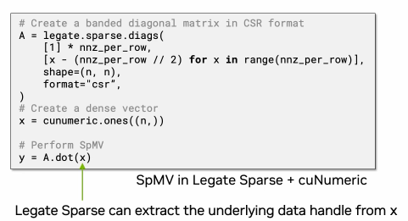
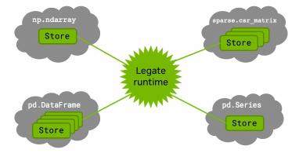

Legate
How does Legate achieve true composability? → Relies on Legate Stores to hold data containers → mapped to Legion region fields or Legion futures
→ Impose partitioning constraints at the task level → the runtime decides when stores need to be repartitioned or can be reused
Credits: Wonchan Lee, Nvidia GTC 2023
(https://www.nvidia.com/en-us/on-demand/session/gtcspring23-s51789/)

Slide 4
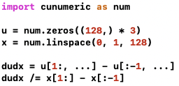
Cunumeric
Drop-in replacement for numpy → no code modification required
Each cunumeric operator launches at least 1 Legion task → runtime overhead
If cunumeric operator not supported, then falls back to numpy operator (can still use OpenMP, but local address space only)
Does not interoperate with Pygion → not able to call arbitrary python packages (for now…)
Gradient computation in Cunumeric
→ Can scale to many nodes, GPUs & OpenMP procs, without any code modification

Slide 5
Useful resources
Presentations
Wonchan Lee, Nvidia GTC 2023 (https://www.nvidia.com/en-us/on-demand/session/gtcspring23-s51789/)
Wonchan Lee, Legion Retreat 2022 (https://theory.stanford.edu/~aiken/LegionRetreat22/videos/04-lee.mp4)
Papers
Legate and CUnumeric: https://legion.stanford.edu/pdfs/legate-preprint.pdf
Legate sparse: https://legion.stanford.edu/pdfs/legate-sparse2023.pdf
Repositories
Legate: https://github.com/nv-legate/legate.core
CUnumeric: https://github.com/nv-legate/cunumeric
Cunumeric online doc
https://nv-legate.github.io/cunumeric/23.11/

