Slide 1

Series Q Q2
Hands-on I: the single-sample
standard pipeline
from raw matrix to cell annotation
10x's public GBM 5k, 5,604 cells. From loading to named clusters and
state scores for malignant cells.
About 55 min | Prerequisites: Q1 | Scripts: R/00–03 | Deeper: B1, B5–B10
https://github.com/Charlene717/scRNA-seq-tutorial-Qseries
Notes:
Q 系列第二集。上一集我們講的是觀念，這一集開始換手指。 資料是 10x Genomics 公開的一份人類膠質母細胞瘤，五千六百零四顆細胞，Chromium 3 prime v3。我們從讀檔開始，一路往下走：QC、normalization、PCA、分群、UMAP、註釋，接著給惡性細胞打狀態分數，再把註釋做到亞群、做完品質檢查。五十五分鐘，畫面會在投影片和 RStudio 之間切換。 程式碼分成四支練習腳本：00 是環境與下載，01 到 03 對應這一集的三段。每一支結尾都有練習題。要先看完影片再做腳本可以，想邊看邊暫停跟著打也可以，看我們自己習慣哪一種。 ──────── Episode two of the Q series. Last episode was concepts; from here on it's fingers on the keyboard. The data is a public human glioblastoma sample from 10x Genomics: five thousand six hundred and four cells, Chromium 3 prime v3. We start where we always start, at reading the files, and then keep going: QC, normalization, PCA, clustering, UMAP, annotation, then state scores for the malignant cells, then annotation down to subclusters, and the quality checks at the end. Fifty-five minutes, and the screen will switch between the slides and RStudio. The code is split into four practice scripts: 00 is environment and download, 01 to 03 match the three sections of this episode. Each script ends with exercises. Watch the video straight through and do the scripts afterwards, or pause and type along — whichever suits us.

Slide 2
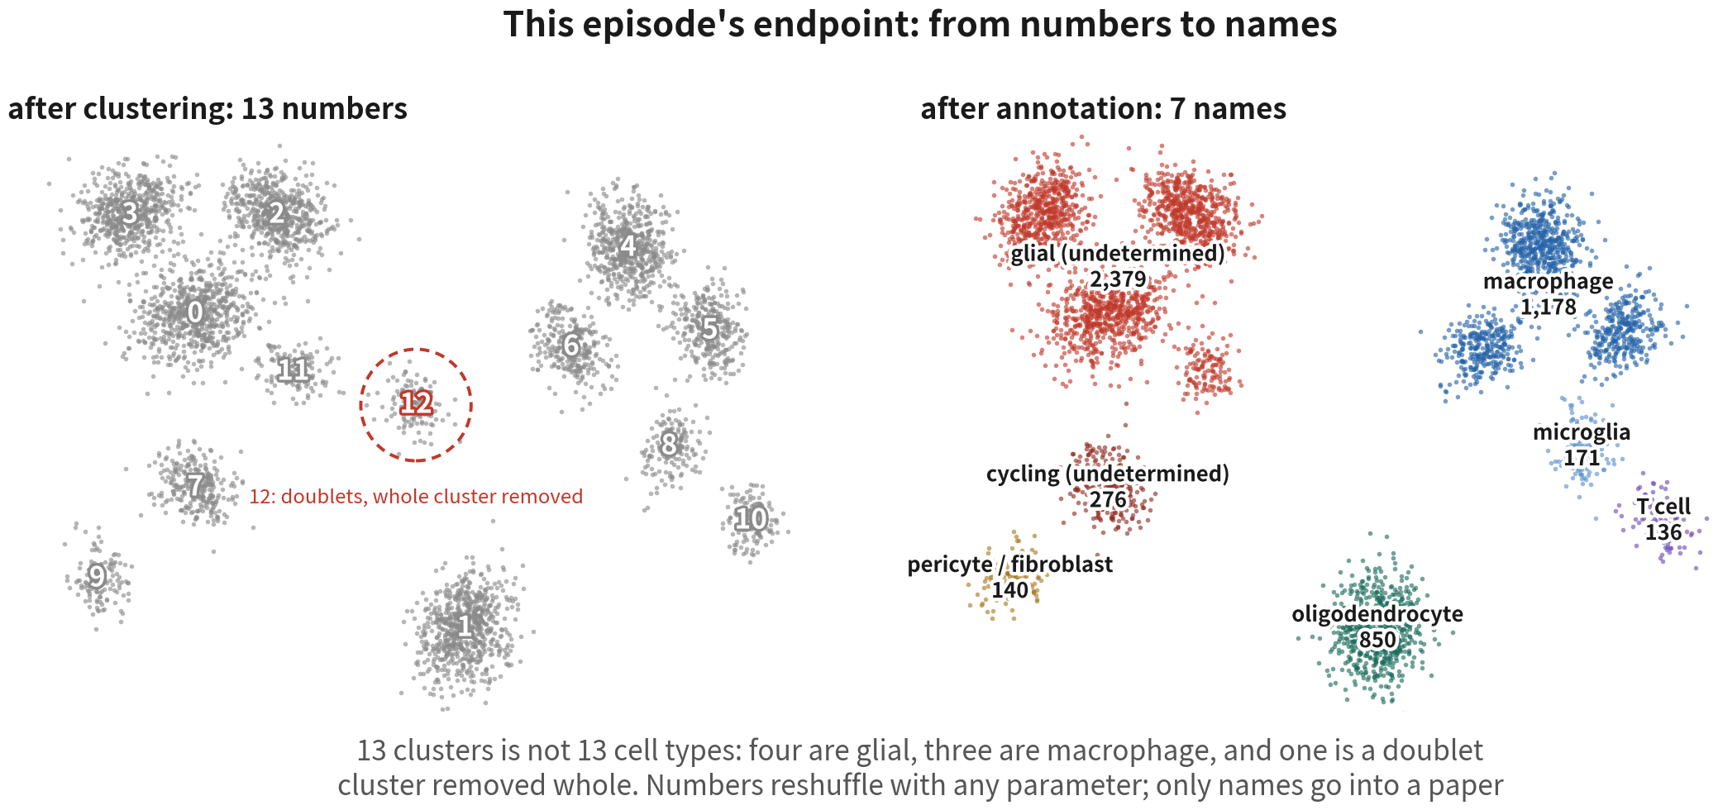
The end result of this episode
13 numbers, 7 names: four clusters are glial, three are macrophage, one doublet cluster is
removed whole. Malignant cells are labelled 'glial (undetermined)', not declared tumour
Q2 Hands-on I
2
Notes:
先把終點給大家看。左邊是分群跑完的十三個編號；右邊是註釋完的七個名字：膠質（待判定）兩千三百七十九顆、巨噬細胞一千一百七十八、寡樹突細胞八百五十、週期中（待判定）兩百七十六、小膠質一百七十一、周細胞／纖維母一百四十、T 細胞一百三十六。 第一件要記住的事：十三群不等於十三種細胞。你看，四群都是膠質，三群都是巨噬細胞——同一種細胞會因為狀態不同被切成好幾群，這很正常，不是分群分壞了。另外第十二群三項診斷全中，是整群 doublet，直接移除，所以右邊只剩五千一百三十顆。編號會隨參數重排，名字才是能寫進論文的東西。 再看膠質那幾群的標籤：它不是「腫瘤」，是「膠質，惡性待判定」。為什麼要這樣寫？因為 marker 只能說譜系，說不了惡性——膠質瘤的惡性細胞，它的正常對應細胞就在同一塊組織裡，開的基因高度重疊。惡性要的是另一類證據：基因體層級的 CNV，加上跨病人的專屬性。這份資料只有一位病人，第二項拿不到。所以這個標籤停在「待判定」是終點，不是欠條。Q3 換成四位病人的資料，才有條件把判定做完整。 這張圖其實不難做。難的是審稿人指著每個參數問「為什麼」的時候，我們答不答得出來。這一集的每一段程式碼，都是為了這件事。 ──────── This is the destination, and it's worth seeing before we build it. On the left, thirteen numbered clusters after clustering; on the right, the seven names after annotation: glial (undetermined) 2,379 cells, macrophage 1,178, oligodendrocyte 850, cycling (undetermined) 276, microglia 171, pericyte / fibroblast 140, T cell 136. The first thing to hold on to: thirteen clusters is not thirteen cell types. Look — four of them are glial, three of them are macrophage. One cell type gets split across several clusters because of state differences, and that is normal, not a clustering failure. Cluster twelve is a separate story: it hits all three doublet diagnostics, so the whole cluster goes, which is why the right-hand side holds 5,130 cells. Numbers reshuffle with any parameter; only the names go into a paper. Now look at the labels on the glial clusters. Not "tumour", but "glial, malignancy undetermined". Why write it that way? Because markers can only tell us lineage, never malignancy — in glioma the normal counterpart of the malignant cell sits in the very same tissue, and the two express heavily overlapping genes. Malignancy needs a different class of evidence: genome-level CNV, plus patient-specificity. This dataset has one patient, so the second is out of reach. That label stops at "undetermined" as an endpoint, not an IOU. Q3 switches to four patients, where the call can actually be completed. This figure is not hard to make. The hard part is that when a reviewer points at every parameter and asks "why", we can answer. Every block of code in this episode exists for that.

Slide 3
THE RULE FOR THIS EPISODE
Every code block answers two questions:
what this line does, and why the
parameter is set that way.
Full code lives in three practice scripts (R/01–03), each ending with
exercises. 'Deeper: Bx' points to the Series B episode that goes all the way.
Q2 Hands-on I
3
Notes:
這一集只有一條規則：每段程式碼只講兩件事——這一行在做什麼、參數為什麼這樣設。 講不完的細節，右下角會標「腳本：幾號、第幾節」和「深入：B 幾」。腳本是完整程式碼的位置；B 幾是 B 系列把這件事講透的那一集。先跑通，再深入。 ──────── One rule for this episode: for every block of code we only cover two things — what this line does, and why the parameter is set this way. Details we can't fit in get a tag in the bottom-right corner: "Script: which number, which section" and "Deep dive: B-something". The script is where the full code lives; B-something is the episode in the B series that covers that topic in depth. Get it running first, go deep later.

Slide 4
Episode goals
Load GBM 5k into Seurat v5, set three QC cutoffs from this dataset's
distributions, flag doublets
1
Run normalization → HVG → scaling → PCA → clustering → UMAP with three
sanity checks (PC1, nPC, per-cluster QC)
2
Draw the four major groups with gate genes, name clusters with markers +
SingleR, score malignant states with Neftel gene sets
3
Q2 Hands-on I
4
Notes:
這一集要做的事，其實是一條線。 起點是讀檔。把 GBM 5k 讀進 Seurat v5，用這份資料自己的分布定 QC 線——不是一條，是三條——並且用 DoubletFinder 把 doublet 標出來。 細胞乾淨了，才輪得到 normalization 到 UMAP 這一段。中間有三個必要檢查：PC1 是不是深度、取幾個 PC、分群後每一群的 QC。腫瘤資料第三個檢查特別重要。 有了群，最後才問得了「這些群是誰」。用四個譜系標誌基因劃出四個主要類群、用 marker 加 SingleR 兩項獨立證據命名、用 Neftel 2019 的基因集給惡性細胞打四種狀態的分數。 開始。 ──────── What we do this episode is really one line of work. It starts at reading files. We read GBM 5k into Seurat v5, set the QC cutoffs from this dataset's own distributions — not one cutoff, three — and flag doublets with DoubletFinder. Only once the cells are clean does the stretch from normalization to UMAP get its turn. Three sanity checks sit along the way: is PC1 just depth, how many PCs to keep, and per-cluster QC after clustering. For tumour data the third one matters most. And only once we have clusters can we ask who those clusters are. Four lineage markers draw the four major groups; markers plus SingleR give us two independent lines of evidence to hang names on; the Neftel 2019 gene sets score the malignant cells for four states. Let's start.

Slide 5
01
Environment and data
Script 00: install, download, set up the project
Q2 Hands-on I
5
Notes:
第一段，腳本 00。裝套件、下載資料、建專案。三分鐘搞定。 ──────── Section one, script 00. Install packages, download the data, set up the project. Three minutes and we're through.

Slide 6
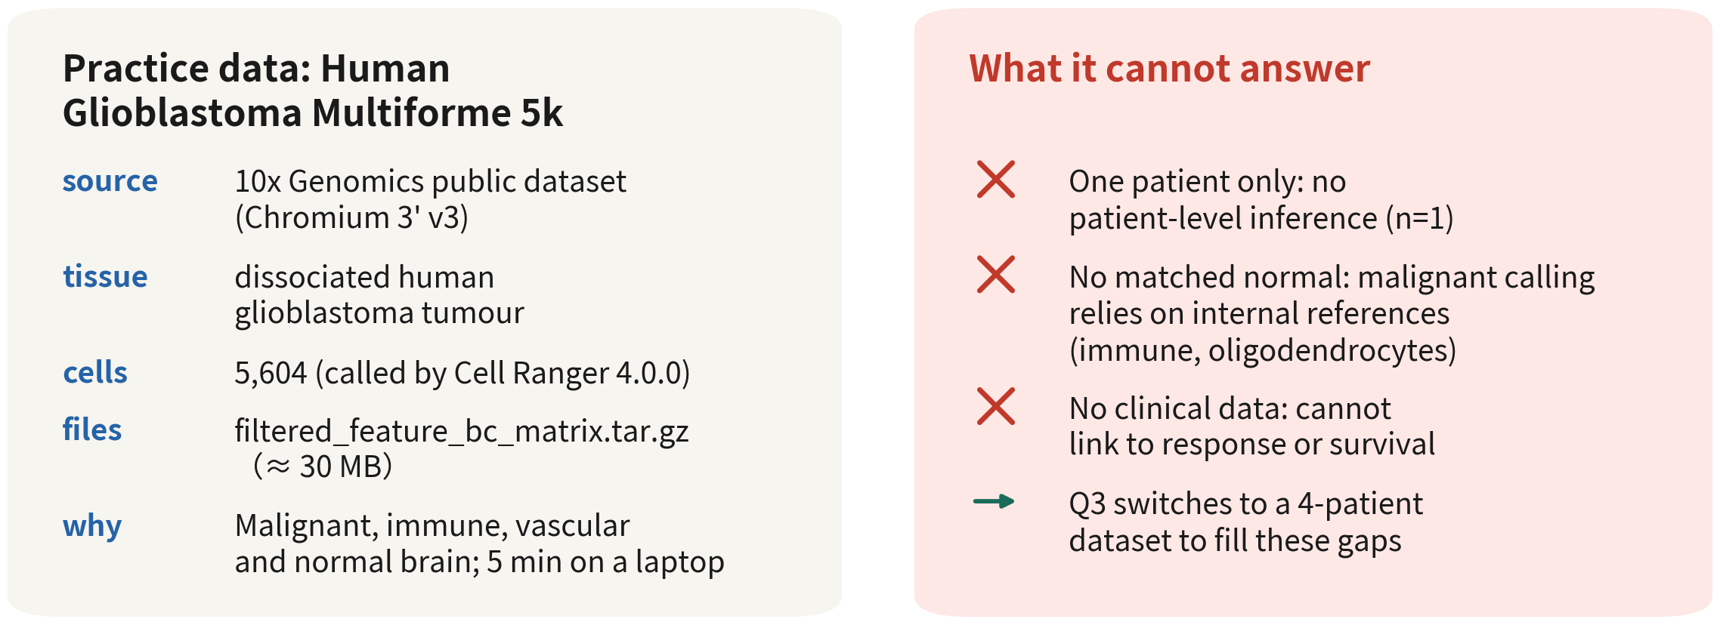
Practice data: a real tumour sample (GBM 5k)
Read the right side first: what a dataset can and cannot answer matters more than its cell count
Q2 Hands-on I
6
Notes:
這一頁反過來讀：先看右邊，再看左邊。 右邊是這份資料不能回答的事。只有一位病人，任何「病人之間」的推論都不成立——上一集講的 n 等於一。沒有配對的正常組織，惡性判定只能靠內部參考，也就是免疫細胞和寡樹突細胞。沒有臨床資料，連不到治療反應。 左邊才是它能做的。一份真實的腫瘤，惡性、免疫、血管、正常腦細胞共存；三十 MB，筆電五分鐘跑完。對這一集的目標——把單一樣本從矩陣做到型別——剛剛好。 拿到任何一份資料，都先問這兩個問題。 ──────── Read this one backwards: right side first, then left. The right side is what this dataset cannot answer. There is only one patient, so any "between patients" inference is invalid — that's last episode's n equals one. There is no matched normal tissue, so malignancy calling has to lean on internal references, namely the immune cells and oligodendrocytes. And there is no clinical data, so we cannot link anything to treatment response. The left side is what it can do. A real tumour, with malignant, immune, vascular and normal brain cells all coexisting; thirty MB, five minutes on a laptop. For this episode's goal — taking a single sample from matrix to cell types — it is exactly right. Whenever we pick up any dataset, these are the first two questions to ask.

Slide 7
Install, pin the version, set the seed
install.packages(c("Seurat", "dplyr", "ggplot2", "clustree")) BiocManager::install(c("SingleR", "celldex", "scDblFinder")) remotes::install_github("chris-mcginnis-ucsf/DoubletFinder") # GitHub only library(Seurat); library(dplyr); library(ggplot2) stopifnot(packageVersion("Seurat") >= "5.0.0") # v4 tutorial code breaks on v5 set.seed(1234) # fixed for the whole series for (d in c("data", "R", "output")) dir.create(d, showWarnings = FALSE)
No setwd(), no absolute paths: open an RStudio Project and the root is the working directory | Script 00 | Deeper: B1
Q2 Hands-on I
7
Notes:
套件分三個來源。Seurat、dplyr、ggplot2、clustree 從 CRAN 裝；SingleR、celldex、scDblFinder 從 Bioconductor 裝；DoubletFinder 只在 GitHub 上有，要用 remotes::install_github 裝。 stopifnot 那一行，是在驗證 Seurat 是第五版以上。這一行別省——網路上很多教學碼是第四版寫的，搬到第五版會直接報錯。先確認我們站在對的版本上。 set.seed 1234，整個系列固定。分群和 UMAP 都有隨機成分，不設 seed，今天跟明天跑出來的圖不一樣。 最後一行建三個資料夾：data 放原始資料，R 放腳本，output 放物件和圖。不用 setwd，也不用絕對路徑。開一個 RStudio Project，工作目錄自動就是專案根。 ──────── The packages come from three places. Seurat, dplyr, ggplot2 and clustree come from CRAN; SingleR, celldex and scDblFinder come from Bioconductor; DoubletFinder lives only on GitHub, so it goes in with remotes::install_github. The stopifnot line verifies Seurat is version five or above. Don't skip it — a lot of tutorial code online was written for version four and errors out on version five. Make sure we are standing on the right version first. set.seed 1234, fixed for the whole series. Clustering and UMAP both have random components; without a seed, today's figure and tomorrow's figure won't match. The last line creates three folders: data for raw data, R for scripts, output for objects and figures. No setwd, no absolute paths. Open an RStudio Project and the working directory is the project root automatically.

Slide 8
Download, extract, load
url <- paste0("https://cf.10xgenomics.com/samples/cell-exp/4.0.0/", "Parent_SC3v3_Human_Glioblastoma/", "Parent_SC3v3_Human_Glioblastoma_filtered_", "feature_bc_matrix.tar.gz") download.file(url, "data/gbm5k.tar.gz", mode = "wb") # about 30 MB untar("data/gbm5k.tar.gz", exdir = "data/gbm5k") mtx.dir <- "data/gbm5k/filtered_feature_bc_matrix" gbm.data <- Read10X(data.dir = mtx.dir) # takes the folder gbm <- CreateSeuratObject(counts = gbm.data, project = "gbm5k", min.cells = 3, min.features = 200) gbm
An object of class Seurat
~25,000 features across ~5,500 samples within 1 assay
min.cells / min.features are a coarse screen; real cutoffs come from distributions next. Use the numbers we actually get | Script 01 §1
Q2 Hands-on I
8
Notes:
網址是 10x 的公開資料集。download.file 負責下載，mode 等於 wb 是為了在 Windows 上避免二進位檔壞掉。untar 解壓縮，會得到一個 filtered_feature_bc_matrix 資料夾，裡面就是上一集講的三個檔案。 Read10X 吃的是資料夾路徑，它把三個檔案組回稀疏矩陣。CreateSeuratObject 再包成物件，這裡有兩個參數：min.cells 等於 3，在少於三顆細胞裡表現的基因刪掉；min.features 等於 200，測到少於兩百個基因的細胞刪掉。這兩個只是粗篩，真正的閾值下一段才用分布決定。 印出來大約是兩萬五千個基因、五千五百顆細胞。實際數字以我們自己跑出來的為準——這一集所有的數字都是。萬一網址失效，就到 10x 的 datasets 頁面搜尋 Glioblastoma，在 Output files 裡下載同名檔案。 ──────── The URL is 10x's public dataset. download.file does the downloading; mode equals wb is there to stop binary files getting corrupted on Windows. untar extracts it, and we're left with a filtered_feature_bc_matrix folder holding the three files from last episode. Read10X takes the folder path and reassembles those three files into a sparse matrix. CreateSeuratObject wraps it into an object, and there are two parameters here: min.cells equals 3 drops genes expressed in fewer than three cells; min.features equals 200 drops cells with fewer than two hundred detected genes. Both are coarse filters; the real thresholds come from the distributions in the next section. Printing it shows roughly twenty-five thousand genes and five thousand five hundred cells. Go by the numbers we actually get — that goes for every number in this episode. If the URL is dead, go to 10x's datasets page, search Glioblastoma, and download the file with the same name under Output files.

Slide 9
First checks after loading: dimensions, sparsity, gene names
dim(gbm) # genes x cells cnt <- LayerData(gbm, layer = "counts") 1 - Matrix::nnzero(cnt) / prod(dim(cnt)) # sparsity: > 0.85 is normal summary(Matrix::colSums(cnt)) # total UMIs per cell grep("^MT-", rownames(gbm), value = TRUE) # human MT-, mouse mt- head(grep("^RP[LS]", rownames(gbm), value = TRUE)) # ribosomal cnt[intersect(c("PTPRC", "SOX2", "MBP"), rownames(cnt)), 1:5] # three lineage marker genes
[1] 25xxx 55xx
[1] 0.86
Min. 1st Qu. Median Mean 3rd Qu. Max.
5xx 2xxx 4xxx 6xxx 8xxx 6xxxx
[1] "MT-ND1" "MT-ND2" "MT-CO1" ... (13 genes)
Thirty seconds that prevent three accidents: wrong species (MT- vs mt-), loading the raw matrix (hundreds of thousands of
columns), Ensembl IDs instead of symbols | Script 01 §1
Q2 Hands-on I
9
Notes:
物件建好了，先別急著往下跑。花三十秒做個初步檢視，這三十秒會擋掉三種最常見的事故。 dim 印出基因數與細胞數。接著 LayerData 取 counts 層，用 nnzero 算非零格子數、換成零的比例——注意，稀疏矩陣不能直接 mean(cnt == 0)，會回 NA。九成以上是 0 才正常，上一集講過為什麼；如果只有五成，我們讀到的很可能根本不是單細胞資料。colSums 是每顆細胞的 UMI 總數，看一下量級就好：中位數幾千、最大幾萬。 第三行最重要：用 grep 找開頭是 MT 橫線的基因。人類的粒線體基因是大寫 MT 加橫線，小鼠是小寫 mt。如果這行回傳空的，要嘛物種弄錯，要嘛基因名用的是 Ensembl ID——不管哪一種，後面 percent.mt 會全部是零，QC 就廢了。核糖體基因 RPL、RPS 也順手看一眼。 最後把三個譜系標誌基因的前五顆細胞印出來。我們會看到一堆 0 跟幾個小整數。這就是接下來要處理的東西。 ──────── Object built — and now don't rush on. Spend thirty seconds poking around it. Those thirty seconds will block the three most common accidents. dim prints gene count and cell count. Then LayerData grabs the counts layer; nnzero counts the non-zero entries, which we convert to the fraction of zeros — and note, we cannot just do mean(cnt == 0) on a sparse matrix, it returns NA. Ninety percent or more zeros is normal, and last episode covered why; if it is only fifty percent, what we are reading may not be single-cell data at all. colSums gives each cell's total UMIs — just check the magnitude: median in the thousands, max in the tens of thousands. The third line matters most: grep for genes starting with MT dash. Human mitochondrial genes are uppercase MT dash; mouse is lowercase mt. If this line comes back empty, either the species is wrong or the gene names are Ensembl IDs — either way, percent.mt will be all zeros later and the whole QC is dead. Glance at the ribosomal genes, RPL and RPS, while we're here. Finally, print the first five cells for the three lineage markers. We'll see a pile of 0s and a few small integers. That is what we're about to work with.

Slide 10



raw, filtered, and ambient RNA
Cell Ranger hands us two matrices; we load filtered, but raw has one more use
raw matrix
filtered matrix
Ambient RNA
raw_feature_bc_matrix:
every Barcode (hundreds of
thousands), mostly empty
droplets. The RNA in
empty droplets is a sample
of the background 'soup'
filtered_feature_bc_matrix:
Barcodes Cell Ranger
calls cells via
EmptyDrops (5,604 here).
This is what we load;
doublets and damaged cells
are still inside
mRNA from lysed cells
drifts into every droplet:
each cell carries a little
of everyone else. Worst in
necrotic, slowly
dissociated tumours
Q2 Hands-on I
10
Notes:
這裡補一個 Q1 沒講細的東西：Cell Ranger 其實給了我們兩個矩陣。 raw_feature_bc_matrix 是所有 Barcode，幾十萬欄，絕大多數是空液滴——Q1 說過，多數液滴是空的。但空液滴裡不是完全沒有 RNA：解離的時候裂解掉的細胞把 mRNA 放進溶液，每一滴都撈到一點。所以空液滴裡的 RNA，正好就是這鍋「湯」的樣本。 filtered_feature_bc_matrix 是 Cell Ranger 用 EmptyDrops 演算法判定為細胞的 Barcode，這份資料是 5,604 顆。我們讀的就是它。但它裡面還混著 doublet 跟壞細胞，那是 QC 的工作。 還有第三個概念，叫環境 RNA，ambient RNA。它不是額外的檔案，是每顆細胞裡都混了一點別人的基因。壞死多、解離久的腫瘤特別嚴重。下一頁看它長什麼樣。 ──────── Here's something Q1 did not cover in detail: Cell Ranger actually hands us two matrices. raw_feature_bc_matrix is every barcode — hundreds of thousands of columns, the vast majority of them empty droplets, because as Q1 said, most droplets are empty. But empty droplets aren't completely RNA-free: cells that lysed during dissociation released mRNA into the solution, and every droplet scoops up a little of it. So the RNA in an empty droplet is exactly a sample of this pot of soup. filtered_feature_bc_matrix is the barcodes Cell Ranger's EmptyDrops algorithm judged to be cells — 5,604 for this dataset. That's the one we read. But it still has doublets and bad cells mixed in; that's QC's job. And there is a third concept: ambient RNA. It's not an extra file — it's a bit of everyone else's genes mixed into every cell. Tumours with lots of necrosis or long dissociation times are hit hardest. Next slide, what it looks like.

Slide 11
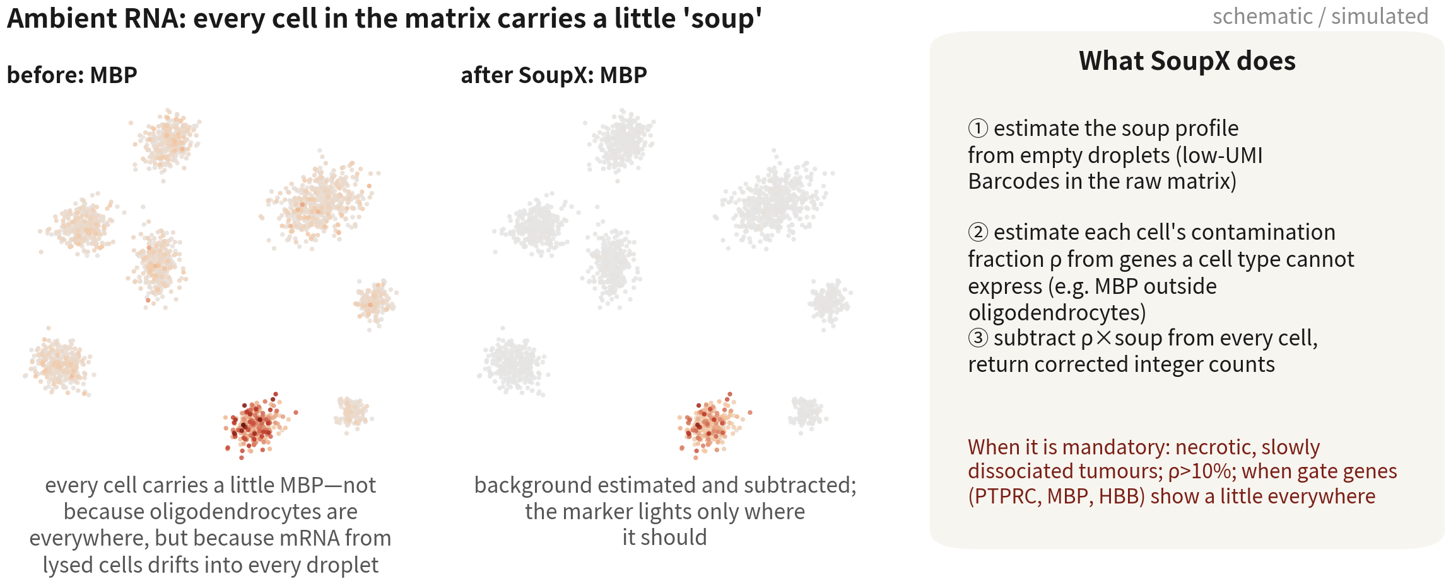
Ambient RNA: how to spot it, how to remove it
A gate gene showing a little everywhere → estimate contamination first; above ρ ≈
10%, run SoupX (or CellBender) before QC
References: Young MD, Behjati S. Gigascience. 2020;9(12):giaa151. doi:10.1093/gigascience/giaa151 ｜ Fleming SJ, et al. Nat Methods. 2023;20(9):1323–1335. doi:10.1038/s41592-023-01943-7
Q2 Hands-on I
11
Notes:
左圖是校正前的 MBP，寡樹突細胞的 marker。寡樹突那一塊很亮，沒問題；問題是每一顆細胞都有一點顏色。這就是環境 RNA：不是寡樹突細胞無所不在，是它們裂解後的 mRNA 飄進了每一顆液滴。腦組織的 MBP 特別多，因為髓鞘的 RNA 量大。 右圖是 SoupX 校正後的樣子：背景被扣掉，譜系標誌基因回到只在該亮的地方亮。 SoupX 做三件事。先用 raw 矩陣裡 UMI 很少的 Barcode——也就是空液滴——估計湯的基因組成。再用一組「某型別絕對不會表現」的基因，估計每顆細胞的污染比例 ρ；比方說免疫細胞裡的 MBP、非免疫細胞裡的 PTPRC。最後按 ρ 從每顆細胞扣掉背景，回傳整數 counts。 那什麼時候一定要做？壞死多、解離久的腫瘤；ρ 超過百分之十；或者我們看到譜系標誌基因到處都有一點。ρ 在百分之五以下，可以略過。 ──────── The left figure is MBP before correction — the oligodendrocyte marker. The oligodendrocyte block being bright is fine. The problem is that every single cell carries a bit of colour. That's ambient RNA: it's not that oligodendrocytes are everywhere, it's that their mRNA drifted into every droplet after they lysed. Brain tissue runs especially high on MBP, because myelin carries a lot of RNA. The right figure is after SoupX correction: the background is subtracted, and the lineage marker is back to lighting up only where it should. SoupX does three things. It uses the barcodes in the raw matrix with very few UMIs — the empty droplets — to estimate the soup's gene composition. It then takes a set of genes that a given cell type absolutely never expresses and uses them to estimate each cell's contamination fraction rho; MBP in immune cells, say, or PTPRC in non-immune cells. And finally it subtracts the background from each cell according to rho and returns integer counts. So when is it mandatory? Tumours with heavy necrosis or long dissociation; rho over ten percent; or when we see lineage markers showing up a little bit everywhere. Below five percent rho, it can be skipped.

Slide 12
SoupX: estimating and removing ambient RNA
(optional, script 01 §0)
library(SoupX) sc <- load10X("data/gbm5k_outs/") # needs raw + filtered side by side sc <- setClusters(sc, gbm$seurat_clusters) # a rough clustering first sc <- autoEstCont(sc) # estimate the contamination fraction rho sc$fit$rhoEst # e.g. 0.06 -> optional at this level adj <- adjustCounts(sc, roundToInt = TRUE) # corrected integer counts gbm <- CreateSeuratObject(adj, project = "gbm5k", min.cells = 3, min.features = 200)
Needs the raw matrix, so datasets that ship filtered-only cannot do this; always keep raw for our own data. Skip below ρ ≈ 5% | Deeper: B5
Reference: Young MD, Behjati S. Gigascience. 2020;9(12):giaa151. doi:10.1093/gigascience/giaa151
Q2 Hands-on I
12
Notes:
程式碼很短。load10X 讀 Cell Ranger 的 outs 資料夾——注意，它需要 raw 和 filtered 同時在。setClusters 給它一個粗略的分群，任何 resolution 都行，因為它只是要用群來找「哪些基因在哪些群裡不該出現」。autoEstCont 自動估污染比例，印出 rhoEst 看數字。adjustCounts 回傳校正後的整數矩陣，重新建物件，後面流程照走。 兩個提醒。第一，10x 官網有些資料集只給 filtered，那就做不了 SoupX；所以我們自己產的資料一定要保留 raw。第二，這是選做：這份資料的 ρ 大約在個位數百分比，做不做對主要結論影響不大；但如果我們手上的腫瘤樣本 ρ 是兩成，不做的話後面每一群都會「表現一點免疫基因」，註釋會非常痛苦。腳本 01 的第 0 節有完整版本。 ──────── The code is short. load10X reads Cell Ranger's outs folder — and note, it needs raw and filtered together. setClusters gives it a rough clustering; any resolution works, because all it does with the clusters is find which genes should not appear in which clusters. autoEstCont estimates the contamination fraction automatically; print rhoEst to see the number. adjustCounts returns the corrected integer matrix; rebuild the object and the rest of the pipeline runs as usual. Two reminders. First, some datasets on the 10x site only ship filtered, and then SoupX simply cannot be done — so for data we generate ourselves, always keep raw. Second, this is optional: this dataset's rho is around single-digit percent, so doing it or not barely changes the main conclusions. But if the tumour sample in front of us has rho at twenty percent and we skip this, every cluster downstream will express a bit of immune genes, and annotation becomes miserable. Script 01 section 0 has the full version.

Slide 13
02
QC: three cutoffs set from the data
Look first, cut second; save the raw object before filtering
Q2 Hands-on I
13
Notes:
第二段，QC。上一集說過，這是唯一不可逆的一步。腫瘤樣本要定三條線，而且每一條都要從這份資料自己的分布來。動手過濾之前，先存一份原始物件。 ──────── Section two, QC. Last episode we said this is the only irreversible step. Tumour samples need three cutoffs, and every one of them has to come from this dataset's own distributions. Before we filter anything, save a copy of the raw object.

Slide 14
The three QC metrics: inspect the distributions before filtering
gbm[["percent.mt"]] <- PercentageFeatureSet(gbm, pattern = "^MT-") saveRDS(gbm, "output/rds/01_gbm_raw.rds") # save before filtering: a cut cannot be undone VlnPlot(gbm, features = c("nFeature_RNA", "nCount_RNA", "percent.mt"), ncol = 3, pt.size = 0.05) FeatureScatter(gbm, "nCount_RNA", "percent.mt") FeatureScatter(gbm, "nCount_RNA", "nFeature_RNA")
nCount catches empties and doublets, nFeature debris, percent.mt dying cells | Script 01 §2 | Deeper: B5
Q2 Hands-on I
14
Notes:
第一行算 percent.mt，也就是粒線體基因的比例。人類的粒線體基因以 MT 橫線開頭。 第二行 saveRDS，過濾前先存一份。三個月後審稿人要我們換一組閾值重跑，就會慶幸有這一行。 接著是三張圖。小提琴圖看三個指標各自的分布，兩張散點圖把它們兩兩配對起來看。這三個指標各抓一種壞東西：nCount 雙低是空滴、雙高是 doublet；nFeature 太低是碎片；percent.mt 衝高是垂死細胞。 ──────── The first line computes percent.mt, the fraction of mitochondrial genes. Human mitochondrial genes start with MT dash. The second line is saveRDS — save before filtering. Three months from now, when a reviewer asks for a different set of thresholds, we'll be glad this line is here. Then three plots. The violin plots show the distribution of each of the three metrics, and two scatter plots pair them up. Each metric catches one kind of bad thing: nCount low on both is empty droplets, high on both is doublets; nFeature too low is debris; percent.mt spiking is dying cells.

Slide 15
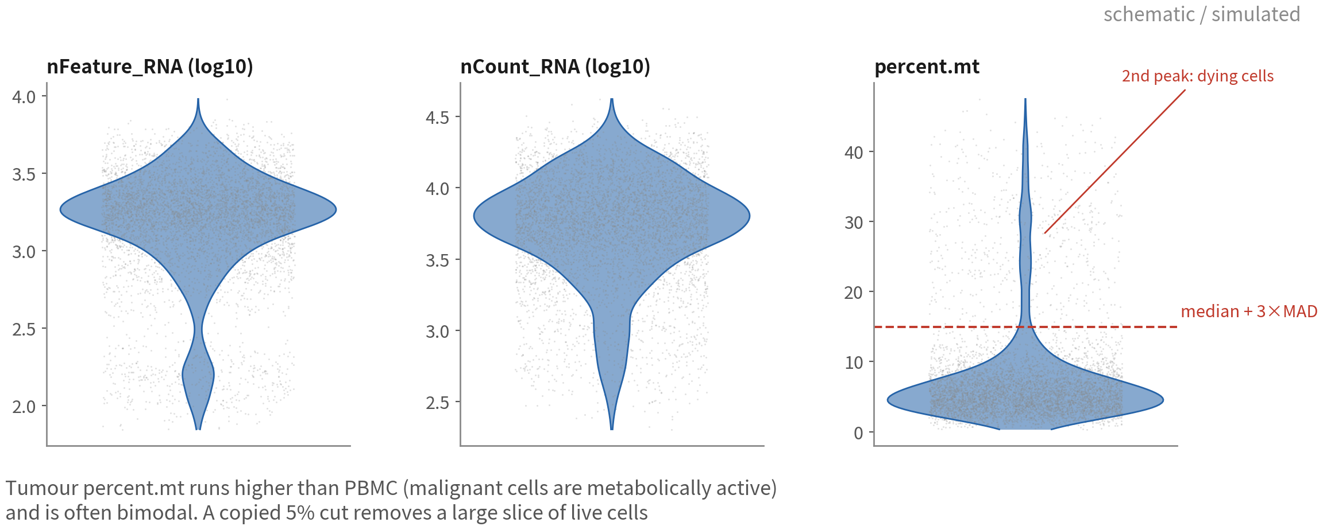
QC distributions: a tumour sample as the example
percent.mt runs higher than PBMC and is often bimodal. The second mode is dying
cells; the line goes between the modes
Q2 Hands-on I
15
Notes:
這是腫瘤樣本典型的長相，先認得它。 nFeature 和 nCount 的主體是乾淨細胞，往下的尾巴是空滴與碎片，往上的離群是 doublet。這部分跟 PBMC 差不多。 不一樣的是 percent.mt。腫瘤的主體本來就比 PBMC 高——惡性細胞代謝旺盛，粒線體多——而且常常還有第二個峰。那個峰就是垂死細胞。所以線要畫在兩峰之間，不是畫在 5%。等一下用 MAD 算出來的線，自然就會落在那裡。 ──────── This is the typical shape for a tumour sample, and it's worth learning to recognise. For nFeature and nCount, the bulk is clean cells, the downward tail is empty droplets and debris, the upward outliers are doublets. Much the same as PBMC. What's different is percent.mt. The tumour's bulk sits inherently higher than PBMC — malignant cells are metabolically hyperactive and packed with mitochondria — and on top of that there is often a second peak. That peak is dying cells. So the line has to go between the two peaks, not at 5%. The MAD-based line we compute in a moment lands there naturally.

Slide 16
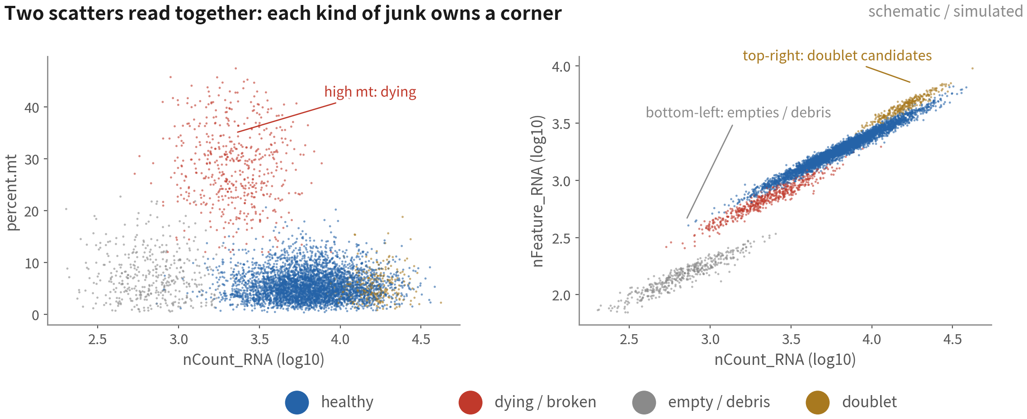
QC scatter plots: where the three failure modes sit
One metric misleads; read them in pairs. The top-right doublet candidates get
confirmed with a dedicated tool shortly
Q2 Hands-on I
16
Notes:
先看左邊這張，橫軸 nCount、縱軸 percent.mt。浮在上方那一撮紅色的，就是 mt 很高的垂死細胞。 再看右邊，nCount 對 nFeature。沿著對角線的那條主帶是乾淨細胞，我們要的就是它們。左下角兩個指標都低，那是空滴跟碎片；右上角兩個指標都高，那是 doublet 候選。 為什麼要兩兩配對著看？因為單一指標一定會誤判。配對之後，三種壞細胞各佔一個角落，一眼就分得出來。右上角那撮 doublet 候選先記著，等一下我們用專門工具確認。 ──────── Start on the left: nCount along the bottom, percent.mt up the side. That red clump floating along the top is the high-mt dying cells. Now the right-hand plot, nCount against nFeature. The main band running along the diagonal is the clean cells — those are the ones we want. Down in the bottom-left corner, low on both metrics, sit the empty droplets and the debris; up in the top-right corner, high on both, sit the doublet candidates. So why look at them in pairs? Because a single metric will always misjudge. Pair them up and the three kinds of bad cell each take a corner, and we can tell them apart at a glance. Keep that top-right clump of doublet candidates in mind — we'll confirm it with a dedicated tool in a moment.

Slide 17
Filtering with MAD-based adaptive cutoffs
mad.hi <- function(x, k = 3) median(x) + k * mad(x) # mad() already includes 1.4826 mad.lo <- function(x, k = 3) median(x) - k * mad(x) mt.hi <- mad.hi(gbm$percent.mt) # actual run on this dataset = 13.1 nf.lo <- 10^mad.lo(log10(gbm$nFeature_RNA)) # lower bound, computed on the log scale nc.hi <- 10^mad.hi(log10(gbm$nCount_RNA)) # upper bound, computed on the log scale c(mt.hi = mt.hi, nf.lo = nf.lo, nc.hi = nc.hi) gbm <- subset(gbm, subset = percent.mt < mt.hi & nFeature_RNA > nf.lo & nCount_RNA < nc.hi) gbm # record how many cells were dropped
nCount / nFeature are log-normal, so compute MAD on log10; percent.mt as is | Script 01 §3
Reference: Amezquita RA, et al. Nat Methods. 2020;17(2):137–145. doi:10.1038/s41592-019-0654-x
Q2 Hands-on I
17
Notes:
不要抄別人的數字。我們用一個對離群值穩健的統計量：中位數加減三倍 MAD。mad 這個函式已經幫我們含了常態校正。 要畫三條線。percent.mt 的上限直接算就好。nFeature 的下限跟 nCount 的上限比較講究，要先取 log10 再算——因為這兩個指標是對數常態分布，在原始尺度算 MAD 會被長尾拉歪。算完再用 10 的次方換回來。 GBM 5k 的 mt 上限算出來是 13.1%，比 PBMC 的 5% 高很多，而且剛好落在兩峰之間。接著 subset 過濾，印出物件，記下濾掉幾顆。 濾掉的比例如果超過兩三成，停一下，先懷疑樣本或閾值，不要急著往下跑。 ──────── Don't copy someone else's numbers. Use a statistic that's robust to outliers instead: the median plus or minus three times the MAD. The mad function already folds in the normality correction for us. Three cutoffs to draw. The percent.mt upper limit we can compute directly. The nFeature lower limit and the nCount upper limit are fussier — take log10 first, because those two metrics are log-normally distributed, and computing MAD on the raw scale gets pulled sideways by the long tail. Compute there, then transform back with ten to the power. For GBM 5k the mt upper limit comes out at 13.1%, much higher than PBMC's 5%, and it lands right between the two peaks. Then subset filters; print the object and note how many cells were removed. And if the fraction removed goes above twenty or thirty percent, stop. Suspect the sample or suspect the thresholds first — don't rush ahead.

Slide 18
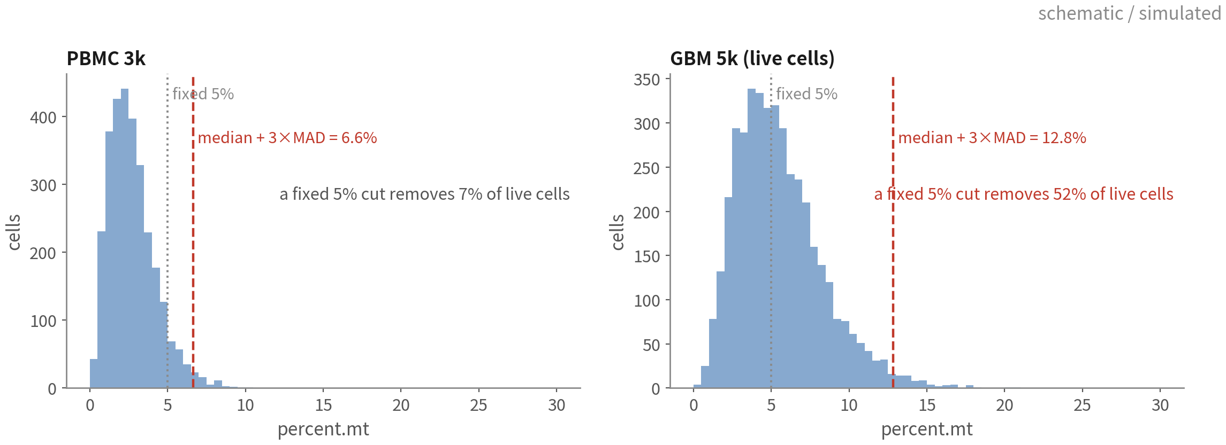
One rule, two datasets, two different lines
A copied 5% cut on GBM removes half the live cells — mostly the metabolically active malignant ones
Q2 Hands-on I
18
Notes:
這一頁就是 MAD 比抄數字好在哪裡。 左邊是 PBMC 3k，中位數加三倍 MAD 算出來大約 6.6%，跟慣例的 5% 其實差不多；固定用 5%，也只砍掉 7% 的活細胞。 右邊換成 GBM 5k 的活細胞，同一條規則算出來的線落在兩峰之間，遠高於 5%——這張是示意圖，實跑真實資料是 13.1%。這時候要是照抄 5%，一刀下去砍掉一半的活細胞——而且砍掉的多半是代謝最旺盛的惡性細胞。剩下的資料裡免疫細胞的比例被灌大，之後所有組成分析全歪。 同一行程式碼，兩份資料，兩條線。這叫跟著資料走。 ──────── This is the slide that shows what MAD buys us over copying numbers. On the left, PBMC 3k. Median plus three MAD comes out around 6.6%, not far off the conventional 5%; take a fixed 5% and we only cut 7% of the live cells. On the right, the live cells of GBM 5k. Same rule, and the line lands between the two peaks, far above 5% - this panel is schematic; the real data gives 13.1%. Copy 5% here and one cut takes half the live cells with it — and mostly the most metabolically active malignant cells. In what remains, the immune fraction is inflated, and every composition analysis afterwards is skewed. Same line of code, two datasets, two cutoffs. That's what following the data means.

Slide 19
COPY-READY METHODS SENTENCE
"Cells were retained with:
percent.mt < median + 3×MAD (13.1%);
nFeature and nCount within median ± 3×MAD on log10 scale;
5,261 of 5,506 cells kept."
98 of the 5,604 barcodes are dropped first by min.features = 200, so the
three MAD cutoffs start from 5,506. Recompute all three on your own data.
Q2 Hands-on I
19
Notes:
這句話可以直接寫進論文的方法段：「細胞保留條件：percent.mt 小於中位數加三倍 MAD，等於 13.1%；nFeature 與 nCount 在 log10 尺度的中位數正負三倍 MAD 內；五千五百零六顆中保留五千兩百六十一顆。」 把 N 跟那三個數字換成我們自己跑出來的就好。原則是：每條線都要有數字、有理由。 ──────── Here's the sentence that goes straight into the paper's methods paragraph: "Cells were retained if percent.mt was below the median plus three MAD, equal to 13.1%; nFeature and nCount within the median plus or minus three MAD on the log10 scale; 5,261 of 5,506 cells retained." Swap N and the three numbers for what we actually got. The principle: every cutoff needs a number and a reason.

Slide 20
Doublets: flag with DoubletFinder, do not delete yet
library(DoubletFinder) # DoubletFinder looks for neighbours in PC space -> build a temporary object (the real clustering is in 02) tmp <- NormalizeData(gbm) |> FindVariableFeatures(nfeatures = 2000) |> ScaleData() |> RunPCA(npcs = 30) |> FindNeighbors(dims = 1:20) |> FindClusters(resolution = 0.5) # 1. sweep pK: the only parameter we tune bcmvn <- find.pK(summarizeSweep(paramSweep(tmp, PCs = 1:20, sct = FALSE), GT = FALSE)) pK.sel <- as.numeric(as.character(bcmvn$pK[which.max(bcmvn$BCmetric)])) # 2. the expected doublet count is ours to supply: 10x is ~0.8% per 1,000 cells, then remove homotypic ones nExp <- round(0.008 * ncol(tmp) / 1000 * ncol(tmp)) nExp <- round(nExp * (1 - modelHomotypic(tmp$seurat_clusters))) tmp <- doubletFinder(tmp, PCs = 1:20, pN = 0.25, pK = pK.sel, nExp = nExp, sct = FALSE) pann <- grep("^pANN_", colnames(tmp@meta.data))[1] # the column name carries the parameters, so grep it dfcl <- grep("^DF.classifications_", colnames(tmp@meta.data))[1] gbm$dbl.score <- tmp@meta.data[[pann]] gbm$dbl.class <- tolower(tmp@meta.data[[dfcl]]) table(gbm$dbl.class)
expected rate 4.2% (5,261 cells) -> nExp = 221 -> after removing homotypic = 198
the doublet count from table() equals 198 - we supplied that number, the tool did not find it
We supply the rate and the flagged count equals nExp exactly — that number belongs in our methods | Script 01 §4 | Deeper: B5
Reference: McGinnis CS, Murrow LM, Gartner ZJ. Cell Syst. 2019;8(4):329–337.e4. doi:10.1016/j.cels.2019.03.003
Q2 Hands-on I
20
Notes:
剛才那些指標抓不到的壞細胞，就是 doublet，得靠專門工具。這一集我們用 DoubletFinder——它發表在 Cell Systems，在 Xi 與 Li 那篇獨立的 benchmark 裡準確度排第一。 DoubletFinder 是在主成分空間裡找鄰居，所以它需要一個已經跑過標準流程的物件。我們先做一份暫時的 tmp：normalize、挑高變異基因、scale、PCA、粗分群，這份只給它用；正式的分群要到下一支腳本才做。 接著兩件事。一是掃 pK，那是 DoubletFinder 唯一要調的參數，講白了就是鄰域要取多大：paramSweep 加 summarizeSweep 加 find.pK，取 BCmetric 最高的那個值。二是給期望 doublet 數，這是它跟其他工具最大的差別——期望率要我們自己給，不是工具替我們估。10x 的經驗法則是每千顆細胞約百分之零點八，再用 modelHomotypic 把「同型別相撞、原理上看不出來的那一部分」扣掉。 然後跑 doubletFinder。它會在 metadata 加兩欄，pANN 是分數、DF.classifications 是判定，我們把它們存成 dbl.score 和 dbl.class。 這裡請一定要記住一件事：DoubletFinder 標記出來的 doublet 數，就等於我們給的 nExp，一顆不多、一顆不少。所以那個期望率不是先驗，它直接決定了答案，必須寫進方法段。 最後選配地再跑一次 scDblFinder 交叉比對。兩個工具都判到的，才是高信心的 doublet。 還有，先標記、先不刪。等分群之後，看哪一群「整群」是 doublet，再決定。 ──────── The one kind of bad cell those metrics cannot catch is doublets, and for those we need a dedicated tool. This episode uses DoubletFinder — published in Cell Systems, and the top method for accuracy in Xi and Li's independent benchmark. DoubletFinder hunts for neighbours in principal-component space, so it needs an object that has already been through the standard pipeline. We build a temporary object here — normalize, variable features, scale, PCA, a rough clustering — purely for its use; the real clustering waits for the next script. Then two things. First, sweep pK, the one parameter DoubletFinder asks us to tune, which in plain terms is how large a neighbourhood to use: paramSweep, then summarizeSweep, then find.pK, and take the value with the highest BCmetric. Second, give it the expected number of doublets. This is the biggest difference from other tools — we supply the rate, the tool does not estimate it for us. The 10x rule of thumb is about 0.8 percent per thousand cells, and modelHomotypic then subtracts the share that is homotypic: same-type collisions, which are invisible in principle. Then run doubletFinder. It adds two metadata columns, pANN for the score and DF.classifications for the call; we store them as dbl.score and dbl.class. Please hold on to one thing here: the number of doublets DoubletFinder flags is exactly the nExp we gave it — not one more, not one fewer. So that expected rate is not a prior. It determines the answer, and it belongs in the methods section. Finally, optionally, run scDblFinder as a cross-check. The cells flagged by both tools are the high-confidence doublets. And note: flag first, don't delete yet. After clustering, look for a cluster that is doublet wall to wall, then decide.

Slide 21
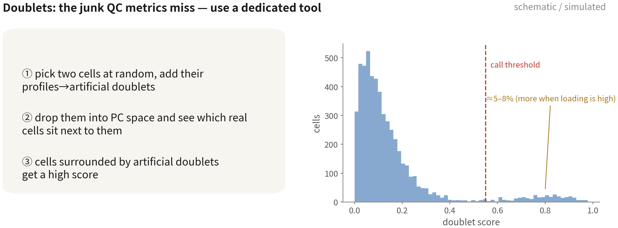
What DoubletFinder does
Tumour doublet risk is high: a malignant cell stuck to a macrophage looks like a
'tumour cell expressing immune genes'
Reference: McGinnis CS, Murrow LM, Gartner ZJ. Cell Syst. 2019;8(4):329–337.e4. doi:10.1016/j.cels.2019.03.003
Q2 Hands-on I
21
Notes:
原理只有三步。隨機挑兩顆細胞，把表現量相加，製造一顆人造 doublet。把人造 doublet 丟回主成分空間，看誰跟它們當鄰居。鄰居裡人造 doublet 比例愈高的細胞，分數就愈高——這個比例就是 pANN。 看右邊的分數分布：大多數細胞 pANN 很低，右邊一小撮很高。但要特別注意，DoubletFinder 不是在谷底畫閾值，而是直接取 pANN 最高的 nExp 顆。閾值落在哪，是我們給的期望率決定的。腫瘤裝載量高的時候，doublet 可以到 5 到 8%。 腫瘤還有兩個方向相反的特有風險。一邊是惡性細胞加巨噬細胞的 doublet，會長得像「同時表現 SOX2 和 CD74 的腫瘤細胞」，很容易被寫成一個有趣的發現。另一邊反過來：惡性細胞本身 RNA 量大、轉錄程式混雜，本來就容易被誤判成 doublet。兩個方向的錯誤都真實存在，所以我們先標記，分群後再用群層級的證據檢查。 ──────── The principle is only three steps. Pick two cells at random and add their expression together to manufacture an artificial doublet. Throw the artificial doublets back into principal-component space and see who ends up neighbouring them. Cells whose neighbourhoods are rich in artificial doublets score high — and that fraction is pANN. Look at the score distribution on the right: most cells have low pANN, with a small clump high up on the right. But note carefully that DoubletFinder does not put a threshold in the valley; it simply takes the nExp cells with the highest pANN. Where the threshold lands is decided by the expected rate we supplied. With high tumour loading, doublets can reach 5 to 8%. Tumours bring a specific risk that runs in two directions. One way, a malignant-cell-plus-macrophage doublet looks like a tumour cell expressing SOX2 and CD74 at the same time, which is very easy to write up as an interesting finding. The other way round, malignant cells carry a lot of RNA and mix transcriptional programs, so they are themselves prone to being mis-called as doublets. Both errors are real, so we flag first and check with cluster-level evidence once we have clustered.

Slide 22
Choosing a doublet tool, and what rate to expect
The more cells loaded, the more doublets: the 10x rule of thumb is ≈ 0.8% per 1,000 cells
Tool | Idea | Strengths | Watch out
DoubletFinder | Artificial doublets + pANN fraction; the top nExp cells are called | Published in Cell Systems; top for accuracy in the Xi & Li 2021 benchmark | We supply both the expected rate and pK; the pK sweep is slow
scDblFinder (cross-check) | Artificial doublets + kNN classifier; rate and threshold estimated automatically | One line, Bioconductor-maintained, native multi-sample | Published in F1000Research; not included in that benchmark
Scrublet (Python) | Same idea, built into scanpy | The default in Python pipelines | Nearly blind to homotypic doublets
Hashing / demuxlet | Wet-lab: antibody tags or SNPs to split samples | The only way to catch homotypic doublets; free when pooling patients | Decided at design time not afterwards
References: Xi NM, Li JJ. Cell Syst. 2021;12(2):176–194.e6. doi:10.1016/j.cels.2020.11.008 ｜ Germain PL, Lun A, et al. F1000Res. 2021;10:979. doi:10.12688/f1000research.73600.2
Q2 Hands-on I
22
Notes:
工具不只 DoubletFinder，這張表就是幫我們選的。 先講期望值。doublet 比例跟裝載的細胞數成正比，10x 的經驗法則是每一千顆細胞大約百分之零點八。裝一萬顆，就預期百分之八左右。所以一份五千顆的樣本，抓到兩三百顆 doublet 是合理的；抓到一千顆，就要回頭看是不是參數給錯了。 DoubletFinder 是本課的選擇：人造 doublet 加 pANN 比例，發表在 Cell Systems，Xi 與 Li 2021 的 benchmark 裡準確度排第一。代價是期望率跟 pK 都要我們自己給，pK 掃描也比較慢。 scDblFinder 原理相近，但實作是獨立的：一行跑完、自動估期望率、自動找閾值、Bioconductor 維護，而且原生支援多樣本。它發表在 F1000Research，也沒有被納入上面那篇 benchmark。兩者準確度相當，所以實務上建議兩個都跑、取交集當高信心 doublet。Scrublet 是 Python 那邊的預設，同型 doublet 幾乎抓不到。 最後一列是實驗端的方法：cell hashing 用抗體標籤、demuxlet 用 SNP，把不同樣本混在一起跑，跨樣本的 doublet 直接看得出來。這是唯一能穩定抓「同型 doublet」——兩顆同型別黏在一起——的方法，多病人混跑的時候等於免費得到。但它要在實驗設計的時候就決定，事後做不了。 ──────── DoubletFinder is not the only tool, and this table is here to help us choose. Expectations first. The doublet fraction scales with the number of cells loaded, and 10x's rule of thumb is roughly 0.8 percent per thousand cells. Load ten thousand, expect around eight percent. So for a five-thousand-cell sample, catching two to three hundred doublets is reasonable; catch a thousand and we go back to check whether a parameter was wrong. DoubletFinder is this course's choice: artificial doublets and the pANN fraction, published in Cell Systems and ranked top for accuracy in Xi and Li's 2021 benchmark. The price is that we supply both the expected rate and pK ourselves, and the pK sweep is slow. scDblFinder works on a similar principle but is an independent implementation: one line, automatic rate estimation, automatic threshold, Bioconductor-maintained, with native multi-sample support. It was published in F1000Research and was not included in that benchmark. The two are comparable in accuracy, so in practice running both and taking the intersection as high-confidence doublets is the safest option. Scrublet is the Python default; it almost never catches homotypic doublets. The last row is the experimental-side methods: cell hashing uses antibody tags, demuxlet uses SNPs — mix different samples into one run and cross-sample doublets are directly visible. This is the only way to reliably catch homotypic doublets, two cells of the same type stuck together, and when we pool multiple patients it comes for free. But it has to be decided at experimental design time; there is no doing it after the fact.

Slide 23
03
Normalize, HVG, scale, PCA
Script 02: four lines of code, three sanity checks
Q2 Hands-on I
23
Notes:
第三段，腳本 02。四行程式碼，然後三個必要檢查。 ──────── Section three, script 02. Four lines of code, and then three sanity checks we don't skip.

Slide 24
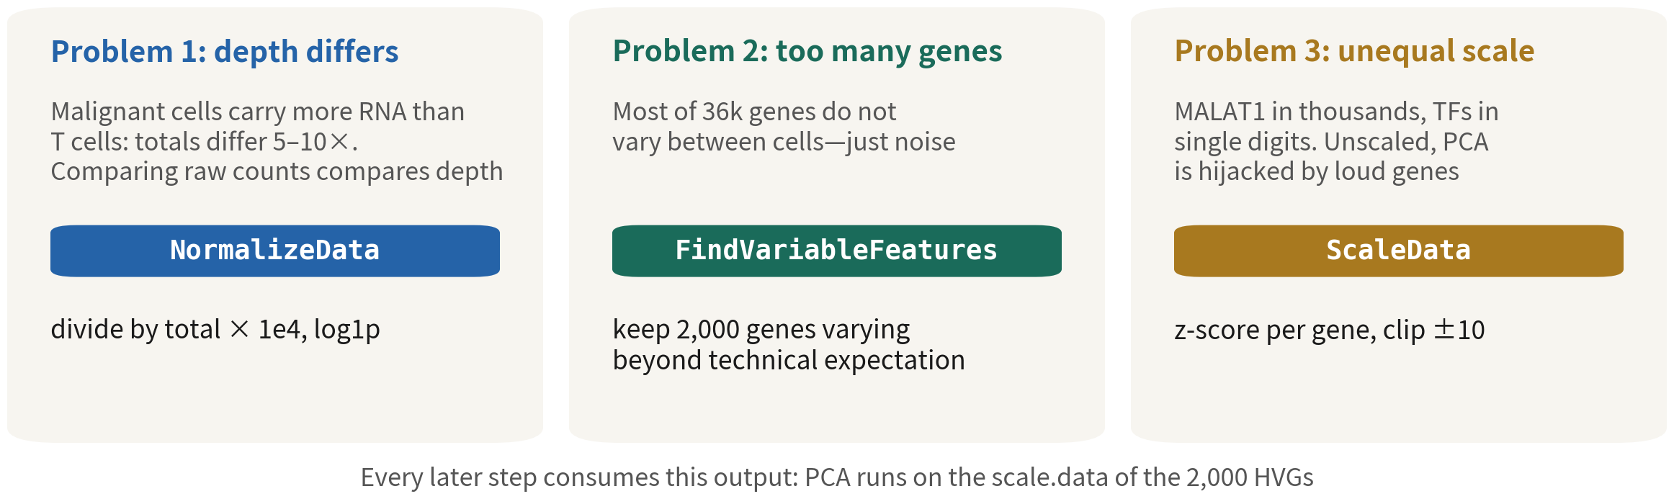
Three problems, three steps
A malignant cell often carries ten times a T cell's RNA — step one removes exactly that difference
Q2 Hands-on I
24
Notes:
先看擋在前面的三個問題。深度不同——惡性細胞的 RNA 總量常常是 T 細胞的十倍，直接比就是在比深度，這個交給 NormalizeData。基因太多——三萬六千個基因，多數在細胞之間沒差異，只是雜訊，所以用 FindVariableFeatures 挑兩千個。量級不等——MALAT1 動輒上千，轉錄因子只有個位數，不拉平，PCA 就被大聲的基因綁架，這是 ScaleData 的工作。 這幾步是串起來的，後面每一步都吃前一步的輸出：PCA 用的，就是那兩千個 HVG 的 scale.data。 ──────── Three problems stand in the way. Depth differs: a malignant cell's total RNA is often ten times a T cell's, so comparing them directly means comparing depth — that one goes to NormalizeData. Too many genes: of the thirty-six thousand genes, most don't differ between cells and are just noise, so FindVariableFeatures picks two thousand. Unequal magnitudes: MALAT1 runs into the thousands while transcription factors sit in single digits, and without flattening that, PCA gets hijacked by the loud genes — that's ScaleData's job. These steps are strung together, and every later one eats the output of the one before: what PCA runs on is the scale.data of those two thousand HVGs.

Slide 25
Four preprocessing steps, plus cell-cycle scores
gbm <- NormalizeData(gbm) # CP10K + log1p: removes depth gbm <- FindVariableFeatures(gbm, nfeatures = 2000) # pick 2,000 HVGs head(VariableFeatures(gbm), 10) # take one look at the list gbm <- CellCycleScoring(gbm, s.features = cc.genes.updated.2019$s.genes, g2m.features = cc.genes.updated.2019$g2m.genes) gbm <- ScaleData(gbm) # z-score, clip at +/-10 (HVGs only) gbm <- RunPCA(gbm, npcs = 50) # compute and keep 50 PCs
Score the cycle now so we can see whether cycling cells form their own cluster; we do not regress by default | Script 02 §1 | Deeper: B6
Reference: Hao Y, et al. Nat Biotechnol. 2024;42(2):293–304. doi:10.1038/s41587-023-01767-y
Q2 Hands-on I
25
Notes:
NormalizeData：每顆細胞除以總量、乘一萬、取 log1p。深度差異就這樣被除掉了。 FindVariableFeatures：挑兩千個 HVG，head 印前十個出來。這份名單值得先看一眼，下一頁講。 中間我們插一步 CellCycleScoring，用 Seurat 內建的 S 期與 G2M 期基因集，給每顆細胞打週期分數，順便得到 Phase 欄位。為什麼是現在算？因為腫瘤裡增殖的細胞很多，週期訊號很強，常常會自成一群。先把分數算好，等一下分群完就能拿來檢查。本系列預設不 regress 掉週期，因為增殖本身就是腫瘤的生物學；但我們要知道它在那裡。 最後 ScaleData 做 z-score、clip 正負十，預設只做那兩千個 HVG；RunPCA 算五十個主成分存著。 ──────── NormalizeData: divide each cell by its total, multiply by ten thousand, take log1p. The depth difference is divided away, just like that. FindVariableFeatures: pick two thousand HVGs, and head prints the top ten. That list is worth a look — the next slide explains why. In the middle we slip in one extra step, CellCycleScoring. Using Seurat's built-in S-phase and G2M-phase gene sets, it scores every cell for the cycle and gives us a Phase column as a bonus. Why compute it now? Because tumours are full of proliferating cells, the cycle signal is strong, and it often forms a cluster of its own. Get the scores in now and we can check right after clustering. This series does not regress out the cycle by default, because proliferation is itself tumour biology — but we need to know it's there. Then ScaleData does the z-score, clipped at plus or minus ten, and by default only on those two thousand HVGs; RunPCA computes fifty principal components and stores them.

Slide 26
LogNormalize or SCTransform?
Both are valid; this course uses the former because every step is visible and it plays well with pseudobulk and inferCNV
LogNormalize (this course)
SCTransform
CP10K + log1p; HVG via vst
Negative-binomial regression; depth
removed more cleanly
•
Simple, fast, interpretable; the data layer
feeds FeaturePlot / DotPlot directly
•
Steadier HVGs, often cleaner clusters; v2
handles wide depth ranges well
•
The counts layer stays untouched —
pseudobulk, inferCNV and SoupX all need it
•
Adds an SCT assay; run PrepSCTFindMarkers
before FindMarkers; run it per sample
before integrating
•
With extreme depth differences (malignant
vs T cells) a little depth effect remains —
the PC1 check catches it
•
DE, CNV and pseudobulk still come from RNA
counts — never from SCT values
Reference: Hafemeister C, Satija R. Genome Biol. 2019;20(1):296. doi:10.1186/s13059-019-1874-1
Q2 Hands-on I
26
Notes:
很多人會問：為什麼不用 SCTransform？兩條路都對，這一頁把差別講清楚，我們自己選。 LogNormalize 是本課的選擇。除以總量、乘一萬、取 log1p；HVG 用 vst 方法挑；要回歸什麼，在 ScaleData 做。它的好處是每一步都看得見、可解釋，data 層直接拿來畫 FeaturePlot 跟 DotPlot；最重要的是 counts 層原封不動——Q3 的 pseudobulk、inferCNV，還有剛才的 SoupX，全部要整數 counts。缺點是深度差異極大的時候，例如惡性細胞跟 T 細胞差十倍，會殘留一點深度效應。下一頁的 PC1 檢查，就是在抓這個。 SCTransform 走的是正則化的負二項回歸，把深度效應除得更乾淨，HVG 挑得更穩，分群常常更乾淨；v2 版對深度差大的資料特別好。代價是多一個 SCT assay，FindMarkers 前要先 PrepSCTFindMarkers，整合時要每個樣本分開跑。而且——這一點我看過太多人踩——DE、CNV、pseudobulk 仍然要回到 RNA 的 counts 層，絕對不能拿 SCT 的值去做。 結論是：兩條路的下游結論通常一致。看得懂 LogNormalize 的每一步，之後要換到 SCTransform，也不過就是換一行程式碼。 ──────── Lots of people ask: why not SCTransform? Both roads are valid — this slide lays out the difference so we can choose for ourselves. LogNormalize is this course's choice. Divide by total, times ten thousand, log1p; HVGs picked with the vst method; anything that needs regressing goes in ScaleData. Its virtue is that every step is visible and explainable, the data layer feeds FeaturePlot and DotPlot directly — and most importantly the counts layer stays untouched. Q3's pseudobulk and inferCNV, and the SoupX we just saw, all need integer counts. The downside: when depth differences are extreme — malignant cells versus T cells at ten to one — a bit of depth effect remains. The PC1 check on the next slide is there to catch exactly that. SCTransform takes the regularized negative binomial regression route: it removes the depth effect more cleanly, picks HVGs more stably, and clustering often comes out cleaner, and the v2 version is especially good for data with large depth differences. The cost: an extra SCT assay, PrepSCTFindMarkers before FindMarkers, and per-sample runs during integration. And — this is the one I've watched people trip over again and again — DE, CNV, and pseudobulk must still go back to the RNA counts layer; never feed them SCT values. Bottom line: the two roads usually reach the same downstream conclusions. Understand every step of LogNormalize, and switching to SCTransform later is just swapping one line of code.

Slide 27
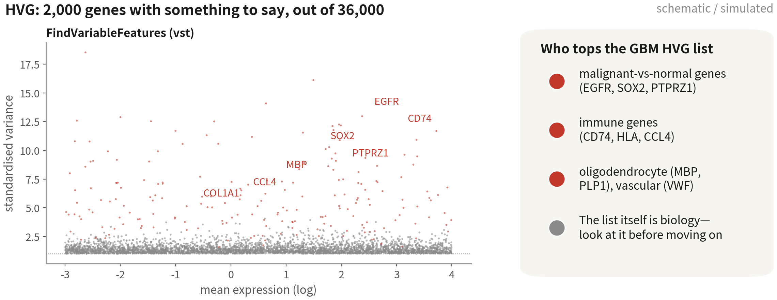
The HVG list carries biology — but the ranking misleads
The top 20 here are almost all stromal genes, from a 140-cell fibroblast cluster.
HVG ranks variance, not importance | Script 02 §1
Q2 Hands-on I
27
Notes:
這是 FindVariableFeatures 的 mean-variance 圖。灰點是所有基因，紅點是被挑出來的兩千個——它們的變異超出了技術預期。 那這份資料的前二十名是誰？COL3A1、COL1A1、DCN、LUM、POSTN——幾乎全是膠原蛋白與基質基因。不是免疫，也不是膠質。 為什麼？因為 HVG 排的是變異量，不是重要性。一群只有一百四十顆、但轉錄體跟其他人完全不一樣的細胞，變異量就會衝到最前面。那是血管周與纖維母細胞，跑完分群我們會看到它是 cluster 9，只佔全部的百分之二點七。 所以「光看名單就知道資料裡有誰」這句話只對一半。名單告訴我們資料裡有一群極端的細胞，但它不會照數量或重要性排序。免疫、膠質、寡樹突的基因都在那兩千個裡面，只是排在後面。腳本裡加了一行檢查，直接印出關鍵譜系有沒有入選——不要只看前二十名就下結論。 ──────── This is the mean-variance plot from FindVariableFeatures. Grey dots are all the genes; the red dots are the two thousand picked out, the ones whose variance exceeds the technical expectation. So who's at the top in this dataset? COL3A1, COL1A1, DCN, LUM, POSTN — almost entirely collagen and stromal genes. Not immune. Not glial. Why? Because HVG ranks variance, not importance. A population of just a hundred and forty cells whose transcriptome looks nothing like anyone else's will shoot straight to the top. Those are the pericytes and fibroblasts, and after clustering we see them as cluster nine, two point seven percent of the data. So "one glance tells us who is in the data" is only half true. The list tells us there is an extreme population in there, but it does not rank by abundance or importance. The immune, glial and oligodendrocyte genes are all inside those two thousand — they just sit further down. The script adds one line that prints whether the key lineages made the cut, so don't draw conclusions from the top twenty alone.

Slide 28
Sanity check 1: PC1 is biology, not depth
print(gbm[["pca"]], dims = 1:2, nfeatures = 6) cor(Embeddings(gbm, "pca")[, 1], gbm$nCount_RNA) # < 0.3 fine; 0.3-0.5 check the loadings; > 0.5 investigate
PC_ 1
Positive: PMP2, CALD1, PTN, GAP43, ITM2C, SEC61G ← glial / malignant
Negative: LAPTM5, TYROBP, SRGN, FCER1G, CYBA, AIF1 ← immune
[1] 0.47
In GBM PC1 is almost always immune vs glial. 0.47 sits in the usual tumour band — judge by the loadings, not the coefficient | Script 02 §2 | Deeper: B7
Q2 Hands-on I
28
Notes:
先 print 出 PC1 的兩端。正端是 PMP2、CALD1、PTN、GAP43，膠質與神經，再往下第七名就是 PTPRZ1；負端是 LAPTM5、TYROBP、SRGN、FCER1G、AIF1，免疫。GBM 的第一主成分幾乎一定是這條軸：免疫對膠質。 第二行算 PC1 分數跟 nCount 的相關係數，這份資料算出來零點四七。門檻不是一刀切：小於零點三可以放心；零點三到零點五在腫瘤資料很常見，因為惡性細胞的 RNA 總量本來就比 T 細胞多好幾倍，深度差異本身就帶著生物學；超過零點五才要回頭查。 真正的判斷依據是載荷，不是係數本身。這裡兩端是免疫對膠質，是清楚的生物學，零點四七就可以往下走。反過來，如果我們看到零點九，而且載荷排出來是核糖體、粒線體這種到處都高的基因，那 PC1 就是「誰測得深」——最常見的原因是漏跑 NormalizeData。 ──────── print shows us the two ends of PC1. The positive end is PMP2, CALD1, PTN, GAP43 — glial and neural, with PTPRZ1 just behind at number seven; the negative end is LAPTM5, TYROBP, SRGN, FCER1G, AIF1 — immune. In GBM the first principal component is almost always this axis: immune versus glial. Second line: the correlation between PC1 scores and nCount. Here it comes out at zero point four seven. The threshold is not a single line. Below zero point three we are fine; zero point three to zero point five is common in tumour data, because malignant cells genuinely carry several times the RNA of a T cell, so the depth difference itself carries biology; above zero point five is when we go back and check. What decides it is the loadings, not the coefficient. Here the two ends are immune versus glial — clean biology — so zero point four seven is fine to move on from. Turn it around: if we saw zero point nine and the loadings came back as ribosomal and mitochondrial genes, genes that are high everywhere, then PC1 really is who got sequenced deeper, and the usual cause is a skipped NormalizeData.

Slide 29
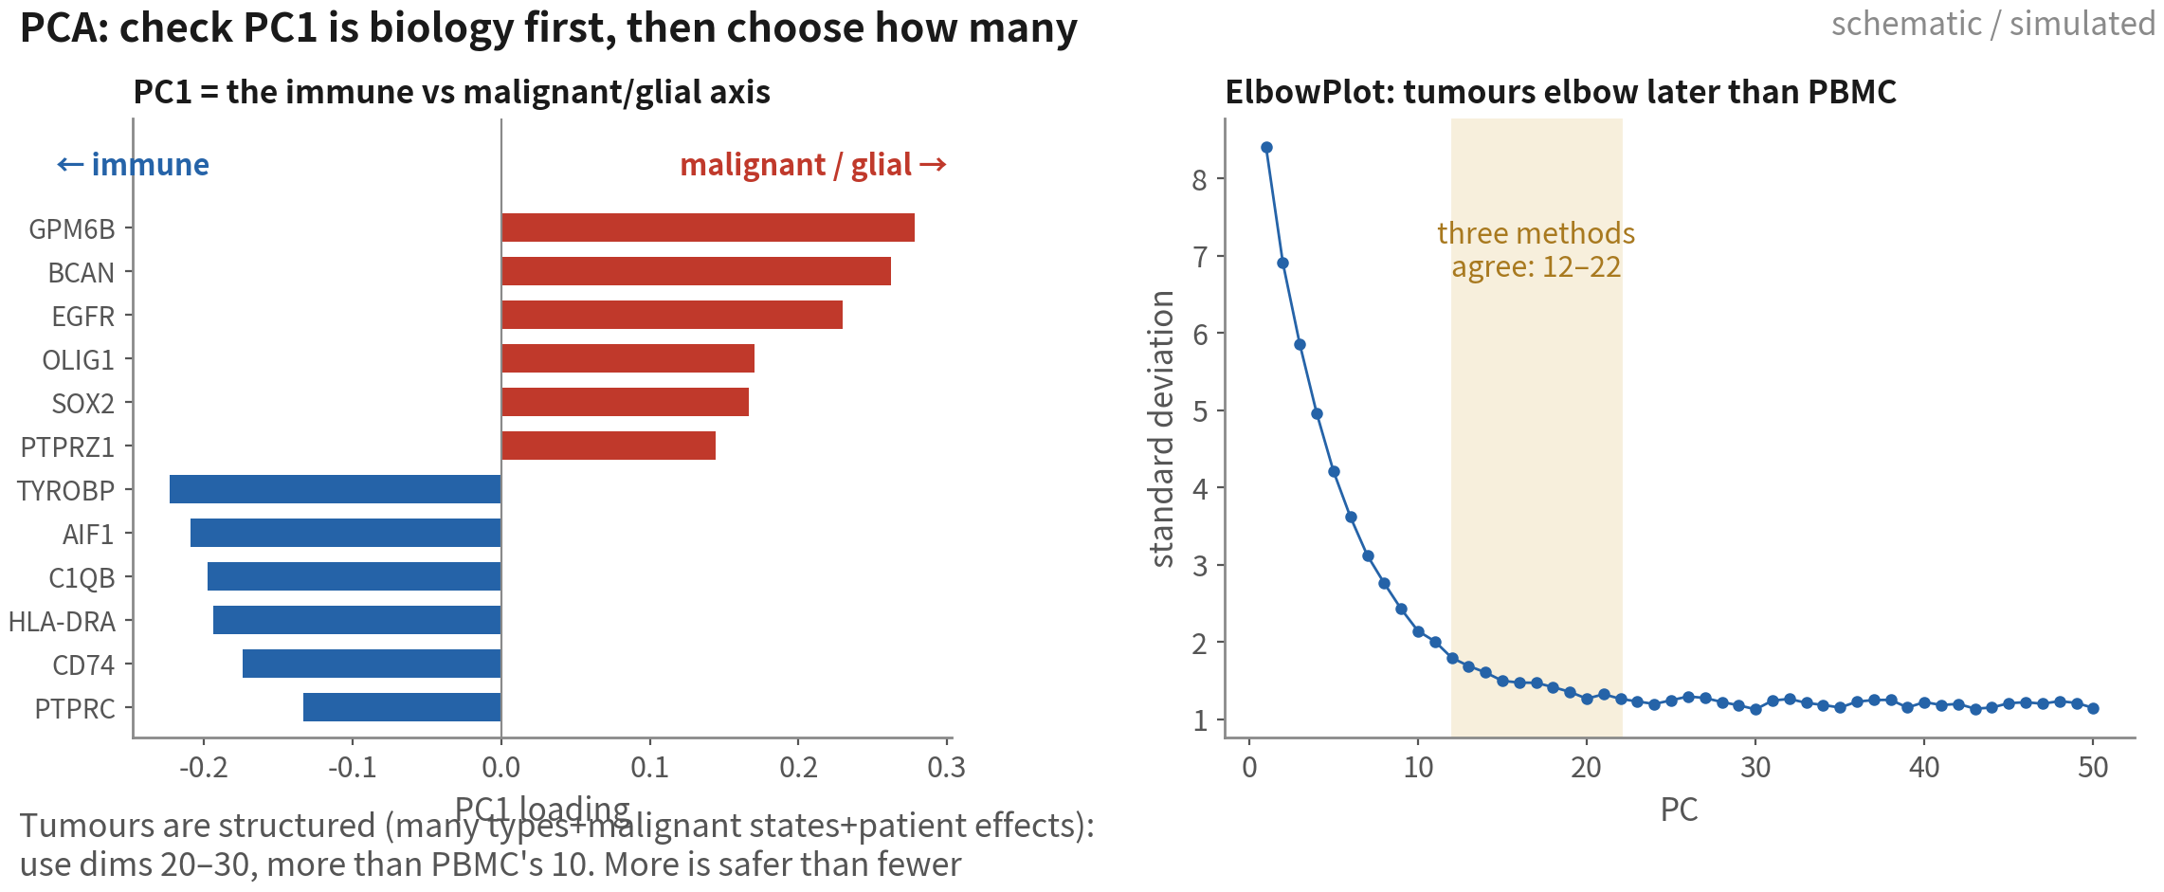
PC1 and the elbow
Tumours are structured, so the elbow comes later than PBMC. Use dims 20–30; more is safer than fewer
Q2 Hands-on I
29
Notes:
左邊是 PC1 的載荷，一邊免疫、一邊膠質。這條軸本身就是生物學。 右邊是 ElbowPlot。腫瘤資料的結構比 PBMC 複雜——多種型別、惡性狀態、增殖——所以拐點通常比較晚，三種方法的交集大約在十二到二十二之間。 dims 建議取二十到三十，比 PBMC 的十多。取多一點比取少安全：取太少會讓亞群消失，取太多只是多一點雜訊。 ──────── On the left, PC1's loadings: immune on one side, glial on the other. That axis is biology in itself. On the right, the ElbowPlot. Tumour data has more structure than PBMC — multiple types, malignant states, proliferation — so the elbow usually comes later, and the intersection of three methods lands roughly between twelve and twenty-two. For dims, take twenty to thirty — more than PBMC's ten or so. Taking more is safer than taking fewer: too few makes subpopulations disappear; too many just adds a little noise.

Slide 30
Sanity check 2: how many PCs
ElbowPlot(gbm, ndims = 50) pct <- gbm[["pca"]]@stdev / sum(gbm[["pca"]]@stdev) * 100 cumu <- cumsum(pct) which(cumu > 90 & pct < 5)[1] # cumulative 90% and a single PC under 5% npc <- 25 # GBM: the three methods agree on 20-30, so take 25
Turn the elbow into a number we can write in the methods: too few PCs merges subtypes away, too many only adds a little noise | Script 02 §2
Q2 Hands-on I
30
Notes:
取幾個 PC？最常見的做法是把 ElbowPlot 畫出來，用眼睛找拐點。問題是，眼睛找到的東西寫不進方法段。所以下面那三行做的，就是把拐點變成一個數字：算每個 PC 佔的變異比例，找累積到百分之九十、而且單一 PC 貢獻低於百分之五的那個位置。這樣一來，你在方法段就有話可寫。 GBM 5k 這份資料算出來是二十五。記住這個數字，接下來 FindNeighbors 和 RunUMAP 都用同一個變數。 ──────── ElbowPlot is eyeballing, and eyeballing gives you nothing you can write into a methods paragraph. So the three lines below turn that elbow into a number: compute each PC's share of variance, then find the position where the cumulative share reaches ninety percent and a single PC contributes under five percent. For GBM 5k it comes out at twenty-five. Hold on to that — FindNeighbors and RunUMAP both use this variable from here on.

Slide 31
Regress out the cell cycle? Check two things first
Cycling cells in tumours are biology; do not regress by default, unless the cycle hijacks the clustering
Do not regress (default)
Regress (vars.to.regress)
Cycling cells form their own cluster;
other clusters still split by type
When every type is cut in
two by the cycle
•
Check DimPlot(group.by = "Phase"): only
a small S / G2M patch
•
ScaleData(vars.to.regress =
c("S.Score", "G2M.Score"))
•
Check: no MKI67 / TOP2A among
PC1–PC5 loadings
•
Cost: the proliferation signal vanishes —
often exactly what tumour studies want
•
Handling: annotate that cluster as
'cycling X', not a new type (Pitfall 3)
•
Same logic for percent.mt: regress only
when it dominates a PC
Q2 Hands-on I
31
Notes:
週期分數算好了，下一句大家都會問：要不要把它回歸掉？這是 Seurat 教學裡最常被整段照抄的一步，而在腫瘤資料上，答案通常是不要。 左邊是預設，也就是不回歸。決定之前先檢查兩件事。第一，DimPlot 按 Phase 上色，如果只有一小塊是 S 和 G2M，其他地方都是 G1，代表增殖細胞自成一群，沒有干擾到別人。第二，看 PC1 到 PC5 的載荷，裡面沒有 MKI67、TOP2A 這類週期基因。兩個都過，就不回歸；註釋的時候把那一群標成「增殖中的 X」就好——它不是新型別，這是雷三。 右邊才是真的該回歸的情況：每一個型別都被週期切成兩半，巨噬細胞一群分裂中、一群沒有，惡性細胞也是。這時候週期已經劫持了分群，用 vars.to.regress 回歸 S.Score 跟 G2M.Score；或者更聰明一點，只回歸 S 減 G2M 的差，把「在不在分裂」這個資訊留下來。代價是增殖本身的訊號會消失——而腫瘤研究常常正是要它。 同樣的邏輯也適用在 percent.mt：只有它主導某個 PC 的時候才回歸，否則不要動。 ──────── The cycle scores are computed, and the next question is always the same: should we regress them out? This is the most blindly copied step in the whole Seurat tutorial, and for tumour data the answer is usually no. On the left is the default, which is no regression. Before you decide, check two things. One: DimPlot coloured by Phase — if only one small patch is S and G2M and everywhere else is G1, the proliferating cells have formed their own cluster and aren't interfering with anyone. Two: look at the loadings of PC1 through PC5 — no cycle genes like MKI67 or TOP2A in there. If both pass, don't regress; at annotation time you label that cluster "proliferating X" and move on — it is not a new cell type. That's pitfall three. On the right is the case that genuinely does need regressing: every cell type gets sliced in half by the cycle — one dividing macrophage cluster and one not, same for the malignant cells. The cycle has hijacked the clustering. Use vars.to.regress on S.Score and G2M.Score; or, smarter, regress only the difference S minus G2M, which keeps the "dividing or not" information. The cost is that the proliferation signal itself disappears — and tumour research often wants exactly that signal. The same logic applies to percent.mt: regress it only when it dominates some PC; otherwise leave it alone.

Slide 32
04
Clustering and UMAP
Cluster in PC space; sweep resolution; QC again after clustering
Q2 Hands-on I
32
Notes:
第四段。分群做在 PC 空間，resolution 掃一遍，然後——腫瘤資料特別重要的一步——分群做完之後，回頭再做一次 QC。 ──────── Section four. Cluster in PC space, sweep the resolution, and then — the step that matters most on tumour data — go back and do QC again, cluster by cluster.

Slide 33
Neighbour graph → communities → projection → sweep
gbm <- FindNeighbors(gbm, dims = 1:npc) # build the KNN/SNN graph in PC space gbm <- FindClusters(gbm, resolution = 0.5) # a starting point, not the answer gbm <- RunUMAP(gbm, dims = 1:npc) # the same set of dims for (r in seq(0.2, 1.2, by = 0.2)) gbm <- FindClusters(gbm, resolution = r, verbose = FALSE) library(clustree); clustree(gbm, prefix = "RNA_snn_res.") Idents(gbm) <- "RNA_snn_res.0.5" # after the sweep, point back to the chosen column DimPlot(gbm, label = TRUE)
After the sweep the active identity is the last one run — always point it back | Script 02 §3 | Deeper: B8, B9
References: Traag VA, Waltman L, van Eck NJ. Sci Rep. 2019;9(1):5233. doi:10.1038/s41598-019-41695-z ｜ McInnes L, Healy J, Melville J. arXiv:1802.03426. doi:10.48550/arXiv.1802.03426
Q2 Hands-on I
33
Notes:
FindNeighbors 在前二十五個 PC 的空間裡建鄰居圖，FindClusters 跑 Louvain 社群偵測，resolution 0.5 當起點，RunUMAP 用同一組 dims 壓成二維。 起點就只是起點，所以接著要掃描：0.2 到 1.2，每隔 0.2 跑一次，各存一個欄位，再用 clustree 畫出來。 掃完之後有個地方要注意：active identity 會停在最後跑的那一輪。Idents 要指回我們定案的那個欄位。這一行很多人漏掉，結果後面所有的圖，畫的都是 1.2 那一輪的分群。 ──────── FindNeighbors builds the neighbour graph in the space of the first twenty-five PCs, FindClusters runs Louvain community detection with resolution 0.5 as the starting point, and RunUMAP compresses the same dims down to two dimensions. But a starting point is only a starting point, so next we sweep: 0.2 to 1.2 in steps of 0.2, each run stored in its own column, and clustree draws the result. One thing to watch after the sweep. The active identity is stuck on whichever resolution ran last, so point Idents back at the column we settled on. Plenty of people miss that single line — and then every figure downstream is quietly showing the 1.2 result.

Slide 34
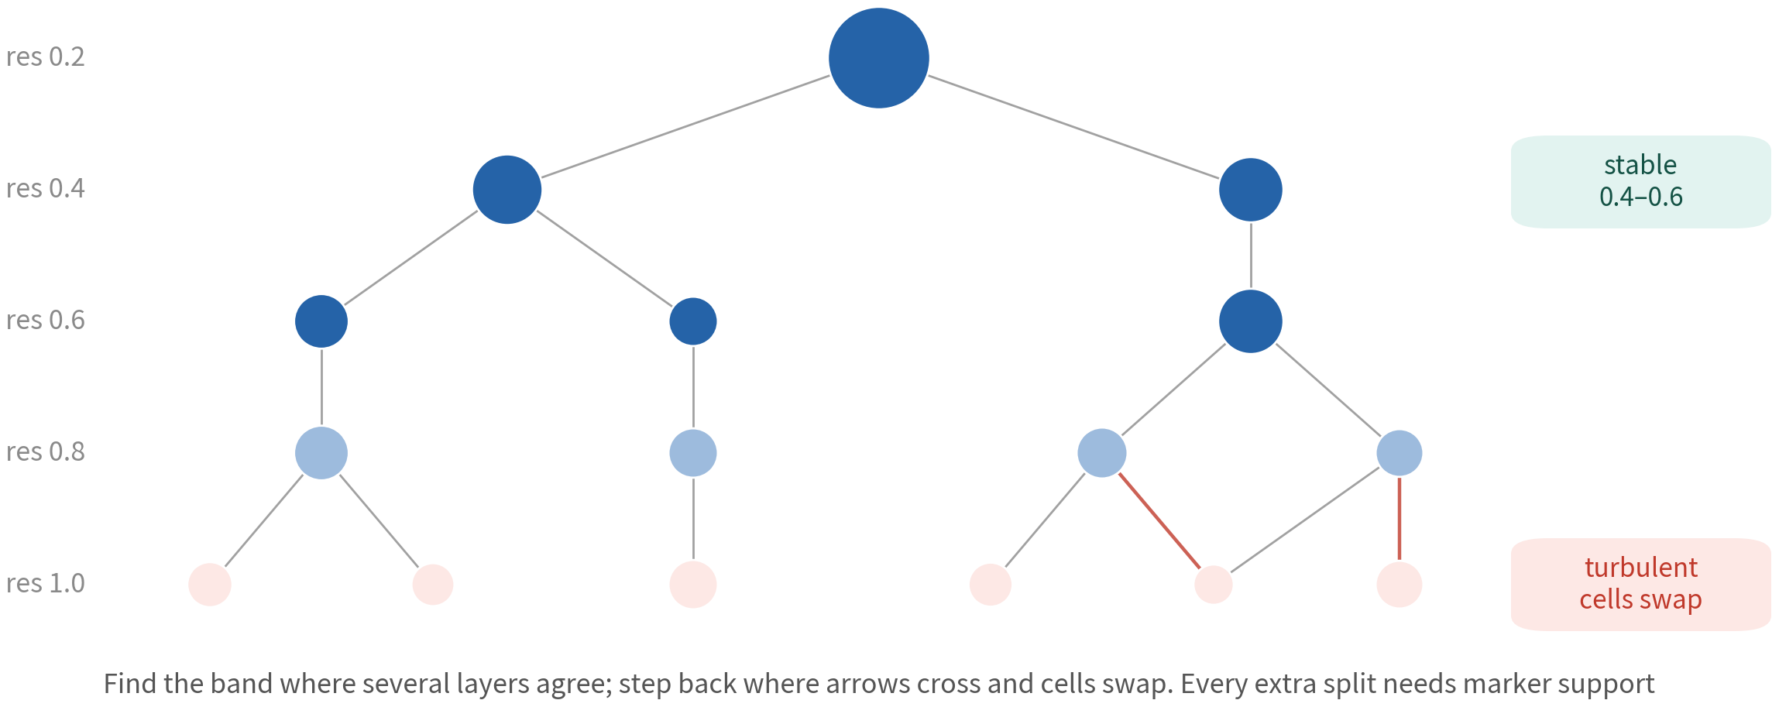
clustree: find the stable band
Tumour data separates immune / glial / oligo at low resolution; further cuts are
malignant states and immune subsets — each needs marker support
Reference: Zappia L, Oshlack A. Gigascience. 2018;7(7):giy083. doi:10.1093/gigascience/giy083
Q2 Hands-on I
34
Notes:
每一層是一個 resolution，節點是群，箭頭是細胞在層與層之間的流向。 腫瘤資料在很低的 resolution 就會把免疫、膠質、寡樹突分開——那是四個主要類群。再往下切出來的，是惡性狀態與免疫亞群。 我們要找的，是連續好幾層結構都不變的那個穩定層。箭頭開始交叉、細胞來回換群的那幾層是不穩定層，退回去。往下多切的每一刀，都要有 marker 支持——下一段就會看到。 ──────── One layer per resolution; the nodes are clusters, and the arrows are cells flowing between layers. Tumour data pulls immune, glial and oligodendrocyte apart at a very low resolution already — those are the four major groups. What splits out further down is malignant states and immune subpopulations. What we're after is the stable band: several consecutive layers where the structure doesn't change. The layers where arrows start crossing and cells swap clusters back and forth are the turbulence layer — step back from it. And every extra cut you make below that has to be backed by markers. The next section is where we check that.

Slide 35
Are the clusters stable? Change the seed,
change k, watch the sizes
# 1. same resolution, new seed: an ARI near 1 means the clustering is stable gbm <- FindClusters(gbm, resolution = 0.5, random.seed = 42, cluster.name = "seed42") mclust::adjustedRandIndex(gbm$RNA_snn_res.0.5, gbm$seed42) # e.g. 0.9x # 2. change k.param (default 20): the skeleton of the clusters should not move gbm <- FindNeighbors(gbm, dims = 1:20, k.param = 30) gbm <- FindClusters(gbm, resolution = 0.5, cluster.name = "k30") table(gbm$RNA_snn_res.0.5, gbm$k30) # a clean diagonal = stable # 3. cluster size: treat anything under 30 cells with suspicion sort(table(gbm$RNA_snn_res.0.5))
Ten seconds for three checks. ARI < 0.8, or a cluster that vanishes when k changes → an unstable cut; let markers decide whether it stays | Script 02 §3
Q2 Hands-on I
35
Notes:
clustree 看的是跨 resolution 的穩定。這一頁再加三個十秒鐘就跑得完的檢查，看的是同一個 resolution 底下，群到底穩不穩。 第一，換隨機種子。同一個 resolution，用 random.seed 等於 42 再跑一次，算 adjusted Rand index。接近 1，代表分群跟種子無關；低於 0.8，代表有些邊界其實是隨機決定的。 第二，換鄰居數 k.param。預設是 20，改成 30 重建鄰居圖再分一次群，兩個結果做 table。對角線清楚，代表骨架穩；某一群在換 k 之後消失、或者被拆掉，那一刀就不穩。 第三，看群大小。sort table 一眼掃過去，小於三十顆的群先存疑——可能是真的稀有群，也可能是 doublet 或雜訊。 那不穩的群怎麼辦？不是直接刪，是交給 marker 決定。下一段的 FindAllMarkers 如果給得出乾淨的 marker，就留；給不出來，就併回鄰居。 ──────── clustree looks at stability across resolutions. This slide adds three checks that take ten seconds each and ask a different question: at one single resolution, is this clustering stable? First, change the random seed. Rerun the same resolution with random.seed equals 42 and compute the adjusted Rand index. Close to 1 and the clustering doesn't depend on the seed; below 0.8 and some of those boundaries are being decided at random. Second, change the neighbour count k.param. The default is 20; set it to 30, rebuild the neighbour graph, recluster, and table the two results against each other. A clean diagonal means the skeleton is stable. If some cluster vanishes or gets shredded when k changes, that cut is unstable. Third, look at cluster sizes. sort table, one glance across: clusters under thirty cells are suspect by default — maybe a genuinely rare population, maybe doublets, maybe noise. So what do you do with an unstable cluster? Don't just delete it — let the markers decide. If next section's FindAllMarkers gives it clean markers, keep it; if it can't, merge it back into its neighbour.

Slide 36
Sanity check 3: per-cluster QC and doublet review
gbm@meta.data |> group_by(cluster = RNA_snn_res.0.5) |> summarise(n = n(), mt = median(percent.mt), nF = median(nFeature_RNA), dbl = mean(dbl.class == "doublet"), cyc = mean(Phase != "G1")) |> arrange(desc(dbl))
cluster n mt nF dbl cyc
12 131 5.1 6221 0.60 0.24 ← 60% doublets, highest nF → drop the cluster
9 140 3.6 5370 0.31 0.20
7 276 4.4 5625 0.20 1.00 ← cyc = 1: a proliferative STATE, not a type
0 1048 4.8 4922 0.02 0.37
...
A cluster that is mostly doublets and sits between two big groups → remove and record; a cluster with runaway mt → back to QC | Script 02 §4
Q2 Hands-on I
36
Notes:
這是腫瘤資料最重要的一個檢查。分群做完之後，每一群算五個數字：細胞數、mt 中位數、nFeature 中位數、doublet 比例，還有非 G1 期的比例。 看例子。七號群，一百四十二顆，六成被標為 doublet，而且在 UMAP 上正好卡在惡性與髓系之間。這一群整群就是 doublet 的產物——惡性細胞加巨噬細胞。整群移除，並且把理由記錄下來。剩下那四成不是真細胞，只是工具沒抓到而已。 另外兩種也要會認。percent.mt 明顯偏高、nFeature 最低的群，是 QC 殘渣，回去修過濾線。cyc 那一欄很高的群，是增殖中的細胞，裡面可能混了好幾種型別——等一下註釋要小心。 ──────── This is the single most important check on tumour data. Once clustering is done, compute five numbers for every cluster: cell count, median mt, median nFeature, doublet fraction, and the fraction of cells outside G1. Look at the example. Cluster seven: one hundred forty-two cells, sixty percent of them flagged as doublets, and on the UMAP it sits wedged right between malignant and myeloid. That entire cluster is the product of doublets — malignant cell plus macrophage. Remove the whole thing, and record the reason. The remaining forty percent aren't real cells either; they're the ones the tool missed. Two more patterns worth recognising. A cluster with mt towering above the rest and nFeature at the bottom is QC residue — go back and fix the cutoffs. A cluster with a very high cyc column is proliferating cells, possibly several types mixed together — be careful with it when we annotate shortly.

Slide 37
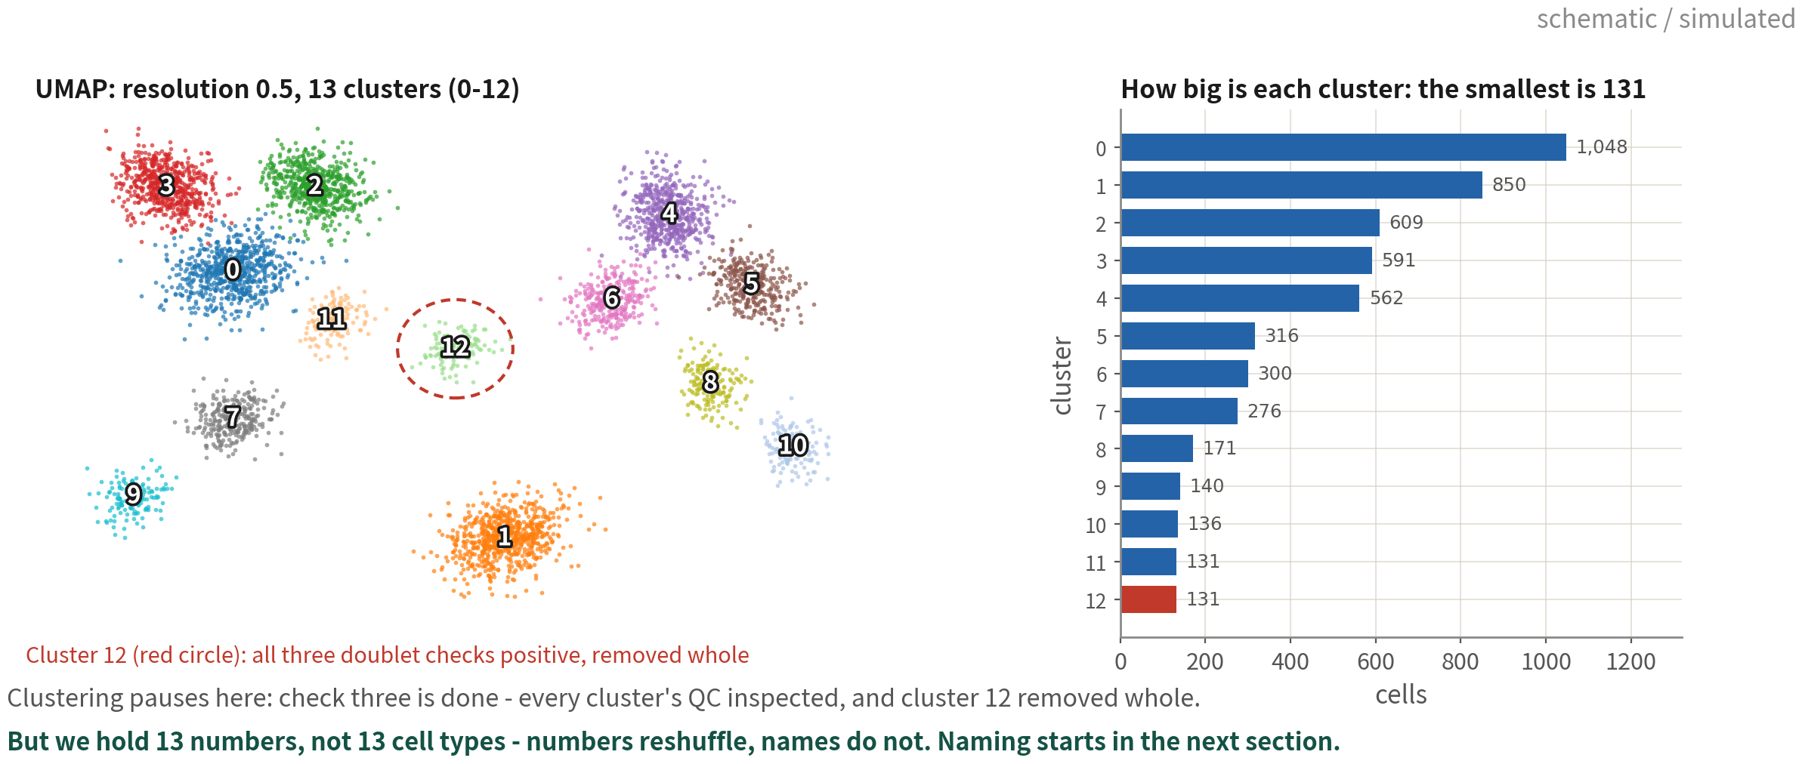
Clustering pauses here: 13 numbers, not yet 13 cell types
This is what the clustering section hands over: one UMAP at res 0.5, 13 clusters, their sizes, and one cluster already
flagged for removal. The numbers reshuffle with any parameter, so this is a waypoint, not a conclusion | Script 02 §4
Q2 Hands-on I
37
Notes:
分群這一段到這裡結束。先停一下，看看手上到底有什麼。 左邊這張就是這一段交出來的東西：resolution 0.5 跑出來的 UMAP，十三個群，編號 0 到 12。右邊是每一群多大——最大的第 0 群一千零四十八顆，最小的兩群各一百三十一顆。第 12 群被紅圈框起來，因為剛剛那張表裡它三項診斷全中，整群移除。 我知道這張圖看起來很有成就感：顏色分明、界線清楚。但請先忍住，不要截圖放進投影片說「我們找到了十三種細胞」。這裡只有十三個編號，不是十三種細胞。編號是 Seurat 按群大小排出來的，你把 resolution 從 0.5 動到 0.6，整組號碼就重新洗牌——原本的第 4 群可能變成第 3 群；換一個 Seurat 版本，也可能不一樣。 編號會變，名字不會。所以下一段要做的，就是把這十三個編號，一個一個換成能寫進論文的名字。 ──────── That is the end of the clustering section. Let's stop for a moment and look at what we actually have. On the left is what this section hands over: the UMAP from resolution 0.5, thirteen clusters, numbered 0 to 12. On the right is how big each one is — cluster 0 is the largest at one thousand and forty-eight cells, and the two smallest have one hundred and thirty-one each. Cluster 12 is circled in red, because in that table a moment ago it failed all three diagnostics, so it goes out whole. I know this plot looks like an achievement: clean colours, clean boundaries. But resist the urge to screenshot it and write "we found thirteen cell types". What we have here is thirteen numbers, not thirteen cell types. Seurat assigns those numbers by cluster size, so move the resolution from 0.5 to 0.6 and the whole set reshuffles — what was cluster 4 may come back as cluster 3. A different Seurat version can do the same. Numbers change; names don't. So what the next section does is take these thirteen numbers and turn them, one at a time, into names that can go into a paper.

Slide 38
05
Annotation: from cluster number to
cell-type name
Four slides of map first, then Script 03: gate genes →
markers → SingleR → state scores
Q2 Hands-on I
38
Notes:
第五段，也是這一集最後一段。 到上一頁為止，我們手上有的是一張 UMAP，加上一堆編號：零號群、一號群、七號群。但編號不是答案——沒有人會在論文裡寫「零號群比較多」。接下來要做的，就是把每一個編號換成一個站得住腳的名字。 這一段分成兩半。先是三頁地圖：註釋到底有哪些做法、它們共同依賴什麼、還有這兩年才多出來的 LLM 這一條。地圖先看過一次，等一下每跑一個步驟，我們才知道自己站在整張圖的哪個位置。 地圖之後才是腳本 03 的實作：四個譜系標誌基因先劃分主要類群，接著用 marker 面板與 SingleR 兩項獨立證據定型別，最後給膠質那幾群打狀態分數。 ──────── Section five, and the last one of this episode. Up to the previous slide, what we hold is a UMAP and a pile of numbers: cluster zero, cluster one, cluster seven. A number is not an answer — nobody writes "cluster zero was more abundant" in a paper. What comes next is turning every one of those numbers into a name we can defend. This section comes in two halves. First, three slides of map: what approaches to annotation actually exist, what they all depend on, and the LLM route that only appeared in the last couple of years. Look at the map once, and every step we run afterwards has a place on it. Then comes the hands-on part, script 03: four gate genes to draw the major groups, then a marker panel and SingleR as two independent lines of evidence to name the types, and finally state scores for the glial clusters.

Slide 39
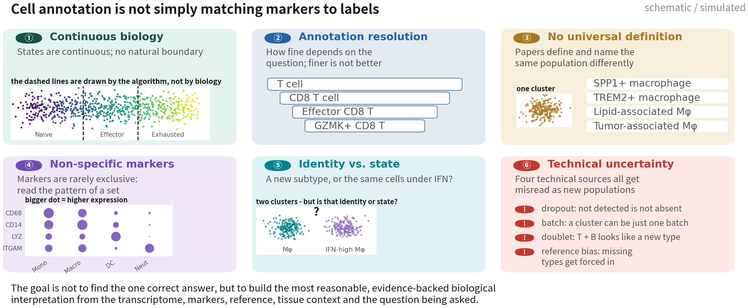
Before the methods: why annotation is hard
Not one of these six is fixed by switching tools. Knowing where the difficulty lies
is what lets you see what each method solves - and what it leaves behind
Q2 Hands-on I
39
Notes:
在看任何一個註釋方法之前，我想先花一頁講一件事：這件事本身就很難，而且難的地方，大多不是「工具不夠好」。 難處有六個。 第一，細胞狀態是連續的。分化、活化、耗竭、疾病進程，幾乎都是漸變的過程，不是一格一格的類別。Naive T 到 Effector T 到 Exhausted T，中間是一整條連續帶。所以左上那張圖裡的兩條虛線，是演算法切出來的，不是生物學上真的有一道牆。分群給你的邊界，是一個決定，不是一個發現。 第二，要標到多細，沒有標準答案。同一群細胞可以叫 T cell、CD8 T cell、Effector CD8 T、GZMK+ CD8 T，一層比一層細。標到哪一層，取決於你的研究問題、樣本數、細胞數和資料品質。這裡要記住的是：越細不等於越好。細胞數不夠還硬要往下切，切出來的亞型是不可靠的。 第三，不同研究對同一群的定義不一樣。右上這一群巨噬細胞，在不同論文裡可能叫 SPP1+ macrophage、TREM2+ macrophage、lipid-associated macrophage、tumor-associated macrophage。這四個名字高度重疊，但不保證指的是同一群細胞。所以你在讀別人的論文、或者引用別人的 marker 表的時候，要先確認他的定義跟你的是不是同一件事。 第四，marker 通常不是某一型專屬的。看左下這張點圖：CD68、CD14、LYZ、ITGAM 這幾個常用的髓系 marker，在單核球、巨噬細胞、樹突細胞、嗜中性球身上都會表現，只是程度不同。所以判斷型別要看一整組 marker 的樣式，不是抓一個基因就下結論。 第五，細胞的身分跟狀態很容易混在一起。中間下面這兩群分得很開——但那是兩種不同的細胞，還是同一種細胞、其中一群剛好被干擾素刺激過？發炎、干擾素反應、細胞週期、缺氧、壓力，這些都會讓細胞在 UMAP 上分開，但它們是狀態，不是新的型別。IFN-high macrophage 到底算不算一個亞型，這個問題到今天都還沒有簡單的答案。 第六，技術性的東西會被誤讀成生物學。dropout：測不到不代表沒表現，尤其是低表現基因、或者定序深度不夠的時候，所以不能因為某個 marker 是零就排除某種細胞。批次效應：一個群可能只是某一批樣本。doublet：一顆 T 細胞加一顆 B 細胞黏在一起，會同時帶 CD3D 和 MS4A1，看起來就像一個全新的型別。參考集偏差：query 裡有的、reference 裡沒有的型別，工具還是會硬把它塞進最像的那一類。 最下面那一句，是我希望你們帶走的態度： 細胞標註不是「找出唯一正確答案」。它是根據轉錄體、marker、參考集、組織背景，還有你自己的研究問題，建立一個最合理、而且拿得出證據的生物學解釋。 知道難在哪裡，接下來看每一種方法的時候，你才看得出來它解掉了什麼、又留下了什麼。 ──────── Before we look at a single annotation method, I want to spend one slide on this: the task itself is hard, and most of the difficulty is not that the tools aren't good enough. Six difficulties. One, cell states are continuous. Differentiation, activation, exhaustion, disease progression — almost all of it is a gradient, not a set of discrete boxes. Naive T to effector T to exhausted T is one continuous band. So those two dashed lines in the top-left panel were drawn by the algorithm, not by biology. The boundary clustering hands you is a decision, not a discovery. Two, there is no standard answer for how fine to go. The same cells can be called T cell, CD8 T cell, effector CD8 T, GZMK+ CD8 T — each level finer than the last. Which level you stop at depends on your question, your sample count, your cell count and your data quality. The thing to remember is that finer is not better. Split further than the cell numbers support and the subtypes you get back are not reliable. Three, different papers define the same population differently. The macrophage cluster at the top right might be called SPP1+ macrophage, TREM2+ macrophage, lipid-associated macrophage or tumour-associated macrophage, depending on who wrote it. Those four names overlap heavily, but they are not guaranteed to mean the same cells. So when you read someone else's paper, or borrow their marker table, check first whether their definition is your definition. Four, markers are rarely exclusive to one type. Look at the dot plot at bottom left: CD68, CD14, LYZ and ITGAM, the standard myeloid markers, are expressed in monocytes, macrophages, dendritic cells and neutrophils alike, just at different levels. So a type call reads the pattern across a set of markers; it never rests on one gene. Five, identity and state are easily confused. The two clusters at bottom middle separate cleanly — but are they two different cell types, or the same type with one group having been hit by interferon? Inflammation, interferon response, cell cycle, hypoxia, stress — every one of those will separate cells on a UMAP, and every one of them is a state, not a new type. Whether IFN-high macrophages count as a subtype is still an open question today. Six, technical artefacts get read as biology. Dropout: not detected does not mean not expressed, especially for low-expression genes or shallow sequencing, so you cannot exclude a cell type because one marker reads zero. Batch: a cluster can be nothing more than one batch of samples. Doublets: one T cell stuck to one B cell carries CD3D and MS4A1 together and looks like a brand-new type. Reference bias: a type present in the query but absent from the reference still gets forced into whatever is closest. The line at the bottom is the attitude I want you to take away. Cell annotation is not about finding the one correct answer. It is about building the most reasonable, evidence-backed biological interpretation from the transcriptome, the markers, the reference, the tissue context and the question you are actually asking. Knowing where the difficulty lies is what lets you see, for each method that follows, what it solves and what it leaves behind.

Slide 40
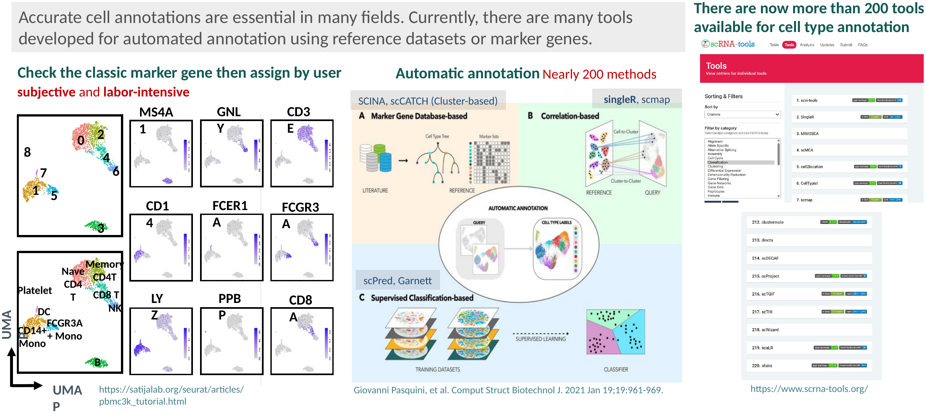
How cell types are annotated today: by hand, or automatically?
The only difference is who assigns the label. Two hundred tools, three families - and what they share matters
more than what separates them: every one needs a reference first, a marker table or an annotated dataset
Reference: Abdelaal T, et al. Genome Biol. 2019;20(1):194. doi:10.1186/s13059-019-1795-z
Q2 Hands-on I
40
Notes:
先看最上面那一句：細胞註釋是所有下游結論的地基。這句話聽起來像客套話，其實不是。分群、DE、通訊分析、軌跡——後面每一個分析，都建立在「這一群是什麼細胞」這個判斷上面。地基標錯，上面蓋得再漂亮都會塌。 那這件事到底怎麼做？整張圖看下來，其實只有兩條路線。 左邊是路線一，人工判讀 marker。注意這裡有兩張 UMAP 上下疊在一起，這就是整條路線的全貌。上面那張，我們現在手上就有——只有編號，零號群、一號群，一直到七號群，一個名字都沒有。下面那張，是我們接下來十幾頁要走到的地方：每一群都有一個站得住腳的名字。中間那一步呢？就是右邊那九格。同一組 UMAP 座標，換一個 marker 就換一塊亮起來：PTPRZ1、SOX2、GFAP 亮在惡性與膠質那幾群，MBP 和 PLP1 亮在寡樹突，AIF1 和 CD74 亮在髓系，CD3E 亮在 T 細胞，PECAM1 亮在血管內皮。一群一群比對，比到你敢下判斷為止。 這條路線的優點寫在下面：可解釋，而且能發現參考集裡沒有的型別——這一點對腫瘤特別重要，等一下你就會知道為什麼。缺點也很誠實地寫在右上角，紅色那三個字：主觀、耗人力。同一份資料交給兩個人，很可能得到兩個不完全一樣的答案。 所以才有了路線二，自動註釋。先看那條白色的骨架——我們的資料、自動註釋、型別標籤。不管是哪一種工具，做的都是這件事。差別只在中間那個盒子裡放什麼。 放什麼呢？兩百多個工具，其實只有三大類。 A 類是 marker 資料庫型：拿一張已經整理好的 marker 表，對每一群打分。SCINA、scCATCH、scType 都是。它最輕便，因為它只需要一張表，不需要另外一份表現量資料。 B 類是相關性比對型：每一顆細胞、或者每一群，跟一份已經註釋好的參考集算相關，取最像的那一型。SingleR、scmap、CHETAH。我們這一課第四十七頁用的就是這一類。 C 類是監督分類型：先在參考集上訓練一個分類器，再拿去預測我們的資料。scPred、Garnett、CellTypist。 右邊那一欄不是裝飾。scrna-tools.org 這個網站在追蹤所有單細胞工具，光是「細胞型別註釋」這一個類別，現在就有兩百多個。上面七個、下面五個，中間那個省略號的意思是——中間還有兩百個。我把它放在這裡，是想讓你對「這個領域有多熱鬧」有一個實感，同時也提醒你：工具多，不代表選哪一個很關鍵。這正好帶到下一頁。 因為三大類有一個共同點，而這個共同點比它們的差別重要得多：不管哪一類，都得先有一份參考——一張 marker 表，或者一份已經註釋好的資料集。工具是換得掉的，參考是換不掉的。 ──────── Start with the line across the top: accurate cell annotation is the foundation of every downstream claim. That sounds like a platitude, and it isn't. Clustering, differential expression, communication, trajectories — every analysis after this one sits on top of one judgement: what kind of cell is this cluster? Get the foundation wrong and everything built on it comes down, however elegant it looks. So how is it actually done? Look across the whole slide and there are only two routes. On the left, route one: read the markers by hand. Notice the two UMAPs stacked one above the other — together they are the whole route. The top one is what we have right now: numbers only, cluster 0 through cluster 7, not a single name. The bottom one is where we will be in about fifteen slides: every cluster carrying a name we can defend. And the step in between is the nine little panels on the right. Same UMAP coordinates every time; change the marker and a different patch lights up. PTPRZ1, SOX2 and GFAP light up the malignant and glial clusters, MBP and PLP1 the oligodendrocytes, AIF1 and CD74 the myeloid cells, CD3E the T cells, PECAM1 the vascular endothelium. Cluster by cluster, until you are willing to commit. The upside of this route is written underneath: it is interpretable, and it can find types that no reference contains — which matters enormously in tumour work, as you will see in a moment. The cost is written honestly in red at the top: subjective and slow. Hand the same data to two people and you will get two answers that do not quite agree. Hence route two: automatic annotation. Look first at the white skeleton — our data, automatic annotation, cell-type labels. Every tool in this space does exactly that. The only difference is what sits inside the middle box. And what sits inside? Two hundred tools, but really only three families. Family A is marker-database based: take a curated marker table and score every cluster against it. SCINA, scCATCH, scType. It is the lightest of the three, because all it needs is a table — no second expression dataset. Family B is correlation based: correlate each cell, or each cluster, against an annotated reference and take the closest type. SingleR, scmap, CHETAH. This is the family we will use on slide 47. Family C is a supervised classifier: train on the reference first, then predict on our data. scPred, Garnett, CellTypist. The column on the right is not decoration. scrna-tools.org tracks every single-cell tool that gets published, and the cell-type annotation category alone now holds more than two hundred. Seven at the top, five at the bottom, and the ellipsis in the middle stands for the other two hundred. I put it there so you get a feel for how crowded this field is — and, at the same time, as a warning: a lot of tools does not mean the choice of tool is what matters. Which leads straight into the next slide. Because the three families share something far more important than what separates them: every one of them needs a reference first — a marker table, or an annotated dataset. You can swap the tool. You cannot swap away the reference.

Slide 41
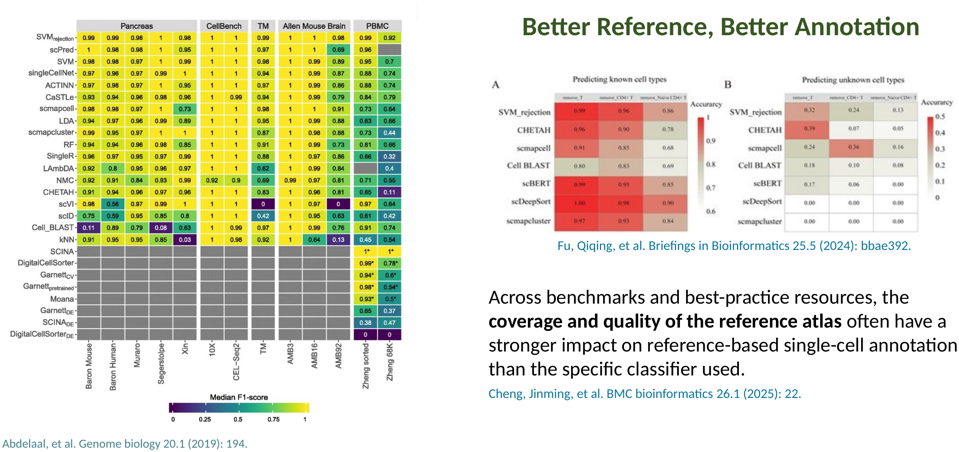
Robust annotation needs a good reference and a good algorithm
Swap the algorithm and the front runners barely differ; remove one type from the reference and the whole panel
collapses together. The algorithm decides how well you do; the reference decides whether you can be right at all
Reference: Abdelaal T, et al. Genome Biol. 2019;20(1):194. doi:10.1186/s13059-019-1795-z
Q2 Hands-on I
41
Notes:
上一頁最後那句話，這一頁我用兩份 benchmark 把它證明給你看。 先看左邊。這是 Abdelaal 二○一九年那篇 benchmark 的形狀：直的是二十幾種註釋方法，橫的是十三份測試資料，分成胰臟、CellBench、TM、小鼠腦、PBMC 五組，顏色是中位 F1，越黃越好。 看兩件事。第一，上面那一大塊監督式方法，整片都是黃綠色——SVM_rejection、scPred、singleCellNet、SingleR、CHETAH，彼此差得有限，而且沒有任何一個在所有資料集上都是第一名。第二，看最右邊那兩欄，PBMC 的 Zheng 68K，整排一起變深、變藍。同樣一批演算法，換一份難一點的資料，全體一起掉下來。 還有第三件事，比前兩件更值得看：下面那四排灰色。SCINA、Garnett、Moana、DigitalCellSorter 這幾個 marker 型的方法，只有 PBMC 那兩欄有顏色，其他全灰。灰色的意思是「那份資料上沒有結果」——因為它們需要一張現成的 marker 表，而胰臟、小鼠腦那些資料，當年沒有可用的表。工具再好，沒有參考就跑不動。 右上角是 Fu 二○二四年那篇，我覺得這是這一頁最鋒利的一張圖。同一批分類器，實驗設計很單純：把某一型細胞從參考集裡拿掉，看它還認不認得出來。A 是「參考集裡還有的型別」，數字都在零點八以上，一片紅——大家都很行。B 是「參考集裡被拿掉的型別」，數字掉到零點三、零點一，甚至是零。注意，這是同一批演算法、同一批資料，唯一改的只有參考集少了一型。整排一起崩，沒有一個例外。 換句話說：演算法決定的是「好一點還是好很多」，參考集決定的是「有沒有可能對」。 Cheng 二○二五年那篇把這件事寫成一句話，就在綠框裡：跨多份 benchmark 與最佳實務資源的一致觀察是，參考圖譜的覆蓋度與品質，對以參考為本的註釋，影響往往大於你選了哪一個分類器。 所以拿到一個自動註釋工具，先問參考集三件事。第一，有沒有這一型——我們樣本裡可能出現的每一種細胞，這份參考集裡都有嗎？第二，組織像不像——腦星狀細胞和血液單核球，不是同一回事。第三，切得夠不夠細——停在「T 細胞」這一層，我們就拿不到 CD4、CD8 和 Treg。 先把這三個問題記住。等一下第四十六、四十七頁，我們用 SingleR 跑這份 GBM 資料，膠質那幾群會被標成星狀細胞或神經前驅細胞。那不是 SingleR 壞掉——那是 Fu 那張 B 圖在我們自己的資料上重演一次：參考集裡沒有腫瘤。知道這件事，你在那一頁就不會慌，而且會知道下一步該做什麼。 ──────── That last sentence from the previous slide — this slide proves it to you with two benchmarks. Start on the left. This is the shape of the Abdelaal 2019 benchmark: twenty-odd annotation methods down the side, thirteen test datasets across the top, grouped into pancreas, CellBench, TM, mouse brain and PBMC. Colour is median F1; yellower is better. Two things to notice. First, the large block of supervised methods at the top is uniformly yellow-green — SVM_rejection, scPred, singleCellNet, SingleR, CHETAH all differ very little, and not one of them wins on every dataset. Second, look at the last two columns, the PBMC data, and especially Zheng 68K: the whole column goes darker together. Same algorithms, harder dataset, everybody drops. And a third thing, more telling than the first two: the four grey rows at the bottom. SCINA, Garnett, Moana and DigitalCellSorter — the marker-based methods — have colour only in the PBMC columns. Grey means no result there, because they need a ready-made marker table, and back then those tables did not exist for pancreas or mouse brain. However good the tool is, with no reference it does not run at all. Top right is Fu 2024, and I think this is the sharpest panel on the slide. Same set of classifiers, very simple experiment: remove one cell type from the reference, then see whether it can still be recognised. Panel A is the types that are still in the reference — everything above 0.8, solid red, everybody does well. Panel B is the type that was removed — the numbers fall to 0.3, 0.1, in several rows straight to zero. Same algorithms, same data; the only thing that changed is that the reference is missing one type. The whole panel collapses together, without exception. Put another way: the algorithm decides whether you do well or very well. The reference decides whether you can be right at all. Cheng 2025 turns that into one sentence, in the green box: across benchmarks and best-practice resources, the coverage and quality of the reference atlas usually matter more for reference-based annotation than which classifier you pick. So when you pick up an automatic annotation tool, ask three things about the reference first. Does it contain this type — every cell type our sample could plausibly contain, is it in there? Does the tissue match — a brain astrocyte and a blood monocyte are not the same thing. Is it fine-grained enough — a reference that stops at "T cell" will never give you CD4, CD8 and Treg. Keep hold of those three questions. On slides 46 and 47 we run SingleR on this GBM sample, and the glial clusters come back labelled astrocyte or neural progenitor. That is not SingleR breaking. That is Fu's panel B replaying itself in our own data: there are no tumour cells in the reference. Knowing that, you will not panic on that slide — and you will know what to do next.

Slide 42
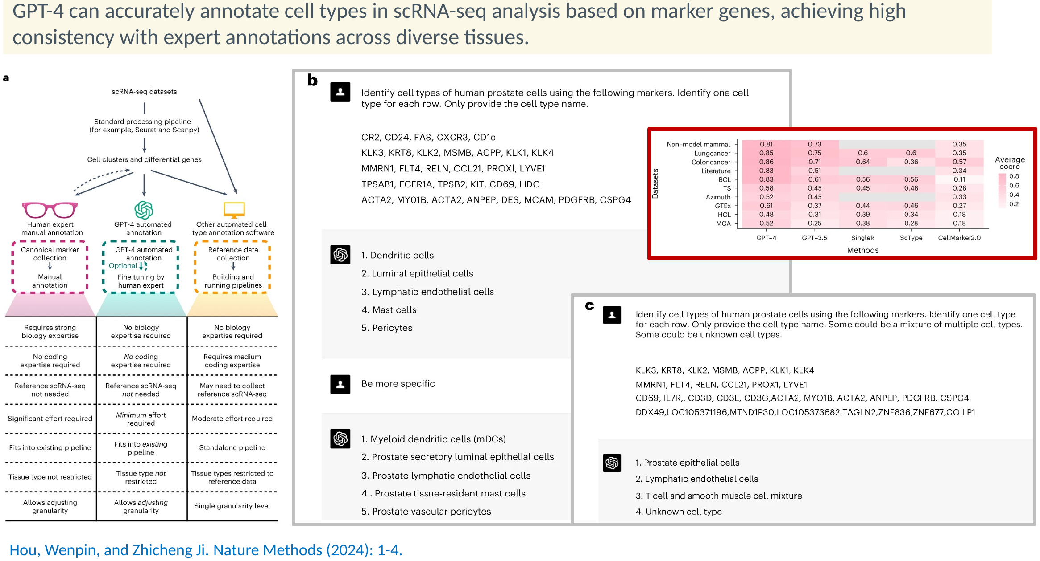
Reading the marker list with GPT-4: where does it actually sit?
Given only the marker list it beats the existing tools - but it never sees our data. It
sits exactly where SingleR sits: a third line of evidence, not the only one | Script 03 §3
Reference: Hou W, Ji Z. Nat Methods. 2024;21(8):1462–1465. doi:10.1038/s41592-024-02235-4
Q2 Hands-on I
42
Notes:
地圖的最後一塊，是這兩年才多出來的第三條路。 Hou 和 Ji 二○二四年發在 Nature Methods 的這篇，做了一件簡單到有點不可思議的事：把每一群的 top marker 基因貼給 GPT-4，請它給型別名。就這樣。結果在多種組織上，它的判斷和專家註釋高度一致。 先看 a 這一塊，它把三條路線放在同一張表上比。人工專家判讀：需要很強的生物學專業，不需要寫程式，人力成本很高。其他自動註釋軟體：不需要生物學專業，但需要中等程度的程式能力，而且可能得自己去收集參考資料，組織型別還會被參考集限制住。GPT-4 這一欄很有意思——生物學專業不需要、程式不需要、參考資料不需要、人力成本最低、組織不限、粒度可調。看起來每一格都贏。 先別急著下結論，先看 b，看它實際上是怎麼被問的。提示詞就是這麼白話：「以人類前列腺為前提，依每一群的 marker，各給一個最可能的細胞型別，只回名稱。」底下貼上每一群的 marker 基因。它回：樹突細胞、管腔上皮細胞、淋巴內皮細胞、肥大細胞、周細胞。 然後看下面那個綠框——這是我覺得最值得學起來的一招。再追問一句「講細一點」，答案就變成：髓系樹突細胞、前列腺分泌型管腔上皮、前列腺淋巴內皮、組織駐留肥大細胞、血管周細胞。同一批 marker，粒度是你用問法調出來的。這就是 a 表格裡「粒度可調」那一格的實際意思。 c 是它跟既有工具的正面對決。十份資料集，從人類細胞圖譜、GTEx，到肺癌、大腸癌、非模式哺乳類；五種方法，GPT-4、GPT-3.5、SingleR、ScType、CellMarker2.0。看第一欄和後面三欄的顏色差：GPT-4 在每一份上都不輸既有工具，多數還更好。灰色格是那份沒有測。 那它是不是可以取代 SingleR？我的答案是不行，理由就是最下面那三個紅色提醒。 第一，它沒看過我們的資料。它讀到的只有一串基因名。它不知道 CD3E 在我們這份樣本裡只有百分之三的細胞表現，也不知道那一群其實只有十九顆細胞。它是在回答「有這些 marker 的細胞通常叫什麼」，不是在回答「你這一群是什麼」。 第二，問法一定要留「未知」這個出口。原文的 c panel 就示範了這件事：在提示詞裡加一句「有些可能是未知型別、有些可能是混合的」，它就會老實回「unknown cell type」。不給這個出口，罕見或新定義的型別就會被塞進一個聽起來很合理的常見答案——而聽起來合理，正是最難被抓到的那種錯。 第三，把提示詞和模型版本寫進 methods。模型會改版，同一句話明年給的答案不保證一樣；不寫，別人重現不了。 所以它的位置，跟 SingleR 完全一樣：第三份證據，和 marker 表、SingleR 對照著看。三份證據都指向同一個名字，我們才敢寫進論文。 地圖看完了。接下來就照路線一，從四個譜系標誌基因開始走。 ──────── The last piece of the map is a third route that only appeared in the last couple of years. Hou and Ji, Nature Methods 2024, did something almost absurdly simple: paste each cluster's top marker genes to GPT-4 and ask for a cell-type name. That is it. Across a range of tissues, what came back agreed closely with expert annotation. Look at panel a first: the three routes side by side. Human expert annotation needs strong biology, no coding, and a lot of person-hours. Other automated software needs no biology but medium coding skill, you may have to go and collect a reference yourself, and the tissue types you can handle are limited by that reference. The GPT-4 column is striking — no biology needed, no coding, no reference, minimum effort, any tissue, adjustable granularity. On paper it wins every row. Before you draw a conclusion, look at panel b — what the prompt actually looks like. It is this plain: one cell type per marker row, human prostate, name only, then the marker genes for each cluster. Back comes: dendritic cells, luminal epithelial cells, lymphatic endothelial cells, mast cells, pericytes. Then look at the green box below it, because this is the trick worth stealing. Ask one follow-up — be more specific — and the answers become myeloid dendritic cells, prostate secretory luminal epithelial cells, prostate lymphatic endothelial cells, tissue-resident mast cells, vascular pericytes. Same markers; the granularity came out of how you asked. That is what "adjustable granularity" in panel a actually means. Panel c is the head-to-head. Ten datasets, from the Human Cell Atlas and GTEx to lung cancer, colon cancer and a non-model mammal; five methods — GPT-4, GPT-3.5, SingleR, ScType, CellMarker2.0. Compare the first column with the other three: GPT-4 matches or beats the existing tools on every dataset, and on most it is clearly ahead. Grey cells are combinations that were not tested. So does it replace SingleR? My answer is no, and the reasons are the three red notes along the bottom. First, it never sees our data. It reads a list of gene names. It does not know that CD3E is expressed in three per cent of the cells in our sample, or that the cluster in question has only nineteen cells in it. It is answering "what are cells with these markers usually called", not "what is your cluster". Second, always let it answer "unknown". Panel c of the original paper demonstrates exactly this: add a line to the prompt saying some clusters may be unknown or a mixture, and it will honestly return "unknown cell type". Without that escape hatch, a rare or newly defined type gets pushed into a plausible-sounding common label — and plausible-sounding is the hardest kind of error to catch. Third, record the prompt and the model version in your methods. Models get updated; the same sentence next year is not guaranteed to give the same answer, and without the record nobody can reproduce what you did. So its place is exactly where SingleR sits: a third line of evidence, read alongside the marker table and SingleR. When all three point at the same name, we are willing to write it down. That is the map. Now we take route one, starting from four lineage marker genes.

Slide 43
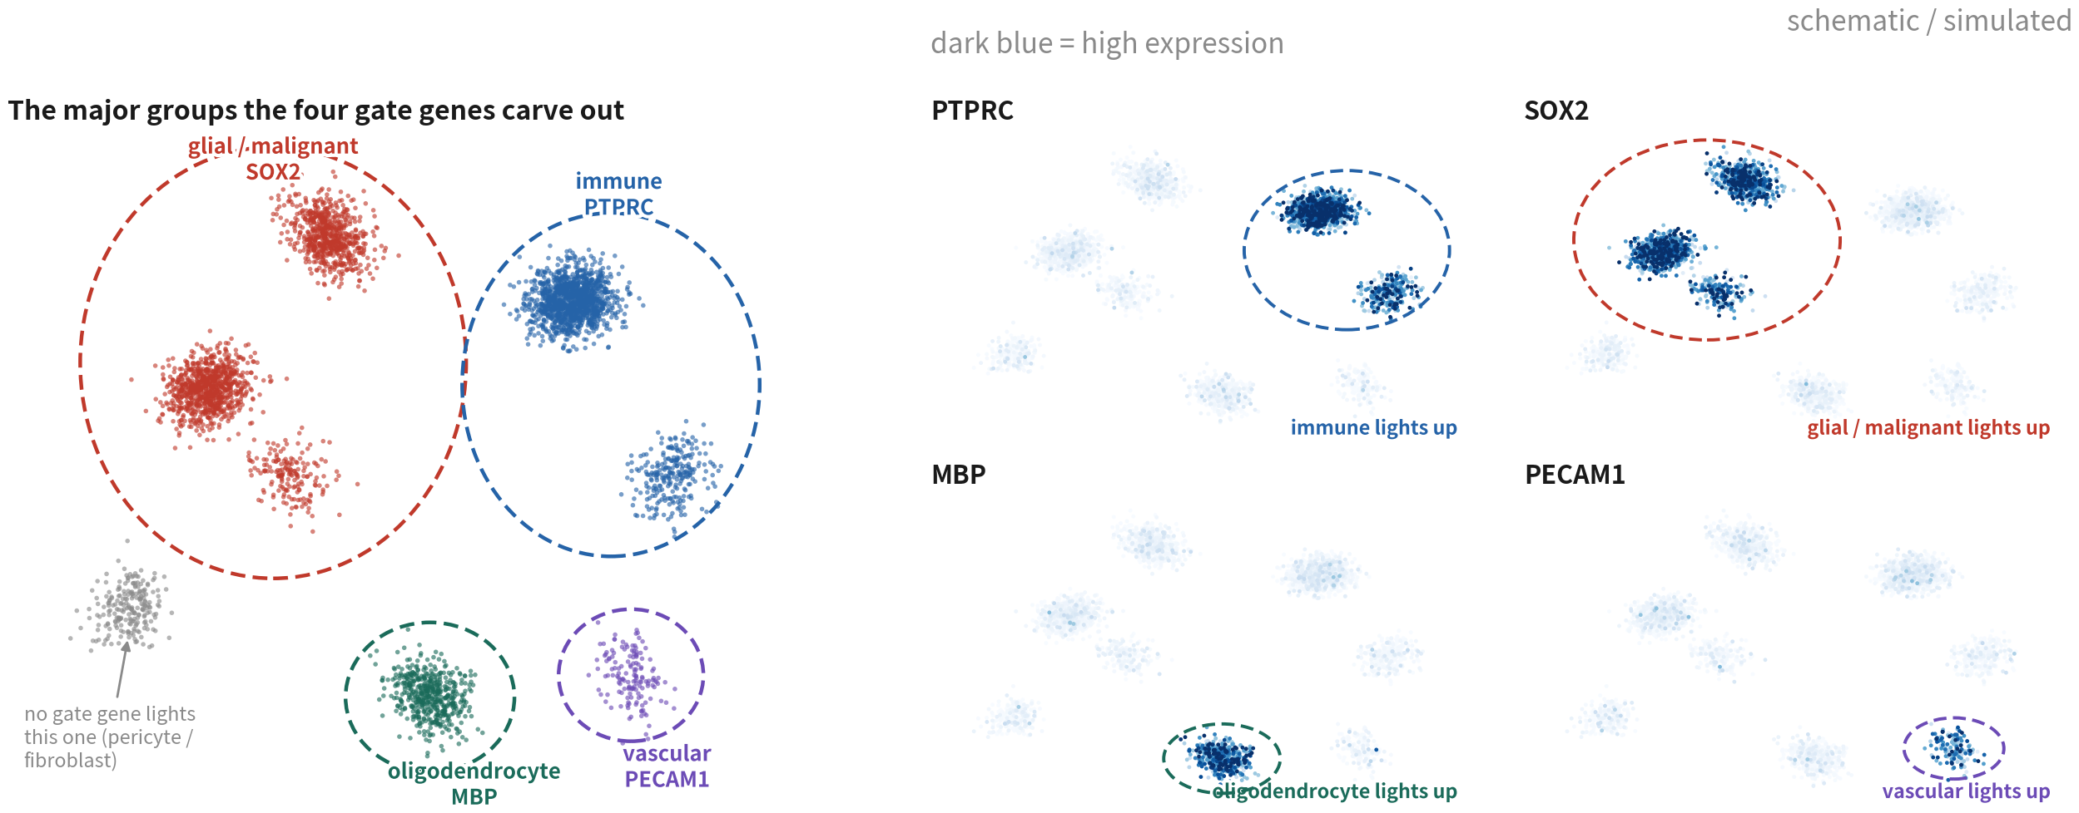
Draw the major groups with four gate genes first
Immune (PTPRC), glial/malignant (SOX2), oligodendrocyte (MBP), vascular (PECAM1).
Settle the four, then subtypes
Q2 Hands-on I
43
Notes:
四張 FeaturePlot。PTPRC 亮起來的是免疫類群。SOX2 亮的是膠質與惡性——注意它不是只亮在惡性細胞，正常的星狀細胞、OPC 也會亮。MBP 亮的是寡樹突細胞。PECAM1 亮的是血管內皮。 四塊劃清楚，每一群的大方向就出來了。接下來才進到每一塊主要類群裡面去分亞群。 ──────── Four FeaturePlots. Where PTPRC lights up is the immune major group. Where SOX2 lights up is glial and malignant — and note that it doesn't light up only in malignant cells; normal astrocytes and OPCs light up too. Where MBP lights up is the oligodendrocytes. Where PECAM1 lights up is the vascular endothelium. With those four blocks drawn clearly, we already know the general direction of every cluster. Only then do we go inside each major group and split subpopulations.

Slide 44
Gate genes and the marker panel
FeaturePlot(gbm, features = c("PTPRC", "SOX2", "MBP", "PECAM1"), ncol = 4) panel <- c("PTPRC", "CD68", "CD163", "P2RY12", "TMEM119", "CD3E", # immune "SOX2", "OLIG2", "PTPRZ1", "EGFR", # glial / malignant "MBP", "PLP1", "PECAM1", "VWF", "PDGFRB", "RGS5", # oligo / vascular / pericyte "MKI67", "TOP2A") # cycling DotPlot(gbm, features = panel) + RotatedAxis()
Blocks along the diagonal mean good clusters; PTPRC lighting three immune types is expected | Script 03 §1 | Deeper: B10
Q2 Hands-on I
44
Notes:
第一行先畫四張譜系標誌基因的圖。 接著是一個面板，一組一組看。免疫：PTPRC 是譜系標誌，CD68、CD163 是巨噬細胞，P2RY12、TMEM119 是小膠質，CD3E 是 T 細胞。膠質：SOX2、OLIG2、PTPRZ1、EGFR。寡樹突：MBP、PLP1。血管：PECAM1、VWF。周細胞：PDGFRB、RGS5。最後 MKI67、TOP2A 是週期。 DotPlot 畫出來，沿著對角線一塊一塊亮起來，就是好的分群。PTPRC 同時亮在三種免疫細胞是正常的，別緊張——它是譜系標誌，不是型別 marker。 ──────── The first line draws the four lineage marker plots. Then a panel, group by group. Immune: PTPRC as the lineage marker; CD68, CD163 for macrophages; P2RY12, TMEM119 for microglia; CD3E for T cells. Glial: SOX2, OLIG2, PTPRZ1, EGFR. Oligodendrocyte: MBP, PLP1. Vascular: PECAM1, VWF. Pericyte: PDGFRB, RGS5. And last, MKI67 and TOP2A for the cycle. DotPlot draws it. Blocks lighting up one after another along the diagonal is what a good clustering looks like. PTPRC lighting up in all three immune types is normal — don't panic; it's a lineage marker, not a type marker.

Slide 45
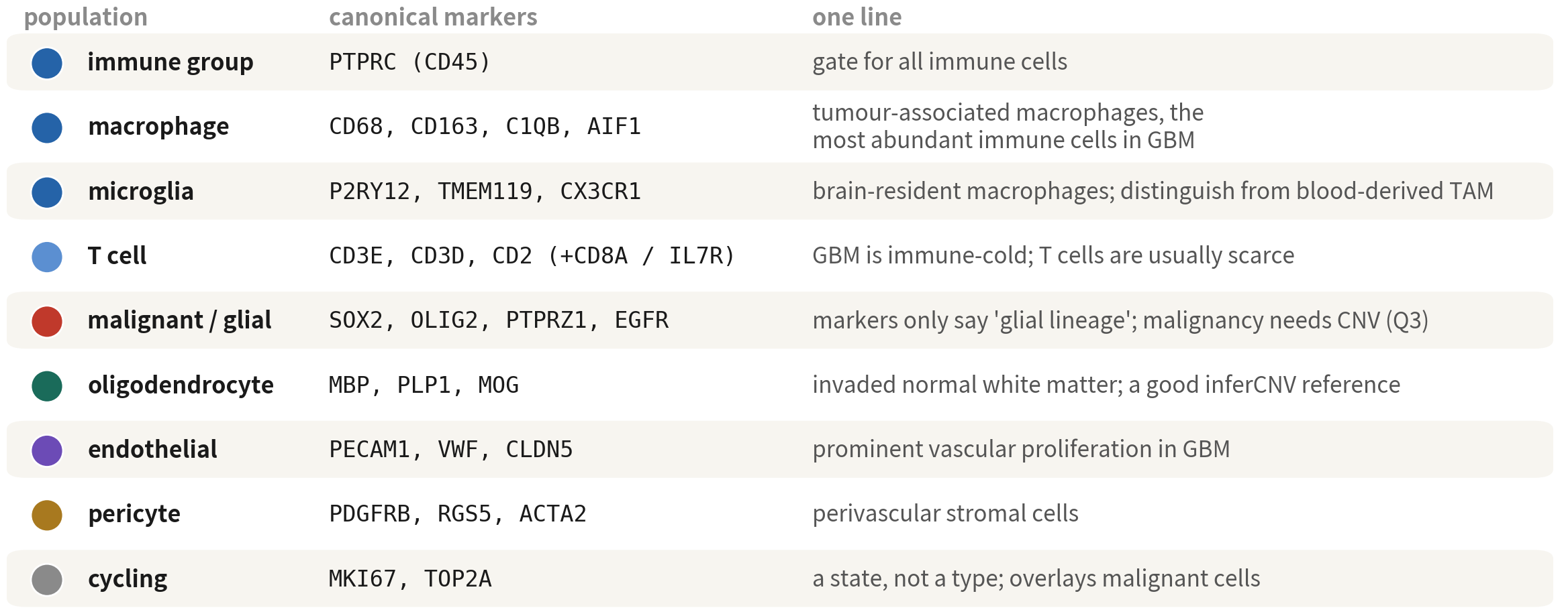
A marker panel for the GBM microenvironment
Microglia vs blood-derived macrophages, and cycling state vs cell type — the two pairs
most often confused in tumour annotation
Q2 Hands-on I
45
Notes:
這張表可以存起來。 先講兩組最常搞混的。第一組：小膠質對上血液來源的巨噬細胞。兩者都是 CD68 陽性的吞噬細胞，但小膠質是腦內駐留的，P2RY12、TMEM119 陽性；血液來源的 TAM 則是 CD163、LYZ 高。它們在 GBM 裡的功能不同。 第二組：增殖狀態對上細胞型別。MKI67、TOP2A 高的不是一種細胞，是一種狀態——正在分裂的惡性細胞、正在分裂的巨噬細胞都會有。它是疊在型別上面的。 最後看倒數第五列，膠質與惡性。marker 只能說譜系；惡性要基因體層級的證據加上跨病人專屬性，單一病人湊不齊，所以這份資料就停在待判定。 ──────── This table is worth saving. Start with the two pairs that get confused most. First: microglia versus blood-derived macrophages. Both are CD68-positive phagocytes, but microglia are brain-resident, P2RY12 and TMEM119 positive, while the blood-derived TAMs run high on CD163 and LYZ. Their functions in GBM differ. Second: proliferation state versus cell type. Cells high in MKI67 and TOP2A are not a cell type — they're a state. Dividing malignant cells have it, dividing macrophages have it. It sits on top of type. Now the fifth row from the bottom: glial versus malignant. Markers only ever speak to lineage; malignancy needs genome-level evidence plus patient-specificity, and one patient cannot supply both — so this dataset stops at undetermined.

Slide 46
Evidence 1: the FindAllMarkers table
markers <- FindAllMarkers(gbm, only.pos = TRUE, min.pct = 0.25, logfc.threshold = 0.5) markers |> group_by(cluster) |> slice_max(avg_log2FC, n = 5) |> select(cluster, gene, avg_log2FC, pct.1, pct.2) |> print(n = 50)
cluster gene avg_log2FC pct.1 pct.2
4 OLR1 3.65 0.98 0.17 ← macrophage (TAM)
1 MAG 7.64 0.94 0.03 ← oligodendrocyte: pct.2 = 0.03, clean
0 PTPRZ1 1.92 0.99 0.38 ← glial (undetermined): high pct.2 = shared lineage
Read in order: avg_log2FC → pct.1 / pct.2 → p. pct.2 near 0 is the clean marker | Script 03 §2
Q2 Hands-on I
46
Notes:
FindAllMarkers 的做法很單純：每一群輪流站出來，跟其餘所有細胞比一次。only.pos 表示我們只要正向的；min.pct 設 0.25；logfc.threshold 這裡用 0.5，比預設嚴一點，因為腫瘤資料的 marker 通常很強。 表打開來，看的順序有講究：先看 avg_log2FC，再看 pct.1 和 pct.2，p 值放到最後。pct.2 接近零，代表這個基因只有這一群在表現——那才叫乾淨的 marker。 實際看幾個。二號群的 C1QB，pct.2 只有百分之五，巨噬細胞。四號群的 MBP，寡樹突。零號群的 PTPRZ1 呢？pct.2 有兩成，看起來沒那麼乾淨——那是因為兩群膠質細胞都表現它。這不是壞消息，它正好提醒我們：這兩群是同一個譜系。 ──────── FindAllMarkers is simple: each cluster steps forward in turn and gets compared against all the remaining cells. only.pos means we keep positives only; min.pct 0.25; logfc.threshold here is 0.5, a bit stricter than the default, because tumour markers are usually strong. Read the table in this order: avg_log2FC first, then pct.1 and pct.2, and the p-value last. pct.2 near zero means only this cluster expresses the gene — that's a clean marker. A few real ones. Cluster two, C1QB, pct.2 five percent: macrophages. Cluster four, MBP: oligodendrocytes. Cluster zero, PTPRZ1? pct.2 around twenty percent, less clean — because both glial clusters express it. Not bad news: that's exactly the reminder that they are one lineage.

Slide 47
Filtering the marker table: four columns, four questions
Look at p last — with 5,000 cells nearly everything is significant
Column | It answers | A good marker | Trap
avg_log2FC | How much higher than the rest | > 1 (over two-fold) | Low genes get their FC squashed by the pseudocount
pct.1 | Fraction expressing inside the cluster | > 0.5 | A 'marker' at pct.1 = 0.3 describes part of the cluster — a hidden subset or doublets
pct.2 | Fraction expressing elsewhere | < 0.1 | Ambient RNA inflates pct.2; MBP at pct.2 = 0.3 does not mean oligodendrocytes everywhere
p_val_adj | Whether the difference is chance | < 0.05 (almost all are) | Cells in a cluster are not independent; p is overstated by orders of magnitude — use only as a sieve
Q2 Hands-on I
47
Notes:
FindAllMarkers 吐出來的表有幾千列，沒有策略就會看到眼花。這一頁帶我們看怎麼篩：四個欄位，各回答一個問題，p 值留到最後看。 avg_log2FC 回答的是「這群比其他所有群高多少」。大於 1，也就是兩倍以上，才算數。這裡有個陷阱：低表現基因的 FC 會被 pseudocount 壓小，所以不要只排序 FC 就下結論。 pct.1 問的是「這群裡有多少比例的細胞表現它」。好的 marker 要大於 0.5。如果一個所謂的「marker」，pct.1 只有 0.3，那它描述的其實只是這群的一部分——裡面可能藏著亞群，也可能藏著一批 doublet。 pct.2 反過來問「其他群裡有多少比例表現」。乾淨的 marker 小於 0.1。陷阱是環境 RNA：MBP 的 pct.2 是 0.3，不代表寡樹突細胞到處都是，那是湯。這也正是前面說 SoupX 的理由之一。 最後是 p_val_adj。你會發現幾乎全部小於 0.05——因為同一群裡的細胞根本不是獨立觀察值，這個 p 值被高估了好幾個量級。它只能當篩子，不能當證據。真正的證據是前面三欄，加上 dotplot 上亮起來的那一塊。 ──────── The table FindAllMarkers gives back has thousands of rows, and with no strategy you'll go cross-eyed; this slide walks through how to filter it. Four columns, each answering one question, p-value last. avg_log2FC answers how much higher this cluster is than all the others. Above 1 — that is, more than two-fold — counts. The trap: fold changes of low-expression genes get shrunk by the pseudocount, so don't sort by FC alone and call it done. pct.1 asks what fraction of the cells in this cluster express it. A good marker is above 0.5. If a "marker" has pct.1 of only 0.3, what it describes is part of the cluster — there may be a subpopulation hiding inside, or a batch of doublets. pct.2 asks the reverse: what fraction of the other clusters express it. A clean marker is below 0.1. The trap is ambient RNA. MBP with pct.2 of 0.3 doesn't mean oligodendrocytes are everywhere — that's the soup. Which is one more reason for the SoupX discussion earlier. Last, p_val_adj. You'll find almost everything is below 0.05 — because cells in the same cluster are not independent observations, and this p-value is inflated by orders of magnitude. It can serve as a sieve, never as evidence. The real evidence is the first three columns, plus that bright block on the dotplot.

Slide 48
Evidence 2: SingleR automated annotation
library(SingleR); library(celldex) ref <- celldex::HumanPrimaryCellAtlasData() pred <- SingleR(test = GetAssayData(gbm, layer = "data"), ref = ref, labels = ref$label.main, clusters = gbm$seurat_clusters) data.frame(cluster = rownames(pred), SingleR = pred$labels, delta = round(pred$delta.next, 2))
cluster SingleR delta
0 Astrocyte 0.12 ← no GBM malignant in the reference — forced to the nearest
1 Astrocyte 0.08 ← actually oligodendrocyte (MAG/HAPLN2); HPCA has none either
4 Macrophage 0.18
9 Tissue_stem_cells 0.05 ← actually pericyte / fibroblast
10 T_cells 0.06 ← immune types are where it is genuinely accurate
Immune types are accurate; anything absent from the reference (malignant, oligodendrocyte) gets forced into the nearest
normal type — a reminder, not an answer | Script 03 §3
Reference: Aran D, et al. Nat Immunol. 2019;20(2):163–172. doi:10.1038/s41590-018-0276-y
Q2 Hands-on I
48
Notes:
第二個證據換一種來源：SingleR 拿參考資料集算相似度。這裡用的是 Human Primary Cell Atlas，三十七種主要型別。clusters 參數是逐群註釋，快、穩、輸出好讀。v5 的物件記得用 layer 等於 data 取 log-normalized 的值。 結果對得上：二號群 Macrophage，四號群 Oligodendrocytes，五號群 Endothelial——跟 marker 一致。 那零號群呢？SingleR 說 Astrocyte。這不是答案，是提醒。參考集裡根本沒有「GBM 惡性細胞」這個類別，SingleR 只能把它塞到最像的正常型別去。惡性的星狀樣細胞，就會被標成星狀細胞。 ──────── The second line of evidence comes from elsewhere: SingleR computes similarity against a reference dataset. Here we use the Human Primary Cell Atlas — thirty-seven major types. The clusters argument annotates per cluster: fast, stable, readable output. For v5 objects, remember layer equals data, for the log-normalized values. The results line up: cluster two Macrophage, cluster four Oligodendrocytes, cluster five Endothelial — consistent with the markers. And cluster zero? SingleR says Astrocyte. That is not an answer, it's a warning. The reference has no "GBM malignant cell" category, so SingleR can only shove it into the most similar normal type. Malignant astrocyte-like cells come back labelled astrocytes.

Slide 49
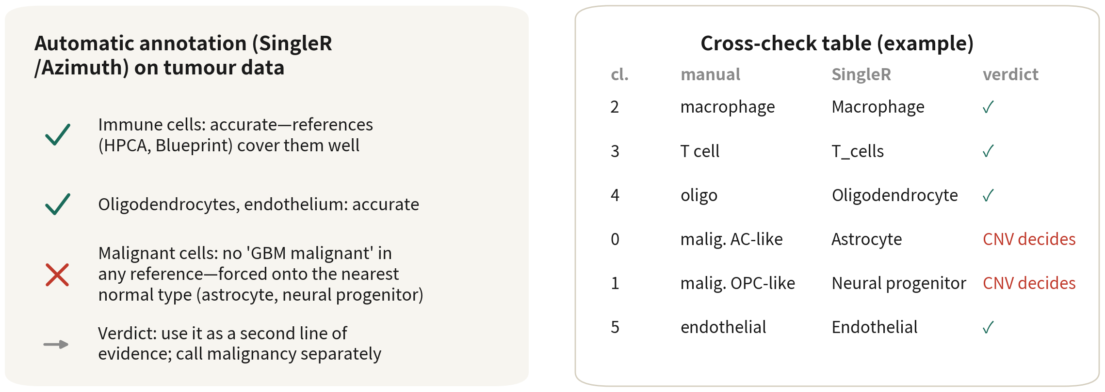
Where automatic annotation stands (tumour data as the example)
Three-column cross-check: agreeing clusters pass; for the glial clusters both columns
stop at lineage — this dataset cannot call malignancy
References: Aran D, et al. Nat Immunol. 2019;20(2):163–172. doi:10.1038/s41590-018-0276-y ｜ Abdelaal T, et al. Genome Biol. 2019;20(1):194. doi:10.1186/s13059-019-1795-z
Q2 Hands-on I
49
Notes:
第四十頁那句話，這一頁就是它的實際樣子。左邊是定位：免疫細胞很準，因為參考集涵蓋得完整；寡樹突、內皮也準；惡性細胞不準，會被硬塞成最像的正常型別——這不是 SingleR 判錯，是 HPCA 裡面根本沒有腫瘤。 所以結論很清楚：自動註釋當第二獨立證據，惡性判定另外做。 右邊是交叉驗證表，三欄：群、手動 marker、SingleR。兩邊一致的群直接過。零號和一號群就不一樣了——手動說膠質，SingleR 說星狀和神經前驅，裁決欄我們寫「待判定」。兩欄都只走到譜系，沒有一欄能說出惡性，那這份資料就到這裡為止。 ──────── That sentence on slide forty — this is what it looks like in practice. On the left, the positioning: immune cells are accurate, because the reference covers them fully; oligodendrocytes and endothelium accurate too; malignant cells inaccurate, forced into the most similar normal type. That is not SingleR getting it wrong — HPCA simply contains no tumour. So the conclusion is clean: automatic annotation serves as the second line of evidence, and malignancy calling is done separately. On the right, the cross-validation table, three columns: cluster, manual markers, SingleR. Clusters where the two agree pass straight through. Clusters zero and one are different — manual says glial, SingleR says astrocyte and neural progenitor — so the verdict column says "undetermined". Both columns stop at lineage; neither can speak to malignancy, and for this dataset that is the end of the road.

Slide 50
Annotation strategies: four roads, usually walked together
No single road is reliable alone; this course goes gate → markers → reference → scores. All four
stop at lineage — malignancy needs a different class of evidence
Strategy | How | Strength | Weakness | Tools
Manual markers | Dotplot / FeaturePlot per cluster against literature markers | Interpretable; finds novel types | Slow, subjective, cluster-dependent | Seurat
Reference set | Correlate each cell / cluster with an annotated reference | Fast, reproducible; accurate for normal types | Types absent from the reference (tumour) get forced into the nearest | SingleR, scType, CellTypist
Gene-set scoring | Mean / AUC of a gene set as a score | Continuous, comparable suits states | High score ≠ type; thresholds are subjective | AddModuleScore, UCell, AUCell
Atlas mapping | Project cells onto a large atlas and inherit labels | Finest subsets, consistent labels | Needs a good atlas malignant cells cannot be mapped | Azimuth, scArches
Q2 Hands-on I
50
Notes:
第三十九頁我們看過註釋的地圖，這一頁是走過一遍之後的版本——同一個工具箱，改按「實際怎麼用」重排，總共四條路。 第一條，手動 marker。每一群看 dotplot、看 FeaturePlot，對照文獻。它可解釋，也有機會發現新型別；代價是慢、主觀，而且完全依賴分群切得對不對。 第二條，參考集分類。把每顆細胞或每一群跟已註釋的參考集比相關，SingleR、scType、CellTypist 都是這一類。快、可重現，正常型別很準。弱點我們剛才已經親眼看到了：參考集裡沒有的型別會被塞成最像的那一個。腫瘤細胞永遠卡在這裡。 第三條，基因集打分數。一組基因的平均或 AUC 就是一個分數。它是連續的、跨研究可比，特別適合描述「狀態」——Neftel 的四種狀態就是這樣做出來的。但要記得，分數高不等於型別，門檻也是主觀的。 第四條，圖譜投影。把細胞投到大型參考圖譜上，直接繼承標籤，Azimuth、scArches 是代表。亞群最細、標籤最一致，但前提是要有一份好的圖譜，而且惡性細胞投不上去。 四條路，沒有一條單獨可靠。本課的順序是：譜系標誌劃分主要類群、marker 定型別、自動參考當第二獨立證據、分數看狀態。四條一起走，每一步互相檢查。 ──────── Slide thirty-nine gave us the map; this is the version after walking it once — the same toolbox, reordered by how it actually gets used. By now we have seen three approaches: lineage markers, the marker panel, SingleR. Four roads in total. Road one, manual markers. Cluster by cluster, look at the dotplot and the FeaturePlots, check against the literature. Explainable, and it can discover new types; the price is that it's slow, subjective, and completely dependent on whether the clustering cuts were right. Road two, reference-based classification. Correlate each cell, or each cluster, against an annotated reference — SingleR, scType and CellTypist all work this way. Fast, reproducible, very accurate for normal types. The weakness we just watched happen: types absent from the reference get shoved into the most similar one. Tumour cells are always stuck there. Road three, gene-set scoring. The mean or the AUC of a gene set becomes a score. It's continuous, comparable across studies, and especially suited to "states" — Neftel's four states are done exactly this way. But a high score is not a type, and the threshold is subjective. Road four, atlas projection. Project cells onto a large reference atlas and let them inherit labels — Azimuth, scArches. Finest subpopulations, most consistent labels; but it needs a good atlas, and malignant cells won't project. Four roads, and not one of them is reliable on its own. This course's order: lineage markers draw the major groups, markers assign types, the automatic reference is the second line of evidence, scores describe states. Walk all four together, each step checking the others.

Slide 51
Choosing an automatic annotation tool
Run all three on the same GBM data: normal types agree above 90%, and the
disagreements are exactly where a human has to look
Tool | Idea | Reference | Unit | Best for / watch out
SingleR | Spearman correlation + fine-tuning | celldex (HPCA, Blueprint, Monaco immune) | Cell or cluster | Default for normal types; an immune reference splits T subsets
scType | Marker database + cluster-level scoring | Built-in human / mouse tissue markers | Cluster | Results in seconds; brain table has no tumour
CellTypist | Logistic-regression models | Immune atlas, multiple human tissues | Cell | Strongest on immune subsets (Python)
Azimuth | Anchor mapping onto a reference UMAP | PBMC, brain, lung kidney, marrow… | Cell | Comes with UMAP coordinates; the brain reference does not apply to GBM malignant cells
scANVI / scArches | Semi-supervised deep model | Any atlas we train | Cell | Cross-technology, large scale; needs GPU
References: Abdelaal T, et al. Genome Biol. 2019;20(1):194. doi:10.1186/s13059-019-1795-z ｜ Hao Y, et al. Cell. 2021;184(13):3573–3587.e29. doi:10.1016/j.cell.2021.04.048
Q2 Hands-on I
51
Notes:
自動註釋的工具一大把，這張表就是幫我們選的。 SingleR 是本課用的：Spearman 相關再加微調，參考集可以用 celldex 的 HPCA、Blueprint，或是 Monaco 的免疫參考。要按細胞或按群都行。正常型別的預設選擇；如果我們要分的是 T 細胞亞群，換成免疫專用的參考集會準很多。 scType 走的是另一條路：用 marker 資料庫在群的層級打分，十秒出結果，內建人和小鼠各組織的 marker 表。方便，但腦組織的表裡沒有腫瘤。 CellTypist 是邏輯迴歸模型，免疫圖譜最強，長在 Python 生態裡。免疫亞群要細分的時候，它常常是最準的那一個。 Azimuth 是 Seurat 的錨點投影，還附帶 UMAP 座標，有 PBMC、人腦、肺、腎、骨髓等參考。這裡要特別注意：人腦參考對 GBM 的惡性細胞無效——它會把惡性細胞投到星狀細胞或 OPC 上。 scANVI 和 scArches 是半監督的深度模型，跨技術、大型圖譜才用它，而且需要 GPU。 實務上的建議：同一份資料跑兩三種。正常型別的一致率通常超過九成；剩下不一致的那些地方，就是需要人坐下來看的地方。 ──────── There is a pile of automatic annotation tools out there; this table helps us choose. SingleR is what this course uses: Spearman correlation plus fine-tuning, with reference sets from celldex — HPCA, Blueprint — or the Monaco immune reference. Per cell or per cluster, either is fine. It's the default choice for normal types; and if what we want is T-cell subsets, switching to an immune-specific reference gets much more accurate. scType takes another route: it scores at the cluster level from a marker database, results in ten seconds, with built-in marker tables for human and mouse tissues. Convenient — but the brain-tissue table has no tumour in it. CellTypist is a logistic regression model, strongest on immune atlases, and it lives in the Python ecosystem. When immune subsets need fine splitting, it's often the most accurate. Azimuth is Seurat's anchor-based projection, bringing UMAP coordinates with it, with references for PBMC, human brain, lung, kidney, bone marrow, and more. One thing to watch: the human brain reference is useless for GBM malignant cells — it will project them onto astrocytes or OPCs. scANVI and scArches are semi-supervised deep models: reach for them across technologies and for large atlases, and they need a GPU. Practical advice: run two or three on the same data. Agreement on normal types is usually above ninety percent; where they disagree is exactly where a human needs to sit down and look.

Slide 52
Naming: the label goes exactly as far as the evidence
new.ids <- c("0" = "Glial (undetermined)", "1" = "Oligodendrocyte", "2" = "Glial (undetermined)", "3" = "Glial (undetermined)", "4" = "Macrophage", "5" = "Macrophage", "6" = "Macrophage", "7" = "Cycling (undetermined)", "8" = "Microglia", "9" = "Pericyte / fibroblast", "10" = "T cell", "11" = "Glial (undetermined)", "12" = "Glial (undetermined)") # which cluster to drop is decided by the QC table from 02 - never hard-code the number qc <- read.csv("output/tables/02_per_cluster_qc.csv") new.ids[as.character(qc$cluster[qc$dbl > 0.5])] <- "DOUBLET" gbm <- RenameIdents(gbm, new.ids); gbm$celltype <- Idents(gbm) gbm <- subset(gbm, subset = celltype != "DOUBLET")
Number-to-name maps differ for every dataset — check our own DotPlot first; which cluster to drop comes from
02’s QC table, never a hard-coded number | Script 03 §4
Q2 Hands-on I
52
Notes:
new.ids 把編號對到名字。膠質那幾群，我們標的是「Glial (undetermined)」——膠質，惡性待判定。這不是替自己留有餘地，是證據到哪裡，標籤就寫到哪裡。 下面三行才是這一頁的重點：要移除的 doublet 群，不要寫死編號。做法是讀 02 存下來的 per-cluster QC 表，把 dbl 超過零點五的群標成 DOUBLET，再 subset 掉。這份資料是十二號群，換一份資料就是別的編號——腳本裡寫死編號，換資料的那天就會刪錯群。 RenameIdents 命名之後，立刻把結果存進 metadata 的 celltype 欄位，因為 RenameIdents 只改 active identity。cluster 編號永遠保留，不要覆蓋。 還有一件事：一定要對照我們自己的 DotPlot 再掛上去。編號跟名字的對應，每一份資料都不一樣。 ──────── new.ids maps the numbers to names. The glial clusters get "Glial (undetermined)" — glial, malignancy undetermined. That is not us hedging; the label goes exactly as far as the evidence goes. The next three lines are the real point of this slide: never hard-code which cluster to remove. Read back the per-cluster QC table that 02 saved, mark every cluster with a doublet rate above zero point five as DOUBLET, and subset those out. In this dataset that is cluster twelve; in another dataset it will be a different number — and a script with the number written into it will delete the wrong cluster the day we change data. RenameIdents hangs the names on, and then we store them straight into the metadata's celltype column, because RenameIdents only changes the active identity. Keep the cluster numbers forever; never overwrite them. One more thing: always check against our own DotPlot before hanging any names. The mapping from numbers to names differs in every dataset.

Slide 53
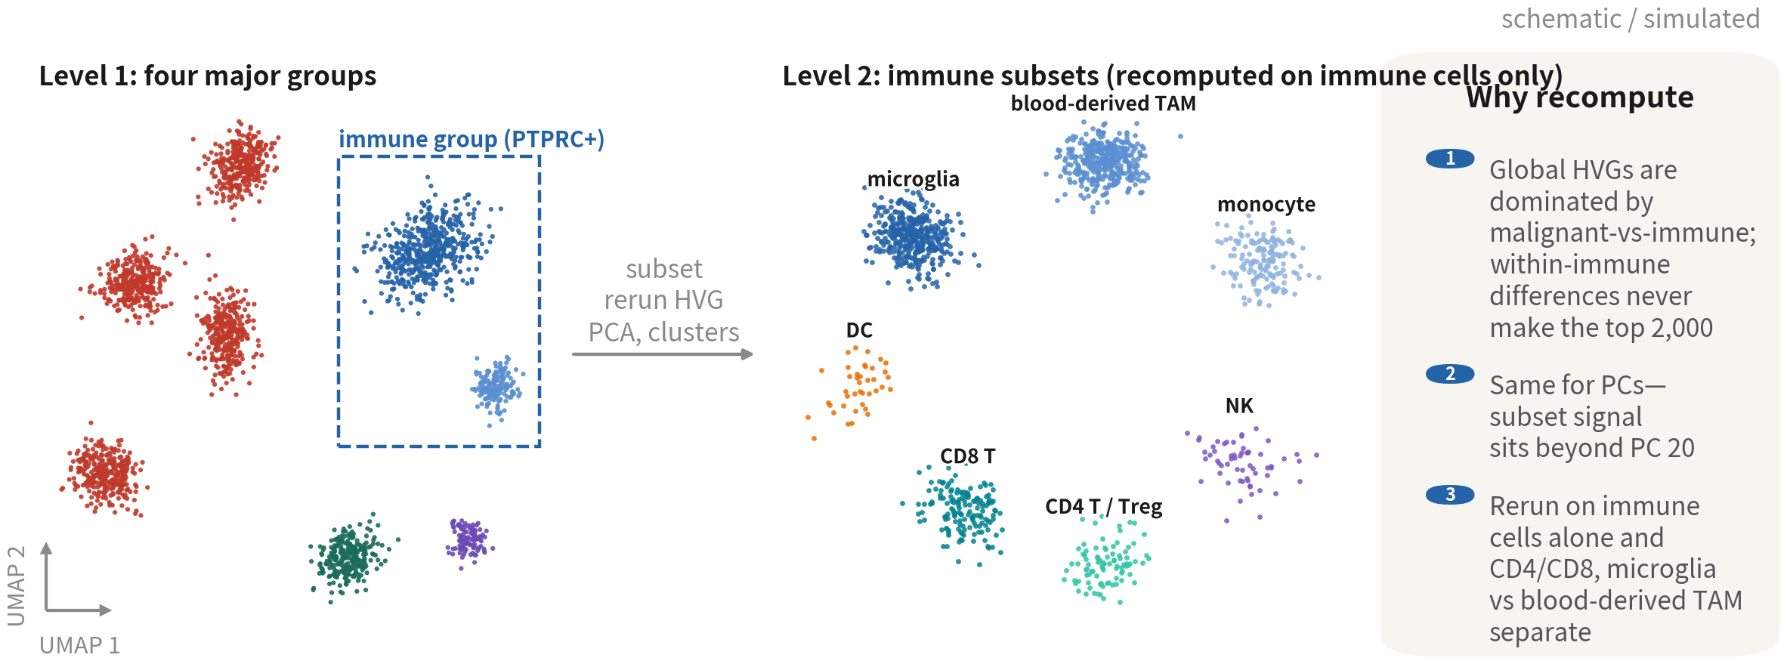
Hierarchical annotation: major groups settled, now the subsets
Take the immune major group out and rerun HVG, PCA and clustering — only then do CD4 / CD8 and
microglia / blood-derived macrophages separate. Malignant 'subsets' use state scores, not clusters
Q2 Hands-on I
53
Notes:
名字掛好了，但這只是第一層：主要類群。論文裡的免疫細胞不會只寫「巨噬細胞」和「T 細胞」，會分到小膠質細胞、血液來源的巨噬細胞、CD8、CD4、Treg。這一頁就講怎麼往下切。 左圖是全體的 UMAP，免疫類群框起來。右圖是把免疫細胞單獨拿出來，重新算 HVG、PCA、分群、UMAP 之後的樣子——七個亞群分得開開的。 為什麼非得重算？三個理由。全體的 HVG 被「惡性 vs 免疫」這個最大的差異佔滿了，免疫內部的差異排不進前兩千個基因；PCA 的前幾軸也一樣，亞群的訊號躲在第二十軸之後，我們取 20 個 PC 根本沒把它算進去；而只留免疫細胞重跑，CD4 和 CD8、小膠質和血液來源的巨噬細胞才分得開。 那惡性類群呢？它的「亞群」不用分群，用狀態分數——這是上一頁講的，也是 Q3 講整合的時候會再強調一次的：惡性細胞的分群按病人走，跨病人比較要靠分數。 ──────── Names are hung — but that's only level one, the major groups. In a paper the immune cells won't just say "macrophages" and "T cells"; they'll split into microglia, blood-derived macrophages, CD8, CD4, Treg. So this slide is about how to cut downward. The left figure is the full UMAP with the immune major group boxed. The right figure is the immune cells taken out on their own, after recomputing HVGs, PCA, clustering and UMAP — seven subpopulations, cleanly separated. Why recompute at all? Three reasons. The global HVGs are saturated by the biggest difference in the data, malignant versus immune, so the differences inside the immune compartment can't crack the top two thousand genes. The first PCA axes have the same problem: the subpopulation signal sits beyond axis twenty, and our 20 PCs never included it. And only by keeping the immune cells alone and rerunning do CD4 and CD8, microglia and blood-derived macrophages, come apart. And the malignant major group? Its "subpopulations" don't come from clustering — they come from state scores. That's what the previous slide said, and Q3 will stress it again when we cover integration: malignant cells cluster by patient, and cross-patient comparison relies on scores.

Slide 54
Subsets: subset, then rerun the whole pipeline
imm <- subset(gbm, celltype %in% c("Macrophage", "Microglia", "T cell")) imm <- NormalizeData(imm) |> FindVariableFeatures(nfeatures = 2000) |> ScaleData() |> RunPCA(npcs = 30) ElbowPlot(imm) # a subset usually needs only 15-20 PCs imm <- FindNeighbors(imm, dims = 1:20) |> FindClusters(resolution = 0.6) |> RunUMAP(dims = 1:20) imm.panel <- c("P2RY12", "TMEM119", "CX3CR1", # microglia "CD163", "LYZ", "TGFBI", "S100A8", "VCAN", # blood-derived TAM / monocyte "CD3E", "CD8A", "GZMK", "CD4", "IL7R", "FOXP3", "PDCD1", "HAVCR2", "NKG7", "GNLY", "CD1C", "MKI67") DotPlot(imm, features = imm.panel) + RotatedAxis() # to split one cluster without rerunning everything: FindSubCluster(gbm, cluster = "2", graph.name = "RNA_snn")
Always recompute HVGs and PCA after subsetting; circling on the old UMAP is a common error. Do not split subsets under ~200 cells | Script 03 §4b
Q2 Hands-on I
54
Notes:
程式碼很直接。subset 把三種免疫型別拿出來，接著 NormalizeData、FindVariableFeatures、ScaleData、RunPCA，一條龍重跑一次。ElbowPlot 看一下，亞群通常 15 到 20 個 PC 就夠了。然後 FindNeighbors、FindClusters、RunUMAP，resolution 從 0.6 開始。 再來是免疫亞群的 marker 面板。小膠質是 P2RY12、TMEM119、CX3CR1；血液來源的 TAM 和單核球是 CD163、LYZ、TGFBI、S100A8、VCAN；T 細胞是 CD3E、CD8A、GZMK、CD4、IL7R、FOXP3，耗竭標記另外放 PDCD1、HAVCR2；NK 是 NKG7、GNLY；DC 是 CD1C；最後放一個 MKI67 看增殖。DotPlot 畫出來，下一頁我們就來讀它。 兩個提醒。第一，subset 之後一定要重算 HVG 與 PCA；很多人圖快，直接在舊的 UMAP 上圈一塊就當亞群，那是常見錯誤。第二，細胞數少於兩百的亞群，不要再往下切了，分出來的東西多半是雜訊。 如果我們只是想把某一群切開、不想重跑整條流程，Seurat 還有 FindSubCluster，在原本的鄰居圖上對單一群做分群。快是快，精度不如重跑。 ──────── The code is straightforward. subset takes out the three immune types, then NormalizeData, FindVariableFeatures, ScaleData, RunPCA — the whole chain rerun. Check the ElbowPlot; for subclusters 15 to 20 PCs is usually enough. Then FindNeighbors, FindClusters, RunUMAP, with resolution starting at 0.6. Then the immune-subset marker panel. Microglia are P2RY12, TMEM119, CX3CR1; blood-derived TAMs and monocytes are CD163, LYZ, TGFBI, S100A8, VCAN; T cells are CD3E, CD8A, GZMK, CD4, IL7R, FOXP3, with the exhaustion markers PDCD1 and HAVCR2 kept separate; NK is NKG7, GNLY; DC is CD1C; and MKI67 goes last, for proliferation. DotPlot draws it, and on the next slide we read it. Two reminders. First, after subset, always recompute HVGs and PCA — plenty of people take the shortcut and just circle a patch on the old UMAP, and that's a common mistake. Second, don't split a subpopulation with fewer than two hundred cells any further; what comes out is mostly noise. If we only want to split one cluster without rerunning the whole pipeline, Seurat has FindSubCluster, which reclusters a single cluster on the original neighbour graph. Fast, yes — but less precise than a full rerun.

Slide 55
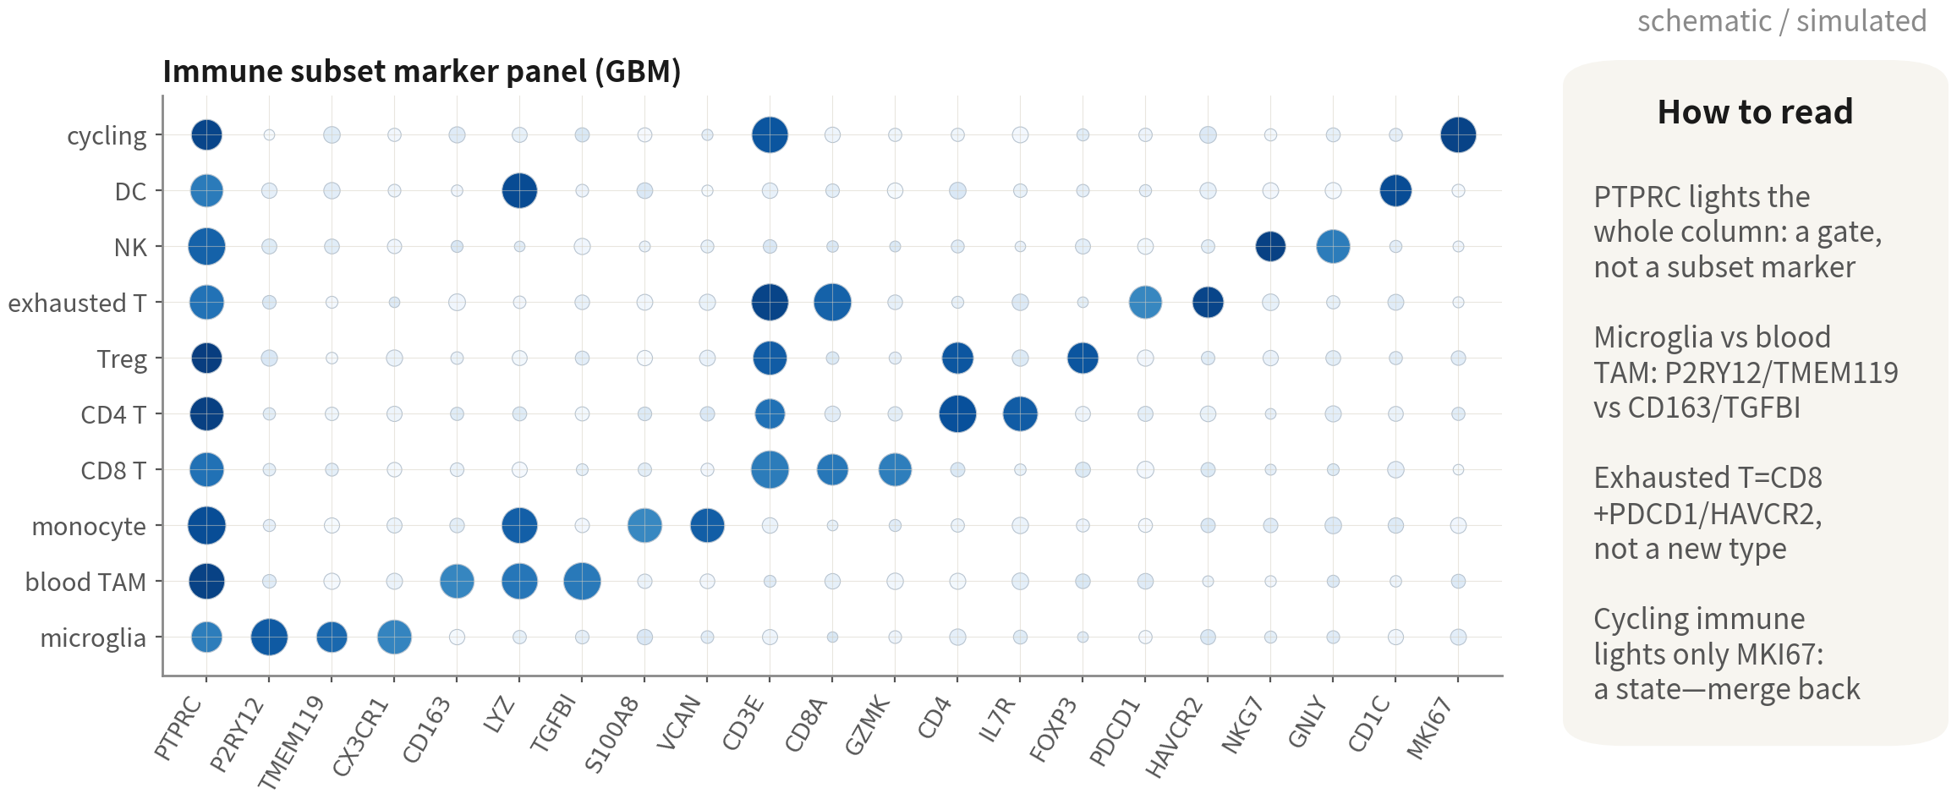
The immune subset panel: the diagonal is the evidence
Microglia vs blood-derived TAM, CD8 vs exhausted CD8, Treg — every cut needs its own
markers; a group lit only by MKI67 is a state, merge it back
Q2 Hands-on I
55
Notes:
這張 dotplot 就是免疫亞群註釋的證據。讀法跟 Q1 講的一樣：點的大小是多少比例的細胞表現，顏色是表現有多高。 先看第一欄 PTPRC，一整欄都亮。它是譜系標誌，證明這些全是免疫細胞——但它不是任何一個亞群的 marker。 真正要看的是對角線。小膠質細胞亮 P2RY12、TMEM119、CX3CR1；血液來源的 TAM 亮 CD163、LYZ、TGFBI；單核球則多了 S100A8 和 VCAN。這是 GBM 免疫註釋最重要的一刀：小膠質細胞是腦內駐留的，血液來源的巨噬細胞是從血管進來的，兩者的來源、功能、跟預後的關係都不同，文獻上一定分開報告。 T 細胞這一塊：CD8 T 亮 CD3E、CD8A、GZMK；CD4 T 亮 CD4、IL7R；Treg 多了 FOXP3；耗竭 T 是 CD8 再加上 PDCD1、HAVCR2——注意，它不是新型別，是 CD8 T 的一種狀態。NK 亮 NKG7、GNLY，而且沒有 CD3E。DC 亮 CD1C。 最後一列，增殖免疫。它只有 MKI67 亮，其他 marker 跟著它原本的型別走。這是狀態，不是型別，註釋的時候併回去，標「cycling」。 ──────── This dotplot is the evidence for the immune subcluster annotation. Read it the same way as in Q1: dot size is what fraction of cells express, colour is how high. Look at column one first, PTPRC — the whole column is lit. It's the lineage marker, and it proves these are all immune cells, but it is not a marker for any subset. What we actually read is the diagonal. Microglia light up P2RY12, TMEM119, CX3CR1; blood-derived TAMs light up CD163, LYZ, TGFBI; monocytes add S100A8 and VCAN. This is the most important cut in GBM immune annotation: microglia are brain-resident, blood-derived macrophages came in through the vessels, and the two differ in origin, in function, and in their relationship to prognosis — the literature always reports them separately. The T-cell block: CD8 T lights CD3E, CD8A, GZMK; CD4 T lights CD4, IL7R; Treg adds FOXP3; exhausted T is CD8 plus PDCD1 and HAVCR2 — and note it's not a new type, it's a state of CD8 T cells. NK lights NKG7 and GNLY, with no CD3E. DC lights CD1C. The last row, cycling immune. Only MKI67 is lit; the other markers follow whatever type the cells originally were. It's a state, not a type — so at annotation time we merge it back and tag it "cycling".

Slide 56
State scores for the glial clusters (Neftel 2019)
neftel <- list( # the first six of each set, as a demo MES = c("CHI3L1", "ANXA2", "ANXA1", "CD44", "VIM", "MT2A"), AC = c("CST3", "S100B", "SLC1A3", "HOPX", "MT3", "SPARCL1"), OPC = c("BCAN", "PLP1", "GPR17", "FIBIN", "LHFPL3", "OLIG1"), NPC = c("DLL3", "DLL1", "SOX4", "TUBB3", "HES6", "TAGLN3")) glial <- subset(gbm, idents = "Glial (undetermined)") glial <- AddModuleScore(glial, features = neftel, name = names(neftel)) FeaturePlot(glial, features = paste0(names(neftel), 1:4), ncol = 4)
Six per set here; use the paper's supplementary table for the full sets (50 each). The states were defined inside confirmed-malignant cells — a score is
never evidence of malignancy | Script 03 §5 | Deeper: B13
Reference: Neftel C, et al. Cell. 2019;178(4):835–849.e21. doi:10.1016/j.cell.2019.06.024
Q2 Hands-on I
56
Notes:
上一集說過，GBM 的惡性細胞有四種狀態。Neftel 等人 2019 年定義了四組基因集：MES 樣、AC 樣、OPC 樣、NPC 樣。這裡每組只取前幾個示範；完整的每組五十個基因，請直接用論文的附表。 做法是 subset 取出膠質那幾群，也就是 0、2、3、11。AddModuleScore 給每一顆細胞算四個分數：一個基因集的平均表現，減掉表現量相近的對照基因的平均。四張 FeaturePlot 攤開來看分數分布。 這一步放在惡性判定之前做也可以，因為分數只是描述。但有一件事一定要記住：Neftel 的四個狀態，是在「已經確認是惡性」的細胞裡定義出來的，所以分數高只能當成傾向，不能反過來拿來證明惡性。 ──────── Last episode said GBM malignant cells come in four states. Neftel and colleagues in 2019 defined four gene sets: MES-like, AC-like, OPC-like, NPC-like. Here each set shows just its top few genes as a demo; the full sets are fifty genes each, so go to the paper's supplementary tables for those. The way it's done: subset takes out the glial clusters, that is 0, 2, 3 and 11. AddModuleScore then computes four scores per cell — the mean expression of a gene set, minus the mean of control genes with similar expression levels. Four FeaturePlots lay out the score distributions. Doing this step before malignancy calling is fine, because a score is only a description. But hold on to one thing: Neftel's four states were defined inside cells already confirmed to be malignant, so a high score is a tendency at best — we cannot run it backwards as proof of malignancy.

Slide 57
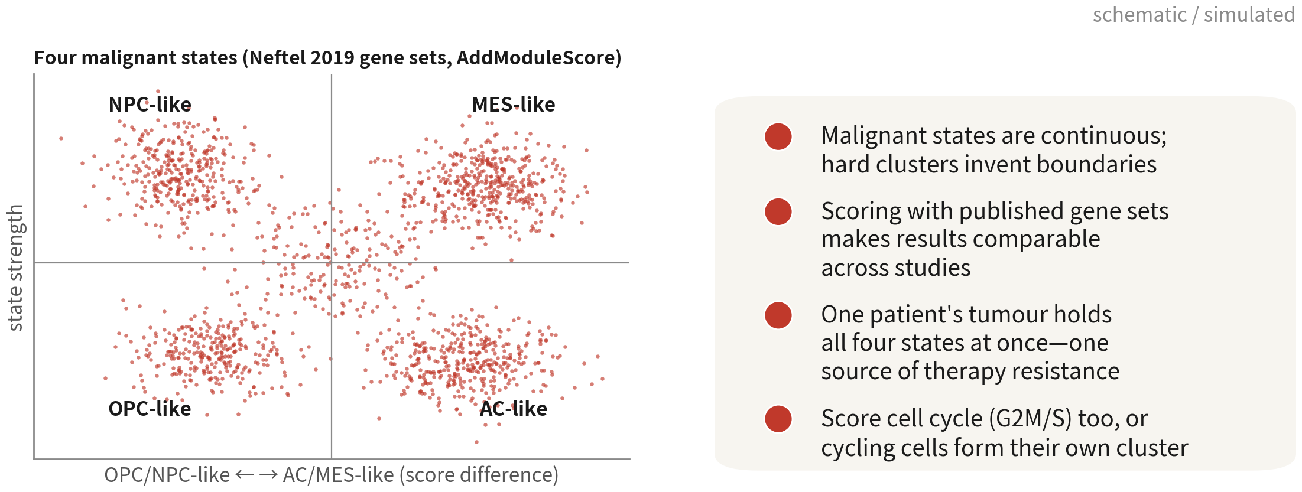
Why score states rather than cluster again
Malignant states are continuous; scores keep that continuity and are comparable across
studies. Read the cycle score alongside
References: Neftel C, et al. Cell. 2019;178(4):835–849.e21. doi:10.1016/j.cell.2019.06.024 ｜ Tirosh I, et al. Science. 2016;352(6282):189–196. doi:10.1126/science.aad0501
Q2 Hands-on I
57
Notes:
左邊是四種狀態的二維圖：橫軸是 OPC/NPC 樣對 AC/MES 樣，縱軸是狀態強度。細胞散在四個象限，中間還有很多過渡的。 那為什麼是打分數，不是分群？第一，惡性狀態本來就是連續的，硬切成群只會製造假邊界。第二，用已發表的基因集，結果可以跨研究比較——我們的 MES 樣，跟別人的 MES 樣是同一件事。第三，同一位病人的腫瘤裡就同時含有四種狀態，這正是治療抗性的來源之一。第四，週期分數要一起看，否則增殖細胞會自成一群，跟四種狀態混在一起。 ──────── The left figure is the four-state two-dimensional plot: the horizontal axis is OPC/NPC-like versus AC/MES-like, the vertical axis is state strength. Cells scatter across four quadrants, with plenty of transitional ones sitting in between. So why score rather than cluster? First, malignant states are continuous to begin with, and hard cuts into clusters only manufacture fake boundaries. Second, using published gene sets makes results comparable across studies — our MES-like and someone else's MES-like are the same thing. Third, one patient's tumour holds all four states at once, which is one source of treatment resistance. Fourth, the cell-cycle scores have to be read alongside, or the proliferating cells form their own cluster and get tangled up with the four states.

Slide 58
Three ways to score: AddModuleScore, UCell, AUCell
# 1. AddModuleScore (Seurat): mean of the set minus the mean of control genes at similar expression. # Fast, but sensitive to sequencing depth glial <- AddModuleScore(glial, features = neftel, name = names(neftel)) # 2. UCell: a Mann-Whitney U score from each gene's rank inside the cell; robust to depth and sparsity library(UCell) glial <- AddModuleScore_UCell(glial, features = neftel, name = "_UCell") # 3. AUCell: how many set members fall in the top 5% of ranked genes per cell (AUC); SCENIC uses it too library(AUCell) rank <- AUCell_buildRankings(LayerData(glial, layer = "counts")) auc <- AUCell_calcAUC(neftel, rank) FeaturePlot(glial, features = paste0(names(neftel), "_UCell"), ncol = 4) cor(glial$MES1, glial$MES_UCell) # AddModuleScore appends an index, UCell does not; ranks agree
Report both the algorithm and the source of the gene set; when the three disagree, trust UCell, which is least sensitive to depth | Script 03 §5
References: Andreatta M, Carmona SJ. Comput Struct Biotechnol J. 2021;19:3796–3798. doi:10.1016/j.csbj.2021.06.043 ｜ Aibar S, et al. Nat Methods. 2017;14(11):1083–1086. doi:10.1038/nmeth.4463
Q2 Hands-on I
58
Notes:
上一頁我們用 AddModuleScore 算了 Neftel 分數。這一頁補上另外兩種算法，因為審稿人一定會問我們：為什麼用這一種？ AddModuleScore 是 Seurat 內建的：基因集的平均表現，減掉一組表現量相近的對照基因的平均。快，但它受定序深度影響——測得深的細胞，分數會系統性偏高。 UCell 乾脆不看表現量，改看排名：每顆細胞內部把所有基因排一次序，再算基因集成員的排名有多前面，用的是 Mann–Whitney U 的邏輯。對深度和稀疏都穩健，跨資料集可比。AddModuleScore_UCell 一行就跑完，欄位名會加上 _UCell 後綴。 AUCell 問的則是：每顆細胞排名前 5% 的基因裡，有多少是基因集成員？輸出一個 AUC。SCENIC 算 regulon 活性用的就是它，Q3 會遇到。 三種算法排出來的順序通常高度一致，cor 一下就知道。萬一不一致，相信 UCell，因為它最不受深度影響。報告的時候寫清楚：用了哪個算法、基因集從哪裡來、幾個基因。 ──────── On the previous slide we computed the Neftel scores with AddModuleScore. This slide adds the other two algorithms, because a reviewer is going to ask us why we used that one. AddModuleScore is built into Seurat: the gene set's mean expression, minus the mean of a matched set of control genes with similar expression. Fast — but it's affected by sequencing depth, so deeper cells score systematically higher. UCell doesn't look at expression levels at all; it looks at ranks. Within each cell it ranks all the genes, then measures how far up the gene-set members sit — the logic of a Mann–Whitney U. Robust to depth and to sparsity, comparable across datasets. One line, AddModuleScore_UCell, and the column names come back with a _UCell suffix. AUCell asks a different question: of each cell's top 5% ranked genes, how many are gene-set members? It outputs an AUC. SCENIC uses it for regulon activity — we meet that in Q3. The three algorithms usually rank cells in high agreement; a quick cor confirms it. When they disagree, trust UCell, because it's the least depth-sensitive. And when reporting, state it clearly: which algorithm, where the gene set came from, how many genes.

Slide 59
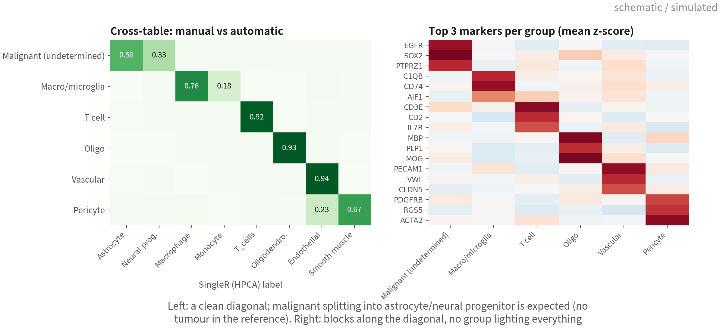
Annotation quality control: the cross-table
and the marker heatmap
Left: a clean manual-vs-automatic diagonal with every deviation explained; right: top
markers light in blocks, no group lights everything. Both go into the supplement
Q2 Hands-on I
59
Notes:
註釋做完了，怎麼證明它是對的？兩張圖，放進補充資料，審稿人會找。 左邊是交叉表：手動標籤對 SingleR 的標籤，每一列加總為一。對角線要清楚——T 細胞九成二被標成 T_cells，寡樹突九成三，血管九成四。偏離的地方要解釋得了：惡性細胞被拆成星狀細胞和神經前驅，這是預期，參考集裡沒有腫瘤；周細胞有兩成被標成內皮，它們本來就長在血管周圍，表現有重疊，也合理。解釋不了的偏離，回去看那一群。 右邊是每一群 top marker 的熱圖，z-score。對角線會一塊一塊亮起來：惡性亮 EGFR、SOX2、PTPRZ1，巨噬亮 C1QB、CD74、AIF1，以此類推。這張圖要抓的是兩種壞事：某一群什麼都亮一點——那可能是 doublet 或低品質；或者兩群的 marker 幾乎一模一樣——那可能是切得太細了。 ──────── Annotation done — so how do we prove it is right? Two figures, both into the supplement; reviewers will look for them. The left is the cross-table: manual labels against SingleR labels, each row summing to one. The diagonal has to be clean — ninety-two percent of T cells labelled T_cells, oligodendrocytes ninety-three, vascular ninety-four. And the deviations have to be explainable: malignant cells split into astrocytes and neural progenitors, which is expected, the reference has no tumour; twenty percent of pericytes labelled endothelium, and they do sit around vessels with overlapping expression, so that's reasonable too. A deviation we cannot explain means going back to look at that cluster. The right is the per-cluster top-marker heatmap, z-scored. Blocks light up along the diagonal: malignant lights EGFR, SOX2, PTPRZ1; macrophages light C1QB, CD74, AIF1, and so on. There are two kinds of trouble to catch: a cluster that lights up a little bit of everything — possibly doublets or low quality; or two clusters with nearly identical markers — possibly cut too fine.

Slide 60
QC code: cross-table, heatmap, cluster tree, silhouette
# cross-table: manual labels vs SingleR (each row sums to 1) round(prop.table(table(gbm$celltype, gbm$singler), 1), 2) # top-5 marker heatmap per cluster (at most 100 cells each, or the figure gets too heavy) top5 <- markers |> group_by(cluster) |> slice_max(avg_log2FC, n = 5) gbm <- ScaleData(gbm, features = unique(c(VariableFeatures(gbm), top5$gene))) # scale heatmap genes first DoHeatmap(subset(gbm, downsample = 100), features = top5$gene, group.by = "celltype") # cluster tree: is the similarity structure sensible (immune on one branch, glial on another) gbm <- BuildClusterTree(gbm, dims = 1:20); PlotClusterTree(gbm) # silhouette: how self-contained each cluster is in PC space (under 0.1 is suspect) library(cluster) cl <- if (ncol(gbm) > 20000) sample(colnames(gbm), 20000) else colnames(gbm) # dist() is O(n^2) sil <- silhouette(as.integer(Idents(gbm)[cl]), dist(Embeddings(gbm, "pca")[cl, 1:20])) tapply(sil[, "sil_width"], Idents(gbm)[cl], mean)
Four checks, four questions: does the automatic label agree, are markers clean, is the structure sensible, are clusters separable | Script 03 §5b
Q2 Hands-on I
60
Notes:
四個檢查，各回答一個問題。 先看交叉表。table 加 prop.table，每列加總為一，然後盯著對角線看。它回答的是「自動同不同意」。 接著是熱圖。從 markers 表每群取 top 5，丟進 DoHeatmap。這裡請記得 downsample 等於 100，每群最多抽一百顆——不然五千顆細胞的熱圖又重又看不清。它回答的是「marker 乾不乾淨」。 再來是分群樹。BuildClusterTree 用 PC 空間的平均把型別做成一棵樹，PlotClusterTree 畫出來。我們預期免疫走一支、膠質走一支、血管跟周細胞靠在一起。如果 T 細胞跟寡樹突變成姊妹，那就有問題了。這一項回答的是「結構合不合理」。 最後是輪廓係數。cluster 套件的 silhouette，用 PC 空間的距離，算每顆細胞跟自己群的緊密度，對比最近的那個別群。按群取平均，低於 0.1 的群要存疑——它跟鄰居分不開，可能本來就該併回去。這一項回答「群分不分得開」。 四個檢查加起來不到一分鐘，但它們就是註釋「對」的證據。 ──────── Four checks, and each one answers a single question. Start with the cross-table. table plus prop.table, rows summing to one, and then keep your eye on the diagonal. What it answers is: does the automatic method agree with us? Then the heatmap. Take the top 5 per cluster from the markers table and hand them to DoHeatmap. Remember downsample equals 100 here — at most one hundred cells per cluster, because a five-thousand-cell heatmap is heavy and you can't read a thing on it. What it answers is: are the markers clean? Next, the cluster tree. BuildClusterTree averages the types in PC space into a tree, and PlotClusterTree draws it. We expect immune down one branch, glial down another, with vasculature and pericytes sitting together. If T cells and oligodendrocytes come out as sisters, something has gone wrong. This one answers: does the structure make sense? Last, the silhouette. The cluster package's silhouette works on PC-space distances, measuring how tightly each cell sits with its own cluster against the nearest other cluster. Average it by cluster, and treat anything below 0.1 as suspect — that cluster can't be separated from its neighbour, and maybe it should be merged back. This one answers: do the clusters actually separate? All four together take under a minute, but they are the evidence that the annotation is right.

Slide 61
Naming convention: keep three label levels in metadata
Papers use level 2, supplementary tables level 3, statistical tests often only level 1
Column | Content | Example | Rule
celltype_l1 | Major group | Immune / Malignant / Oligo / Vascular / Stromal | Five to seven; composition analysis uses this
celltype_l2 | Type | Microglia, blood-derived TAM CD8 T, glial (undetermined) | Each backed by ≥ 2 markers; names aligned to Cell Ontology
celltype_l3 | State / subset | Exhausted CD8 T, cycling TAM, MES-like | States as 'adjective + type'; do not coin new nouns
celltype_conf | Confidence | high / medium / unresolved | Write unresolved when unsure; never force
Q2 Hands-on I
61
Notes:
最後講命名。很多分析走到後面會亂掉，原因其實很單純：metadata 裡只有一欄 celltype，一下寫主要類群、一下寫狀態。建議拆成三層，再加一欄信心。 celltype_l1 是主要類群：Immune、Malignant、Oligo、Vascular、Stromal，五到七個。組成分析要用它，因為型別切太細的時候，每個樣本的細胞數根本不夠做檢定。 celltype_l2 是型別：Microglia、Blood-derived TAM、CD8 T、Glial (undetermined)。規則是每一個都要有至少兩個 marker 支持，名字對齊 Cell Ontology——這樣別人的資料才跟我們的對得上。論文主圖用這一層。 celltype_l3 是狀態或亞群：Exhausted CD8 T、Cycling TAM、MES-like。規則是形容詞加型別，不要自己發明新名詞。補充表用這一層。 celltype_conf 是信心：high、medium、unresolved。不確定的就誠實寫 unresolved，不要硬塞——Q3 判惡性的時候，這個原則我們會再遇到一次。 三層都存進 metadata，之後任何一張圖都可以 group.by 切換層級，也不用回頭改程式。 ──────── Last, naming. A lot of analyses fall apart late on, and the reason is usually simple: the metadata has one celltype column that sometimes holds a major group and sometimes holds a state. So split it into three levels, and add one column for confidence. celltype_l1 is the major group: Immune, Malignant, Oligo, Vascular, Stromal — five to seven of them. Composition analysis uses this level, because once the types get too fine, the per-sample cell counts simply aren't big enough to test. celltype_l2 is the type: Microglia, Blood-derived TAM, CD8 T, Glial (undetermined). The rule is that every entry has at least two markers behind it, and the names align with the Cell Ontology — that's how other people's data and ours line up. The paper's main figures use this level. celltype_l3 is the state or subpopulation: Exhausted CD8 T, Cycling TAM, MES-like. The rule here is adjective plus type; don't go coining new nouns. Supplementary tables use this level. celltype_conf is the confidence: high, medium, unresolved. When you're not sure, write unresolved honestly — don't force it. We meet that principle again in Q3, when we call malignancy. Store all three levels in the metadata, and any figure can switch levels with group.by — we never have to go back and rewrite code.

Slide 62
Common mis-annotations: five 'novel types' and
what they really are
Looks like | Actually | How to catch it | What to do
Tumour cells expressing immune genes | Malignant + macrophage doublets | High per-cluster doublet rate, high nCount, sits between two big groups | Remove the cluster and record it
A stem-like subset | A cycling existing type | Markers are only MKI67 / TOP2A; Phase nearly all S/G2M | Merge back, label 'cycling'
A stress-response subset | Dissociation artefact | FOS / JUN / HSPA1A high; a slice inside every type | Regress or annotate; not biology
Undifferentiated / unknown type | Low-quality cells | Lowest nFeature, highest mt, no marker lights | Back to QC
Immune cells expressing oligodendrocyte genes | Ambient RNA | MBP / PLP1 a little in every group high pct.2 | Rerun after SoupX
References: van den Brink SC, et al. Nat Methods. 2017;14(10):935–936. doi:10.1038/nmeth.4437 ｜ McGinnis CS, Murrow LM, Gartner ZJ. Cell Syst. 2019;8(4):329–337.e4. doi:10.1016/j.cels.2019.03.003
Q2 Hands-on I
62
Notes:
收尾這一張表，是這一段最實用的東西：五種最常被當成新型別的東西。 最常見的，是表現免疫基因的腫瘤細胞。九成是惡性加巨噬細胞的 doublet。怎麼抓？整群的 doublet 比例高、nCount 偏高、在 UMAP 上卡在兩大群之間。處理方式是整群移除並記錄。這是雷二。 再來是幹細胞樣亞群，多半只是增殖中的既有型別。marker 只有 MKI67、TOP2A，Phase 幾乎全是 S 和 G2M。併回原型別，加一個 cycling。這是雷三。 第三種是壓力反應亞群，那是解離假象。FOS、JUN、HSPA1A 高，而且散在每一種型別裡各一撮——真正的亞群不會平均分布在所有型別。回歸掉或註明，不要當成生物學。 第四種是低分化或未知型別，其實是低品質細胞。nFeature 最低、mt 最高、什麼 marker 都不亮。回 QC 調整閾值。 最後一種是表現寡樹突基因的免疫細胞，來源是環境 RNA。MBP、PLP1 在所有群都有一點，pct.2 高。SoupX 之後重跑。 五種裡面，沒有一種是新型別。真的新型別當然存在，但它要通過這五關之後才算數。 ──────── This closing table is the most practical thing in the section: the five things most often mistaken for new cell types. The most common is tumour cells expressing immune genes. Nine times out of ten those are malignant-plus-macrophage doublets. How do you catch it? The whole cluster's doublet fraction runs high, nCount runs high, and on the UMAP it's wedged between two big clusters. Remove the whole cluster and record it. That's pitfall two. Next, a stem-cell-like subpopulation — usually just a proliferating version of a type you already have. Its only markers are MKI67 and TOP2A, and Phase is almost all S and G2M. Merge it back into the original type and add cycling. That's pitfall three. Third, a stress-response subpopulation. That one is a dissociation artefact. FOS, JUN and HSPA1A high, and scattered as a little clump inside every single type — a real subpopulation doesn't distribute itself evenly across all types. Regress it out or note it, but don't call it biology. Fourth, a poorly differentiated or unknown type. Those are low-quality cells: lowest nFeature, highest mt, and no marker lights up at all. Back to QC to fix the cutoffs. And the last one, immune cells expressing oligodendrocyte genes. That's ambient RNA. MBP and PLP1 show a little in every cluster, pct.2 high. Rerun after SoupX. Not one of the five is a new type. Genuinely new types do exist — but they only count once they've come through these five gates.

Slide 63
Deliverables: the three plots and one table of a Figure 1
p1 <- DimPlot(gbm, group.by = "celltype", label = TRUE, repel = TRUE) + NoLegend() p2 <- DotPlot(gbm, features = panel, group.by = "celltype") + RotatedAxis() p3 <- VlnPlot(gbm, features = c("nFeature_RNA", "percent.mt"), group.by = "celltype", pt.size = 0, ncol = 2) fig1 <- (p1 | p2) / p3 # patchwork layout ggsave("output/figs/03_fig1_annotation.pdf", fig1, width = 14, height = 9, bg = "white") comp <- gbm@meta.data |> dplyr::count(celltype) |> mutate(pct = round(100 * n / sum(n), 1)) write.csv(comp, "output/tables/03_composition.csv", row.names = FALSE)
celltype n pct
Glial (undetermined) 2379 46.4
Macrophage 1178 23.0
Oligodendrocyte 850 16.6
Cycling (undetermined) 276 5.4
Microglia 171 3.3
Pericyte / fibroblast 140 2.7
T cell 136 2.7
UMAP for position, dotplot for evidence, violin for QC consistency, the table for numbers. Hand in all four and
half the first-round questions disappear | Script 03 §6
Q2 Hands-on I
63
Notes:
註釋做完，就要把它變成可以交出去的東西。論文的 Figure 1 幾乎永遠是這三張圖加一張表。 第一張是 DimPlot，按 celltype 上色、標籤打在群上——它給的是位置。第二張是 DotPlot，marker 面板對 celltype——它給的是證據，你會看到它沿著對角線一塊一塊亮起來。第三張是 VlnPlot，nFeature 與 percent.mt 按 celltype 拆開——它證明每個型別的 QC 是一致的，沒有哪一群其實是壞細胞。排版用 patchwork 的直線跟斜線，ggsave 存成 PDF。 表是組成表：每個型別幾顆、佔幾成，count 加 mutate 兩行，存成 CSV。特別注意膠質那一列的名字：Glial，括號 undetermined。這是一個誠實的標籤，而且在這份資料裡它不會被拿掉——要拿掉，需要單一病人給不了的證據。 四樣一起交，審稿人第一輪的問題會少一半。腳本 03 的第 6 節有完整版本。 ──────── Annotation done — now turn it into something we can hand over. A paper's Figure 1 is almost always these three figures plus one table. Figure one is the DimPlot, coloured by celltype with labels on the clusters — that gives you location. Figure two is the DotPlot, the marker panel against celltype — that gives you evidence, and you'll watch it light up block by block along the diagonal. Figure three is the VlnPlot, nFeature and percent.mt split by celltype — that proves QC is consistent across types, that no cluster is secretly a pile of bad cells. patchwork lays them out with the pipe and slash operators, and ggsave writes the PDF. The table is composition: how many cells per type, what share — two lines, count plus mutate, saved as CSV. Look closely at the name on the glial row: Glial, parenthesis undetermined. It is an honest label, and in this dataset the parenthesis never comes off — removing it needs evidence a single patient cannot give. Hand all four over together and the reviewer's first-round questions drop by half. Script 03, section 6 has the full version.

Slide 64
Wrap-up: save the object, record the versions
saveRDS(gbm, "output/rds/03_gbm_annotated.rds") write.csv(markers, "output/tables/03_markers.csv", row.names = FALSE) sessionInfo() # goes in the supplement; a reviewer's best friend
Every file in output/ can be regenerated from the scripts in R/ — that is what reproducible means | Script 03 §6
Q2 Hands-on I
64
Notes:
saveRDS 存物件，write.csv 存 marker 表，sessionInfo 記版本。 標準只有一條：output 資料夾裡的每一個檔案，都能從 R 資料夾的腳本重生。這就是可重現。 ──────── saveRDS saves the object, write.csv saves the marker table, sessionInfo records the versions. There is really only one standard to hold ourselves to: every file in the output folder can be regenerated from the scripts in the R folder. That is what reproducible means.

Slide 65
06
COMMON PITFALLS
The six most common hands-on traps in tumour data
Q2 Hands-on I
65
Notes:
腫瘤資料最常見的三個實作雷。 ──────── The three hands-on pitfalls that come up most often in tumour data.

Slide 66

Pitfall 1: copying the 5% mito cut
What it is
Applying the PBMC tutorial's 5% to GBM.
Why it happens
Every tutorial uses PBMC; 5% looks like common sense.
What it costs you
Half the live cells gone, mostly active malignant ones.
Immune proportions get inflated and every downstream
composition analysis is skewed.
Q2 Hands-on I
66
Notes:
做了什麼？把 PBMC 教學那個 5%，直接套到 GBM 上。 為什麼會踩？因為每一份教學都用 PBMC，5% 看起來就像常識。 踩了會怎樣？你砍掉一半活細胞，而且砍掉的多半是代謝旺盛的惡性細胞。剩下的資料裡，免疫細胞比例被灌大，之後任何組成分析——例如「這顆腫瘤免疫浸潤程度高」——全部歪掉。解法就是第十三頁講的：MAD，數字寫進方法段。 ──────── What was done? The 5% from the PBMC tutorials, applied straight to GBM. Why do people step on it? Because every tutorial uses PBMC, so 5% looks like common sense. And what happens? You cut half your live cells, and most of what you cut are the metabolically hyperactive malignant ones. In what's left, the immune fraction is inflated, and any composition analysis afterwards — "this tumour has high immune infiltration", say — comes out completely skewed. The fix is the one from slide thirteen: MAD, with the numbers written into the methods paragraph.

Slide 67
Pitfall 2: a doublet cluster reported as
'immune-like tumour cells'
What it is
A cluster expressing both SOX2 and CD74 written
up as an 'antigen-presenting malignant subset'.
Why it happens
The markers look exciting and there is literature to cite.
What it costs you
Sixty percent of the cluster is flagged by the doublet
tool and it sits between malignant and myeloid. Sanity
check 3 exists for exactly this.
Q2 Hands-on I
67
Notes:
做了什麼？一群同時表現 SOX2 和 CD74 的細胞，被寫成「具抗原呈現能力的惡性亞群」。 為什麼會踩？因為這組 marker 看起來很有趣，也有文獻可以引——確實有人報導過抗原呈現的腫瘤細胞。 踩了會怎樣？那一群有六成被 doublet 工具標記，位置又剛好卡在惡性與髓系之間。那不是新亞群，是惡性細胞加巨噬細胞黏在一起。必要檢查三就是為了抓這個。 ──────── What was done? A cluster co-expressing SOX2 and CD74, written up as "a malignant subpopulation with antigen-presenting capacity". Why do people step on it? Because that marker pair looks interesting, and there's literature to cite — antigen-presenting tumour cells have indeed been reported. And what happens? Sixty percent of that cluster gets flagged as doublets by the tool, and it sits wedged between malignant and myeloid. It isn't a new subpopulation; it's malignant cells stuck to macrophages. Sanity check three exists precisely to catch this.

Slide 68
Pitfall 3: cycling cells reported as a new type
What it is
An MKI67/TOP2A-high cluster named a
'stem-like subpopulation'.
Why it happens
Cell-cycle signal is strong and easily
dominates clustering.
What it costs you
It is a state, not a type: dividing malignant cells and
macrophages mixed together. Check the Phase column first,
then decide whether to regress.
Q2 Hands-on I
68
Notes:
做了什麼？一群 MKI67、TOP2A 高的細胞自成一個群集，被命名為「幹細胞樣亞群」。 為什麼會踩？因為週期基因訊號很強，容易主導分群，看起來就真的像一個獨立的群。 踩了會怎樣？那是狀態，不是型別，裡面還混著正在分裂的惡性細胞和巨噬細胞。所以先看 Phase 欄位——這就是第二十頁要先算週期分數的理由——再決定要不要 regress。 ──────── What was done? A cluster high in MKI67 and TOP2A forms its own cluster and gets named "a stem-cell-like subpopulation". Why do people step on it? Because cycle genes signal strongly and easily dominate the clustering, so it really does look like an independent cluster. And what happens? That's a state, not a type — and inside it, dividing malignant cells and dividing macrophages are mixed together. So check the Phase column first — this is exactly why slide twenty computed the cycle scores early — and then decide whether to regress.

Slide 69
Pitfall 4: cranking the resolution up and naming every cluster
What it is
Turning the resolution up to 1.2, getting
twenty-odd clusters, and giving every one a name.
Why it happens
More clusters look more refined, and clustree
still draws something.
What it costs you
The extra cuts have no marker support and vanish when the seed
changes. The number of clusters is not the goal; being able to
justify each cut with markers is. Go back to the stable band, then
let markers decide whether to split further.
Q2 Hands-on I
69
Notes:
做了什麼？把 resolution 開到 1.2，切出二十幾群，然後每一群都寫一個名字。 為什麼會踩？因為群多看起來比較細緻，而且 clustree 照樣畫得出來，看起來沒毛病。 踩了會怎樣？多切的那幾刀沒有 marker 支持，換個 seed 就消失了。這裡要記得一件事：分幾群從來不是目標，能不能用 marker 把每一刀說清楚才是。回到穩定層，再讓 marker 決定要不要往下切。 ──────── What happened? The resolution went up to 1.2, out came twenty-odd clusters, and every one got a name. Why does it happen? More clusters look more refined, and clustree still draws something, so nothing looks wrong. What does it cost? The extra cuts have no marker support and vanish the moment the seed changes. Remember this one: the number of clusters was never the goal — being able to justify each cut with markers is. Go back to the stable band, then let the markers decide whether to split further.

Slide 70
Pitfall 5: reading the marker table by p value alone
What it is
FindAllMarkers returns padj = 1e-40, so that gene
is taken as the cluster's marker.
Why it happens
A tiny p value looks like strong evidence.
What it costs you
A cell-level test treats cells as samples, so with thousands
of cells the p values are tiny by construction and rank
poorly. Read pct.1 against pct.2 and the size of avg_log2FC
as well — a gene at pct.1 = 0.22 versus pct.2 = 0.19
separates nothing, however small its padj.
Q2 Hands-on I
70
Notes:
做了什麼？FindAllMarkers 給了 padj 等於 1e-40，就直接把那個基因當成該群的 marker。 為什麼會踩？p 值小，看起來就是證據強，這是很自然的直覺。 踩了會怎樣？cell-level 檢定把細胞當樣本，幾千顆細胞下 p 值天生就極小，拿來排序意義有限。要一起看 pct.1 跟 pct.2 差多少、avg_log2FC 有多大。舉個例子：pct.1 等於 0.22、pct.2 等於 0.19，兩邊幾乎一樣常見，padj 再小也分不出群——那就不是 marker。 ──────── What happened? FindAllMarkers returned padj = 1e-40, so that gene went straight in as the cluster's marker. Why does it happen? A tiny p value looks like strong evidence. That is a natural instinct. What does it cost? A cell-level test treats cells as samples, so with thousands of cells the p values are tiny by construction and rank poorly. Read pct.1 against pct.2 and the size of avg_log2FC as well. Take an example: pct.1 = 0.22 against pct.2 = 0.19 means the gene is about as common outside the cluster as inside, and no padj can rescue that — it is not a marker.

Slide 71
Pitfall 6: copying someone else's marker panel
What it is
Lifting a PBMC tutorial's marker panel
wholesale onto tumour data.
Why it happens
The panel is ready-made and looks generic.
What it costs you
The immune half still works, but the tissue-specific half is simply
missing — without PTPRZ1, MBP and PECAM1, the glial,
oligodendrocyte and vascular cells all fall into unknown. A marker
panel is rebuilt for the tissue and the cancer type, not copied.
Q2 Hands-on I
71
Notes:
做了什麼？把 PBMC 教學的 marker 面板整份搬到腫瘤資料上。 為什麼會踩？面板現成、看起來通用，而且免疫那幾條確實還管用。 踩了會怎樣？組織專屬的那一半整個缺席。沒有 PTPRZ1、沒有 MBP、沒有 PECAM1，膠質、寡樹突、血管就全部落進 unknown，然後你會以為是資料有問題。marker 面板要照組織與癌別重配一次，不是照抄。 ──────── What happened? A PBMC tutorial's marker panel was lifted wholesale onto tumour data. Why does it happen? The panel is ready-made, it looks generic, and the immune half genuinely still works. What does it cost? The tissue-specific half is simply missing. No PTPRZ1, no MBP, no PECAM1 — so the glial, oligodendrocyte and vascular cells all land in unknown, and you start suspecting the data. A marker panel gets rebuilt for the tissue and the cancer type; it does not get copied.

Slide 72
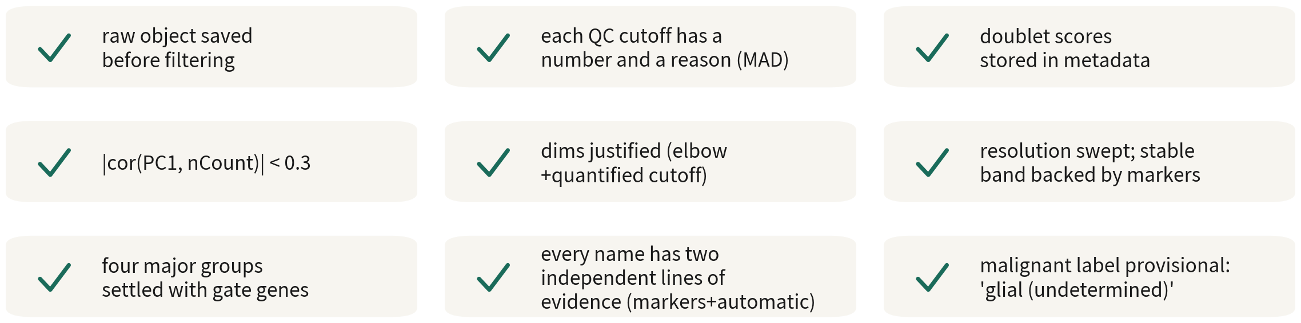
Q2 checklist
All nine boxes before the object goes to Q3
Q2 Hands-on I
72
Notes:
九格，一格一格對過去。原始物件存了。三條 QC 線各有數字與理由。doublet 分數在 metadata。PC1 與 nCount 的相關小於 0.3。dims 有依據。resolution 掃過、穩定層有 marker 支持。四個主要類群用譜系標誌基因劃清楚。每群名字有兩項獨立證據。惡性標籤停在「膠質，待判定」，而且有說得出口的理由。 九格全勾，這個物件才能進 Q3。 ──────── Nine boxes, and we go through them one at a time. Raw object saved. Each of the three QC cutoffs has a number and a reason. Doublet scores in the metadata. PC1 versus nCount correlation below 0.3. dims justified. Resolution swept, with the stable band supported by markers. Four major groups drawn cleanly with lineage markers. Every cluster's name carries two independent lines of evidence. And the malignant label stops at "glial, undetermined", with a reason we can state out loud. All nine ticked — and only then does the object move on to Q3.

Slide 73
ONE-LINE SUMMARY
Every parameter is a hypothesis: a number, a reason, a record.
Annotation settles lineage first; malignancy awaits
multiple lines of evidence.
Do this and our pipeline is reproducible and defensible. Calling malignancy
needs evidence one sample cannot give; Q3 switches datasets to show it.
Q2 Hands-on I
73
Notes:
一句話：每個參數都是一個假設，所以它要有數字、有理由、有紀錄。 註釋也一樣，先確定譜系，惡性與否留待多重證據共同判定。 做到這些，我們的流程就可重現、可辯護。至於惡性判定，它需要的證據單一樣本給不了，Q3 會換一份資料示範。 ──────── One sentence: every parameter is a hypothesis, so it needs a number, a reason, a record. Annotation works the same way — settle lineage first, and leave malignancy to be decided by multiple lines of evidence together. Do these, and our pipeline is reproducible and defensible. As for calling malignancy: it needs evidence one sample cannot give, so Q3 switches datasets to show it.

Slide 74
Check yourself 1
GBM: median percent.mt 7%, median + 3×MAD = 13%.
Where does the cutoff go?
A The conventional 5%
B 13%, with the number and reason in the methods
C Skip the percent.mt filter
Answer B. A threshold is a property of the data. 5% removes most live cells; no
filter keeps the dying-cell mode.
Q2 Hands-on I
74
Notes:
第一題。GBM 資料 percent.mt 中位數 7%、中位數加三倍 MAD 等於 13%。閾值該怎麼定？ A，照慣例 5%。B，13%，並把數字與理由寫進方法段。C，不過濾 percent.mt。 先自己想一下，再往下聽。 答案是 B。閾值是資料的性質。5% 會砍掉大半活細胞；不過濾，則會留下第二個峰的垂死細胞。 ──────── Question one. In a GBM dataset, the percent.mt median is 7% and median plus three MAD comes to 13%. How should the threshold be set? A: follow convention, 5%. B: 13%, with the number and reason written into the methods paragraph. C: don't filter on percent.mt. Take a moment before you hear the answer. The answer is B. The threshold is a property of the data. 5% would cut away most of the live cells; no filtering would keep the dying cells in that second peak.

Slide 75
Check yourself 2
A cluster expresses both SOX2 and C1QB; the doublet tool
flags 65% of it. What now?
A An exciting new subset — report it
B Remove the whole cluster and record why
C Remove only the flagged 65%
Answer B. Mostly flagged and sitting between two big groups — the whole cluster is
a doublet product; the remaining 35% are the ones the tool missed, not real cells.
Q2 Hands-on I
75
Notes:
第二題。某群同時高表現 SOX2 與 C1QB，doublet 工具標記其中 65% 為 doublet。該怎麼處理？ A，這是有趣的新亞群，寫進結果。B，整群移除並記錄理由。C，只移除被標記的 65%。 先自己想一下，再往下聽。 答案是 B。過半被標記、又卡在兩大群之間，整群就是 doublet 的產物。剩下的 35% 是工具沒抓到的，不是真細胞。 ──────── Question two. A cluster highly expresses both SOX2 and C1QB, and the doublet tool flags 65% of it as doublets. What do we do? A: it's an interesting new subpopulation — into the results. B: remove the whole cluster and record the reason. C: remove only the flagged 65%. Take a moment before you hear the answer. The answer is B. Over half of it flagged, and wedged between two big clusters — the whole cluster is the product of doublets. The remaining 35% are the ones the tool missed, not real cells.

Slide 76
Check yourself 3
SingleR labels cluster 0 as Astrocyte; markers are SOX2 / PTPRZ1 /
EGFR. The honest label?
A Astrocyte
B Malignant
C Glial (malignancy undetermined)
Answer C. No GBM malignant cells exist in the reference, so SingleR
picks the nearest; markers only give lineage. Malignancy needs genome-level
evidence plus patient-specificity — one patient cannot supply both, so
undetermined is the honest label.
Q2 Hands-on I
76
Notes:
第三題。SingleR 把零號群標成 Astrocyte，marker 是 SOX2、PTPRZ1、EGFR。最誠實的標籤是哪一個？ A，Astrocyte。B，Malignant。C，Glial，惡性待判定。 先自己想一下，再往下聽。 答案是 C。參考集裡沒有 GBM 惡性細胞，SingleR 只能塞一個最像的；而 marker 只說得出譜系。惡性要基因體層級的證據，加上跨病人專屬性，單一病人湊不齊，那麼誠實的標籤就是待判定。 ──────── Question three. SingleR labels cluster zero Astrocyte; the markers are SOX2, PTPRZ1, EGFR. Which is the most honest label? A: Astrocyte. B: Malignant. C: Glial, malignancy undetermined. Take a moment before you hear the answer. The answer is C. The reference has no GBM malignant cells, so SingleR can only shove in the closest match it has; and markers only speak to lineage. Malignancy needs genome-level evidence plus patient-specificity — one patient cannot supply both, so undetermined is the honest label.

Slide 77
Check yourself 4
clustree shows res 0.4, 0.5 and 0.6 agreeing, and cells start swapping
clusters from 0.8 up. Which do you take?
A 0.8 — more clusters, finer detail
B 0.5 — the middle of the stable band, then check each cut with markers
C Run them all and keep whichever looks best
Answer B. A stable band means those cuts survive a change of parameter, and the
middle of it is the safest pick. Choosing the prettiest result means letting the
answer decide the method — any line can be justified after the fact.
Q2 Hands-on I
77
Notes:
第四題。clustree 顯示 res 0.4、0.5、0.6 三層結構一致，0.8 以後細胞開始來回換群。該用哪一個？ A，0.8，群比較多比較細。B，0.5，穩定層裡的中間值，再用 marker 檢查每一刀。C，都跑，最後挑結果最好看的。 先自己想一下，再往下聽。 答案是 B。穩定層的意思就是這幾刀換參數也不會變，取中間值最保險。至於 C，挑「看起來最好看的」，等於用結果決定方法——那條線畫在哪裡都能自圓其說。 ──────── Question four. clustree shows res 0.4, 0.5 and 0.6 agreeing, and cells start swapping clusters from 0.8 upward. Which do you take? A, 0.8 — more clusters, finer detail. B, 0.5 — the middle of the stable band, then check each cut with markers. C, run them all and keep whichever looks best. Take a moment before you hear the answer. The answer is B. A stable band means those cuts survive a change of parameter, and the middle of it is the safest pick. As for C, choosing the prettiest result means letting the answer decide the method — and any line can be justified after the fact.

Slide 78
Check yourself 5
A marker has padj = 1e-40 but pct.1 = 0.22 and
pct.2 = 0.19. Can it be used?
A Yes — a padj that small must be real
B No — nearly the same fraction of cells express it inside and outside
C It depends on whether avg_log2FC is positive or negative
Answer B. A cell-level test treats cells as samples, so with thousands of cells
padj is tiny by construction. A 0.03 gap between pct.1 and pct.2 means the gene is
just as common outside the cluster as inside — no discrimination, no marker.
Q2 Hands-on I
78
Notes:
第五題。某個 marker 的 padj 等於 1e-40，但 pct.1 是 0.22、pct.2 是 0.19。這個 marker 能用嗎？ A，能，padj 這麼小一定是真的。B，不能，群內群外幾乎一樣多細胞在表現。C，要看 avg_log2FC 是正是負。 先自己想一下，再往下聽。 答案是 B。cell-level 檢定把細胞當樣本，幾千顆細胞下 padj 天生極小。pct.1 跟 pct.2 只差 0.03，代表這個基因在群內群外一樣常見——不具區辨力，就不是 marker。 ──────── Question five. A marker has padj = 1e-40, but pct.1 is 0.22 and pct.2 is 0.19. Can it be used? A, yes — a padj that small must be real. B, no — nearly the same fraction of cells express it inside and outside. C, it depends on whether avg_log2FC is positive or negative. Take a moment before you hear the answer. The answer is B. A cell-level test treats cells as samples, so with thousands of cells padj is tiny by construction. A gap of 0.03 between pct.1 and pct.2 means the gene is just as common outside the cluster as inside — no discrimination, no marker.

Slide 79
Check yourself 6
One cluster lights up none of the four gate genes. What
is the reasonable next step?
A Label it unknown and move on
B Delete it — we cannot identify it anyway
C Read its own top markers and QC first, and subset-rerun if needed
Answer C. The gate genes only cover the four major groups, so pericytes and
fibroblasts are expected to fall outside. Read the cluster's own top markers first —
they are often recognisable at a glance — and check its QC, because low-quality
cells also light up nothing. Once it is not junk, subset and rerun.
Q2 Hands-on I
79
Notes:
第六題。有一群細胞，四個譜系標誌基因都不亮。下一步最合理的做法？ A，標成 unknown 就好。B，刪掉，反正認不出來。C，先看它自己的 top marker 與 QC，必要時 subset 重跑。 先自己想一下，再往下聽。 答案是 C。gate 基因只涵蓋四大類群，本來就會漏掉周細胞、纖維母這一類。先看它自己的 top marker，常常一眼就認得出來；QC 也要看，因為低品質細胞同樣是什麼都不亮。確定它不是垃圾，再 subset 重跑一次。 ──────── Question six. One cluster lights up none of the four gate genes. What is the reasonable next step? A, label it unknown and move on. B, delete it — we cannot identify it anyway. C, read its own top markers and QC first, and subset-rerun if needed. Take a moment before you hear the answer. The answer is C. The gate genes only cover the four major groups, so pericytes and fibroblasts are expected to fall outside. Read the cluster's own top markers first — they are often recognisable at a glance — and check the QC too, because low-quality cells also light up nothing. Once you know it is not junk, subset and rerun.

Slide 80
NEXT
Q3: multi-sample integration and
downstream analysis
Four patients, core vs periphery (GSE84465) — the dataset changes
precisely to supply what one sample cannot.
Malignancy is called from multiple lines of evidence led by inferCNV, pseudobulk puts
DE at the patient level, and the episode closes with a downstream routing guide.
scRNA-seq video series · Series Q Quick Start
https://github.com/Charlene717/scRNA-seq-tutorial-Qseries
Notes:
單一樣本走完了。但一位病人的資料回答不了「病人之間」的問題，也沒辦法確定誰是惡性的。 所以下一集 Q3 換資料：四位病人、核心對邊緣的 GBM——換資料就是為了拿到單一樣本給不了的那項證據。以 inferCNV 為主的多重證據完成惡性判定，pseudobulk 讓差異表達以病人為單位，然後把下游走一遍：CellChat 六種圖、軌跡、調控、反卷積。六十五分鐘，五支練習腳本。 --- ──────── The single sample is done. But one patient's data can't answer questions about what happens between patients, and it can't determine who is malignant. So the next episode, Q3, switches to four patients and core-versus-margin GBM data — the dataset changes precisely to supply the evidence a single sample cannot. Malignancy is called from multiple lines of evidence led by inferCNV, pseudobulk makes differential expression run at the patient level, and then we walk the downstream: CellChat's six plot types, trajectories, regulons, deconvolution. Sixty-five minutes, five practice scripts. ---

