Slide 1

Series Q Q1
Concepts: what scRNA-seq sees,
how it works, how to read the plots
Using a tumour as the worked example: why we look one cell at a time, what the
plots may claim, how malignancy is called, and whose number a conclusion is.
About 45 min | Prerequisites: none | Example: glioblastoma (GBM) | Deeper: Series A
https://github.com/Charlene717/scRNA-seq-tutorial-Qseries
Notes:
歡迎來到 Q 系列第一集。Q 就是「快速上手」——因為你很可能下個月就得看懂一份腫瘤的單細胞結果，甚至得自己交出一份分析，而 A、B、C 三個系列四十幾集，你沒有時間慢慢看完。 所以這幾集只做一件事：挑一種癌症當主線——膠質母細胞瘤，也就是 GBM——把整條流程裡最不能省的觀念跟操作走過一遍。今天這一集不寫程式，只講觀念。 自我介紹就先跳過，我們直接從一位病人開始。 ──────── Welcome to the first episode of the Q series. Q stands for quick start — because there's a good chance that next month you'll have to make sense of a single-cell tumour result, or even hand in an analysis of your own, and the A, B and C series run to forty-odd episodes. You haven't got time to work through all of that first. So these episodes do one thing only. We take one cancer as the through-line — glioblastoma, GBM — and walk the concepts and the operations in the pipeline that genuinely cannot be skipped. Today there's no code. Concepts only. I'll skip the introductions. Let's start with a patient.

Slide 2
A SCENE
A 58-year-old patient, a 4 cm brain tumour on MRI.
What is actually inside the tissue the surgeon removes?
Pathology says: glioblastoma, grade IV. That name gives us a diagnosis —
not the contents of the tissue.
Q1 Concepts
2
Notes:
一位五十八歲的病人，因為頭痛跟右手無力來看診。MRI 上，左側額葉一顆四公分、環狀顯影的腫瘤。神經外科把它切下來，病理科看了切片，診斷寫下：膠質母細胞瘤，WHO 第四級。 這個名字給了我們診斷，也給了預後——中位存活大約十五個月。但有一件事它完全沒說：手術切下來的那塊組織，裡面到底有什麼。 這不是哲學問題。這位病人接下來會接受放療加 temozolomide，然後很可能在一年內復發。到那個時候，是哪一群細胞活下來了？它們跟原來的腫瘤細胞還一樣嗎？旁邊的免疫細胞，是在幫忙，還是在幫倒忙？這些問題，每一個都要先知道「組織裡面有什麼」，才回答得了。 ──────── A fifty-eight-year-old patient comes in with headaches and weakness in the right hand. On MRI there's a four-centimetre, ring-enhancing tumour in the left frontal lobe. Neurosurgery takes it out, pathology looks at the slide, and the diagnosis reads: glioblastoma, WHO grade four. That name gives us the diagnosis, and it gives us the prognosis — median survival around fifteen months. But there's one thing it says nothing about: what is actually inside the piece of tissue the surgeon removed. This isn't a philosophical question. This patient will now have radiotherapy plus temozolomide, and will very likely relapse within the year. When that happens — which population of cells survived? Are they still the same as the original tumour cells? And the immune cells sitting next to them, are they helping, or making things worse? Every one of those questions needs you to know what's inside the tissue before you can answer it.

Slide 3
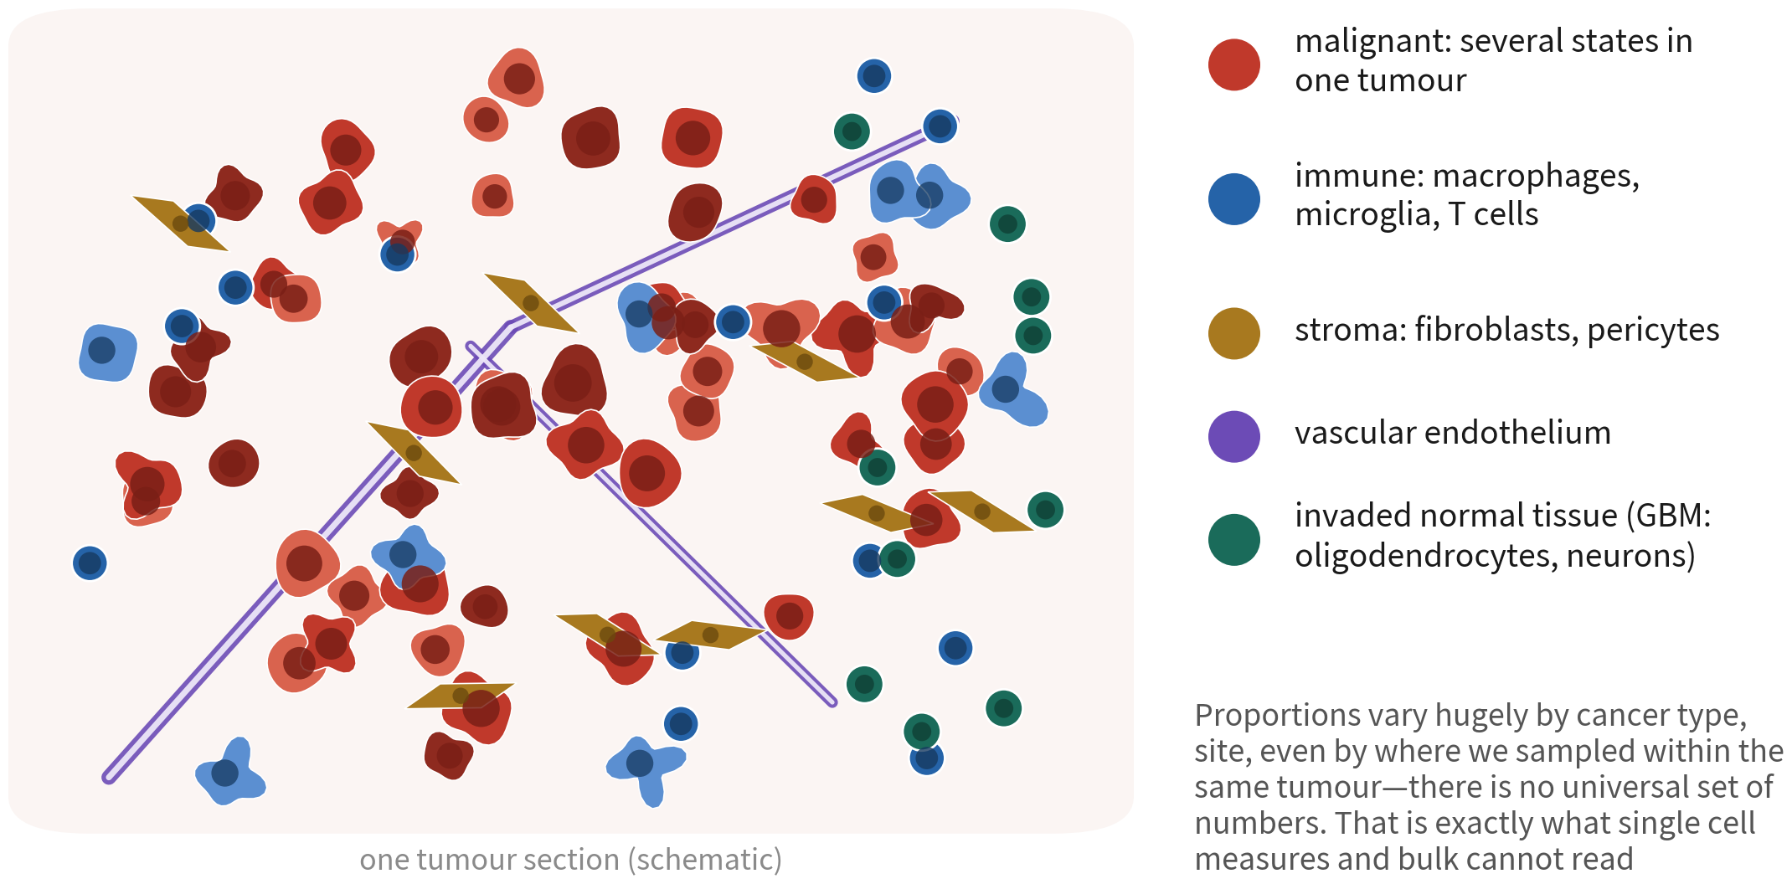
A tumour is an ecosystem, not just malignant cells
Malignant cells are only part of it, and come in several states; the rest is immune,
stroma, vessels and invaded normal brain
References: Tirosh I, et al. Science. 2016;352(6282):189–196. doi:10.1126/science.aad0501 ｜ Neftel C, et al. Cell. 2019;178(4):835–849.e21. doi:10.1016/j.cell.2019.06.024
Q1 Concepts
3
Notes:
我們把那塊組織畫出來，長這樣。 紅色是惡性細胞。你注意一下，它們有深有淺——同一顆腫瘤裡的惡性細胞就不只一種狀態，有的像星狀細胞、有的像神經前驅細胞、有的像間質細胞。這叫腫瘤內異質性，也是 GBM 治療失敗的核心原因之一。 藍色是免疫細胞。GBM 裡最多的是巨噬細胞跟小膠質細胞，常常佔到三、四成；T 細胞反而很少，所以 GBM 才會被叫做「免疫冷」的腫瘤。 金色是基質，纖維母細胞跟周細胞。紫色是血管，GBM 的血管增生非常明顯。綠色則是被浸潤的正常腦組織——寡樹突細胞、神經元，腫瘤往外長的時候，把它們一起包在裡面。 右邊那個比例只是給你一個量級。真正的重點是：這些比例會因為癌別、部位、取樣位置而差異極大，而且傳統方法讀不出來。 ──────── Draw that piece of tissue out and it looks like this. Red is the malignant cells. Notice they come in different shades — even inside one tumour the malignant cells are in more than one state: some look like astrocytes, some like neural progenitors, some like mesenchymal cells. That's intratumoural heterogeneity, and it's one of the core reasons GBM treatment fails. Blue is the immune cells. In GBM the most abundant are macrophages and microglia, often thirty or forty percent of the tissue. T cells are rare, which is why GBM gets called an immunologically cold tumour. Gold is the stroma, fibroblasts and pericytes. Purple is blood vessels — vascular proliferation in GBM is very prominent. Green is the infiltrated normal brain: oligodendrocytes and neurons, wrapped up inside the tumour as it grew outwards. The proportions on the right are only there to give you an order of magnitude. The real point is that these proportions vary enormously with cancer type, with location, with where you happened to sample — and traditional methods cannot read them out at all.

Slide 4
WHERE THIS EPISODE STARTS
Treatment failure, relapse, resistance —
the answer is usually 'which cell, in which state'.
Answering that needs a technology that looks one cell at a time. This
episode explains why, and what the data looks like.
Q1 Concepts
4
Notes:
所以這一集的起點，就是這句話：治療失敗、復發、抗藥性，答案常常藏在「哪一種細胞、處在哪一種狀態」。 要回答這種問題，我們需要一種能一顆一顆看細胞的技術。單細胞 RNA 定序就是這個技術。 這一集的結構是四條紅線。它們不是四個章節，是四條會一路貫穿到 Q2、Q3 的規則——每一條我們都會講清楚它是什麼、證據在哪裡、最容易怎麼踩。 ──────── So this episode starts from one sentence: treatment failure, relapse, drug resistance — the answer is very often hiding in which kind of cell, in which state. To answer a question like that we need a technology that can look at cells one at a time. Single-cell RNA sequencing is that technology. This episode is built around four red lines. They aren't four chapters. They're four rules that will run all the way through Q2 and Q3 — and for each one we'll be clear about what it is, where the evidence for it comes from, and how people most often step on it.

Slide 5
Episode goals
1
A tumour is an ecosystem — name four questions bulk cannot answer, and say
when single cell is not needed
2
Analysis lives in PC space, the UMAP is a projection — know what a UMAP may
and may not claim, and read dotplots and FeaturePlots
3
How malignancy is called depends on the cancer — the preconditions of the
three kinds of evidence, and when markers suffice versus when CNV is required
4
The unit is the patient — why n counts patients, not cells, and what that
decides in design and in analysis
Q1 Concepts
5
Notes:
第一條，腫瘤是生態系，所以要一顆一顆看。這一段結束的時候，你能說出四個 Bulk 一定答不了的問題；同樣重要的是，你也能說出什麼時候其實不需要單細胞。 第二條，分析在 PC 空間，UMAP 只是投影。我們會弄清楚一張 UMAP 能說什麼、不能說什麼，也會讓你看得懂 dotplot 跟 FeaturePlot。 第三條，惡性怎麼判定，看的是癌別，不是通則。判定惡性有三種證據，各有各的前提；什麼時候 marker 就夠、什麼時候非 CNV 不可，這是那一段的重點。 第四條，統計單位是病人，不是細胞。前面三條決定我們看到什麼，這一條決定我們能宣稱什麼。 中間還夾了兩段基礎：資料是怎麼來的，以及流程在做什麼。它們不算紅線，但少了它們，紅線講不下去。 ──────── Red line one: a tumour is an ecosystem, so we look one cell at a time. By the end of that stretch you'll be able to name four questions bulk simply cannot answer — and, just as important, say when you don't actually need single cell at all. Red line two: the analysis lives in PC space, and the UMAP is only a projection. We'll get clear on what one UMAP can say and what it can't, and you'll come away able to read a dotplot and a FeaturePlot. Red line three: how malignancy is called depends on the cancer, not on some general rule. There are three kinds of evidence for malignancy, each with its own preconditions — and the heart of that stretch is knowing when markers are enough and when nothing but CNV will do. Red line four: the statistical unit is the patient, not the cell. The first three decide what we see. This one decides what we're allowed to claim. Wedged in between there are two foundational stretches: where the data come from, and what the pipeline does. They aren't red lines, but without them the red lines don't hold together.

Slide 6
01
A tumour is an ecosystem, so we look
one cell at a time
See bulk's limits first; the value of single cell — and
when it is not needed — follows
Q1 Concepts
6
Notes:
第一條紅線。要理解單細胞的價值，得先理解 Bulk RNA-seq 的限制——以及它什麼時候其實比較好。 ──────── The first red line. To understand what single cell is worth, you first have to understand where bulk RNA-seq runs out — and where bulk is in fact the better choice.

Slide 7
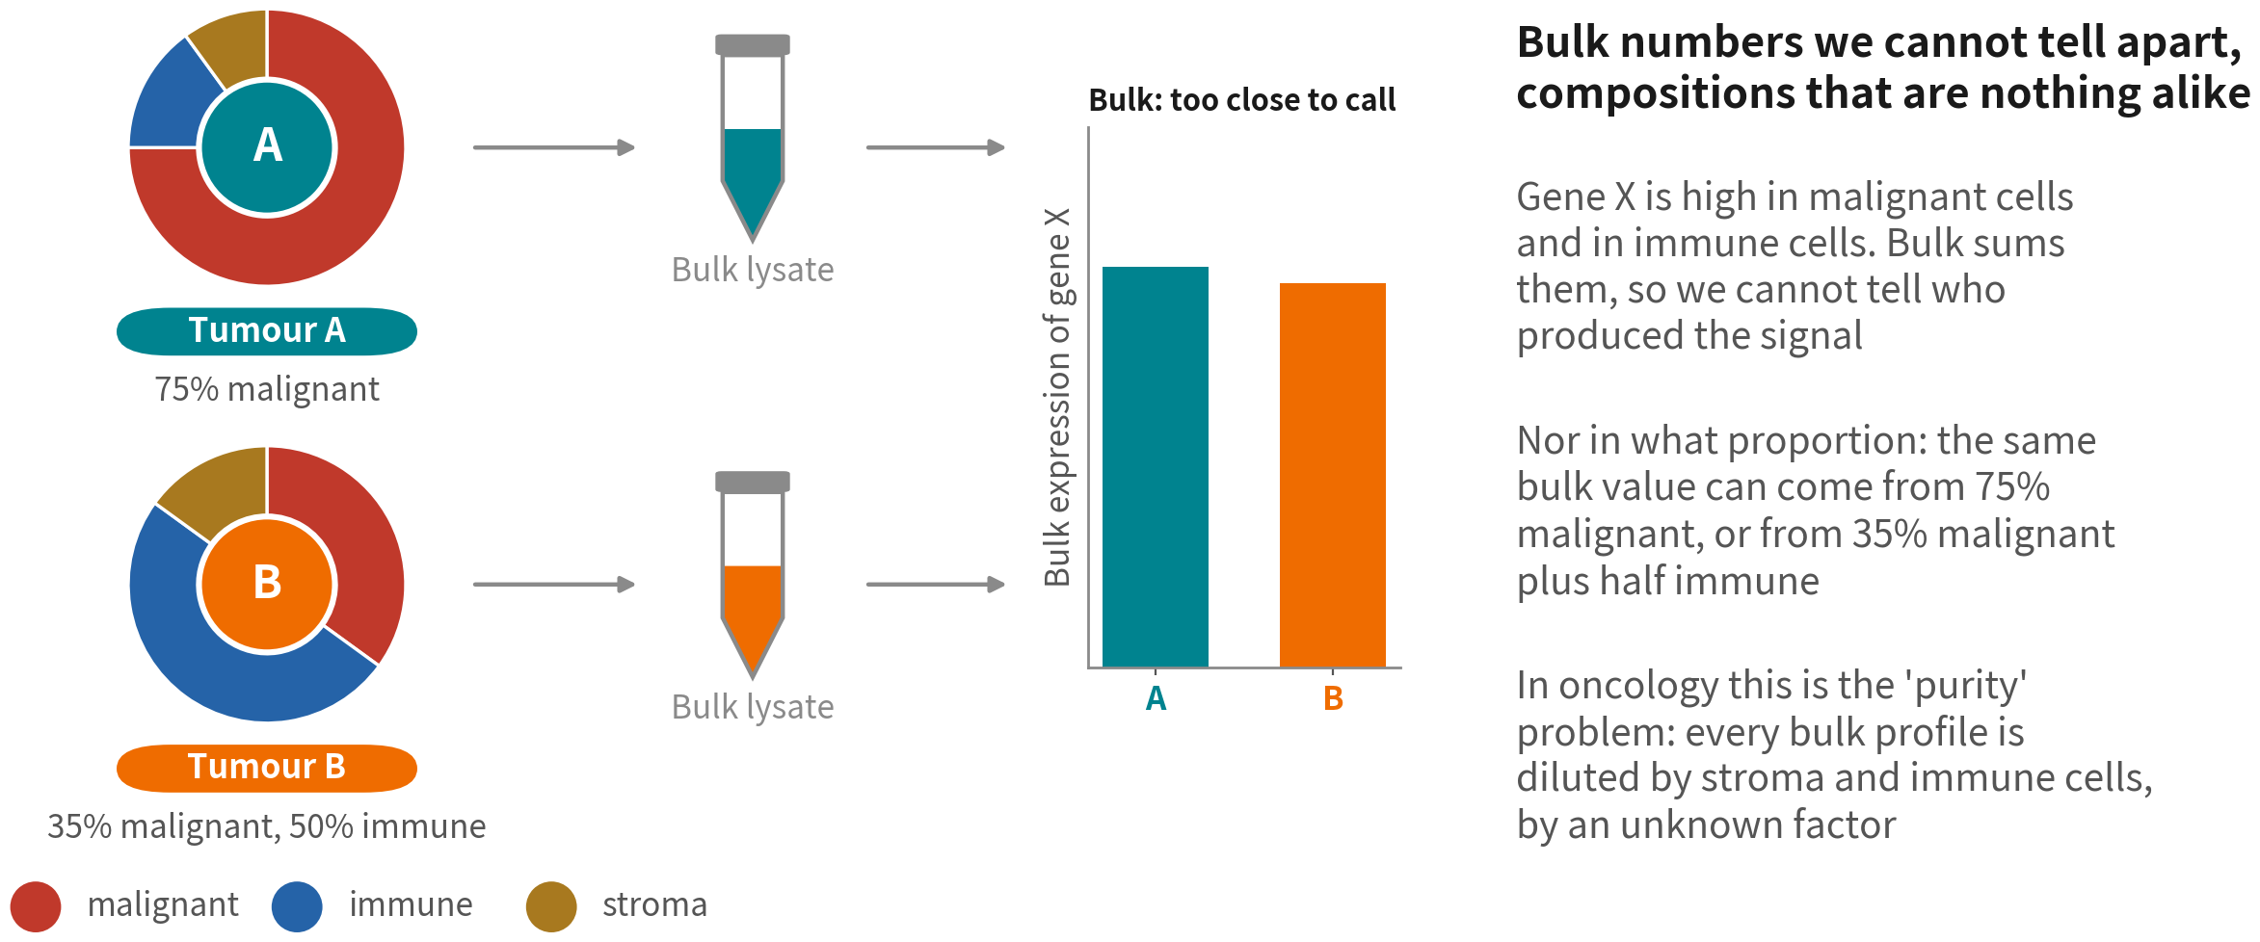
Bulk RNA-seq: grind the whole tissue, measure one average
Two tumours with completely different composition can give bulk numbers too close to
tell apart — oncology calls this the purity problem
Q1 Concepts
7
Notes:
Bulk 的做法很直接：把整塊組織打碎，所有 RNA 抽出來一起定序。我們拿到的是每個基因一個數字。 那這個數字到底是什麼？它是組織裡所有細胞的表現量，依照它們的比例加權平均。 看左邊。腫瘤 A 是百分之七十五的惡性細胞；腫瘤 B 惡性只有三成五，免疫細胞佔了一半。這是兩顆完全不同的腫瘤——一顆是實心的腫瘤，一顆是被免疫細胞大量浸潤的腫瘤，臨床意義天差地遠。 但是，假設基因 X 在惡性細胞跟免疫細胞裡都高表現，那這兩顆腫瘤的 Bulk 數字會一模一樣。訊號來自誰，看不出來；比例是多少，也看不出來。 在腫瘤研究裡，這叫「純度」問題。每一份 Bulk 都被基質跟免疫細胞稀釋過，而且稀釋比例未知。TCGA 那幾萬份 Bulk 資料，每一份都帶著這個問題。 ──────── What bulk does is very direct: grind up the whole piece of tissue, pull out all the RNA, sequence it together. What comes back is one number per gene. So what is that number, really? It's the expression of every cell in the tissue, averaged and weighted by how common each of them is. Look at the left. Tumour A is seventy-five percent malignant cells. Tumour B is only thirty-five percent malignant, with immune cells making up half of it. These are two completely different tumours — one solid, one heavily infiltrated by immune cells — and clinically they're worlds apart. But suppose gene X is highly expressed in both malignant cells and immune cells. Then the bulk numbers for those two tumours come out identical. Who the signal came from, you can't see. What the proportions were, you can't see either. In tumour research this is the purity problem. Every bulk sample has been diluted by stroma and immune cells, and the dilution factor is unknown. Those tens of thousands of bulk samples in TCGA — every single one carries it.

Slide 8
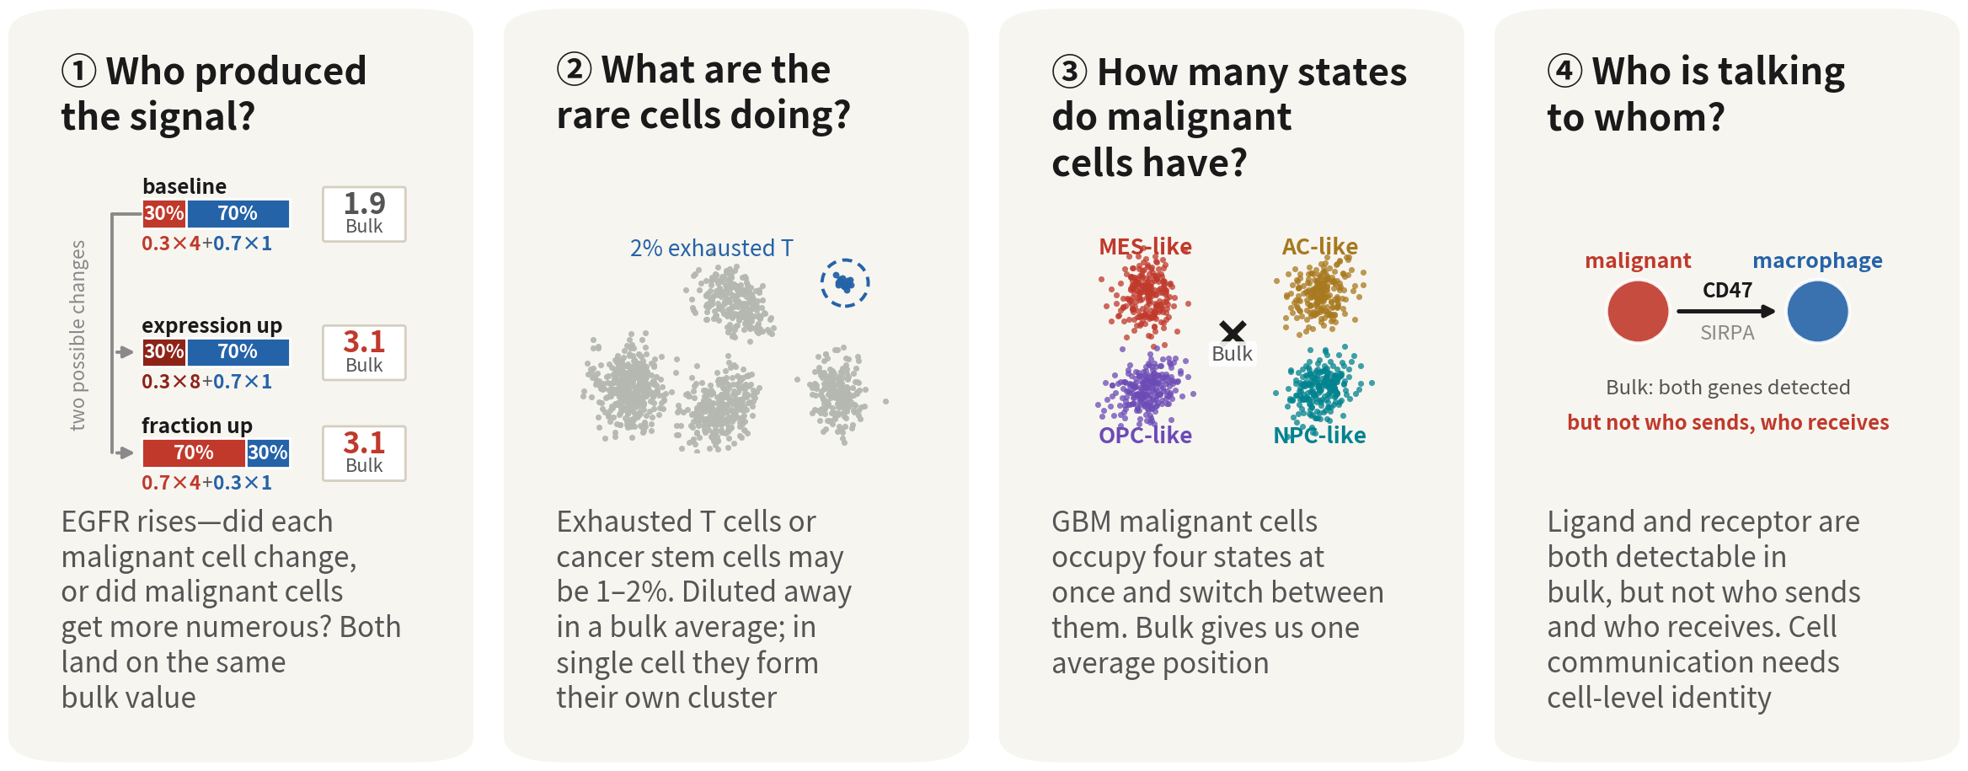
Four tumour questions bulk cannot answer
Who produced the signal, what the rare cells are doing, how many states malignant
cells occupy, who is talking to whom — all four are clinically real
References: Patel AP, et al. Science. 2014;344(6190):1396–1401. doi:10.1126/science.1254257 ｜ Tirosh I, et al. Science. 2016;352(6282):189–196. doi:10.1126/science.aad0501
Q1 Concepts
8
Notes:
把這個邏輯往外推，有四類問題 Bulk 很難直接回答。 第一，訊號來自誰。惡性細胞佔三成、每顆表現量四，Bulk 算出來是一點九。現在給它兩種變化：每顆細胞的表現從四變成八，Bulk 是三點一；或者細胞表現完全沒變，只是惡性細胞比例從三成升到七成，Bulk 一樣是三點一。同一個數字，背後是兩種完全不同的生物學。 第二，少數但重要的細胞在做什麼。exhausted T cell、幹細胞樣的族群，可能只佔幾個百分點，在 Bulk 裡就被稀釋掉了。而免疫治療最在意的其實不是「有沒有 T 細胞」，是「這些 T 細胞處在什麼狀態」。 第三，惡性細胞本身有幾種狀態。Neftel 二〇一九年發現 GBM 的惡性細胞有四種主要狀態，而且可以互相轉換。Bulk 只會把它們平均成一個數字，而那個「平均狀態」，在真正的腫瘤裡可能沒有任何一顆細胞真的長那個樣子。 第四，誰可能在跟誰講話。腫瘤細胞的 CD47 配上巨噬細胞的 SIRPα，是抑制吞噬的訊號。Bulk 看得到這兩個基因都表現，卻不知道是哪一群在表現。單細胞可以先把身分拆開，再從配體跟受體去推測——注意，那是推論；要證明它們真的在空間上相鄰，得靠空間轉錄體。 一句話收起來：Bulk 告訴我們整塊組織平均發生了什麼；單細胞才回答得了訊號來自誰、少數細胞在做什麼、有哪些狀態、可能誰在跟誰講話。 ──────── Push that logic outwards and you get four kinds of question bulk struggles to answer directly. First, where the signal came from. Malignant cells are thirty percent of the tissue and each one expresses at a level of four, so bulk reads out one point nine. Now give it two different changes. Per-cell expression goes from four to eight: bulk reads three point one. Or per-cell expression doesn't move at all and only the malignant fraction rises, from thirty percent to seventy percent: bulk again reads three point one. Same number, two completely different pieces of biology behind it. Second, what the rare but important cells are doing. Exhausted T cells, stem-cell-like populations — they might be a few percent of the tissue, and in bulk they get diluted away. And what immunotherapy actually cares about isn't whether there are T cells; it's what state those T cells are in. Third, how many states the malignant cells themselves occupy. Neftel found in twenty nineteen that GBM malignant cells sit in four principal states, and that they can convert into one another. Bulk averages them into a single number — and that average state may be one that no cell in the real tumour is actually in. Fourth, who might be talking to whom. CD47 on the tumour cell paired with SIRPα on the macrophage is a signal that suppresses phagocytosis. Bulk can see both genes expressed, but not which population is expressing them. Single cell lets you separate the identities first and then infer from the ligand and the receptor — and note the word infer. Proving that the two are genuinely next to each other in space takes spatial transcriptomics. One sentence to close it: bulk tells us what happened on average across the whole piece of tissue; only single cell answers where the signal came from, what the rare cells are doing, which states exist, and who might be talking to whom.

Slide 9



When single cell is not actually needed
One test: does our question need to know who each individual cell is? If not, do not use single cell
Skip it |
overall change
Skip it |
just counting
We need it |
unknown types
Overall change after
treatment, prognostic
subtyping, cohorts of
hundreds. The answer is one
tissue-level number — bulk
is cheaper, steadier and
better powered
We know which types to
count and have markers:
flow, IHC or bulk
deconvolution (Q3) all
answer it, across hundreds
of samples
Rare populations with no
marker, unnamed types,
continuous states among
malignant cells, who
signals to whom. The answer
IS each cell's identity —
average it and it is gone
Q1 Concepts
9
Notes:
限制講完了，也要公平地講另一面：很多問題根本不需要單細胞。它貴、雜訊大、統計功效低，用錯地方就是浪費。 判準只有一句話：我們的問題需不需要「知道每一顆細胞是誰」。不需要，就不要用。 第一種，整體有沒有變。治療前後的整體變化、預後分型、幾百人的世代——Bulk 更便宜、更穩、功效更高。TCGA 的 GBM 都是 Bulk，它們到今天仍然是分型與預後的基礎。 第二種，型別已知，只想數比例。流式、免疫組化就能算；Bulk 也可以用反卷積估，Q3 最後會提到。這時候單細胞只是一台很貴的計數器。 第三種才是單細胞的主場：誰、處在什麼狀態、跟誰互動。沒有 marker 可以數的稀有群、還沒有名字的型別、惡性細胞之間連續的狀態——這些沒有別的技術回答得了。 差別就在那句判準。前兩種的答案是一個組織層級的數字，細胞的個別身分算完就丟掉了；第三種的答案「就是」每顆細胞的身分，一旦平均掉，答案就不存在了。 所以設計研究的第一步，不是選平台，是把問題寫清楚，然後問自己一句：把細胞的身分平均掉，我的答案還在嗎？ ──────── That's the limits of bulk. Now let's be fair about the other side: a great many questions don't need single cell at all. It's expensive, it's noisy, it has low statistical power, and used in the wrong place it's simply a waste. There's only one test, and it fits in a sentence: does our question need to know who each individual cell is? If it doesn't, don't use single cell. First kind of question: did the whole thing change? Overall changes before and after treatment, prognostic subtyping, cohorts of a few hundred people — bulk is cheaper, steadier, better powered. TCGA's GBM data are all bulk, and to this day they're still the foundation of subtyping and prognosis. Second kind: the cell types are already known and we only want to count proportions. Flow cytometry or immunohistochemistry will do that; bulk can estimate it by deconvolution too, which Q3 mentions at the end. Here, single cell is just a very expensive counting machine. The third kind is single cell's home ground: who, in what state, interacting with whom. Rare populations with no marker to count on, cell types that don't have a name yet, the continuous range of states among malignant cells — nothing else answers those. The difference is exactly that test. In the first two, the answer is a tissue-level number, and each cell's individual identity gets thrown away the moment the sum is taken. In the third, the answer is each cell's identity — average it away and the answer stops existing. So the first step in designing a study isn't choosing a platform. It's writing the question down clearly, and then asking yourself: if I average the cell identities away, is my answer still there?

Slide 10
02
From a piece of tissue to a matrix
Three words are enough: GEM, Barcode, UMI
Q1 Concepts
10
Notes:
第二段是基礎，講資料是怎麼來的。化學細節不需要懂，只要記住三個詞：GEM、Barcode、UMI。 ──────── The second stretch is groundwork — where the data come from. You don't need the chemistry. You only need three words: GEM, barcode, UMI.

Slide 11




Operating table to sequencer: four steps
Dissociation
Enzymes break tissue into a single-cell suspension. Tumours
are tough and necrotic; this step is brutal and leaves marks
Partitioning
A microfluidic chip seals each cell with a bead
in an oil droplet (GEM)
Library
Each cell's mRNA is tagged with its bead's Barcode;
everything is pooled into one library
Sequencing &
counting
Cell Ranger sorts reads back to cells by Barcode,
de-duplicates by UMI, then builds the matrix
Q1 Concepts
11
Notes:
第一步，解離。酵素把組織拆成單顆細胞的懸浮液。腫瘤組織硬、壞死多、細胞外基質厚，所以這一步要消化得比較久、比較暴力。它會留下痕跡，這一段最後我們會回來講。 第二步，分裝。微流道晶片把每一顆細胞跟一顆珠子包進一滴油裡。這一滴油，就叫 GEM。 第三步，建庫。在每一顆 GEM 裡，細胞裂解，mRNA 被珠子上的引子抓住，帶上這顆珠子的 Barcode。接著把所有 GEM 打破，幾千顆細胞的 cDNA 混在一起，做成一個定序庫。 第四步，定序與計數。定序完，Cell Ranger 依 Barcode 把每一條 read 分回它原來的細胞，再依 UMI 去除 PCR 重複，產生矩陣。 ──────── Step one, dissociation. Enzymes break the tissue down into a suspension of single cells. Tumour tissue is stiff, full of necrosis, with thick extracellular matrix, so this step has to be digested for longer and more roughly. That leaves marks, and at the end of this stretch we'll come back to them. Step two, partitioning. A microfluidic chip wraps each cell together with one bead inside a droplet of oil. That droplet is what's called a GEM. Step three, library construction. Inside each GEM the cell lyses, its mRNA gets caught by the primers on the bead, and it picks up that bead's barcode. Then all the GEMs are broken open, the cDNA of thousands of cells is pooled together, and that becomes one sequencing library. Step four, sequencing and counting. Once sequencing is done, Cell Ranger uses the barcodes to sort every read back to the cell it came from, uses the UMIs to strip out PCR duplicates, and produces the matrix.

Slide 12
More than one platform: 3′, 5′, full-length, nuclei
This series uses two: 10x 3′ in Q2, Smart-seq2 in Q3. The differences set QC and CNV parameters
Platform | What is read | Cells / depth | Best for | Watch out
10x 3′ (Q2) | 3′ end + UMI | 5–10k cells 20–50k reads | Composition, types, states the default | Doublets, ambient RNA
10x 5′ + V(D)J | 5′ end + TCR/BCR | as above | Immunotherapy T/B clones | No extra info on tumour cells
Smart-seq2 (Q3) | Full-length no UMI | 100s–1000s ~1M reads | CNV, splicing, mutations few precious cells | Costly, slow reads ≠ molecules
snRNA-seq (nuclei) | Nuclear RNA mostly unspliced | as 10x | Frozen tissue, brain fragile tissue | mt ≈ 0 fewer immune cells
References: Picelli S, et al. Nat Protoc. 2014;9(1):171–181. doi:10.1038/nprot.2014.006 ｜ Zheng GXY, et al. Nat Commun. 2017;8:14049. doi:10.1038/ncomms14049
Q1 Concepts
12
Notes:
剛才講的是 10x 的 3′ 化學，最常見的一種。但你在論文裡至少會遇到四種，而且我們這幾集就用了兩種：Q2 是 10x 3′，Q3 是 Smart-seq2。平台差異會直接影響 QC 跟 CNV 的參數。 10x 3′ 只讀每個 mRNA 的 3′ 端，加上 UMI，所以矩陣裡放的是分子數。組成、型別、狀態這類問題，它是預設選擇；缺點是 doublet 跟環境 RNA。10x 5′ 讀的是 5′ 端，好處是可以同時拿到 T 細胞與 B 細胞受體的序列，追蹤克隆，做免疫治療研究就會選它。 Smart-seq2 是盤式的，每個孔一顆細胞，讀全長轉錄本。它沒有 UMI，所以矩陣裡是 read 數，不是分子數。細胞數少但是深，適合看 CNV、剪接、突變——Q3 的資料就是它，所以 Q3 的 inferCNV 閾值跟 10x 不一樣。 最後是細胞核定序：冷凍檢體、腦組織，不解離細胞，直接抽核。核裡多數是未剪接的 RNA，粒線體基因幾乎為零，所以 percent.mt 那條 QC 線對它沒有意義。 看論文的時候，先看平台，再看它的 QC 合不合理。 ──────── What we've just described is 10x 3′ chemistry, the most common one. But you'll meet at least four platforms in the literature, and these episodes alone use two of them: Q2 is 10x 3′, Q3 is Smart-seq2. Platform differences feed straight into your QC and CNV parameters. 10x 3′ reads only the 3′ end of each mRNA, with a UMI attached, so what sits in the matrix is molecule counts. For questions about composition, cell type and state it's the default choice; the downsides are doublets and ambient RNA. 10x 5′ reads the 5′ end instead, and its advantage is that you also get T-cell and B-cell receptor sequences, so you can track clones — which is why immunotherapy work picks it. Smart-seq2 is plate-based: one cell per well, full-length transcripts. It has no UMI, so the matrix holds read counts, not molecule counts. Few cells but deep, which suits CNV, splicing and mutations — Q3's data come from it, and that's why Q3's inferCNV thresholds aren't the same as the 10x ones. Last, single-nucleus sequencing. Frozen specimens, brain tissue: instead of dissociating cells you extract the nuclei directly. Most of what's in a nucleus is unspliced RNA, and mitochondrial genes are close to zero, so that percent.mt QC line means nothing here. When you read a paper, look at the platform first, and only then judge whether its QC makes sense.

Slide 13
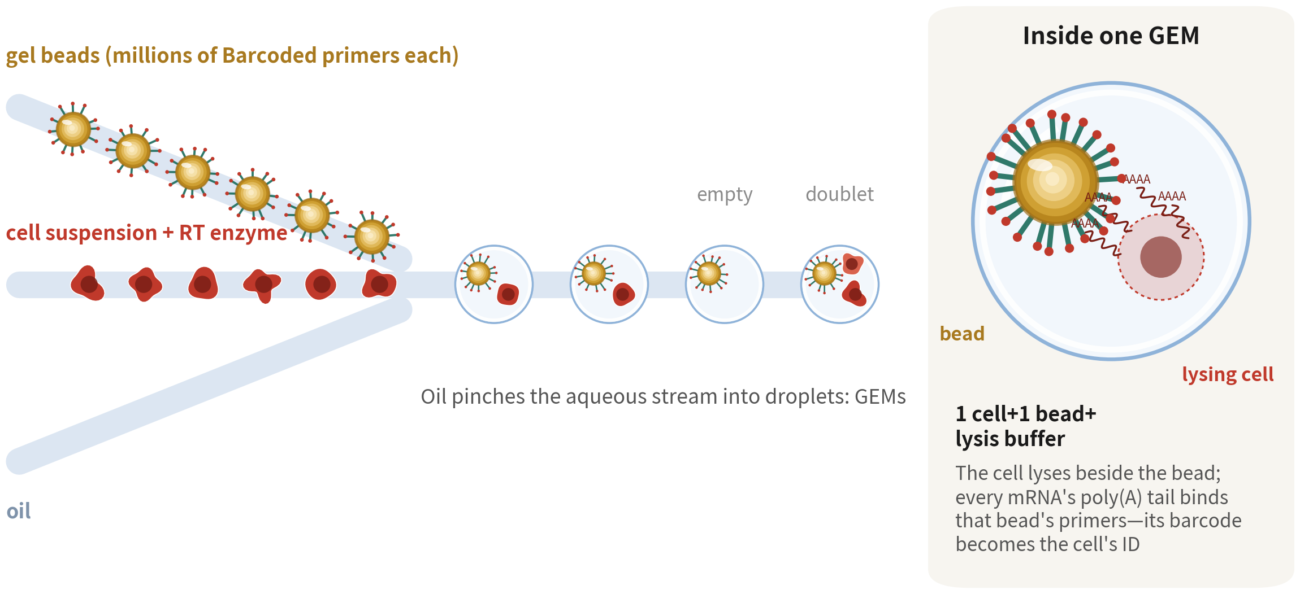
A GEM: one cell, one bead, one droplet
Bead–cell pairing is random: most droplets are empty, a few catch two cells. Both become QC's job later
Reference: Zheng GXY, et al. Nat Commun. 2017;8:14049. doi:10.1038/ncomms14049
Q1 Concepts
13
Notes:
我們把第二步放大來看。 左邊三條流道匯到同一個交會點：上面送的是帶著 Barcode 引子的凝膠珠，中間是細胞懸浮液加酵素，下面是油。三條撞在一起，油把水相切成一顆一顆的液滴。 右邊把一顆 GEM 放大：裡面一顆細胞、一顆珠子、一點裂解液。細胞就在珠子旁邊裂解，跑出來的 mRNA 全部抓上同一顆珠子的引子。從這一刻起，這顆珠子的 Barcode 就是這顆細胞的身分證。 有兩件事請記住。第一，珠子跟細胞是隨機配對的，所以大多數液滴其實是空的，少數液滴會一次包到兩顆細胞，這叫 doublet。第二，這兩件事之後都會變成 QC 的工作。 ──────── Let's zoom in on step two. On the left, three channels feed into one junction: from the top come the gel beads carrying barcoded primers, through the middle comes the cell suspension with the enzymes, and from the bottom comes oil. The three streams collide, and the oil chops the aqueous phase into droplets, one after another. On the right we've blown up a single GEM: one cell, one bead, a little lysis buffer. The cell lyses right next to the bead, and every mRNA that spills out is captured onto the primers of that one bead. From that moment on, that bead's barcode is this cell's identity card. Two things worth holding on to. First, beads and cells are paired at random, so most droplets are in fact empty, and a few will catch two cells at once — that's what we call a doublet. Second, both of those come back later as work for QC.

Slide 14
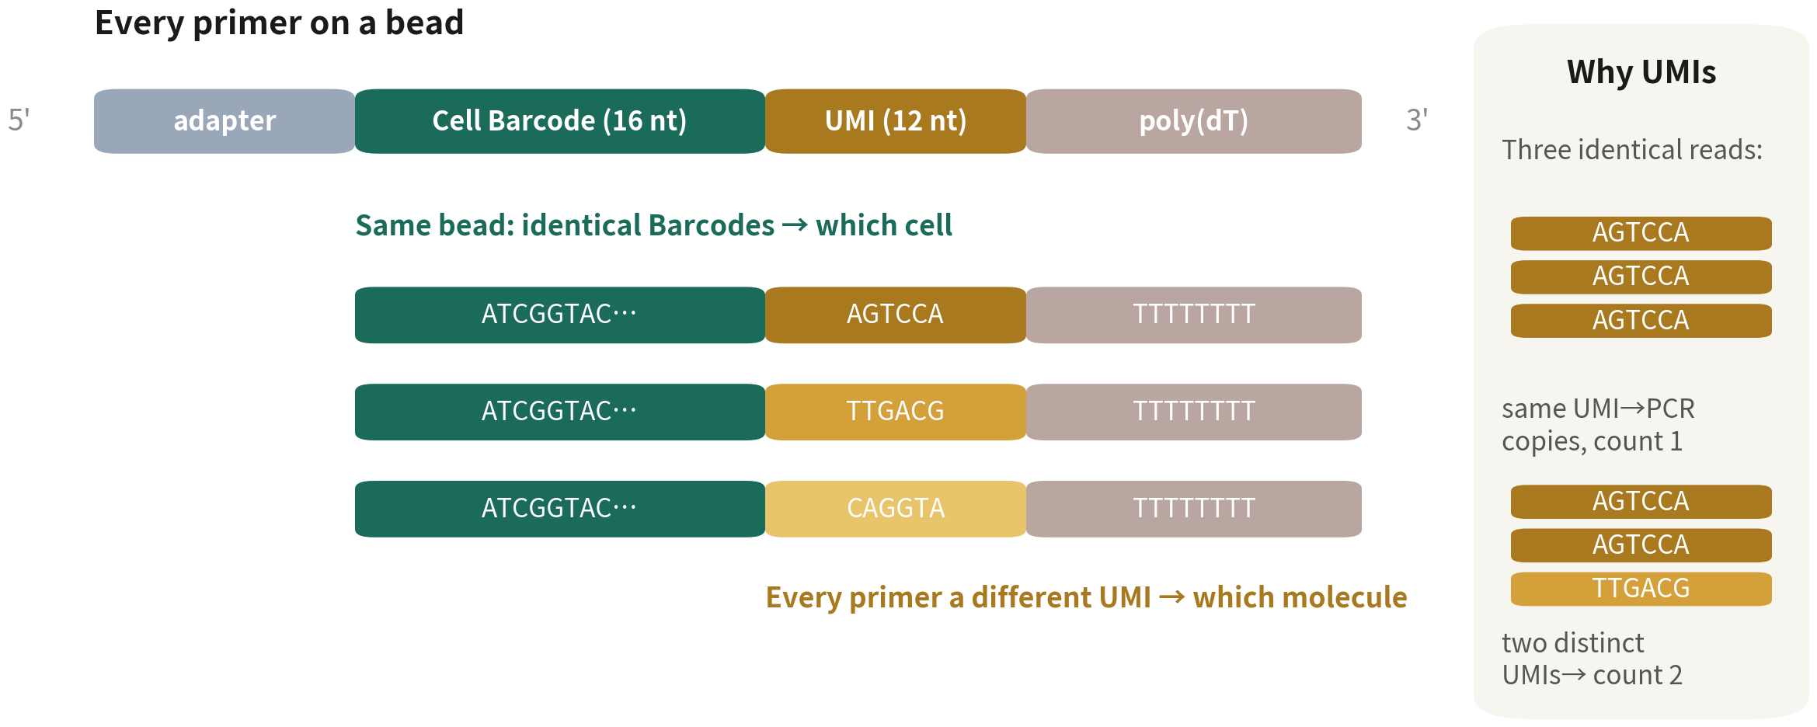
The Barcode records which cell; the UMI records which molecule
The numbers in the matrix are molecules, not reads — the most fundamental difference from bulk
Q1 Concepts
14
Notes:
珠子上每一條引子的長相都一樣：接頭、Cell Barcode、UMI、poly-T。 Cell Barcode 是十六個鹼基。同一顆珠子上有幾百萬條引子，這幾百萬條的 Barcode 全部相同。所以同一顆細胞的所有 mRNA 都會帶著同一個 Barcode——它回答的是「這條 read 來自哪顆細胞」。 UMI 是十二個鹼基，而且每一條引子都不一樣。它回答的是另一個問題：定序跑出三條一模一樣的 read，到底是同一個分子被 PCR 複製了三次，還是本來就有三個分子？看 UMI 就知道。UMI 相同的是複製品，只算一個；UMI 不同才算不同分子。 所以請記得，矩陣裡的數字是分子數，不是 read 數。它會比 Bulk 的 read count 少很多，但它更誠實，因為 PCR 的放大偏差已經被拿掉了。 ──────── Every primer on the bead has the same shape: adapter, cell barcode, UMI, poly-T. The cell barcode is sixteen bases. A single bead carries several million primers, and across all several million the barcode is identical. So every mRNA from the same cell carries the same barcode — it answers the question "which cell did this read come from?" The UMI is twelve bases, and here every primer is different. It answers a different question. Sequencing hands us three identical reads: is that one molecule that PCR copied three times, or were there three molecules to begin with? The UMI tells us. Same UMI means duplicates, count them once; different UMIs mean genuinely different molecules. So please remember: the numbers in the matrix are molecule counts, not read counts. They come out far smaller than a bulk read count, but they're more honest, because the PCR amplification bias has already been taken out.

Slide 15
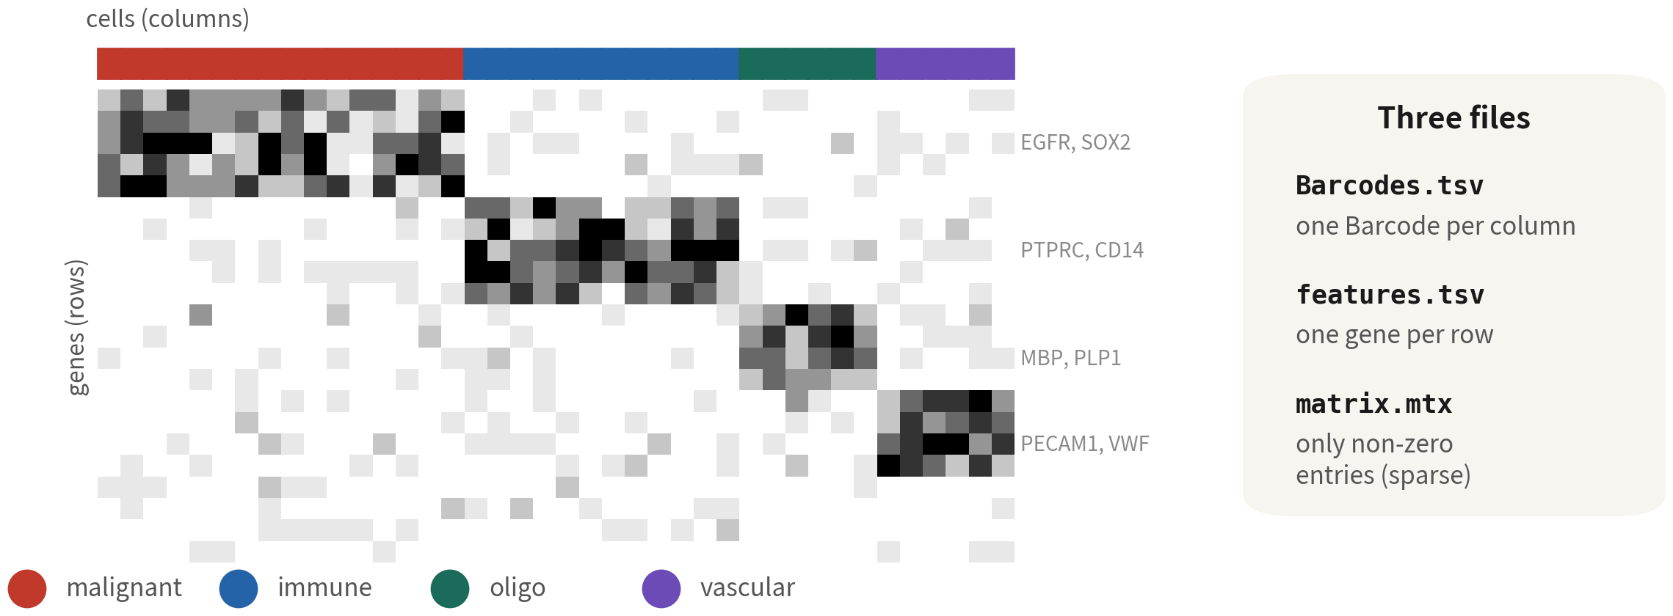
The output: a gene-by-cell count matrix
One column per cell, one row per gene; over 90% zeros — the nature of the technology, not broken data
Q1 Concepts
15
Notes:
Cell Ranger 跑完，我們手上會拿到三個檔案：barcodes、features、matrix。這三個合起來就是一個矩陣：每一欄是一顆細胞，每一列是一個基因，格子裡的數字是這顆細胞測到這個基因幾個分子。 Q2 要用的 GBM 5k 資料，就是三萬六千個基因乘上五千六百顆細胞。上面那條色條標的是不同的細胞型別；你可以看到不同型別各自亮在不同的基因列——EGFR、SOX2 亮在惡性細胞，PTPRC、CD14 亮在免疫細胞，MBP 亮在寡樹突細胞。之後的註釋要做的就是這件事。 先習慣一個特徵：這張矩陣九成以上的格子是零。一顆細胞大約只測得到一兩千個基因，剩下三萬多個都是零。下一頁我們把這件事講透，因為它決定了後面所有分析的邏輯。 ──────── Once Cell Ranger has finished, we're holding three files: barcodes, features, matrix. Put them together and you have a matrix: every column is a cell, every row is a gene, and the number in each box is how many molecules of that gene were detected in that cell. The GBM 5k data we'll use in Q2 is thirty-six thousand genes by five thousand six hundred cells. The colour bar along the top marks the different cell types, and you can see each type lighting up its own rows of genes — EGFR and SOX2 light up in the malignant cells, PTPRC and CD14 in the immune cells, MBP in the oligodendrocytes. Annotation, later on, is exactly this job. Get used to one feature straight away: more than ninety percent of the boxes in this matrix are zero. One cell only yields around one or two thousand detected genes; the other thirty-odd thousand are zeros. The next slide takes that apart properly, because it decides the logic of every analysis that comes after.

Slide 16
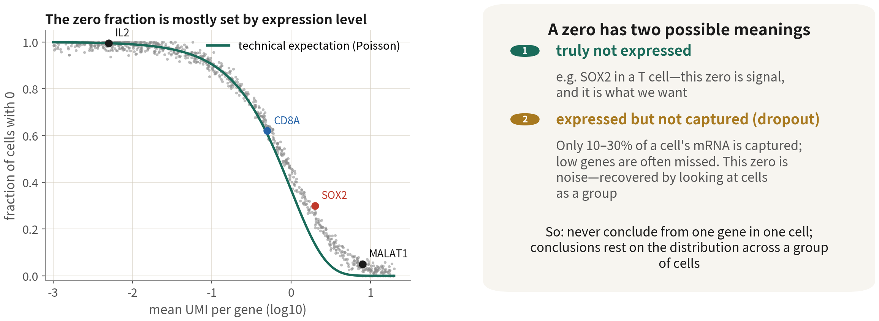
Ninety percent zeros: two kinds of zero, and
conclusions rest on groups of cells
The zero fraction is mostly set by expression level — technical expectation, not broken
data. One gene in one cell means nothing; that is why every analysis looks at groups
Q1 Concepts
16
Notes:
先看左圖。橫軸是每個基因的平均分子數，縱軸是有多少比例的細胞在這個基因上是 0。那條綠線是純粹技術上的期望——如果抓取是隨機的，一個平均只有零點零一個分子的基因，當然九成九的細胞抓不到。IL2 這種低表現的細胞激素就落在最左上角；MALAT1 這種每顆細胞都很多的基因落在右下角，幾乎沒有 0。所以零的比例主要是由表現量決定的，這是技術的本質，不是資料壞掉。 再看右邊。一個 0 有兩種可能。第一種是真的沒表現——T 細胞裡的 SOX2 是 0，這是訊號，正是我們要的。第二種是有表現但沒抓到，叫 dropout。每顆細胞只有大約一到三成的 mRNA 被抓到，低表現的基因很容易整個漏掉。這種 0 是雜訊。 那我們怎麼知道眼前這個 0 是哪一種？單看一個格子，分不出來。分得出來的方法只有一個：一群細胞一起看。一百顆 T 細胞裡 CD8A 有六成是 0，但另外四成的分布明顯高過其他群——那就是表現。這就是為什麼後面所有的分析都在「群」的層級做，從來不對單顆細胞的單一基因下結論。 ──────── Look at the left plot first. The x-axis is each gene's mean molecule count, the y-axis is the fraction of cells in which that gene reads zero. That green line is the purely technical expectation — if capture is random, then a gene averaging zero point zero one molecules will of course be missed in ninety-nine percent of cells. A low-expressed cytokine like IL2 sits right up in the top-left corner; a gene like MALAT1, plentiful in every cell, sits down at the bottom-right with almost no zeros at all. So the fraction of zeros is driven mainly by expression level. That's the nature of the technology, not data gone wrong. Now the right. A zero can mean two things. The first is genuinely not expressed — SOX2 in a T cell is zero, and that's signal, exactly what we're after. The second is expressed but not captured, and that one is called dropout. Only about ten to thirty percent of each cell's mRNA gets caught, so a low-expressed gene can slip through entirely. That kind of zero is noise. So how do we know which kind the zero in front of us is? From a single box, we can't. There's only one way that works: look at a group of cells together. In a hundred T cells, CD8A might be zero in sixty percent of them — but the distribution in the other forty percent sits clearly above every other cluster. That's expression. And that's why every analysis from here on is done at the level of the group, and never draws a conclusion about a single gene in a single cell.

Slide 17
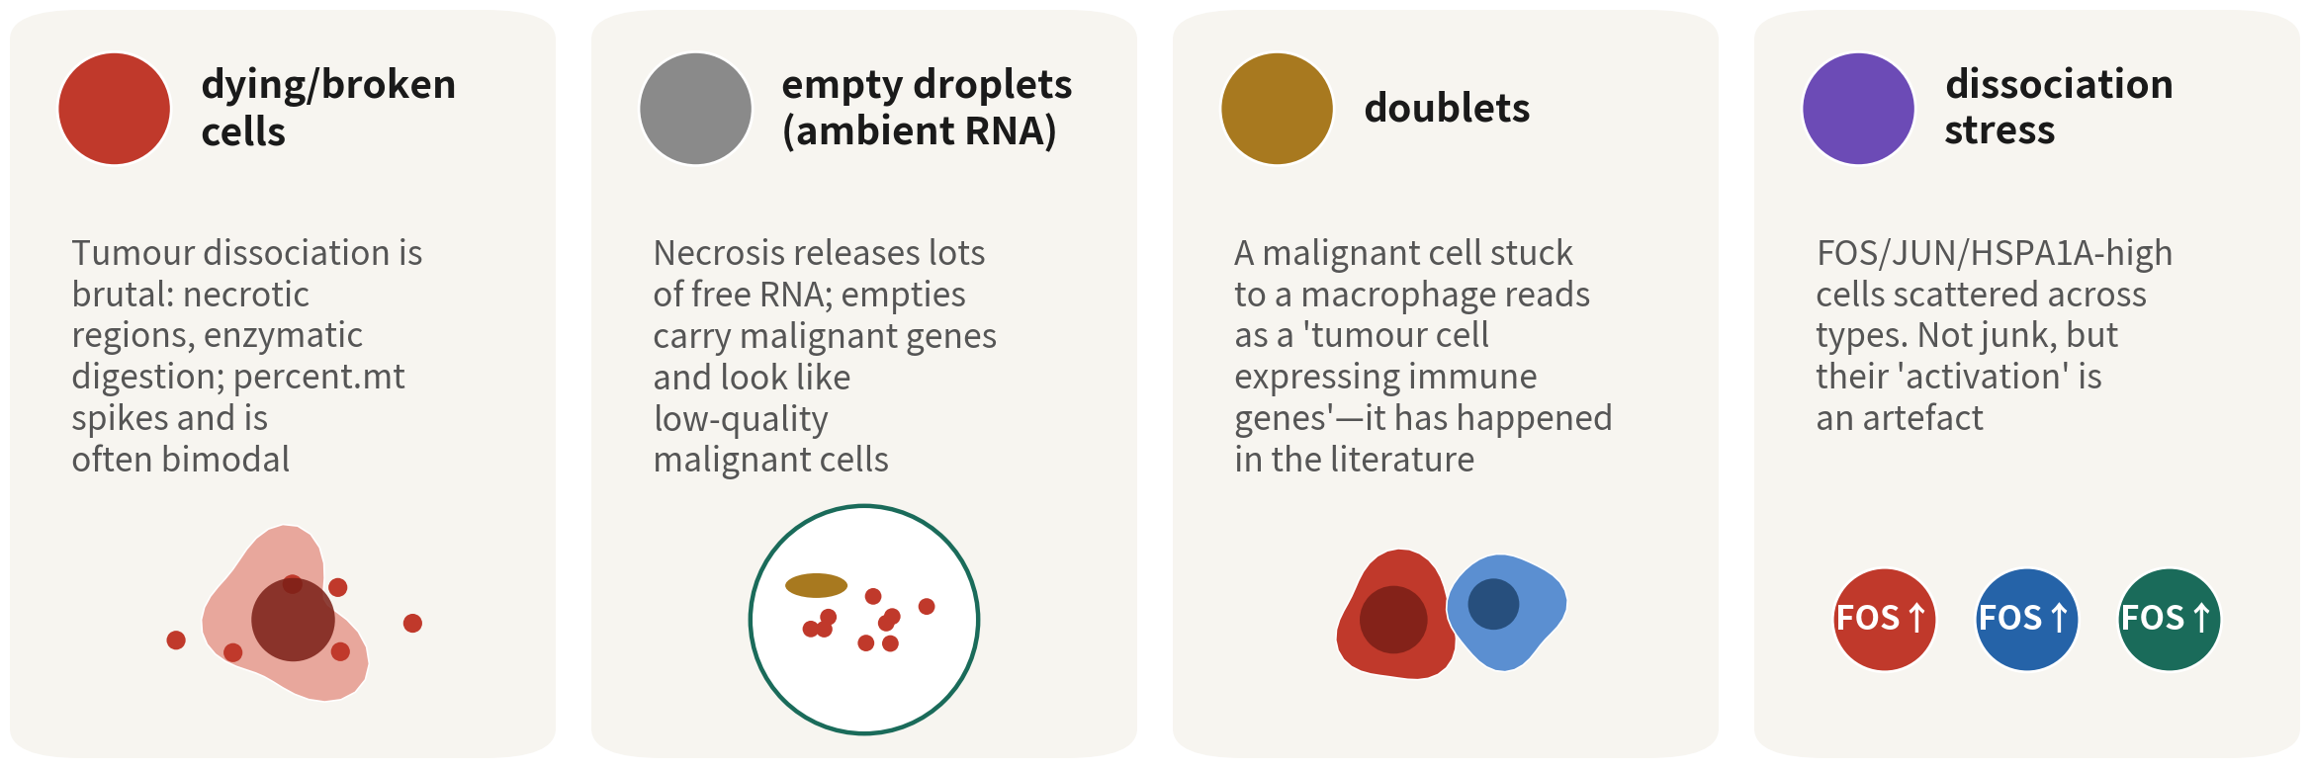
Not every column is a cell
Tumour samples have plenty of all four. Each has a barcode and looks like a cell — hence QC is step one
References: Young MD, Behjati S. Gigascience. 2020;9(12):giaa151. doi:10.1093/gigascience/giaa151 ｜ McGinnis CS, Murrow LM, Gartner ZJ. Cell Syst. 2019;8(4):329–337.e4. doi:10.1016/j.cels.2019.03.003
Q1 Concepts
17
Notes:
還有一件事要先講清楚：矩陣裡不是每一欄都是好細胞。有四種東西會混進來，而且腫瘤樣本這四種都特別多。 第一種是垂死或破損的細胞。腫瘤解離的過程很暴力，壞死區本來就有很多快死的細胞。細胞膜一破，細胞質的 RNA 往外漏，粒線體的 RNA 相對留了下來，粒線體比例就衝高。所以腫瘤樣本的 percent.mt 常常是雙峰的。 第二種是空滴。沒包到細胞的液滴，只包到溶液裡漂浮的背景 RNA，叫 ambient RNA。壞死釋出的游離 RNA 特別多，所以腫瘤的空滴會帶著惡性細胞的基因，看起來就像一顆「低品質的惡性細胞」。 第三種是 doublet，兩顆細胞黏在一起被包進同一滴。腫瘤裡最危險的組合是惡性細胞加巨噬細胞——它會被誤讀成「表現免疫基因的腫瘤細胞」。這在文獻裡真的發生過。 第四種比較特別，值得單獨用一頁講。 ──────── One more thing to get straight first: not every column in the matrix is a good cell. Four kinds of thing sneak in, and tumour samples are especially rich in all four. The first is dying or damaged cells. Dissociating a tumour is a violent process, and the necrotic regions are full of cells that were already on their way out. Once the membrane breaks, cytoplasmic RNA leaks away while mitochondrial RNA is relatively retained, and the mitochondrial fraction shoots up. That's why percent.mt in a tumour sample is so often bimodal. The second is empty droplets. A droplet that caught no cell still catches the background RNA floating in the solution — that's called ambient RNA. Necrosis releases a great deal of free RNA, so a tumour's empty droplets carry malignant-cell genes and look for all the world like a low-quality malignant cell. The third is doublets — two cells stuck together and wrapped into the same droplet. The most dangerous combination in a tumour is a malignant cell plus a macrophage, because it gets read as "a tumour cell expressing immune genes". That has genuinely happened in the literature. The fourth is a bit different, and it deserves a slide of its own.

Slide 18

Getting the data leaves marks: dissociation stress
What it is
A FOS/JUN/HSPA1A-high malignant subset gets
written up as a 'stress-response subclone'.
Why it happens
Clean markers, significant enrichment, and it resembles a
published 'MES-like state'.
What it costs you
It is the immediate-early response to enzymatic
dissociation, present in every type. Tumour tissue
dissociates slowly, so the artefact is strong.
Reference: van den Brink SC, et al. Nat Methods. 2017;14(10):935–936. doi:10.1038/nmeth.4437
Q1 Concepts
18
Notes:
第四種混進來的東西不是壞細胞，是好細胞被弄壞了狀態。 先講這個坑長什麼樣子。分群之後，發現一群 FOS、JUN、HSPA1A 高表現的惡性細胞，於是把它寫成一個「壓力反應亞群」。 為什麼會踩下去？因為它看起來太像真的了：marker 很乾淨、富集分析顯著，而且跟文獻上某個「間質樣狀態」看起來很像。 但那其實是酵素解離時的立即早期反應，不是腫瘤的生物學。判準很簡單，而且很好用——看它是不是跨型別出現。真正的生物學亞群通常屬於某一個譜系；如果這一群散在所有型別裡，巨噬細胞有一撮、寡樹突有一撮，那就是技術假象最典型的長相。腫瘤組織解離時間長，這個假象特別強。 前面三種東西都有 Barcode，看起來就像細胞；這第四種連 QC 都攔不住，因為它們的品質指標完全正常。所以流程第一步是 QC，但請記得，QC 不是萬能的。 ──────── The fourth thing that gets mixed in isn't a bad cell. It's a good cell whose state we damaged. Let me describe the pit first. After clustering, you find a group of malignant cells with FOS, JUN and HSPA1A running high, and you write it up as a "stress-response subpopulation". Why do people fall in? Because it looks so convincing: the markers are clean, the enrichment analysis is significant, and it looks a lot like one of those "mesenchymal-like states" in the literature. But what you're actually looking at is the immediate-early response to enzymatic dissociation, not the biology of the tumour. The test is simple, and it works well — check whether it turns up across cell types. A real biological subpopulation usually belongs to one lineage; if this group is scattered through all of them, a pinch in the macrophages, a pinch in the oligodendrocytes, that's the most typical look of a technical artefact. Tumour tissue takes a long time to dissociate, so the artefact is especially strong here. The first three things all have barcodes and all look like cells. This fourth one QC can't even stop, because its quality metrics are completely normal. So the first step of the pipeline is QC — but please remember, QC is not all-powerful.

Slide 19
03
What the pipeline does
Do not memorise step names — remember the problem each solves; downstream analysis
starts once annotation is done
Q1 Concepts
19
Notes:
第三段一樣是基礎：流程在做什麼。不要背步驟名稱，記住每一步解決什麼問題。問題記住了，流程就記住了，哪一步不能省也就清楚了。 ──────── Part three is basics again: what the pipeline is doing. Don't memorise the names of the steps — remember what problem each one solves. Hold on to the problems and the pipeline comes with them, and which step can't be skipped becomes clear too.

Slide 20
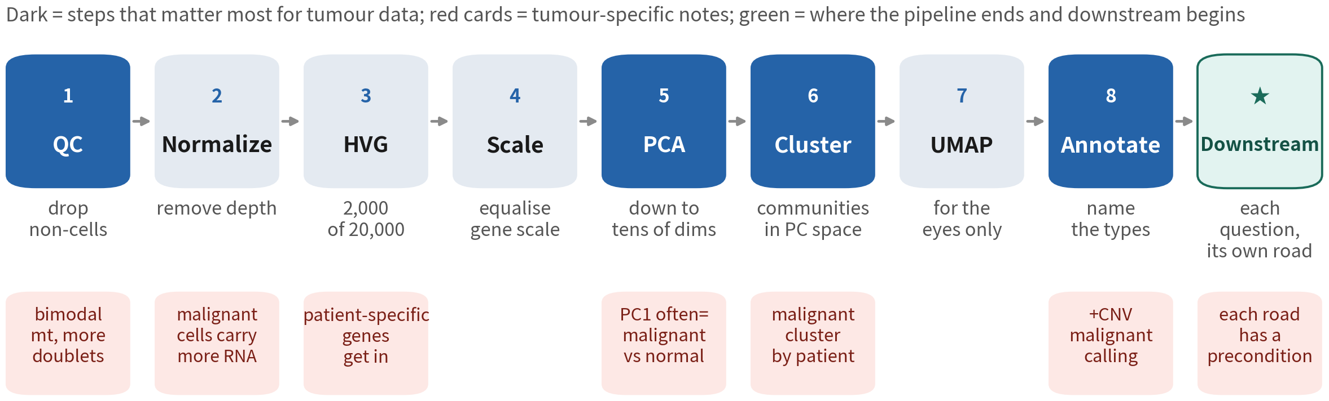
What problem each step of the pipeline solves
The number of steps varies with the data (SoupX, doublets, integration...) — the count is not the
point. Red cards mark what is special about tumours; Q2 runs this route line by line on real GBM data
References: Hao Y, et al. Nat Biotechnol. 2024;42(2):293–304. doi:10.1038/s41587-023-01767-y ｜ Amezquita RA, et al. Nat Methods. 2020;17(2):137–145. doi:10.1038/s41592-019-0654-x
Q1 Concepts
20
Notes:
從左到右看，每一格上面是步驟，下面是它解決的問題。 QC 負責丟掉不是細胞的東西，這是整條流程唯一不可逆的一步。Normalize 除掉定序深度的差異，不然分群會按深度分——惡性細胞的 RNA 量常常比免疫細胞大很多，所以這一步在腫瘤資料特別重要。HVG 從三萬多個基因裡挑出兩千個有話要說的。Scale 把每個基因的音量拉平，PCA 才不會被幾個高表現基因綁架。PCA 把維度壓到幾十維。Cluster 在 PC 空間建鄰居圖找社群。UMAP 畫給眼睛看。Annotate 用 marker 命名。 那幾張紅色卡是腫瘤資料的特殊之處：粒線體雙峰、病人特異基因會擠進 HVG 榜、第一主成分幾乎一定是「惡性 vs 免疫」、惡性細胞會按病人分群、註釋之後還要多做一步惡性判定。這幾張紅卡，後面兩條紅線都會回來講。 最後那一格是灰色的，而且沒有編號。因為它不是「第九步」，它是流程結束、下游開始的入口。步數本來就會因資料而增減——多做 SoupX、多做 doublet 移除、多樣本還要整合——所以數字不是重點，每一步解決什麼問題才是。 這就是 Q2 會拿真實資料逐行跑一遍的路線。 ──────── Read it left to right: the top of each box is the step, the bottom is the problem it solves. QC is there to throw out the things that aren't cells, and it's the one irreversible step in the whole pipeline. Normalize takes out the differences in sequencing depth, because otherwise the clustering will split the cells by depth — and malignant cells often carry a lot more RNA than immune cells, which is why this step matters so much in tumour data. HVG picks, out of thirty-odd thousand genes, the two thousand that have something to say. Scale levels out each gene's volume so that PCA doesn't get hijacked by a handful of highly expressed genes. PCA compresses the whole thing down to a few dozen dimensions. Cluster builds a neighbour graph in PC space and finds the communities in it. UMAP draws it for our eyes. Annotate puts names on using markers. The red cards are where tumour data is its own special case: the bimodal mitochondrial fraction, patient-specific genes shoving their way onto the HVG list, a first principal component that is almost always "malignant versus immune", malignant cells clustering by patient, and one extra step after annotation to call malignancy. We'll come back to every one of those red cards in the two red lines still ahead. That last box is grey, and it has no number. That's deliberate: it isn't "step nine", it's the doorway where the pipeline ends and the downstream begins. The number of steps genuinely goes up and down with the data — add SoupX, add doublet removal, add integration once there's more than one sample — so the number is not the point. What each step solves is. And this is the route Q2 walks line by line on real data.

Slide 21
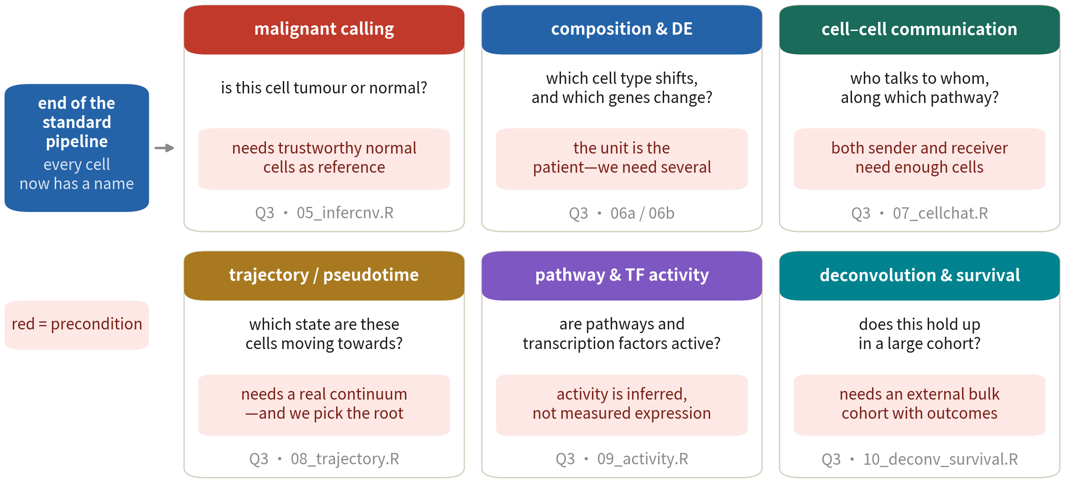
Once annotation is done: six downstream roads
The red text is each road's precondition — why 「how many patients」 is one of them comes in the last section
Q1 Concepts
21
Notes:
註釋做完，我們手上是一份「每顆細胞都有名字」的物件。很多人以為分析到這裡就結束了——剛好相反，這才是開始。 不過要注意：這六條路不是一份選單。它們是六個不同的問題，問題不一樣，走的路就不一樣。惡性判定問的是這顆細胞是不是腫瘤的；組成與差異表現問的是哪一型變多了、哪些基因變了；細胞通訊問的是哪一群在對哪一群講話；軌跡問的是這群細胞正在往哪個狀態變；路徑與轉錄因子活性問的是訊號通路有沒有在動；反卷積加存活問的是這個發現放到幾百人的世代裡還站不站得住。 每張卡片下面那一行紅字，才是這一頁真正要留下來的東西：那是這條路的前提。惡性判定要有可信的正常細胞當參考；差異表現要有幾位病人——為什麼是「病人」而不是「細胞」，最後一條紅線會講；細胞通訊要來源和目標兩群都夠多細胞；軌跡要真的存在一個連續過程；活性是推論出來的，不是量到的；反卷積要有外部的 bulk 世代和臨床資料。 為什麼現在就講？因為下游分析最常見的錯誤不是選錯工具，是資料撐不起那個問題，圖卻還是畫出來了——而圖一旦畫出來，看的人就會相信它。Q3 我們會一條一條真的跑，也會遇到跑不動的時候；到時候就當場示範，跑不動要怎麼寫。 ──────── With annotation done, we're holding an object in which every cell has a name. A lot of people assume the analysis finishes here. It's the other way round — this is where it starts. But be careful: these six roads are not a menu. They're six different questions, and a different question means a different road. Malignancy calling asks whether this cell belongs to the tumour. Composition and differential expression ask which type has grown in number and which genes have changed. Cell communication asks which population is talking to which. Trajectory asks which state this group of cells is moving towards. Pathway and transcription factor activity ask whether the signalling is actually moving. Deconvolution plus survival asks whether the finding still stands up when you take it out to a cohort of several hundred people. That line of red text under each card is what this slide really wants you to keep: it's the precondition for that road. Malignancy calling needs trustworthy normal cells as a reference. Differential expression needs several patients — and why it's patients rather than cells is what the last red line will explain. Cell communication needs enough cells in both the source and the target population. Trajectory needs a continuous process that genuinely exists. Activity is inferred, not measured. Deconvolution needs an external bulk cohort with clinical data. Why raise this now? Because the commonest mistake downstream isn't picking the wrong tool. It's that the data can't hold the question up, and the plot gets drawn anyway — and once a plot exists, the people looking at it will believe it. In Q3 we run these one by one for real, and we do run into the cases that won't go; when that happens we'll show you on the spot how to write that up.

Slide 22
04
Analysis lives in PC space, the
UMAP is only a projection
For most people this is the only skill they will ever need: knowing
what a plot may and may not claim
Q1 Concepts
22
Notes:
第二條紅線。我們可能永遠不會自己跑分析，但一定會看別人的圖、審別人的稿、判斷合作者的結果可不可信。這一段練的就是那個技能。 ──────── Red line two. We may never run an analysis ourselves, but we will certainly look at other people's figures, review other people's manuscripts, and judge whether a collaborator's results can be trusted. This stretch is where we practise that skill.

Slide 23
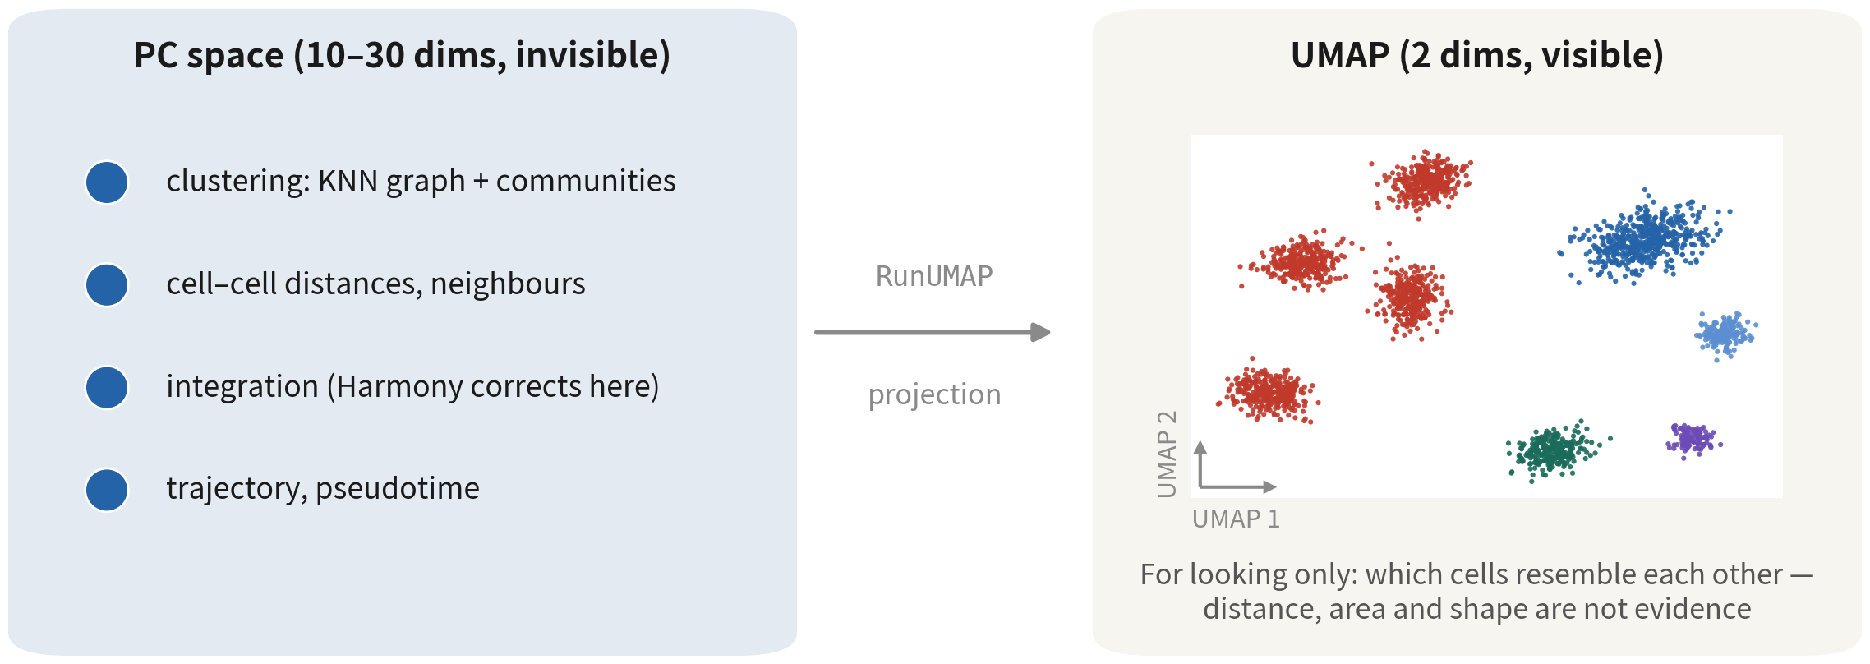
The left side does the maths, the right side is for our eyes
Clustering, distances, integration and trajectories all happen on the left; the right is just for our eyes
Reference: McInnes L, Healy J, Melville J. arXiv:1802.03426. doi:10.48550/arXiv.1802.03426
Q1 Concepts
23
Notes:
左邊是 PC 空間，十到三十維，我們的眼睛看不到它。但分群在這裡做，距離在這裡算，整合校正的是這裡的座標，軌跡也是在這裡算的。 右邊是 UMAP，二維，我們看得到。它就是一台投影機，把左邊的東西投到牆上。而投影一定會失真：它會盡量保留誰跟誰是鄰居，但不保證群與群的距離，也不保證面積。 所以這一條紅線只有一句話：分群、距離、整合、軌跡，全都不用 UMAP 的座標。 ──────── On the left is PC space, ten to thirty dimensions, and our eyes can't see it. But clustering happens there, distances are computed there, integration corrects those coordinates, and trajectories are worked out there too. On the right is the UMAP, two dimensions, and this is the one we can see. It's a projector: it throws what's on the left onto the wall. And a projection always distorts. It does its best to preserve who is whose neighbour, but it guarantees nothing about the distance between clusters, and nothing about their area. So this red line comes down to a single sentence: clustering, distances, integration, trajectories — not one of them uses UMAP coordinates.

Slide 24
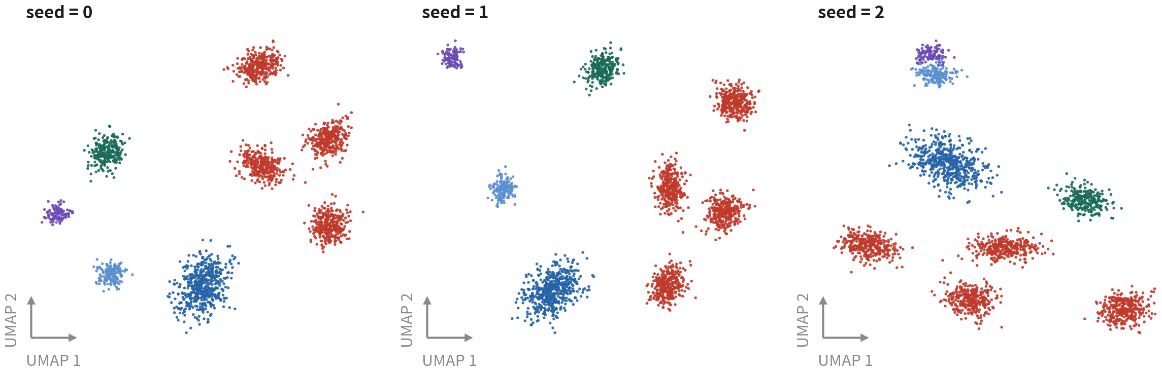
Same data, only the seed changes
Same data, same code, only the seed changes: positions and shapes all move, yet not one cell's
cluster label changes — clustering finished in PC space; the UMAP is only drawn at the end
Reference: Chari T, Pachter L. PLoS Comput Biol. 2023;19(8):e1011288. doi:10.1371/journal.pcbi.1011288
Q1 Concepts
24
Notes:
證據在這裡。三張圖，同一份腫瘤資料、同一行程式碼，只換隨機種子。 你會看到群的相對位置整個換掉，形狀也變了。但是每顆細胞的 cluster 標籤，一個都沒變。 為什麼？因為分群在 PC 空間就已經做完了，UMAP 只是最後畫出來的那張圖。換 seed 換掉的是投影機的角度，不是資料本身。 ──────── Here's the evidence. Three plots: the same tumour data, the same line of code, only the random seed changed. You'll see the relative positions of the clusters completely rearranged, and the shapes change as well. But not one cell's cluster label has moved. Why? Because the clustering was already finished back in PC space, and the UMAP is only the picture drawn at the end. Changing the seed changes the angle of the projector, not the data itself.

Slide 25
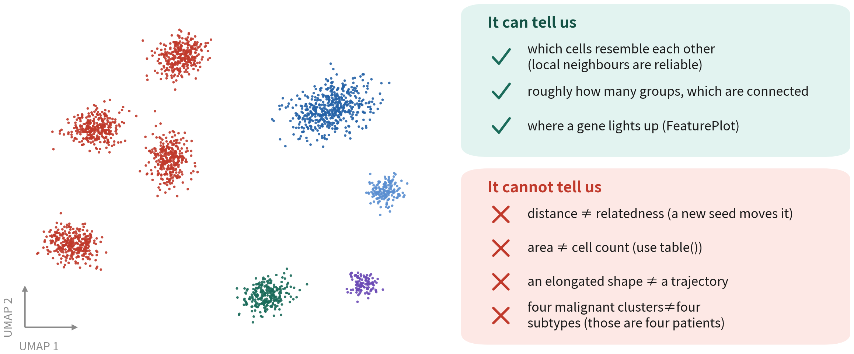
What a UMAP can and cannot tell us
Before reading a band as a trajectory, rule out three things: cell cycle, a
sequencing-depth gradient, and a doublet bridge
References: Chari T, Pachter L. PLoS Comput Biol. 2023;19(8):e1011288. doi:10.1371/journal.pcbi.1011288 ｜ McInnes L, Healy J, Melville J. arXiv:1802.03426. doi:10.48550/arXiv.1802.03426
Q1 Concepts
25
Notes:
先講綠色這一半，這些是 UMAP 真的能告訴我們的事：哪些細胞彼此相似——靠在一起的點就是鄰居，這件事可信；大致分成幾群、哪些群是相連的；還有某個基因亮在哪一群。 紅色那一半是它不能告訴我們的，一共四條。每一條我都配一個具體的替代做法，因為光說「不能這樣看」沒有用，你得知道那該怎麼看。 第一條，兩群離多遠，不等於親緣多遠。剛剛換 seed 的那張圖就是證據。以後讀到「這兩群距離很遠，所以關係很遠」這種句子，請打個折扣。 第二條，群的面積不等於細胞數。面積反映的是密度和參數，不是數量。想知道某一群到底幾顆，就用 table() 去數，不要用眼睛量。 第三條，拉長的形狀不等於分化軌跡。看到一條長帶，先排除三件事：細胞週期、定序深度的梯度，還有 doublet 造成的橋。三件都排除掉了，才輪到「這可能是一條軌跡」這句話出場。 第四條是腫瘤資料專屬的：惡性細胞分成四個群集，不代表四種亞型，那是四位病人。真的要看亞型，得在每一位病人內部用狀態分數看。這個錯誤，我在審稿的時候看過不只一次。 ──────── Start with the green half — the things a UMAP genuinely does tell us. Which cells resemble each other: points sitting together are neighbours, and that much we can trust. Roughly how many clusters there are, and which of them are connected. And which cluster a given gene lights up in. The red half is what it cannot tell us, and there are four items. I've paired each one with a concrete alternative, because saying "don't read it that way" on its own is no help — you need to know how to read it instead. First, how far apart two clusters sit does not equal how related they are. The plot we just looked at, where all we changed was the seed, is the evidence. From now on, when you read a sentence like "these two clusters are far apart, so they are distantly related", discount it. Second, a cluster's area does not equal its cell count. Area reflects density and parameters, not numbers. If you want to know how many cells are actually in a cluster, count them with table. Don't measure by eye. Third, an elongated shape does not equal a differentiation trajectory. When you see a long band, rule out three things first: cell cycle, a gradient in sequencing depth, and a bridge created by doublets. Only once all three are ruled out does the sentence "this might be a trajectory" get to come out. Fourth, and this one belongs to tumour data: malignant cells splitting into four clusters does not mean four subtypes. Those are four patients. If you really want subtypes, you look at state scores within each individual patient. I've seen this mistake in peer review more than once.

Slide 26
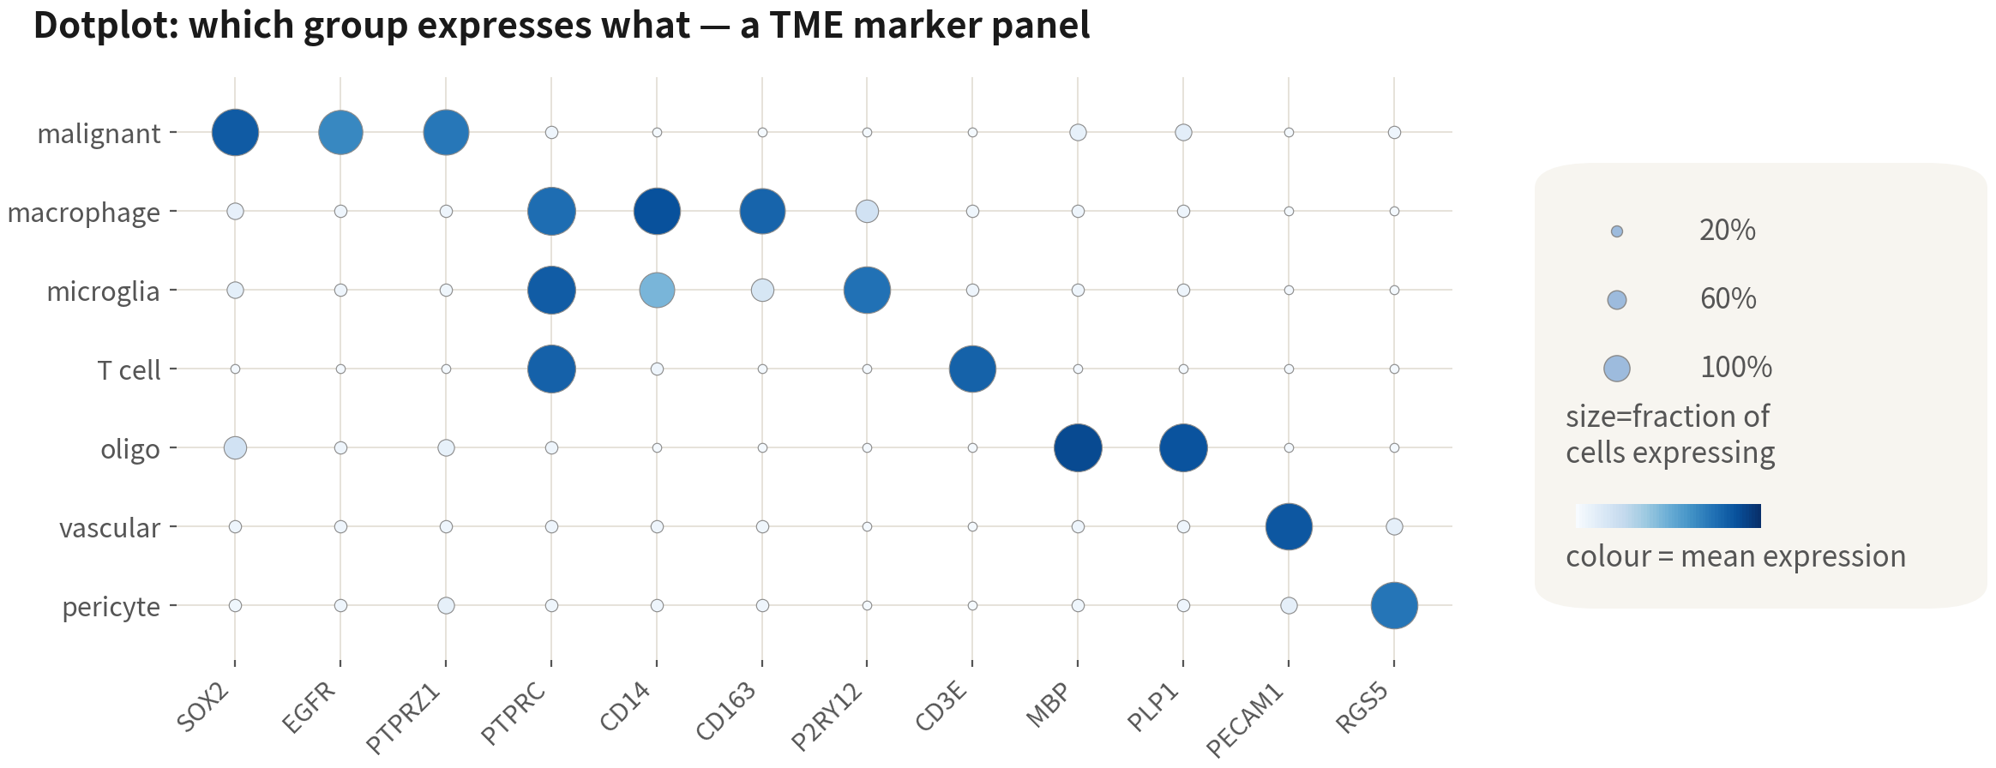
Dotplot: read the two dimensions separately
Size is the fraction of cells expressing, colour the level. Blocks along the diagonal mean a good annotation
Q1 Concepts
26
Notes:
註釋階段最有用的圖，是 dotplot。每一列是一群細胞，每一欄是一個基因。 每個點帶著兩個維度。點的大小，是這一群裡有多少比例的細胞表現這個基因；點的顏色，是有表現的那些細胞平均表現多高。 這兩個維度一定要分開讀。又大又深，代表整群都高表現，那是好的 marker。小而深，代表少數細胞衝很高——這時候要留意，群裡可能混了另一種細胞，或者藏著一個沒分出來的亞群。大而淺，整群都有一點點，通常就是持家基因。 回頭看這張腫瘤的面板：亮點沿著對角線一塊一塊排開，這就是註釋做得好的樣子。另外注意 PTPRC 同時亮在巨噬細胞、小膠質、T 細胞三列——那是正常的，它是「免疫類群」的譜系標誌，不是型別 marker。 ──────── The most useful plot at the annotation stage is the dotplot. One row per cluster of cells, one column per gene. Every dot carries two dimensions. The size of the dot is the fraction of cells in that cluster expressing the gene; the colour of the dot is how high the average expression is among the cells that do express it. Those two dimensions have to be read separately. Big and dark means the whole cluster expresses it highly — that's a good marker. Small and dark means a few cells are running very high, and that's when to pay attention: the cluster may have another cell type mixed in, or be hiding a subpopulation that hasn't been split out. Big and pale means everyone has a little of it, and that's usually a housekeeping gene. Now look back at this tumour panel: the bright blocks laid out one after another along the diagonal — that's what good annotation looks like. And notice that PTPRC lights up across three rows at once, macrophages, microglia and T cells. That's normal. It's the lineage marker of the immune major group, not a cell-type marker.

Slide 27
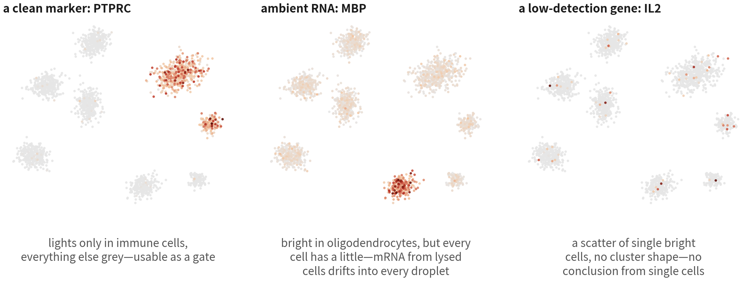
FeaturePlot: colour does not always mean expression
A clean gate lights one block; ambient RNA gives every cell a little; a low-detection
gene is a sprinkle. First question: does the bright region have the shape of a cluster?
Q1 Concepts
27
Notes:
另一種我們最常看到的圖是 FeaturePlot——把一個基因的表現量直接塗在 UMAP 上。它很直覺，也很容易騙人。這三張圖是同一份資料的三個基因。 左邊是 PTPRC，免疫細胞的譜系標誌。只有免疫細胞那兩塊亮起來，其他地方幾乎全灰。這種圖，可以放心當譜系標誌用。 中間是 MBP，寡樹突細胞的 marker。寡樹突那塊很亮，沒問題；但你仔細看，每一顆細胞都染上了一點顏色。這不是寡樹突細胞無所不在，是解離的時候裂解的細胞把 mRNA 放進了溶液，每一顆液滴都撈到一點——就是前面說的環境 RNA，腫瘤樣本特別多。 右邊是 IL2，T 細胞的細胞激素。零星幾顆很亮，卻沒有任何群的形狀。這就是低偵測基因：表現量低、dropout 多，亮的那幾顆可能是真的，也可能只是隨機。 所以看 FeaturePlot，先問自己一個問題：亮的地方有沒有「群的形狀」。有，才是型別層級的表現；沒有，就回到 dotplot 或 violin 去看分布。 ──────── The other plot we see most often is the FeaturePlot — one gene's expression painted straight onto the UMAP. It's intuitive, and it's very easy to be fooled by. These three panels are three genes from the same dataset. On the left, PTPRC, the immune lineage marker. Only the two immune blocks light up; everywhere else is almost entirely grey. A plot like this you can safely use as a lineage marker. In the middle, MBP, the oligodendrocyte marker. The oligodendrocyte block is bright, that's fine — but look closely and every single cell has picked up a little colour. That isn't oligodendrocytes being everywhere. It's mRNA released into the solution by cells that lysed during dissociation, and every droplet scooped up a bit of it. That's the ambient RNA we talked about earlier, and tumour samples have a lot of it. On the right, IL2, a T-cell cytokine. A scattering of very bright individual cells, but no cluster shape at all. This is a low-detection gene: low expression, heavy dropout. Those few bright cells might be real, and they might just be random. So when you look at a FeaturePlot, ask yourself one question first: does the bright region have the shape of a cluster? If it does, that's expression at the cell-type level. If it doesn't, go back to a dotplot or a violin plot and look at the distribution.

Slide 28
05
How malignancy is called
depends on the cancer
Ask one thing first: is the normal counterpart of this tumour mixed into the sample
Q1 Concepts
28
Notes:
第三條紅線，而且是最容易被講成通則的一條。 很多教材直接說「惡性要看 CNV」。這句話在膠質瘤是對的，但它不是通則。真正決定用哪一種證據的，是一個很具體的問題：這種腫瘤的「正常對應細胞」有沒有混在樣本裡。 ──────── Red line number three — and it's the one most often taught as a general rule. Plenty of teaching material simply says "malignancy is called from CNV". That's true in glioma, but it isn't a general rule. What actually decides which kind of evidence you use is a very specific question: is the normal counterpart of this tumour's cells mixed into the sample or not?

Slide 29
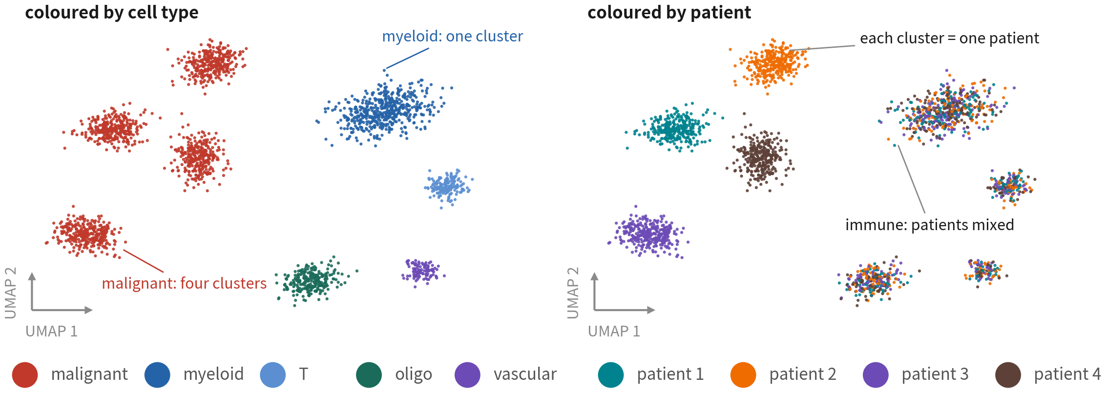
Why calling it is hard: malignant cells
cluster by patient, normal cells mix
Each patient's tumour carries its own CNV and mutation set, so its malignant cells usually form their own
cluster. This is more likely biology than batch; check with normal cells as a control before integrating (Q3)
References: Tirosh I, et al. Science. 2016;352(6282):189–196. doi:10.1126/science.aad0501 ｜ Neftel C, et al. Cell. 2019;178(4):835–849.e21. doi:10.1016/j.cell.2019.06.024
Q1 Concepts
29
Notes:
先看一個現象，它解釋了為什麼判定這麼難。 四位病人的 GBM 資料，同一張 UMAP，左邊按細胞型別上色，右邊按病人上色。 左邊你會看到：紅色的惡性細胞分成四個群集；藍色的髓系細胞是一大群；寡樹突、T 細胞、血管各自一小群。再看右邊，答案就出來了：惡性細胞那四個群集，每一座正好是一位病人；而髓系那一大群，四位病人的細胞混在一起。 這是腫瘤單細胞資料最一致的現象，從二〇一六年 Tirosh 的黑色素瘤資料到現在都是這樣。原因是每位病人的腫瘤有自己的 CNV 與突變組合，惡性細胞的整體表現被基因體改變主導；正常細胞沒有這些改變，所以跨病人看起來一樣。 從這裡可以推出兩件事。第一，這比較可能是生物學差異，而不是批次效應；如果一律當成批次整合掉，抹掉的可能是真實的生物學。要不要修、修多少，得先用正常細胞當對照來判斷，Q3 會處理這個兩難。第二，也是這一段的重點：既然惡性細胞的身分寫在基因體上，那判定惡性最直接的證據，也應該來自基因體。問題只剩一個——我們手上這份矩陣，讀不讀得到。 ──────── Start with one phenomenon, because it explains why calling malignancy is so hard. GBM data from four patients, the same UMAP twice: on the left coloured by cell type, on the right coloured by patient. On the left you'll see the red malignant cells split into four clusters; the blue myeloid cells form one big cluster; oligodendrocytes, T cells and vasculature each form a small one. Now look at the right and the answer falls out: each of those four malignant clusters is exactly one patient, while in that big myeloid cluster the cells from all four patients are mixed together. This is the most consistent phenomenon in tumour single-cell data, and it has looked like this from Tirosh's melanoma data in 2016 right through to today. The reason is that each patient's tumour carries its own combination of CNVs and mutations, so the overall expression of the malignant cells is dominated by those genomic changes. Normal cells don't carry them, so they look the same from patient to patient. Two things follow. First, this is more likely to be biological difference than batch effect; if we treat it as batch and integrate it away wholesale, what we erase may be real biology. Whether to correct it, and how much, has to be judged using the normal cells as a control — Q3 takes on that dilemma. Second, and this is the point of this section: if the identity of a malignant cell is written in its genome, then the most direct evidence for calling malignancy ought to come from the genome as well. Which leaves one question — can the matrix we're holding actually read it?

Slide 30
Three kinds of evidence for malignancy, each
with its own precondition
There is no universal answer. What decides is whether the normal counterpart is in the
sample, and what your sequencing can read
Evidence | Strength and limits | When it suffices
Defining variants IDH1 R132H H3K27M, EGFRvIII fusions | Strongest — diagnostic. But these are point mutations or specific variants, and 10x 3′ reads only the transcript end, so it usually misses them | Use it directly when full-length (Smart-seq2) or targeted data exists
Lineage markers EPCAM/KRT, SOX2/EGFR... | Gives lineage only. Whether that equals malignancy depends on whether same-lineage normal cells are present | Often enough in epithelial tumours (lung, colorectal, breast, ovary), where normal epithelium is scarce; still worth confirming with CNV
Inferred CNV inferCNV, CopyKAT | Genome-level evidence. Needs a trustworthy normal reference; fails in low-CNV tumours (IDH-mutant low-grade glioma, some paediatric tumours) | In tumours like glioma, where the normal counterpart sits right next door, this is usually what separates them
References: Patel AP, et al. Science. 2014;344(6190):1396–1401. doi:10.1126/science.1254257 ｜ Gao R, et al. Nat Biotechnol. 2021;39(5):599–608. doi:10.1038/s41587-020-00795-2
Q1 Concepts
30
Notes:
判定惡性有三種證據。沒有哪一種永遠正確，所以我們一種一種來看它的前提。 第一種，定義性變異。IDH1 的 R132H、瀰漫性中線膠質瘤的 H3K27M、EGFR 的 vIII、各種融合基因——帶了就是腫瘤細胞，病理科就是靠它們診斷。這是最強的證據。可惜它們都是點突變或特定變異，而 10x 的 3′ 定序只讀轉錄本尾端，讀不到那些位點。除非我們有全長資料或做了靶向定序，否則這一種在手上這份矩陣裡拿不到。 第二種，譜系 marker。最直覺的做法：EGFR、SOX2 高表現就是腫瘤細胞。這個答案只對了一半——這些基因確實把細胞定位到膠質譜系，註釋的第一刀就是靠它；但它說的是譜系，不是惡性。 它夠不夠用，完全取決於一件事：樣本裡有沒有同一個譜系的正常細胞。上皮腫瘤——肺癌、大腸癌、乳癌、卵巢癌——腫瘤樣本裡的正常上皮本來就很少，EPCAM 陽性幾乎就等於腫瘤，marker 分得相當好。膠質瘤剛好是最壞的情況：反應性星狀細胞、寡樹突前驅細胞就長在旁邊，跟惡性細胞表現同一批基因，用 marker 完全分不開。所以「marker 能不能用」不是是非題，是看癌別。 第三種，CNV 推斷。inferCNV、CopyKAT 從表現量沿著基因體平滑回推拷貝數，那是基因體層級的證據，在膠質瘤這類腫瘤通常要靠它才分得開。但它一樣有前提：要有一組可信的正常細胞當參考；而且低 CNV 的腫瘤——IDH 突變的低度膠質瘤、部分兒童腫瘤——訊號會弱到失效。血液惡性腫瘤又是另一套，二倍體居多，判定多半靠克隆型。 所以這一頁的結論不是「用哪一種」，是三句話：先看你的定序讀得到什麼；再看正常對應細胞在不在樣本裡；能三角驗證就三角驗證。沒有 CNV 佐證的「腫瘤細胞」，在膠質瘤審稿人不會接受——但在上皮腫瘤，這個要求不必然。 ──────── There are three kinds of evidence for calling malignancy. None of them is always right, so let's take them one at a time and look at what each one assumes. The first kind is definitional variants. R132H in IDH1, H3K27M in diffuse midline glioma, the vIII variant of EGFR, the various fusion genes — carry one and you are a tumour cell, and this is exactly what pathology diagnoses on. It's the strongest evidence there is. Unfortunately they are all point mutations or specific variants, and 10x 3′ sequencing only reads the tail end of the transcript, so those positions are simply not readable. Unless we have full-length data or we've done targeted sequencing, this kind of evidence isn't available in the matrix in front of us. The second kind is lineage markers. The intuitive approach: high EGFR and SOX2 means tumour cell. That answer is only half right — those genes really do place a cell in the glial lineage, and the first cut of annotation depends on exactly that. But what they're telling us is lineage, not malignancy. Whether markers are good enough depends entirely on one thing: is there a normal cell of the same lineage in the sample? In epithelial tumours — lung, colorectal, breast, ovarian — there is very little normal epithelium in a tumour sample to begin with, so EPCAM-positive is close enough to tumour, and markers separate things rather well. Glioma happens to be the worst case: reactive astrocytes and oligodendrocyte precursor cells are growing right next door, expressing the same set of genes as the malignant cells, and markers cannot tell them apart at all. So "can we use markers" isn't a yes-or-no question. It depends on the cancer. The third kind is CNV inference. inferCNV and CopyKAT smooth expression along the genome and infer copy number back from it, which is evidence at the genomic level, and in tumours like glioma it's usually the only thing that separates them. But it has its own preconditions: you need a trustworthy set of normal cells as a reference, and in low-CNV tumours — IDH-mutant low-grade gliomas, some paediatric tumours — the signal gets weak enough to fail. Haematological malignancies are a different game again: mostly diploid, and calling there tends to rest on clonotype. So the conclusion of this slide isn't "use this one". It's three sentences. Look first at what your sequencing can actually read. Then look at whether the normal counterpart cells are in the sample. And triangulate whenever you can. In glioma, "tumour cells" without CNV support will not get past a reviewer — but in epithelial tumours, that demand isn't necessarily reasonable.

Slide 31
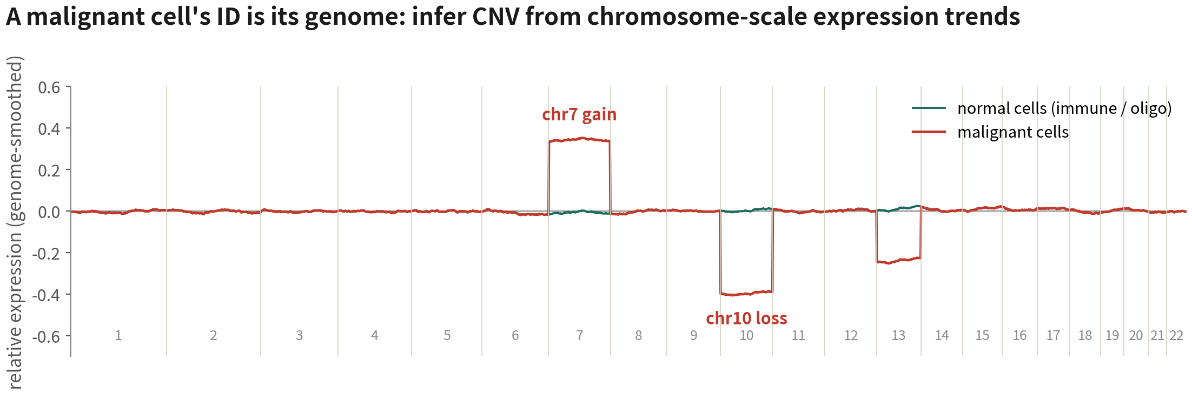
CNV: a whole chromosome arm shifting together
One gene says nothing, but a hundred neighbouring genes on the same chromosome moving together has one explanation: the copy number of that DNA
changed. This is how inferCNV works — and the only reliable basis in tumours like glioma, where the normal counterpart cell sits right next door
References: Patel AP, et al. Science. 2014;344(6190):1396–1401. doi:10.1126/science.1254257 ｜ inferCNV of the Trinity CTAT Project. github.com/broadinstitute/inferCNV
Q1 Concepts
31
Notes:
第三種證據值得看一眼原理，因為 Q3 會實際做一次。 GBM 最經典的事件是第七號染色體增加、第十號染色體缺失，超過八成的病人有。看這張圖：綠色是正常細胞，沿著基因體的表現量是平的；紅色是惡性細胞，第七號染色體整段偏高、第十號整段偏低。 關鍵就在「整段」這兩個字。一個基因的表現高低說不了什麼——它可能只是調控變了。但同一條染色體上一百個相鄰的基因一起偏高或偏低，就只剩一種解釋：這段 DNA 的拷貝數變了。這就是 inferCNV 的原理。 ──────── The third kind of evidence is worth one look at the principle, because Q3 will do it for real. The classic GBM events are gain of chromosome 7 and loss of chromosome 10, present in over eighty percent of patients. Look at this figure: green is the normal cells, and their expression along the genome is flat; red is the malignant cells, with chromosome 7 shifted up along its whole length and chromosome 10 shifted down along its whole length. The key is that phrase, "whole length". One gene being high or low tells us nothing — it might just be a change in regulation. But when a hundred neighbouring genes on the same chromosome shift up or down together, only one explanation is left: the copy number of that stretch of DNA has changed. That's the principle behind inferCNV.

Slide 32
The four major groups: three are easy, one is not
The first cut in annotating tumour data is always these four
Three: immune · vascular · oligo
The fourth: glial / malignant
Naming ends here
Naming is not the end
•
Immune — PTPRC
•
Glial — SOX2, OLIG2, PTPRZ1, EGFR
•
Vascular — PECAM1, VWF
•
Malignancy needs CNV + patient
specificity
•
Oligo — MBP, PLP1 (the
inferCNV reference)
•
Call first, then states
(MES/AC/OPC/NPC)
Q1 Concepts
32
Notes:
把前面兩頁合起來，就變成註釋腫瘤資料的第一刀。 先看左邊這一塊：免疫、血管、正常組織。它們跨病人混合、marker 明確，好分。PTPRC 是所有免疫細胞的譜系標誌；PECAM1、VWF 是血管內皮；MBP、PLP1 是寡樹突細胞——而且寡樹突細胞是 inferCNV 最好的參考，因為它們幾乎不可能是惡性的。 右邊這一塊就是麻煩的那個：膠質與惡性。它們按病人分成不同群集，marker 只說得出譜系。SOX2、OLIG2、PTPRZ1、EGFR 可以把這一塊圈出來，但惡性判定得另外做。判定完，再在惡性細胞內部看狀態。 第一刀永遠是這四塊。四塊劃清楚，之後的每一步才有地基。 ──────── Put the last two slides together and you get the first cut of annotating tumour data. Look at the block on the left first: immune, vasculature, normal tissue. They mix across patients and their markers are unambiguous, so they're easy. PTPRC is the lineage marker for every immune cell; PECAM1 and VWF are vascular endothelium; MBP and PLP1 are oligodendrocytes — and oligodendrocytes are the best reference inferCNV can have, because they are almost never malignant. The block on the right is the awkward one: glial and malignant. They split into separate clusters by patient, and markers only get as far as lineage. SOX2, OLIG2, PTPRZ1 and EGFR will draw a circle round this block, but the malignancy call has to be made separately. Once it's made, then you look at states within the malignant cells. The first cut is always these four blocks. Get the four blocks clearly drawn, and every step afterwards has a foundation.

Slide 33
06
The unit is the patient,
not the cell
The first three decide what we see; this one decides what we may claim
Q1 Concepts
33
Notes:
最後一條紅線。前面三條決定我們看到什麼，這一條決定我們能宣稱什麼。 ──────── The last red line. The first three decide what we get to see; this one decides what we get to claim.

Slide 34
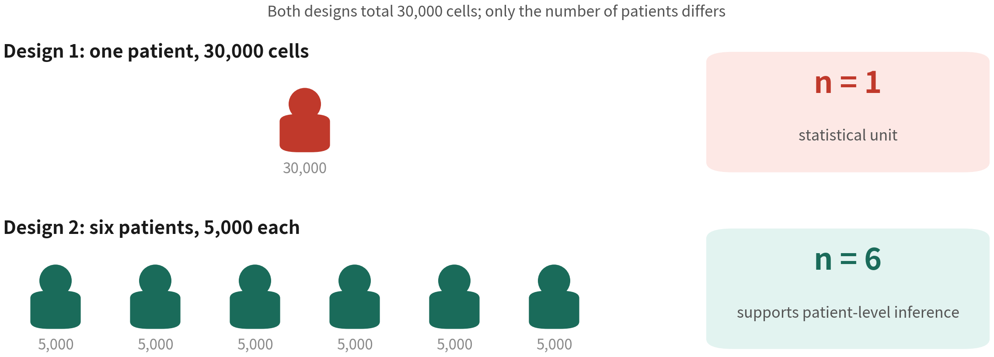
Thirty thousand cells from one patient is still n = 1
30,000 cells from one patient is still n = 1. Testing cells as samples inflates the
degrees of freedom into false significance — Q3 measures how big the effect is
References: Squair JW, et al. Nat Commun. 2021;12(1):5692. doi:10.1038/s41467-021-25960-2 ｜ Zimmerman KD, Espeland MA, Langefeld CD. Nat Commun. 2021;12(1):738. doi:10.1038/s41467-021-21038-1
Q1 Concepts
34
Notes:
看上下兩種設計。上面：一位病人，抓了三萬顆細胞。下面：六位病人，每人五千顆。細胞總數一模一樣。 但統計上，上面的 n 是一，下面的 n 是六。 為什麼？因為同一位病人的那三萬顆細胞，彼此不是獨立的。它們共享同一個基因體、同一組突變、同一個年齡、同一天的用藥、同一批解離條件。我們要回答的問題是「GBM 病人的腫瘤有什麼特徵」，那重複單位就是病人。 那灌出來的假顯著到底有多少？Q3 會用同一份資料實際跑一次給你看：以細胞為單位跑，三千四百八十六個顯著基因；改以病人為單位跑，只剩六百零八個。中間差的那五倍多，就是偽陽性。 所以這句話在兩個地方各決定一件事：設計實驗的時候，它決定我們要收幾位病人；做分析的時候，它決定我們的檢定要在哪一個層級做。 ──────── Look at the two designs, top and bottom. On top: one patient, thirty thousand cells captured. Below: six patients, five thousand cells each. Exactly the same total number of cells. Statistically, though, the top one has n of one and the bottom one has n of six. Why? Because those thirty thousand cells from the same patient are not independent of one another. They share the same genome, the same set of mutations, the same age, the same day's medication, the same batch of dissociation conditions. The question we're trying to answer is "what characterises the tumours of GBM patients", so the unit of replication is the patient. And how much false significance does that pump in? Q3 will run it on one dataset and show you: run the test with the cell as the unit and you get three thousand four hundred and eighty-six significant genes; switch to the patient as the unit and only six hundred and eight are left. That gap of more than five-fold is false positives. So this one sentence decides something in two different places. At design time, it decides how many patients we recruit. At analysis time, it decides what level we run our test at.

Slide 35
The most common way to cross it: counting cells as samples
What it is
One patient's tumour vs one patient's normal brain,
a test over 30,000 cells, 3,000 'disease genes'.
Why it happens
Every cell looks like an independent observation.
What it costs you
Cells from one patient are correlated; n is really 1.
Most of those genes will not hold in the next patient.
Reference: Squair JW, et al. Nat Commun. 2021;12(1):5692. doi:10.1038/s41467-021-25960-2
Q1 Concepts
35
Notes:
做了什麼：一位病人的腫瘤對一位病人的正常腦，三萬顆細胞拿去做檢定，找到三千個「疾病基因」。 為什麼會踩：因為程式不會報錯，圖還特別漂亮。p 值小到 1e-200，火山圖左右兩邊掛滿基因。 踩了會怎樣：那三千個基因反映的，是「這位病人跟那位病人的差別」——年齡、性別、用藥、批次——不是「腫瘤跟正常的差別」。換下一位病人，大半不成立。 ──────── What was done: one patient's tumour against one patient's normal brain, thirty thousand cells thrown into a test, three thousand "disease genes" found. Why people cross it: because the code never errors, and the figures come out unusually pretty. P-values down to 1e-200, and genes hanging off both sides of the volcano plot. What happens when you do: those three thousand genes reflect the difference between this patient and that patient — age, sex, medication, batch — not the difference between tumour and normal. Swap in the next patient and most of them won't hold.

Slide 36
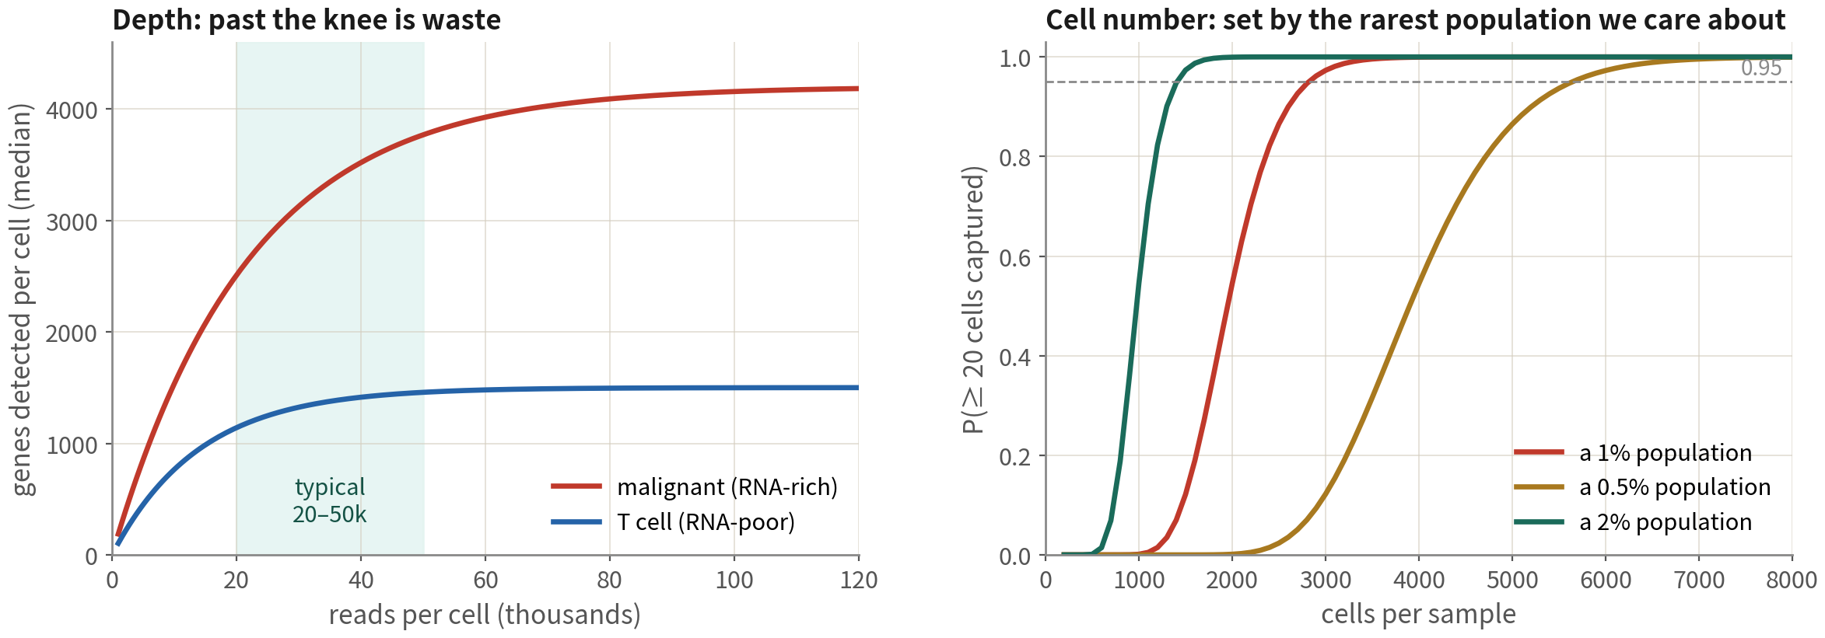
Three numbers in study design: patients, cells, depth
Decide in this order: patients (power), then cells (rarest population), then depth (waste
past the knee). On a fixed budget, one more patient nearly always beats 10,000 more cells
Reference: Zimmerman KD, Espeland MA, Langefeld CD. Nat Commun. 2021;12(1):738. doi:10.1038/s41467-021-21038-1
Q1 Concepts
36
Notes:
那條紅線拉回到設計端，就變成三個數字。而且這三個數字有個共同點：定案之後補不回來。 第一個是病人數。它決定的是統計功效，理由就是上一頁講的那件事。組間比較，每組至少三位，五位以上你才會睡得比較安穩。 第二個是每個樣本要收幾顆細胞。看右邊這張圖，橫軸是細胞數，縱軸是「至少抓到二十顆某個稀有群」的機率。假設你在乎的那一群佔百分之一，例如 GBM 裡的 T 細胞，三千顆左右就能穩定看到；但如果只佔千分之五，你就得收到六千顆以上。所以細胞數不是越多越好，是被你最想看的那個最稀有的群綁住的。 第三個是每顆細胞的定序深度。左邊是飽和曲線，過了膝點——大約兩到五萬條 reads——你再加深度，多測到的基因很少。不同細胞的膝點也不一樣：惡性細胞 RNA 多，膝點高一點；T 細胞 RNA 少，很早就飽和了。 決定的順序是：先病人數，再細胞數，最後才是深度。預算就是那麼多的時候，多收一位病人，幾乎永遠比多測一萬顆細胞值得。 ──────── Pull that red line back to the design stage and it turns into three numbers. And the three of them have something in common: once they're settled, you cannot go back afterwards and top them up. The first is the number of patients. What it buys you is statistical power, for exactly the reason the last slide gave. For a group comparison, at least three per group — and at five or more you'll sleep rather more soundly. The second is how many cells to collect per sample. Look at the plot on the right: the x-axis is cell count, the y-axis is the probability of catching at least twenty cells of some rare population. If the population you care about is one percent of the tissue — T cells in GBM, say — around three thousand cells will see it reliably; but if it's only half a percent, you have to get past six thousand. So cell count is not a case of the more the better. It's pinned by the rarest population you actually want to look at. The third is sequencing depth per cell. On the left is the saturation curve: past the knee — around twenty to fifty thousand reads — extra depth buys you very few extra genes. And the knee sits in a different place for different cells: malignant cells carry more RNA, so their knee is higher; T cells carry little, and saturate very early. The order you decide them in is patients, then cells, then depth. When the budget is only so big, one more patient is almost always worth more than ten thousand more cells.

Slide 37
Reading Figure 1 of a single-cell paper: five questions first
All five answers live in the methods and supplements; if we cannot find one, discount the conclusion
Question | Why it matters | Where to look
How many patients per group? | n is patients; between-group claims at n < 3 are descriptive | Table 1, 'Samples' in methods
How were cells QC'd and doublets removed? | Without doublet removal, 'dual-lineage' types are usually artefacts | 'QC' in methods, Fig S1
What was integrated, what was corrected away? | Integrating by patient flattens real malignant differences (Q3) | 'Integration' in methods, pre/post UMAPs
How was malignancy called? | 'Tumour cells' by markers alone are not credible; look for CNV or mutations | inferCNV / copyKAT heatmap
Is DE done per cell or per patient? | Cell-level tests hand us thousands of false positives (Q3) | 'Differential expression': pseudobulk or not
Q1 Concepts
37
Notes:
四條紅線講完了。我們先把它們拿出去用一次——用在別人的論文上。 以後你拿到一篇腫瘤單細胞論文，先忍住，別急著看 Figure 1 那張漂亮的 UMAP。翻到方法段和補充圖，把這五個答案找出來再回頭看圖。 第一，幾位病人、每組幾位。n 是病人，不是細胞；每組不到三位，那篇就是描述，不是推論。第二，細胞怎麼 QC、有沒有去 doublet。沒做的資料裡，那些「同時表現兩種譜系」的新型別，多半只是兩顆細胞黏在一起。第三，整合了什麼、又修掉了什麼。如果作者按病人整合完，回頭宣稱惡性亞型，那些差異可能早就被抹平了。 第四題要照癌別讀。膠質瘤只給你 marker 是不夠的，你要去找 inferCNV 或 copyKAT 的熱圖；上皮腫瘤可以寬一點，但最好還是有第二種證據。 第五，DE 的單位是細胞還是病人。方法段裡如果沒有 pseudobulk、也沒有以樣本為單位這類字眼，那幾千個差異基因裡有多少是假的，我們就無從判斷。 五個答案只要有任何一個找不到，就把那篇的結論打個折。這不是苛刻，這是這個領域自己在二〇二〇年之後學到的教訓。 ──────── That's the four red lines done. Let's take them outside and use them once — on somebody else's paper. From now on, when a tumour single-cell paper lands in front of you, hold back. Don't go straight to that beautiful UMAP in Figure 1. Turn to the methods and the supplementary figures, find these five answers, and then come back to the picture. First, how many patients, and how many per group? The n is patients, not cells; fewer than three per group and that paper is description, not inference. Second, how were the cells QC'd, and were doublets removed? In data where that wasn't done, those novel types that "express two lineages at once" are usually just two cells stuck together. Third, what was integrated, and what got corrected away? If the authors integrated by patient and then turn round and claim malignant subtypes, those differences may already have been flattened out. The fourth one you read by cancer type. For glioma, markers alone won't do — go and find the inferCNV or copyKAT heatmap. For epithelial tumours you can be a bit more relaxed, though a second kind of evidence is still better. Fifth, is the unit of DE the cell or the patient? If the methods never say pseudobulk and never mention anything at the sample level, then we have no way of judging how many of those few thousand differential genes are false. If any one of those five answers can't be found, discount that paper's conclusions. That's not being harsh — it's the lesson this field taught itself after 2020.

Slide 38
What this technology can and cannot answer
What it cannot do is not a flaw but the edge of what we may claim — better written by us than by a reviewer
CAN ANSWER
CANNOT ANSWER
What single cell gives
The edge of what we may claim
•
Which cell type the signal came from — composition
change vs per-cell change, which bulk cannot separate
•
Position — lost at dissociation; asking about it needs
spatial transcriptomics
•
What rare populations are doing — exhausted T cells,
stem-like cells, diluted away by averaging
•
Anything but RNA — protein, modifications,
metabolites are absent; high mRNA is not high protein
•
How many states one cell type holds — the four GBM
malignant states; bulk gives only the average
•
The in vivo state — what we measure is the cell after
half an hour in enzyme
•
Who may be talking to whom — ligand–receptor inference
(inference, not proof of contact)
•
Point mutations, splicing, fusions — 10x 3′ reads
only ~90 bases from the end; hence CNV as the
fallback
•
No need to assume which populations exist — they
emerge from the data
•
Time — each cell is measured once; 'A becomes B' is
inference, and a trajectory is an ordering, not time
•
One experiment feeds everything downstream —
malignancy, trajectories, communication, deconvolution
•
Power — more cells never buys n; statistical power
comes from the number of patients
Q1 Concepts
38
Notes:
這一頁和下一頁，是這一集唯一的總結，也是唯一值得你截圖帶走的兩頁。 左邊六件事，是單細胞給了我們什麼：訊號到底來自哪一種細胞、稀有族群在做什麼、同一種細胞裡藏了幾種狀態、誰可能在跟誰講話。還有兩件很容易被忽略的：一是你不必先假設有哪些族群，族群是資料自己長出來的，這在遇到還沒有名字的型別時特別重要；二是一次實驗接得上整條下游，惡性判定、軌跡、通訊、反卷積，全都從這一份矩陣出發。 右邊六條，則是我們可以宣稱的邊界。別把它們當缺點看——這些話由你在討論段自己寫出來，遠比被審稿人指出來好。 位置沒了。解離的那一刻，每顆細胞就離開了它原本待的地方，所以「它在血管旁邊」「它在壞死區邊緣」你都講不出來。要問位置，得換空間轉錄體。 RNA 以外的東西都不在。mRNA 高不等於蛋白高，中間還隔著好幾層調控，所以「這條路徑活化了」，用 RNA 只能算旁證。 量到的是解離後的狀態。那不是細胞在體內的樣子，是它泡在酵素裡半小時之後的樣子。 3′ 定序只讀末端大約九十個鹼基。點突變、剪接、融合幾乎都讀不到——這正是剛才惡性判定要退回 CNV 的技術原因。 只有一個時間點。每顆細胞你只量得到一次，所以「A 變成 B」永遠是推論；軌跡給你的是排序，不是時間。 最後一條是功效：細胞再多也換不到 n。這就是第四條紅線的另一面。 ──────── This slide and the next one are the only summary in this episode, and the only two worth screenshotting and taking away with you. Six things on the left: what single cell has given us. Which kind of cell the signal actually came from, what the rare populations are doing, how many states are hiding inside one cell type, who might be talking to whom. And two more that get overlooked. One, you don't have to assume in advance which populations exist — the populations grow out of the data themselves, and that matters especially when you meet a type that doesn't have a name yet. Two, one experiment connects to the whole downstream stretch — malignancy calling, trajectories, communication, deconvolution, all of it starting from this one matrix. The six on the right are the boundary of what we're allowed to claim. Don't read them as flaws — these sentences are far better written by you in the discussion than pointed out by a reviewer. Position is gone. At the moment of dissociation every cell leaves the place it used to sit in, so "this one was beside a vessel", "this one was at the edge of the necrosis" — you can say neither. To ask about position you switch to spatial transcriptomics. Anything that isn't RNA isn't in there. High mRNA doesn't mean high protein; there are several layers of regulation in between. So "this pathway is activated", from RNA alone, is circumstantial. What you measured is the dissociated state. That isn't what the cell looked like inside the body — it's what it looks like after half an hour in an enzyme bath. 3′ sequencing reads only about ninety bases at the end. Point mutations, splicing and fusions are essentially unreadable — and that is precisely the technical reason the malignancy call had to fall back to CNV just now. One time point only. You measure each cell once, so "A becomes B" is always an inference; a trajectory gives you an ordering, not time. The last one is power: no number of cells buys you n. That's the other face of the fourth red line.

Slide 39



Four rules to keep before touching the data
The first line is the principle; below it is what the principle looks like in practice
1. A tumour is an ecosystem
2. The UMAP is only a projection
Ask who produced the signal before asking
how much it differs
When the question does not need each cell's identity,
bulk is cheaper and better powered
Clustering, distances, integration and trajectories
never use its coordinates
Count area with table(); for a band, first rule out
cycle, depth and doublets
3. Malignancy calling
depends on the cancer
4. The unit is the patient
Normal counterpart in the sample → CNV is required;
absent → markers can do
Triangulate whenever possible; never rest
on one kind of evidence
In design it sets how many patients; in analysis it
sets the level of the test
Check each downstream road's precondition; when it
fails, say so instead of drawing the plot
Q1 Concepts
39
Notes:
第二張總結是操作版。上面那一句是原則，下面就是它在你動手的時候長什麼樣。 腫瘤是生態系——所以先問訊號來自誰，再問差多少；反過來說，問題不需要「知道每顆細胞是誰」的時候，Bulk 更便宜，功效也更好。 UMAP 只是投影——分群、距離、整合、軌跡，都不要用它的座標；面積要用 table 去數；看到長帶，先排除細胞週期、深度梯度、doublet。 惡性判定看癌別——正常對應細胞混在樣本裡，就得用 CNV；不在裡面，marker 可行；能三角驗證，就三角驗證。 統計單位是病人——設計時它決定你收幾位病人，分析時它決定檢定要放在哪一層；下游每一條路都先檢查前提，前提不成立就說清楚，不要硬把圖畫出來。 Q2 的每一行程式碼、Q3 的每一個決定，都是建立在這四條上面的。 ──────── The second summary is the hands-on version. The line at the top of each row is the principle; underneath it is what that principle looks like when you're actually working. A tumour is an ecosystem — so ask who the signal came from before you ask how big the difference is. And the other way round: when the question doesn't need you to know who each cell is, Bulk is cheaper, and better powered. UMAP is only a projection — clustering, distances, integration, trajectories, none of them should use its coordinates; count area with table; and when you see a long band, first rule out cell cycle, a depth gradient and doublets. Malignancy calling depends on the cancer — if the normal counterpart cells are mixed into the sample, you need CNV; if they aren't in there, markers will do; and if you can triangulate, triangulate. The statistical unit is the patient — at design time it decides how many patients you recruit, at analysis time it decides which level the test goes at. And on every downstream road, check the precondition first; when it doesn't hold, say so plainly, rather than forcing the figure out anyway. Every line of code in Q2 and every decision in Q3 is built on these four.

Slide 40


What lies beyond single-cell transcriptomes
This series reads RNA only; knowing what else exists tells us what we are missing
Multimodal
Spatial
transcriptomics
Genome and
lineage
RNA + protein / chromatin.
CITE-seq adds surface
proteins (sharper immune
calls); 10x Multiome adds
ATAC (regulation,
lineage). Same analysis
skeleton as this course
Visium, Xenium, MERFISH
keep position: who sits by
vessels, in necrosis, at
the core–edge boundary.
Single-cell data often
serves as the reference for
deconvolution
TCR / BCR sequencing
tracks clones; scDNA-seq
or mitochondrial variants
track subclones.
Tumour-evolution studies
pair these with expression
Q1 Concepts
40
Notes:
做不到的講完了，那接下來的問題很自然：那些看不到的東西，要拿什麼補？這幾集我們讀到的都只有 RNA，但你讀論文一定會遇到另外三類。 多模態。CITE-seq 在同一顆細胞上同時量表面蛋白，免疫細胞的分型會準很多，因為 CD4、CD8 在 RNA 層級常常抓不到；10x Multiome 則是同時量 ATAC，讓你看調控與譜系。分析骨架跟這門課一樣，只是多一個模態要對齊。 空間轉錄體。Visium、Xenium、MERFISH 把位置保留下來了——誰在血管旁邊、誰在壞死區、核心和邊緣的界線到底在哪。它們常常需要一份單細胞資料當參考，才能把每個位置反卷積成型別比例。 譜系與基因體。TCR、BCR 定序追蹤免疫細胞的克隆；單細胞 DNA 定序或粒線體變異則追蹤腫瘤的亞株。腫瘤演化的研究常常把它們跟表現資料配對著看。 今天講的這四條紅線，在上面每一類上都還是用得上。 ──────── We've finished with what it can't do, so the next question follows naturally: what do we use to fill in the things it can't see? These episodes have read nothing but RNA, but in the literature you will certainly meet three other kinds. Multimodal. CITE-seq measures surface proteins on the same cell at the same time, and immune cell typing gets a great deal more accurate, because CD4 and CD8 often can't be caught at the RNA level. 10x Multiome measures ATAC alongside, which lets you look at regulation and lineage. The analytical skeleton is the same as this course — there's just one more modality to align. Spatial transcriptomics. Visium, Xenium and MERFISH keep the positions: who sits next to the vessels, who is in the necrotic zone, where the boundary between core and periphery actually runs. They often need a single-cell dataset as a reference before each location can be deconvolved into cell-type proportions. Lineage and the genome. TCR and BCR sequencing track the clones of immune cells; single-cell DNA sequencing, or mitochondrial variants, track the tumour's subclones. Tumour evolution studies often read these paired with expression data. The four red lines we covered today still apply to every one of them.

Slide 41
Check yourself 1
Bulk shows CD8A three-fold higher in tumour A than B.
The most conservative reading?
A A's T cells are more cytotoxic
B A may have more CD8 T cells, or each expresses more — Bulk cannot tell
C A will respond better to immunotherapy
Answer B. Composition change and intrinsic change look identical in bulk. A and C
over-interpret; we need single-cell data (and multiple patients) to move in that
direction.
Q1 Concepts
41
Notes:
第一題。Bulk RNA-seq 顯示腫瘤 A 的 CD8A 比腫瘤 B 高三倍。最保守的解讀是什麼？ A，A 的 T 細胞更有攻擊性。B，A 的 CD8 T 細胞比例可能較高，或每顆表現較高——Bulk 分不開。C，A 對免疫治療反應較好。 先自己想一下，再往下聽。 答案是 B。組成改變跟內在改變，在 Bulk 裡長得一模一樣。A 和 C 都是過度詮釋，要往那個方向推，得有單細胞資料，而且要多位病人。 ──────── Question one. Bulk RNA-seq shows CD8A three times higher in tumour A than in tumour B. What's the most conservative interpretation? A: A's T cells are more aggressive. B: A may have a higher proportion of CD8 T cells, or higher expression per cell — Bulk can't tell them apart. C: A will respond better to immunotherapy. Take a moment before you hear the answer. The answer is B. Compositional change and intrinsic change look identical in Bulk. A and C are both over-interpretations — to push in that direction you'd need single-cell data, and several patients.

Slide 42
Check yourself 2
Four GBM patients: malignant cells form four clusters, macrophages one
blended cluster. This means?
A Severe batch effect; integrate
B Four malignant subtypes
C Expected: malignant cells carry patient-specific CNV, normal cells do not
Answer C. Macrophages blend well, so technical batch is small; the malignant
clusters come from genomic differences. Forcing integration erases real patient
biology.
Q1 Concepts
42
Notes:
第二題。四位病人的 GBM 資料，UMAP 上惡性細胞分成四個群集、巨噬細胞混成一群。這代表什麼？ A，有嚴重批次效應，要整合。B，惡性細胞有四種亞型。C，正常現象：惡性細胞帶病人特異的 CNV，正常細胞沒有。 先自己想一下，再往下聽。 答案是 C。巨噬細胞混得這麼好，本身就證明技術批次不大；惡性細胞分開，來自基因體差異。這時候硬整合，會把真實的病人差異一起抹掉。 ──────── Question two. GBM data from four patients: on the UMAP the malignant cells split into four clusters and the macrophages mix into one. What does that mean? A: a severe batch effect — integrate it. B: the malignant cells have four subtypes. C: it's normal — malignant cells carry patient-specific CNVs, normal cells don't. Take a moment before you hear the answer. The answer is C. The macrophages mixing that well is itself proof that the technical batch effect is small; the malignant cells separate because of genomic differences. Force integration here and you erase the real patient differences along with it.

Slide 43
Check yourself 3
The strongest evidence that a cluster is malignant?
A High EGFR and SOX2
B Whole chromosome arms (e.g. chr7 gain, chr10 loss) shifting together
C Sitting far from immune cells on the UMAP
Answer B. Markers only give lineage and UMAP distance is not evidence; CNV is
genome-level. Note this asks about GBM — in epithelial tumours the normal
counterpart is scarce and markers often suffice (see question 6).
Q1 Concepts
43
Notes:
第三題。要證明某群細胞是惡性的，最有力的證據是哪一個？ A，高表現 EGFR、SOX2。B，整段染色體的表現一起偏移。C，在 UMAP 上離免疫細胞很遠。 先自己想一下，再往下聽。 答案是 B。marker 只能說譜系，UMAP 距離則完全沒有證據力。不過注意，這題問的是 GBM——上皮腫瘤裡正常對應細胞很少，marker 常常就夠用了，這正是第六題要問你的。 ──────── Question three. To show that a group of cells is malignant, which is the strongest evidence? A: high expression of EGFR and SOX2. B: expression shifting together across a whole chromosome. C: sitting far away from the immune cells on the UMAP. Take a moment before you hear the answer. The answer is B. Markers only speak to lineage, and UMAP distance has no evidential force at all. But notice what this question asked about: GBM. In epithelial tumours there are very few normal counterpart cells, so markers are often enough on their own — which is exactly what question six is going to ask you.

Slide 44
Check yourself 4
After clustering, a FOS/JUN/HSPA1A-high group appears — with a patch
inside malignant, macrophage and oligodendrocyte cells alike.
Most likely?
A A cross-lineage 'stress-response subpopulation'
B The immediate-early response to dissociation — a technical artefact
C Low-quality cells that QC should have removed
Answer B. The test is that it appears across types: a real biological
subpopulation usually belongs to one lineage, while a signal present in every type
is almost always a handling artefact.
Q1 Concepts
44
Notes:
第四題。分群之後你發現一群 FOS、JUN、HSPA1A 高表現的細胞，而且惡性、巨噬、寡樹突細胞裡各有一撮。最可能是什麼？ A，一個跨譜系的「壓力反應亞群」。B，解離造成的立即早期反應，是技術假象。C，低品質細胞，應該在 QC 就刪掉。 先自己想一下，再往下聽。 答案是 B。判準就在「跨型別出現」這四個字：真正的生物學亞群通常屬於某一個譜系，散在所有型別裡的訊號，幾乎都是操作留下來的。C 也不對——這些細胞的品質指標其實很正常，QC 攔不住它們。 ──────── Question four. After clustering you find a group of cells with high FOS, JUN and HSPA1A, and there's a pinch of them in the malignant cells, a pinch in the macrophages and a pinch in the oligodendrocytes. What is it most likely to be? A: a cross-lineage "stress-response subpopulation". B: the immediate-early response caused by dissociation, a technical artefact. C: low-quality cells that should have been removed at QC. Take a moment before you hear the answer. The answer is B. The test is in one phrase — it turns up across cell types. A genuine biological subpopulation usually belongs to one lineage, and a signal scattered through every type is almost always something the handling left behind. C is wrong too: the quality metrics of these cells are perfectly normal, and QC won't stop them.

Slide 45
Check yourself 5
Fixed budget, one choice: one more patient, or raising each sample
from 5,000 to 15,000 cells. The question is core vs periphery
differences in malignant cells — which?
A One more patient
B More cells per sample
C Equivalent — take whichever is easier
Answer A. The unit here is the patient and power comes from patient count;
more cells only measure the same patient more finely. More cells pay off
only when hunting a rare population.
Q1 Concepts
45
Notes:
第五題。預算固定，只能二選一：多收一位病人，或者把每個樣本從五千顆細胞加到一萬五千顆。研究問題是「核心與邊緣的惡性細胞有什麼差異」。你選哪一個？ A，多收一位病人。B，每個樣本多收細胞。C，兩者等價，看哪個好收。 先自己想一下，再往下聽。 答案是 A。這個問題的統計單位是病人，功效由病人數決定；細胞再多，也只是把同一位病人量得更仔細而已。多收細胞只有在「要找稀有族群」的時候才划算。 ──────── Question five. Fixed budget, and you can only have one of two things: recruit one more patient, or take each sample from five thousand cells up to fifteen thousand. The research question is what differs between the malignant cells in the core and those at the periphery. Which do you choose? A: one more patient. B: more cells per sample. C: they're equivalent — take whichever is easier to get. Take a moment before you hear the answer. The answer is A. The statistical unit for this question is the patient, and power is set by the number of patients; however many more cells you collect, you're only measuring the same patient in finer detail. Collecting more cells pays off only when you're hunting for a rare population.

Slide 46
Check yourself 6
In which situation do lineage markers alone suffice to call malignancy?
A Any solid tumour, as long as the markers are clean
B When same-lineage normal cells are essentially absent — e.g.
epithelium in lung or colorectal cancer
C Never — a CNV heatmap makes markers unnecessary
Answer B. Markers give lineage, not malignancy. In epithelial tumours normal
epithelium is scarce, so EPCAM+ is nearly synonymous with tumour; glioma is the
opposite — reactive astrocytes and OPCs sit right next door, so CNV is required.
Q1 Concepts
46
Notes:
第六題。哪一種情況下，只靠譜系 marker 就足以判定惡性？ A，任何實體腫瘤，只要 marker 夠乾淨。B，樣本裡幾乎沒有同譜系的正常細胞時，例如肺癌、大腸癌的上皮。C，都不行，一定要 CNV。 先自己想一下，再往下聽。 答案是 B。marker 說的是譜系，不是惡性；它等不等於惡性，取決於樣本裡有沒有同譜系的正常細胞。上皮腫瘤裡正常上皮本來就少，EPCAM 陽性幾乎等於腫瘤；膠質瘤剛好相反，反應性星狀細胞和 OPC 就長在旁邊，非 CNV 不可。所以 A 太寬、C 太嚴——這一題要問的就是「看癌別，不是通則」。 ──────── Question six. In which situation are lineage markers alone enough to call malignancy? A: any solid tumour, as long as the markers are clean. B: when the sample contains almost no normal cells of the same lineage — the epithelium in lung or colorectal cancer, for instance. C: neither — you always need CNV. Take a moment before you hear the answer. The answer is B. A marker speaks to lineage, not to malignancy; whether it amounts to malignancy depends on whether there are normal cells of the same lineage in the sample. Epithelial tumours have little normal epithelium to start with, so EPCAM positive is very nearly the same thing as tumour; glioma is the exact opposite — reactive astrocytes and OPCs are growing right next door, and there it has to be CNV. So A is too loose and C is too strict. What this question is really asking is that you read the cancer, not the general rule.

Slide 47
NEXT
Q2: the single-sample standard pipeline
— from raw matrix to cell annotation
Concepts done — now the hands-on. Next episode runs 10x's public GBM 5k (5,604
cells) from loading to annotation,
with three practice scripts — every block copy-ready.
scRNA-seq video series · Series Q Quick Start
https://github.com/Charlene717/scRNA-seq-tutorial-Qseries
Notes:
觀念有了，接下來換手指動。 下一集 Q2 用的是 10x 公開的 GBM 5k 資料——五千六百顆細胞，一份真實的腫瘤——從讀檔一路做到每一群都有名字、惡性細胞都有狀態分數。附三支練習腳本，每一段程式碼都可以直接複製。五十五分鐘。 今天任何一個觀念想再深入：A1 講單細胞的理由與 n 的問題，A2 講 10x 平台，A4 講標準流程，A5 講看圖。 --- ──────── We've got the concepts. Now the fingers get to move. Next episode, Q2, uses 10x's public GBM 5k data — five thousand six hundred cells, one real tumour — and goes from reading the files all the way to every cluster having a name and the malignant cells having state scores. Three practice scripts are included, and every block of code can be copied straight across. Fifty-five minutes. If you want to go deeper on anything from today: A1 covers the case for single-cell and the n problem, A2 the 10x platform, A4 the standard pipeline, A5 reading the plots.

