Slide 1

Series Q Q3
Hands-on II: multi-sample integration
and downstream analysis
Four GBM patients (core vs infiltrating periphery). Call malignancy —
which the single-patient data in Q2 could not support — put DE at the
patient level, then choose the downstream route.
About 70 min | Prerequisites: Q2 | Scripts: R/04–10 | Deeper: B11–B17
https://github.com/Charlene717/scRNA-seq-tutorial-Qseries
Notes:
歡迎回來，Q 系列最後一集。前面兩集，我們手上只有一位病人的一份樣本；從這一頁開始，樣本變成八個——四位病人，每個人身上取兩個地方，腫瘤的核心，還有腫瘤正在往外長的邊緣。 資料是 Darmanis 等人 2017 年發表在 Cell Reports 的 GBM 資料，GEO 編號 GSE84465。有了多個病人，三件 Q2 做不到的事現在做得了：做惡性判定、讓差異表達以病人為單位、然後把整條下游走一遍——CellChat 六種圖、軌跡、調控、反卷積。六十五分鐘，五支練習腳本，04 到 06。我們開始。 ──────── Welcome back — this is the last episode of the Q series. For the first two episodes we had one sample from one patient. From this slide on we have eight: four patients, two sites each, the tumour core and the infiltrating periphery where the tumour is pushing out into normal brain. The data are the GBM dataset Darmanis and colleagues published in Cell Reports in 2017, GEO accession GSE84465. With more than one patient, three things that Q2 simply could not support become possible: calling which cells are malignant, moving the unit of differential expression from cells to patients, and then walking the whole downstream stretch — six kinds of CellChat plots, trajectories, regulation, deconvolution. Sixty-five minutes, five practice scripts, 04 through 06. Let's start.

Slide 2
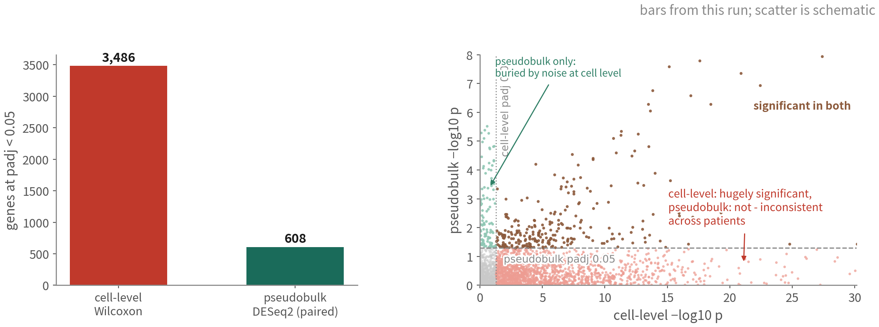
Same question, two answers
Which genes differ between core and periphery within one cell type? Cell-level says
3,486, pseudobulk says 608. In 65 minutes we will know which to trust
Q3 Hands-on II
2
Notes:
先不講方法，先看一個結果。問題很單純：腫瘤核心跟浸潤邊緣，同一種細胞差了哪些基因？ 左邊是 cell-level 的 Wilcoxon 檢定，跑出三千四百八十六個顯著基因。右邊是 pseudobulk 加配對的 DESeq2，六百零八個。 同一份資料，同一個問題，兩張圖差了五點七倍。這六十五分鐘要帶你走到一個地方：知道該信哪一個，而且知道為什麼。 還有一件事先講，後面會回來找我們。這一頁比的是免疫細胞，不是惡性細胞。我知道大家真正想問的是惡性細胞在核心跟邊緣差在哪——但這份資料的邊緣，惡性細胞總共只有三十一顆，這個問題問不了。為什麼問不了、以及你該在哪一步就發現它問不了，是這一集後半的重點之一。 ──────── Before any methods, let's look at a result. The question is a simple one: between tumour core and infiltrating periphery, which genes differ within one and the same cell type? On the left, a cell-level Wilcoxon test: three thousand four hundred and eighty-six significant genes. On the right, pseudobulk plus paired DESeq2: six hundred and eight. Same data, same question, and the two answers sit five-point-seven-fold apart. Sixty-five minutes from now I want you to know which one to trust, and to know why. One thing to flag now, because it will come back to find us: this slide compares immune cells, not malignant cells. What everyone actually wants to ask is how malignant cells differ between core and periphery — but this dataset holds thirty-one malignant cells at the periphery in total, so that question cannot be asked. Why it cannot, and where in the workflow you ought to notice that it cannot, is one of the main lessons in the second half of this episode.

Slide 3
WHERE THIS EPISODE STARTS
Multi-patient tumour data has plenty of moving
parts. This episode focuses on three of them:
how far to integrate, who is malignant, and
what the unit of DE is.
These three come first because they are the ones most likely to send everything
downstream off course; settle them and the rest becomes discussable.
Q3 Hands-on II
3
Notes:
多病人的腫瘤資料要顧的環節不少，這一集不會全部講完。我們聚焦其中三個，因為它們最常在一開始就把後面的分析帶偏。 整合要修到什麼程度——腫瘤資料的整合是個兩難，等一下細講。誰是惡性的——這件事靠 CNV 回答。還有 DE 的單位是什麼——是病人，不是細胞。 這三個顧好了，後面的問題——參數怎麼調、圖怎麼畫——才有討論的基礎；其中一個歪了，後面做得再細也很難救回來。 ──────── Multi-patient tumour data has plenty of moving parts, and this episode will not cover all of them. We focus on three, because these are the ones most likely to send everything downstream off course from the very start. How far to integrate — for tumour data, integration is a dilemma, and we'll get to it in a moment. Who is malignant — that one rests on CNV. And what the unit of DE is — patients, not cells. Settle these three and the later questions — which parameter, which plot — become worth discussing. Get one of them skewed and no amount of care further down will fully undo it.

Slide 4
Episode goals
Combine four patients with Seurat's default integration (Harmony as the
comparison), and use positive / negative controls to check under- and
over-correction
1
Call malignant cells with inferCNV using immune and
oligodendrocyte references, triangulate, write to metadata, check
against the authors' labels
2
Run composition analysis, pseudobulk + DESeq2 (paired), GSEA, and use
one table to choose the next downstream road
3
Q3 Hands-on II
4
Notes:
這一集要做的事，其實是一條線。 先把四位病人的資料合在一起，判斷哪些細胞該整合、哪些不該。我們用 Seurat 預設的整合先跑一次，Harmony 當比較，再拿正負對照檢查整合到底是不足還是過頭。 細胞湊在一起之後，才問得了「誰是壞的」。這是 inferCNV 的工作，以免疫細胞與寡樹突細胞為參考來判定惡性細胞，三角驗證之後把標籤寫進 metadata，再跟作者的標籤比對。 惡性標籤寫進去了，最後那一段才有意義：做組成分析、pseudobulk 加 DESeq2 的配對設計、GSEA，最後用一張表決定下一條下游路。 ──────── What we do this episode is really one chain. First we merge the four patients' data and decide which cells should be integrated and which shouldn't: Seurat's default integration first, Harmony as the comparison, then positive and negative controls to check whether the integration under- or over-corrected. Only once the cells sit together can we ask which of them are malignant. That is inferCNV's job, with immune cells and oligodendrocytes as the reference; after triangulation, write the calls into the metadata and check them against the answer key — the authors' published labels. And only with those labels written in does the last stretch mean anything: composition analysis, pseudobulk plus DESeq2 with a paired design, GSEA, and finally one table to decide which downstream route to take next.

Slide 5
01
Four patients, eight samples
Script 04: load Smart-seq2 counts and GEO metadata
Q3 Hands-on II
5
Notes:
第一段，腳本 04。載入 Smart-seq2 的 counts 和 GEO 的 metadata。 ──────── Part one, script 04. We load the Smart-seq2 counts and the GEO metadata.

Slide 6
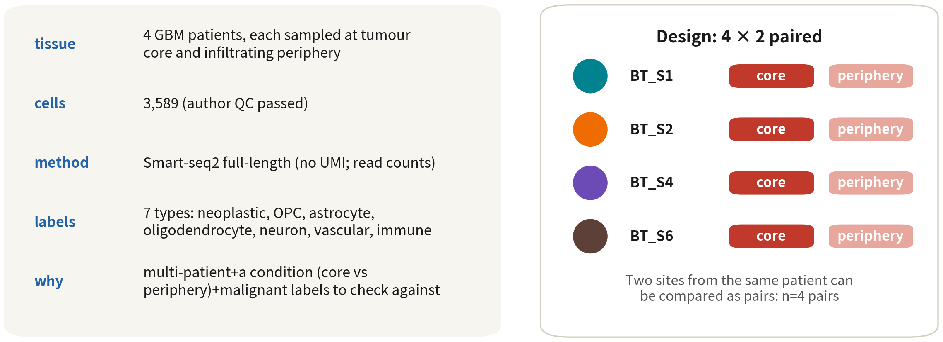
Practice data: Darmanis et al. 2017
Three things Q2 lacked: multiple patients, a condition (core vs periphery), and
author malignant labels to check against
Reference: Darmanis S, et al. Cell Rep. 2017;21(5):1399–1410. doi:10.1016/j.celrep.2017.10.030
Q3 Hands-on II
6
Notes:
先看左邊這份資料的長相。四位 GBM 病人，每一位都取了兩個地方：腫瘤核心，還有邊緣——邊緣就是腫瘤正在往正常腦組織裡長的那條前線。加起來三千五百八十九顆細胞，作者的 QC 都過了。技術是 Smart-seq2 全長定序，沒有 UMI，所以計數是 read counts。作者還給了七種型別的標籤：惡性、OPC、星狀、寡樹突、神經元、血管、免疫。 右邊是設計，四乘二配對。同一位病人的兩個部位可以配對比較，n 是四對。 那為什麼選這份資料？因為它有三樣 Q2 沒有的東西：多位病人、一個條件，還有作者的惡性標籤可以拿來比對。 ──────── Look at the left first, at what this dataset actually is. Four GBM patients, each sampled in two places: the tumour core, and the infiltrating periphery — the periphery being the front line where the tumour grows into normal brain tissue. Three thousand five hundred and eighty-nine cells altogether, all of them past the authors' QC. The technology is Smart-seq2 full-length sequencing — no UMIs, so the counts are read counts. The authors also hand us labels for seven cell types: malignant, OPC, astrocyte, oligodendrocyte, neuron, vascular, immune. On the right, the design: four by two, paired. The two sites come from the same patient, so they can be compared as a pair, and n is four pairs. So why this dataset? Because it has three things Q2 didn't: multiple patients, one condition, and the authors' malignant labels to check our answers against.

Slide 7
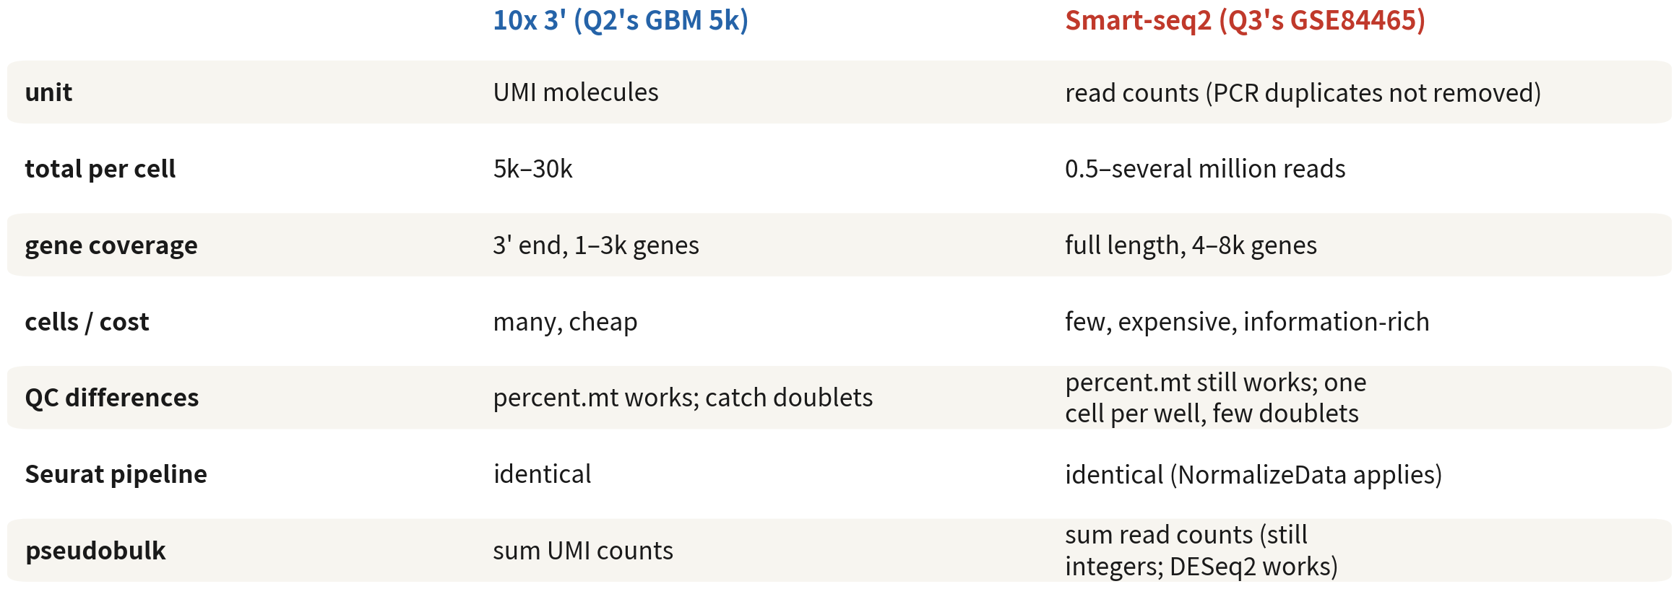
Smart-seq2 vs 10x: what differs, what does not
The Seurat pipeline is identical; the differences are the counting unit, information
per cell, and that doublets are barely a concern
References: Picelli S, et al. Nat Protoc. 2014;9(1):171–181. doi:10.1038/nprot.2014.006 ｜ Zheng GXY, et al. Nat Commun. 2017;8:14049. doi:10.1038/ncomms14049
Q3 Hands-on II
7
Notes:
換技術了，先把差別講清楚，免得後面踩坑。 計數單位不一樣：10x 數的是 UMI 分子數，Smart-seq2 是 read counts，PCR 重複沒有去除。每顆細胞的總量也差很多：10x 幾千到幾萬，Smart-seq2 是幾十萬到幾百萬 reads。基因涵蓋更是兩回事：10x 只測 3 端，抓到一兩千個基因；Smart-seq2 是全長，四到八千個。細胞數跟成本剛好相反：10x 多而便宜，Smart-seq2 少而貴，但每顆細胞的資訊多。 QC 上也有差。percent.mt 兩邊都有效；至於 doublet，Smart-seq2 每孔就一顆細胞，幾乎不用擔心。 那哪裡是一樣的？Seurat 流程完全相同，NormalizeData 一樣適用。pseudobulk 把 read counts 加總起來，仍然是整數，DESeq2 照樣可以用。 ──────── We've switched technology, so let's be clear about what changes before anyone trips over it. The counting unit differs: 10x counts UMI molecules, Smart-seq2 gives read counts, with PCR duplicates not removed. The total per cell differs a lot too — 10x is a few thousand to a few tens of thousands, Smart-seq2 hundreds of thousands to millions of reads. Gene coverage is a different world again: 10x only sequences the 3′ end and picks up one to two thousand genes, Smart-seq2 is full-length and gives four to eight thousand. Cell numbers and cost run the opposite way: 10x gives many cells cheaply, Smart-seq2 fewer cells at higher cost, but more information per cell. QC differs too. percent.mt works on both; as for doublets, Smart-seq2 is one cell per well, so they are almost a non-issue. And what stays the same? The Seurat workflow is identical, and NormalizeData still applies. Pseudobulk sums read counts, which remain integers, so DESeq2 works.

Slide 8
Load counts and metadata
# GEO supplementary file (about 20 MB): note it is space-separated, so read.csv returns 0 columns cnt <- read.table(gzfile("data/GSE84465_GBM_All_data.csv.gz"), header = TRUE, sep = " ", row.names = 1, check.names = FALSE) bad <- c("no_feature", "ambiguous", "alignment_not_unique", "too_low_aQual", "not_aligned") # HTSeq summary rows cnt <- cnt[!rownames(cnt) %in% bad, ] # The metadata lives in the series matrix. Do not use getGEO(GSEMatrix = TRUE): an incomplete # cached download throws "parsing failed--expected only one '!series_data_table_begin'". # Reading the header lines yourself is the reliable route. sm <- "data/geo/GSE84465_series_matrix.txt.gz" # already fetched by 00_setup.R hdr <- grep("^!Sample_characteristics_ch1", readLines(gzfile(sm), warn = FALSE), value = TRUE) meta <- as.data.frame(do.call(cbind, lapply(hdr, function(x) scan(text = sub("^![^ ]+ ", "", x), what = "", sep = " ", quote = """, quiet = TRUE))))
getGEO's parseGSEMatrix fails easily on this GSE; downloading and reading the header lines ourselves is more reliable | Script 04 §1
Q3 Hands-on II
8
Notes:
GEO 的補充檔是一個 csv，內容是基因乘細胞的 read counts，大約二十 MB。但副檔名騙人——它其實是空白分隔的，你用 read.csv 讀，會讀成零欄。要用 read.table，sep 給一個空格，row.names 等於 1 把基因名當列名，check.names 等於 FALSE 保留細胞名的原樣。 還有一個地雷：HTSeq 產生的 counts 檔，最後幾列是統計列，no_feature、ambiguous 那些。它們不是基因，一定要拿掉。不拿掉會怎樣？no_feature 那一列的數字比任何一個基因都大，normalization 直接毀掉。 metadata 在 GEO 的 series matrix 裡。這裡不要用 GEOquery 的 getGEO 加 GSEMatrix 等於 TRUE——只要暫存檔沒下載完整，它就會丟出「expected only one series data table begin」，而且重跑不一定會好。改成自己把 series matrix 下載到專案裡，直接讀開頭那些以驚嘆號 Sample 開頭的標頭列，穩定得多。腳本 00 已經先幫我們下載好了。 最後一個提醒，這個錯我看過太多次：characteristics 的欄位順序不保證，千萬不要寫死 ch1 點 1、ch1 點 2 這種索引。腳本 04 是用 grep 依「內容」找欄——找開頭是 patient id 的那一欄，而不是第幾欄。 ──────── The GEO supplementary file is one csv: gene-by-cell read counts, about twenty MB. But the extension lies — it is actually space-delimited, and read.csv returns zero columns. Use read.table with sep set to a single space, row.names equals 1 to make gene names the row names, check.names equals FALSE to keep the cell names as they are. There's a second mine here. Counts files produced by HTSeq end with a few statistics rows: no_feature, ambiguous, and so on. They are not genes and must be removed. What happens if you leave them in? The no_feature row carries numbers bigger than any gene's, which wrecks normalization. The metadata live in GEO's series matrix. Do not use GEOquery's getGEO with GSEMatrix equals TRUE here — whenever the cached file downloads incompletely it throws 'expected only one series data table begin', and rerunning does not reliably fix it. Download the series matrix into the project ourselves and read the header lines that start with exclamation-mark Sample; that is far steadier. Script 00 already downloads it for us. One last warning, and this is the mistake I've watched go wrong most often: the order of the characteristics columns is not guaranteed, so never hard-code indices like ch1.1 or ch1.2. Script 04 uses grep to find columns by content — the column whose entries start with 'patient id', not the nth column.

Slide 9
Build the object, quick QC
# Column order is not guaranteed -> find columns by content, never hard-code ch1.1 / ch1.2 get.val <- function(df, key) { hit <- sapply(df, function(v) any(grepl(paste0("^", key, ":"), v))) sub(paste0("^", key, ": *"), "", df[[names(df)[which(hit)[1]]]]) } meta$patient <- get.val(meta, "patient id"); meta$tissue <- get.val(meta, "tissue") meta$celltype_author <- get.val(meta, "cell type") meta$cell <- paste(get.val(meta, "plate id"), get.val(meta, "well"), sep = ".") # e.g. 1001000173.G8 meta <- meta[match(colnames(cnt), meta$cell), ] # align with the counts columns gbm4 <- CreateSeuratObject(as.matrix(cnt), meta.data = meta, min.cells = 3, min.features = 500) gbm4[["percent.mt"]] <- PercentageFeatureSet(gbm4, pattern = "^MT-") table(gbm4$patient, gbm4$tissue)
Periphery Tumor
BT_S1 55 433 ← all eight present, but a 17-fold spread
BT_S2 445 712
BT_S4 554 957
BT_S6 179 204
Smart-seq2 nFeature runs 4–8k, so the floor is 500 not 200; check the distributions with VlnPlot by patient. The eight samples run from 55 to 957 cells
— that imbalance comes back at DE time | Script 04 §2
Q3 Hands-on II
9
Notes:
counts 的欄名長得像「plate.well」，例如 1001000173 點 G8。metadata 裡的 plate id 和 well 拼起來就能對上。用 match 對齊順序，然後建 Seurat 物件，metadata 直接掛進去。 min.features 這裡用五百，不是兩百，因為 Smart-seq2 的 nFeature 動輒四到八千。作者已經做過 QC，我們在這裡只是再確認一次：小提琴圖按病人分組，看有沒有離群；table 看八個樣本都在。 但有件事要注意，它們的細胞數差很多：從 BT_S1 邊緣的五十五顆，到 BT_S4 腫瘤的九百五十七顆，差了十七倍。記住這個不平衡，等到後面做以病人為單位的差異表達，它還會回來找我們。 ──────── The column names in the counts look like plate.well, for example 1001000173 dot G8. Paste the plate id and well from the metadata together and they match. Align the order with match, then build the Seurat object and attach the metadata directly. min.features here is five hundred, not two hundred, because Smart-seq2's nFeature is routinely four to eight thousand. The authors already did QC, so all we're doing is double-checking: violin plots grouped by patient to look for outliers, and a table to confirm all eight samples are present. But look at how unbalanced they are: from fifty-five cells in BT_S1's periphery to nine hundred and fifty-seven in BT_S4's tumour — a seventeen-fold spread. Hold on to that imbalance. It comes back to find us when we do patient-level differential expression later.

Slide 10
02
Integration: how much
correction is enough
Integration is a dilemma in tumour data; look at the unintegrated plot first
Q3 Hands-on II
10
Notes:
第二段，整合。腫瘤資料的整合是一個兩難。先看未整合的圖。 ──────── Part two, integration. For tumour data, integration is a dilemma. Let's start with the unintegrated plot.

Slide 11
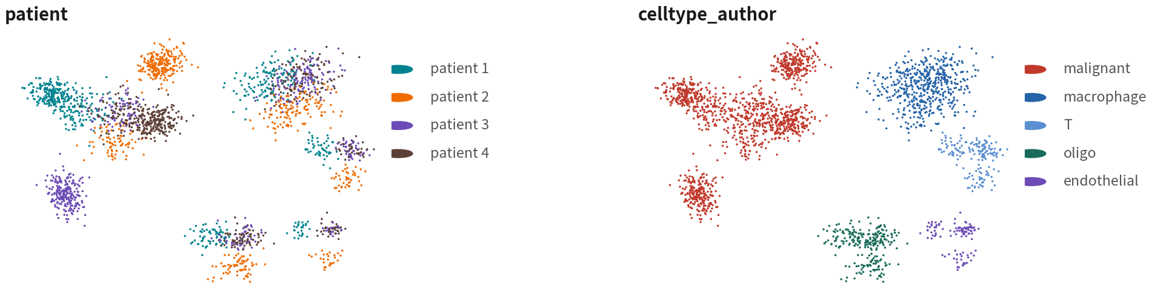
Run the pipeline once without integration and keep the baseline
gbm4 <- NormalizeData(gbm4) |> FindVariableFeatures() |> ScaleData() |> RunPCA() gbm4 <- FindNeighbors(gbm4, dims = 1:25) |> FindClusters(resolution = 0.5, cluster.name = "raw_clusters") gbm4 <- RunUMAP(gbm4, dims = 1:25, reduction.name = "umap.raw") DimPlot(gbm4, reduction = "umap.raw", group.by = c("patient", "celltype_author")) saveRDS(gbm4, "output/rds/04_gbm4_unintegrated.rds") # the malignant analysis comes back to this one
output (schematic)
Without a baseline we cannot tell what integration changed. Author labels serve as the known answer here | Script 04 §3 | Deeper: B11
Q3 Hands-on II
11
Notes:
流程跟 Q2 一模一樣：normalize、HVG、scale、PCA、鄰居圖、分群、UMAP。dims 取二十五。UMAP 存成 umap.raw。 DimPlot 畫兩張，一張按病人上色，一張按作者標籤上色。然後 saveRDS 存起來——之後惡性細胞的分析要回來用這一份。 為什麼要多跑這一次？因為沒有基線，我們之後根本無法判斷整合到底改變了什麼。作者的標籤在這裡就當「已知答案」用。 ──────── The pipeline is the same one as Q2: normalize, HVG, scale, PCA, neighbour graph, clustering, UMAP. Take dims of twenty-five. Save the UMAP as umap.raw. Two DimPlots: one coloured by patient, one coloured by the authors' labels. Then saveRDS the object — the malignant-cell analyses later will come back to this exact version. Why bother with this extra pass? Because without a baseline we have no way to tell what integration actually changed. The authors' labels serve as the known answer here.

Slide 12
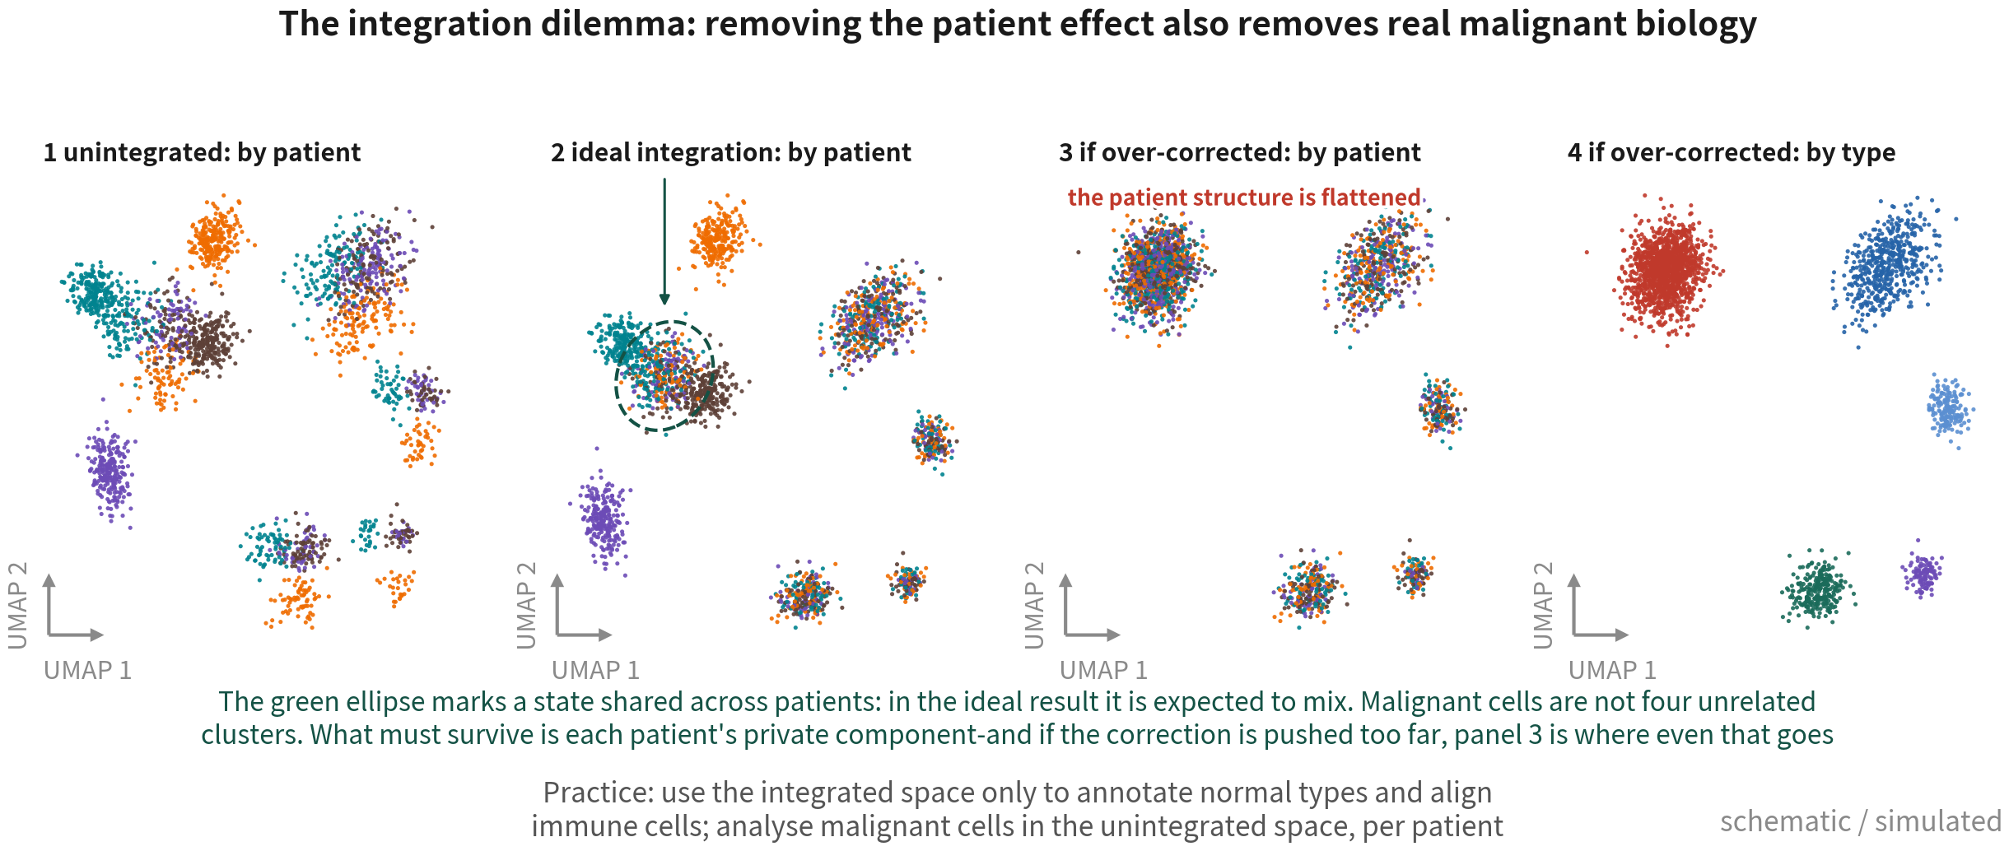
What the unintegrated baseline shows
Panel 2 is the ideal: normal cells blend, the malignant patient structure survives, and the green ellipse - a state shared across
patients - is expected to mix. Panel 3 is where too much correction lands you: even each patient's private component has been flattened
Q3 Hands-on II
12
Notes:
這一頁有四格，順序是有意義的：現況、理想、校正過頭，以及同一張校正過頭的圖換個顏色看。 第一格是未整合、按病人上色。先看免疫與寡樹突細胞：四位病人各自偏在一邊，這就是批次效應，我們要修掉的就是它。再看惡性細胞：主要按病人各自成群。 這裡我想講得精確一點，因為這件事很容易講得太絕對。惡性細胞不是四個互不相干的群集。同一種轉錄狀態的惡性細胞，本來就會跨病人落在一起——Neftel 二○一九年那篇把 GBM 的惡性細胞分成 AC-like、MES-like、NPC-like、OPC-like 四種狀態，這四種狀態每一位病人身上都有。所以真實的結構是「一部分共通、一部分各自為政」。 第二格是理想的整合。這一格很關鍵，因為少了它，很容易讓人以為「惡性細胞只要混在一起就是錯的」。理想的結果長這樣：正常細胞跨病人混得漂漂亮亮，惡性細胞的病人結構還在，而綠圈圈起來的那一塊——跨病人共享的狀態——在這裡本來就是混的。混，不是錯。 判斷標準到這裡就清楚了：不是「病人有沒有完全分開」，而是「每位病人私有的那一部分還在不在」。 第三格不是我們跑出來的結果，而是「校正強度給太多時會落到哪裡」的示意——這件事不挑工具，Harmony、Seurat CCA、任何一種方法，只要修得太用力都可能長成這樣。正常細胞混好了，很好；但惡性細胞的病人結構整個被抹平，連私有的那一部分都沒了。對照第二格，差別一目了然。 為什麼要花一格畫失敗的樣子？因為整合做過頭的時候，圖看起來反而更漂亮——四位病人混得乾乾淨淨，很容易被當成成功。認得出③長什麼樣，才知道自己該不該停下來檢查。 第四格是同一張圖按型別上色。看起來很乾淨——惡性、免疫、寡樹突各自一群。乾淨，但是空的：病人層級的資訊已經不在裡面了。 為什麼會這樣？因為四位病人的惡性細胞各自帶著不同的 CNV，那是基因體層級的差異，不是批次；整合演算法分不出來，一律當批次抹平。不論用 Seurat 還是 Harmony 都會。 所以做法寫在最下面那一行：整合後的空間只拿來註釋正常細胞型別、對齊免疫細胞；惡性細胞的分析回到未整合的空間，按病人分開看。 ──────── Four panels here, and the order matters: where we are, where we want to be, what over-correction looks like, and that same over-corrected result coloured differently. Panel one, unintegrated, coloured by patient. Start with the immune cells and the oligodendrocytes: each patient sits slightly off to one side. That is the batch effect, and it is what we want to remove. Now the malignant cells: they mostly cluster per patient. I want to be precise here, because this is easy to overstate. Malignant cells are not four unrelated clusters. Malignant cells in the same transcriptional state land together across patients — Neftel 2019 split GBM malignant cells into AC-like, MES-like, NPC-like and OPC-like states, and every patient carries all four. So the real structure is part shared, part private. Panel two, the ideal integration. This panel matters, because without it people conclude that malignant cells mixing at all is wrong. The ideal looks like this: normal cells blend beautifully across patients, the malignant patient structure survives, and the region inside the green ellipse — the state shared across patients — is mixed, as it should be. Mixing is not an error. Which makes the standard clear: not did the patients separate completely, but is each patient's private component still there. Panel three is not our result — it is what happens when the correction is pushed too hard. This is not a property of any one tool: Harmony, Seurat CCA, any method can land here if it corrects too strongly. The normal cells blend, which is good. But the malignant patient structure is flattened entirely — even the private part is gone. Put it next to panel two and the difference is obvious. Why spend a whole panel on the failure? Because over-integration produces the prettier picture — four patients blended spotlessly — and that is exactly what gets mistaken for success. Recognising what panel three looks like is what tells you to stop and check. Panel four, the same plot coloured by cell type. It looks clean: malignant, immune, oligodendrocyte, each in their own cluster. Clean, but empty — the patient-level information is no longer in there. Why does this happen? Each patient's malignant cells carry different CNVs. That is a genomic difference, not a batch one, and the integration algorithm cannot tell them apart, so it flattens both. Seurat or Harmony, either will do it. Which is why the way to work is written on the bottom line: use the integrated space only to annotate normal cell types and align immune cells; for malignant cells, go back to the unintegrated space and look at each patient separately.

Slide 13
The integration map: how hard it corrects,
what it needs, the risk for tumours
There is no best method, only a correction strength that matches the question
Method | Idea | Strength | Best for | Risk in tumour data
Seurat CCA / RPCA (default here) | Anchor pairs of cells across samples; built into Seurat v5, one IntegrateLayers call | RPCA weak CCA strong | Samples with high type overlap | CCA over-corrects most; patient-private types get merged into others
Harmony (comparison) | Iteratively pulls batch centroids together in PC space | medium | Many patients / batches fast, light | High theta forces malignant cells together
scVI / scANVI | Variational autoencoder with batch as covariate | tunable | Large atlases, cross-technology (10x + Smart-seq2) | Needs GPU and Python latent space is hard to interpret
No integration, analyse apart | Integrated space for normal cells; malignant cells per patient | — | The mainstream tumour approach | Comparing malignant states across patients needs scores (Neftel), not clusters
References: Stuart T, et al. Cell. 2019;177(7):1888–1902.e21. doi:10.1016/j.cell.2019.05.031 ｜ Korsunsky I, et al. Nat Methods. 2019;16(12):1289–1296. doi:10.1038/s41592-019-0619-0
Q3 Hands-on II
13
Notes:
動手之前，先看一張地圖。整合方法很多，但沒有最好的一個，只有修正強度跟你的問題相不相稱。 本課的預設是 Seurat 自己的整合，CCA 或 RPCA，做法是找跨樣本的錨點細胞對。它內建在 Seurat v5 裡，IntegrateLayers 一行就跑完，也是多數人的起點。RPCA 修得弱，CCA 修得強；樣本之間型別重疊高的時候好用。但要注意，CCA 最容易過度修正，某位病人私有的型別會被塞進別人的群裡——所以跑完一定要看下一頁的正負對照。資料大、或者你擔心過度修正，就換 RPCA。 Harmony 是拿來比較的替代方案：在 PC 空間裡迭代，把各批次的質心拉近。修正強度中等、快、省記憶體。什麼時候用它？當 Seurat 整合的正對照沒過——免疫細胞還是按病人分成不同群集——的時候。這次練習我們兩個都跑，用同一套檢查並排比。 scVI 和 scANVI 是變分自編碼器，把批次當條件變數。強度可調，適合大型圖譜，或者跨技術的整合，例如把 10x 跟 Smart-seq2 放在一起。代價是要 GPU 跟 Python，而且潛在空間不可解釋。 最後一列其實才是腫瘤研究的主流做法：正常細胞用整合空間，惡性細胞每位病人各自分析。要跨病人比較惡性細胞的狀態，就靠 Neftel 那種分數，不靠分群。這就是下一頁之後要講的原則。 ──────── Before we integrate, a map. There are many integration methods; there is no best one, only a match or mismatch between correction strength and the problem in front of us. This course's default is Seurat's own integration: CCA or RPCA, which finds anchor cell pairs across samples. It's built into Seurat v5 — IntegrateLayers runs it in one line — and it's most people's starting point. RPCA corrects weakly, CCA corrects strongly; they work well when cell types overlap heavily across samples. But watch out: CCA is the most prone to over-correction — a cell type private to one patient can get stuffed into someone else's cluster — so after running it, always check the positive and negative controls on the next slide. For big data, or whenever over-correction is a worry, switch to RPCA. Harmony is the comparison alternative: it iterates in PC space, pulling each batch's centroids together. Medium correction strength, fast, memory-light. When do we reach for it? When Seurat integration fails the positive control — that is, the immune cells still form per-patient clusters. In this exercise we run both and compare them side by side with the same set of checks. scVI and scANVI are variational autoencoders that treat batch as a conditioning variable. Strength is tunable; they suit large atlases or cross-technology integration, say putting 10x and Smart-seq2 together. The cost is needing a GPU and Python, and a latent space we cannot interpret. The last row is actually the mainstream practice in tumour research: integrated space for normal cells, per-patient analysis for malignant cells. To compare malignant cell states across patients we use scores — Neftel-style scores — not clusters. That is the principle we spell out after the next slide.

Slide 14
Integration: Seurat default first, Harmony to compare
gbm4[["RNA"]] <- split(gbm4[["RNA"]], f = gbm4$patient) # one layer per patient gbm4 <- NormalizeData(gbm4) |> FindVariableFeatures() |> ScaleData() |> RunPCA() # (a) Seurat default: CCA anchors (switch to RPCAIntegration for large data) gbm4 <- IntegrateLayers(gbm4, method = CCAIntegration, orig.reduction = "pca", new.reduction = "integrated.cca") # (b) for comparison: Harmony (the fallback when Seurat integration disappoints) gbm4 <- IntegrateLayers(gbm4, method = HarmonyIntegration, orig.reduction = "pca", new.reduction = "harmony") gbm4 <- JoinLayers(gbm4) for (red in c("integrated.cca", "harmony")) { # same dims and resolution, or they are not comparable tag <- sub("integrated.", "", red, fixed = TRUE) gbm4 <- FindNeighbors(gbm4, reduction = red, dims = 1:25, graph.name = paste0(tag, "_snn")) |> FindClusters(graph.name = paste0(tag, "_snn"), resolution = 0.5, cluster.name = paste0(tag, "_clusters")) |> RunUMAP(reduction = red, dims = 1:25, reduction.name = paste0("umap.", tag)) } DimPlot(gbm4, reduction = "umap.cca", group.by = "patient") | DimPlot(gbm4, reduction = "umap.harmony", group.by = "patient")
Integration only adds reductions; no expression value changes; DE always returns to RNA counts. Judge Seurat's result first; switch to Harmony only when
the positive control fails (immune cells still split by patient) | Script 04 §4 | Deeper: B11
References: Stuart T, et al. Cell. 2019;177(7):1888–1902.e21. doi:10.1016/j.cell.2019.05.031 ｜ Korsunsky I, et al. Nat Methods. 2019;16(12):1289–1296. doi:10.1038/s41592-019-0619-0
Q3 Hands-on II
14
Notes:
來看 Seurat v5 的做法。先用 split 把 RNA assay 依病人拆成四個 layer，批次就是病人。前處理那四行在 split 狀態下，會對每個 layer 各自執行。 然後 IntegrateLayers 跑兩次。第一次 method 是 CCAIntegration，Seurat 的預設，結果存成 integrated.cca；資料大可以換 RPCAIntegration。第二次 method 是 HarmonyIntegration，結果存成 harmony。最後 JoinLayers 合回來。 接著用一個迴圈，對兩個整合空間各自建鄰居圖、分群、UMAP。這裡請一定要記得用同一組 dims 和 resolution，否則兩邊根本不能比。graph.name 和 cluster.name 加上 cca 或 harmony 的前綴，兩套結果就並存在同一個物件裡。最後兩張 UMAP 並排，按病人上色。 三件事收尾。整合只新增 reduction，表達值一個都沒動，DE 永遠回 RNA counts。先看 Seurat 的結果，用下一頁的正負對照判斷；只有正對照失敗——免疫細胞還是按病人分成不同群集——才改用 Harmony。兩個都跑不是為了選漂亮的那一張，是為了有依據地選。 ──────── Now the Seurat v5 way. split divides the RNA assay into four layers by patient — batch is patient. In the split state, the four preprocessing lines run on each layer separately. Then IntegrateLayers runs twice. First with method CCAIntegration, Seurat's default, saved as integrated.cca — for big data we can swap in RPCAIntegration. Second with method HarmonyIntegration, saved as harmony. JoinLayers merges the layers back. Then a loop builds, for each of the two integrated spaces, its own neighbour graph, clustering, and UMAP. Please use the same dims and resolution for both, or the two sides simply can't be compared. graph.name and cluster.name get a cca or harmony prefix, so both sets of results live in the same object. Finally, two UMAPs side by side, coloured by patient. Three things to close on. Integration only adds reductions — not a single expression value is touched, and DE always goes back to RNA counts. Look at the Seurat result first and judge it with the next slide's positive and negative controls; only if the positive control fails — immune cells still in per-patient clusters — do we switch to Harmony. And running both is not about picking the prettier picture; it is about choosing with evidence.

Slide 15
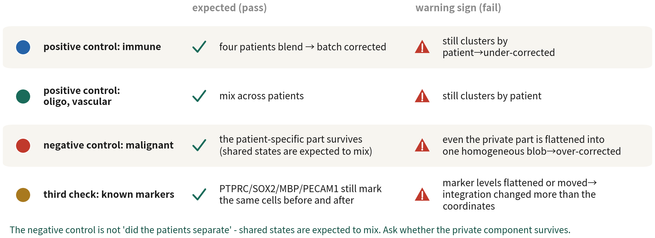
Three checks on integration: what should blend,
what should survive, was expression altered
The negative control is not 'did the patients separate completely' - shared states are expected to mix; the question is whether the
private component survives. Patient entropy here (max 1.386): immune 0.79 to 1.01 passes; malignant 0.17 to 1.09 fails - higher than
immune, meaning even the private events were flattened | Script 04 §4
Q3 Hands-on II
15
Notes:
怎麼判斷整合的品質？用實驗設計裡你最熟悉的概念：正對照和負對照。這一頁我還多加了第三道，等一下講。 正對照是免疫細胞、寡樹突細胞、血管——這些正常細胞在每位病人身上本來就一樣，整合後應該跨病人混合。混好了，代表批次效應修掉了，正對照通過；如果還是按病人分成不同群集，那就是整合不足。 負對照是惡性細胞。它們帶著每位病人各自的 CNV，整合後應該還保留得住「病人特異」的那一部分，這才是對的。但要注意，這裡的標準不是「完全不混」：同一種狀態的惡性細胞本來就會跨病人落在一起，那一塊混是應該的。負對照失敗長的樣子是「連私有的部分都被抹平」，四位病人的惡性細胞變成同質的一團。 所以同一張整合後的圖，免疫細胞混得好是好事，惡性細胞混得好是壞事。腳本裡把這件事量化成「病人熵」：每群裡各病人佔比的熵，對免疫、寡樹突、惡性三種細胞各算一個，未整合、Seurat CCA、Harmony 三欄並排。正對照的熵要上升，負對照的熵要盡量不動——兩個整合方法用同一套對照比，選方法就有依據。 這份資料跑出來是這樣：免疫從零點七九上到一點零一，正對照過了。惡性從零點一七衝到一點零九，比免疫的一點零一還高——負對照沒過。兩個整合方法都一樣。 這不是參數調錯，這是這一類方法的本質：它們的工作就是把批次差異拉齊，而它們分不出哪些差異該留。所以本課的做法不是「換個方法把負對照救回來」，而是接受它，然後限制整合空間的用途——只拿來註釋正常細胞、對齊免疫細胞。惡性細胞的分析回未整合空間。下一段的 inferCNV，讀的就是未整合那一份。 最後是第三道，在表格最下面那一列，我建議每個人都做：拿幾個你確定的 marker 去檢查。挑四個譜系標誌基因就夠了——PTPRC 標免疫、SOX2 標膠質與惡性、MBP 標寡樹突、PECAM1 標血管——整合前後各畫一次 FeaturePlot 或 DotPlot，看兩件事：這個 marker 還標到同一群細胞嗎？它的高低對比還在嗎？ 為什麼要多做這一道？因為前兩道看的都是「座標有沒有混」，而 Seurat 的 CCA 整合除了改座標，還會產生一個修正過的表現量矩陣，也就是 integrated assay。如果你不小心拿那個矩陣去畫 marker、去做 DE，那些數字就已經不是原始表現量了。Harmony 只動嵌入、不動表現量，比較單純。 所以這一道檢查其實在問一個更根本的問題：整合到底動了什麼？只動座標，還是連表現量也動了？知道答案，你才知道後面哪些分析可以用整合後的物件、哪些一定要回到原始的 RNA assay。這也就是 Q1 那句「畫圖與 DE 一律用原始 RNA assay」的來源。 ──────── How do we judge integration quality? With the most familiar concept in experimental design: positive and negative controls. And then a third check I've added, which comes at the end. The positive control is the immune cells, oligodendrocytes, vasculature — these normal cells are inherently the same across patients, so after integration they should mix across patients. If they mix well, the batch effect has been corrected and the positive control passes; if they still sit in per-patient clusters, the integration under-corrected. The negative control is the malignant cells. They carry each patient's own CNVs, so after integration the patient-specific part should still be visible — that is the correct outcome. Note the standard is not no mixing at all: malignant cells in the same transcriptional state are expected to land together across patients, and that part mixing is fine. The negative control fails when even the private part is flattened and the four patients' malignant cells become one homogeneous blob. So on the same integrated plot, immune cells mixing well is good news, and malignant cells mixing well is bad news. The script quantifies this as patient entropy: the entropy of each patient's share within each cluster, computed separately for immune, oligodendrocyte, and malignant cells, in three columns — unintegrated, Seurat CCA, Harmony — side by side. The positive control's entropy should go up, the negative control's should barely move. Compare both integration methods against the same controls, and the choice of method has a basis. And then the third check, the bottom row of the table, which I recommend everyone runs: take a few markers you are certain about and go and look at them. Four lineage genes is enough — PTPRC for immune, SOX2 for glial and malignant, MBP for oligodendrocytes, PECAM1 for vasculature. Draw a FeaturePlot or DotPlot before and after integration and ask two things: does the marker still mark the same cells, and is the contrast between high and low still there? Why add this one? Because the first two checks only look at whether coordinates blended, and Seurat's CCA integration produces a corrected expression matrix — the integrated assay — on top of the new coordinates. If you accidentally plot markers or run DE on that matrix, the numbers are no longer raw expression. Harmony only touches the embedding and leaves expression alone, which is simpler. So this check is really asking a more fundamental question: what did integration actually change — the coordinates only, or the expression values too? Knowing the answer tells you which downstream analyses can use the integrated object and which must go back to the raw RNA assay. That is where the Q1 rule, always plot and run DE on the raw RNA assay, comes from. And here is what this dataset gives us. Immune goes from zero point seven nine to one point zero one — the positive control passes. Malignant jumps from zero point one seven to one point zero nine, higher than the immune cells' one point zero one — the negative control fails. Both integration methods, the same story. This is not a badly tuned parameter; it is what this class of method does. Their job is to pull batch differences into line, and they cannot tell which differences deserve to stay. So the course's answer is not switch methods until the negative control passes — it is to accept the result and restrict what the integrated space is used for: annotating normal cells and aligning immune cells, nothing more. Malignant cells go back to the unintegrated space. The inferCNV section that follows reads exactly that unintegrated object.

Slide 16
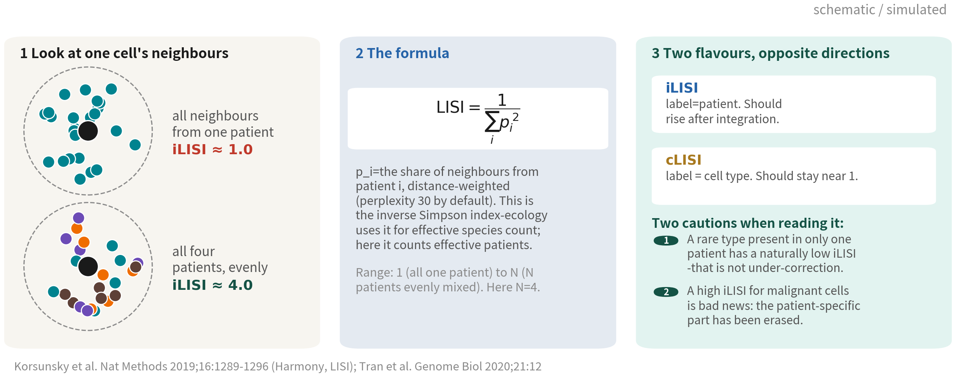
LISI: turning 'did it blend' into a single number
High iLISI means batches mixed; cLISI near 1 means types were not fused. Both need biological
context: a rare type has a naturally low iLISI, and a high iLISI for malignant cells is bad news
Reference: Korsunsky I, et al. Nat Methods. 2019;16(12):1289–1296. doi:10.1038/s41592-019-0619-0
Q3 Hands-on II
16
Notes:
上一頁的三道檢查，有兩道是用眼睛看的。但審稿人會要數字，所以這一頁我們先把 LISI 講清楚——它是整合評估裡最常被引用的指標，也是最常被誤讀的一個。 先看它在算什麼。看左邊，挑一顆細胞，找出它在嵌入空間裡最近的一圈鄰居，然後問一句話：這些鄰居來自幾位病人？上面那個例子，鄰居清一色是同一位病人，答案是「一位」；下面那個例子，四位病人各佔四分之一，答案是「四位」。LISI 做的事，就是把這個「幾位」變成一個可以算的數字。 公式在中間。LISI 等於一除以各病人佔比的平方和。這個式子有名字，叫 inverse Simpson 指數，生態學拿它算一片森林裡的「有效物種數」——不是數有幾種，而是問「等效上相當於幾種均勻分布的物種」。這裡我們把物種換成病人，算的就是「有效病人數」。 舉個例子你就懂了。鄰居全是同一位病人，p 等於一，平方和是一，LISI 等於一。四位病人各佔四分之一，平方和是四個零點零六二五，等於零點二五，LISI 等於四。那如果是零點七、零點一、零點一、零點一這種偏斜的組成呢？平方和是零點五二，LISI 大約一點九——四位病人明明都在，等效上卻只有不到兩位。這正是我們要的：它懲罰的是不均勻，不是只數種類。 實作上還有兩個細節。第一，鄰居不是硬性的 k 個，而是用距離加權的軟鄰域，寬度由 perplexity 控制，預設三十。第二，它是逐細胞算的，所以最後你會拿到每顆細胞一個數字，通常按型別取中位數來看。 右邊這一塊很重要：同一個公式，換個標籤就換了意思，而且兩種用法的方向剛好相反。 拿「病人」當標籤，叫 iLISI。整合後它應該變高，因為批次混開了。 拿「細胞型別」當標籤，叫 cLISI。它應該維持接近一——一顆 T 細胞的鄰居應該還是 T 細胞，型別沒有被融掉。 所以一次好的整合是 iLISI 上去、cLISI 不動。只看其中一個，很容易把「全部混成一團」誤判成整合成功。 最後兩個提醒，我覺得比公式更重要。 第一，只出現在一位病人身上的稀有型別，iLISI 天生就低。那不是整合不足，那是生物學。看到某一群 iLISI 特別低，先問一句「這一群是不是本來就只有一位病人有」，不要急著調參數。 第二，惡性細胞的 iLISI 衝高不是好消息。上一頁講過了，那代表病人特異的那一部分被抹掉了。這也是為什麼我要把 iLISI 跟正負對照放在一起講——同一個數字變高，在免疫細胞身上是通過，在惡性細胞身上是失敗。指標本身不會告訴你這件事，得你自己知道哪一群該混、哪一群不該。 下一頁我們就把這兩個數字實際算出來。 ──────── Two of the three checks on the last slide are done by eye. Reviewers want numbers, so let us get LISI straight first — it is the most cited metric in integration assessment, and the most misread. Start with what it measures. Look at the left: take one cell, find the ring of nearest neighbours around it in the embedding, and ask one question — how many patients do those neighbours come from? In the top example every neighbour is the same patient, so the answer is one. In the bottom example the four patients each contribute a quarter, so the answer is four. What LISI does is turn that how many into a number you can compute. The formula is in the middle. LISI is one divided by the sum of the squared patient shares. That expression has a name — the inverse Simpson index — and ecology uses it for the effective number of species in a forest: not how many species are present, but how many evenly distributed species this is equivalent to. Swap species for patients and you get the effective number of patients. An example makes it concrete. All neighbours from one patient: p is one, the sum of squares is one, LISI is one. Four patients at a quarter each: four times 0.0625 is 0.25, so LISI is four. And a skewed mix of 0.7, 0.1, 0.1, 0.1? The sum of squares is 0.52, so LISI is about 1.9 — all four patients are present, but the effective count is under two. That is exactly what we want: it penalises imbalance rather than just counting categories. Two implementation details. First, the neighbourhood is not a hard k; it is distance-weighted and soft, with the width set by perplexity, thirty by default. Second, it is computed per cell, so you end up with one number per cell and normally read the median per cell type. The block on the right matters: same formula, different label, different meaning — and the two run in opposite directions. Label the cells by patient and you get iLISI. After integration it should go up: the batches mixed. Label them by cell type and you get cLISI. It should stay near one: a T cell's neighbours should still be T cells, meaning the types were not fused together. So a good integration raises iLISI and leaves cLISI alone. Read only one of them and it is easy to mistake everything blending into one blob for success. And two cautions that matter more than the formula. First, a rare type present in only one patient has a naturally low iLISI. That is not under-correction, that is biology. When one cluster shows a strikingly low iLISI, ask first whether only one patient has those cells before you start tuning parameters. Second, a high iLISI for malignant cells is bad news. As the previous slide said, it means the patient-specific component has been erased. That is why I teach iLISI alongside the positive and negative controls: the same number going up is a pass for immune cells and a failure for malignant ones. The metric will not tell you which is which — you have to know which populations should blend and which should not. On the next slide we compute both numbers for real.

Slide 17
Turn 'did it blend' into numbers: per-cluster patient mix, LISI
# 1. how much of each integrated cluster each patient contributes: a normal cluster should hold all four round(prop.table(table(gbm4$cca_clusters, gbm4$patient), 1), 2) # 2. LISI: the effective number of patients among a cell's neighbours (1 = all one patient, 4 = evenly mixed) library(lisi) for (red in c("pca", "integrated.cca", "harmony")) { emb <- Embeddings(gbm4, red)[, 1:25] gbm4[[paste0("lisi_", sub("integrated.", "", red, fixed = TRUE))]] <- compute_lisi(emb, gbm4@meta.data, "patient")$patient } gbm4@meta.data |> group_by(celltype_author) |> summarise(across(starts_with("lisi_"), ~ median(.x)))
celltype_author lisi_pca lisi_cca lisi_harmony
Immune cell 1.22 1.61 1.87 ← positive control: mixes further open
Oligodendrocyte 1.26 2.00 1.91
OPC 1.28 1.96 1.90
Neoplastic 1.00 1.64 1.76 ← negative control: near 1 = patient signal kept
Normal cells should move toward the patient count (4); malignant should stay near 1. Here both methods blur the malignant cells — CCA blurs them less
without losing on the normal ones, so CCA it is | Script 04 §5
Q3 Hands-on II
17
Notes:
正負對照走到這裡，有一半還是靠眼睛看。但眼睛看出來的東西，審稿人不一定買單——他們要數字。這一頁給兩個，而且兩個整合空間各算一次。 第一個很簡單：整合後的每一群裡，各病人佔多少。table 加 prop.table 就出來了。正常細胞的群應該四位病人都有，比例接近各人的細胞數；如果某一群九成來自一位病人，那就只有兩種可能——要嘛它是惡性細胞，要嘛是那位病人特有的批次。 第二個是 LISI，local inverse Simpson's index。它問的是：每一顆細胞的鄰居裡，有效病人數是多少。1 代表鄰居清一色同一位病人，4 代表四位均勻混合。compute_lisi 吃 harmony 的嵌入跟 metadata，回傳每顆細胞一個數字，然後按型別取中位數。 那這份資料算出來長什麼樣？未整合的空間裡，惡性細胞的 LISI 中位數正好是一點零零——每一顆惡性細胞的鄰居，都來自同一位病人。這就是「按病人分成不同群集」最直接的量化證據，也正是 Q2 說的惡性判定第二項依據：跨病人專屬性。 整合之後，Seurat CCA 把它推到一點六四，Harmony 推到一點七六。免疫細胞從一點二二上到一點六一與一點八七，寡樹突從一點二六上到二點零與一點九一。 數字上去了，先別急著高興，有兩件事要提醒。第一，沒有任何一個數字接近四。四位病人的細胞數差很多，LISI 本來就跑不滿，所以我們看的是相對變化，不是絕對值。第二，惡性細胞從一點零被推到一點六以上，代表病人差異確實被混掉一部分——兩個方法都是。 那怎麼選？兩個判準分開看：正常細胞誰混得開、惡性細胞誰保得住。Harmony 的免疫混得比較好，但惡性也混得比較多；CCA 的寡樹突和 OPC 反而比 Harmony 高，惡性又保得比較住。所以這份資料我們選 Seurat CCA。 ──────── Positive and negative controls get us a long way, but half of it is still eyeball. And what your eye is happy with, a reviewer may not be — they want numbers. So this slide gives two, and each one gets computed twice, once for each of the two integrated spaces. The first is simple: inside each integrated cluster, what fraction does each patient contribute? table plus prop.table and it's there. A normal-cell cluster should contain all four patients, in proportions close to each patient's cell count. If a cluster is ninety percent one patient, there are only two possibilities — either those are malignant cells, or it's a batch peculiar to that patient. The second is LISI, the local inverse Simpson's index. What it asks of every cell is: among your neighbours, what is the effective number of patients? 1 means all the neighbours come from one patient, 4 means an even mix of four. compute_lisi takes the harmony embedding and the metadata, returns one number per cell, and then we take the median per cell type. So what does this dataset give us? In the unintegrated space the median LISI for malignant cells is exactly one point zero zero — every malignant cell's neighbours are all from the same patient. That is the most direct quantification of "malignant cells form patient clusters", and it is the second line of evidence for calling malignancy that Q2 talked about: patient specificity. After integration, Seurat CCA pushes it to one point six four and Harmony to one point seven six. Immune cells go from one point two two up to one point six one and one point eight seven; oligodendrocytes from one point two six up to two point zero and one point nine one. The numbers went up — but before we celebrate, two things to flag. First, nothing comes near four. The four patients contribute very different cell numbers, so LISI never saturates; read the relative change, not the absolute value. Second, malignant cells moving from one point zero to above one point six means the patient differences really do get partly blended away, by both methods. So how do we choose? Judge the two criteria separately: which method opens up the normal cells, and which one preserves the malignant ones. Harmony mixes immune better but blends malignant more; CCA comes out higher on oligodendrocytes and OPCs and holds the malignant cells better. So for this dataset, Seurat CCA.

Slide 18
Metrics for integration and clustering: what
each measures, and when it misleads
No single metric is trustworthy alone; integration needs both 'batches mixed enough' and 'types not fused'
Metric | What it measures | Input | Good direction | When it misleads
iLISI / cLISI | Effective number of batches (i) or types (c) among a cell's neighbours | Embedding + batch (c also needs types) | iLISI high cLISI near 1 | A rare type present in only one patient has a low iLISI by construction — not under-correction
kBET | Whether a local neighbourhood's batch mix matches the global mix (rejection rate) | Embedding + batch | Low rejection | When samples genuinely differ in composition — almost always in tumour — rejection is guaranteed
ASW (silhouette) | Batch ASW: how separable batches are; type ASW: how separable cell types are | Embedding + labels | Batch ASW low type ASW high | Purely geometric; elongated or curved groups (differentiating cells) always score poorly
ARI / NMI | Agreement between clustering and a reference labelling | Two labellings | Higher is better | Needs a ground truth; tumour data rarely has one, so author labels stand in as an approximation
Purity | The share of the dominant type inside each cluster | Clusters + types | Higher is better | Rises as clusters get finer — resolution 3.0 makes everything pure and meaningless
Positive / negative controls (this course) | Did what should mix (immune) mix, and did what should stay apart (malignant) stay apart | Embedding + type + patient | Both hold | We must nominate the controls ourselves — but for tumour data this is the one check that actually holds
References: Luecken MD, et al. Nat Methods. 2022;19(1):41–50. doi:10.1038/s41592-021-01336-8 ｜ Büttner M, et al. Nat Methods. 2019;16(1):43–49.
doi:10.1038/s41592-018-0254-1 ｜ Tran HTN, et al. Genome Biol. 2020;21(1):12. doi:10.1186/s13059-019-1850-9
Q3 Hands-on II
18
Notes:
上一頁我們用了 LISI。但審稿人問的可能是 kBET、可能是 ASW、可能是 ARI。這一頁把常見的幾個放在一起，重點不是怎麼算——是每一個在什麼情況下會騙你。 LISI 我們剛用過：一顆細胞的鄰居裡有幾個有效批次。它的陷阱是，稀有型別本來就只出現在一位病人身上，iLISI 天生就低。所以看到低值，先問一句「這一群本來就該混嗎」，不要急著說整合不夠。 kBET 問的是局部鄰域的批次組成跟整體比例一不一致。它背後的假設是「每個樣本的型別組成應該一樣」。腫瘤資料幾乎不可能滿足這件事——四位病人的免疫比例本來就不同——所以 kBET 一定拒絕。那不代表整合失敗。 ASW，也就是輪廓係數，分兩種用法：批次 ASW 要低、型別 ASW 要高。它的限制是純幾何——細長或彎曲的群，例如正在分化的細胞，分數天生就差。 ARI 和 NMI 比的是分群結果與一組參考標籤的一致性。問題在於，你得先有正確答案。腫瘤資料通常沒有，我們這一課能拿的只有作者標籤，而那也只是另一種判斷。 Purity 是每一群裡最大宗的型別佔多少。它有一個致命的性質：群切得越碎，分數越高。resolution 調到三點零，每一群都很純，卻完全沒有意義——所以 purity 不能單獨看，一定要跟群數一起報。 最後一列是我們這一課實際在用的：正負對照。該混的免疫細胞有沒有混、該分的惡性細胞有沒有保住。它要我們自己指定對照，但對腫瘤資料來說，這是唯一真正站得住的檢查。 一句話：沒有一個指標單獨可信。整合要同時滿足兩件事——批次混得夠，而且型別沒被融掉。Tran 二〇二〇年那篇 benchmark 就是這樣設計評分的。 ──────── We just used LISI. But the reviewer's question may be about kBET, or ASW, or ARI. This slide puts the common ones side by side, and the point is not how each is computed — it's when each one lies to you. LISI we have used: the effective number of batches among a cell's neighbours. Its trap is that a rare type genuinely present in only one patient has a low iLISI by construction. So when you see a low value, ask first whether this group should mix at all, rather than concluding under-correction. kBET asks whether a local neighbourhood's batch composition matches the global proportions. Underneath it is an assumption: that every sample has the same type composition. Tumour data essentially never satisfies that - four patients simply have different immune fractions - so kBET will reject. That is not evidence of failure. ASW, the silhouette width, is used two ways: batch ASW should be low, cell-type ASW high. Its limitation is that it is purely geometric: elongated or curved groups, such as differentiating cells, always score poorly. ARI and NMI compare a clustering with a reference labelling. The problem is that you need the right answer first. Tumour data rarely has one; here the best we have is the author labels, which are themselves a judgement. Purity is the share of the dominant type in each cluster. It has one fatal property: it rises as clusters get finer. At resolution three everything is pure and nothing is meaningful, so purity must never travel alone — always report it next to the number of clusters. The last row is what this course actually uses: positive and negative controls. Did the immune cells that should mix, mix; did the malignant cells that should stay apart, stay apart. It requires us to nominate the controls ourselves, but for tumour data it is the one check that actually holds. In one sentence: no single metric is trustworthy alone. Integration has to satisfy two things at once - batches mixed enough, and cell types not fused. That is exactly how Tran and colleagues designed their 2020 benchmark scoring.

Slide 19
THE INTEGRATION RULE FOR TUMOUR DATA
Use the integrated space only to annotate
normal cells and align immune cells;
analyse malignant cells in the
unintegrated space, per patient.
Not a compromise — the two populations have different statistical
structure. Most tumour papers (Tirosh, Neftel, Puram) do exactly this.
Q3 Hands-on II
19
Notes:
這一頁請一定要記得：整合後的空間只拿來註釋正常細胞、對齊免疫細胞；惡性細胞的分析回到未整合空間，按病人分開看。 這不是折衷，是兩種細胞本來就有不同的統計結構。正常細胞跨病人是同一種東西，差異幾乎都是技術的；惡性細胞跨病人則是「一部分共通、一部分各自為政」——共通的是轉錄狀態，各自為政的是基因體。整合會把後面那一半也一起修掉，所以它不能拿來做惡性細胞的分析。 Tirosh 2016 的黑色素瘤、Neftel 2019 的 GBM、Puram 2017 的頭頸癌，都是這樣做的。 ──────── If you take one thing from this section, take this. Use the integrated space only to annotate normal cells and align immune cells; for malignant cells, go back to the unintegrated space and analyse each patient separately. This is not a compromise — the two kinds of cells simply have different statistical structure. Normal cells across patients are the same thing, and their differences are almost entirely technical. Malignant cells are part shared and part each patient's own: the transcriptional states are common to everyone, the genomes are not. Integration removes that second half along with the batch effect, which is exactly why the integrated space cannot carry a malignant-cell analysis. Tirosh 2016 in melanoma, Neftel 2019 in GBM, Puram 2017 in head and neck cancer — they all did it this way.

Slide 20



The other road: map cells onto a reference atlas
With a good reference we need not annotate from scratch — normal cells especially
Azimuth
scArches
Malignant cells
cannot be mapped
Project our cells onto an
annotated reference
(PBMC, human brain,
lung…) and inherit labels
and UMAP coordinates.
The easiest route for
immune subsets
Fine-tune the reference
model (scVI / scANVI) on
our data without
re-training the atlas;
works across
technologies. Python
ecosystem
No atlas contains this
patient's tumour. Mapped
malignant cells only get
'the nearest normal type'
— like SingleR, a
reminder, not an answer
Reference: Hao Y, et al. Cell. 2021;184(13):3573–3587.e29. doi:10.1016/j.cell.2021.04.048
Q3 Hands-on II
20
Notes:
整合是把幾份資料放在一起找共同空間。但還有另一條路：如果已經有一份做得好的參考圖譜，那就直接把我們的細胞投上去，繼承它的標籤。正常細胞特別適合這樣做。 Azimuth，也就是 Seurat 的 MapQuery，有現成的參考：PBMC、人腦、肺、腎等等。我們的細胞投上去，標籤跟 UMAP 座標直接就有了。免疫細胞的亞群——CD4 跟 CD8 的各種狀態、單核球的亞型——用它最省事，也比自己拿 marker 一群一群猜準得多。 scArches 跟 scANVI 是 Python 生態的做法：在參考模型上「續訓」我們的資料，不用重跑整個圖譜，跨技術也行。大型圖譜計畫都是用它。 第三張卡是這一頁真正的重點：惡性細胞不能靠投影。參考圖譜裡根本沒有這位病人的腫瘤，投上去只會得到「最像的正常型別」，GBM 常常就被標成星狀細胞或 OPC。這跟 Q2 的 SingleR 一樣——是提醒，不是答案。惡性的判定，還是要等下一段的 CNV。 ──────── Integration puts several datasets together to find a shared space. But there is another route: if a good reference atlas already exists, project our cells onto it and inherit its labels. Normal cells are especially well suited to this. Azimuth — Seurat's MapQuery — has ready-made references: PBMC, human brain, lung, kidney, and more. Project our cells on and the labels and UMAP coordinates come straight back. For immune subsets — the various CD4 and CD8 states, monocyte subtypes — this is by far the easiest way, and much more accurate than guessing cluster by cluster with markers. scArches and scANVI are the Python-ecosystem approach: "fine-tune" our data on top of a reference model, without rebuilding the whole atlas, and it works across technologies. The big atlas projects all use it. The third card is the point of this slide: malignant cells cannot be projected. The reference atlas does not contain this patient's tumour, so projection can only hand back "the most similar normal type" — GBM often comes out labelled astrocyte or OPC. Same as SingleR in Q2 — it's a hint, not an answer. Malignancy calling still comes from CNV, in the next section.

Slide 21
03
Cell identity: calling malignancy
with inferCNV
Script 05: calling malignancy — only a dataset that can support it
Q3 Hands-on II
21
Notes:
第三段，腳本 05，惡性判定。Q2 停在「待判定」不是偷懶，是單一病人湊不齊證據；換到這份資料才做得成。inferCNV 是主要證據，配合譜系與病人分群三角驗證。 ──────── Part three, script 05. Calling malignancy. Q2 stopping at "undetermined" was not laziness — one patient cannot supply the evidence. This dataset can. inferCNV is the lead evidence, triangulated with lineage and the per-patient clustering pattern.

Slide 22
Three inputs: counts, annotations, gene positions
library(infercnv) # BiocManager::install("infercnv") refs <- c("Immune cell", "Oligodendrocyte") ann <- data.frame(row.names = colnames(gbm4), group = ifelse(gbm4$celltype_author %in% refs, gbm4$celltype_author, paste0("obs_", gbm4$patient))) write.table(ann, "data/infercnv_annot.txt", sep = " ", col.names = FALSE, quote = FALSE) # gene position file: the official hg38 gencode build (download link in script 05) cts <- LayerData(gbm4, layer = "counts") obj <- CreateInfercnvObject(raw_counts_matrix = cts, annotations_file = "data/infercnv_annot.txt", gene_order_file = "data/hg38_gencode_v27.txt", ref_group_names = refs) obj <- infercnv::run(obj, cutoff = 1, # Smart-seq 1; 10x 0.1 out_dir = "output/rds/05_infercnv", cluster_by_groups = TRUE, denoise = TRUE, HMM = FALSE)
References must be cells known to be normal: immune and oligodendrocytes are safest. Not astrocytes — they may
be the malignant ones | Script 05 §1 | Deeper: B16
References: inferCNV of the Trinity CTAT Project. github.com/broadinstitute/inferCNV ｜ Patel AP, et al. Science. 2014;344(6190):1396–1401. doi:10.1126/science.1254257
Q3 Hands-on II
22
Notes:
inferCNV 要三件輸入，一件都不能將就。 第一，原始 counts 矩陣，從 RNA assay 的 counts layer 取——不是 data，不是 integrated。 第二，註釋檔：每顆細胞一個群組。參考組是免疫細胞和寡樹突細胞，用作者的標籤；其他細胞按病人分成觀察組，obs 底線病人編號。為什麼要按病人分？因為這樣每位病人的 CNV 才會各自顯示。 第三，基因座標檔：每個基因落在哪條染色體的哪個位置。官方提供 hg38 gencode 的版本，腳本 05 裡有下載連結。 再來是 run 的參數：cutoff，Smart-seq 用 1、10x 用 0.1，這是過濾低表現基因的門檻。cluster_by_groups 按群組分別聚類。denoise 去雜訊。HMM 先關掉，速度差很多，等你需要亞株的時候再開。 最後一件事情比參數更重要：參考組必須是「確定正常」的細胞。免疫與寡樹突最安全。星狀細胞不行——它可能就是 AC 樣的惡性細胞。這一點，常見錯誤那一段還會再講一次。 ──────── inferCNV needs three inputs, and you can't cut corners on any of them. First, the raw counts matrix, taken from the counts layer of the RNA assay — not data, not integrated. Second, the annotation file: one group per cell. The reference group is the immune cells and oligodendrocytes, using the authors' labels; the other cells are split into observation groups by patient, obs underscore patient ID. Why split by patient? Because that is what makes each patient's CNVs get displayed separately. Third, the gene coordinates file: which chromosome and position each gene sits at. The official hg38 gencode version is provided; script 05 has the download link. Then the parameters for run: cutoff — 1 for Smart-seq, 0.1 for 10x — is the threshold for filtering low-expressed genes. cluster_by_groups clusters each group separately. denoise removes noise. Leave HMM off at first, because it makes a huge difference to speed, and turn it on when you need subclones. And one last thing that matters more than any parameter: the reference group must be cells that are definitely normal. Immune and oligodendrocyte are the safest. Astrocytes are not allowed — they may themselves be AC-like malignant cells. That pitfall gets its own slide later.

Slide 23
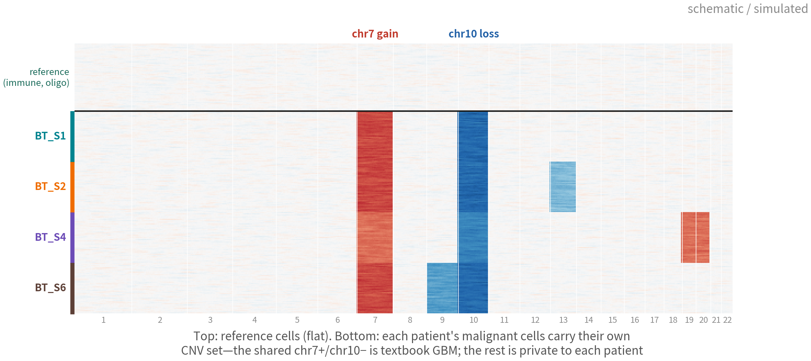
How to read the inferCNV heatmap
chr7 gain and chr10 loss are textbook GBM, shared by all four; the rest are private
to each patient — the genomic reason behind Q1's patient-specific clusters
References: inferCNV of the Trinity CTAT Project. github.com/broadinstitute/inferCNV ｜ Tirosh I, et al. Science. 2016;352(6282):189–196. doi:10.1126/science.aad0501
Q3 Hands-on II
23
Notes:
先講怎麼看：每一列一顆細胞，每一欄一段基因體，從第一號排到第二十二號染色體。紅色是相對參考偏高，藍色偏低。 上半是參考細胞：平的，白的。這是基準。 下半是四位病人的觀察細胞，訊號一眼就跳出來。第七號染色體整段紅、第十號整段藍——這是 GBM 的教科書事件，四位病人都有。除此之外，每位病人還各有私有事件：第二位有十三號缺失、第三位有十九、二十號增加、第四位有九號缺失。 看到這裡，Q1 說的「按病人分成不同群集」就有了基因體上的原因。每位病人的惡性細胞帶著自己的一組 CNV，表現量被整體拉動。 ──────── How to read it first. Each row is a cell, each column a stretch of the genome, from chromosome 1 to chromosome 22. Red means higher than the reference, blue means lower. The top half is the reference cells: flat, white. That's the baseline. The bottom half is the observation cells from the four patients, and the signal jumps straight out at you. Chromosome 7 red along its whole length, chromosome 10 blue along its whole length — the textbook GBM events, present in all four patients. Beyond that, each patient has private events: patient two has a chromosome 13 deletion, patient three has gains on 19 and 20, patient four has a chromosome 9 deletion. Once you see that, the "per-patient clusters" from Q1 have a genomic reason behind them. Each patient's malignant cells carry their own CNV combination, and expression gets shifted wholesale.

Slide 24
Key inferCNV parameters: different platforms, different numbers
The commonest error is copying the cutoff from the wrong platform; the next is the wrong reference (Pitfall 1)
Parameter | Meaning | Smart-seq2 | 10x | Note
cutoff | Drop genes whose mean expression is below this | 1 | 0.1 | 1 on 10x drops nearly all genes: a blank heatmap
ref_group_ names | Who is 'known normal' | Immune + Oligodendrocyte | same | ≥ 50–100 cells per group never astrocytes
window_length | Smoothing window along the genome (genes) | 101 | 101 | Larger = smoother focal events vanish
HMM / denoise | Segment the signal into discrete CNV states | i6, optional | i6, optional | HMM is slow this course uses score + correlation
cluster_by_ groups | How observation cells are grouped in the plot | by patient | by sample | Per patient is what reveals private events
Reference: inferCNV of the Trinity CTAT Project. github.com/broadinstitute/inferCNV
Q3 Hands-on II
24
Notes:
熱圖看得懂了，回頭看參數。inferCNV 最常出錯的地方是 cutoff 抄錯平台，其次是參考組選錯——那是雷一。 cutoff：基因的平均表現低於這個值就不用。Smart-seq2 用 1，10x 用 0.1，因為 10x 的每顆細胞分子數少一個量級。把 Smart-seq2 的 1 抄到 10x 資料上會怎樣？基因幾乎全被丟掉，熱圖一片空白，然後很多人以為是資料有問題。 ref_group_names：誰是確定正常的。本集用免疫細胞加寡樹突細胞，每組至少五十到一百顆。永遠不要用星狀細胞——它們可能就是惡性的。 window_length：沿基因體平滑的視窗，預設 101 個基因。越大越平滑，代價是小片段的事件就看不到了。 HMM 跟 denoise：把連續的訊號切成離散的 CNV 狀態。i6 模式可以開，但很慢；本課用分數加相關的做法代替，下一頁就講。 cluster_by_groups：觀察組按什麼分開畫。按病人畫，才看得到每位病人私有的事件；混在一起畫，就只剩 chr7 跟 chr10 那種共有的了。 ──────── Now that we can read the heatmap, back to the parameters. The most common inferCNV mistake is copying the cutoff from the wrong platform; the second is choosing the wrong reference group — that's pitfall one. cutoff: genes with mean expression below this value are dropped. Smart-seq2 uses 1, 10x uses 0.1, because 10x has an order of magnitude fewer molecules per cell. So what happens if you copy the Smart-seq2 value of 1 onto 10x data? Nearly all the genes get thrown away, the heatmap comes out blank, and many people conclude their data are broken. ref_group_names: who is definitely normal. This episode uses immune cells plus oligodendrocytes, at least fifty to a hundred cells per group. Never use astrocytes — they may be malignant themselves. window_length: the smoothing window along the genome, default 101 genes. Bigger is smoother, and the price is that small focal events disappear. HMM and denoise: they turn the continuous signal into discrete CNV states. The i6 mode can be switched on, but it's slow; this course uses a score-plus-correlation approach instead — next slide. cluster_by_groups: how the observation cells are split in the plot. Plot by patient and each patient's private events show up; plot them mixed together and only the shared ones — chr7 and chr10 — survive.

Slide 25
From the heatmap to two per-cell scores
# Take the CNV matrix from the object run() returns. Do not read infercnv.observations.txt - # those text files are only written by plot_cnv(write_expr_matrix = TRUE); run() does not write them. obj <- readRDS("output/rds/05_infercnv/run.final.infercnv_obj") # only needed after restarting R cnv.all <- obj@expr.data # genes x cells, smoothed, denoised, centred on the reference cnv.score <- colMeans((cnv.all - 1)^2) # 1. how far the cell sits from the reference top <- names(sort(cnv.score, decreasing = TRUE))[1:200] mal.profile <- rowMeans(cnv.all[, top]) # mean profile of the 200 most malignant-looking cells cnv.cor <- apply(cnv.all, 2, cor, y = mal.profile) # 2. correlation with that malignant profile gbm4$cnv.score <- cnv.score[colnames(gbm4)] gbm4$cnv.cor <- cnv.cor[colnames(gbm4)] FeatureScatter(gbm4, "cnv.score", "cnv.cor", group.by = "celltype_author")
This is Tirosh 2016's approach: score plus correlation, plotted to see whether two clear groups emerge | Script 05 §2
Q3 Hands-on II
25
Notes:
熱圖看得出來，但要變成每顆細胞頭上的標籤，還是得有數字。這是 Tirosh 2016 的做法，兩個維度。 CNV 矩陣直接從 run 回傳的物件拿，obj 的 expr.data，基因乘細胞，已經平滑、已經 denoise、以參考為中心在一。如果 R 中間重開過，物件不在 session 裡了，就從 out_dir 底下的 run.final.infercnv_obj 讀回來，不必重跑。 這裡有個坑要特別講：很多教學會寫成去讀 infercnv.observations.txt 和 infercnv.references.txt 兩個文字檔。但那兩個檔，只有在你呼叫 plot_cnv 而且把 write_expr_matrix 設成 TRUE 的時候才會寫出來，run 預設不寫——照著抄，你會拿到「無法開啟連接」。物件裡的 expr.data 就是同一份資料，而且省掉幾百 MB 的文字讀寫。 第一個數字，CNV 分數：每顆細胞偏離一的平方平均。偏離越大，CNV 越多。 第二個數字，CNV 相關：先取分數最高的兩百顆細胞，算它們的平均 profile——也就是「最像惡性的樣子」——再算每顆細胞跟這個 profile 的相關。相關高，代表它的 CNV 模式跟惡性細胞一致。 兩個數字存回 metadata，畫散點圖，按作者標籤上色。 ──────── We can see it in the heatmap, but turning it into a label on each cell still needs numbers. This is the Tirosh 2016 approach, two dimensions. Take the CNV matrix straight from the object run returns — obj's expr.data, genes by cells, already smoothed, already denoised, centred on the reference at one. If R was restarted and the object is gone from the session, read run.final.infercnv_obj back from out_dir; no need to rerun. One trap worth calling out: many tutorials tell you to read the two text files, infercnv.observations.txt and infercnv.references.txt. Those are only written when you call plot_cnv with write_expr_matrix set to TRUE; run does not write them by default, so copy that line and what you get is "cannot open the connection". The object's expr.data is the same data, and it saves you a few hundred megabytes of text I/O. The first number, the CNV score: for each cell, the mean squared deviation from one. The bigger the deviation, the more CNV. The second number, the CNV correlation: take the two hundred highest-scoring cells, compute their average profile — "what the most malignant-looking cells look like" — then correlate every cell with that profile. High correlation means the cell's CNV pattern matches the malignant one. Store both numbers back in the metadata and draw a scatter plot, coloured by the authors' labels.

Slide 26
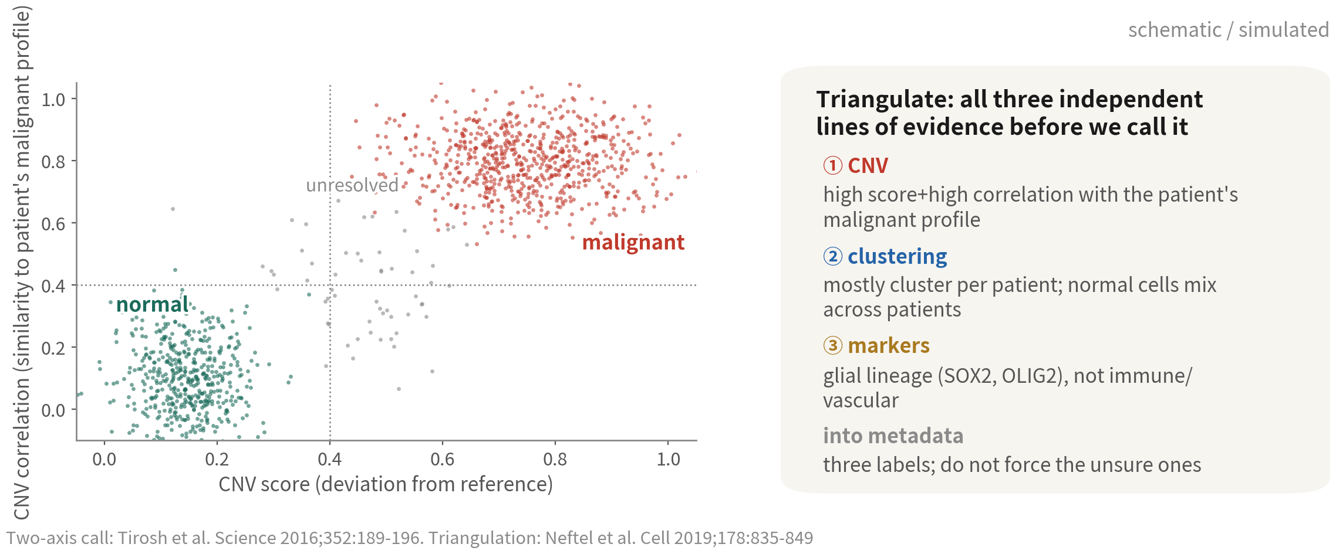
Two numbers per cell, four quadrants
Top-right malignant, bottom-left normal, the middle unresolved. Do not force the
unsure ones — reviewers prefer an honest grey zone
Reference: Tirosh I, et al. Science. 2016;352(6282):189–196. doi:10.1126/science.aad0501
Q3 Hands-on II
26
Notes:
橫軸 CNV 分數，縱軸 CNV 相關。 右上：分數高、相關高，惡性。左下：分數低、相關低，正常。中間那一撮呢？不確定，就標 unresolved。 不確定的不要硬判。審稿人寧可看到誠實的灰色地帶，也不要看到一條線硬切下去。閾值怎麼定？看我們自己的散點圖，找兩群之間的那個谷。腳本裡的數字只是起點。 右邊是三角驗證：三項獨立證據到齊才定案。CNV 是第一個。第二個是分群——惡性細胞應該按病人各成一個群集。第三個是 marker——膠質譜系，不是免疫或血管。 ──────── X axis, CNV score; y axis, CNV correlation. Top right: high score, high correlation — malignant. Bottom left: low score, low correlation — normal. And the clump sitting in the middle? Uncertain — label it unresolved. Do not force a call on the uncertain ones. A reviewer would much rather see an honest grey zone than a hard line slicing through. So how do we set the thresholds? Look at our own scatter plot and find the valley between the two groups. The numbers in the script are only a starting point. On the right is triangulation: three independent lines of evidence must all show up before the verdict. CNV is the first. The second is clustering — malignant cells should form per-patient clusters. The third is markers — glial lineage, not immune or vascular.

Slide 27
Triangulation: write to metadata, compare with
the authors' labels
ref.cell <- gbm4$celltype_author %in% refs # thresholds grow out of the reference cells s.hi <- quantile(gbm4$cnv.score[ref.cell], 0.99) # ceiling of a normal CNV score c.hi <- quantile(gbm4$cnv.cor[ref.cell], 0.99) # ceiling of a normal correlation c.lo <- quantile(gbm4$cnv.cor[ref.cell], 0.90) # below this line = clearly normal gbm4$malignant <- with(gbm4@meta.data, ifelse( cnv.score > s.hi & cnv.cor > c.hi, "malignant", ifelse(cnv.score <= s.hi & cnv.cor < c.lo, "normal", "unresolved"))) # Third evidence: lineage. Immune / vascular / oligodendrocyte / neuron go back to unresolved gbm4$malignant[gbm4$malignant == "malignant" & gbm4$celltype_author %in% c("Immune cell", "Vascular", "Oligodendrocyte", "Neuron")] <- "unresolved" table(gbm4$malignant, gbm4$celltype_author)
Neoplastic Astrocyte OPC Oligodendrocyte Immune cell Vascular Neuron
malignant high few few 0 0 0 0
normal few most most all all all most
unresolved ...
Check against the authors' Neoplastic label: our run gives 87.6% agreement, 99.4% precision, 59.1% recall. The
disagreements are worth a look — often periphery cells | Script 05 §3
Q3 Hands-on II
27
Notes:
第一段：用兩個閾值把細胞分成 malignant、normal、unresolved。閾值一樣是看我們自己的散點圖。 第二段是第三項證據：如果一顆細胞被標成 malignant，但作者標籤是免疫或血管，一律改回 unresolved。理由很直接——免疫細胞不可能有 chr7 增加、chr10 缺失；如果 CNV 分數說它有，那多半是 doublet 或雜訊。 最後 table 跟作者的 Neoplastic 標籤與作者標籤比對，一致率通常超過九成。不一致的那幾顆反而值得看——常常是浸潤邊緣的細胞，CNV 訊號弱，或者是作者自己也不確定的。 ──────── First block: use the two thresholds to split cells into malignant, normal, and unresolved. Set the thresholds from our own scatter plot, same as before. The second block is the third line of evidence: if a cell got labelled malignant but the authors' label says immune or vascular, flip it to unresolved, no exceptions. The reason is straightforward — an immune cell cannot have a chr7 gain and chr10 loss; if the CNV score says it does, it's most likely a doublet or noise. Finally, table the calls against the authors' Neoplastic label — checking against the answer key. Agreement is usually above ninety percent. The handful that disagree are the ones worth looking at — they're often cells from the infiltrating periphery with weak CNV signal, or cells the authors weren't sure about either.

Slide 28



Evidence of malignancy beyond CNV
CNV-quiet tumours (paediatric brain tumours, some blood cancers, near-diploid carcinomas) need
different independent lines of evidence
Mutations
and alleles
A second CNV tool
Expression
programmes and
pathology
Smart-seq2 reads coding SNVs
(IDH1 R132H, TP53); 10x
catches them only near the 3′
end. HoneyBADGER and Numbat
add allelic imbalance to CNV
copyKAT needs no reference;
SCEVAN is automatic. Call
malignant only where all
agree; leave the rest
unresolved
High Neftel state scores,
high proliferation, unlike any
normal type; plus pathology
(e.g. IDH1 R132H
immunostain). Supporting,
never sole evidence
References: Neftel C, et al. Cell. 2019;178(4):835–849.e21. doi:10.1016/j.cell.2019.06.024 ｜ Gao R, et al. Nat Biotechnol. 2021;39(5):599–608. doi:10.1038/s41587-020-00795-2
Q3 Hands-on II
28
Notes:
inferCNV 在 GBM 很好用，因為 GBM 的 CNV 又大又典型。但不是每種腫瘤都這麼配合。兒童腦瘤、部分血液腫瘤、近二倍體的癌，CNV 訊號很弱，這時候就得換獨立證據。 第一個獨立證據：突變與等位基因。Smart-seq2 讀全長，可以直接在 reads 裡找編碼區的點突變，例如 IDH1 R132H、TP53；10x 只讀 3′ 端，只有突變剛好落在末端才抓得到。HoneyBADGER 跟 Numbat 更進一步，用等位基因失衡——雜合的 SNP 在某段染色體上突然只剩一個等位基因——來補強 CNV 的判定。 第二項證據：換第二個 CNV 工具。copyKAT 不需要參考組，SCEVAN 全自動。三個工具都說惡性的細胞，才寫 malignant；不一致的就留在 unresolved。這不是保守，是誠實。 第三項證據：表現程式跟病理。Neftel 狀態分數高、增殖高、跟任何正常型別都不像；再加上病理科的免疫染色，例如 IDH1 R132H 的抗體。不過這些是輔助證據，單獨不能定罪。 ──────── inferCNV works great in GBM because GBM's CNVs are big and typical. But not every tumour is that obliging. Paediatric brain tumours, some blood cancers, near-diploid cancers — the CNV signal is weak, and we need different independent lines of evidence. First line of evidence: mutations and alleles. Smart-seq2 reads full length, so we can look for coding point mutations directly in the reads — IDH1 R132H, TP53; 10x only reads the 3′ end, so a mutation is caught only if it happens to sit near the end. HoneyBADGER and Numbat go further, using allelic imbalance — heterozygous SNPs that suddenly show only one allele along a chromosome segment — to reinforce the CNV call. Second line of evidence: a second CNV tool. copyKAT needs no reference group; SCEVAN is fully automatic. Only cells that all three tools call malignant get written as malignant; the inconsistent ones stay unresolved. That is not conservatism, it is honesty. Third line of evidence: expression programmes and pathology. High Neftel state scores, high proliferation, resembling no normal type; plus immunostaining from pathology, for example the IDH1 R132H antibody. These are supporting evidence — on their own they cannot convict.

Slide 29
04
Composition: what differs between
core and periphery
Script 06a §1: proportions are compositional; the unit is the patient
Q3 Hands-on II
29
Notes:
第四段，腳本 06a 第一節。比例是組成資料，單位是病人。 ──────── Part four, script 06a section one. Proportions are compositional data, and the unit is the patient.

Slide 30
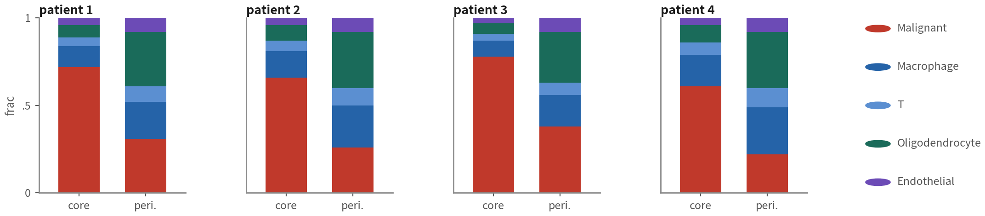
Type proportions per patient and site
gbm4$type <- ifelse(gbm4$malignant == "malignant", "Malignant", gbm4$celltype_author) prop <- gbm4@meta.data |> dplyr::count(patient, tissue, type) |> group_by(patient, tissue) |> mutate(frac = n / sum(n)) ggplot(prop, aes(tissue, frac, fill = type)) + geom_col() + facet_wrap(~ patient, nrow = 1) + theme_classic() library(speckle); library(limma) # unit = the sample (8 of them), paired design p8 <- getTransformedProps(gbm4$type, paste(gbm4$patient, gbm4$tissue, sep = "_"), transform = "logit")$TransformedProps pat <- sub("_[^_]*$", "", colnames(p8)) # patient IDs contain "_": split on the last one tis <- factor(sub(".*_", "", colnames(p8)), c("Periphery", "Tumor")) topTable(eBayes(lmFit(p8, model.matrix(~ pat + tis))), coef = "tisTumor", n = Inf)
output (schematic)
'Fewer malignant cells at the periphery' is tested with propeller / scCODA on n = 8 samples; a t-test on proportions is wrong | Script 06a §1 | Deeper: B12
Q3 Hands-on II
30
Notes:
先建一個 type 欄位：CNV 判定為惡性的標 Malignant，其他就用作者的型別。接著 count 算每位病人、每個部位、每種型別各有幾顆，除以總數得到比例。ggplot 畫堆疊長條圖，一位病人一個面板。 那要檢定「邊緣的惡性細胞比例比較低」怎麼做？用 propeller，在 speckle 套件裡。它以樣本為單位——這裡是八個樣本——先做 logit 轉換，再用 limma 的線性模型。配對設計可以加 patient 當區塊。 有一件事千萬別做：直接對比例做 t-test 是錯的。比例是封閉的，一種細胞變少，其他的必然變多。 ──────── First build a type column: cells the CNV calls say are malignant get Malignant; everything else keeps the authors' type. Then count how many cells of each type each patient has at each site, divide by the total to get proportions. ggplot draws stacked bars, one panel per patient. And how do we test "the malignant fraction is lower at the periphery"? Use propeller, in the speckle package. It works at the sample level — eight samples here — applying a logit transform first, then limma's linear model. For the paired design we can add patient as a block. One thing you must not do: run a t-test directly on the proportions. Proportions are closed — when one cell type goes down, the others necessarily go up.

Slide 31
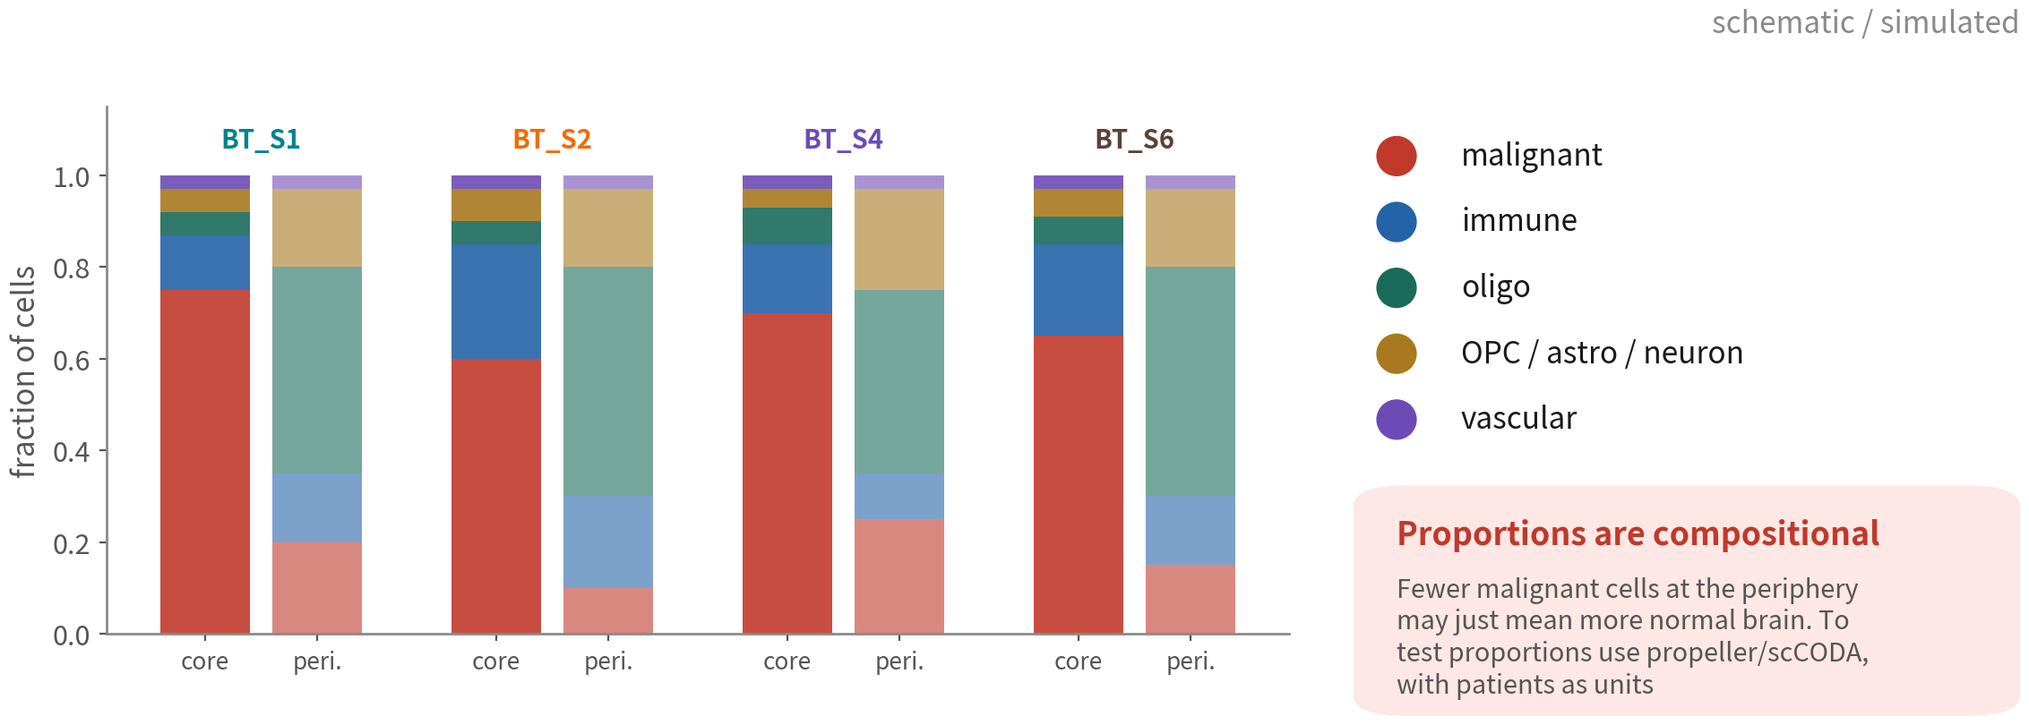
Composition: one pair per patient
It counts only if all four patients agree. Proportions are closed: one type falling forces the others up
Q3 Hands-on II
31
Notes:
四位病人，每位兩根柱子。核心那一根，惡性細胞佔六到七成。邊緣那一根，惡性細胞掉到一兩成，換成寡樹突細胞變成主體——因為邊緣切到的是被浸潤的白質。 四位病人方向一致，這個結論才算數。而且要記得：邊緣的惡性細胞「變少」，可能只是因為正常腦組織變多。這就是組成資料的封閉性。 ──────── Four patients, two bars each. In the core bar, malignant cells are sixty to seventy percent. In the periphery bar, malignant drops to ten or twenty percent, and oligodendrocytes take over as the majority — because the periphery samples infiltrated white matter. It only counts if all four patients agree in direction. And remember: the malignant cells "decreasing" at the periphery may just be normal brain tissue increasing. That is the closure property of compositional data.

Slide 32


Three things about composition: closure, pairing, the unit
Closure
Pairing
The unit is
the sample
Proportions sum to 1:
fewer malignant cells
'automatically' means
more immune cells. Test
on the logit or CLR scale
(propeller, scCODA),
never a t-test on raw
proportions
Core and periphery come
from the same patient;
a paired design removes
between-patient
variance and boosts
power. In propeller, a
~ patient + tissue
design matrix does it
n = 8 samples (4 × 2),
not 3,589 cells. A
chi-square at the cell
level gives absurdly
small p values — the same
mistake as Pitfall 1
Q3 Hands-on II
32
Notes:
組成圖看起來簡單，錯起來也很簡單。三件事。 第一，閉合。比例加總是 1。惡性細胞一減少，免疫細胞的比例就「自動」增加，即使免疫細胞的絕對數量一顆都沒變。所以檢定要在 logit 或 CLR 尺度做——propeller 的 transform 等於 logit 就是這個意思——不能對原始比例做 t 檢定。 第二，配對。核心跟邊緣來自同一位病人，配對設計把病人之間的差異扣掉，功效大增。propeller 用 patient 加 tissue 的設計矩陣就做得到。 第三，單位。n 是 8 個樣本，四位病人乘以兩個部位，不是三千五百八十九顆細胞。在細胞層級做卡方檢定，p 值會小到荒謬——這跟雷一是同一個錯，只是換了一件衣服。 ──────── Composition plots look simple, and the mistakes are just as simple. Three things. First, closure. Proportions sum to 1. When malignant cells decrease, the immune fraction "automatically" increases even if not a single immune cell changed in absolute number. So the test must run on the logit or CLR scale — that is what propeller's transform equals logit means — never a t-test on raw proportions. Second, pairing. Core and periphery come from the same patient; a paired design subtracts the between-patient differences, and power goes way up. propeller does it with a patient plus tissue design matrix. Third, the unit. n is 8 samples — four patients times two sites — not three thousand five hundred and eighty-nine cells. Run a chi-squared test at the cell level and the p-value becomes absurdly small — the same mistake as pitfall one, in different clothes.

Slide 33
05
DE: each cell type, core
vs periphery
Scripts 06a (the pseudobulk mainline) and 06b (the cell-level
fallback for too few samples)
Q3 Hands-on II
33
Notes:
第五段，腳本 06a 第二到五節。要問的問題很單純：核心跟邊緣，每一種細胞各自差了哪些基因。我們原本的計畫是以惡性細胞為主、其他型別當對照——等一下你會看到，這份資料直接把這個計畫否決掉。而「發現自己問不了原本想問的問題」，正是這一段最值得學的地方。問完基因，再把基因變成 pathway：GSEA 跟 ORA，Hallmark、GO、KEGG 三個資料庫。 ──────── Part five, script 06a sections two to five. The question is simple: between core and periphery, which genes differ within each cell type. Our plan was to lead with the malignant cells and use the other types as context — and you're about to watch this dataset overrule that plan. Discovering you can't ask the question you came to ask is the part of this section most worth learning. Then we turn genes into pathways: GSEA and ORA, across three databases — Hallmark, GO, KEGG.

Slide 34
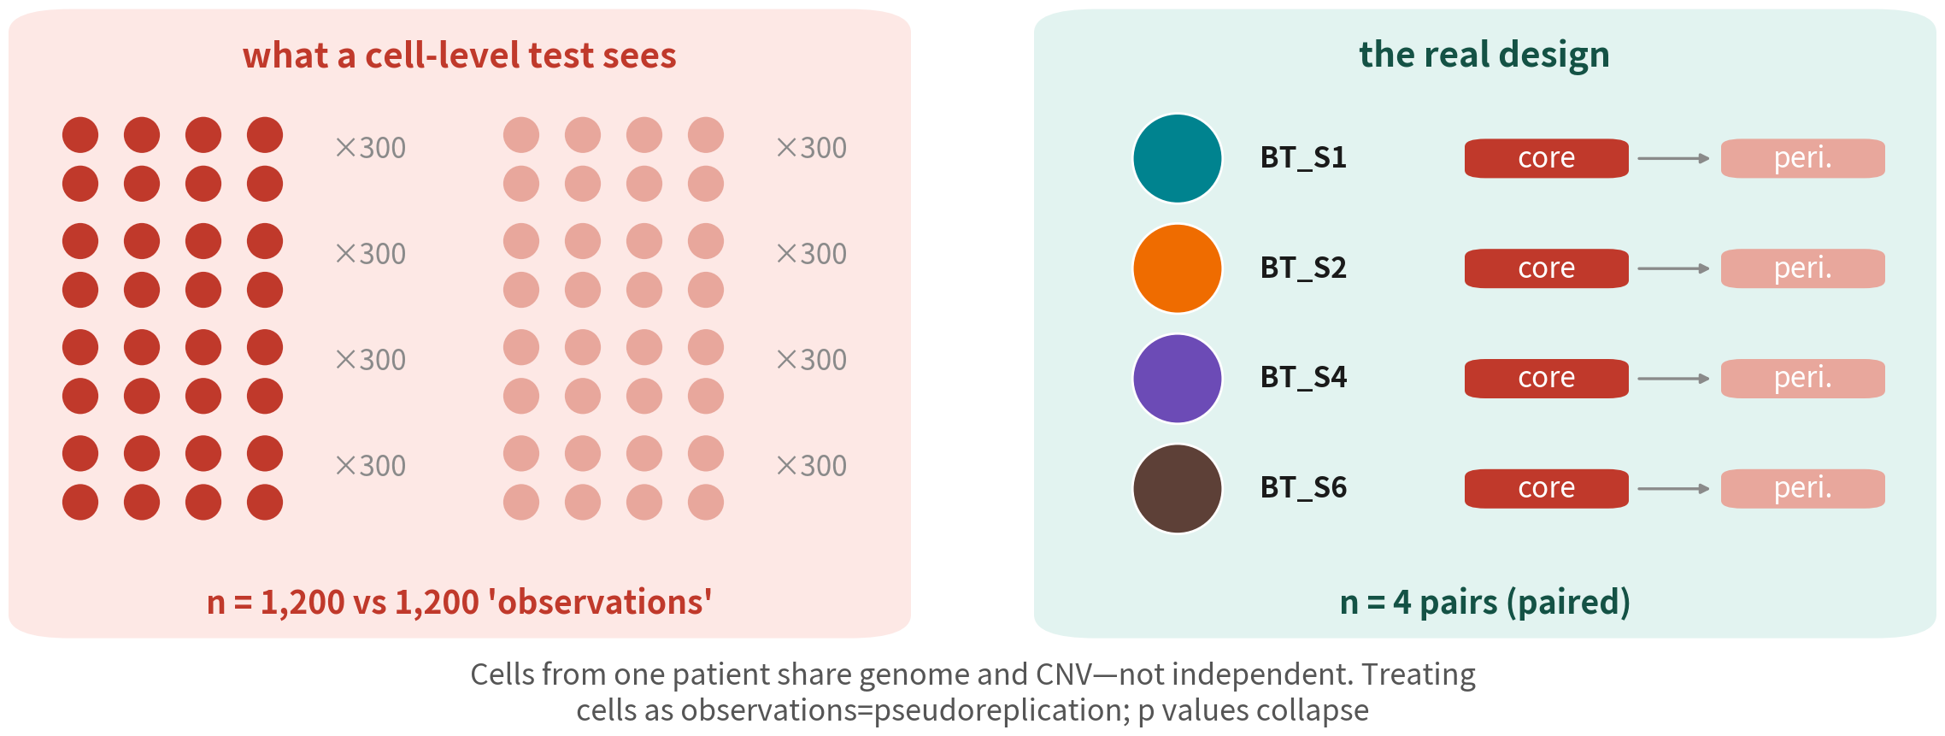
Why a cell-level test hands back two thousand genes
Malignant cells from one patient share one CNV set and are highly correlated. The
real design is 4 pairs, not 2,400 observations
Reference: Squair JW, et al. Nat Commun. 2021;12(1):5692. doi:10.1038/s41467-021-25960-2
Q3 Hands-on II
34
Notes:
先看左邊，這是 cell-level 檢定眼中的世界：每位病人每個部位三百顆細胞，四位病人，於是變成一千兩百對一千兩百個「觀察值」。看起來威風得不得了。 再看右邊，這才是真正的實驗設計：四位病人，每位一個核心一個邊緣。四對。就這樣。 差別在哪？同一位病人的惡性細胞共享同一套 CNV，彼此高度相關；你把它們當成獨立觀察值，n 就被灌大三百倍，p 值當然小到不像話。這件事有名字，叫 pseudoreplication，假重複。cold open 那兩千一百四十個基因，就是這樣來的。 ──────── Left first. This is the world a cell-level test thinks it is in: three hundred cells per patient per site, four patients, so twelve hundred versus twelve hundred "observations". Impressive, on paper. Now the right — the real design: four patients, one core and one periphery each. Four pairs. That is all. So where does it go wrong? Malignant cells from the same patient share one set of CNVs and are highly correlated with each other. Treat them as independent observations and n gets inflated three-hundred-fold, so of course the p-values shrink beyond belief. The thing has a name: pseudoreplication. The two thousand one hundred and forty genes in the cold open came from exactly this.

Slide 35
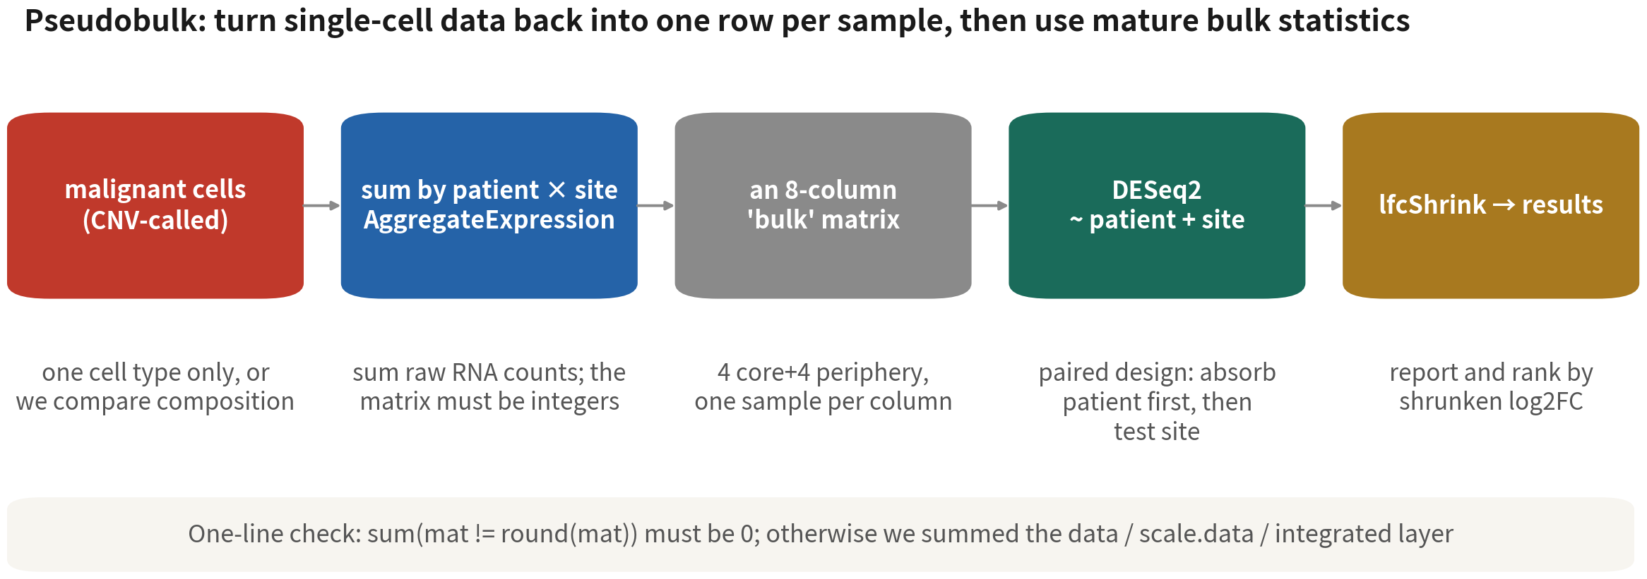
Pseudobulk in five steps
One cell type at a time — otherwise we are comparing composition (more normal brain at
the periphery), not that type's change
References: Crowell HL, et al. Nat Commun. 2020;11(1):6077. doi:10.1038/s41467-020-19894-4 ｜ Squair JW, et al. Nat Commun. 2021;12(1):5692. doi:10.1038/s41467-021-25960-2
Q3 Hands-on II
35
Notes:
解法其實很直觀：把單細胞資料變回每個樣本一列。 第一步，只取一種細胞。這一步很多人漏掉，而漏掉的代價很大：如果把所有細胞加總，我們比的其實是組成——邊緣的正常腦細胞比較多——而不是那種細胞本身的變化。 第二步，按病人乘部位加總，用 AggregateExpression，加總的是 RNA 原始 counts。 第三步，你會拿到一個每個「病人乘部位」一欄的 Bulk 矩陣。這份資料的免疫細胞剛好四位病人、兩個部位都夠，所以是八欄。但別以為每種型別都這麼好命，下一頁你會看到，大多數型別連兩欄都湊不出來。 第四步，DESeq2 上場，設計寫成 patient 加 tissue。這是配對設計：先吸掉病人之間的差異，再回頭比部位。 第五步，lfcShrink，報告用收縮後的 log2FC；但先記著，等一下 GSEA 的排序和火山圖都不用它。 一行抓雷：矩陣必須是整數。如果不是整數，代表我們加總到了錯的層。 ──────── The fix is more intuitive than the problem: turn single-cell data back into one row per sample. Step one, take one cell type only. Plenty of people skip this, and the cost is high — sum across all cells and we are comparing composition, because there is more normal brain at the periphery, rather than the change within that cell type. Step two, sum by patient times site. AggregateExpression, and what it sums is raw RNA counts. Step three gives us a bulk matrix with one column per patient-by-site. For the immune cells in this dataset, all four patients happen to have enough cells at both sites, so that is eight columns. Don't assume every type is that lucky; on the next slide we see that most types cannot even reach two. Step four, DESeq2 comes in, with the design written as patient plus tissue. A paired design: absorb the patient differences first, then compare sites. Step five, lfcShrink; report the shrunken log2FC — but hold on to this, because neither the GSEA ranking nor the volcano plot coming up will use it. One line to catch the trap: the matrix must be integers. If it is not, we summed at the wrong layer.

Slide 36


Each cell type separately: why, and the thresholds
Mixed together =
comparing
composition
Two thresholds
Only one type
clears the
gates here
Core vs periphery differs in
malignant cells, macrophages
and oligodendrocytes in
different ways. DE on all
cells puts MBP and PLP1 on
top — that is just more
oligodendrocytes at the
periphery
MIN_CELLS = 20: a patient ×
site needs ≥ 20 cells to count
as a pseudobulk sample; drop
the cell otherwise. MIN_PAIRS
= 2: at least two patients
with both sites, or the paired
design cannot exist
Across all four patients the
periphery holds 31 malignant
cells in total (17 in the best
patient); nobody reaches
MIN_CELLS = 20, so core vs
periphery in malignant cells
cannot be done here. The type
that does run is Immune cell:
4 patient pairs, 608
significant genes
Reference: Crowell HL, et al. Nat Commun. 2020;11(1):6077. doi:10.1038/s41467-020-19894-4
Q3 Hands-on II
36
Notes:
這一頁三張卡。 第一張，混在一起就等於在比組成。核心對邊緣的差異，在惡性細胞、巨噬細胞、寡樹突裡各不相同；全部細胞一起做 DE，前十名會是 MBP、PLP1——那不是任何一種細胞的變化，只是邊緣的寡樹突比較多而已。所以每種型別各自跑一次。順帶一提，這件事在我們自己的結果裡也驗證了：分完型別以後，MBP 在免疫細胞裡的 log2FC 只有 0.13、padj 0.95，完全不動了。 第二張，兩個門檻。MIN_CELLS 等於二十：每個「病人乘部位」至少要二十顆細胞，才算得上一個 pseudobulk 樣本，太少的那一格整格丟掉——三顆細胞加總出來的「Bulk」是噪音，它會把所有基因往同一邊拉。MIN_PAIRS 等於二：至少兩位病人的兩個部位都有樣本，配對設計才成立。門檻不夠的型別直接跳過，腳本會印出來給你看。 第三張是這一頁最重要的一句話：這份資料只有一種型別過得了這兩道門檻。四位病人的邊緣加起來只有三十一顆惡性細胞，最多的一位十七顆，沒有一位到二十。所以「惡性細胞在核心和邊緣有什麼不同」——大家最想問的那個問題——這份資料回答不了，一對病人都湊不出來。真正跑得出來的是免疫細胞：四對病人、六百零八個顯著基因。 要記住的不是這個數字，是這個處境。多樣本設計裡，決定你能問什麼的不是總細胞數，是「最小的那一格有幾顆」。而這件事在收樣本之前就決定了，事後補不回來。 ──────── Three cards on this slide. First card: mixed together equals comparing composition. The core-versus-periphery difference is a different difference in malignant cells, in macrophages and in oligodendrocytes. Run DE on all cells together and the top ten will be MBP and PLP1 — which is nobody's change, just more oligodendrocytes at the periphery. So we run each type separately. And our own results back it up: once the types are separated, MBP inside the immune cells has a log2FC of 0.13 and a padj of 0.95. It stops moving entirely. Second card: two thresholds. MIN_CELLS equals twenty — a patient-by-site cell needs at least twenty cells to count as a pseudobulk sample, and anything less is dropped whole, because a "bulk" summed from three cells is noise that drags every gene one way. MIN_PAIRS equals two: at least two patients with both sites, or the paired design does not exist. Types below the thresholds are skipped, and the script prints which ones so you can see it happen. Third card, and this is the sentence that matters on this slide: in this dataset only one type clears both thresholds. Across all four patients the periphery holds thirty-one malignant cells in total, seventeen in the best patient, and not one patient reaches twenty. So "how do malignant cells differ between core and periphery" — the question everyone actually wants to ask — cannot be answered from this data. Not even one pair. What does run is the immune cells: four patient pairs, six hundred and eight significant genes. What is worth remembering is not the number, it is the situation. In a multi-sample design, what decides which questions we can ask is not the total cell count, it is how many cells sit in the smallest cell of the table. That is settled before the samples are collected, and no amount of analysis fixes it afterwards.

Slide 37
Wrap pseudobulk + paired DESeq2 in a function; call it per type
pb_de <- function(obj, type, min.cells = 20, min.pairs = 2) { sub <- subset(obj, cells = colnames(obj)[obj$type == type]) n <- table(sub$patient, sub$tissue) ok <- names(which(rowSums(n >= min.cells) == 2)) # patients with enough cells at both sites if (length(ok) < min.pairs) return(NULL) sub <- subset(sub, cells = colnames(sub)[sub$patient %in% ok]) pb <- as.matrix(AggregateExpression(sub, assays = "RNA", group.by = c("patient", "tissue"))$RNA) stopifnot(sum(pb != round(pb)) == 0) # one line that catches the trap: must be integers coldata <- data.frame(patient = sub("_[^_]*$", "", colnames(pb)), tissue = factor(sub(".*_", "", colnames(pb)), levels = c("Periphery", "Tumor"))) dds <- DESeq(DESeqDataSetFromMatrix(pb[rowSums(pb) >= 10, ], coldata, design = ~ patient + tissue)) raw <- results(dds, name = "tissue_Tumor_vs_Periphery") # stat -> GSEA and the volcano shr <- lfcShrink(dds, coef = "tissue_Tumor_vs_Periphery", type = "ashr") list(res = data.frame(gene = rownames(raw), log2FC = raw$log2FoldChange, log2FC_shrunk = shr$log2FoldChange, stat = raw$stat, padj = raw$padj), pb = pb, coldata = coldata) } de <- lapply(types, function(ty) pb_de(gbm4, ty)); names(de) <- types
~ patient + tissue: the paired design absorbs patient differences first. Patient IDs contain underscores — split the
column name at its last segment | Script 06a §2 | Deeper: B12
Reference: Love MI, Huber W, Anders S. Genome Biol. 2014;15(12):550. doi:10.1186/s13059-014-0550-8
Q3 Hands-on II
37
Notes:
既然要對每種型別各跑一次，那就把整段包成一個函式，pb_de。 subset 記得用 cells 等於，不要用 subset 等於——這是為了避免欄名跟變數名撞在一起。接著 table 病人乘部位，rowSums 大於等於門檻的等於二，找出兩個部位都夠的病人。湊不到 MIN_PAIRS 就回傳 NULL。 回傳 NULL 不是錯誤，在這份資料裡它是常態。上一頁說過，八種型別裡只有免疫細胞過關，其他型別的 pb_de 全部回傳 NULL。所以函式不能寫成「湊不出來就停下來」，要寫成「湊不出來就回報，然後繼續下一種」——不然我們連哪些型別做不了都看不到。 再來 AggregateExpression 加總，stopifnot 檢查整數。coldata 從欄名拆出病人和部位——這裡有個坑：病人 ID 本身就有底線，BT 底線 S1，所以要從最後一段切，不能用第一個底線切，否則四位病人會全部變成 BT。 DESeq 一行跑完。results 拿的是未收縮的結果——stat 給 GSEA 排序、log2FC 給火山圖。lfcShrink 用 ashr 收縮，報告效應量時用它。回傳一個 list：結果表、pseudobulk 矩陣、coldata。 最後 lapply 對每種型別呼叫，細胞數不到一百的型別，連試都不用試。 ──────── Since we run it once per cell type, wrap the whole thing into a function, pb_de. Use subset with cells equals, not subset equals — that avoids a column name colliding with a variable name. Then table patient by site, rowSums of "at least the threshold" equals two, and that gives the patients with enough cells at both sites. Below MIN_PAIRS, return NULL. Returning NULL is not an error here; in this dataset it is the normal case. As the last slide said, of the eight types only the immune cells clear the gates, and pb_de returns NULL for every other type. So the function must not be written as "stop if it does not qualify" but as "report it and move to the next type" — otherwise we cannot even see which types are impossible. Then AggregateExpression sums, and stopifnot checks the integers. coldata splits patient and site out of the column names — and here is a pit to watch: the patient IDs contain underscores themselves, BT underscore S1, so we split on the last segment, not the first underscore, or all four patients collapse into "BT". DESeq runs in one line. results gives the unshrunken output — stat for the GSEA ranking, log2FC for the volcano. lfcShrink with ashr shrinks it, and that is what we report as effect size. Return a list: the result table, the pseudobulk matrix, and coldata. Finally lapply calls it for each type, and types with fewer than a hundred cells are not worth attempting.

Slide 38
One DE result, three log2FCs: which goes where
Shrinkage pulls the exaggerated FC of low-count, noisy genes toward 0; how hard it pulls differs a lot by method
Column | Where it comes from | Behaviour | Use it for
raw log2FC | log2FoldChange from results(dds) | Low-count genes: huge FC, huge SE | The volcano x-axis (keeps the shape honest)
stat (Wald) | log2FC ÷ SE | Carries effect size and uncertainty; few ties | The GSEA ranking statistic
log2FC_shrunk (ashr) | lfcShrink(type = "ashr") | Stable at small n; keeps large effects, damps noise | Reported effect sizes; picking genes to validate
apeglm (not for small n) | lfcShrink(type = "apeglm") | At n = 8 the prior dominates: nearly every gene lands on one value → a bar-shaped volcano and all-tied GSEA ranks | Only with more samples (≥ 3 vs 3, ample counts)
Reference: Love MI, Huber W, Anders S. Genome Biol. 2014;15(12):550. doi:10.1186/s13059-014-0550-8
Q3 Hands-on II
38
Notes:
這張表要回答一個很多人卡住的問題：DESeq2 給了好幾種 log2FC，到底該用哪一個？ 未收縮的 log2FC，是 results 直接給你的。低 count 的基因會有很大的 FC 配上很大的 SE。它用在火山圖的橫軸——因為火山圖要的就是原始形狀。 stat，也就是 Wald 統計量：log2FC 除以 SE，同時帶著效應量和不確定性，而且很少同分。它是 GSEA 的排序統計量。 ashr 收縮後的 log2FC：小 n 也穩定，保留大效應、壓掉小雜訊。報告效應量、挑基因去做驗證，用它。 至於 apeglm，樣本只有八個的時候先驗太強，幾乎所有基因會被壓成同一個值——火山圖變成一根直柱，GSEA 的排序全是同分，跑幾個小時跑不完。這不是嚇你，這就是我們第一次跑的時候看到的樣子。apeglm 留給樣本多、count 充足的設計。 ──────── This table answers a question a lot of people get stuck on: DESeq2 hands us several log2FCs, so which one goes where? The unshrunken log2FC is what results gives you straight out. Low-count genes get a big fold change with a big standard error. It belongs on the x-axis of the volcano plot, because the raw shape is exactly what a volcano is for. stat, the Wald statistic: log2FC divided by its standard error, carrying effect size and uncertainty at once, and rarely tied. It is the ranking statistic for GSEA. The ashr-shrunken log2FC: stable at small n, keeping the large effects and squashing the small noisy ones. Use it to report effect sizes and to pick genes for validation. As for apeglm — with only eight samples the prior is too strong and almost every gene is squashed to the same value, so the volcano becomes a single vertical bar and the GSEA ranking is all ties, running for hours without finishing. I am not inventing that to frighten you; it is exactly what we saw on our first run. Keep apeglm for designs with many samples and plenty of counts.

Slide 39
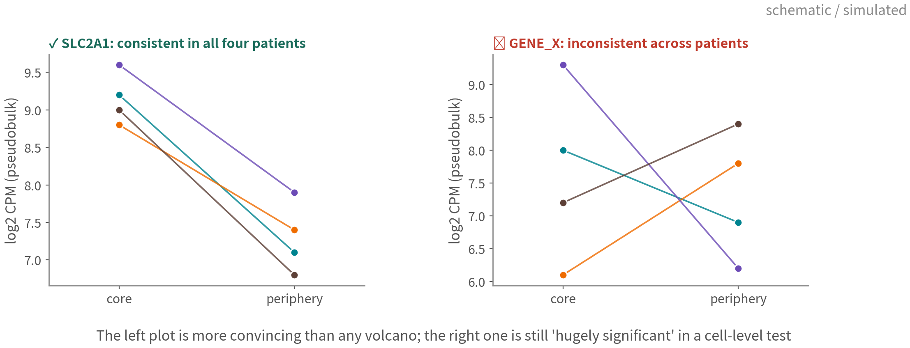
When reporting, show it holds per patient
One line per patient (schematic; SLC2A1 is a real hit from this course's run, log2FC 5.7, padj 3.6e-12).
The left is more convincing than any volcano; the right is still 'hugely significant' at cell level
Q3 Hands-on II
39
Notes:
每位病人一條線，從核心走到邊緣。這張是示意圖，不過左邊那個基因是真的：SLC2A1，也就是 GLUT1，在我們這份資料的免疫細胞裡 log2FC 五點七、padj 三乘十的負十二次方。它是缺氧反應最典型的下游基因，核心高、邊緣低，跟 GBM 的生物學對得起來。 順便看一件很有意思的事。SLC2A1 動得這麼明顯，但 HIF1A 本身的 log2FC 只有零點二五、padj 零點九，完全不顯著。矛盾嗎？不矛盾。HIF1A 主要是在蛋白質層次被調控的：有氧的時候蛋白被降解掉，缺氧的時候才穩定下來，mRNA 的量本來就不太變。我們在 RNA 層次看得到的是它的下游，不是它自己。這也正好是 Q1 講過的那條限制：這門技術只讀得到 RNA。 再看右邊某個基因 X：兩位病人上升、兩位下降。在 cell-level 檢定裡它照樣「極顯著」，因為每位病人各三百顆細胞把 p 值灌小了。pseudobulk 會誠實地說它不顯著。 左邊這種圖比火山圖更有說服力。所以兩張都放。 ──────── One line per patient, running from core to periphery. The figure is schematic, but the gene on the left is real: SLC2A1, better known as GLUT1, with a log2FC of five point seven and a padj of three times ten to the minus twelve in the immune cells of this dataset. It is the most canonical downstream target of the hypoxia response — high in the core, lower at the periphery — and that lines up with GBM biology. While we are here, look at something interesting. SLC2A1 moves that clearly, yet HIF1A itself has a log2FC of zero point two five and a padj of zero point nine: not significant at all. A contradiction? No. HIF1A is regulated mainly at the protein level — the protein is degraded when oxygen is present and only stabilised under hypoxia — so its mRNA does not need to change much. What we can see at the RNA level is its downstream, not the factor itself. This is the same limit Q1 spelled out: this technology only reads RNA. On the right, some gene X: two patients up, two patients down. In a cell-level test it still comes out "hugely significant", because three hundred cells per patient inflate the p-value. Pseudobulk honestly calls it not significant. The plot on the left is more convincing than any volcano. So show both.

Slide 40
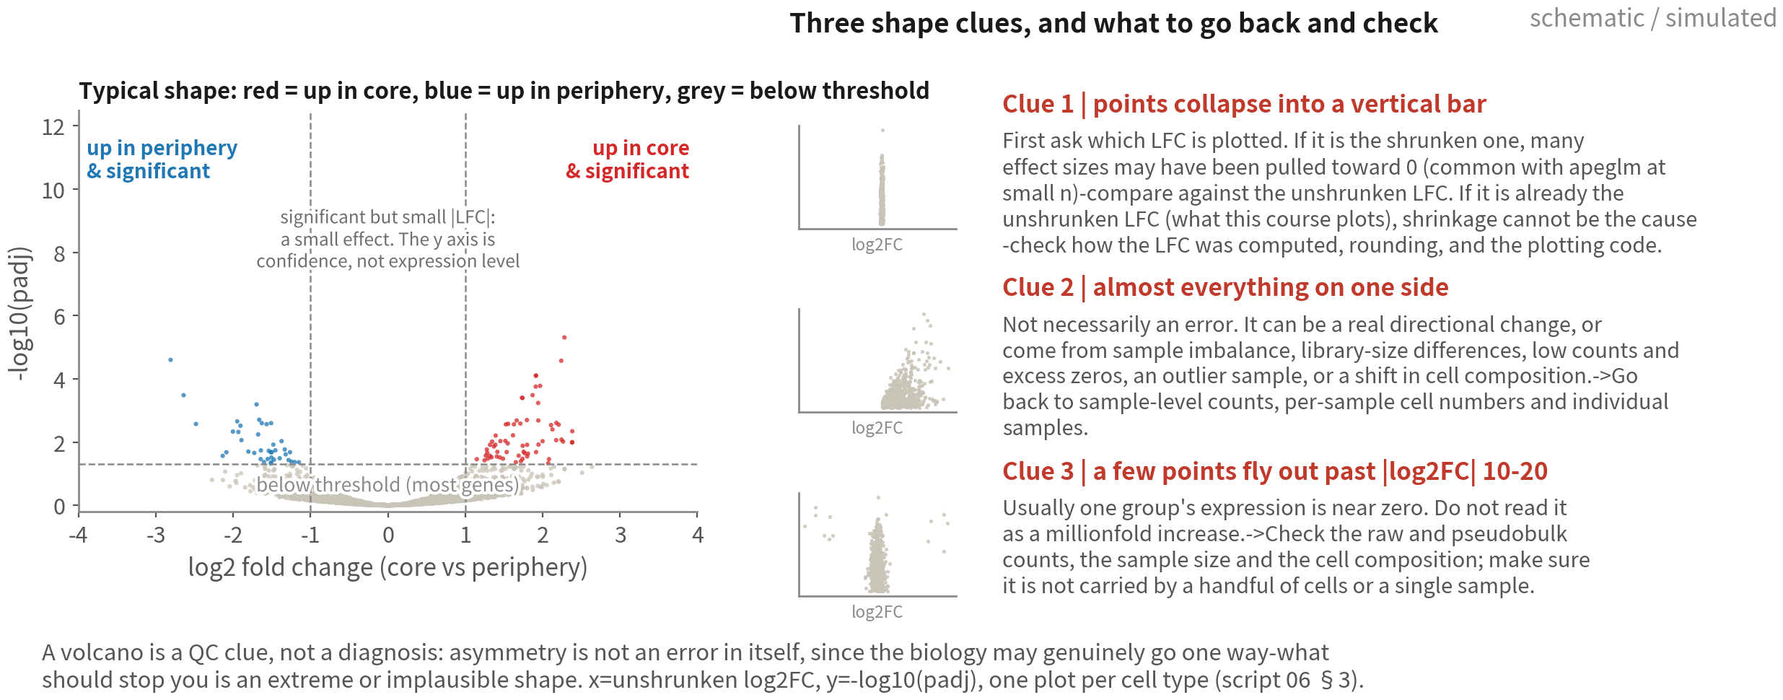
Reading a volcano: shape first, then look for the cause
Shape is a clue, not a diagnosis: a bar means first check whether the LFC is shrunken; one side may be real direction or
sample imbalance or an outlier; extreme |log2FC| usually means one group is near zero - go back to the counts | Script 06a §3
Q3 Hands-on II
40
Notes:
火山圖每種型別一張，用 EnhancedVolcano 畫。橫軸是未收縮的 log2FC，縱軸是負 log10 的 padj——是 padj，不是 p。 先破除一個常見的印象：火山圖不需要左右對稱。如果生物效應本身就偏向一個方向，那只有一邊多是完全合理的。所以請不要把「不對稱」直接讀成「分析出錯」。真正該讓你停下來的，不是不對稱，而是極端或不合理的分布型態。 還有一個容易混淆的地方：縱軸是統計信心，不是表現量高低。一個點在很上面，只代表它的 padj 很小，不代表這個基因表現量高。中間偏上、絕對值 LFC 又小的那些點，講的是「效應量小但很確定」，跟表現量沒有關係。 接下來看三種值得追下去的形狀線索。但要先說清楚：這些是線索，不是診斷——看到形狀就直接判定原因，是最容易教錯的地方。 線索一，大量點擠成一根直柱。這裡有個順序問題：先問你畫的是哪一種 LFC。如果畫的是收縮後的 LFC，那很可能是大量 effect size 被 shrink 到接近零——DESeq2 用 lfcShrink 之後，低資訊基因的 LFC 被拉向零，但 padj 還是沿用原本模型的結果，於是出現「顯著、但 shrunk LFC 接近零」的點。這時候拿未收縮的 LFC 對照著看就清楚了。但如果你畫的本來就是未收縮的 LFC——像我們這一課——那直柱就不可能是 shrinkage 造成的，得回去查 LFC 的計算方式、rounding、資料處理，或者是繪圖流程本身。 線索二，幾乎全部落在單側。這不一定是錯誤。可能是真實的方向性變化；也可能來自樣本不平衡、library size 差異、低 counts 或大量零值、某一個 outlier 樣本，或者兩組之間的細胞組成不同。要回去查的是 sample-level 的 counts、每個樣本的細胞數，還有個別樣本長什麼樣子，不要只看合併後的結果。 線索三，少數點飛到 log2FC 絕對值十到二十以上。這通常代表其中一組的表現量接近零。這裡最重要的是：不要把它讀成「表現量增加幾百萬倍」——那只是把一個接近零的分母放進 fold change 的結果。要回查原始或 pseudobulk 的 counts、樣本數與細胞組成，確認它不是靠少數幾顆細胞、或某一個樣本撐起來的。 我們這份資料就有一個很好的例子。免疫細胞那張圖，前幾名是 TPSAB1、CTSG、HDC、TPSB2，log2FC 二十二、二十六。這四個基因其實是同一件事：類胰蛋白酶、組織胺合成酶，全都是肥大細胞的標誌。回查 counts 之後就清楚了：不是「免疫細胞在核心和邊緣的表現不同」，是「核心和邊緣的免疫細胞裡，肥大細胞的比例不一樣」。 看出來了嗎？這就是第一張卡講的那個陷阱，只是往下一層。我們把細胞分成型別，就是為了不比組成，結果「免疫細胞」這個桶子本身還是太粗，裡面又混了好幾種細胞。修法只有一個：把註釋做細一點，把肥大細胞分出來，再各自比。 所以這一頁的結論就寫在最底下：火山圖是 QC 線索，不是診斷結果。看到直柱，去查 LFC 是哪一種、怎麼算的；看到單側，去查生物學方向加上 sample-level 的資料；看到極端 LFC，去查零值、低 counts、outlier 與細胞組成。 ──────── One volcano per cell type, drawn with EnhancedVolcano. The x axis is the unshrunken log2FC, the y axis is minus log10 of padj — padj, not p. Let's clear up a common impression first: a volcano does not need to be symmetric. If the biological effect genuinely goes one way, having more points on one side is entirely reasonable. So do not read asymmetry as a sign that the analysis is broken. What should stop you is not asymmetry; it is an extreme or implausible shape. And one more thing that is easy to confuse: the y axis is statistical confidence, not expression level. A point high up only means its padj is small; it says nothing about how highly the gene is expressed. Points that sit above the line with a small absolute LFC are saying "a small effect that we are confident about" — expression level does not come into it. Now three shape clues worth chasing. Note the word: these are clues, not diagnoses. Going straight from a shape to a cause is the easiest thing to teach wrongly here. Clue one, points collapsing into a vertical bar. There is an order of operations here: first ask which LFC you plotted. If it is the shrunken LFC, then a great many effect sizes may have been pulled toward zero — after lfcShrink, low-information genes get their LFC dragged to zero while padj still comes from the original model, so you get points that are significant with a shrunken LFC near zero. Holding it up against the unshrunken LFC settles it. But if you plotted the unshrunken LFC to begin with — as this course does — shrinkage cannot be the cause, and you should go back to how the LFC was computed, to rounding, to data handling, or to the plotting code itself. Clue two, almost everything on one side. Not necessarily an error. It may be a real directional change. It may also come from sample imbalance, library-size differences, low counts or excess zeros, a single outlier sample, or a difference in cell composition between the groups. What you go back to is the sample-level counts, the per-sample cell numbers, and what the individual samples look like — not just the pooled result. Clue three, a handful of points out past a log2FC of ten or twenty. That usually means one group's expression is near zero. The important thing is not to read it as a millionfold increase — that is only what happens when a near-zero denominator enters a fold change. Go back to the raw or pseudobulk counts, the sample size and the cell composition, and confirm it is not carried by a few cells or a single sample. Our own data has a good example. In the immune-cell volcano the top hits are TPSAB1, CTSG, HDC, TPSB2 with log2FCs of twenty-two and twenty-six. Those four genes are all the same thing: tryptases and histidine decarboxylase, all mast cell markers. Going back to the counts makes it clear: this is not "immune cells are expressed differently in core and periphery", it is "the immune cells in core and periphery contain different proportions of mast cells". See it? That is the trap from the first card, one level down. We split cells into types precisely so that we are not comparing composition — and the "immune cell" bucket was still too coarse, with several cell types inside it. There is only one fix: annotate more finely, separate the mast cells out, and compare each type on its own. So the conclusion at the bottom of this slide: a volcano is a QC clue, not a diagnosis. A bar sends you to check which LFC it is and how it was computed; one-sidedness sends you to the biological direction plus the sample-level data; extreme LFCs send you to zeros, low counts, outliers and cell composition.

Slide 41
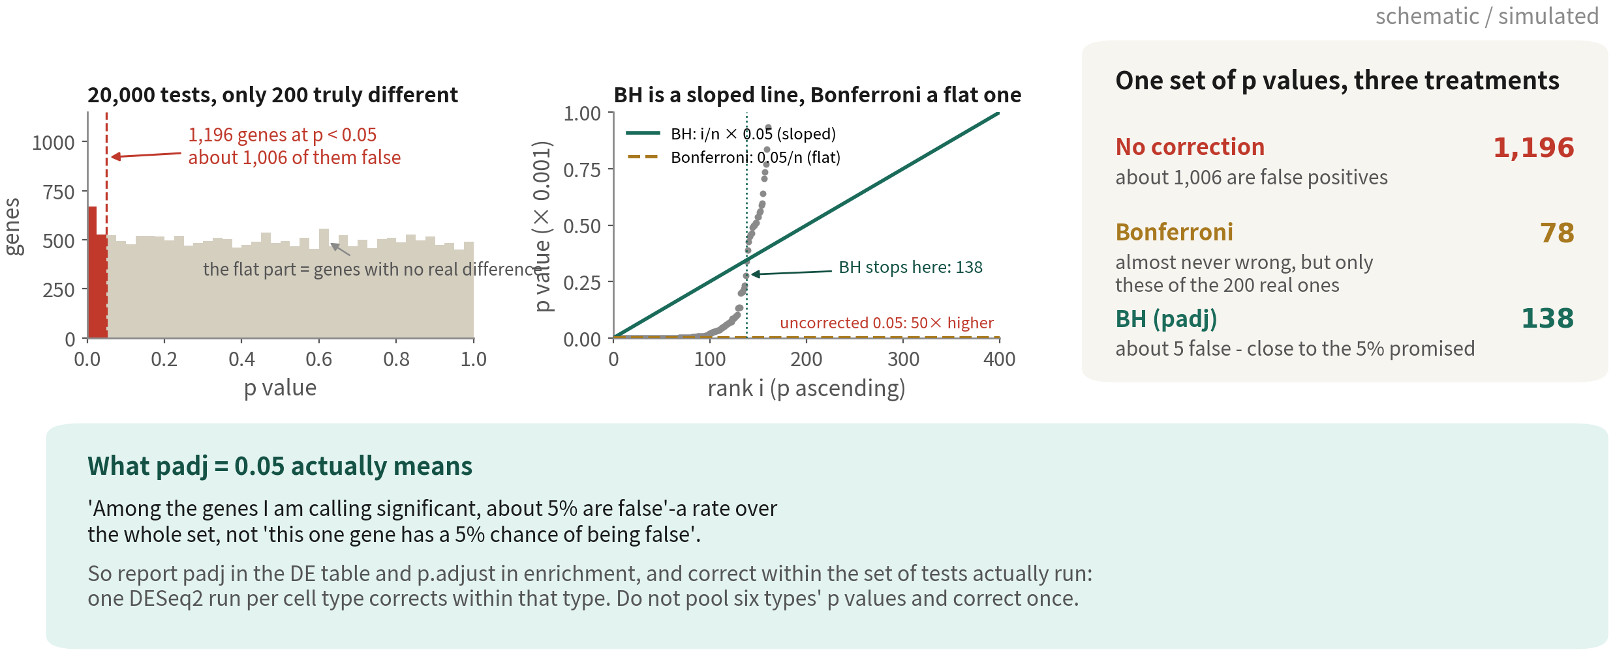
Twenty thousand tests: multiple comparisons and FDR
BH is not cosmetic: it changes the question from 'is there any false positive at all' to 'what
fraction of this list is false' - which is the right question for genome-scale data | Script 06a §2
Reference: Benjamini Y, Hochberg Y. J R Stat Soc Series B. 1995;57(1):289–300. doi:10.1111/j.2517-6161.1995.tb02031.x
Q3 Hands-on II
41
Notes:
火山圖上那條橫線是 padj，不是 p。這一頁講為什麼。 左邊這張圖是一個思想實驗：兩萬個基因，假設沒有任何一個真的有差異。這時候 p 值會是零到一的均勻分布。那麼 p 小於零點零五的，仍然會有大約一千個。一個真差異都沒有，卻交出一千個「顯著」基因——這就是多重比較問題。而基因體資料，每一次分析都在做這件事。 中間這張圖是兩種校正的幾何長相。Bonferroni 是一條水平線：門檻直接除以檢定次數，兩萬次就是零點零五除以兩萬。它控制的是「有沒有任何一個假陽性」，非常嚴格，代價是真訊號也一起被砍掉。BH 是一條斜線：把 p 值由小到大排序，第 i 名的門檻是 i 除以 n 再乘以零點零五。排在前面的基因門檻很嚴，排在後面的逐漸放寬。 右邊是同一份結果、三種處理的下場。不校正留下一千零一十八個，多數是假的；Bonferroni 只留六個，過度保守；BH 留一百四十二個，允許大約百分之五的假陽性，換回檢定力。單細胞的差異表達幾乎都用 BH。 最後是最容易講錯的一句話。padj 等於零點零五，意思是「在我宣告顯著的這一批基因裡，大約百分之五是假的」。這是整批的錯誤率，不是「這一個基因有百分之五的機率是假的」。兩者差很多，寫論文的時候不要混用。 還有一個實務要點：校正的範圍就是「這一次跑的所有檢定」。每種細胞型別各自跑一次 DESeq2，就各自校正各自的；不要把六個型別的 p 值倒在一起再校正一次——那會把每一個型別的門檻都拉得莫名其妙地嚴。 ──────── The horizontal line on the volcano plot is padj, not p. This slide is why. The left panel is a thought experiment: twenty thousand genes, and suppose not one of them is truly different. The p values are uniform between zero and one. So roughly a thousand of them still come in under 0.05. Nothing is real, and we would walk out with a thousand significant genes. That is the multiple comparisons problem, and every genome-scale analysis runs into it. The middle panel is what the two corrections look like geometrically. Bonferroni is a flat line: divide the threshold by the number of tests, so 0.05 over twenty thousand. It controls whether there is any false positive at all, which is very strict, and the price is that real signal is cut away with it. BH is a sloped line: sort the p values, and the threshold for rank i is i over n times 0.05. The top-ranked genes face a strict bar, and it relaxes as you go down the list. The right panel is what happens to one result under all three. No correction leaves 1,018, mostly false. Bonferroni leaves six, far too conservative. BH leaves 142, allowing about five percent false positives and buying back power. Single-cell differential expression essentially always uses BH. Now the sentence people get wrong most often. padj of 0.05 means: among the genes I am calling significant, about five percent are false. That is a rate over the whole set. It does not mean this one gene has a five percent chance of being false. The two are very different, so do not mix them in the write-up. One practical point: the correction applies within the set of tests actually run. One DESeq2 run per cell type corrects within that cell type. Do not pool the p values of six cell types and correct once - that pushes every type's threshold to an arbitrarily strict place.

Slide 42
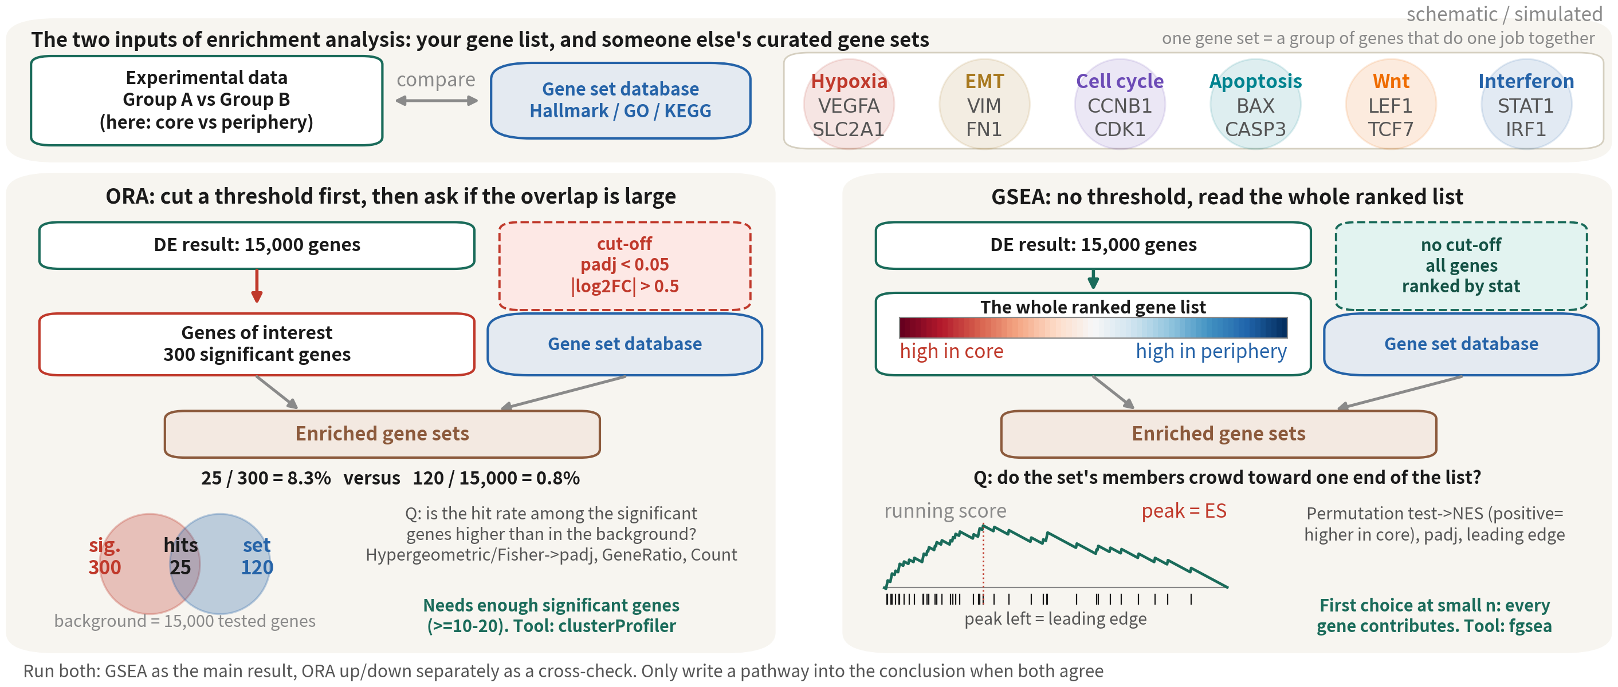
Same DE result, two enrichment questions: ORA
counts, GSEA ranks
GSEA uses every gene with no threshold — first choice at small n; ORA needs enough significant
genes and the right background. Run both; a pathway goes into the conclusion only when both agree
References: Subramanian A, et al. Proc Natl Acad Sci USA. 2005;102(43):15545–15550. doi:10.1073/pnas.0506580102 ｜ Wu T, et al. Innovation (Camb). 2021;2(3):100141. doi:10.1016/j.xinn.2021.100141
Q3 Hands-on II
42
Notes:
DE 表做完了，下一步是把一長串基因變成一句生物學。富集分析有兩種問法，它們回答的是不同的問題。 左邊 ORA，over-representation。它先切一條閾值：padj 小於 0.05、絕對 LFC 大於 0.5，得到一份顯著基因清單。然後問：某個基因集的成員，在顯著清單裡的比例，是不是高於它在背景裡的比例？用超幾何或 Fisher 檢定，給我們 padj、GeneRatio、Count。它需要夠多的顯著基因——至少十到二十個——還要有正確的背景。小 n 的 DE 表很短的時候，ORA 幾乎沒東西可算。 右邊 GSEA。它不切閾值，把全部基因按 DESeq2 的 stat 排成一列，左邊是核心較高。然後沿著清單走，遇到基因集成員就加分、不是就扣分，畫出 running score。峰值是 ES；峰值左邊的成員就是 leading edge。它問的是：這個基因集的成員，是不是擠在清單的某一端？置換檢定給 NES——正的是核心較高——還有 padj、leading edge。全部基因都貢獻證據，所以它是小 n 的首選。 兩種都跑。GSEA 當主結果，ORA 上調、下調分開做，當交叉驗證。同一條 pathway 兩邊都出現，才寫進結論。 ──────── DE table done — the next step is turning a long list of genes into a sentence of biology. Enrichment analysis comes in two ways of asking, and they answer different questions. Left, ORA — over-representation. It cuts thresholds first: padj below 0.05, absolute LFC above 0.5, giving a list of significant genes. Then it asks: is the fraction of a gene set's members inside the significant list higher than their fraction in the background? Hypergeometric or Fisher test, giving padj, GeneRatio, Count. It needs enough significant genes — at least ten to twenty — and the correct background. When a small-n DE table is short, ORA has almost nothing to compute. Right, GSEA. No threshold: rank all genes by DESeq2's stat, higher-in-core on the left. Walk down the list; hit a gene-set member, score goes up, otherwise down — that's the running score. The peak is the ES; the members left of the peak are the leading edge. The question: do this gene set's members crowd toward one end of the list? A permutation test gives the NES — positive means higher in core — plus padj and the leading edge. Every gene contributes evidence, which is why it's the first choice at small n. Run both. GSEA is the main result; ORA, run separately for up- and down-regulated genes, is the cross-check. Only pathways that show up on both sides go into the conclusions.

Slide 43
Three gene-set databases: Hallmark, GO, KEGG
All from msigdbr and run with the same fgsea; ORA via clusterProfiler enrichGO / enrichKEGG
Database | Content and size | Strength | Caveat
Hallmark (H) | 50 curated, minimally overlapping programmes: hypoxia, EMT, interferon, G2M… | Look here first: fits on one page, easiest to read, almost no redundancy | Only 50 sets; fine detail (which signal, which metabolic branch) is out of reach
GO BP (C5) | About 7,500 BP terms hierarchical, heavily overlapping | The finest grain; the default language of ORA; runs offline (org.Hs.eg.db) | One biology shows up as ten terms — simplify() first; terms with 3–5 hits stay out of the conclusion however significant
KEGG (C2 CP) | About 190 metabolic and signalling pathways, with pathway maps | Most intuitive for metabolism (glycolysis, OXPHOS); pathview draws on the map | enrichKEGG needs the internet; many are disease pathways ('Alzheimer disease') that are not mechanisms; the msigdbr copy is the legacy version
Reference: Liberzon A, et al. Cell Syst. 2015;1(6):417–425. doi:10.1016/j.cels.2015.12.004
Q3 Hands-on II
43
Notes:
三個資料庫都從 msigdbr 拿，同一套 fgsea 跑；ORA 那邊用 clusterProfiler。 Hallmark，五十個精選、彼此少重疊的生物程式：缺氧、EMT、干擾素、G2M。先看這個。一頁講得完，結果最好解讀，幾乎不會互相冗餘。缺點也很誠實：只有五十條，細節問不到。 GO 生物過程，大約七千五百個詞條，階層式、高度重疊。它最細，是 ORA 的預設語言，離線就能跑。但要注意，同一件事會以十個詞條出現——response to hypoxia、response to decreased oxygen levels、response to oxygen levels——所以先 simplify 合併；還有，命中三到五個基因的詞條，再顯著也別寫進結論。 KEGG，大約一百九十條代謝與訊號路徑，而且有路徑圖。代謝問題最直觀，糖解、氧化磷酸化；pathview 還能把結果直接畫在路徑圖上。要注意的是 enrichKEGG 得連網；另外很多條是疾病路徑，「阿茲海默症」出現在 GBM 的結果裡不代表機制；msigdbr 裡的是 legacy 版。 ──────── All three databases come from msigdbr and run through the same fgsea; ORA uses clusterProfiler. Hallmark: fifty curated, minimally overlapping biological programmes — hypoxia, EMT, interferon, G2M. Look at this one first. It fits on one page, the results are the easiest to interpret, and they're almost never redundant with each other. The drawback is an honest one: only fifty sets, no fine detail. GO biological process: about seven and a half thousand terms, hierarchical, heavily overlapping. It's the finest grain, the default language of ORA, and it runs offline. But beware: the same thing appears as ten terms — response to hypoxia, response to decreased oxygen levels, response to oxygen levels — so run simplify to merge first; and a term hit by three to five genes doesn't go in the conclusions no matter how significant. KEGG: about a hundred and ninety metabolic and signalling pathways, and it comes with pathway diagrams. The most intuitive for metabolic questions — glycolysis, oxidative phosphorylation; pathview can even paint our results onto the diagram. Beware: enrichKEGG needs internet access; many entries are disease pathways, and "Alzheimer's disease" showing up in GBM results does not mean mechanism; and what msigdbr carries is the legacy version.

Slide 44
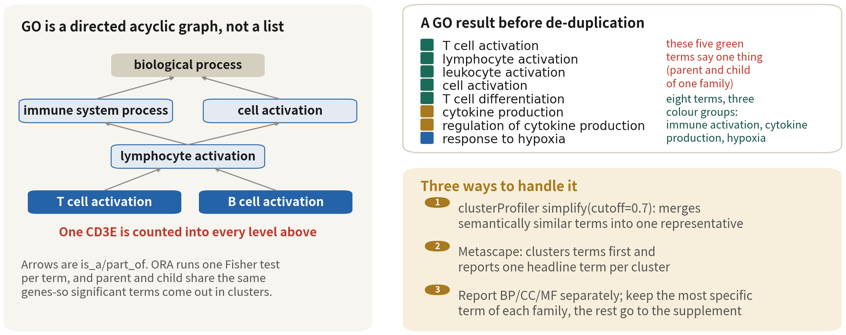
Why GO returns twenty terms all saying the same thing
GO is a hierarchy, not a list: parent and child share the same genes and ORA tests every
term separately, so a whole family lights up. De-duplicate before reporting | Script 06a §4
Reference: Wu T, et al. Innovation (Camb). 2021;2(3):100141. doi:10.1016/j.xinn.2021.100141
Q3 Hands-on II
44
Notes:
ORA 跑完，第一次看到結果的人通常會愣住：前二十條裡有八條都在講 T 細胞活化。這不是我們做錯了，是 GO 的結構決定的。 左邊就是 GO 的樣子。它是一個有向無環圖，不是清單。「T 細胞活化」的上面是「淋巴球活化」，再上面是「免疫系統程序」和「細胞活化」，最上面是「生物程序」。箭頭是 is_a 或 part_of。 關鍵就在紅字那一行：一個 CD3E，會同時被算進上面每一層。ORA 對每一個詞條各做一次 Fisher 檢定，父項與子項共用同一批基因——所以只要子項顯著，整條祖先鏈通常也跟著顯著。 右上是沒去冗餘的結果長什麼樣。看顏色就好：綠色那五條——T cell activation、lymphocyte activation、leukocyte activation、cell activation、T cell differentiation——是同一族的父子項，講的是同一件事。金色兩條是細胞激素生成，也是父子項。藍色一條是缺氧。八條詞條，其實只對應到三組訊號：免疫活化、細胞激素生成、缺氧。 右下給你三個處理方式。第一個是 clusterProfiler 的 simplify，cutoff 設零點七，它用語意相似度把同族詞條併成一條代表。第二個是用 Metascape：它會先把詞條聚類再報告，一族只留最顯著的那一條當標題。第三個是報告的時候 BP、CC、MF 分開列，同一族只寫最具體的那一條，其餘放補充資料。 順帶一提，這也是為什麼很多人偏好 Hallmark：五十條、彼此幾乎不重疊，一眼看得完。GO 的優點是細，代價就是這一頁講的冗餘。 ──────── When people see an ORA result for the first time, they usually stop short: eight of the top twenty terms are about T cell activation. That is not our mistake, it is the structure of GO. The left panel is what GO is. It is a directed acyclic graph, not a list. Above 'T cell activation' sits 'lymphocyte activation', above that 'immune system process' and 'cell activation', and at the top 'biological process'. The arrows are is_a or part_of. The key is the line in red: one CD3E is counted into every level above. ORA runs one Fisher test per term, and parent and child share the same genes - so when a child term is significant, the whole ancestor chain usually is too. Top right is what a result looks like before de-duplication. Read the colours. The five green terms - T cell activation, lymphocyte activation, leukocyte activation, cell activation, T cell differentiation - are parent and child of one family, all saying one thing. The two gold ones are cytokine production, again parent and child. The blue one is hypoxia. Eight terms, and they map onto three signals: immune activation, cytokine production, and hypoxia. Bottom right, three ways to handle it. First, clusterProfiler's simplify with a cutoff of 0.7, which merges semantically similar terms into one representative. Second, Metascape, which clusters the terms first and reports one headline term per cluster. Third, at write-up: list BP, CC and MF separately, keep the most specific term of each family, and send the rest to the supplement. Incidentally, this is why many people prefer Hallmark: fifty sets, almost non-overlapping, readable at a glance. GO's advantage is granularity, and the redundancy on this slide is the price.

Slide 45
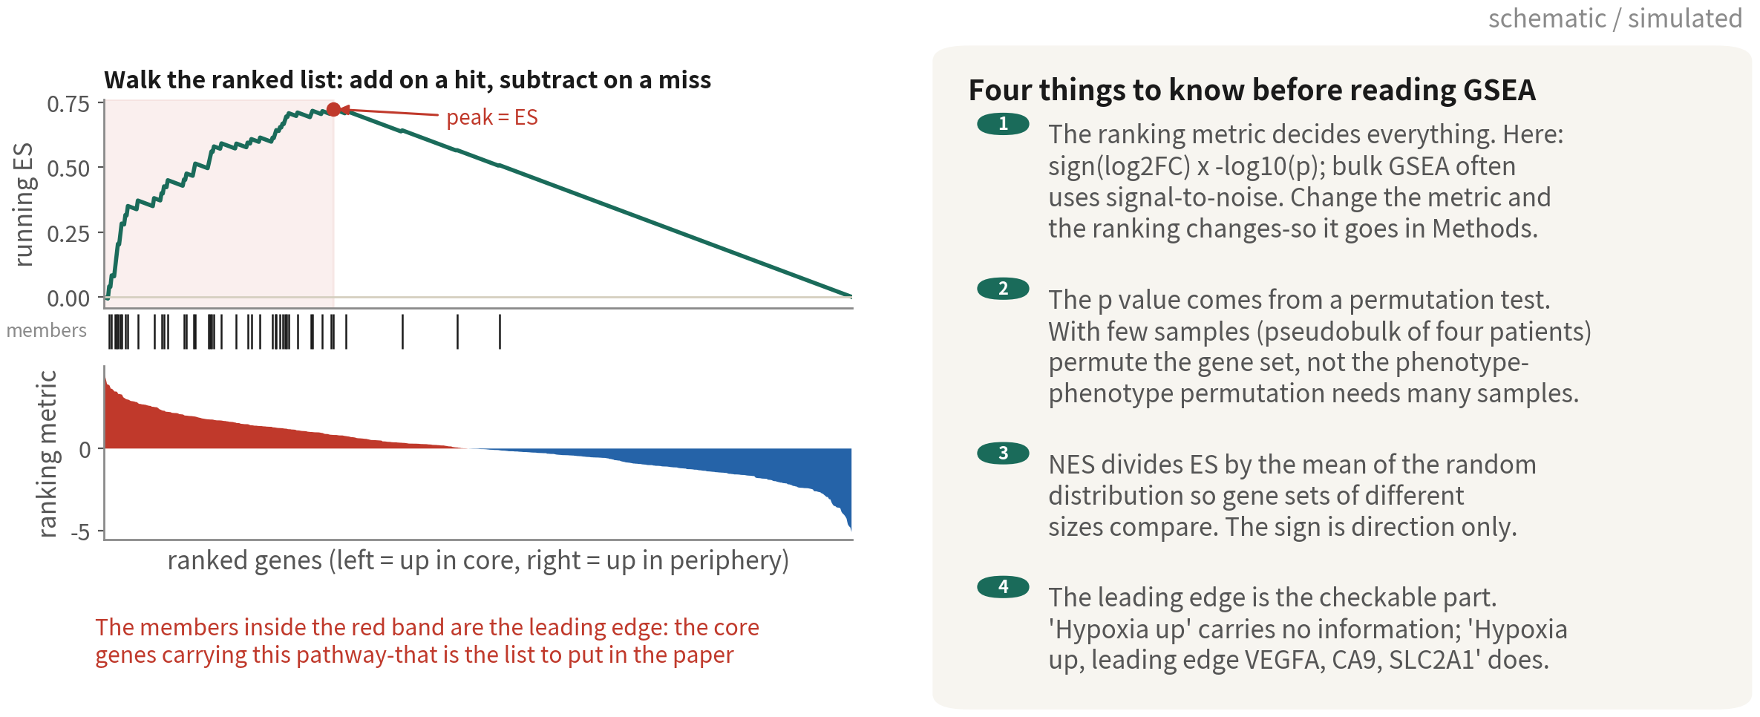
Inside GSEA: the running score, the peak and the leading edge
GSEA sets no threshold; it asks whether a gene set clusters at one end of the ranking. What
goes in the paper is not the pathway name but the leading-edge gene list | Script 06a §4
Reference: Subramanian A, et al. Proc Natl Acad Sci USA. 2005;102(43):15545–15550. doi:10.1073/pnas.0506580102
Q3 Hands-on II
45
Notes:
ORA 要先切一條線，把基因分成顯著和不顯著。GSEA 不切線，它問的是另一個問題：這一組基因，是不是集中在排序的某一端。 左邊三張圖，從下往上看。最下面是排序好的基因，左邊是核心側高的、右邊是邊緣側高的。中間那排黑線，是某一條路徑的成員落在哪些位置。最上面是走過去的累積分數：從左邊開始走，遇到成員就往上加，沒遇到就往下減一點點。如果成員集中在左邊，曲線會先往上衝，再一路下滑，那個峰值就是這條路徑的 ES。 峰值左邊那一段——紅色區間裡的成員基因——就是 leading edge。它是撐起這條路徑的核心基因。這件事很重要：要寫進論文的不是路徑名字，是這一串基因。 右邊有四件事。第一，排序指標決定一切。本課用 log2FC 的正負乘上負 log10 p 值；bulk 的 GSEA 常用 signal-to-noise。換指標，排序就換，結論也可能跟著換，所以一定要寫進 methods。 第二，p 值來自置換檢定。樣本數少的時候——我們 pseudobulk 只有四位病人——要用 gene_set 置換，也就是隨機抽同樣大小的基因集來比；不能用 phenotype 置換，因為打亂樣本標籤這件事，需要夠多樣本才有意義。 第三，NES 是把 ES 除以隨機分布的平均，目的是讓不同大小的基因集可以互相比較。正負只代表方向，不代表強弱等級。 第四，回到 leading edge。只寫「缺氧路徑上調」沒有資訊量，任何人都可以這樣宣稱；寫「缺氧路徑上調，leading edge 是 VEGFA、CA9、SLC2A1」，別人才查得下去。 ──────── ORA has to draw a line first, splitting genes into significant and not. GSEA draws no line; it asks a different question: is this set of genes concentrated at one end of the ranking. Read the three panels on the left from the bottom up. At the bottom are the genes in rank order, higher in the core to the left, higher in the periphery to the right. The row of black ticks marks where one pathway's members fall. At the top is the running score: walk the list from the left, add on a hit, subtract a little on a miss. If the members cluster at the left, the curve climbs and then drifts down, and the peak is this pathway's ES. Everything to the left of the peak - the members inside the red band - is the leading edge. Those are the genes carrying the pathway. This matters: what goes in the paper is not the pathway name, it is that gene list. Four things on the right. First, the ranking metric decides everything. Here we use the sign of log2FC times minus log10 p; bulk GSEA often uses signal-to-noise. Change the metric and the ranking changes, and the conclusion can change with it, so it belongs in Methods. Second, the p value comes from a permutation test. With few samples - our pseudobulk has four patients - permute the gene set, that is, draw random sets of the same size to compare against. Do not permute the phenotype: shuffling sample labels needs many samples to mean anything. Third, NES divides ES by the mean of the random distribution so that gene sets of different sizes are comparable. Its sign is direction only, not a grade of strength. Fourth, back to the leading edge. 'Hypoxia pathway up' carries no information; anyone can claim it. 'Hypoxia pathway up, leading edge VEGFA, CA9, SLC2A1' is something a reader can check.

Slide 46
GSEA: three databases, every type, one loop
library(fgsea); library(msigdbr) msig <- function(coll, sub = NULL) { m <- msigdbr(species = "Homo sapiens", collection = coll, subcollection = sub) split(m$gene_symbol, m$gs_name) } gene.sets <- list(Hallmark = msig("H"), GO_BP = msig("C5", "GO:BP"), KEGG = msig("C2", "CP:KEGG_LEGACY")) rank_stat <- function(res) { # rank by the Wald stat, not the shrunken LFC r <- setNames(res$stat, res$gene); r <- r[!is.na(r)] sort(r + rnorm(length(r), sd = 1e-6), decreasing = TRUE) } # break ties run_gsea <- function(d, sets) rbindlist(lapply(names(sets), function(nm) { g <- fgsea(sets[[nm]], rank_stat(d$res), minSize = 15, maxSize = 500, nproc = 1) g$collection <- nm; g$type <- d$type; g })) gsea.all <- rbindlist(lapply(de, run_gsea, sets = gene.sets)) gsea.all[padj < 0.05][order(-abs(NES))][, .SD[1:min(5, .N)], by = .(type, collection)]
eps = 0 demands infinitely precise p values and runs for hours; the default 1e-10 is plenty. The background is
automatically the tested genes | Script 06a §4 | Deeper: B13
Reference: Korotkevich G, Sukhov V, Sergushichev A. bioRxiv. doi:10.1101/060012
Q3 Hands-on II
46
Notes:
msig 是個小函式，包住 msigdbr 新舊版參數名的差異，回傳 gene set 的 list。三個資料庫：Hallmark、GO BP、KEGG legacy。 rank_stat：排序統計量用 Wald stat，不用收縮後的 LFC。再加一個極小的雜訊把同分打散——fgsea 遇到同分會警告，結果也會不穩。然後由大到小排。 run_gsea：對一種型別，三個資料庫各跑一次 fgsea，minSize 十五、maxSize 五百，eps 留預設。這裡別手癢：eps 設成零，等於要求 p 值算到無限精細，五十條 Hallmark 也可能跑上幾個小時——預設的 1e-10 已經夠報告用了。 rbindlist 把所有型別、所有資料庫疊成一張大表。最後一行是 data.table 的寫法：padj 小於 0.05、按絕對 NES 排、每種型別每個資料庫各看前五。 還有一個好消息：背景基因集自動就是「被檢定的基因」，不是全基因組。這是 GSEA 相對 ORA 少一個坑的地方。 ──────── msig is a small helper function that hides the parameter-name differences between old and new msigdbr, returning a list of gene sets. Three databases: Hallmark, GO BP, KEGG legacy. rank_stat: the ranking statistic is the Wald stat, not the shrunken LFC. Add a tiny bit of noise to break ties — fgsea warns on ties, and the results wobble too. Then sort from largest to smallest. run_gsea: for one cell type, run fgsea once per database, minSize fifteen, maxSize five hundred, and leave eps at its default. Resist the itch to touch it. Setting eps to zero demands infinitely precise p-values — even fifty Hallmark sets can grind for hours. The default of 1e-10 is plenty for a paper. rbindlist stacks every cell type and every database into one big table. The last line is data.table style: padj below 0.05, sorted by absolute NES, top five per cell type per database. And one piece of good news: the background gene set is automatically "the genes that were tested", not the whole genome. That is one trap GSEA has that ORA doesn't — solved for free.

Slide 47
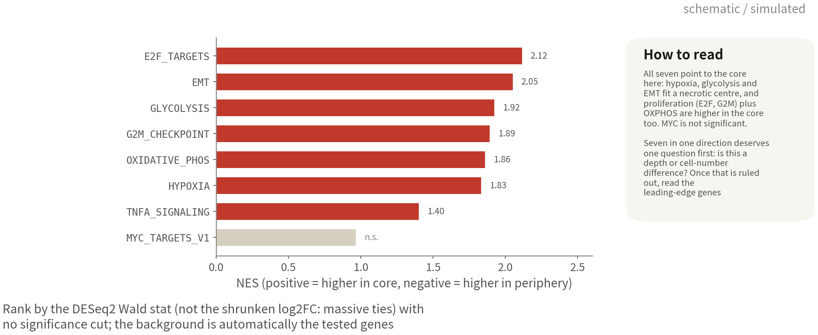
GSEA: turn a hundred-odd genes into one sentence
All seven Hallmark sets are higher in the core here (hypoxia, glycolysis, EMT, proliferation, OXPHOS); MYC is not
significant. Agreement this uniform means ruling out a depth difference first, then reading the leading-edge genes
Reference: Subramanian A, et al. Proc Natl Acad Sci USA. 2005;102(43):15545–15550. doi:10.1073/pnas.0506580102
Q3 Hands-on II
47
Notes:
正的 NES 是核心較高：缺氧、糖解、EMT、TNFα 訊號。負的是邊緣較高：干擾素反應、G2M、氧化磷酸化、MYC 標的。 怎麼讀？核心是壞死中心的微環境——缺氧、糖解，合理。邊緣是浸潤中的細胞——增殖、氧化磷酸化，也合理。方向合理，代表已知答案驗證通過。接著就去看 leading edge 裡是哪些基因，那才是我們真正的發現。 ──────── Positive NES means higher in the core: hypoxia, glycolysis, EMT, TNF-alpha signalling. Negative means higher at the periphery: interferon response, G2M, oxidative phosphorylation, MYC targets. How do we read that? The core is the microenvironment of a necrotic centre — hypoxia, glycolysis — makes sense. The periphery is cells mid-infiltration — proliferation, oxidative phosphorylation — also makes sense. Directions make sense, so the known-answer check passes. Next, go and look at which genes sit in the leading edge — that is where the discovery actually is.

Slide 48
ORA: GO and KEGG in clusterProfiler, up and down separately
library(clusterProfiler); library(org.Hs.eg.db); library(enrichplot) run_ora <- function(d, direction = "up", fc = 0.5, p = 0.05) { r <- d$res[!is.na(d$res$padj), ] sig <- r$gene[r$padj < p & (if (direction == "up") r$log2FC > fc else r$log2FC < -fc)] if (length(sig) < 10) return(NULL) # too few significant genes: use GSEA instead go <- enrichGO(sig, OrgDb = org.Hs.eg.db, keyType = "SYMBOL", ont = "BP", universe = d$res$gene, # * background = the genes tested, not the whole genome minGSSize = 15, maxGSSize = 500) |> clusterProfiler::simplify(cutoff = 0.7) # igraph has simplify() too, so write the full name ids <- bitr(sig, "SYMBOL", "ENTREZID", org.Hs.eg.db) uni <- bitr(d$res$gene, "SYMBOL", "ENTREZID", org.Hs.eg.db) kegg <- enrichKEGG(ids$ENTREZID, "hsa", universe = uni$ENTREZID, minGSSize = 15) |> setReadable(org.Hs.eg.db, keyType = "ENTREZID") # needs an internet connection list(go = go, kegg = kegg) } ora <- run_ora(de[["Immune cell"]], "down") # the only type that clears the bar dotplot(ora$go, showCategory = 12); dotplot(ora$kegg, showCategory = 12) cnetplot(ora$go, showCategory = 5) # term-gene network: which genes carry which term
Leave universe empty and clusterProfiler uses the whole genome as background — twice the terms, all spurious. Up and down separately, because 'hypoxia up'
and 'proliferation down' cancel when mixed. We demo the down side: this dataset returns no terms on the up side | Script 06a §4
Reference: Wu T, et al. Innovation (Camb). 2021;2(3):100141. doi:10.1016/j.xinn.2021.100141
Q3 Hands-on II
48
Notes:
run_ora 一個函式就夠。先從結果表挑出顯著基因：padj 小於 0.05，上調是 log2FC 大於 0.5，下調是小於負 0.5。不到十個就回傳 NULL——那種情況改看 GSEA。 enrichGO：OrgDb 用 org.Hs.eg.db，keyType 是 SYMBOL，ont 是 BP。universe 這個參數是整段最重要的一行：背景等於被檢定的基因，也就是結果表裡所有的基因。留空的話，clusterProfiler 會拿全基因組當背景，顯著詞條會多一倍，而且全是假的。跑完再 simplify，cutoff 0.7，把相似詞條合併。 KEGG 那邊要 Entrez ID，用 bitr 轉換，顯著基因跟背景都要轉。enrichKEGG 要連網抓資料庫；setReadable 再把 ID 轉回基因名。 上調下調為什麼一定要分開？因為「缺氧上升」和「增殖下降」是相反方向的程式，混在一起做 ORA 會互相抵銷，結果兩邊都看不到。 圖的部分：dotplot 看前十二名，GO 和 KEGG 各一張；cnetplot 畫詞條和基因的網路，看哪些基因撐起哪個詞條——你常常會發現，是同一批基因撐起了五個詞條。 ──────── run_ora is one function, and one is enough. First pick significant genes from the results table: padj below 0.05, up is log2FC above 0.5, down is below minus 0.5. Fewer than ten, return NULL — go look at GSEA instead. enrichGO: OrgDb is org.Hs.eg.db, keyType is SYMBOL, ont is BP. The universe argument is the most important line of the whole block: background equals the genes that were tested — every gene in the results table. Leave it empty and clusterProfiler takes the whole genome as background, doubling the significant terms — all of them fake. After running, simplify with cutoff 0.7 to merge similar terms. KEGG wants Entrez IDs — convert with bitr, both the significant genes and the background. enrichKEGG fetches the database over the internet; setReadable turns the IDs back into gene names. Why up and down separately? Because "hypoxia up" and "proliferation down" are programmes moving in opposite directions; run ORA on them mixed and they cancel each other out — we see neither. Plots: dotplot for the top twelve, one each for GO and KEGG; cnetplot draws the network of terms and genes, showing which genes prop up which term — and very often you'll find the same batch of genes propping up five terms.

Slide 49
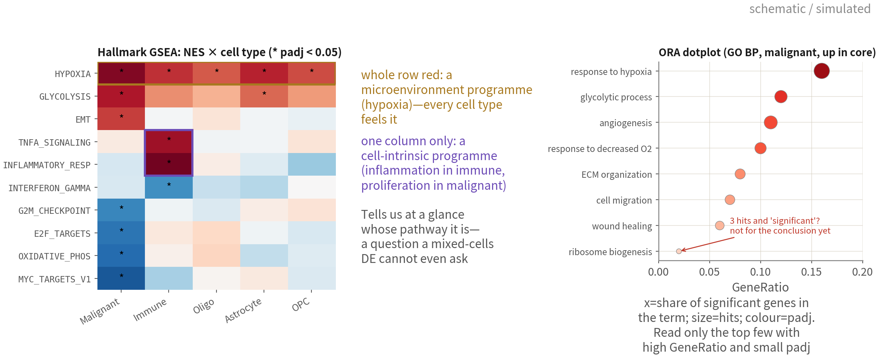
Reading enrichment: the NES heatmap and the dotplot
A whole red row = a microenvironment programme every type feels; one column = a cell-intrinsic programme.
In the dotplot read only the top few with high GeneRatio and small padj | Script 06a §4, plots A–C
Q3 Hands-on II
49
Notes:
左邊這張是這一段的招牌圖。Hallmark 的 NES 排成熱圖，列是 pathway，欄是細胞型別，格子上有星號的，就是 padj 小於 0.05。 看的時候，其實你只要找兩種 pattern。一種是整列都紅——缺氧、糖解就是這樣——這是微環境程式，每一種細胞都感受得到，因為它們都泡在同一個壞死中心裡，誰也躲不掉。另一種是只有一欄紅，像免疫細胞的發炎、惡性細胞的增殖，那就是細胞內在的程式。一張圖看下去，你一眼就答得出「這條 pathway 到底是誰的」。回頭想想，要是剛才 DE 把所有細胞混在一起做，這個問題根本問不出來。這就是每種型別各自比，比到現在才領到的回報。 右邊是 ORA 的 dotplot。橫軸 GeneRatio，意思是顯著基因裡有多少比例落在這個詞條；點的大小是命中數；顏色是 padj。讀法很簡單：只看前幾名，而且要 GeneRatio 高、padj 又小的那些。最底下那個 ribosome biogenesis，命中三個基因就顯著了——這種先別急著寫進結論。 ──────── On the left is this section's signature figure. Hallmark NES laid out as a heatmap — rows are pathways, columns are cell types, and a cell with an asterisk means padj below 0.05. Reading it, you are really only hunting two patterns. A whole row red — hypoxia, glycolysis — is a microenvironment programme: every cell type feels it, because they are all soaking in the same necrotic centre and nobody gets to opt out. A single column red — inflammation in immune cells, proliferation in malignant cells — is a cell-intrinsic programme. One glance and you can answer "whose pathway is this". And if we had run DE with everything mixed together, that question could not even be asked. This is the payoff of per-cell-type comparisons. On the right is the ORA dotplot. X axis is GeneRatio — the fraction of our significant genes falling in that term; dot size is the hit count; colour is padj. The reading rule is simple: only the top few, and only the ones with high GeneRatio and small padj. That ribosome biogenesis at the bottom, significant on three gene hits — do not rush that one into the conclusions.

Slide 50



The five most common enrichment mistakes
Wrong background
Direction flipped
or mixed
Redundancy is not
evidence
The universe must be the tested
genes, not the genome. Single
cell detects ~12k genes; a 20k
background inflates every term
NES sign follows the tissue
level order. Unsplit ORA lets
opposite programmes cancel —
check direction first
GO's three 'response to …
oxygen' terms are one thing.
Count after simplify(); report
one term, not three
Concluding from too
few hits
Whose pathway is it?
Terms with 3–5 hits stay
out of the conclusion. A
leading edge needs a dozen
genes we can explain
Hypoxia rises in malignant
cells and macrophages alike —
that is the microenvironment,
not a malignant trait
Q3 Hands-on II
50
Notes:
五張卡，每一張都是審稿人真的會抓的。 第一，背景錯了。ORA 的 universe 必須是被檢定的基因。單細胞其實只測到一萬多個基因，你要是拿兩萬多當背景，每個詞條都會膨脹。 第二，方向弄反，或者上下調混在一起。NES 的正負完全取決於 tissue 的 levels 順序；ORA 上下調不分開做，兩邊會互相抵銷。所以先拿一個已知答案回頭校對——核心該缺氧——方向確認了再往下讀。 第三，把冗餘詞條當成多重證據。GO 裡那三個 hypoxia 詞條講的是同一件事。simplify 之後再數，報告的時候寫一條就好。 第四，命中太少就下結論。三到五個基因撐起來的詞條，不進結論；leading edge 至少要十來個基因，而且你要能一個一個說出它們在做什麼。 第五，忘了問這是誰的 pathway。缺氧在惡性細胞升、在巨噬細胞也升——那是微環境，不是惡性細胞的特性。每種型別各自做、再排成熱圖，共同的和專屬的才分得出來。 ──────── Five cards, and every one of them is something a reviewer will genuinely catch. One, wrong background. ORA's universe must be the genes that were actually tested. Single-cell only detects ten-odd thousand genes; hand it twenty-odd thousand as background and every term inflates. Two, direction flipped, or up and down mixed together. The sign of NES depends entirely on the order of tissue's levels; and if ORA does not separate up from down, the two sides cancel each other. So take a known answer — the core should be hypoxic — and check the direction against it before you read any further. Three, treating redundant terms as multiple lines of evidence. GO's three hypoxia terms are all saying one thing. Count after simplify, and report it as one line. Four, drawing conclusions from too few hits. A term propped up by three to five genes does not enter the conclusions; a leading edge needs at least a dozen genes, and you should be able to say what each one of them does. Five, forgetting whose pathway it is. Hypoxia rises in malignant cells and it also rises in macrophages — that is the microenvironment, not a property of malignant cells. Only running each cell type separately and laying them out as a heatmap separates the shared from the exclusive.

Slide 51
Deliverables: per-type DE tables, volcanoes,
GSEA and ORA summaries
for (ty in names(de)) # one table per cell type write.csv(de[[ty]]$res, sprintf("output/tables/06_de_%s.csv", ty), row.names = FALSE) write.csv(de.summary, "output/tables/06_de_summary_by_type.csv", row.names = FALSE) vol <- lapply(de, function(d) { # red = up in core, blue = up in periphery, grey = NS kv <- with(d$res, ifelse(padj < 0.05 & log2FC > 1, "#D62728", ifelse(padj < 0.05 & log2FC < -1, "#1F77B4", "grey70"))) names(kv) <- c("#D62728" = "Up in core", "#1F77B4" = "Up in periphery", grey70 = "NS")[kv] EnhancedVolcano(d$res, lab = d$res$gene, x = "log2FC", y = "padj", colCustom = kv, pCutoff = 0.05, FCcutoff = 1, title = paste0(d$type, ": core vs periphery")) }) ggsave("output/figs/06_volcano_all_types.png", wrap_plots(vol, ncol = 2), bg = "white") gsea.all[, leadingEdge := sapply(leadingEdge, paste, collapse = ";")] # turn the list column into a string write.csv(gsea.all, "output/tables/06_gsea_all_types.csv", row.names = FALSE) # NES heatmap (rows = pathway, columns = cell type) and the ORA dotplot: see script 06a section 4, plots A-C foc <- de[["Immune cell"]] # the only type that clears the bar here plotEnrichment(gene.sets$Hallmark[["HALLMARK_HYPOXIA"]], rank_stat(foc$res))
Tables carry raw and shrunken LFC, padj and baseMean; the volcano plots padj, not p; the GSEA table includes the leading edge. Everything regenerates
from the script; nothing in output is hand-made | Script 06a §5
Q3 Hands-on II
51
Notes:
DE 跟富集都做完了，接下來把它變成交得出去的東西。 先是 DE 表。每種型別一份 CSV，欄位要有未收縮和收縮後的 log2FC、stat、padj，還有 baseMean——baseMean 低的基因，就算 FC 看起來很大也要小心。再留一張 de.summary 總表：每種型別用了幾對病人、拿到幾個顯著基因，一眼看完。 火山圖每種型別一張，最後再拼成一張總圖。標題寫清楚是哪種細胞、核心對邊緣。 GSEA 表有個地雷：leadingEdge 是 list 欄位，要先 paste 成字串再存 CSV，否則 write.csv 會出錯。leading edge 一定要附，因為審稿人會問「缺氧到底是哪些基因在動」。再加上 NES 熱圖、每種型別的條圖、hypoxia 的 enrichment plot，還有 ORA 的表和 dotplot。 這些全部由腳本 06a 重生。這就是 Q2 講的可重現：output 裡沒有任何一個檔案是手工做的。 ──────── DE and enrichment are both done — now we turn them into something we can hand over. DE tables first. One CSV per cell type, and the columns must include unshrunken and shrunken log2FC, stat, padj and baseMean — a gene with a low baseMean deserves caution even when the FC looks big. Then de.summary as one master table: patient pairs and significant genes per cell type, all in one view. Volcano plots, one per cell type, then assembled into one master figure. Titles must state which cell type, core versus periphery. The GSEA table has a landmine in it: leadingEdge is a list column, so paste it into a string before saving to CSV, or write.csv errors out. And always attach the leading edge, because reviewers will ask "which genes exactly are moving in hypoxia". Then the NES heatmap, the per-type bar plots, the enrichment plot for hypoxia. ORA tables and dotplots. All of it regenerated by script 06a. This is the reproducibility from Q2: not a single file in output is handmade.

Slide 52
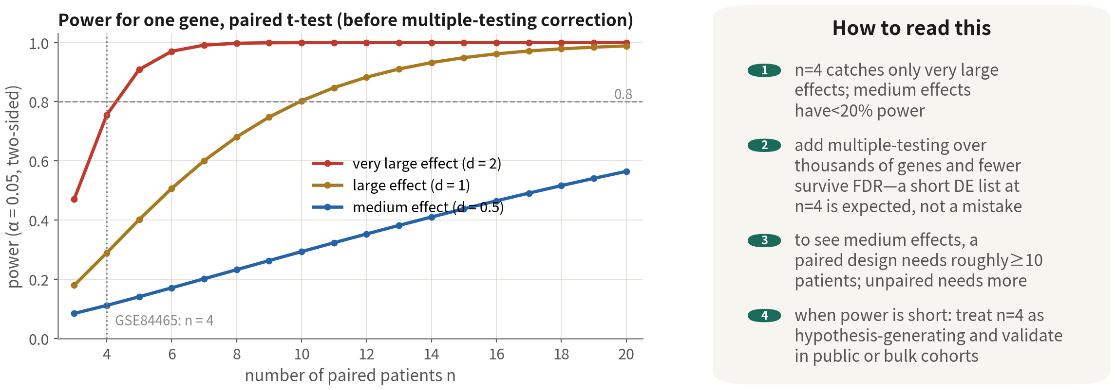
How many patients are enough? Power comes from patients
n = 4 sees only very large effects, so a short DE list is expected. Treat n = 4 as
hypothesis-generating and validate in public cohorts — Pitfall 3 stated positively
References: Zimmerman KD, Espeland MA, Langefeld CD. Nat Commun. 2021;12(1):738. doi:10.1038/s41467-021-21038-1 ｜ Squair JW, et al. Nat Commun. 2021;12(1):5692. doi:10.1038/s41467-021-25960-2
Q3 Hands-on II
52
Notes:
DE 做完，很多人第一個反應是：為什麼只有一百多個基因？答案就在這張圖裡。 左圖是單一基因、配對 t 檢定的功效曲線，橫軸是配對的病人數。紅線是很大的效應，Cohen's d 等於 2，n 等於 4 的功效已經七成多。金線是大效應，d 等於 1，n 等於 4 只有三成。藍線是中等效應，n 等於 4 連兩成都不到。 而這還只是單一基因。再加上幾千個基因的多重校正，能過 FDR 的又更少。所以 n 等於 4 的 DE 表短，是正常的，不是分析做錯。反過來說才要緊張：如果 cell-level 檢定一口氣給你兩千個基因，那才是有問題。 想看到中等效應，配對設計大約需要十位以上病人；非配對的設計還要更多。這就是 Q1 講實驗設計時，那句「多一位病人比多一萬顆細胞值」的理由。 那功效不夠的時候怎麼辦？正確的做法是把 n 等於 4 當作假說產生，然後用公開資料驗證——TCGA 幾百份 Bulk、其他人的單細胞資料。這是雷三的正面版本。 ──────── After DE, the first reaction is usually: why only a hundred-odd genes? The answer is in this figure. The left panel is the power curve for a single gene under a paired t-test, x axis the number of paired patients. The red line is a very large effect — Cohen's d of 2 — where n equals 4 already gives seventy-plus percent power. The gold line is a large effect, d of 1: n equals 4 gives only thirty percent. The blue line is a medium effect: n equals 4 does not even reach twenty. And that is for one gene. Add multiple-testing correction over thousands of genes, and even fewer clear FDR. So a short DE table at n equals 4 is normal, not a botched analysis. The reverse is what should worry you: if a cell-level test hands us two thousand genes in one go — that is what is broken. To see medium effects, a paired design needs roughly ten or more patients; an unpaired design needs even more. This is exactly why Q1's experimental-design episode said "one more patient is worth more than ten thousand more cells". So what do we do when power falls short? Treat n equals 4 as hypothesis-generating, then validate on public data — hundreds of TCGA bulk samples, other people's single-cell data. That is the positive version of pitfall three.

Slide 53


When pseudobulk is impossible: three lines of defence
First admit
where we are
Defences 1 + 2: covariate
and per-patient consistency
Defence 3: label
permutation
Pseudobulk needs ≥ 2–3
biological replicates per
condition. Too few patients
(skipped in 06a's de.summary,
like OPC here) means falling
back to cell level — where cell
counts inflate p, so the result
can only be
hypothesis-generating
Run Seurat's default Wilcoxon
as the baseline, then MAST
with patient in latent.vars
(Wilcoxon cannot) — genes
significant only under
Wilcoxon are mostly patient
effects. Then compute logFC
per patient and keep
one-direction genes; NA in the
table = that patient has < 5
cells on one side
Shuffle tissue labels within
patients and rerun: real signal
should far exceed the
'significant' count under
permutation. If they are
comparable, that is
pseudoreplication talking.
State method and limits on the
deliverable table
References: Squair JW, et al. Nat Commun. 2021;12(1):5692. doi:10.1038/s41467-021-25960-2 ｜ Crowell HL, et al. Nat Commun. 2020;11(1):6077. doi:10.1038/s41467-020-19894-4
Q3 Hands-on II
53
Notes:
上一頁說功效不夠是常態；這一頁要講更糟的情況：連 pseudobulk 都做不成。pseudobulk 要每個條件至少兩三個生物重複，湊不出來就沒得做。06a 的 de.summary 裡被跳過的那些型別，就是實例——這份資料的 OPC，兩個部位都夠的病人只有一位。這時候只能退到 cell-level 做，但要帶著三道防線走。 第一件事是先承認自己落到哪裡。cell-level 的 p 值是被細胞數灌大的，這就是雷一的假重複。所以不管結果多漂亮，定位只能是「假說產生」。 防線一，檢定的時候把病人放進模型。先跑 Seurat 預設的 Wilcoxon 當基準——它沒辦法放共變量——再用 MAST，latent.vars 給 patient。兩張表一對照，只在 Wilcoxon 顯著的那些基因，多半是病人差異假扮的差異。只有一位病人的時候這個共變量沒有意義——那也就代表，結論只屬於這位病人。 防線二，逐病人一致性。對前三十名基因，每位病人各算一次 logFC，方向全一致的才留下來。表裡會冒出很多 NA——NA 不是錯誤，是「這位病人某一側不到五顆、無法評估」。整欄都是 NA，那就是「為什麼不能 pseudobulk」的視覺化。只有一位病人可評估的時候，一致性根本無從談起——這句話請原封不動寫進報告的限制段落。 防線三，標籤置換。把 tissue 標籤在病人內隨機打散重跑，看能撈到幾個「顯著」基因。真實訊號應該遠多於置換值；如果差不多多，那就是假重複在說話。 ──────── The last slide said underpowered is the norm. This one is about something worse: pseudobulk isn't even possible. Pseudobulk needs at least two or three biological replicates per condition, and if you cannot assemble them there is nothing to run. The cell types skipped in 06a's de.summary are the real example — in this dataset that is OPC, where only one patient has enough cells at both sites. Then we fall back to cell-level testing, but we go in carrying three lines of defence. The first thing is to admit where we have landed. Cell-level p-values are inflated by cell numbers — that is the pseudoreplication of pitfall one. So however pretty the result, its status can only be "hypothesis-generating". Defence one: put patient into the model when testing. Run Seurat's default Wilcoxon first as the baseline — it cannot take covariates — then run MAST with latent.vars set to patient. Put the two tables side by side: the genes significant only in Wilcoxon are mostly patient differences masquerading as condition differences. With only one patient the covariate is meaningless — which also means the conclusion belongs to that one patient and nobody else. Defence two: per-patient consistency. For the top thirty genes, compute the logFC once per patient, and keep only those consistent in direction across all patients. The table will sprout a lot of NAs — an NA is not an error, it means "this patient has under five cells on one side, can't be assessed". A column of all NAs is the visualisation of "why pseudobulk was impossible". And when only one patient is assessable, consistency cannot even be discussed — put that sentence, verbatim, in the limitations paragraph of the report. Defence three: label permutation. Shuffle the tissue labels within each patient, rerun, and count how many "significant" genes come out. Real signal should far exceed the permuted values; if they come out about the same, that is pseudoreplication talking.

Slide 54
Cell-level DE done properly (script 06b)
obj <- subset(gbm4, cells = colnames(gbm4)[gbm4$type == "OPC"]) table(obj$patient, obj$tissue) # look at the sample structure first: only one patient has both sites Idents(obj) <- "tissue" fm <- function(...) FindMarkers(obj, ident.1 = "Tumor", ident.2 = "Periphery", logfc.threshold = 0.25, min.pct = 0.1, ...) |> tibble::rownames_to_column("gene") # genes live in rownames: pull them out de.wilcox <- fm() # Seurat's default Wilcoxon: the baseline de <- fm(test.use = "MAST", latent.vars = "patient") # defence 1: patient as a covariate setdiff(head(de.wilcox$gene, 30), head(de$gene, 30)) # significant only under the default ~ a patient effect # Defence 2: per-patient logFC; keep a gene only if the direction agrees # (a patient with < 5 cells on one side does not count) # Defence 3: permute tissue within patient 20 times, compare the real number of significant genes with the null perm.sig <- replicate(20, { o <- obj; o$tissue <- ave(as.character(o$tissue), o$patient, FUN = sample) Idents(o) <- factor(o$tissue, levels = c("Periphery", "Tumor")) sum(FindMarkers(o, ident.1 = "Tumor", ident.2 = "Periphery", logfc.threshold = 0.25)$p_val_adj < 0.05, na.rm = TRUE) }) de$method <- "cell-level MAST; hypothesis-generating" # state the limitation in the deliverable table
The point is not the p value — it is the three defences and honest framing. Whenever pseudobulk is possible, use 06a; 06b is the
fallback when the sample structure forbids it | Script 06b
Reference: Squair JW, et al. Nat Commun. 2021;12(1):5692. doi:10.1038/s41467-021-25960-2
Q3 Hands-on II
54
Notes:
程式碼過一遍。subset 取出那個型別，第一件事先印 table 病人乘部位——誠實面對自己的樣本結構。 FindMarkers 先照 Seurat 預設跑一次 Wilcoxon 當基準；然後再跑一次，test.use 用 MAST、latent.vars 給 patient，logfc.threshold 0.25、min.pct 0.1 把雜訊先擋掉。跑完用 setdiff 看看哪些基因只在預設法的前三十名裡——那批就是共變量幫你扣掉的病人效應。 逐病人一致性，是一個小函式：對每位病人算 Tumor 減 Periphery 的平均表現差，單邊不到五顆的病人記 NA、不算。 置換的部分，replicate 二十次——教學用二十，正式分析至少一百——ave 把 tissue 在病人內打散，重跑 FindMarkers 數顯著基因，最後畫一張直方圖，紅線是真實值。 最後交付的表，加一欄 method，明寫「cell-level、假說產生」。能 pseudobulk 就永遠用 06a；06b 是樣本結構不允許時的備案，不是捷徑。 ──────── A pass through the code. subset the cell type out, and the first thing you print is the patient-by-site table — face the sample structure honestly. FindMarkers runs once with Seurat defaults, Wilcoxon, as the baseline; then again with test.use MAST and latent.vars patient, logfc.threshold 0.25 and min.pct 0.1 to block noise up front. Then setdiff shows the genes in the top thirty of the default method only — that batch is the patient effect the covariate is subtracting for you. Per-patient consistency is a small function: for each patient it computes the mean expression difference of Tumor minus Periphery, and a patient with under five cells on either side is recorded NA and not counted. For the permutation, replicate twenty times — twenty for teaching, a real analysis needs at least a hundred — ave shuffles tissue within patient, we rerun FindMarkers and count significant genes, then draw a histogram with a red line at the real value. And the deliverable table gets a method column that states plainly "cell-level, hypothesis-generating". If pseudobulk is possible, always use 06a; 06b is the fallback when the sample structure forbids it — not a shortcut.

Slide 55
06
After DE: choosing the
downstream route
Six roads tumour studies take; each needs the right data
Q3 Hands-on II
55
Notes:
標準流程到 DE 為止。後面每一條路，都需要對的資料才走得下去。 ──────── The standard pipeline ends at DE. Every route beyond only opens up if you have the right data.

Slide 56
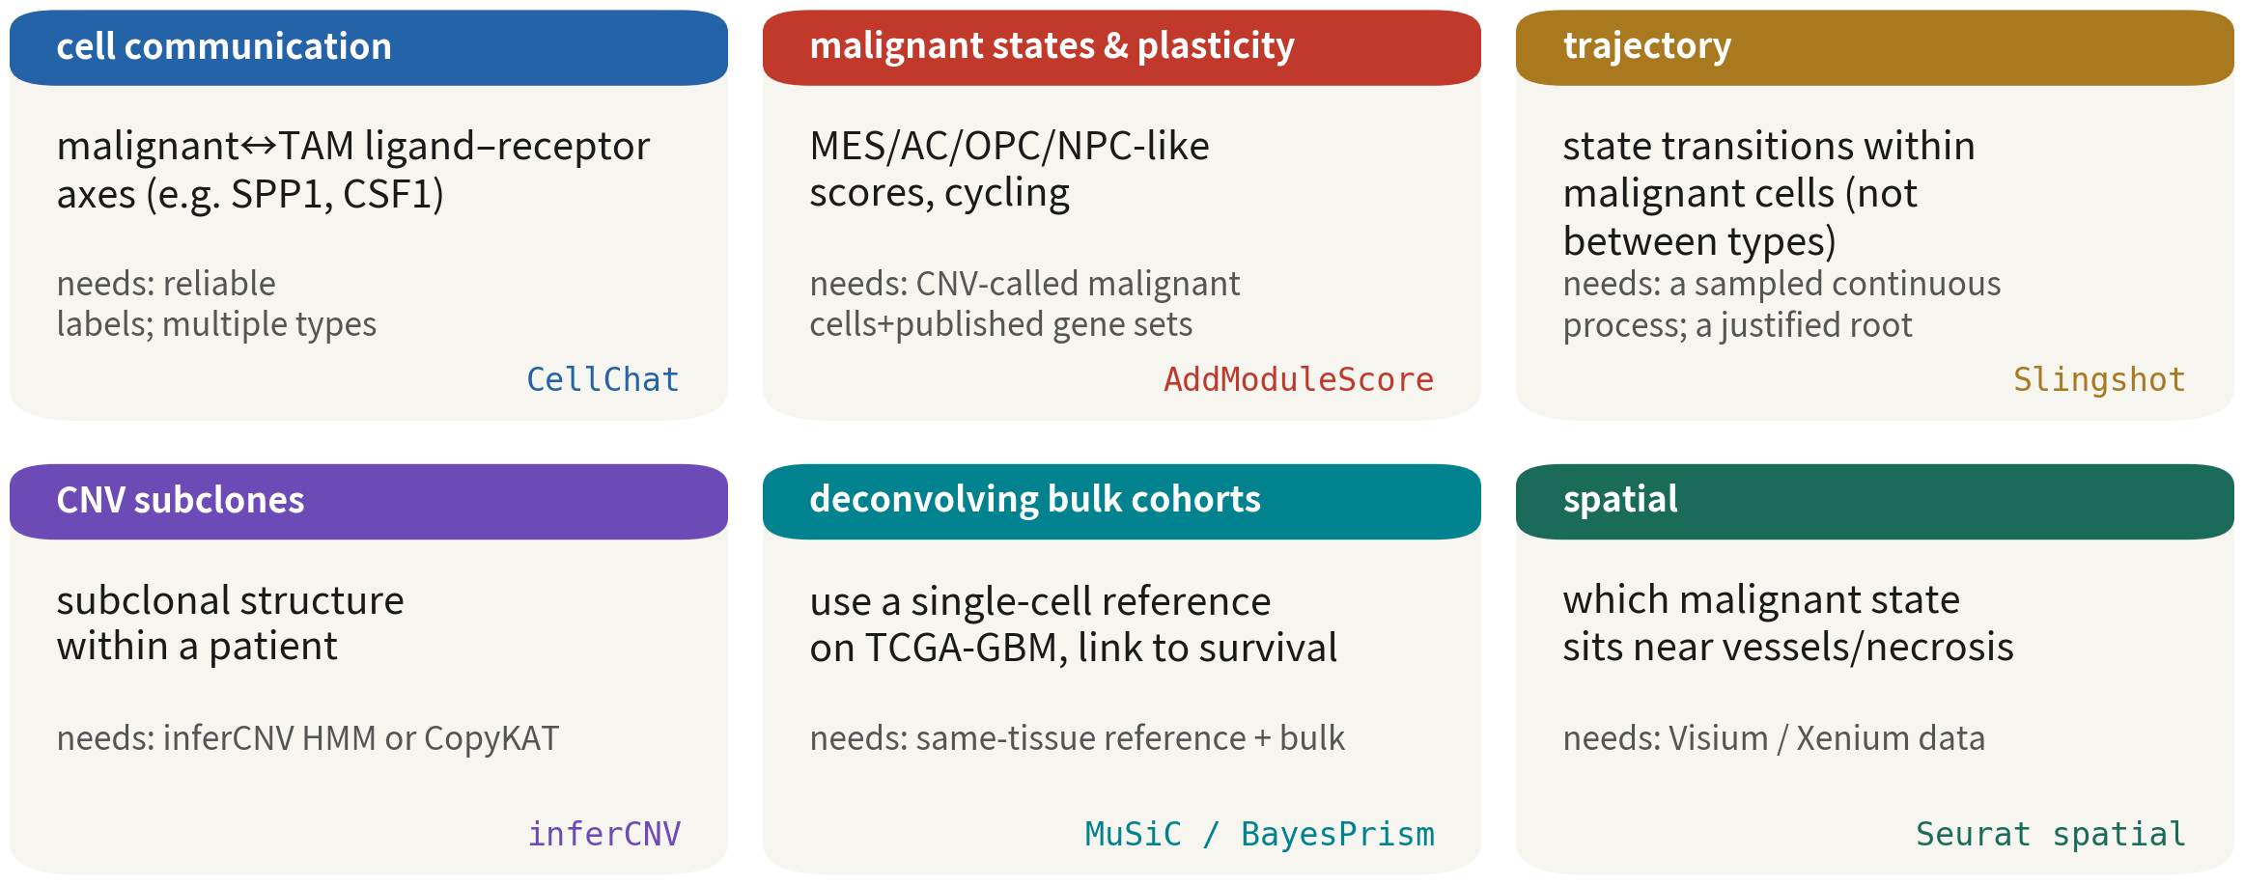
Six roads and what each needs
Check the 'needs' line first, then choose. Pick the wrong data and the whole road is void
Q3 Hands-on II
56
Notes:
六張卡，每張三行：問什麼、需要什麼、用什麼工具。 細胞通訊，問的是惡性與 TAM 之間的配體受體軸，例如 SPP1、CSF1。需要可靠的型別標籤、多種型別共存。工具是 CellChat。 惡性狀態與可塑性，看的是四種狀態的分數、還有週期。需要已判定的惡性細胞，加上發表的基因集。這條 Q2 做過了。 軌跡，是惡性細胞內部的狀態轉換——注意，不是型別之間。需要連續過程真的被取樣到、起點有依據。Slingshot。 CNV 亞株，看的是同一位病人內的亞株結構。inferCNV 開 HMM，或者 CopyKAT。 反卷積 Bulk 隊列，是用單細胞參考去拆 TCGA-GBM 幾百份 Bulk 的比例，再連結存活。需要同組織的單細胞參考加上 Bulk。MuSiC、BayesPrism。 空間，問的是哪一種惡性狀態靠近血管、靠近壞死區。需要 Visium 或 Xenium 資料。 選路的順序是這樣：先對照「需要」那一行，再決定走哪一條。選錯資料，整條路作廢。 ──────── Six cards, three lines each: what it asks, what it needs, what tool to use. Cell–cell communication asks about the ligand–receptor axes between malignant cells and TAMs, SPP1 and CSF1 for example. It needs reliable type labels, multiple types coexisting. The tool is CellChat. Malignant states and plasticity looks at scores for the four states, and at cell cycle. It needs called malignant cells plus published gene sets. This one we did in Q2. Trajectory is state transitions within malignant cells — and note, not between cell types. It needs a continuous process actually sampled, and a starting point you can justify. Slingshot. CNV subclones: the subclonal structure within one patient. inferCNV with HMM on, or CopyKAT. Deconvolution of bulk cohorts uses a single-cell reference to unmix proportions in hundreds of TCGA-GBM bulk samples, then links to survival. It needs a same-tissue single-cell reference plus bulk. MuSiC, BayesPrism. Spatial asks which malignant state sits near vessels or necrotic zones. It needs Visium or Xenium data. The order is this: check the "needs" line first, then pick the route. Pick the wrong data, and the whole route is void.

Slide 57
07
Cell–cell communication: CellChat
from run to reading
Script 07: six plots, each answering one question
Q3 Hands-on II
57
Notes:
第七段，細胞通訊。六條路裡最受歡迎的一條，也是圖最多、最容易看錯的一條。這一段用 CellChat 從跑到讀圖，六種圖，每一種回答一個問題。 ──────── Part seven, cell–cell communication. The most popular of the six routes — and also the one with the most plots and the most misreadings. This section takes CellChat from running it to reading the plots: six kinds of figures, each answering one question.

Slide 58


Cell–cell communication (CellChat / LIANA): three preconditions
The favourite downstream analysis in tumour studies — and the most often misused
Within
one sample
Both ends need
enough cells
Results are
hypotheses
Ligand and receptor must
come from the same site of
the same patient —
macrophages from patient A
cannot talk to tumour cells
of patient B. Run per
sample, then compare
Default thresholds are often
10% of cells; ambient RNA
fabricates ligands. Run
after SoupX, and only with
CNV-called malignant cells
Ligand–receptor
co-expression at the RNA
level is not binding and not
signalling. Write 'X drives
Y' only with a second line
of evidence (spatial,
protein, perturbation)
Reference: Jin S, et al. Nat Commun. 2021;12(1):1088. doi:10.1038/s41467-021-21246-9
Q3 Hands-on II
58
Notes:
六條路裡最受歡迎的一條是細胞通訊，因為大家都想知道：巨噬細胞跟惡性細胞到底在說什麼。CellChat、LIANA、CellPhoneDB 做的其實是同一件事——在配體受體資料庫裡，找一群細胞表現配體、另一群表現受體的配對。動手之前，先講三個前提。 第一，要在同一個樣本裡。配體跟受體必須來自同一位病人的同一個部位。病人 A 的巨噬細胞，不可能跟病人 B 的腫瘤細胞對話。所以按樣本分開跑，跑完再比較核心跟邊緣。把四位病人合併起來跑，出來的結果沒有意義。 第二，兩端都要有夠多的細胞表現，預設門檻通常是一成的細胞。而且環境 RNA 會製造假的配體——就是 Q2 講的那鍋湯——所以 SoupX 之後再跑，而且只用 CNV 判定後的惡性細胞。 第三，也是最要記住的：結果是假說，不是機制。RNA 層級的配體受體共表現，不等於蛋白有做出來、不等於結合、不等於訊號真的傳過去了。要寫成「X 驅動 Y」，你需要第二種證據：空間上它們真的相鄰、蛋白層級有表現、或者擾動實驗。細胞通訊分析的正確用法是產生候選，然後去驗證。 ──────── The most popular of the six routes is cell–cell communication, because everyone wants to know what the macrophages and the malignant cells are saying to each other. CellChat, LIANA, CellPhoneDB are all doing the same thing — searching a ligand–receptor database for pairs where one cell group expresses the ligand and another the receptor. Before we start, three prerequisites. First, within the same sample. Ligand and receptor must come from the same patient and the same site. Patient A's macrophages cannot talk to patient B's tumour cells. So run each sample separately, then compare core and periphery afterwards. Pool four patients into one run and the results are meaningless. Second, enough cells expressing at both ends — the default threshold is usually ten percent of cells. And ambient RNA fabricates fake ligands, the soup from Q2, so run after SoupX, and use only the CNV-called malignant cells. Third, and this is the one to hold on to: the results are hypotheses, not mechanisms. Ligand–receptor co-expression at the RNA level does not mean the protein got made, does not mean binding, does not mean signal transmitted. To write "X drives Y" we need a second kind of evidence: spatial adjacency, protein-level expression, or a perturbation experiment. The correct use of communication analysis is to generate candidates — then go and validate them.

Slide 59
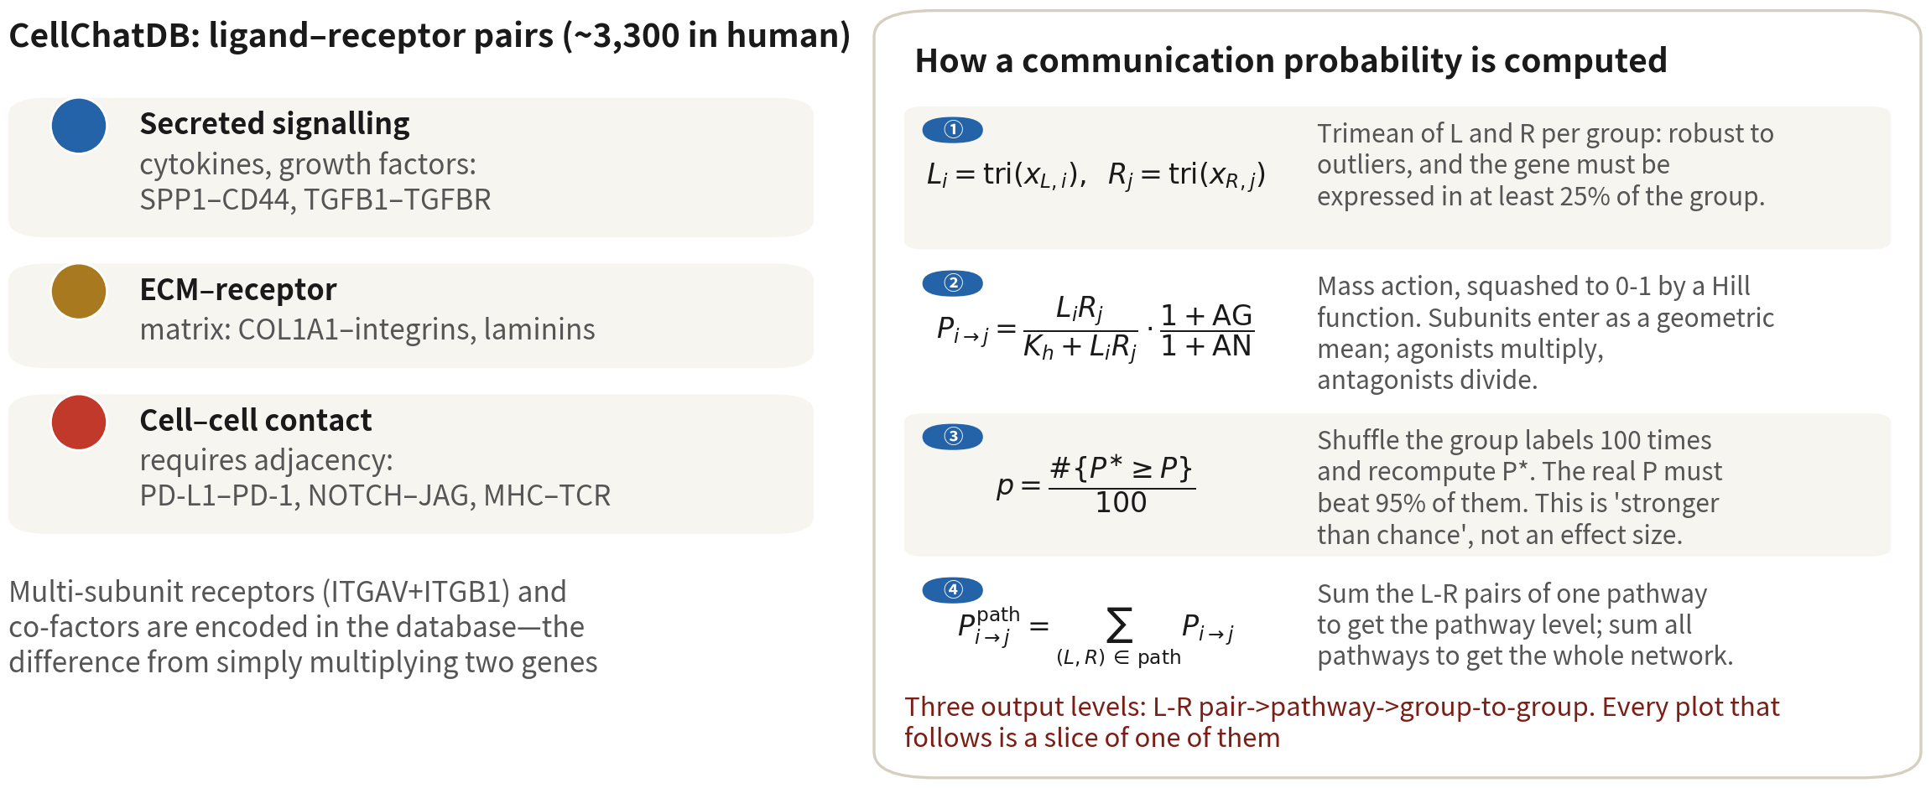
What CellChat computes
The database decides which pairs are possible, expression decides which hold, permutation
decides which are not chance. Three output levels: L–R pair, pathway, group-to-group
Reference: Jin S, et al. Nat Commun. 2021;12(1):1088. doi:10.1038/s41467-021-21246-9
Q3 Hands-on II
59
Notes:
先講原理，不然後面的圖看不懂。 左邊是資料庫 CellChatDB，人類大約三千三百對配體與受體，分成三類。分泌型是細胞激素、生長因子，例如 SPP1 對 CD44、TGFB1 對它的受體。ECM 對受體是細胞外基質那一類，膠原蛋白對整合素。第三類是細胞對細胞接觸，這一類需要兩顆細胞真的相鄰，像 PD-L1 對 PD-1、NOTCH 對 JAG、MHC 對 TCR。資料庫裡還寫了多亞單位的受體——例如 ITGAV 加 ITGB1 湊起來才是一個受體——以及協同和拮抗因子。這就是 CellChat 跟單純「兩個基因相乘」的差別。 右邊是通訊機率怎麼算，四步。第一步，每個細胞群取配體和受體的 trimean 表現——比平均更抗離群值，而且要求至少四分之一的細胞有表現，否則視為零。第二步，質量作用定律：機率等於 L 乘 R 除以 K 加 L 乘 R；多亞單位取幾何平均，協同因子乘上去、拮抗因子除下來。第三步，置換檢定：把細胞的標籤隨機打亂一百次、重算機率，真實的機率要高於 95% 的隨機值才算顯著。第四步，把同一條路徑的機率加總——例如 SPP1 路徑那三對配體受體——得到路徑層級；再把所有路徑加總，得到群對群的總網路。 所以輸出是三層：配體受體對、路徑、群對群。後面每一種圖，都只是其中一層的某個切面。把這個結構記住，六張圖就不會混。 ──────── Principles first, or the plots that follow won't make sense. On the left is the database, CellChatDB: about three thousand three hundred human ligand–receptor pairs, in three classes. Secreted signalling is the cytokines and growth factors — SPP1 to CD44, TGFB1 to its receptor. ECM–receptor is the extracellular matrix family, collagens to integrins. The third is cell–cell contact, and that one needs the two cells genuinely adjacent — PD-L1 to PD-1, NOTCH to JAG, MHC to TCR. The database also records multi-subunit receptors — ITGAV plus ITGB1 together make one receptor — along with cofactors, agonists and antagonists. That is what separates CellChat from naively multiplying two genes. On the right, how communication probability is computed, in four steps. Step one, take each cell group's trimean expression of ligand and receptor — more outlier-resistant than the mean, and it demands at least a quarter of cells expressing, otherwise counted as zero. Step two, the law of mass action: probability equals L times R over K plus L times R; multi-subunit receptors take the geometric mean, agonists multiply in, antagonists divide out. Step three, a permutation test: shuffle the cell labels a hundred times and recompute, and the real probability must beat 95 percent of the random values to be significant. Step four, sum the pairs of one pathway — say the three ligand–receptor pairs of the SPP1 pathway — to get the pathway level; sum all pathways to get the group-to-group aggregate network. So the output has three levels: ligand–receptor pair, pathway, group-to-group. Every plot that follows is just a slice of one of those levels. Hold on to that structure and the six figures won't blur together.

Slide 60
One CellChat run: Seurat object to aggregated
network (once per sample)
library(CellChat) run_cc <- function(obj, label = "cc_label") { obj$samples <- factor(paste(obj$patient, obj$tissue, sep = "_")) # v2 requires a samples column cc <- createCellChat(obj, group.by = label, assay = "RNA") # uses the data layer cc@DB <- subsetDB(CellChatDB.human, search = "Secreted Signaling") cc <- subsetData(cc) |> identifyOverExpressedGenes() |> identifyOverExpressedInteractions() cc <- computeCommunProb(cc, type = "triMean", # mind the capitalisation population.size = TRUE) # correct for cluster size cc <- filterCommunication(cc, min.cells = 20) # clusters under 20 cells do not take part cc <- computeCommunProbPathway(cc) |> aggregateNet() netAnalysis_computeCentrality(cc) } core <- run_cc(subset(gbm4, tissue == "Tumor" & patient == "BT_S2")) peri <- run_cc(subset(gbm4, tissue == "Periphery" & patient == "BT_S2")) # 4 patients x 2 sites = 8 objects; run them with lapply and keep the list
Three keys: the log-normalized data layer, one run per sample, labels after CNV calling. About 5–15 min per sample | Script 07 §1
Reference: Jin S, et al. Nat Commun. 2021;12(1):1088. doi:10.1038/s41467-021-21246-9
Q3 Hands-on II
60
Notes:
程式碼包成一個函數，因為這要跑八次——四位病人、兩個部位。 先在 meta 加一欄 samples，CellChat 第二版要求有這一欄，沒有的話它會警告，然後把全部當成同一個樣本。createCellChat 吃 Seurat 物件，group.by 給型別標籤，assay 用 RNA——它會拿 data 層，也就是 log-normalized 的值，不是 counts、也不是整合後的值。subsetDB 先只選分泌型訊號，熟了之後可以全用。subsetData 之後，identifyOverExpressedGenes 和 identifyOverExpressedInteractions 負責找出每群高表現的配體受體。computeCommunProb 是主要計算，type 寫 triMean——注意 M 是大寫，寫成小寫會直接報錯——population.size 等於 TRUE 做群大小校正，不然大群永遠贏。filterCommunication 把少於二十顆細胞的群排除。computeCommunProbPathway 和 aggregateNet 產生路徑層級和總網路。最後 netAnalysis_computeCentrality 算每群在每條路徑裡的角色，圖四要用到。 三個關鍵。第一，用 log-normalized 的 data 層。第二，每個樣本分開跑：Q3 前面說過，病人 A 的巨噬細胞不可能跟病人 B 的腫瘤細胞對話。第三，標籤要用 CNV 判定後的，惡性和正常分清楚。一個樣本大約五到十五分鐘，用 lapply 跑完存成 list。 ──────── The code is wrapped in a function, because it has to run eight times — four patients, two sites. First add a samples column to the meta: CellChat version two requires it, and without it we get a warning and everything is treated as one sample. createCellChat takes the Seurat object, group.by gives the type labels, assay is RNA — it uses the data layer, the log-normalized values; not counts, and not integrated values. subsetDB selects secreted signalling only, to start; once we are comfortable, use the whole database. After subsetData, identifyOverExpressedGenes and identifyOverExpressedInteractions find each group's highly expressed ligands and receptors. computeCommunProb is the main computation — type is triMean, and note the capital M, lower case errors out immediately — and population.size equals TRUE applies group-size correction, otherwise big groups always win. filterCommunication drops groups with fewer than twenty cells. computeCommunProbPathway and aggregateNet produce the pathway level and the aggregate network. And finally netAnalysis_computeCentrality computes each group's role in each pathway — figure four needs it. Three keys. One, use the log-normalized data layer. Two, run each sample separately: as Q3 already said, patient A's macrophages cannot talk to patient B's tumour cells. Three, use the post-CNV labels, malignant and normal cleanly separated. One sample takes about five to fifteen minutes; run them all with lapply and store as a list.

Slide 61
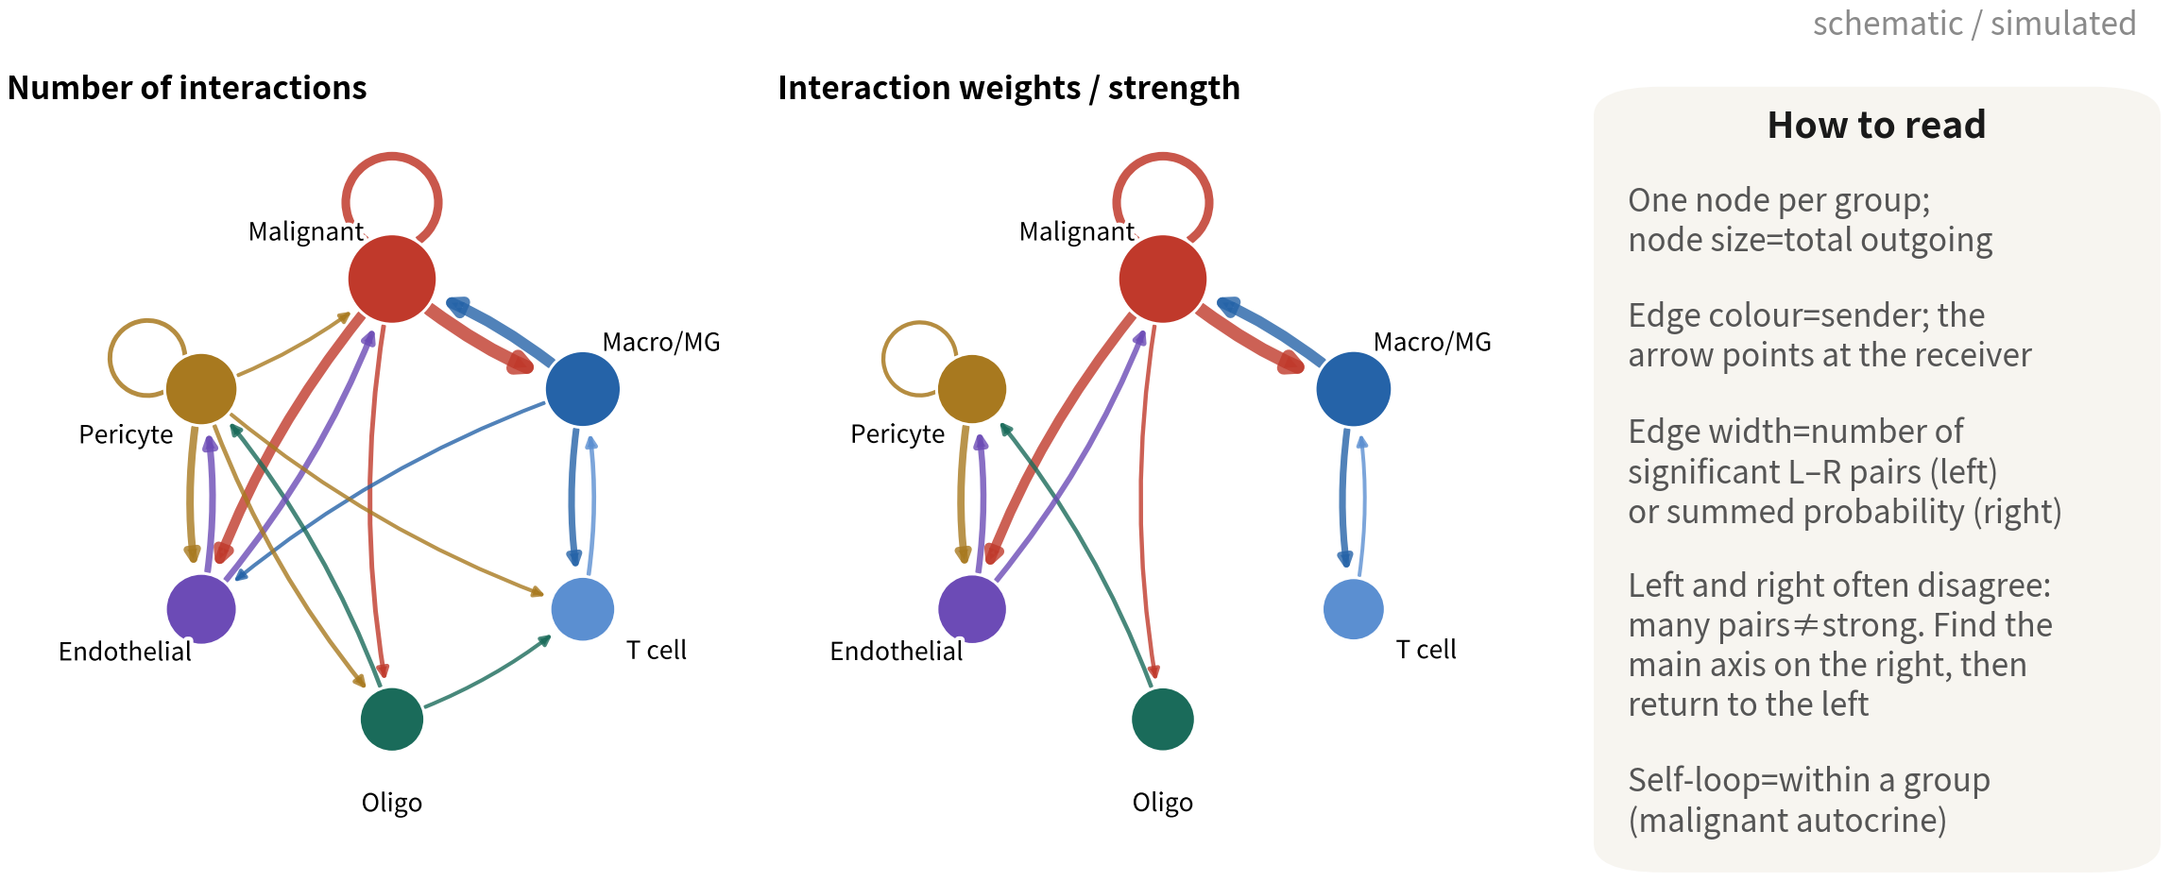
Plot 1: netVisual_circle — the whole network at a glance
groupSize <- table(cc@idents); netVisual_circle(cc@net$count, vertex.weight =
groupSize), and again with cc@net$weight. Find the main axis on the right first
Q3 Hands-on II
61
Notes:
第一張圖，circle plot，整個網路的鳥瞰。兩張並排：左邊是互動數，右邊是互動強度。 每個節點是一種細胞群，節點大小是這群送出的總量。邊的顏色是來源——誰送的就是誰的顏色；箭頭指向接收者。至於邊的粗細，左圖是顯著配體受體對的數目，右圖是機率的總和。 讀的時候要注意，左右不一致很常見。對數多不代表強：兩群之間可能有二十對弱弱的訊號，加起來還不如另外兩群之間那一對很強的。所以先看右圖找主軸——GBM 幾乎永遠是惡性細胞和巨噬細胞之間那條最粗的邊——再回頭看左圖，看有多少對在撐它。 還有自環，那是同一群內部的訊號，例如惡性細胞對惡性細胞的自分泌，PTN 路徑就是典型。 程式碼很短：groupSize 是每群的細胞數，netVisual_circle 吃 cc@net$count 畫左圖、吃 cc@net$weight 畫右圖。 ──────── The first figure, the circle plot — a bird's-eye view of the whole network. Two panels side by side: interaction counts on the left, interaction strength on the right. Each node is a cell group, and node size is that group's total outgoing signal. Edge colour is the source — whoever sends owns the colour; the arrow points at the receiver. As for edge thickness: in the left panel it is the number of significant ligand–receptor pairs, in the right it is the sum of probabilities. When reading, watch out — left and right disagreeing is very common. Many pairs does not mean strong: two groups might share twenty weak pairs that together still add up to less than one very strong pair between two other groups. So look at the right panel first to find the main axis — in GBM it is almost always the thickest edge between malignant cells and macrophages — then go back to the left panel and see how many pairs are carrying it. And the self-loops are signals within one group — malignant-to-malignant autocrine signalling, with the PTN pathway as the classic example. The code is short: groupSize is the cell count per group, and netVisual_circle takes cc@net$count for the left panel and cc@net$weight for the right.

Slide 62
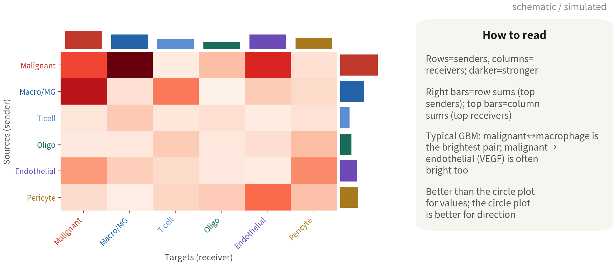
Plot 2: netVisual_heatmap — who sends to whom
netVisual_heatmap(cc, measure = "weight", color.heatmap = "Reds"). Rows are sources,
columns targets; bars are sums. Quote numbers from this one, read direction from the circle
Q3 Hands-on II
62
Notes:
第二張，熱圖。跟 circle 圖是同一份資料，只是換一種呈現。 列是送出的群，欄是接收的群，顏色越深代表通訊越強。右側的長條是每一列加總——誰最會送；上方的長條是每一欄加總——誰最會收。 GBM 的典型樣子是這樣：惡性對巨噬細胞、巨噬細胞對惡性，這兩格最亮。惡性對血管內皮也常常亮，那是 VEGF——腫瘤在叫血管長過來。至於 T 細胞，那一列一欄都淡，因為 GBM 是免疫冷的腫瘤。 那什麼時候用熱圖、什麼時候用 circle？要引用數字的時候用熱圖，格子讀得出值；要看方向的時候用 circle，箭頭清楚。論文裡常常兩張一起放。 程式碼是 netVisual_heatmap，measure 等於 weight，color.heatmap 等於 Reds。 ──────── The second figure, the heatmap. Same data as the circle plot, just presented differently. Rows are the sending groups, columns the receiving groups, and darker colour means stronger communication. The bars on the right are row sums — who sends the most; the bars on top are column sums — who receives the most. The typical GBM picture looks like this: malignant-to-macrophage and macrophage-to-malignant are the two brightest cells. Malignant-to-endothelial is often bright too — that is VEGF, the tumour calling blood vessels over. And the T cells? That row and that column are both faint, because GBM is an immunologically cold tumour. So when do we use the heatmap and when the circle? Use the heatmap when we need to quote numbers, because values can be read straight off the cells; use the circle when we need direction, because the arrows are clear. Papers often show both. The code is netVisual_heatmap, measure equals weight, color.heatmap equals Reds.

Slide 63
Pathway level: rank first, then take one pathway apart
cc@netP$pathways # the list of significant pathways netAnalysis_signalingRole_heatmap(cc, pattern = "outgoing", height = 8) # plot 4, left netAnalysis_signalingRole_heatmap(cc, pattern = "incoming", height = 8) # plot 4, right netAnalysis_signalingRole_scatter(cc) # plot 4, scatter pw <- "SPP1" netVisual_aggregate(cc, signaling = pw, layout = "circle") # plot 3, left (also "chord", "hierarchy") netAnalysis_contribution(cc, signaling = pw) # plot 3, right: which L-R pair carries the pathway netVisual_heatmap(cc, signaling = pw, color.heatmap = "Reds")# source x target for one pathway plotGeneExpression(cc, signaling = pw) # violins of the pathway genes: confirm it netAnalysis_signalingRole_network(cc, signaling = pw) # sender / receiver / mediator / influencer
Reading order: signalingRole for the actors → aggregate for direction → contribution for the concrete pair → plotGeneExpression
to verify. Pathway names from cc@netP$pathways | Script 07 §2
Q3 Hands-on II
63
Notes:
總網路看完了，接下來下一層：路徑。這一頁的程式碼對應圖三和圖四。 起手式是 cc@netP$pathways，它把所有顯著的路徑名稱列出來。記住這份清單，因為之後每一個函數的 signaling 參數，都要從這裡面挑名字寫進去。 先做圖四。netAnalysis_signalingRole_heatmap，pattern 等於 outgoing 畫誰在送、等於 incoming 畫誰在收，再加一張 netAnalysis_signalingRole_scatter 的散點。這三張回答的是同一個問題：每一條路徑的主角是誰。 主角找到了，才挑一條拆開來看，比方說 SPP1。netVisual_aggregate 畫這條路徑的 circle 圖，版型也可以換成 chord 或 hierarchy。netAnalysis_contribution 告訴我們是哪一對配體受體在撐這條路徑。netVisual_heatmap 加上 signaling 參數，畫單一路徑的來源對目標。plotGeneExpression 把這條路徑所有基因的 violin 攤開來——這一步是驗證：配體真的在那群細胞表現嗎？netAnalysis_signalingRole_network 再把每一群分成 sender、receiver、mediator、influencer 四種角色。 讀圖的順序請記住：signalingRole 找主角，aggregate 看方向，contribution 找到具體的配體受體對，plotGeneExpression 驗證表現。 ──────── That's the aggregate network done; now we drop a level, down to pathways. The code on this slide corresponds to figures three and four. The opening move is cc@netP$pathways, which lists every significant pathway name. Keep that list in view — every function that follows takes its signaling argument from it. Figure four comes first. netAnalysis_signalingRole_heatmap with pattern equals outgoing shows who is sending, incoming shows who is receiving, and netAnalysis_signalingRole_scatter adds the scatter. All three answer one question: who is the protagonist of each pathway. Only then do we pick one pathway apart — say SPP1. netVisual_aggregate draws that pathway's circle plot, and the layout can be switched to chord or hierarchy. netAnalysis_contribution tells us which ligand–receptor pair is carrying the pathway. netVisual_heatmap with the signaling argument draws source against target for that one pathway. plotGeneExpression lays out violins for every gene in it — and that step is the validation: is the ligand really expressed in that group? netAnalysis_signalingRole_network then splits each group into four roles: sender, receiver, mediator, influencer. Hold on to the reading order: signalingRole to find the protagonists, aggregate for direction, contribution for the specific ligand–receptor pair, plotGeneExpression to check the expression is really there.

Slide 64
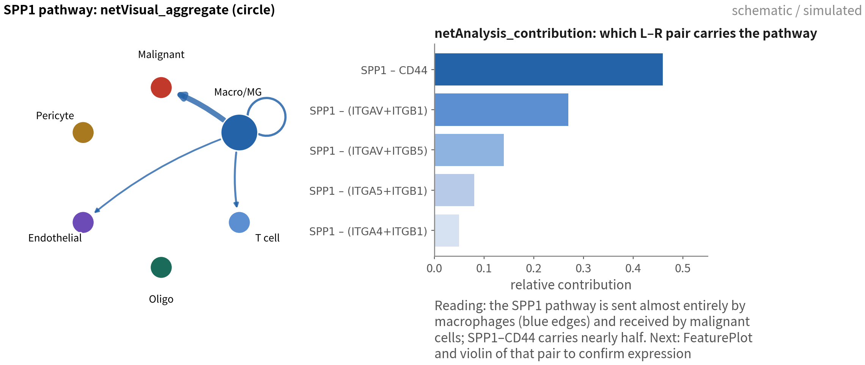
Plot 3: direction and composition of one pathway
SPP1 is the textbook TAM → malignant signal in GBM. Seeing this, the next step is
not the paper — it is the violin of SPP1 and CD44 to confirm expression and fraction
Q3 Hands-on II
64
Notes:
圖三，SPP1 路徑。左邊那張是 netVisual_aggregate 的 circle 圖，你會發現整張圖只有藍色的邊，而且全部從巨噬細胞出發：最粗的一條指向惡性細胞，其他幾條分別指向 T 細胞、血管內皮，還有一個繞回自己的自環。換句話說，這條路徑幾乎完全由巨噬細胞送出。 右邊是 netAnalysis_contribution，看的是誰在撐這條路徑：SPP1 對 CD44 就佔了將近一半，SPP1 對 ITGAV 加 ITGB1 四分之一，其他整合素組合分掉剩下的。 SPP1 在 GBM 是教科書等級的訊號：腫瘤相關巨噬細胞分泌 osteopontin，惡性細胞用 CD44 接收，跟浸潤、幹性、免疫抑制都有關，文獻很多。但看到這麼漂亮的一張圖，下一步不是打開檔案開始寫論文，是回到 Seurat 畫 SPP1 和 CD44 的 violin 和 FeaturePlot：SPP1 是不是真的在巨噬細胞高表現、有多少比例的細胞表現、CD44 在惡性細胞的表現又有多廣。CellChat 的圖是候選，表現圖才是證據。 ──────── Figure three, the SPP1 pathway. Look at the netVisual_aggregate circle plot on the left: the whole thing is blue, and every edge leaves the macrophages. The thickest one points at the malignant cells, the others at T cells and endothelium, plus one self-loop. So this pathway is sent almost entirely by macrophages. On the right, netAnalysis_contribution asks what is carrying it: SPP1 to CD44 accounts for nearly half, SPP1 to ITGAV plus ITGB1 a quarter, and the other integrin combinations share out the rest. SPP1 is textbook-grade GBM signalling — tumour-associated macrophages secrete osteopontin, malignant cells receive it through CD44, and it is tied to invasion, stemness and immunosuppression, with a large literature behind it. But when a plot comes out looking this clean, the next step is not writing it into the paper. It is going back to Seurat and drawing SPP1 and CD44 violins and FeaturePlots: is SPP1 really high in macrophages, what fraction of cells express it, how broadly is CD44 expressed on the malignant cells. The CellChat plot is the candidate; the expression plots are the evidence.

Slide 65
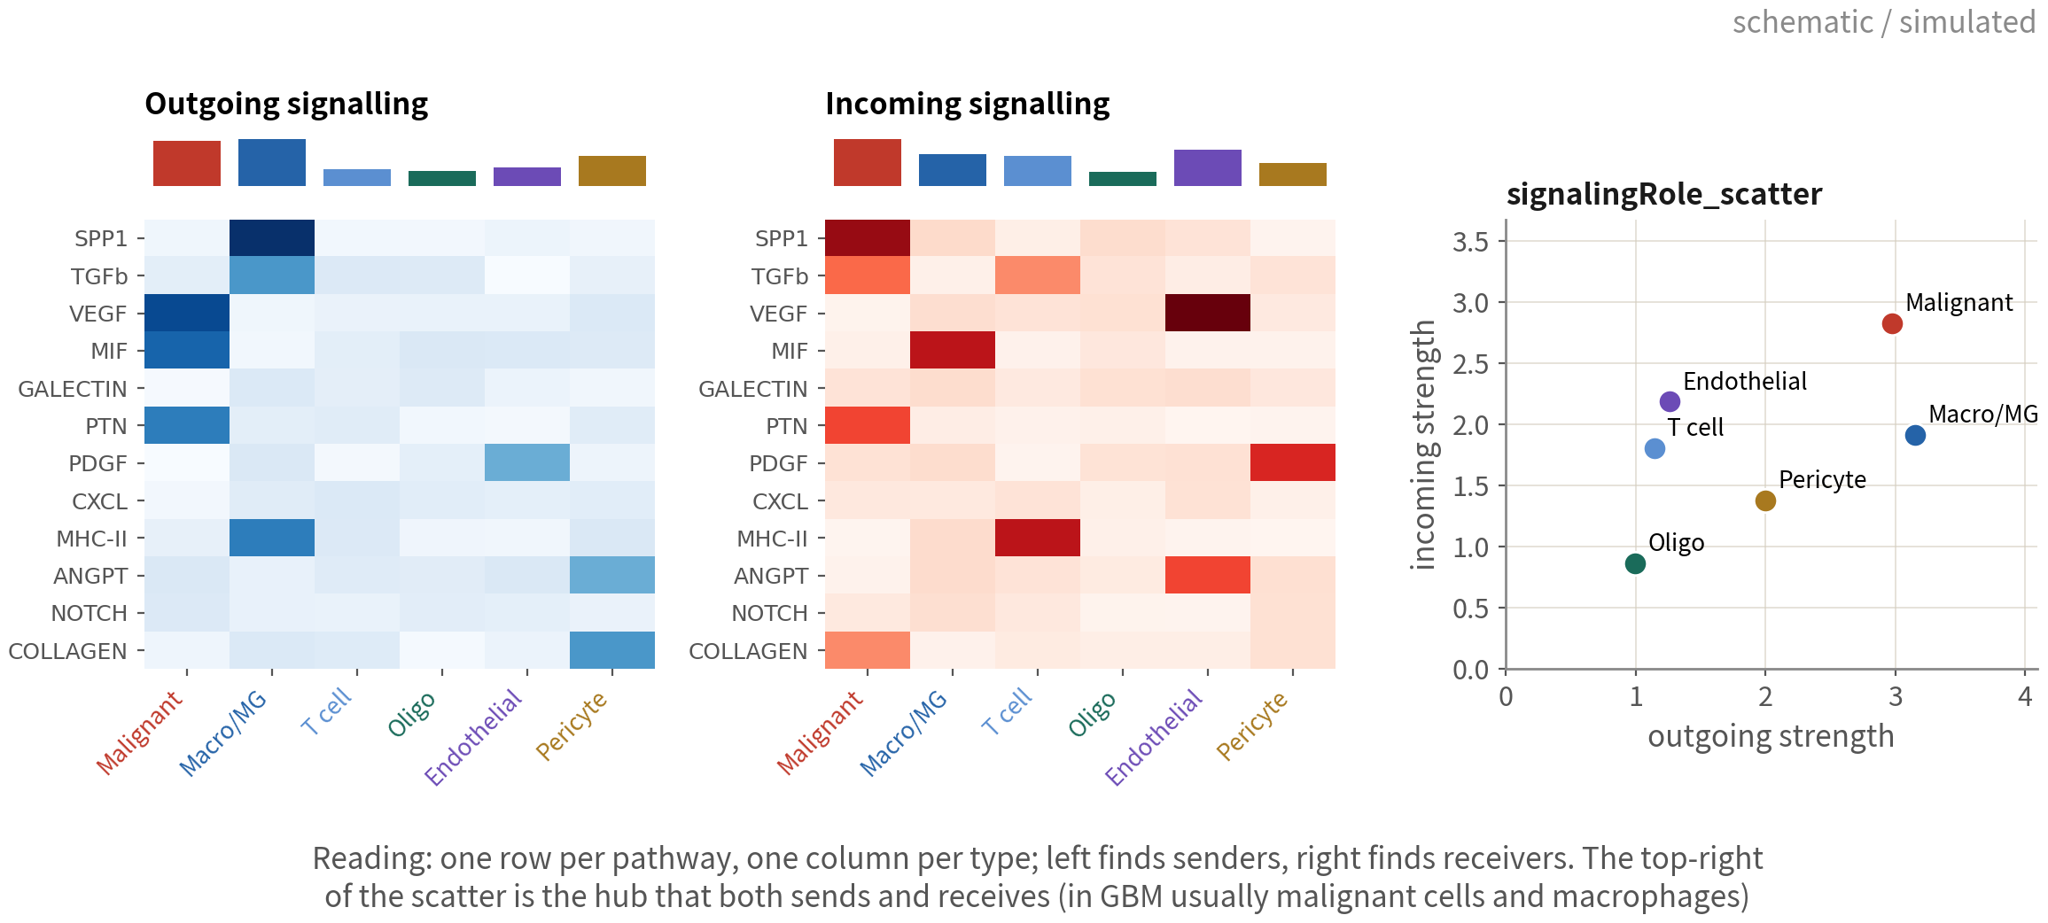
Plot 4: signalingRole — each type's role on each pathway
The most informative plot in the analysis: malignant cells send VEGF / MIF / PTN, macrophages
send SPP1 / TGFb / MHC-II, at one glance. The top-right of the scatter is the hub
Q3 Hands-on II
65
Notes:
圖四。整個通訊分析裡，我認為這是資訊量最大的一張。 左邊兩張熱圖，一列一條路徑、一欄一種細胞。左圖是送出，藍色；右圖是接收，紅色；上方那排長條是每一群的總量。 左圖看誰在送：惡性細胞送 VEGF、MIF、PTN；巨噬細胞送 SPP1、TGFb、MHC-II；周細胞送 ANGPT 和膠原蛋白。右圖看誰在收：惡性細胞收 SPP1、TGFb、PTN；血管內皮收 VEGF；T 細胞收 MHC-II；周細胞收 PDGF。 把兩張疊在一起，故事就出來了：巨噬細胞用 SPP1 和 TGFb 對惡性細胞說話，惡性細胞則用 MIF 把巨噬細胞叫過來、用 VEGF 叫血管長過來、用 PTN 對自己說話。這就是 GBM 微環境的核心迴路，一張圖看完。 右邊那張散點圖，橫軸是送出的總強度、縱軸是接收的總強度。右上角那幾群是既送又收的樞紐——在 GBM 通常就是惡性細胞和巨噬細胞。這張圖的用途很明確：決定我們接下來要深入挖哪兩種細胞之間的對話。 ──────── Figure four. Of everything in communication analysis, this is the figure I think carries the most information. Two heatmaps on the left: one row per pathway, one column per cell type. The left panel is outgoing, in blue; the right is incoming, in red; the bars along the top are each group's totals. Read the left panel for who sends. Malignant cells send VEGF, MIF, PTN; macrophages send SPP1, TGFb, MHC-II; pericytes send ANGPT and collagens. Read the right for who receives: malignant cells receive SPP1, TGFb, PTN; endothelium receives VEGF; T cells receive MHC-II; pericytes receive PDGF. Lay the two on top of each other and the story appears. Macrophages speak to malignant cells with SPP1 and TGFb; the malignant cells call macrophages over with MIF, call vessels over with VEGF, and talk to themselves with PTN. That is the core loop of the GBM microenvironment, read off a single figure. The scatter on the right has total outgoing strength on the x axis and total incoming on the y. The groups sitting in the top right corner are the hubs that both send and receive — in GBM, usually the malignant cells and the macrophages. The use of this plot is very specific: it decides which two cell types' conversation we dig into next.

Slide 66
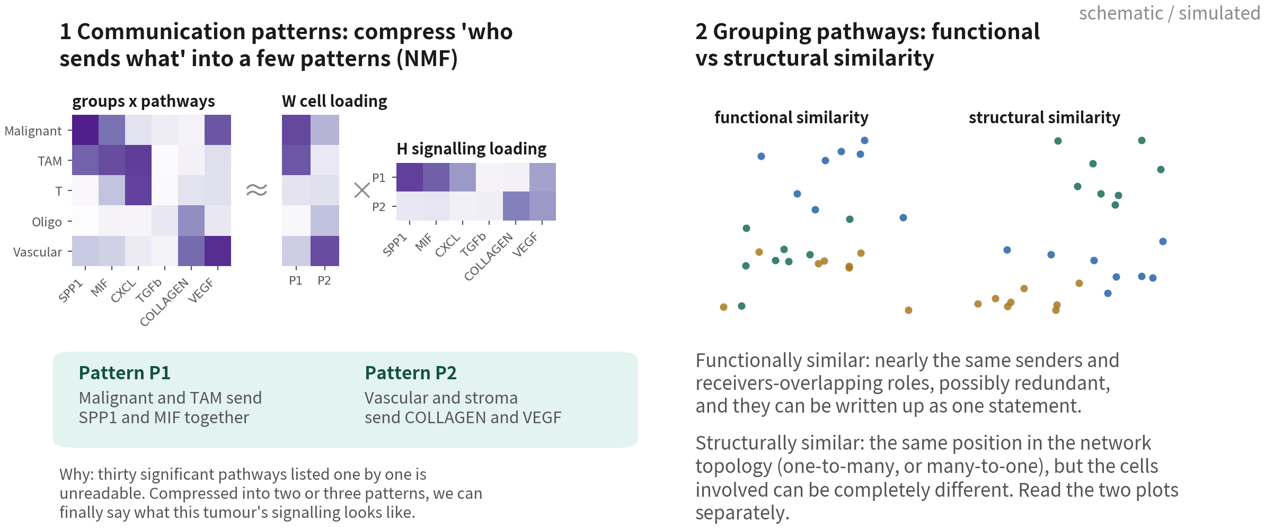
Thirty pathways is too many: communication
patterns and pathway grouping
identifyCommunicationPatterns() uses NMF to compress groups x pathways into two or three patterns; netEmbedding + netClustering then
groups pathways by function or by structure. Both exist so the conclusion is sayable | Script 07 §5 (advanced; not in the script)
Q3 Hands-on II
66
Notes:
跑完 CellChat，顯著的路徑動不動就三、四十條。一條一條講，沒有人看得完，也寫不進論文。所以 CellChat 準備了兩個收斂的工具。 第一個是通訊模式，identifyCommunicationPatterns。左邊畫的就是它在做的事：我們手上有一個細胞群乘以路徑的矩陣，每一格是這群細胞在這條路徑上送出多少訊號。NMF 把它拆成兩個小矩陣，W 是細胞載荷，說每一群屬於哪個模式；H 是訊號載荷，說每個模式包含哪些路徑。R 就是模式的數目，通常兩到四個。 拆出來會長得像圖上這樣：模式一是惡性細胞加上 TAM 一起送出 SPP1 和 MIF，模式二是血管和基質送 COLLAGEN 和 VEGF。原本三十條路徑，收斂成兩句話。這才是能寫進 results 第一段的敘述。 第二個是路徑分群，netEmbedding 加 netClustering。它有兩種相似度，圖上右邊那兩張一定要分開讀。 功能相似度看的是送出與接收的細胞群像不像。功能相似的路徑，角色重疊，可能互相取代——論文裡可以把它們合成一句話講。 結構相似度看的是網路拓撲的位置像不像：都是一對多，或者都是多對一。結構相似的路徑，參與的細胞可以完全不同。這一點常常被誤讀，兩張圖不要當成同一件事。 實務上怎麼用？先跑通訊模式定出敘事骨架，再用功能相似度決定哪幾條路徑可以合併著講，最後才挑一到兩條做單一路徑的細部圖。 ──────── Run CellChat and the significant pathway list will often come back thirty or forty long. Nobody reads that one by one, and it cannot be written up. So CellChat gives us two tools for collapsing it. The first is communication patterns, identifyCommunicationPatterns. The left panel shows exactly what it does: we are holding a groups-by-pathways matrix where each cell is how much signal that group sends on that pathway. NMF factorises it into two smaller matrices — W, the cell loading, saying which pattern each group belongs to, and H, the signalling loading, saying which pathways make up each pattern. R is the number of patterns, usually two to four. What comes out looks like the figure: pattern one is malignant cells and TAM sending SPP1 and MIF together; pattern two is vascular and stromal cells sending COLLAGEN and VEGF. Thirty pathways become two sentences. That is the kind of sentence that can open a results section. The second tool is pathway grouping, netEmbedding plus netClustering. It offers two similarities, and the two plots on the right have to be read separately. Functional similarity asks whether the senders and receivers are alike. Functionally similar pathways have overlapping roles, may be redundant, and can be written up as one statement. Structural similarity asks something else: whether the position in the network topology is alike — one-to-many, or many-to-one. Structurally similar pathways can involve completely different cells. This gets misread often, so do not treat the two plots as the same thing. In practice: run communication patterns first to get the narrative skeleton, use functional similarity to decide which pathways can be described together, and only then pick one or two for a single-pathway figure.

Slide 67
Down to concrete ligand–receptor pairs, then
compare two conditions
# Plot 5: name the source and target groups, list the significant L-R pairs netVisual_bubble(cc, sources.use = c("Macro/MG", "Malignant"), targets.use = c("Malignant", "Macro/MG", "Vascular"), remove.isolate = TRUE) sig3 <- head(intersect(c("SPP1", "MIF", "VEGF"), cc@netP$pathways), 3) # names must match cc@netP$pathways netVisual_bubble(cc, signaling = sig3) # just a few pathways # Plot 6: comparing two conditions - merge first cc.m <- mergeCellChat(list(Core = core, Periphery = peri), add.names = c("Core", "Periphery")) compareInteractions(cc.m, group = c(1, 2)) # number of interactions compareInteractions(cc.m, group = c(1, 2), measure = "weight") netVisual_diffInteraction(cc.m, weight.scale = TRUE) # difference circle: red up, blue down netVisual_heatmap(cc.m, measure = "weight") # difference heatmap rankNet(cc.m, mode = "comparison", stacked = TRUE, do.stat = TRUE) # Wilcoxon netVisual_bubble(cc.m, sources.use = "Macro/MG", targets.use = "Malignant", comparison = c(1, 2), angle.x = 45) # the same L-R pair under both conditions
Each of the four patients has a pair of objects; when comparing, look for pathways consistent across all four, not one
patient. The unit is still the patient | Script 07 §3–4
Q3 Hands-on II
67
Notes:
這一頁的程式碼對應圖五和圖六。 圖五，netVisual_bubble。sources.use 指定來源群、targets.use 指定目標群，remove.isolate 把沒有顯著配對的組合清掉；也可以用 signaling 參數只看幾條路徑。它做的事，是把路徑拆回具體的配體受體對。 圖六是兩個條件的比較。先把核心和邊緣的兩個 CellChat 物件放進 list，用 mergeCellChat 合併。接著 compareInteractions 畫互動數和總強度的長條，group 等於 1 和 2 就是兩個條件。netVisual_diffInteraction 畫差異的 circle 圖，紅色是第二個條件比第一個多的邊、藍色是少的。netVisual_heatmap 對合併物件畫差異熱圖。rankNet 把每條路徑在兩個條件的相對資訊流排出來，do.stat 等於 TRUE 會做 Wilcoxon 檢定，粗體的那幾條就是有差的。最後 netVisual_bubble 加上 comparison 參數，同一對配體受體在兩個條件並排。 提醒一件事：四位病人各有一對物件。比較的時候要找的是四位方向一致的路徑，不是某一位病人特別亮的那一條。統計單位仍然是病人——這句話在 Q3 已經說了五次，這是最後一次。 ──────── The code on this slide corresponds to figures five and six. Figure five is netVisual_bubble. sources.use picks the source groups, targets.use the target groups, and remove.isolate drops combinations with no significant pairs; we can also use the signaling argument to look at just a few pathways. What it does is unpack pathways back into specific ligand–receptor pairs. Figure six is the comparison of two conditions. Put the core and periphery CellChat objects into a list and mergeCellChat. compareInteractions then draws bars of interaction counts and total strength — group equals 1 and 2 are the two conditions. netVisual_diffInteraction draws the difference circle plot: red edges are stronger in the second condition, blue weaker. netVisual_heatmap on the merged object draws the difference heatmap. rankNet ranks each pathway's relative information flow across the two conditions, and with do.stat equals TRUE it runs a Wilcoxon test — the bold ones are the ones that differ. Finally, netVisual_bubble with the comparison argument puts the same ligand–receptor pair side by side across conditions. One reminder before we go on: each of the four patients has their own pair of objects. When comparing, what we are looking for is the pathways where all four patients agree in direction, not the one that lights up in a single patient. The statistical unit is still the patient — Q3 has said this five times now; this is the last.

Slide 68
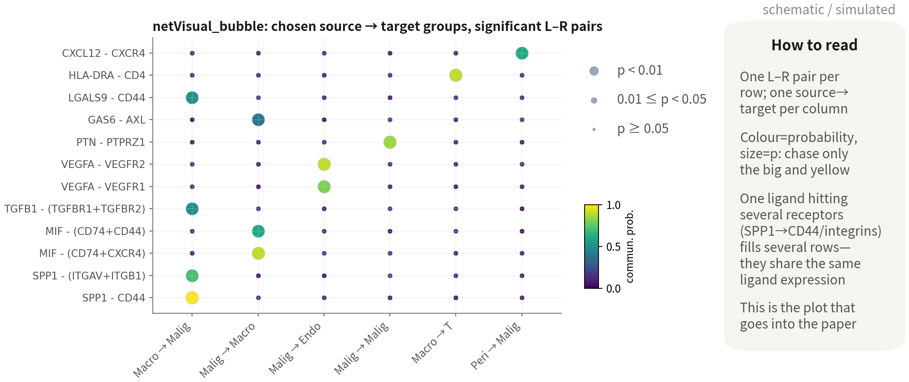
Figure 5: netVisual_bubble — the publication panel
Chase only the big and yellow; one ligand hitting several receptors fills several
rows. Once we have a concrete pair, go back to Seurat for FeaturePlot and VlnPlot
Q3 Hands-on II
68
Notes:
圖五，bubble plot。縱軸一列一對配體受體，橫軸一欄一組來源到目標。顏色是通訊機率，大小是 p 值。所以判準很簡單：又大又黃的才值得追。 我們一欄一欄看。巨噬細胞到惡性那一欄，SPP1 對 CD44 最大最黃，SPP1 對整合素次之，還有 TGFB1、LGALS9。惡性到巨噬細胞那一欄，MIF 對 CD74 加 CXCR4——這是腫瘤把巨噬細胞叫過來的訊號。惡性到內皮，VEGFA 對兩種 VEGFR。惡性到惡性，PTN 對 PTPRZ1，自分泌，GBM 的幹性維持迴路。巨噬到 T，MHC-II 對 CD4。 這裡有個陷阱：同一個配體對到多種受體，會佔掉好幾列，例如 SPP1 的那三列。它們共用同一個配體的表現，不是三條獨立證據。 這是要寫進論文的那張圖，也因此方法段要交代清楚：資料庫版本、用了哪幾群、p 值門檻。追到具體的配對之後，一樣回 Seurat 畫 FeaturePlot 和 VlnPlot 驗證表現。 ──────── Figure five, the bubble plot. Each row is a ligand–receptor pair, each column a source-to-target combination. Colour is communication probability, size is p-value, so the rule for reading it is simple: only the big and yellow ones are worth chasing. Let's go column by column. In the macrophage-to-malignant column, SPP1 to CD44 is the biggest and yellowest, SPP1 to integrins next, plus TGFB1 and LGALS9. In the malignant-to-macrophage column, MIF to CD74 plus CXCR4 — that is the tumour's signal for calling macrophages in. Malignant to endothelium, VEGFA to the two VEGFRs. Malignant to malignant, PTN to PTPRZ1 — autocrine, GBM's stemness-maintenance loop. Macrophage to T, MHC-II to CD4. Here is the trap. One ligand hitting several receptors occupies several rows — SPP1's three rows, for example. They share the same ligand's expression; they are not three independent pieces of evidence. This is the figure that goes into the paper, which is also why the methods section has to state: database version, which groups, the p-value threshold. And once we have chased down a specific pair, the same rule applies — back to Seurat, verify expression with FeaturePlot and VlnPlot.

Slide 69
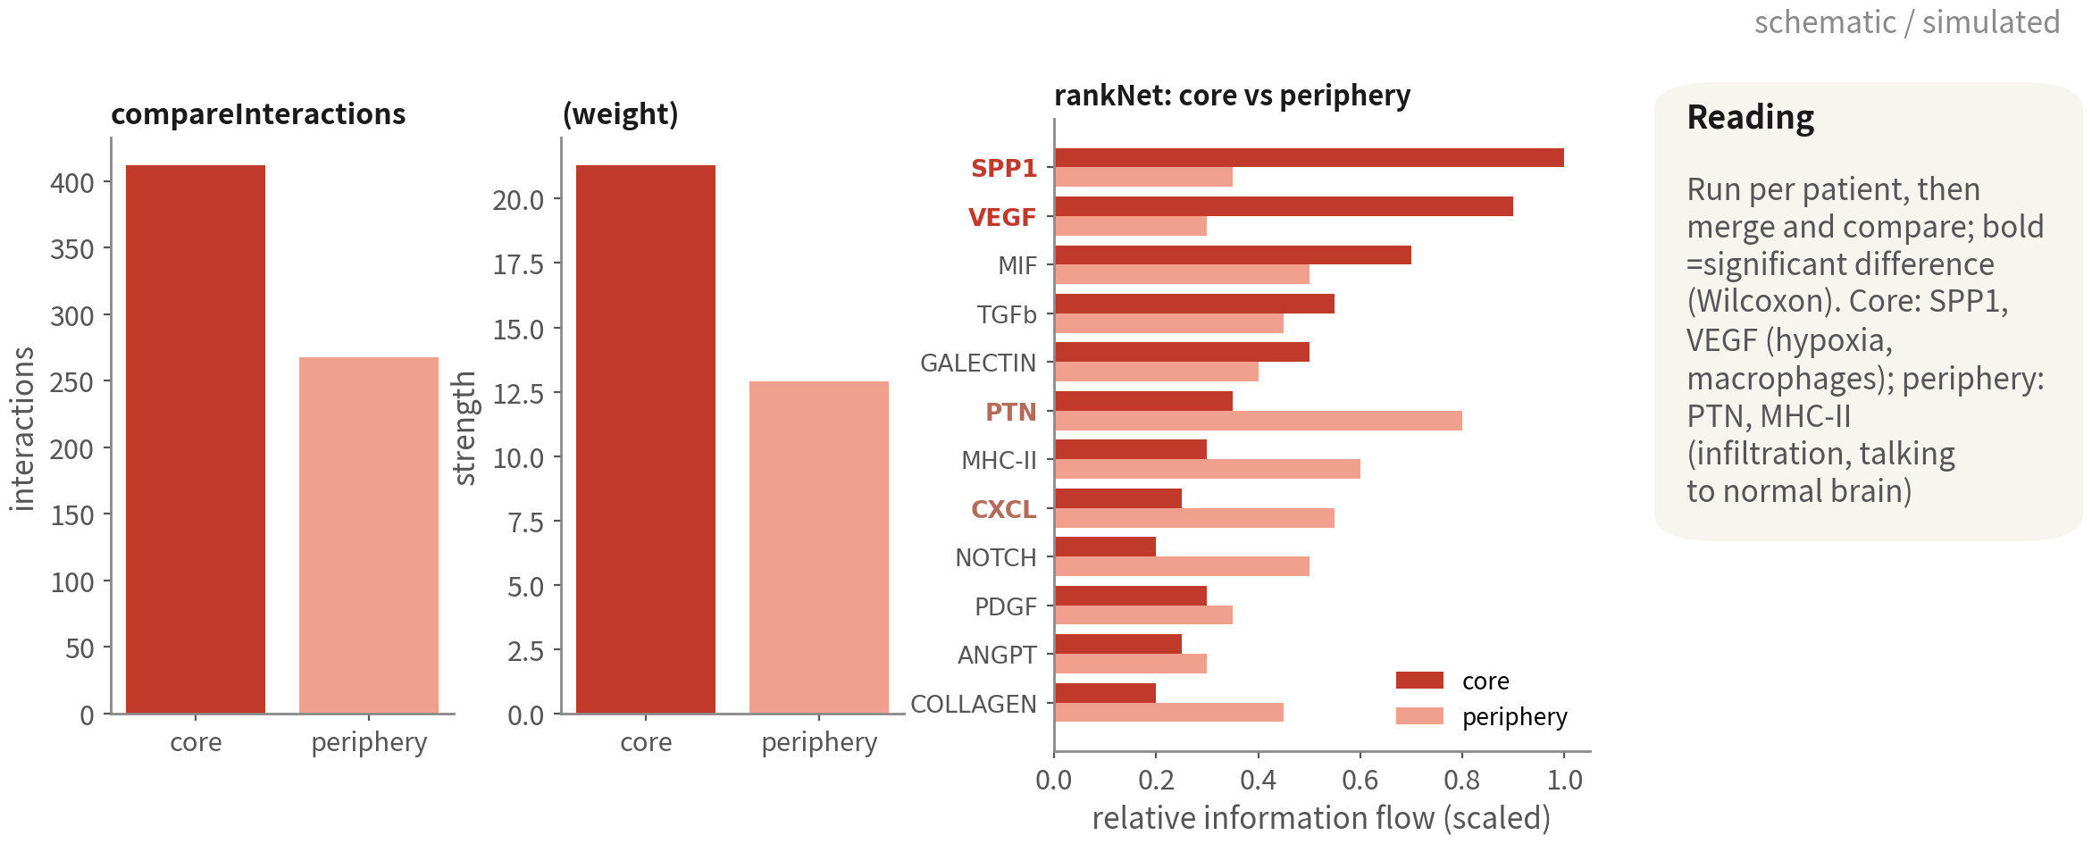
Plot 6: core vs periphery — after mergeCellChat
The core has more and stronger interactions (hypoxia, macrophage infiltration); only bold pathways
in rankNet differ between conditions. One set per patient; write it up only when all four agree
Reference: Jin S, et al. Nat Commun. 2021;12(1):1088. doi:10.1038/s41467-021-21246-9
Q3 Hands-on II
69
Notes:
圖六，兩條件比較，三張圖。 左邊兩張長條：核心的互動數和總強度都比邊緣高。這很符合生物學——核心缺氧、壞死、巨噬細胞浸潤多，訊號自然密。但先不要急著解讀，因為互動數也受細胞數和型別數影響；邊緣樣本的惡性細胞少，可以比較的配對本來就少。 右邊是 rankNet，每條路徑在兩條件的相對資訊流。粗體的是 Wilcoxon 顯著的：核心佔優的是 SPP1、VEGF，缺氧與巨噬細胞的訊號；邊緣佔優的是 PTN、MHC-II，那是浸潤中的惡性細胞跟正常腦組織、免疫細胞的互動。回頭看，這跟 Q3 前面 GSEA 看到的「核心缺氧、邊緣增殖」是一致的故事，兩個獨立分析互相支持。 最後還是那句：每位病人各跑一組、各畫一次 rankNet，四位一致的路徑才寫進結果。只有一位病人亮的，放補充，並且標註。 ──────── Figure six, the two-condition comparison, three panels. Start with the two bar charts on the left: the core beats the periphery on both interaction count and total strength. That fits the biology — the core is hypoxic, necrotic, heavily infiltrated by macrophages, so the signalling is naturally dense. But hold the interpretation for a moment, because interaction counts are also driven by cell numbers and by the number of types present, and the periphery samples have few malignant cells, so there are fewer comparable pairs to begin with. On the right is rankNet, each pathway's relative information flow in the two conditions. The bold ones are Wilcoxon-significant: the core favours SPP1 and VEGF — hypoxia and macrophage signalling; the periphery favours PTN and MHC-II, which is infiltrating malignant cells interacting with normal brain tissue and immune cells. Look back and this is the same story GSEA told earlier in Q3 — core hypoxic, periphery proliferative — two independent analyses backing each other up. And the same rule as always: run one set per patient, draw rankNet once per patient, and only the pathways consistent across all four go into the results. One that lights up in a single patient goes to the supplement, flagged.

Slide 70
Beyond CellChat: LIANA consensus and other tools
Methods disagree substantially; reviewers often ask for agreement between at least two
Tool | Feature | Output | When
CellChat | Multi-subunit, co-factors, pathway level richest plots | L–R, pathway, network | Default; when we need the plots
LIANA+ | Runs CellPhoneDB, NATMI, Connectome and more, takes a consensus rank | Consensus L–R rank | To cross-validate CellChat
CellPhoneDB | The original; curated human database | L–R + p values | Python pipelines; human data
NicheNet | Asks which ligand best explains target-cell expression change — infers from downstream genes | Ligand activity + target genes | When we have a clear receiver DE signature
Spatial validation | Visium / Xenium: are ligand and receptor actually adjacent | Co-localisation | Before writing 'X drives Y'
References: Efremova M, Vento-Tormo M, Teichmann SA, Vento-Tormo R. Nat Protoc. 2020;15(4):1484–1506. doi:10.1038/s41596-020-0292-x ｜ Browaeys R, Saelens W,
Saeys Y. Nat Methods. 2020;17(2):159–162. doi:10.1038/s41592-019-0667-5
Q3 Hands-on II
70
Notes:
CellChat 不是唯一的工具，而且不同方法跑出來的結果差異很大。這張表列了幾個。 CellChat 是本課的選擇：多亞單位、協同因子、路徑層級，圖也最完整。要畫圖就是它。 LIANA plus 的玩法不一樣，它一次跑好幾種方法——CellPhoneDB、NATMI、Connectome、SingleCellSignalR——然後取共識排名。審稿人越來越常要求「至少兩種方法一致」，LIANA 是最省事的交叉驗證。 CellPhoneDB 是最早的，資料庫嚴謹，人類專用，Python 流程。 NicheNet 問的是完全不一樣的問題：不是「誰對誰有配體受體」，而是「哪個配體最能解釋目標細胞的表現變化」——它是從下游基因反推回去的。所以當我們已經有一組明確的 DE 結果，例如某一型細胞在邊緣相對核心上調了哪些基因，用 NicheNet 回頭找是哪個配體造成的，會比 CellChat 更直接。 最後一列不是軟體，是空間驗證：用 Visium 或 Xenium 看配體和受體是不是真的相鄰。在我們寫下「X 驅動 Y」之前，這是最有力的一步。 ──────── CellChat is not the only tool, and different methods disagree a lot. This table lists a few. CellChat is this course's choice: multi-subunit receptors, cofactors, a pathway level, and the most complete plotting. If figures are what we need, it is the one. LIANA plus plays it differently — it runs several methods at once, CellPhoneDB, NATMI, Connectome, SingleCellSignalR, and takes a consensus ranking. Reviewers increasingly demand that at least two methods agree, and LIANA is the least-effort way to give them that cross-validation. CellPhoneDB is the original: a rigorous database, human-only, a Python workflow. NicheNet asks a completely different question. Not who has ligand–receptor with whom, but which ligand best explains the target cells' expression changes — it works backwards from downstream genes. So when we already have a clear DE result, say which genes one cell type upregulates at the periphery relative to the core, NicheNet finds the ligand responsible more directly than CellChat does. The last row is not software at all — it is spatial validation: Visium or Xenium, checking that ligand and receptor really are adjacent. Before we write that X drives Y, this is the most powerful step available.

Slide 71
08
Trajectory: how states transition
Script 08: Slingshot + tradeSeq mainline; Monocle3 / Monocle2
comparison and hand-picked roots
Q3 Hands-on II
71
Notes:
第八段，軌跡分析，處理的是狀態怎麼轉換的問題。工具是 Slingshot 加 tradeSeq，而且只在一位病人的惡性細胞內做。 ──────── Part eight, trajectory analysis, and the question it handles is how states transition. The tools are Slingshot plus tradeSeq, and we do this only within one patient's malignant cells.

Slide 72
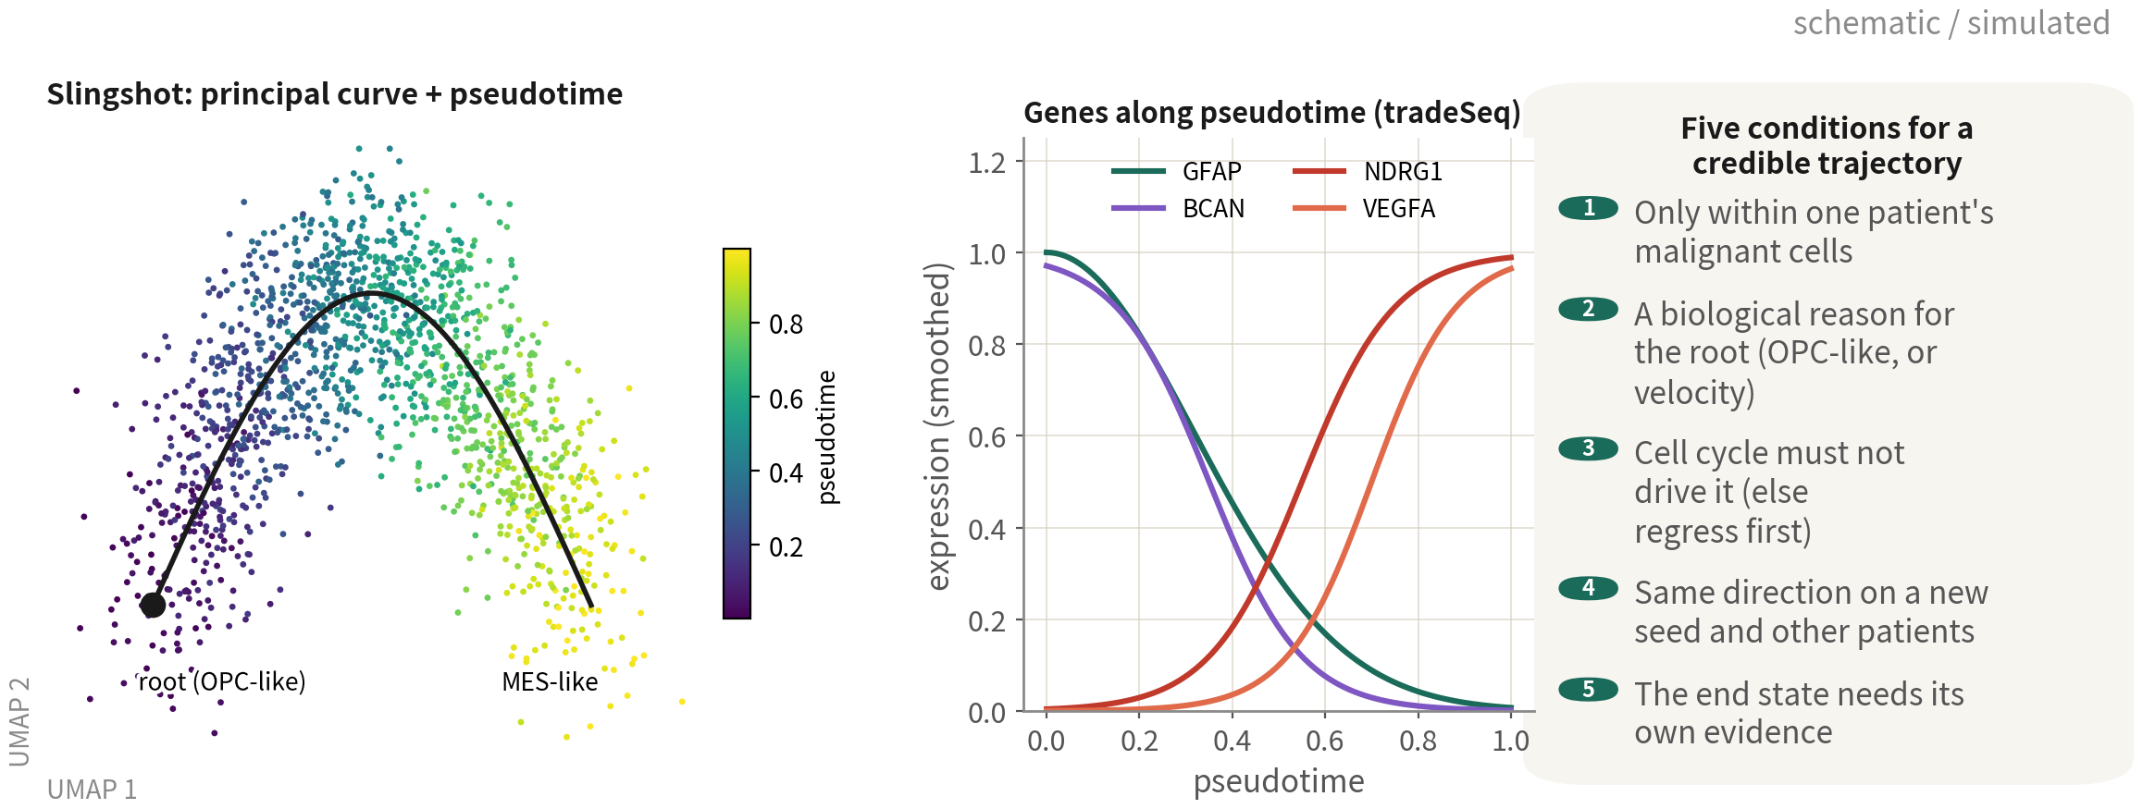
Trajectory: reading pseudotime and gene dynamics
One patient's malignant cells only; the root needs a reason; the cycle must not drive it; the direction survives a
new seed and other patients; the end state is verified separately. Fail any of the five and the curve is decoration
References: Street K, et al. BMC Genomics. 2018;19(1):477. doi:10.1186/s12864-018-4772-0 ｜ Van den Berge K, et al. Nat Commun. 2020;11(1):1201. doi:10.1038/s41467-020-14766-3
｜ Cao J, et al. Nature. 2019;566(7745):496–502. doi:10.1038/s41586-019-0969-x
Q3 Hands-on II
72
Notes:
軌跡分析。這一頁先講正確的用法怎麼做、圖怎麼讀；下一頁再看最常被踩的那個誤用長什麼樣。 左圖是一位病人的惡性細胞，Slingshot 的主曲線疊在 UMAP 上，顏色是 pseudotime，從紫色的起點走到黃色的終點。起點是 OPC 樣狀態分數最高的那一群，終點落在 MES 樣。中間那張是沿著 pseudotime 變化的基因，四個名字、四個方向，全部是腳本 08 在這份資料實際跑出來的，不是照文獻舉例。往下走的兩個：GFAP 從三點六掉到零點五六，它的 waldStat 是八百四十九、全體最高；BCAN 從二點九九掉到零點一七，而 BCAN 正是我們挑起點用的那組 OPC 標誌裡的基因。往上走的兩個：NDRG1 從零點一升到一點七五、VEGFA 從零點一五升到一點六八，兩個都是缺氧程式。 所以這條軌跡在講什麼？星形膠質與 OPC 的標誌一路流失，缺氧的程式一路打開。這就是 GBM 裡最有名的 AC 樣走向 MES 樣，而且是缺氧在推。我們還有第二個佐證——直接看 Neftel 分數的兩端：OPC 分數從零點四四降到負零點三八，MES 分數從零點七六升到一點五五。方向對了，才敢說這是一條「從 OPC 樣走向間質樣」的軌跡。 順帶一提，升上來的前十名裡有 SLC2A1、ENO2、PGK1、VEGFA、BNIP3。這批基因我們在第四十二頁看過，那時候的身分是核心區的 GSEA 結果：缺氧、糖解。同一套程式，在兩種完全不同的分析裡各出現一次。這不是巧合，是同一件生物學。 右邊是五個條件，不滿足就不要相信那條曲線。第一，只在同一位病人的惡性細胞內做——跨病人的軌跡是走在 CNV 差異上，不是狀態轉換。第二，起點要有生物學理由，例如 OPC 樣、或者 RNA velocity 指向它；Slingshot 自己不知道方向。第三，週期分數不能主導軌跡，否則我們畫出來的其實是細胞週期。第四，換 seed、換病人，主軸方向要一致。 第五條要特別講，因為它最常被跳過：終點的狀態要另外驗證，不能從起點推。前面四條管的全是起點和穩健性——起點是我們自己選的，我們知道它是什麼；但終點不是我們選的，是演算法自己走出來的，所以它更需要獨立的證據。這一集我們就是這樣驗的：拿 Neftel 的 OPC 分數和 MES 分數去比軌跡兩端，OPC 從零點四四降到負零點三八、MES 從零點七六升到一點五五，兩個方向都對，才敢在這頁寫「OPC 樣走向 MES 樣」。跳過這一步，我們證明的其實只有「有一條曲線」，沒有證明「它從哪裡走到哪裡」。五個都過，軌跡才是結果，不然只是裝飾。 ──────── Trajectory analysis. This slide covers what the correct use looks like and how to read the plots; the next one shows what the most common misuse looks like. The left panel is one patient's malignant cells, with Slingshot's principal curve laid over the UMAP, coloured by pseudotime, running from the purple start to the yellow end. The root is the cluster with the highest OPC-like state score; the end lands in MES-like. The middle panel shows genes changing along pseudotime. All four names, and all four directions, come from what script 08 actually returns on this dataset — not from a textbook example. Two fall: GFAP drops from 3.62 to 0.56, and its waldStat of 849 is the highest of any gene here; BCAN drops from 2.99 to 0.17, and BCAN is one of the OPC markers we used to choose the root in the first place. Two rise: NDRG1 from 0.10 to 1.75 and VEGFA from 0.15 to 1.68, both hypoxia genes. So what is this trajectory saying? The astrocytic and OPC markers bleed away, and the hypoxia programme switches on. That is the well-known AC-like to MES-like shift in GBM, with hypoxia driving it. And we have a second line of evidence — the Neftel scores at the two ends: the OPC score falls from 0.44 to minus 0.38, the MES score rises from 0.76 to 1.55. Only once the directions line up do we get to call this a trajectory from OPC-like toward mesenchymal-like. One more thing worth noticing. The top risers include SLC2A1, ENO2, PGK1, VEGFA and BNIP3 — we saw that same set back on slide 42, where it was wearing a different badge: the GSEA result for the tumour core, hypoxia and glycolysis. The same programme, surfacing in two completely different analyses. That is not a coincidence; it is one piece of biology seen twice. On the right are five conditions, and if they are not met, do not trust the curve. One, run only within one patient's malignant cells — a cross-patient trajectory walks along CNV differences, not state transitions. Two, the starting point has a biological reason: OPC-like, say, or RNA velocity pointing at it, because Slingshot itself doesn't know direction. Three, cell-cycle scores do not dominate the trajectory, or what we have drawn is the cell cycle. Four, change the seed, change the patient, and the main axis stays consistent. The fifth is worth dwelling on, because it is the one people skip: the end state needs its own evidence; you cannot infer it from the root. The first four are all about the root and about robustness — and the root is the one thing we chose ourselves, so we already know what it is. The end is not chosen; the algorithm walked there. That is exactly why it needs independent evidence. Here is how we checked it in this episode: we took the Neftel OPC and MES scores and compared the two ends of the trajectory. OPC falls from 0.44 to minus 0.38, MES rises from 0.76 to 1.55. Both directions line up, and only then do we get to write OPC-like toward MES-like on this slide. Skip that step and all we have shown is that a curve exists — not where it goes from and to. Pass all five and the trajectory is a result; otherwise it's decoration.

Slide 73
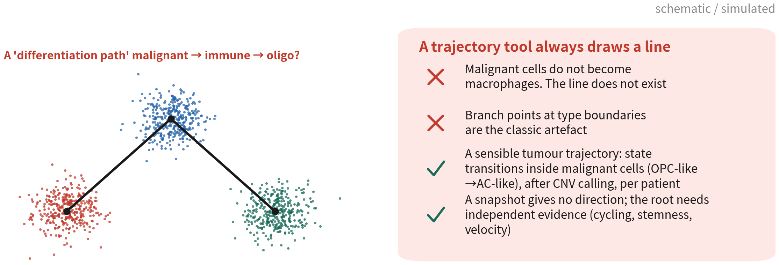
The most common downstream misuse
The trajectory that usually holds up in a tumour is a state transition inside malignant
cells - call malignancy first, split by patient first, and only then talk about pseudotime
Q3 Hands-on II
73
Notes:
上一頁那五個條件，缺了第一條會發生什麼事？就是這一頁。把惡性、免疫、寡樹突三群一起餵給軌跡工具，它照樣給你畫出一條漂亮的「分化路徑」：惡性變免疫、免疫變寡樹突。 但這條線不存在。惡性細胞不會分化成巨噬細胞。分支點剛好落在型別交界，這就是人工產物的典型長相。 腫瘤裡真正說得通的軌跡，通常是惡性細胞內部的狀態轉換，例如 OPC 樣到 AC 樣。而且要先判定惡性、先按病人分開。還有，快照推不出方向，起點要有獨立的依據——週期、幹性、RNA velocity。 ──────── What happens when the first of those five conditions is missing? This. Feed the malignant, immune and oligodendrocyte clusters to a trajectory tool together and it will happily draw you a "differentiation path": malignant becomes immune becomes oligodendrocyte. But that path does not exist. Malignant cells do not differentiate into macrophages. A branch point landing right on a type boundary is the classic look of an artefact. The trajectory that usually holds up in a tumour is a state transition within malignant cells, for example OPC-like to AC-like. And we must call malignancy first and split by patient first. One more thing: a snapshot cannot give us direction, so the starting point needs independent evidence — cell cycle, stemness, RNA velocity.

Slide 74
Slingshot + tradeSeq: one patient's malignant cells
library(slingshot); library(tradeSeq) mal1 <- subset(gbm4, malignant == "malignant" & patient == "BT_S2") # 388 cells mal1 <- NormalizeData(mal1) |> FindVariableFeatures() |> ScaleData() |> RunPCA() |> FindNeighbors(dims = 1:15) |> FindClusters(resolution = 0.4) |> RunUMAP(dims = 1:15) # Never hard-code the root cluster: pick it by OPC-like score, so the reason can go in the paper mal1 <- AddModuleScore(mal1, features = neftel["OPC"], name = "OPC") root <- names(which.max(tapply(mal1$OPC1, Idents(mal1), mean))) sce <- slingshot(as.SingleCellExperiment(mal1), clusterLabels = "seurat_clusters", reducedDim = "UMAP", start.clus = root) mal1$pt <- slingPseudotime(sce)[, 1] # Condition 3, checked here: does the cycle drive the trajectory? |r| > 0.5 -> regress it out mal1 <- CellCycleScoring(mal1, s.features = cc.genes.updated.2019$s.genes, g2m.features = cc.genes.updated.2019$g2m.genes) cor(mal1$pt, mal1$S.Score, use = "complete.obs") # here -0.25 cor(mal1$pt, mal1$G2M.Score, use = "complete.obs") # here -0.14, passes # Genes changing along pseudotime (negative binomial GAM, the slowest step in this episode) keep <- !is.na(mal1$pt) counts <- LayerData(mal1, layer = "counts")[VariableFeatures(mal1), keep] gam <- fitGAM(as.matrix(counts), pseudotime = mal1$pt[keep], cellWeights = rep(1, sum(keep)), nknots = 6) assoc <- associationTest(gam) # 38 genes here have p underflow to 0, head(assoc[order(-assoc$waldStat), ], 20) # so always rank by waldStat
The root is chosen by a score, not clicked, so it is reproducible; the cycle correlations -0.25 / -0.14 are the evidence for condition
3. fitGAM is the slowest step in this episode | Script 08 §1
Q3 Hands-on II
74
Notes:
程式碼。先 subset 出一位病人的惡性細胞——這份資料是 BT_S2 的三百八十八顆——然後整條流程重跑一次。跟 Q2 講亞群的時候一樣：subset 之後一定重算。 起點這件事要特別小心：不要寫死群號。我們的做法是用 Neftel 的 OPC 樣分數，算出哪一群平均最高，再把那一群交給 slingshot 當 start.clus。跑出來可能跟直接寫 start.clus 等於 2 一模一樣，但差別不在結果，在於「為什麼是這一群」寫得進論文，而一個寫死的 2 寫不進去。 接下來這三行，是當場驗前一頁的條件三。CellCycleScoring 算完 S 和 G2M 分數，跟 pseudotime 求相關：這份資料是負零點二五和負零點一四，兩個都遠低於零點五，所以週期沒有主導軌跡。這不是裝飾——五個條件裡，這是唯一能用一行程式碼當場證明的。不過關的話，先把週期回歸掉再重跑。 然後是 tradeSeq，處理的是哪些基因沿著 pseudotime 變化。fitGAM 對每個基因擬合負二項的廣義加法模型，nknots 等於 6。三百八十八顆細胞乘兩千個基因，我們在同一台機器上跑過三次：五分鐘、八分鐘、二十分鐘都有過，差別只在當下的負載。總之它是這一集最慢的一步，數分鐘到二十分鐘都算正常，先去倒杯咖啡。associationTest 檢定基因跟 pseudotime 有沒有關聯，plotSmoothers 畫單一基因的平滑曲線，就是中間那張圖。 看結果的時候有兩個地方特別容易踩。第一，排序要用 waldStat，不要用 p 值：這次有三十八個基因的 p 直接下溢成零，它們之間排出來是任意順序——照 p 值排，第一名會是 waldStat 只有九十一的 TAGLN，而真正最強、waldStat 八百四十九的 GFAP 反而掉到第六。第二，waldStat 和 meanLogFC 是兩件事。waldStat 是「變化模式有多明確」，效應量除以不確定性——這正是我們在第三十六頁講 DESeq2 的 stat 時講過的同一個道理，它在軌跡分析又出現一次。meanLogFC 是「變化幅度有多大」，而且是絕對值，看不出是升還是降。這次 GPR37L1 幅度四點九，名次卻只排第二十；COL1A2 幅度不到零點八，名次第九。所以挑基因畫圖用 waldStat，報告效應量用 meanLogFC。 RNA velocity 是選配：要先用 velocyto 產生剪接和未剪接的 loom 檔，再用 Python 的 scVelo。它的價值是給方向和起點——這正是 Slingshot 缺的那一塊。 Monocle3 是另一個常見選擇，graph-based、允許分支。用哪一個都可以，但起點和方向都要有獨立證據。 ──────── The code. First subset one patient's malignant cells — 388 of them for BT_S2 — and then rerun the whole pipeline. Same rule as Q2's subclustering: after subset, always recompute. The root deserves care, and the care starts here: never hard-code a cluster number. We use the Neftel OPC-like score, find which cluster has the highest mean, and hand that cluster to slingshot as start.clus. The result may come out identical to writing start.clus equals 2 — but the difference was never in the result. It is that why this cluster can go in the paper, and a hard-coded 2 cannot. The next three lines check condition 3 on the spot. CellCycleScoring gives S and G2M scores; we correlate them with pseudotime. Here that is minus 0.25 and minus 0.14, both far below 0.5, so the cycle is not driving the trajectory. This is not decoration — of the five conditions, this is the only one a single line of code can settle. If it fails, regress the cycle out and rerun. Then tradeSeq, which handles the question of which genes change along pseudotime. fitGAM fits each gene with a negative binomial generalised additive model, nknots equals 6. For 388 cells by 2,000 genes we timed it three times on the same machine: five minutes, eight minutes, twenty minutes — the difference was just load at the time, so anything from a few minutes to twenty is normal. Either way it is the slowest step in this episode, so go and make a coffee. associationTest tests whether a gene tracks pseudotime, and plotSmoothers draws one gene's smooth curve: that is the middle panel. Two traps when you read the result. First, sort by waldStat, not by p value: 38 genes here have a p that underflows to zero, so their order among themselves is arbitrary. Sorted by p, the top hit is TAGLN with a waldStat of only 91, while the genuinely strongest gene — GFAP, at 849 — drops to sixth. Second, waldStat and meanLogFC answer different questions. waldStat is how clear the pattern is: effect size divided by uncertainty. That is exactly the point we made about DESeq2's stat back on slide 36, showing up again in trajectory analysis. meanLogFC is how large the change is, and it is an absolute value, so it cannot tell you up from down. Here GPR37L1 has a fold change of 4.9 but ranks only twentieth; COL1A2 has under 0.8 and ranks ninth. So pick genes to plot by waldStat; report effect sizes with meanLogFC. RNA velocity is optional: it needs velocyto to produce the spliced and unspliced loom file first, then Python's scVelo. Its value is direction and the starting point — exactly what Slingshot lacks. Monocle3 is another common choice — graph-based, allows branching. Either is fine; the root and the direction always need independent evidence.

Slide 75
Monocle3 / Monocle2: two ways to set the root
# Monocle3 (the most widely used; graph-based) library(monocle3) cds <- SeuratWrappers::as.cell_data_set(mal1) # reuses Seurat's UMAP and clustering cds <- cluster_cells(cds) |> learn_graph(use_partition = FALSE) # (a) interactive: a window opens and we click the root - intuitive, but not reproducible cds <- order_cells(cds) # (b) scripted: write the reason as code - the 10 most OPC-like cells as root, reproducible root.cells <- colnames(mal1)[order(mal1$OPC1, decreasing = TRUE)[1:10]] cds <- order_cells(cds, root_cells = root.cells) plot_cells(cds, color_cells_by = "pseudotime", label_branch_points = TRUE) # Monocle2 (the classic DDRTree; root_state is still ours to choose) cds2 <- reduceDimension(cds2, method = "DDRTree") |> orderCells() plot_cell_trajectory(cds2, color_by = "State") # read the plot, then decide which State is the root cds2 <- orderCells(cds2, root_state = 3) # <- filled in by hand; the scripted version picks by score cor(mal1$pt, mal1$pt_m2, method = "spearman") # cross-tool agreement: read it as a grade, not one cutoff # > 0.8 strong | 0.6-0.8 needs a third, independent line of evidence | < 0.6 go back to the root # Here r = 0.757 - the middle band; our evidence is the Neftel end-state scores and the four gene directions
Pick by hand to explore, script it for the final run — hand-picking is irreproducible. Read cross-tool agreement as a grade: here Slingshot vs Monocle2
gives r = 0.757, the middle band, carried by the end-state scores | Script 08 §2–3
References: Cao J, et al. Nature. 2019;566(7745):496–502. doi:10.1038/s41586-019-0969-x ｜ Qiu X, et al. Nat Methods. 2017;14(10):979–982. doi:10.1038/nmeth.4402
Q3 Hands-on II
75
Notes:
Slingshot 之外，Monocle 家族是最多人用的軌跡工具，08 的第二、三節帶我們各跑一次，重點放在「起點怎麼選」。 先看 Monocle3。as_cell_data_set 把 Seurat 物件轉過去，沿用同一份 UMAP 和分群；cluster_cells、learn_graph 在圖上學出一張可以分支的主圖。然後是關鍵的 order_cells——它有兩種姿勢。姿勢一，手動互動式：不給參數直接呼叫，RStudio 會跳出視窗讓我們用滑鼠點起點，點完按 Done。最直觀，適合探索；但每次點的可能不一樣，不可重現。姿勢二，腳本化：把「起點的理由」寫成程式碼——OPC 樣分數最高的十顆細胞當 root_cells。腳本裡用一個開關切換，預設腳本化。 Monocle2 是經典的 DDRTree，老論文常見。它把細胞排成樹之後分成幾個 State；orderCells 的 root_state 參數就是「使用者自己選起點」——先畫 State 圖看哪個該當起點，再把數字填回去。腳本版一樣用分數選，可重現。 原則一句話：探索用手動、定稿用腳本。 最後是跨工具檢查。這裡要先處理一個很多教材都在講的說法：「Spearman 相關大於零點八才可信」。這句話流傳很廣，但它是慣例，不是定律，而且拿來比「不同工具」其實太嚴格。原因是幾何假設不一樣：Slingshot 學的是一條主曲線，Monocle2 是 DDRTree 排出來的樹，Monocle3 是在 UMAP 上長一張圖。三種東西即使講的是同一件生物學，數值也不會貼得那麼近。 所以我們改成分級來讀。相關大於零點八，強一致，可以直接寫「這個結論不依賴工具」。零點六到零點八，方向一致但細節有差，這時候要有第三個佐證，而且那個佐證不能也是 pseudotime。低於零點六，就是不一致，先回頭查起點和細胞子集，這時候不該報軌跡。 我們自己這份資料就落在中間那一帶：Slingshot 跟 Monocle2 的相關是零點七五七。按舊的說法，零點七五七不到零點八，這條結論就得丟掉——但那樣是丟錯了。因為我們手上有兩個獨立佐證，而且兩個都不是 pseudotime 的數值：一個是終點端的 Neftel 狀態分數，OPC 從零點四四降到負零點三八、MES 從零點七六升到一點五五；另一個是四個基因的方向，GFAP 和 BCAN 一路降、NDRG1 和 VEGFA 一路升。有這兩個，「從 OPC 樣走向間質樣」這個結論就站得住。 反過來說也要講清楚：如果只有零點七五七、沒有那兩個佐證，該寫的就是「趨勢一致，待驗證」，不是結論。分級不是把門檻放寬，是把「還需要什麼」講明白。 ──────── Beyond Slingshot, the Monocle family is the most widely used trajectory tool, and sections two and three of script 08 run each of them once, with the emphasis on how the root gets chosen. Monocle3 first. as_cell_data_set converts the Seurat object, reusing the same UMAP and clustering; cluster_cells and learn_graph then learn a branching principal graph. And then the key step, order_cells, which has two modes. Mode one is manual and interactive: call it with no arguments and RStudio pops up a window where we click the root with the mouse and press Done. It's the most intuitive and it's good for exploring — but the click may land somewhere different each time, so it is not reproducible. Mode two is scripted: write the reason for the root as code, so the ten cells with the highest OPC-like scores become root_cells. The script has a switch between the two; the default is scripted. Monocle2 is the classic DDRTree, the one you meet in older papers. It arranges cells into a tree and splits them into States, and orderCells' root_state argument means the user picks the root — draw the State plot first, see which should be the root, then fill in the number. The scripted version again chooses by score, reproducibly. The principle in one sentence: explore by hand, finalise by script. Last comes the cross-tool check, and first we have to deal with a line many tutorials repeat: a Spearman correlation above zero point eight before you believe it. That line is widespread, but it is a convention, not a law, and it is too strict for comparing different tools. The reason is that their geometric assumptions differ: Slingshot fits a principal curve, Monocle2 builds a DDRTree, Monocle3 grows a graph on the UMAP. Three different objects will not sit numerically close even when they are describing the same biology. So read it as a grade instead. Above zero point eight: strong agreement, and you can write that the conclusion does not depend on the tool. Between zero point six and zero point eight: the direction agrees but the details do not, and you need a third line of evidence — one that is not itself a pseudotime. Below zero point six: they disagree; go back and check the root and the cell subset, and do not report a trajectory yet. Our own data lands squarely in that middle band: Slingshot against Monocle2 gives zero point seven five seven. Under the old rule, zero point seven five seven falls short of zero point eight and the conclusion would be thrown out — and that would be the wrong call. Because we hold two independent pieces of evidence, and neither of them is a pseudotime value: the Neftel end-state scores, OPC falling from zero point four four to minus zero point three eight and MES rising from zero point seven six to one point five five; and the direction of the four genes, GFAP and BCAN down, NDRG1 and VEGFA up. With those, from OPC-like toward mesenchymal holds. The reverse has to be said just as plainly: with only zero point seven five seven and none of that supporting evidence, what you write is that the trend is consistent, pending validation — not a conclusion. Grading the threshold is not loosening it; it is spelling out what else you owe.

Slide 76
09
Pathway and TF activity:
who drives it
Script 09: decoupleR / PROGENy (R, fast) and SCENIC (Python, slow, optional)
Q3 Hands-on II
76
Notes:
第九段，調控與活性。decoupleR 加 PROGENy 在 R 裡幾分鐘就跑完；SCENIC 要跨到 Python 的 pySCENIC，數小時，列為選配。 ──────── Part nine, regulation and activity. decoupleR plus PROGENy runs in R in minutes; SCENIC crosses over to Python's pySCENIC, takes hours, and is optional.

Slide 77
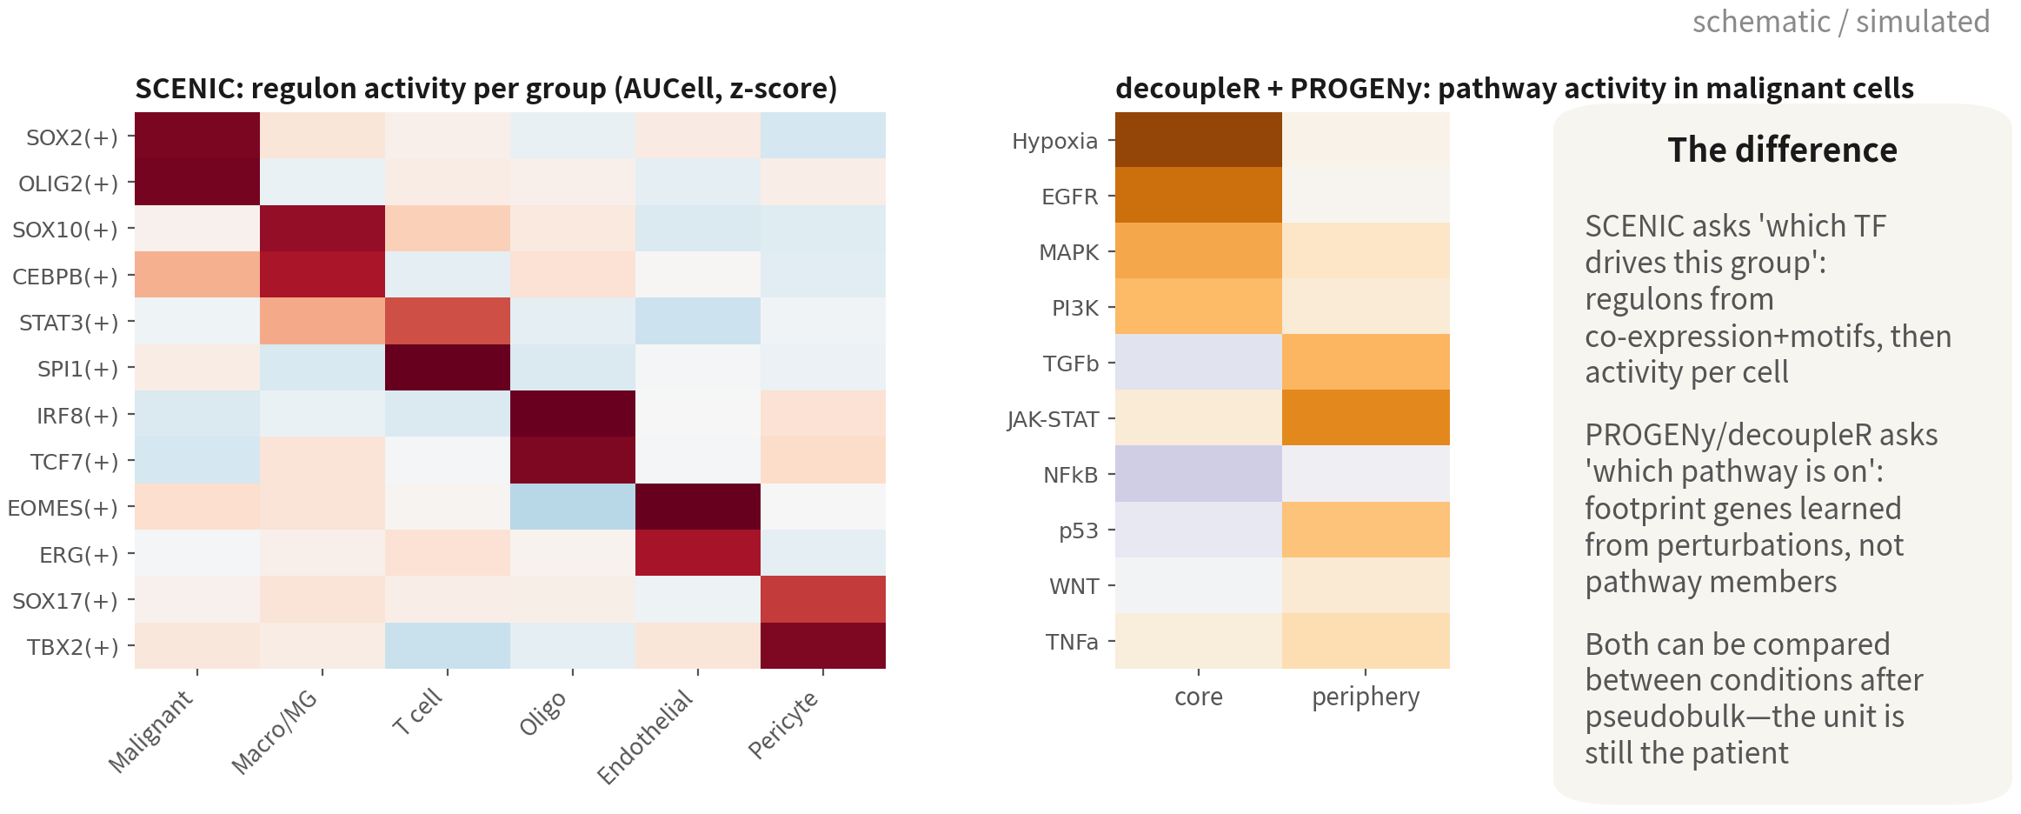
Regulation and activity: who is driving this group
Both panels are illustrative. Here the periphery side has just 1 / 13 / 17 / 0 malignant cells — only 3 patients pair
up, and one of those values comes from a single cell. Method demonstrated; hypothesis-generating only | Script: 09
References: Aibar S, et al. Nat Methods. 2017;14(11):1083–1086. doi:10.1038/nmeth.4463 ｜ Badia-i-Mompel P, et al. Bioinform Adv. 2022;2(1):vbac016. doi:10.1093/bioadv/vbac016 ｜ Schubert M, et al. Nat Commun.
2018;9(1):20. doi:10.1038/s41467-017-02391-6 ｜ Van de Sande B, et al. Nat Protoc. 2020;15(7):2247–2276. doi:10.1038/s41596-020-0336-2
Q3 Hands-on II
77
Notes:
DE 告訴我們哪些基因變了，這一頁再往上一層問：誰在驅動。兩個工具，回答兩個不同的問題。 左圖是 SCENIC，畫的是每一群的 regulon 活性。regulon 就是一個轉錄因子加上它的目標基因，SCENIC 先從共表現網路推出候選，再用 motif 修剪，最後用 AUCell 算每一顆細胞的活性。GBM 的經典結果長這樣：惡性細胞是 SOX2、OLIG2；寡樹突是 SOX10；巨噬細胞是 SPI1、CEBPB；T 細胞是 TCF7、EOMES；血管是 ERG、SOX17。所以 SCENIC 回答的是「哪個轉錄因子在驅動這群」。 右圖是 decoupleR 加 PROGENy，看的是惡性細胞在核心與邊緣的路徑活性。先說清楚，這一格是示意圖——右上角標了 SIM——畫的是文獻上常見的樣子：核心缺氧、EGFR、MAPK，邊緣 JAK-STAT、TGFb。我們自己這份資料跑出來的結果等一下講，跟這張不一樣。這裡的重點是方法：PROGENy 用的不是路徑的成員基因，是從擾動實驗學到的 footprint 基因，也就是路徑被打開之後下游會動的那些基因。這比 GSEA 用成員基因更接近「活性」。它回答的是「哪條訊號路徑活著」。 兩者都可以 pseudobulk 之後再比較條件，單位還是病人。 那我們這份資料呢？腳本 09 真的跑了，而且我建議你們也真的去跑一次，因為它跑出來的東西比一個漂亮的結果有用。 先看細胞數。四位病人的邊緣樣本裡，惡性細胞分別是一顆、十三顆、十七顆、零顆。BT_S6 的邊緣一顆都沒有，那位病人直接配不成對；剩下三位配得成對，但三位的邊緣那一格全都不到二十顆。而 BT_S1 那個邊緣的活性值三點八，是一顆細胞算出來的。一顆。 現在再看檢定。配對 t 檢定的 p 是零點八三，平均差零點三，九五％信賴區間從負五點一九到正五點八零，三位裡有一位方向是反的——反的那位，就是 BT_S1。 所以這裡其實有兩層問題，而且第一層就足以判出局。第一層：進到檢定裡的東西本身就不可信。一顆細胞的平均值不是那位病人邊緣的缺氧活性，它就只是一顆細胞。BT_S1 方向相反，最合理的解釋就是這個，不是生物學。第二層：就算那三個數字都可信，n 等於三也測不到東西——信賴區間寬到從負五跨到正五，代表這個檢定根本沒有能力分辨有沒有差別，它只是看不出來。第四十七頁講的就是這件事：功效來自病人數。「不顯著」和「沒有差異」是兩件事，這裡是前者。 這也是為什麼「n 先於 p」在這一頁要問兩次：幾位病人配得成對，以及每一格是幾顆細胞平均出來的。只問第一次，你會寫出「n 等於三，功效不足」——對，但不完整。問了第二次，你才知道連那三個數字都不能用。 那為什麼第四十二頁的 GSEA 看得到「核心缺氧」？因為問的根本不是同一件事。那邊是免疫細胞、pseudobulk 到八個樣本、比的是幾千個基因排出來的排名；這裡是惡性細胞、先把每一格的細胞平均成一個數字，再拿三個數字做檢定。第七十四頁的軌跡也一樣——那是在惡性細胞內部沿著 pseudotime 看缺氧基因怎麼升，用的是幾千顆細胞的連續變化，不是三個病人平均值的差。同一份資料、同一套生物學，換個問法就從看得到變成看不到，差別在統計單位和進到檢定裡的量，不在生物學。 所以這一頁誠實的寫法是：方法示範完整，結論只到「假設生成」。要真的下結論，需要的是更多病人，不是更多細胞。這也順便回答了很多人心裡的疑問——為什麼不乾脆用五千顆細胞去做檢定？因為那樣算出來的 p 值會小得很漂亮，但它回答的是「這五千顆細胞之間有沒有差」，不是「這種病人的核心跟邊緣有沒有差」。 ──────── DE tells us which genes changed; this slide goes one level up and asks who is driving them. Two tools, two different questions. The left panel is SCENIC, drawing regulon activity per group. A regulon is a transcription factor plus its target genes; SCENIC infers candidates from a co-expression network, prunes them with motifs, and finally scores per-cell activity with AUCell. The classic GBM result looks like this: malignant cells are SOX2, OLIG2; oligodendrocytes SOX10; macrophages SPI1, CEBPB; T cells TCF7, EOMES; vasculature ERG, SOX17. So SCENIC answers which transcription factor is driving this group. The right panel is decoupleR plus PROGENy, showing pathway activity of the malignant cells in core versus periphery. To be clear before we read it, this panel is illustrative — it is marked SIM in the corner — and it draws the pattern the literature usually reports: hypoxia, EGFR and MAPK in the core, JAK-STAT and TGFb at the periphery. What our own data gave is a different story, and I will come to it in a moment. The key point here is the method: PROGENy doesn't use a pathway's member genes, it uses footprint genes learned from perturbation experiments, the downstream genes that move once the pathway switches on. That is closer to activity than GSEA on member genes is. It answers which signalling pathway is alive. Both can be pseudobulked before comparing conditions — and the unit is still the patient. So what about our data? Script 09 really ran it — and I would encourage you to run it yourselves, because what comes out is more useful than a clean result would have been. Look at the cell counts first. In the four periphery samples, the malignant cell counts are one, thirteen, seventeen, and zero. BT_S6 has no malignant cells at the periphery at all, so that patient cannot be paired; the other three can, but all three have fewer than twenty cells on the periphery side. And BT_S1's periphery activity of three point eight is computed from one cell. One. Now the test. The paired t-test gives p equal to zero point eight three, a mean difference of zero point three, a ninety-five percent confidence interval running from minus five point one nine to plus five point eight zero — and one of the three patients runs in the opposite direction. That one is BT_S1. So there are two problems here, and the first one alone is disqualifying. First: what goes into the test is not trustworthy. A mean over one cell is not that patient's periphery hypoxia activity; it is one cell. The most plausible explanation for BT_S1 running backwards is exactly that, not biology. Second: even if all three numbers were sound, n equal to three detects nothing — the interval runs from minus five to plus five, which means this test has no power to tell whether a difference exists; it simply cannot see one. That is what slide forty-seven is about: power comes from the number of patients. Not significant and no difference are two different statements, and this is the first one. That is why n before p has to be asked twice on this slide: how many patients pair up, and how many cells each cell of the table was averaged from. Ask it once and you write n equals three, underpowered — true, but incomplete. Ask it twice and you find that even those three numbers cannot be used. Then why does the GSEA on slide forty-two see hypoxia in the core? Because it is not the same question. That was immune cells, pseudobulked to eight samples, comparing a ranking over thousands of genes. This is malignant cells, averaged down to one number per patient per site, then three numbers into a test. The trajectory on slide seventy-four is different again — hypoxia genes rising along pseudotime within malignant cells, a continuous change across thousands of cells, not a difference between three patient averages. Same data, same biology; change the question and it goes from visible to invisible. The difference is the statistical unit and how much reaches the test, not the biology. So the honest way to write this slide is: the method is demonstrated in full, the conclusion stops at hypothesis generation. Getting to a conclusion needs more patients, not more cells. Which also answers the question many people are silently asking — why not just run the test on five thousand cells? Because that p-value would be beautifully small, and it would answer whether these five thousand cells differ, not whether core and periphery differ in this kind of patient.

Slide 78
decoupleR (R) and SCENIC (pySCENIC)
# 1. decoupleR + PROGENy: 14 pathway activities per cell library(decoupleR) net <- get_progeny(organism = "human", top = 500) mat <- as.matrix(LayerData(gbm4, layer = "data")) act <- run_mlm(mat, net, .source = "source", .target = "target", .mor = "weight") act.w <- tidyr::pivot_wider(act, id_cols = source, names_from = condition, values_from = score) |> tibble::column_to_rownames("source") |> as.matrix() gbm4[["progeny"]] <- CreateAssayObject(act.w) DefaultAssay(gbm4) <- "progeny" FeaturePlot(gbm4, features = c("Hypoxia", "JAK-STAT")) # Comparing conditions: average activity to patient x site first, # then a paired test - the unit is the patient # 2. SCENIC: export a loom from R -> three pySCENIC steps -> read the AUCell matrix back # pyscenic grn counts.loom tfs.txt -o adj.csv # co-expression (GRNBoost2) # pyscenic ctx adj.csv *.feather --annotations_fname motifs.tbl -o reg.csv # pyscenic aucell counts.loom reg.csv -o auc.loom # regulon activity auc <- read.csv("output/tables/09_scenic_auc.csv", row.names = 1) # regulon x cell gbm4[["scenic"]] <- CreateAssayObject(as.matrix(auc)) DoHeatmap(gbm4, features = c("SOX2(+)", "OLIG2(+)", "SPI1(+)", "CEBPB(+)"), assay = "scenic")
SCENIC takes hours per run; the classic GBM result is malignant SOX2 / OLIG2 and TAM SPI1 / CEBPB. The (+) after a regulon means activating | Script 09
Q3 Hands-on II
78
Notes:
decoupleR 在 R 裡幾行就跑完。get_progeny 拿人類的 PROGENy 模型，每條路徑取前五百個 footprint 基因；run_mlm 用多變量線性模型算出每顆細胞的十四條路徑活性。結果轉成矩陣、包成一個新的 assay 叫 progeny，之後 FeaturePlot 就可以直接畫 Hypoxia、JAK-STAT。要比較條件的話，先 AggregateExpression 到病人乘部位，再對活性做配對檢定，單位是病人。 SCENIC 就得跨到 Python 了。R 端先把 counts 存成 loom，pySCENIC 三步走：grn 用 GRNBoost2 算轉錄因子與目標基因的共表現網路；ctx 用 motif 資料庫修剪，只留下真的有結合位點的目標，得到 regulon；aucell 算每顆細胞的 regulon 活性。跑一次幾小時。結果讀回 R，包成 scenic assay，用 DoHeatmap 畫。regulon 名稱後面的加號代表活化型。 報告 SCENIC 的時候，最好的驗證是這一句：regulon 的目標基因在 DE 裡也跟著動。轉錄因子活性高、目標基因卻沒變，那個 regulon 不可信。 ──────── decoupleR runs in a few lines of R. get_progeny fetches the human PROGENy model, top five hundred footprint genes per pathway. run_mlm uses a multivariate linear model to score each cell on the fourteen pathways. Convert the result to a matrix, wrap it as a new assay called progeny, and from then on FeaturePlot draws Hypoxia and JAK-STAT directly. For a condition comparison: AggregateExpression to patient-times-site first, then a paired test on the activities — the unit is the patient. SCENIC means crossing over to Python. On the R side, save the counts as a loom; pySCENIC then runs three steps: grn uses GRNBoost2 to compute the TF–target co-expression network; ctx prunes with the motif database, keeping targets with real binding sites, which gives us regulons; aucell scores per-cell regulon activity. One run takes hours. Read the results back into R, wrap them as a scenic assay, draw with DoHeatmap. The plus sign after a regulon name means the activating form. When reporting SCENIC, the best validation is one sentence: the regulon's target genes also move in the DE. High TF activity with unmoved targets — that regulon is not credible.

Slide 79
10
Deconvolution and survival:
validation in large cohorts
Script 10: MuSiC + TCGA-GBM + KM / Cox — the exit for single-cell hypotheses
Q3 Hands-on II
79
Notes:
第十段，反卷積與存活。這是單細胞假說的出口：拿註釋好的資料當參考，到 TCGA 的一百七十份 Bulk 去驗證。MuSiC 加 KM 加 Cox。 ──────── Part ten, deconvolution and survival. This is the exit route for single-cell hypotheses: take our annotated data as the reference and go and validate in TCGA's one hundred and seventy bulk samples. MuSiC plus KM plus Cox.

Slide 80
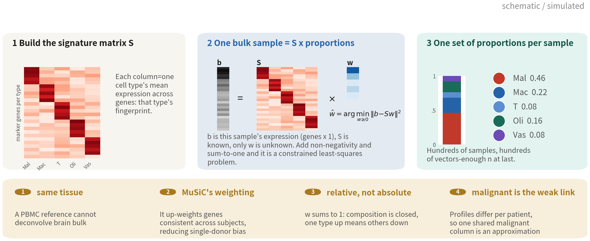
What deconvolution solves: bulk is a weighted
mixture, we solve for the weights
b = S w: the bulk expression is known, the signature matrix S built from single cells is known, only the
proportions w are unknown. Add non-negativity and a sum-to-one constraint and it is solvable | Script 10
References: Wang X, Park J, Susztak K, Zhang NR, Li M. Nat Commun. 2019;10(1):380. doi:10.1038/s41467-018-08023-x ｜ Newman AM, et al. Nat Biotechnol. 2019;37(7):773–782. doi:10.1038/s41587-019-0114-2
Q3 Hands-on II
80
Notes:
在跑程式之前，先花一頁把原理講清楚。反卷積這個詞聽起來很玄，但它骨子裡就是一組國中程度的聯立方程式，只是變數多了一點。 先想清楚 bulk 是什麼。你把一塊腫瘤組織打碎、抽 RNA、拿去定序，最後得到的每一個基因表現量，其實是那塊組織裡所有細胞加總起來的結果。惡性細胞貢獻一部分、巨噬細胞貢獻一部分、寡樹突細胞再貢獻一部分。所以一份 bulk 的表現量，本質上就是「各種細胞型別的表現量，按它們的比例加權平均」。 那反過來想：如果我們已經知道每一種細胞型別長什麼樣子，是不是就能反推出比例？可以。這就是反卷積。 第一步，做出特徵矩陣。看左邊這張。我們手上有單細胞資料，每一顆細胞都已經標好型別了，所以可以算出「惡性細胞在每個基因上的平均表現」「巨噬細胞在每個基因上的平均表現」，一種型別一欄。這張矩陣叫 signature matrix，我這裡寫作 S，大小是基因數乘以型別數。你看那個對角線的紅色區塊——每一型都有自己一段高表現的代表基因，那就是它的指紋。 第二步，寫下那條式子。中間這張。b 等於 S 乘以 w。 b 是這一份 bulk 樣本的表現量，一個基因數乘以一的向量，已知。S 是剛才做出來的特徵矩陣，已知。w 是我們真正要的東西，五種細胞型別各佔多少比例，一個五乘以一的向量，未知。 未知數只有五個，方程式卻有幾千條——每個基因一條。這叫超定方程組，不會有完美解，所以我們退一步求最小平方解：找一組 w，讓 b 減掉 S 乘 w 的平方誤差最小。 而且還要再加兩個約束，不然解出來會很荒謬。第一，比例不能是負的。第二，加起來要等於一。加上這兩條，就是右下角那個式子：在 w 大於等於零的條件下，最小化 b 減 S w 的範數平方。 第三步，解出來。右邊。每一份 bulk 樣本，解一次，得到一組比例。TCGA-GBM 有兩百多位病人，就是兩百多組比例。這才是重點——我們終於有足夠的 n 可以做存活分析了。 底下四個提醒，每一個都會影響你的結論，不是細節。 第一，參考要同組織。你拿 PBMC 的單細胞參考去解腦組織的 bulk，S 裡面根本沒有星狀細胞、沒有寡樹突細胞這幾欄，解出來的比例毫無意義。我們用的參考就是我們自己這份 GBM 單細胞資料，這是它最合理的用途之一。 第二，MuSiC 的加權。最單純的做法是每個基因同等重要。MuSiC 多做一件事：它給「跨個體一致」的基因較高的權重。道理很直接——某個基因如果在四位病人身上的表現差很多，拿它當指紋就不可靠。這就是 MuSiC 比 CIBERSORT 那類方法更適合處理跨個體資料的原因。 第三，這是相對比例，不是細胞數。w 加起來是一。所以它是封閉的組成資料——一種細胞的比例上升，其他的必然下降。你不能說「巨噬細胞變多了」，只能說「巨噬細胞佔的比例變高了」。這跟第三十二頁講組成分析時的邏輯完全一樣。 第四，惡性細胞是這整套方法的弱點。前面整合那一段講過，每位病人的惡性細胞 profile 都不一樣。但 S 裡面只有一欄「惡性」。用一根共用的惡性指紋去解每一位病人的 bulk，本身就是一個近似。所以反卷積出來的免疫細胞比例，通常比惡性細胞比例可信。 原理講完了，下一頁看實際跑出來的結果。 ──────── Before we run any code, let's spend one slide on the principle. Deconvolution sounds mysterious. It isn't — underneath, it is a set of simultaneous equations of the kind you met at school, just with a few more variables. Start from what a bulk sample actually is. You take a piece of tumour, homogenise it, extract the RNA and sequence it, and every expression value that comes back is the sum over every cell in that piece. Malignant cells contribute some, macrophages contribute some, oligodendrocytes contribute some more. So a bulk profile is exactly that: the expression of each cell type, averaged with weights equal to their proportions. Which raises the obvious question. If we already knew what each cell type looks like, could we work backwards to the proportions? We can. That is deconvolution. Step one, build the signature matrix. Look at the left panel. We have single-cell data with every cell already labelled, so we can compute the mean expression of malignant cells across genes, the mean expression of macrophages across genes, and so on — one column per type. That matrix is the signature matrix, written S here, of size genes by types. Notice the red blocks running down the diagonal: each type has its own stretch of high-expressing genes, and that is its fingerprint. Step two, write down the equation. The middle panel. b equals S times w. b is this bulk sample's expression, a genes-by-one vector, and we know it. S is the signature matrix we have just built, also known. w is the thing we actually want — the fraction of each of the five types, a five-by-one vector, unknown. Five unknowns, but thousands of equations, one per gene. That is an overdetermined system, so there is no exact solution; we settle for the least-squares one, the w that minimises the squared error between b and S times w. And two constraints on top, or the answer comes out absurd. Proportions cannot be negative, and they must sum to one. Put those in and you get the expression at the bottom right: minimise the squared norm of b minus S w, subject to w greater than or equal to zero. Step three, solve. The right panel. One solve per bulk sample, one proportion vector out. TCGA-GBM has a couple of hundred patients, so a couple of hundred proportion vectors. And that is the whole point — we finally have enough n for survival analysis. Four cautions along the bottom. None of them is a detail; each one can change your conclusion. First, the reference has to match the tissue. Deconvolve brain bulk with a PBMC reference and S has no astrocyte column and no oligodendrocyte column at all, so the proportions that come out mean nothing. Our reference is our own GBM single-cell data, which is one of the most defensible uses it has. Second, MuSiC's weighting. The naive approach treats every gene as equally informative. MuSiC does one extra thing: it up-weights genes that are consistent across subjects. The reasoning is direct — if a gene swings wildly between our four patients, it is an unreliable fingerprint. That is why MuSiC handles cross-subject data better than CIBERSORT-style methods. Third, these are relative proportions, not cell counts. The weights sum to one, which makes this closed compositional data — if one type's share goes up, the others must come down. You cannot say "there are more macrophages", only "macrophages make up a larger fraction". Exactly the same logic as the composition analysis on slide thirty-two. Fourth, malignant cells are the weak link in the whole method. As the integration section showed, every patient's malignant profile is different. But S has only one malignant column. Using one shared malignant fingerprint to deconvolve every patient's bulk is already an approximation. So the immune fractions that come out of deconvolution are generally more trustworthy than the malignant ones. That is the principle. Next slide, what actually came out.

Slide 81
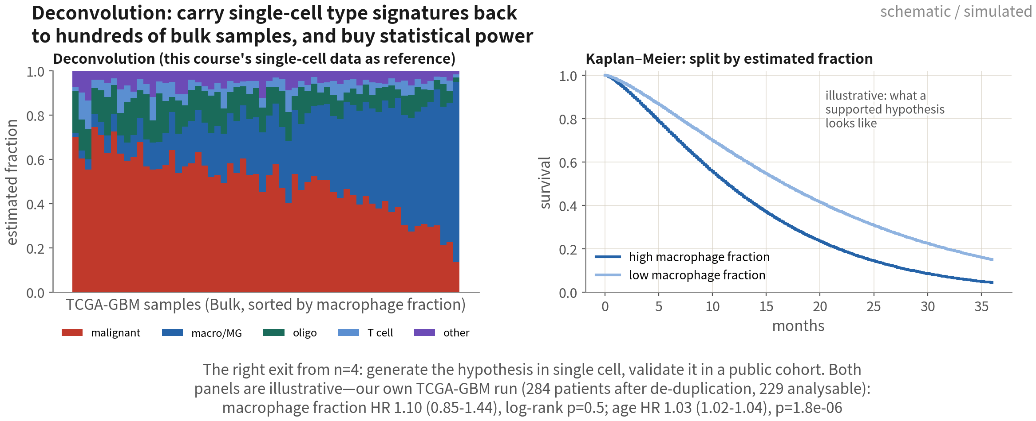
Deconvolution: taking n = 4 to n = 284
The figure is illustrative. Our TCGA-GBM run: 391 files → 372 primaries → 284 patients after de-duplication. Macrophage fraction HR
1.10 (0.85–1.44), p = 0.46 — no association; age HR 1.03, p = 1.8e-06 — the positive control does come through | Script: 10
Reference: Brennan CW, et al. Cell. 2013;155(2):462–477. doi:10.1016/j.cell.2013.09.034
Q3 Hands-on II
81
Notes:
最後一條路，反卷積，也是 n 等於 4 最正確的出路。 先看左圖：TCGA-GBM 幾百份 Bulk 樣本，用我們註釋好的單細胞當參考，估每份的型別比例，再按巨噬細胞比例排序。每一根柱子是一位病人，紅色惡性、藍色巨噬、綠色寡樹突。你會看到巨噬比例從一成一路拉到六成——這就是 Q1 講過的純度問題，只是現在我們有工具可以估它了。 右圖：按巨噬比例分成上下半，畫 Kaplan–Meier。先說清楚，這張曲線是示意——畫的是「假說如果成立，會看到的樣子」。 整條邏輯是這樣的：單細胞的 n 等於 4 產生假說——「巨噬細胞比例跟預後有關」——然後用公開世代驗證。單細胞給型別的定義，Bulk 給統計功效。這是單細胞研究最常見、也最有說服力的驗證路線，就是 Q3 功效那一頁講的正面版本。 那我們真的跑了。腳本 10 的結果是這樣的，我一項一項講，因為每一項都是你們自己跑的時候會遇到的。 第一，TCGA 給你的是檔案，不是病人。這次抓回來三百九十一個檔案，裡面有三百七十二份原發腫瘤、十四份復發、五份癌旁正常組織。復發和正常組織要拿掉，這沒有爭議。真正容易漏掉的是後面這一步：三百七十二份原發裡，只有兩百八十四位病人——同一位病人常常有兩三份 aliquot。不去重，就是把同一個人的死亡事件算兩次。這跟第三十四頁講的「把細胞當樣本」是同一個錯，只是這裡重複的不是細胞，是定序檔案。統計單位這件事，從單細胞一路跟到 Bulk。 第二，臨床欄位要自己檢查。兩百八十四位裡，只有兩百二十九位算得出存活時間，而且這兩百二十九位裡有兩百二十七位是死亡——事件率百分之九十九。為什麼這麼高？因為還活著的五十四位病人裡，有五十三位的 days_to_last_follow_up 是空的。也就是說，存活者幾乎整批被刪掉了。這不是我們的程式壞了，這是公開資料的常態；但它會讓 KM 曲線被系統性拉低，所以中位存活這種絕對數字不能報，只能報兩組之間的比較——因為兩組被削掉的方式是一樣的。這一段一定要寫進論文的限制。 第三，結果本身。巨噬比例高低兩組，log-rank 的 p 是零點五；Cox 調整年齡之後，風險比一點一零，九五％信賴區間零點八五到一點四四，p 值零點四六。看不出關聯。但是同一個模型裡，年齡的風險比是一點零三、每多一歲，信賴區間一點零二到一點零四，p 值一點八乘十的負六次方。 年齡出來了，這件事比巨噬比例的 null 還重要。年齡是這裡的陽性對照：GBM 的年齡效應是教科書等級的已知答案，它有出來，就代表臨床欄位接對了、時間軸沒接反、模型沒寫錯。所以「巨噬比例看不出關聯」是一個可以報的結果，不是「程式壞了」。一個沒有陽性對照的 null，你不知道它是真的 null 還是接線接錯；有了陽性對照，null 才有意義。 那為什麼是 null？最可能的原因是解析度。我們的 Immune 是把所有免疫細胞併成一格，而文獻連到預後的是特定的 TAM 狀態，不是巨噬細胞的總量。這正好是練習 10-3 要你做的：把參考組拆細一點再跑一次，看估計值和結論會不會變。反卷積對參考組非常敏感，這件事你自己跑過一次就會記得。 ──────── The final route, deconvolution — and the most correct way out of n equals 4. Left panel: hundreds of TCGA-GBM bulk samples, deconvolved with our annotated single-cell data as the reference, estimating each sample's cell type proportions, then sorted by macrophage fraction. Each bar is a patient — red malignant, blue macrophage, green oligodendrocyte. You will see the macrophage fraction run all the way from ten to sixty percent. That is the purity problem from Q1, except that now we have a tool to estimate it. Right panel: split at the median macrophage fraction and draw Kaplan–Meier. Be clear about this one — the curve is illustrative. It draws what we would see if the hypothesis held. The logic goes like this. Single-cell at n equals 4 generates the hypothesis, macrophage fraction relates to prognosis, and then a public cohort validates it. Single-cell supplies the cell type definitions; Bulk supplies the statistical power. This is the most common and most persuasive validation route in single-cell research — the positive version of what Q3's power slide described. And we actually ran it. Here is what script 10 returned, item by item, because every item is something you will hit yourself. First, TCGA hands you files, not patients. This query returned three hundred and ninety-one files: three hundred and seventy-two primary tumours, fourteen recurrences, five adjacent normal samples. Dropping the recurrences and the normals is uncontroversial. What is easy to miss is the step after that: those three hundred and seventy-two primaries come from only two hundred and eighty-four patients — the same patient often has two or three aliquots. Skip the de-duplication and you count the same person's death twice. That is the same error as slide thirty-four's "treating cells as samples"; the thing being duplicated here is a sequencing file rather than a cell. The statistical unit follows you all the way from single cell to bulk. Second, check the clinical fields yourself. Of the two hundred and eighty-four patients, only two hundred and twenty-nine have a computable survival time — and two hundred and twenty-seven of those are deaths, an event rate of ninety-nine percent. Why so high? Because of the fifty-four patients still alive, fifty-three have an empty days_to_last_follow_up. In other words, the survivors were almost all dropped. That is not a bug in our script; it is normal for public data. But it drags the KM curve down systematically, so an absolute number like median survival cannot be reported — only the comparison between groups, because both groups are truncated the same way. This belongs in the limitations section. Third, the result itself. Between the high- and low-macrophage groups the log-rank p is zero point five; adjusted for age, the Cox hazard ratio is one point one zero, ninety-five percent confidence interval zero point eight five to one point four four, p equals zero point four six. No detectable association. But in the same model, age gives a hazard ratio of one point zero three per year, interval one point zero two to one point zero four, p equals one point eight times ten to the minus six. That age result matters more than the macrophage null. Age is the positive control here: the age effect in GBM is a textbook-level known answer, so the fact that it turns up tells us the clinical fields are wired correctly, the time axis is not reversed, and the model is right. Which makes "macrophage fraction shows no association" a reportable result rather than "the code is broken". A null without a positive control leaves you unable to tell a real null from a wiring error; with one, the null means something. So why is it null? The most likely reason is resolution. Our Immune category lumps every immune cell into one bin, whereas what the literature ties to prognosis is a specific TAM state, not total macrophage abundance. Which is exactly what exercise 10-3 asks you to do: split the reference finer, run it again, and see whether the estimates and the conclusion move. Deconvolution is extremely sensitive to its reference — and you only really remember that once you have run it yourself.

Slide 82
MuSiC deconvolution + TCGA survival
library(MuSiC); library(TCGAbiolinks); library(survival); library(survminer) ref <- as.SingleCellExperiment(JoinLayers(gbm4)); ct <- gbm4$celltype_author ref$celltype_l1 <- ifelse(gbm4$malignant == "malignant", "Malignant", # deconvolve on major groups ifelse(ct == "Immune cell", "Immune", ifelse(ct == "Oligodendrocyte", "Oligo", ifelse(ct == "Vascular", "Vascular", "Other")))) q <- GDCquery("TCGA-GBM", data.category = "Transcriptome Profiling", data.type = "Gene Expression Quantification", workflow.type = "STAR - Counts") GDCdownload(q, directory = "C:/GDCdata"); bulk <- GDCprepare(q, directory = "C:/GDCdata") mtx <- assay(bulk, "unstranded"); rownames(mtx) <- rowData(bulk)$gene_name # * barcode field 4: 01 = primary tumour; one patient often has several aliquots - de-duplicate sel <- which(substr(colnames(mtx), 14, 15) == "01") sel <- sel[!duplicated(substr(colnames(mtx)[sel], 1, 12))] # 391 -> 372 -> 284 patients est <- music_prop(bulk.mtx = mtx[, sel], sc.sce = ref, clusters = "celltype_l1", samples = "patient") prop <- as.data.frame(est$Est.prop.weighted); cl <- as.data.frame(colData(bulk))[rownames(prop), ] cl$time <- ifelse(cl$vital_status == "Dead", cl$days_to_death, cl$days_to_last_follow_up)/30.4 cl$event <- as.integer(cl$vital_status == "Dead") # build the time axis yourself cl$mac_hi <- prop$Immune > median(prop$Immune) ggsurvplot(survfit(Surv(time, event) ~ mac_hi, data = cl), pval = TRUE) coxph(Surv(time, event) ~ mac_hi + age_at_index, data = cl) # age = the positive control
BayesPrism and CIBERSORTx are alternatives. Adjust the Cox model for age, MGMT and other known factors; fractions are estimates, not truth | Script 10
References: Wang X, Park J, Susztak K, Zhang NR, Li M. Nat Commun. 2019;10(1):380. doi:10.1038/s41467-018-08023-x ｜ Brennan CW, et al. Cell. 2013;155(2):462–477. doi:10.1016/j.cell.2013.09.034
Q3 Hands-on II
82
Notes:
程式碼三段。 第一段，參考：本課的單細胞物件 JoinLayers 之後轉成 SingleCellExperiment，需要 counts、型別標籤——用第一層 celltype_l1 就好，型別太細反卷積會不穩——和病人標籤。 第二段，Bulk：TCGAbiolinks 的 GDCquery 抓 TCGA-GBM 的 STAR counts，GDCdownload、GDCprepare 得到 SummarizedExperiment。Windows 有個雷，一定要先講：路徑長度上限兩百六十字元，TCGA 的檔名很長，下載目錄放在很深的專案資料夾會整批解壓失敗——directory 參數指到 C 槽根附近的短路徑就好，已下載的檔案重跑會自動跳過。接著 music_prop 吃 Bulk 矩陣和單細胞參考，clusters 給型別欄、samples 給病人欄——MuSiC 會用病人之間的變異給基因加權，這就是它跟簡單線性回歸的差別。Est.prop.weighted 是每份樣本的型別比例。 第三段，存活：把臨床資料對上，巨噬比例高於中位數的標 TRUE。survfit 加 ggsurvplot 畫 KM，coxph 做多變量——一定要調整年齡，GBM 還要調 MGMT 甲基化和 IDH 狀態。 替代工具也講一下：BayesPrism 對腫瘤特別好，因為它允許惡性細胞的表現在 Bulk 裡跟參考不一樣；CIBERSORTx 是網頁版。無論你用哪一個，記住比例是估計值，拿來分組和相關可以，不要當真值報告。 ──────── Three blocks of code. Block one, the reference: this course's single-cell object, after JoinLayers, converted to a SingleCellExperiment. It needs counts, type labels — use the first level, celltype_l1, because overly fine types make deconvolution unstable — and patient labels. Block two, the bulk: TCGAbiolinks' GDCquery fetches TCGA-GBM STAR counts, and GDCdownload and GDCprepare give you a SummarizedExperiment. One Windows trap to flag before you start: the path length limit of two hundred and sixty characters. TCGA's file names are long, so a download directory buried deep in a project folder makes the whole batch fail to unpack. Point the directory argument at a short path near the C drive root; already-downloaded files are skipped automatically on rerun. Then music_prop takes the bulk matrix and the single-cell reference, clusters gets the type column, samples the patient column — MuSiC uses between-patient variance to weight genes, and that is what separates it from simple linear regression. Est.prop.weighted is each sample's type proportions. Block three, survival: join the clinical data, flag TRUE where the macrophage fraction is above the median. survfit plus ggsurvplot draws the KM; coxph does the multivariate model — always adjust for age, and in GBM also for MGMT methylation and IDH status. A word on alternatives: BayesPrism is particularly good for tumours, because it allows the malignant cells' expression in bulk to differ from the reference; CIBERSORTx is the web version. Whichever we use, the proportions are estimates — fine for grouping and correlation, not to be reported as ground truth.

Slide 83
Downstream toolbox: question → tool → input → minimum evidence
Question | Tool | Input | Minimum evidence before the paper
Who talks to whom | CellChat, LIANA | Same sample, post-CNV labels, log-normalized | Two methods agree, all patients agree expression verified
How states transition | Slingshot, Monocle3 scVelo | One patient's malignant cells | Justified root + consistent across seeds / patients
Who drives it | SCENIC, decoupleR | counts (SCENIC) / data (decoupleR) | Regulon targets also move in the DE
Does it hold in a large cohort | MuSiC, BayesPrism | Single-cell reference + bulk counts | Still significant after adjusting known factors
Where in space | RCTD, cell2location | Single-cell reference + Visium | Ligand and receptor truly adjacent in space
Q3 Hands-on II
83
Notes:
把第七、第八段收成一張表。五個問題、五組工具，每一組寫清楚要什麼輸入，還有寫進論文之前的最小證據。 誰跟誰對話：CellChat、LIANA。輸入是同一個樣本、CNV 之後的標籤、log-normalized 的值。最小證據：兩種方法一致、四位病人一致、表現圖驗證過。 狀態怎麼轉換：Slingshot、Monocle3、scVelo。輸入是一位病人的惡性細胞。最小證據：起點有理由、換 seed 和換病人方向一致。 誰在驅動：SCENIC、decoupleR。SCENIC 吃 counts，decoupleR 吃 data。最小證據：regulon 的目標基因在 DE 裡也動。 在大世代成不成立：MuSiC、BayesPrism。輸入是單細胞參考加 Bulk counts。最小證據：調整已知因子後仍然顯著。 空間上在哪：RCTD、cell2location。輸入是單細胞參考加 Visium。最小證據：配體和受體在空間上真的相鄰。 這張表你要看的是最後一欄。每條路的圖都很漂亮，但圖不是證據，右邊那一欄才是。 ──────── Fold parts seven and eight into one table. Five questions, five tool sets, each with the required input spelled out, and the minimum evidence needed before it goes in a paper. Who talks to whom: CellChat, LIANA. Input: same sample, post-CNV labels, log-normalized values. Minimum evidence: two methods agree, four patients agree, expression plots verified. How states transition: Slingshot, Monocle3, scVelo. Input: one patient's malignant cells. Minimum evidence: a justified root, and direction consistent across seeds and across patients. Who's driving: SCENIC, decoupleR. SCENIC takes counts, decoupleR takes data. Minimum evidence: the regulon's target genes also move in the DE. Does it hold in a large cohort: MuSiC, BayesPrism. Input: single-cell reference plus bulk counts. Minimum evidence: still significant after adjusting for known factors. Where is it in space: RCTD, cell2location. Input: single-cell reference plus Visium. Minimum evidence: ligand and receptor genuinely adjacent in space. The column to look at is the last one. Every route makes beautiful figures, but figures are not evidence — that right-hand column is.

Slide 84
The pitfalls, in one table
Ep. | Trap | One-line fix
Q1 | Cells as samples | n is patients; pseudobulk for DE
Q1 | Malignancy from markers | Markers give lineage; malignancy needs CNV and corroborating evidence
Q1 | Four malignant clusters as four subtypes | Those are four patients; read states within patients
Q2 | Copying the 5% mito cut | median + 3×MAD, number in the methods
Q2 | Doublet cluster as immune-like tumour | Per-cluster doublet rate after clustering; remove the cluster
Q3 | Integration erasing patient-specific malignant biology | Integrated space for normal cells only; malignant in unintegrated
Q3 | inferCNV reference contaminated by malignant cells | Reference = immune + oligo; never astrocytes
Q3 | Pooling patients for CellChat | Run per sample; report only what all patients agree on
Q3 | Trajectories across patients' malignant cells | One patient, after CNV, a justified root
Q3 Hands-on II
84
Notes:
三集九個雷，一次收在這裡。 Q1：把細胞數當樣本數——n 是病人，DE 用 pseudobulk。用 marker 判定惡性——marker 只定譜系，惡性判定需要 CNV 等多重證據。惡性的四個群集當四種亞型——那是四位病人。 Q2：percent.mt 照抄 5%——MAD。doublet 群當免疫樣腫瘤細胞——分群後看每群 doublet 比例。 Q3：整合把惡性細胞的病人差異修掉——整合空間只註釋正常細胞。inferCNV 參考選到惡性細胞——參考等於免疫加寡樹突，星狀細胞不行。把多位病人合併跑 CellChat——每個樣本分開跑，四位一致才寫。跨病人的惡性細胞畫軌跡——一位病人、CNV 之後、起點有理由。 這張表可以印出來，貼在螢幕旁邊。 ──────── Three episodes, nine pitfalls, collected here in one place. Q1: treating cell counts as sample size — n is patients, and DE uses pseudobulk. Calling malignancy from markers — markers only speak to lineage, and the malignancy call needs CNV and corroborating evidence. Reading the four malignant clusters as four subtypes — those are four patients. Q2: copying percent.mt at 5% — use MAD. Treating a doublet cluster as immune-like tumour cells — check each cluster's doublet fraction after clustering. Q3: integration correcting away the malignant cells' patient differences — the integrated space annotates normal cells only. inferCNV's reference contaminated with malignant cells — reference equals immune plus oligodendrocyte, astrocytes not allowed. Pooling multiple patients into one CellChat run — run each sample separately, and only write up what all four agree on. Drawing trajectories across patients' malignant cells — one patient, post-CNV, a justified root. This is the table to print out and keep beside the screen.

Slide 85
09
COMMON PITFALLS
Six traps that get a manuscript bounced
Q3 Hands-on II
85
Notes:
三個會被審稿人直接退回的雷。 ──────── Three pitfalls that get a paper sent straight back by reviewers.

Slide 86
Pitfall 1: the wrong inferCNV reference
What it is
Using the 'Astrocyte' cluster as the normal
reference because its markers look like normal
astrocytes.
Why it happens
Astrocytes are normal brain cells in the textbook.
What it costs you
Most GBM malignant cells are AC-like; with malignant
cells in the reference, the chr7/chr10 signal is
subtracted away, the heatmap flattens and every
call fails.
References: inferCNV of the Trinity CTAT Project. github.com/broadinstitute/inferCNV ｜ Patel AP, et al. Science. 2014;344(6190):1396–1401. doi:10.1126/science.1254257
Q3 Hands-on II
86
Notes:
做了什麼：拿「Astrocyte」群當正常參考，因為它 marker 很像正常星狀細胞。 為什麼會踩：星狀細胞在教科書裡就是正常腦細胞。 踩了會怎樣：GBM 的惡性細胞大半是 AC 樣狀態，SingleR 也會把它們標成 Astrocyte。參考組裡一旦混了惡性細胞，chr7、chr10 的訊號就被當成基準扣掉，全圖 CNV 歸零，惡性判定全滅。參考組只能是免疫與寡樹突。 ──────── What was done: the "Astrocyte" cluster was taken as the normal reference, because its markers look just like normal astrocytes. Why people step on it: astrocytes are normal brain cells in the textbook. What happens: most GBM malignant cells sit in an AC-like state, and SingleR will label them Astrocyte too. Once malignant cells are mixed into the reference, the chr7 and chr10 signal gets subtracted out as baseline, CNV across the whole plot collapses to zero, and the malignancy call is wiped out. The reference group can only be immune and oligodendrocyte.

Slide 87
Pitfall 2: DE or CNV on integrated values
What it is
Running FindMarkers on core vs periphery
right after integration, or feeding integrated
values to inferCNV.
Why it happens
The integrated object looks like clean data.
What it costs you
Corrected values are not expression. DE returns to RNA
counts and pseudobulk; inferCNV wants raw counts. One
check: is the matrix integers?
References: Luecken MD, et al. Nat Methods. 2022;19(1):41–50. doi:10.1038/s41592-021-01336-8 ｜ Squair JW, et al. Nat Commun. 2021;12(1):5692. doi:10.1038/s41467-021-25960-2
Q3 Hands-on II
87
Notes:
做了什麼：整合完直接 FindMarkers 比核心對邊緣，或者把 integrated 值餵給 inferCNV。 為什麼會踩：整合後的物件看起來就是「乾淨的資料」。 踩了會怎樣：corrected 值不是表現量。DE 要回 RNA counts 並 pseudobulk；inferCNV 要原始 counts。一行就能檢查：矩陣是整數嗎。 ──────── What was done: FindMarkers run on core versus periphery straight after integration, or integrated values fed to inferCNV. Why people step on it: the integrated object looks like "the clean data". What happens: corrected values are not expression. DE has to go back to RNA counts and pseudobulk; inferCNV needs raw counts. And one line settles it: is the matrix integers?

Slide 88
Pitfall 3: clinical conclusions from n = 4 pairs
What it is
'Periphery malignant cells express gene X — a
therapeutic target for infiltration.'
Why it happens
Paired design, pseudobulk and GSEA all done
right, and p looks good.
What it costs you
Right method, insufficient power and generalisability. Four
patients give candidates and a consistent direction; conclusions
need more patients and independent validation (TCGA
deconvolution, spatial data).
Reference: Zimmerman KD, Espeland MA, Langefeld CD. Nat Commun. 2021;12(1):738. doi:10.1038/s41467-021-21038-1
Q3 Hands-on II
88
Notes:
做了什麼：「邊緣的惡性細胞高表現基因 X，可作為浸潤的治療標靶。」 為什麼會踩：配對設計、pseudobulk、GSEA 都做對了，p 值也漂亮。 踩了會怎樣：方法對，但功效與外推性不夠。四位病人能給我們的是「候選」與「一致的方向」；要下結論，需要更多病人與獨立驗證——例如用我們的單細胞參考去反卷積 TCGA 幾百份 Bulk，看基因 X 跟存活有沒有關係，或者用空間資料確認它真的在浸潤前線。 ──────── What was done: "Peripheral malignant cells overexpress gene X, a candidate therapeutic target for invasion." Why people step on it: the paired design, the pseudobulk and the GSEA were all done correctly, and the p-values look great. What happens: the methods are right, but the power and the generalisability are not there. Four patients can give us candidates and a consistent direction; a conclusion needs more patients and independent validation — deconvolve hundreds of TCGA bulk samples with our single-cell reference and test whether gene X relates to survival, say, or use spatial data to confirm it really sits at the invasive front.

Slide 89
Pitfall 4: no unintegrated baseline
What it is
Running IntegrateLayers straight away and only ever
looking at the integrated UMAP.
Why it happens
The integrated plot looks better, and four patients
blended together looks like success.
What it costs you
Without a baseline there is nothing to compare against: you
cannot separate normal cells that should mix from malignant
cells that were forced to. Script 04 runs the unintegrated pass
first precisely to keep that reference — every positive and
negative control is built on it.
Q3 Hands-on II
89
Notes:
做了什麼？拿到多病人資料就直接 IntegrateLayers，從頭到尾只看整合後的 UMAP。 為什麼會踩？整合後的圖比較漂亮，四個病人混在一起，看起來就是「成功了」。 踩了會怎樣？沒有基線，就沒有比較的對象。你分不出哪些是「本來就該混的正常細胞」，哪些是「被硬混掉的惡性細胞」。腳本 04 先跑一次不整合，就是為了留下這張對照圖——這一集所有的正負對照，全部建立在它上面。 ──────── What happened? IntegrateLayers went in the moment the multi-patient data arrived, and nobody ever looked at anything but the integrated UMAP. Why does it happen? The integrated plot looks better, and four patients blended together reads as success. What does it cost? Without a baseline there is nothing to compare against. You cannot separate the normal cells that should mix from the malignant cells that were forced to. Script 04 runs the unintegrated pass first precisely to keep that reference — every positive and negative control in this episode is built on it.

Slide 90
Pitfall 5: using the whole genome as the ORA background
What it is
Calling enrichGO without universe, so the whole of
org.Hs.eg.db becomes the background.
Why it happens
It runs without universe, and the term list comes out
longer and more significant.
What it costs you
The background should be the genes that were actually tested. Using
the whole genome puts genes that are neither expressed nor tested
into the denominator, inflating the ratio and turning everything
significant. Pass the gene list from the DE table as universe.
Q3 Hands-on II
90
Notes:
做了什麼？呼叫 enrichGO 的時候不給 universe，讓它預設拿整個 org.Hs.eg.db 當背景。 為什麼會踩？不寫 universe 也跑得動，而且詞條看起來更多、更顯著，很難察覺哪裡不對。 踩了會怎樣？背景應該是「這一次真的被檢定的基因」。用全基因體當背景，等於把根本沒表現、也沒進到檢定裡的基因算進分母，比例被灌大，padj 就一片顯著。universe 要給 DE 表裡的那份基因清單。 ──────── What happened? enrichGO was called without universe, so the whole of org.Hs.eg.db became the background. Why does it happen? It runs perfectly well without universe, and the term list comes out longer and more significant, which makes the mistake hard to notice. What does it cost? The background should be the genes that were actually tested. Using the whole genome puts genes that are neither expressed nor tested into the denominator, inflating the ratio until everything looks significant. Pass the gene list from the DE table as universe.

Slide 91
Pitfall 6: one CellChat object for both conditions
What it is
Putting core and periphery cells into one
object, running CellChat once, then splitting
the plots by condition.
Why it happens
One run is faster, and the plots still render.
What it costs you
CellChat's probabilities are computed under the cell composition
of that one object, so a mixed object describes neither
condition. Run it once per sample and compare with mergeCellChat
— which is also why the comparison is read from rankNet rather
than by eyeballing two circle plots.
Q3 Hands-on II
91
Notes:
做了什麼？把核心與邊緣的細胞放進同一個物件，跑一次 CellChat，再按條件把圖拆開。 為什麼會踩？跑一次比較快，而且圖真的畫得出來，不會報錯。 踩了會怎樣？CellChat 的機率是在「這個物件裡的細胞組成」之下算出來的。兩個條件混在一起，算出來的東西既不是核心也不是邊緣。正確作法是每個樣本各跑一次，再用 mergeCellChat 比較——這也是為什麼比較要看 rankNet，而不是把兩張 circle 圖擺在一起用眼睛比。 ──────── What happened? Core and periphery cells went into one object, CellChat ran once, and the plots were split by condition afterwards. Why does it happen? One run is faster, and the plots really do render — nothing errors out. What does it cost? CellChat's probabilities are computed under the cell composition of that one object. Mix the two conditions and the result describes neither. Run it once per sample and compare with mergeCellChat — which is also why the comparison is read from rankNet rather than by putting two circle plots side by side and eyeballing them.

Slide 92
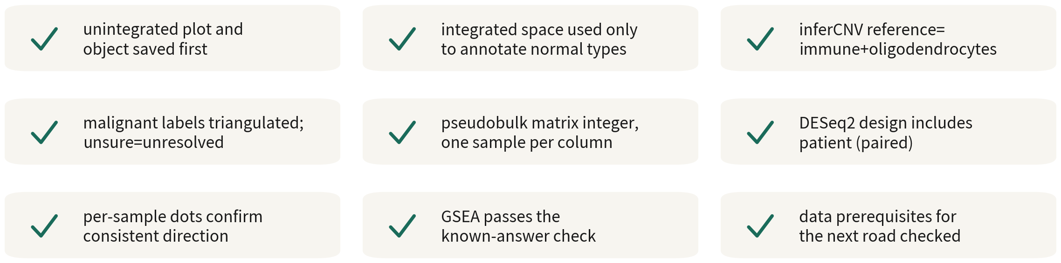
Q3 checklist
All nine boxes before it goes into a paper
Q3 Hands-on II
92
Notes:
九格，跟著唸一次。整合前存了未整合的圖與物件。整合空間只用來註釋正常型別。inferCNV 參考是免疫加寡樹突。惡性標籤三角驗證，不確定者標 unresolved。pseudobulk 矩陣是整數、每欄一個樣本。DESeq2 設計含 patient。每樣本點圖確認方向一致。GSEA 通過已知答案驗證。下一條路的資料前提已對照。 九格全勾，結果才能寫進論文。 ──────── Nine boxes; let's go through them once. The unintegrated plot and object were saved before integrating. The integrated space is used only to annotate normal types. The inferCNV reference is immune plus oligodendrocyte. Malignant labels are triangulated, with uncertain cells marked unresolved. The pseudobulk matrix is integers, one sample per column. The DESeq2 design includes patient. Per-sample dot plots confirm consistent direction. GSEA passes the known-answer check. The data prerequisites of the next route have been checked against the table. Only with all nine ticked do the results go in a paper.

Slide 93
ONE-LINE SUMMARY
Integration aligns the cell types shared across samples; malignant cells
carry patient-specific genomic changes and are analysed per patient;
the unit of differential expression is the patient; each downstream
analysis has its own data requirements.
With the six sentences from Q1 and Q2, that is the skeleton
of tumour single-cell analysis.
Q3 Hands-on II
93
Notes:
整合的目的是對齊各樣本的共同細胞型別；惡性細胞帶病人特異的基因體變異，宜逐病人分析；差異表達以病人為統計單位；下游分析各有其適用的資料條件。 加上 Q1、Q2 的六句，這就是腫瘤單細胞分析的骨架。 ──────── Integration aligns the cell types shared across samples; malignant cells carry patient-specific genomic changes and are analysed per patient; the unit of differential expression is the patient; and each downstream analysis has its own data requirements. Add the six sentences from Q1 and Q2, and that is the skeleton of tumour single-cell analysis.

Slide 94
Check yourself 1
Which group is the safest inferCNV reference?
A The GFAP-expressing astrocyte cluster
B Immune cells and oligodendrocytes
C Whatever sits farthest from malignant cells on the UMAP
Answer B. The reference must be certainly CNV-free. Immune cells and
oligodendrocytes are essentially never malignant in GBM; astrocytes may be AC-like
malignant cells; UMAP distance is not evidence.
Q3 Hands-on II
94
Notes:
第一題。跑 inferCNV 時，哪一組最適合當參考細胞？ A，表現 GFAP 的星狀細胞群。B，免疫細胞與寡樹突細胞。C，UMAP 上離惡性細胞最遠的群。 先自己想一下，再往下聽。 答案是 B。參考組必須確定沒有 CNV。免疫與寡樹突在 GBM 裡幾乎不可能是惡性的；星狀細胞可能就是 AC 樣的惡性細胞；UMAP 距離不是證據。 ──────── Question one. When you run inferCNV, which group makes the best reference cells? A, the GFAP-expressing astrocyte cluster. B, immune cells and oligodendrocytes. C, the cluster farthest from the malignant cells on the UMAP. Take a moment before you hear the answer. The answer is B. The reference group has to be certain to carry no CNV. Immune cells and oligodendrocytes are almost never malignant in GBM; astrocytes may themselves be AC-like malignant cells; and distance on a UMAP is not evidence.

Slide 95
Check yourself 2
After integrating four patients, malignant cells are one blended cluster. This means?
A Integration worked; proceed downstream
B Integration also erased the patient-specific CNV biology; analyse
malignant cells in the unintegrated space
C The four patients share a subtype
Answer B. Malignant cells cluster by patient largely because of genomic differences
such as CNV, not batch. Cells in the same state are expected to mix across patients, so
partial overlap is normal - one single blended blob is over-correction. Use the
integrated space only to annotate normal cells.
Q3 Hands-on II
95
Notes:
第二題。四位病人的資料，整合之後惡性細胞混成一團。這代表什麼？ A，整合成功，可以直接做下游。B，整合把病人特異的 CNV 生物學修掉了，惡性分析要回未整合空間。C，這四位病人是同一種亞型。 先自己想一下，再往下聽。 答案是 B。惡性細胞按病人分成不同群集是基因體差異，不是批次。整合空間只拿來註釋正常細胞。 ──────── Question two. You have four patients' data, and after integration the malignant cells blend into one blob. What does that mean? A, integration succeeded — go straight to downstream analysis. B, integration corrected away patient-specific CNV biology, and malignant-cell analysis must go back to the unintegrated space. C, these four patients share the same subtype. Take a moment before you hear the answer. The answer is B. Malignant cells forming per-patient clusters is genomic difference, not batch. The integrated space is only for annotating normal cells.

Slide 96
Check yourself 3
For core vs periphery malignant DE, what should the DESeq2 design be?
A ~ tissue
B ~ patient + tissue
C ~ tissue + n_cells
Answer B. Each patient contributes both sites — a paired design; absorb patient
first, then test site. Cell number is not a covariate; pseudobulk already
handled it.
Q3 Hands-on II
96
Notes:
第三題。核心對邊緣的惡性細胞 DE，DESeq2 的 design 該怎麼寫？ A，波浪 tissue。B，波浪 patient 加 tissue。C，波浪 tissue 加細胞數。 先自己想一下，再往下聽。 答案是 B。同一位病人同時有兩個部位，這是配對設計；先吸掉病人差異再比部位，功效高很多。細胞數不是共變量，pseudobulk 已經處理了。 ──────── Question three. For core-versus-periphery DE on malignant cells, how should the DESeq2 design be written? A, tilde tissue. B, tilde patient plus tissue. C, tilde tissue plus cell count. Take a moment before you hear the answer. The answer is B. The same patient contributes both sites, so this is a paired design — absorb the patient differences first, then compare sites, and power goes way up. Cell count is not a covariate; pseudobulk has already handled it.

Slide 97
Check yourself 4
After integration the normal cells from all four patients mix well - and
so do the malignant cells. What is the reasonable read?
A Integration succeeded; carry on
B Likely over-corrected; go back and check with the negative control and known markers
C Malignant cells should mix — they are all GBM
Answer B. Malignant cells carry their own CNVs, so a substantial part of them
separates by patient. Four patients blending completely usually means the correction
removed real signal along with the patient effect. That is what the negative control
is for; then confirm with a few known markers that expression itself was not altered.
Q3 Hands-on II
97
Notes:
第四題。整合之後，正常細胞四位病人混得很好，惡性細胞也混在一起了。最合理的判斷是什麼？ A，整合成功，可以往下走。B，很可能校正過頭，要用負對照與已知 marker 回頭檢查。C，惡性細胞本來就該混，因為它們都是 GBM。 先自己想一下，再往下聽。 答案是 B。惡性細胞帶著各自的 CNV，跨病人本來就會有相當一部分分開。四位完全混在一起，通常是校正把病人差異連同真訊號一起壓掉了。負對照就是為了抓這件事，抓到之後再用幾個已知 marker 確認表現量本身沒有被動到。 ──────── Question four. After integration the normal cells from all four patients mix well — and so do the malignant cells. What is the reasonable read? A, integration succeeded, carry on. B, likely over-corrected; go back and check with the negative control and known markers. C, malignant cells should mix, they are all GBM. Take a moment before you hear the answer. The answer is B. Malignant cells carry their own CNVs, so a substantial part of them separates by patient. Four patients blending completely usually means the correction stripped out real signal along with the patient effect. That is what the negative control is for — and once it fires, confirm with a few known markers that expression itself was not altered.

Slide 98
Check yourself 5
A cell type has only 2 patients with a usable pair, and DESeq2 returns
300 genes at padj < 0.05. Report them?
A Yes — padj is already corrected
B No — report n first, and call the genes candidates at most
C Tighten the threshold and then report
Answer B. A paired design at n = 2 has almost no power, and three hundred hits
usually means the dispersion estimate is unreliable rather than that three hundred
genes truly differ. Tightening the threshold does not add power. The honest version
states how many patients paired up, then labels the list as candidates.
Q3 Hands-on II
98
Notes:
第五題。某種細胞型別只有兩位病人配得成對，DESeq2 給出三百個 padj 小於 0.05 的基因。可以報嗎？ A，可以，padj 已經校正過了。B，不行，先報 n，再說這批基因只能當候選。C，把門檻改嚴一點就可以報。 先自己想一下，再往下聽。 答案是 B。n 等於 2 的配對設計幾乎沒有功效，跑得出三百個顯著基因，通常代表離散度估不準，而不是真的有三百個基因有差。門檻改嚴也不會讓功效變高。誠實的寫法是先講清楚幾位病人配得成對，再把那份清單標成候選。 ──────── Question five. A cell type has only two patients with a usable pair, and DESeq2 returns three hundred genes at padj below 0.05. Do you report them? A, yes — padj is already corrected. B, no — report n first, and call the genes candidates at most. C, tighten the threshold and then report. Take a moment before you hear the answer. The answer is B. A paired design at n = 2 has almost no power, and three hundred hits usually means the dispersion estimate is unreliable rather than that three hundred genes truly differ. Tightening the threshold does not add power. The honest version states how many patients paired up, then labels the list as candidates.

Slide 99
Check yourself 6
On one DE result, ORA returns no significant terms while GSEA returns five
at padj < 0.05. How do you read that?
A They contradict each other, so neither can be trusted
B ORA is right and GSEA is too permissive
C Normal: at small n the DE list is short and ORA has little to work with; read GSEA's leading
edge and see whether it makes sense
Answer C. The two ask different questions: ORA cuts a threshold first, so a short list cannot build a
significant overlap, while GSEA uses the whole ranking and is therefore more sensitive at small n.
Neither is wrong — read GSEA's leading edge, see whether those genes hang together biologically, and
let that decide what goes into the conclusion.
Q3 Hands-on II
99
Notes:
第六題。同一份 DE 結果，ORA 沒有任何顯著詞條，GSEA 卻有五條 padj 小於 0.05。這要怎麼看？ A，矛盾，兩個都不能信。B，ORA 對，GSEA 太寬鬆。C，正常，小 n 時 DE 表短，ORA 幾乎沒東西可算；先看 GSEA 的 leading edge 合不合理。 先自己想一下，再往下聽。 答案是 C。這兩種問法本來就不一樣：ORA 先切閾值，清單短的時候交集自然湊不出顯著；GSEA 不切閾值，整份排序都在貢獻證據，所以在小 n 更靈敏。不是誰對誰錯，而是先看 GSEA 的 leading edge 是不是一批說得通的基因，再決定要不要寫進結論。 ──────── Question six. On one DE result, ORA returns no significant terms while GSEA returns five at padj below 0.05. How do you read that? A, they contradict each other, so neither can be trusted. B, ORA is right and GSEA is too permissive. C, normal — at small n the DE list is short and ORA has little to work with; read GSEA's leading edge and see whether it makes sense. Take a moment before you hear the answer. The answer is C. The two ask different questions. ORA cuts a threshold first, so a short list cannot build a significant overlap. GSEA cuts no threshold, so the whole ranking contributes evidence, which makes it more sensitive at small n. Neither is wrong — read GSEA's leading edge, see whether those genes hang together biologically, and let that decide what goes into the conclusion.

Slide 100
FURTHER LEARNING
Three series for going deeper
Series A ·
Getting Started
Series B · Hands-on
Series C · The
Mathematics
Concepts and interpretation:
experimental design, reading the
figures, and turning results
into a research narrative. No
coding required.
The complete workflow on public
data: from FASTQ and Cell
Ranger through the Seurat
pipeline and downstream
analyses, with per-episode
scripts. The 'Deeper: Bx' tags
in this course are the index.
The mathematics and statistics
behind the methods: PCA and
dimensionality reduction,
variance stabilisation,
statistical inference (why
pseudobulk is valid), and how
integration works.
All series are bilingual; the full index and links are in the video description.
Q3 Hands-on II
100
Notes:
如果我們想在某個方向繼續深入，這門課還有三個系列。 A 系列，入門篇。觀念與判讀：實驗設計、圖表解讀、從結果到研究敘事。整個系列不需要寫程式，適合建立整體框架，也適合需要跟生資合作者溝通的人。 B 系列，實作篇。以 PBMC 公開資料完整實作，從 FASTQ 與 Cell Ranger 一路到 Seurat 標準流程與各項下游分析，每一集附練習腳本。這門課每頁右下角的「深入：B 幾」，就是對應到 B 系列的索引。 C 系列，數學篇。方法背後的數學與統計：PCA 與降維、變異數穩定化、統計推論——包括 pseudobulk 為什麼成立——以及整合演算法的原理。 三個系列都是中英雙語。完整索引和連結在影片說明欄。 ──────── If we want to go deeper in a particular direction, this course has three companion series. Series A, Getting Started. Concepts and interpretation: experimental design, reading the figures, and turning results into a research narrative. No coding is required anywhere in the series — it suits both building the overall framework and talking to bioinformatics collaborators. Series B, Hands-on. The complete workflow on public PBMC data, from FASTQ and Cell Ranger through the Seurat pipeline and the downstream analyses, with practice scripts in every episode. Those "Deeper: Bx" tags at the bottom right of this course's slides are the index into Series B. Series C, The Mathematics. The mathematics and statistics behind the methods: PCA and dimensionality reduction, variance stabilisation, statistical inference — including why pseudobulk is valid — and how integration works. All three series are bilingual. The full index and links are in the video description.

Slide 101
END OF SERIES Q
Closing: a complete skeleton for
scRNA-seq analysis
Practice scripts R/00–10 and the self-test quiz accompany this course.
Next, apply the workflow to our own data — tumour or otherwise.
scRNA-seq video series · Series Q Quick Start
https://github.com/Charlene717/scRNA-seq-tutorial-Qseries
Notes:
Q 系列到此結束。三集、大約兩小時，我們已經有了一套完整的 scRNA-seq 分析骨架。 練習腳本 R/00 到 10 和自測題庫都隨課程提供。接下來，就把這套流程用到我們自己的資料上——不限於腫瘤。我們在 A、B、C 系列見。 --- ──────── That is the end of the Q series. Three episodes, roughly two hours, and we now have a complete skeleton for scRNA-seq analysis. Practice scripts R/00 through 10 and the self-test quiz come with the course. Next, we take the workflow to our own data — tumour or otherwise. See you in Series A, B, and C. ---

