Slide 1
HMAC-Based One-Time Password (HOTP) Ian McCullough Charlie White

Slide 2
AGENDA
Overview of HOTP
Define key concepts:
HMAC
One Time Password
How HOTP Works
HOTP vs TOTP
Examples
Advantages and Weaknesses

Slide 3
overview of hotp
HOTP is an event based one-time password
Provides enhanced security compared to static passwords
HMAC and OTP combine to form a secure authentication algorithm for generating 2FA codes
Algorithm calculates 2FA code using a secret value and a counter value
Client generates the HOTP with the algorithm and the HOTP is checked against what the server calculated using the same algorithm and values. The client is verified if the calculation matches
Provides larger window for user authentication

Slide 4
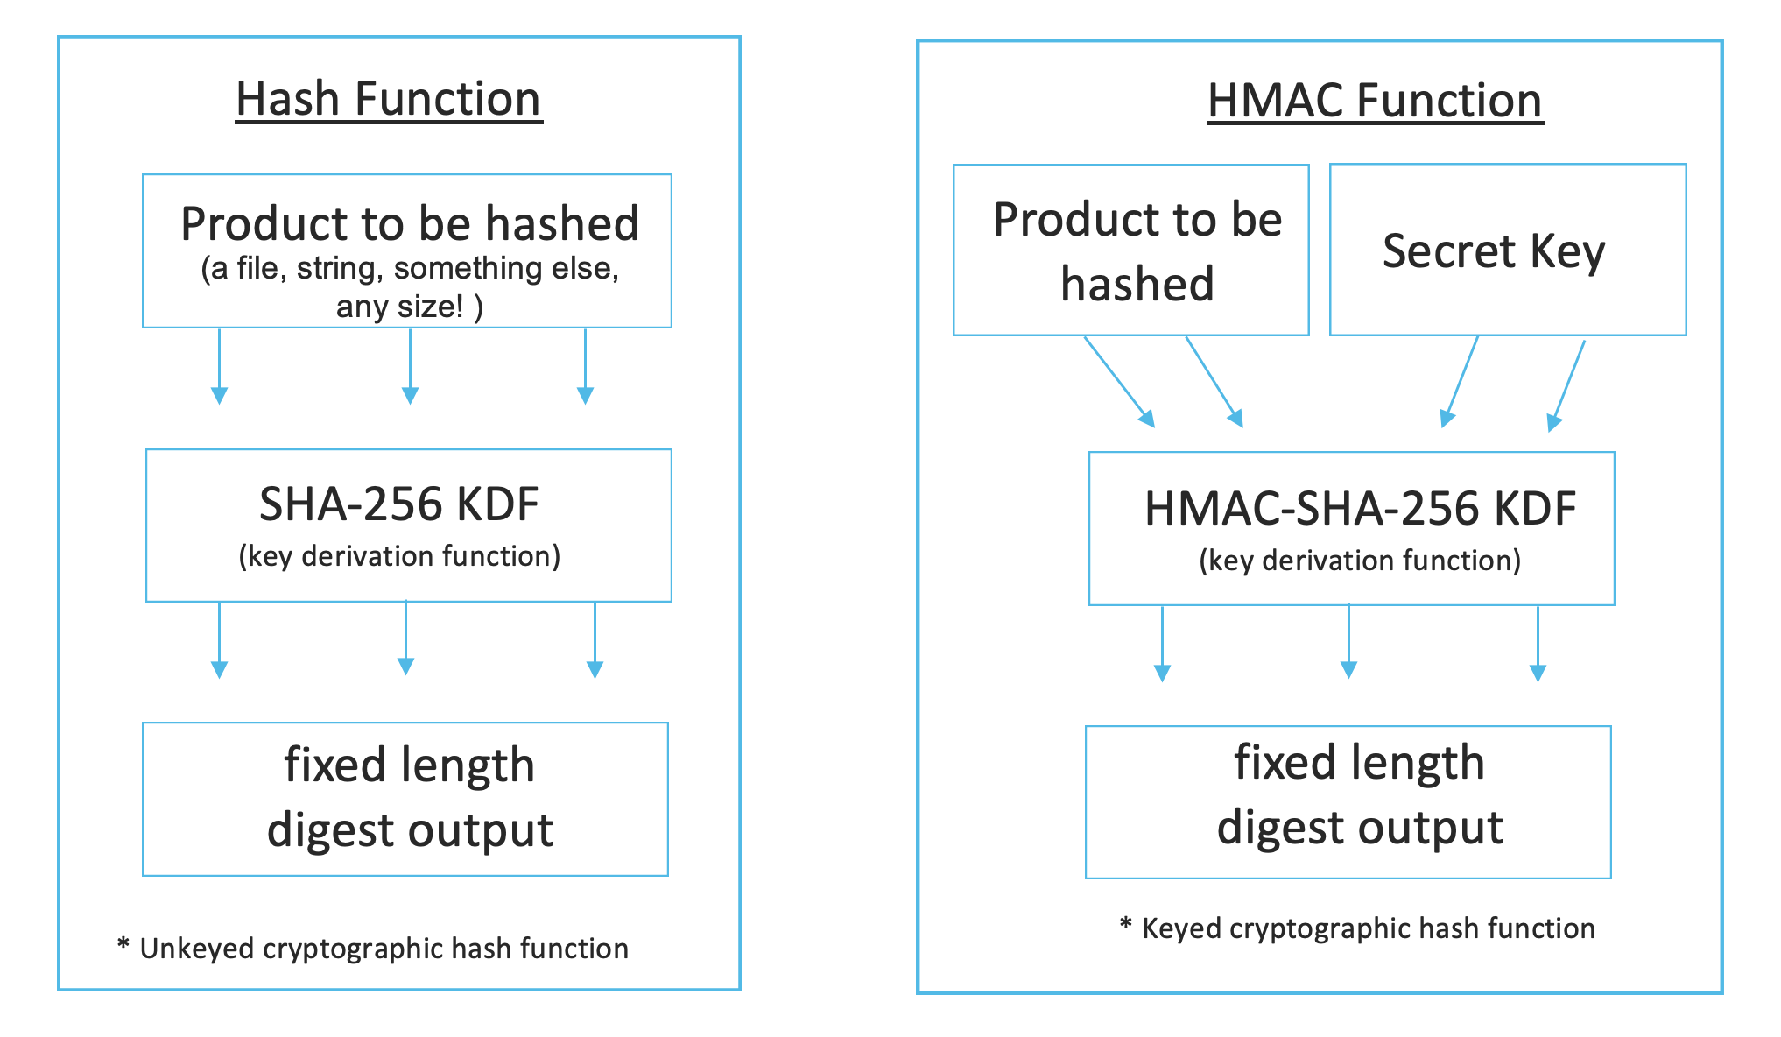
What is HMAC?
HMAC: keyed Hash-Based Message Authentication Code
Cryptographic Hash Function Used for Authentication
Hash Function: deterministic method of taking a numerical input of one value and returning a compressed numerical input of a fixed (smaller) length.
MAC: Key-dependent one-way hash function used for checking authenticity and integrity
https://community.cisco.com/t5/image/serverpage/image-id/133868iB61D48FB3C6BBEEE?v=v2
4

Slide 5
What is HMAC? (cont.)
Keyed hashes use hash functions to create a MAC
HMACs are less affected by collision
Secret Key + Message/arbitrary data + hash function = HMAC
In HOTP the "message" is the moving value
https://community.cisco.com/t5/image/serverpage/image-id/133868iB61D48FB3C6BBEEE?v=v2
5

Slide 6
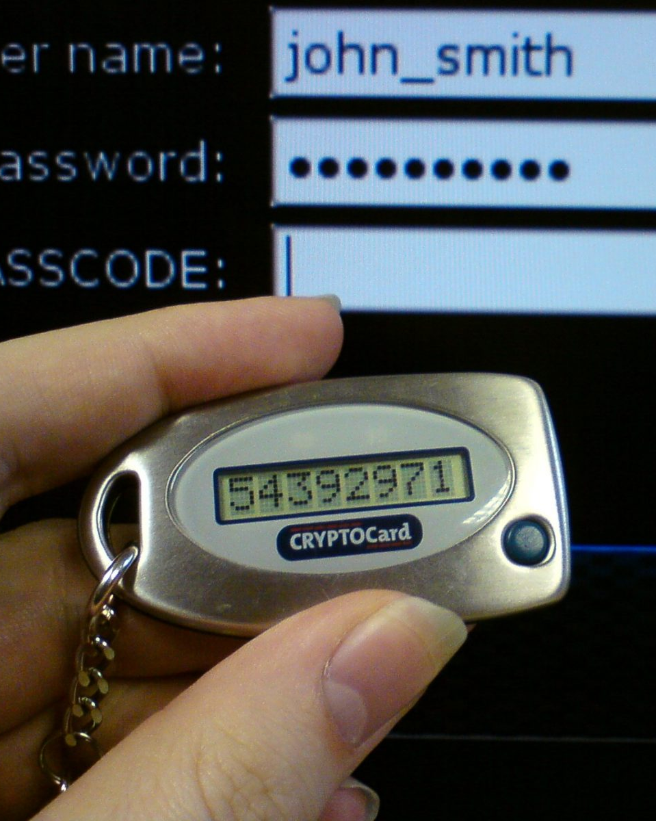
OTP: ONE-TIME PASSWORD
DYNAMIC PASSWORD THAT is valid for only one login session or transaction.
Used in 2fa/mfa
ENHANCES security AUTHENTICATION
Otp algorithm generates password
Secret key (seed) & Moving value (counter)
Delivery Methods: SMS, authenticator apps, push notifications, and otp tokens
https://www.10duke.com/wp-content/uploads/2019/01/one-time-password.jpg3

Slide 7
How HOtp works
Step 1: Server & Client share a secret key (K), also called the seed
Length of secret key must be at least 128 bits. 160 bits is recommended.
Step 2: Server generates a challenge/counter value (C) and sends it to the Client
Server and client must be synchronized to have the same counter value.
Step 3: Client uses C and K in the HMAC algorithm to calculate the hash value and truncates it to produce the HOTP value
Step 4: Client sends HOTP to Server
Step 5: Server verifies HOTP using the same C and K values to calculate the expected HOTP
Step 6: Authentication succeeds if HOTP matches

Slide 8
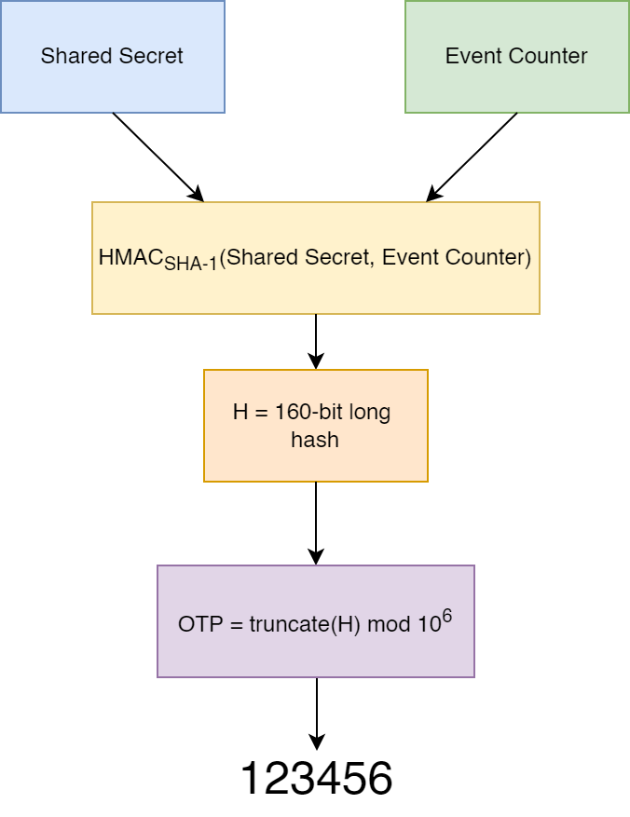
How HOTP Works
https://rublon.com/wp-content/uploads/2022/03/hotp-work.png

Slide 9
HOTP vs TOTP
HOTP
TOTP
Secret value and a counter as a moving value to generate the password
Counter changes after every use or can be forced to count up and generate a new password
BOTH: HOTP and TOTP can be used while offline.
Secret value and time-based moving value to generate password
Time derived from unix time with a 30-60 window before a new code is generated
Dependency on Time / Finite Validity Period
Considered more secure since codes only last for a short time

Slide 10
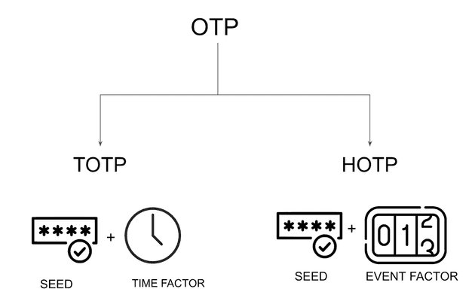

Slide 11
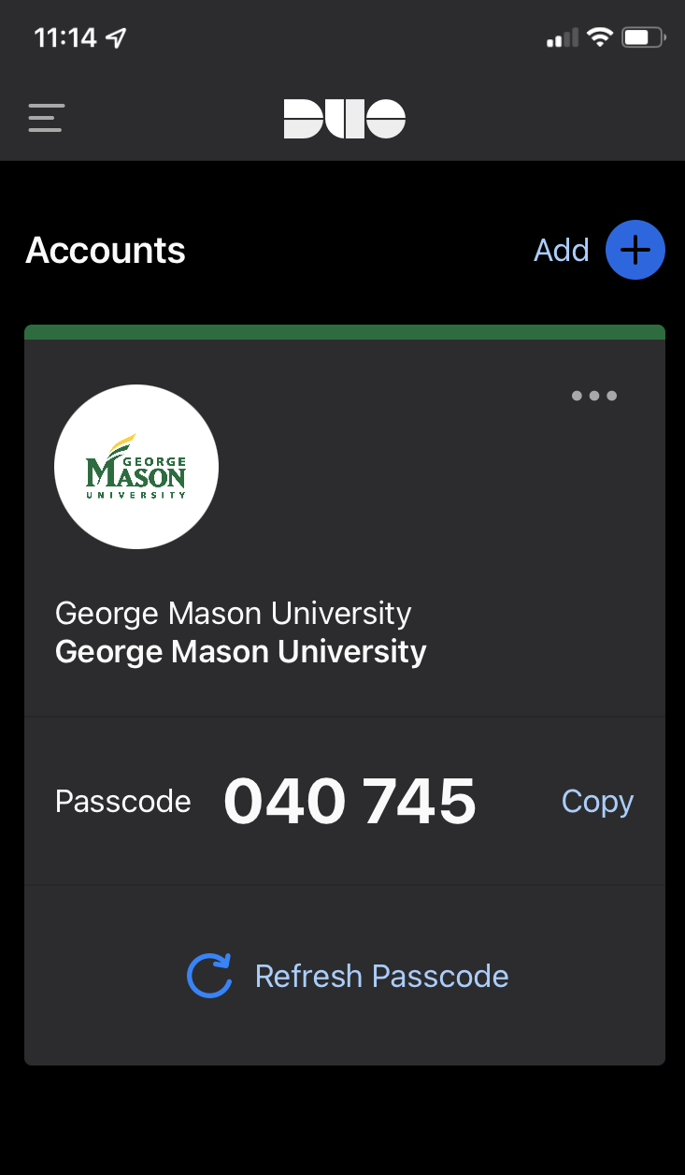
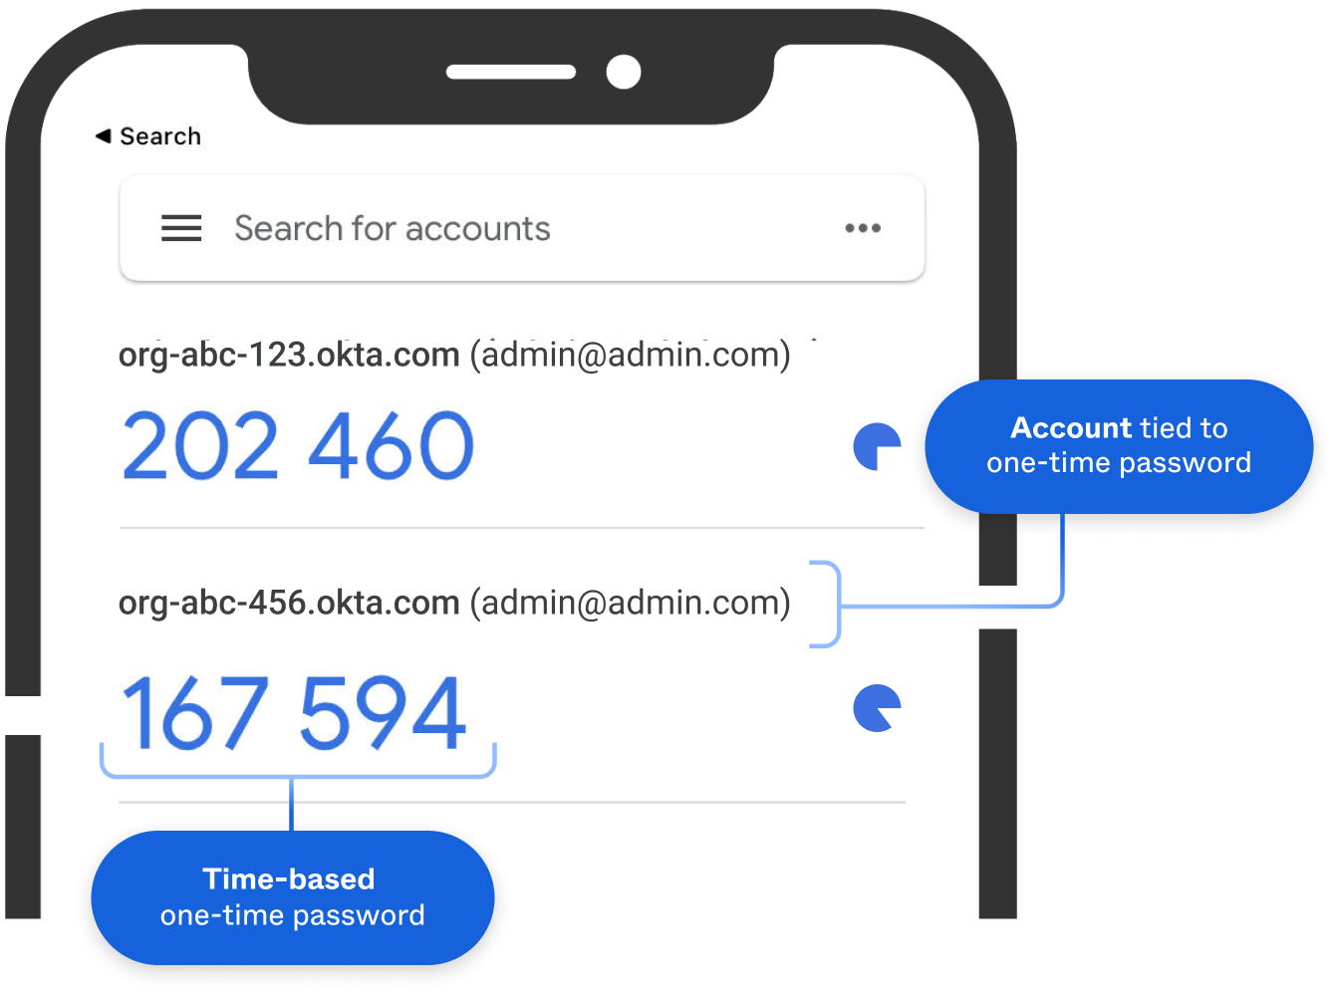
Examples of hotp/TOTP
Duo Security
Google Authenticator
Microsoft Authenticator
Practice makes perfect
https://its.gmu.edu/wp-content/uploads/DuoAppPasscode2.pngs
https://developer.okta.com/img/authenticators/authenticators-google-one-time-password-fetch.png

Slide 12
Weaknesses of HOTP and TOTP
Man-in-the-Middle attacks can be used to intercept and alter OTP codes sent between user and authentication server.
Phishing Attacks and fraudulent websites are used to get valid access tokens from users.
Brute Force attacks can be used against HOTP and was considered to be the most effective attack against HOTP when it was first introduced. However, secure HOTP algorithms have counter measures in place to prevent these attacks.
Desynchronization can occur between the client and server and OTPs won't match. Servers will look ahead at future key values to attempt to resync. Manual resync will be required if the server and client are too out of sync.

Slide 13
References
https://www.rfc-editor.org/rfc/pdfrfc/rfc4226.txt.pdf
https://www.descope.com/blog/post/totp-vs-hotp
https://www.professormesser.com/security-plus/sy0-401/one-time-password-algorithms/#google_vignette
https://www.onelogin.com/learn/otp-totp-hotp#:~:text=Put%20in%20layman's%20terms%2C%20HMAC,incremented%20based%20on%20a%20counter.
https://www.youtube.com/watch?v=XvQ7iOGjEsA
One-time password - Wikipedia
One-Time Password (OTP) - Guide For ISVs 2023 (10duke.com)
One-Time Password vs. One-Time Pad: What’s the Difference? - Rublon
https://www.youtube.com/watch?v=MKn3cxFNN1I
https://www.youtube.com/watch?v=46AKWNOJ3-Y

Slide 14
THANK YOU Questions?

