Slide 1
NVIDIA Cyber Supply Chain Model
Members: Ben Bowers, Ben Cross, Luis Gutierrez Sanchez, Robert Huba, Ty Jackson, Patrick O'Dacre, Charlie White

Slide 2
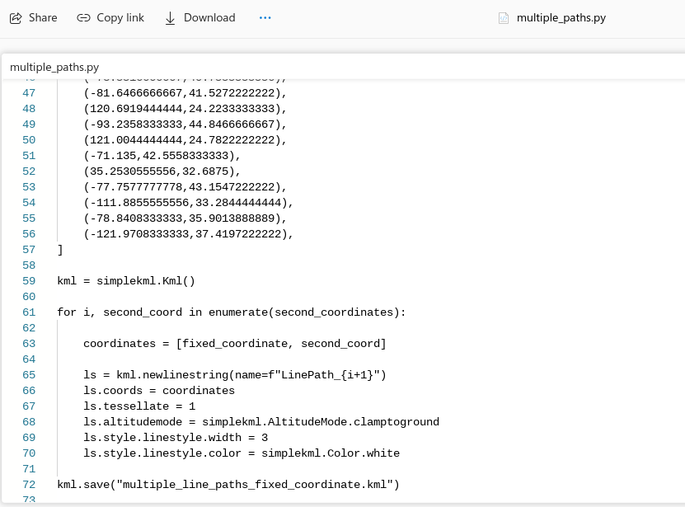
Modeling Challenges
KML scripting
Python line/attack vector automation
Switch Board/embedded HTML
Google Earth Pro usability
Program crashes/performance issues
Losing 'unsaved' progress
File organization/sharing between classmates

Slide 3

Lessons Learned
Google Earth is extremely powerful
Basic KML and HTML scripting
Save Work Regularly
Large amount of company supply chain data publicly available

Slide 4
Benefits of This Experience
Enterprise context
Logistics management
Supplier/warehouse management
Route optimization
Supplier sourcing optimization
Natural disaster/contingency planning
Alternate sites
Cyber risk context
Asset mapping
Data centers
Servers
Other critical infrastructure components
Threat intelligence mapping
Better understanding of cyber threat profile
Helps guide security investments

Slide 5
Next Steps
Supply Chain Context
Using the model to achieve business objectives
High quality decision making
Continuous monitoring and updates
Supply chains are always fluctuating
Adding and removing suppliers as business mission and buy/sell needs evolve
New threats – use threat intelligence
Cyber Professional Context
Useful tool in our toolbox.
Using the experience from this assignment to be better security professionals and further our careers.
Impress future employers
Earn the big bucks

