Slide 1
Hidden Gem of Marinduque

Slide 2
Table of contents
01
02
04
07
11
14
Title Page
Table of contents
Project Overview
The title of the project is placed on this page
The table of content of the project is placed on this page
This is where we introduce the project
Objectives
Audience
Scope
This is where we discuss the aim of the project
The page is about the involve audience in the project
This is where the scope of the project lies

Slide 3
Table of contents
17
19
21
24
Features
Functionality
Project Navigation
This is where we will discuss about the features of the project
This is where we will discuss about the functionality of the project
This is where we navigate the project
Interface
This page is where we will show the screeshots of the interface of the project

Slide 4
Project Overview
Marinduque is a stunning island that is located at the heart of Philippines, have a vast mysterious natural wonders, cultural heritage and excellent service and hospitality from the natives. Marinduque Tourism Guide is created to provide the best experience to explore and to have exposure to the tourist spots and events in Marinduque. The Marinduque Tourism Guide is a free and valuable website that will serve as a gateway to captivate more foreign tourist to visit Marinduque.

Slide 5
The Marinduque Tourism Guide project that we created was focused to attracts foreign tourist to visit Marinduque for a new experience in the culture and heritage of Marinduque not just from a long time ago but also the new and improvised tourist spots and events in Marinduque. This website will also provide up-to-date information, hotel or resorts to stay, budget management, best time to visit and other related detail. Marinduque Tourism Guide website will be made prioritizing our foreign tourist sake, so the website will have an easy and user-friendly interface that will maximize the the experience of the tourist when browsing the website.

Slide 6
Overall, the Marinduque Tourism Guide is a website that will provide various information to our guest and tourist from other places. This will also be a way to help the province as a fellow native to advertise it to make the province more lively and energetic. In the end, the aim of the website is to promote the tourism of Marinduque. The Marinduque Tourism Guide website serves as a comprehensive and user-friendly resource for travelers seeking to relax and explore the wonders of Marinduque. With it’s detailed information on cultural heritage, natural landscapes, and practical tips, and community engagement, the website invites travelers and tourists to unlock the secrets of this captivating destination, leaving them with lasting memories and a desire to return.

Slide 7
Objectives
The Marinduque Tourism PHP Scripting project had the objective to disseminate information to the tourist that are interested to go and tour in Marinduque. This tourist website aims to provide accurate and comprehensive information about the destination, including some cultural background, landmarks, the best date to go, prices and budget management and other relevant information. The tourist website will provide the best possible experience to our visitors.

Slide 8
This tourist website will also be the gateway to promote the cultural heritage of Marinduque as a must visit destination in the Philippines. By providing detailed information about the province’s culture and heritage, natural attraction, travel tips and other relevant information, the website aims to showcase the beauty and uniqueness of Marinduque. The website also highlights local business, artisan and entrepreneurs, providing them exposure and support. This will also enhance the business of the natives in Marinduque, it will not only just promoting the places and events in this province but also the business of the people. It will be a very good way to attract tourists from other places and at the same time promotes the business of our own people.

Slide 9
Finally, the Marinduque Tourism website aims to satisfy the needs of our instructor, for they are the one to tell us create this website as a way of completing this semesters subject. This is the most important objective in creating this tourist website in Marinduque and that is to pass this subject by doing this final output that was instructed to us by our teacher in the subject. Creating this website needs a very detailed information about the tourist spots and events and should also have a good design, at the same time a good user interface.

Slide 10
Overall, the Marinduque Tourism Guide website has three main objective: to provide detailed and user-friendly information for guests and tourists, to promote the must visit destination in the province and finally to satisfy our instructor in this subject and pass. By achieving these objectives, the website will definitely contribute to the growth and development of Marinduque’ tourism industry while showcasing the beauty and nature of this remarkable island of Marinduque.

Slide 11
Audience
The the Marinduque Tourist website have two major audience and that is the tourists that will visit the province’s natural spots and destination and the other is the local and native businessmen, entrepreneur and artisans that is governing the natural spots and destinations in Marinduque. The website is not only for foreign tourist but also for the local tourist that haven’t yet explore the province. The website’s content will be in universal language, “English”, to ensure that the tourist can easily understand the information in the website.

Slide 12
Aside from the foreign and local tourists, the other audience for this subject will be the local businessmen, artisans, and entrepreneurs. The website will serve as a way so that their product and services will be promoted to the tourists. This method will provide a good path for more employment in Marinduque, making the province more lively and have more economic employment for our native.

Slide 13
Finally, there is actually another audience that can enter the discussion of the Marinduque Tourist Guide website which are the individuals and organizations outside the province that are interested in collaborating and promoting their own businesses. This will provide for more employment opportunities for our province and this cause will make the province lean in the development side. The project can be a marketing strategy that our own people can use for their own advantage for free promotion of their own businesses.

Slide 14
Scope
The Marinduque Tourism Guide project that we created was focused to attracts foreign tourist to visit Marinduque for a new experience in the culture and heritage of Marinduque not just from a long time ago but also the new and improvised tourist spots and events in Marinduque. The website’s content will be in universal language, “English”, to ensure that the tourist can easily understand the information in the website. The project can be a way to provide more employment opportunities for our local workers.

Slide 15
The website will also serve as a gateway to promote the natural destinations and other tourist spots in Marinduque. Not only will the project serve as a way to promote the natural destinations in the province but it will also unconditionally promotes our businessmen, artisans, and entrepreneurs businesses. Aside from that, this project will further enhance the development of the province into a more massive community. Different enterprise and business will emerge from the promotion of the natural destination and businesses and this will attract more tourists to visit the province.

Slide 16
The project will also provide the users to have an easy access to the website so that they will have a relaxed and good impression of the website. The website will provide the tourists a detailed up-to-date information about the tourists spots and events they will visits. Aside from that, the website will also provide some multimedia content such as images to make the tourist have some more overview about the beauty of the natural destination of the province. Lastly, the most important part of the project is to use it to provide more job related opportunities to our own people so that they can also contribute to the growth and development of our own province since many talented people leave their homeland just to successful since there is a limited opportunities in the province so the development of Marinduque will take place using the marketing of the businesses using the website.

Slide 17
Features
The Marinduque Tourist Guide website will offer various kinds of features to our tourists that will improve the experience of the tourists and promote the Marinduque tourism. This tourist website aims to provide accurate and comprehensive information about the destination, including some cultural background, landmarks, the best date to go, prices and budget management and other relevant information. Aside from that, the website will also provide some multimedia content such as images to make the tourist have some more overview about the beauty and uniqueness Marinduque.

Slide 18
The website’s content will be in universal language, “English”, to ensure that the tourist can easily understand the information in the website. In summary, the tourist guide website will serve as a one-stop resource for travelers and tourists, offering a wealth of information and user generated content. Whether seeking historical sites, natural wonders, or cultural experience, tourist can rely o this website to navigate their way and make the most of their adventures.

Slide 19
Functionality
The project will serve as a way to assist travelers and tourist in planning, managing budget, and organizing their trips effectively. Firstly, it acts as an information hub, providing comprehensive details about various destinations, hotels and resort, restaurants, including popular attractions, landmarks, historical sites, local culture and events. This helps travelers and tourist gain insights into the places they wish to visit and enables them to make informed decisions about their choices.

Slide 20
One key function of the project is it’s ability to search the the tourist spots and events in a certain town by just typing the name of the town. In addition to that, we also provided the users the places they can stay like hotel and resorts near the tourist spots or events. So if their visit takes more than day, they can spend the night in one of the hotels and resort provided in the same town. Not only that, we also added the restaurants, cafe and bar they can visit, this will ensure that it the user will have it more easy to find dining place when they are hungry and so that they can try local dishes.

Slide 21
PROJECT NAVIGATION
The navigation of the website will start with the homepage which will serve as the main entry point for users and should provide a visually appealing and intuitive design. The homepage will be featured by a prominent search bar where users can enter the name of their desired destination or browse through popular destinations. The homepage will also showcase attractions or destinations, along with enticing images and brief descriptions.

Slide 22
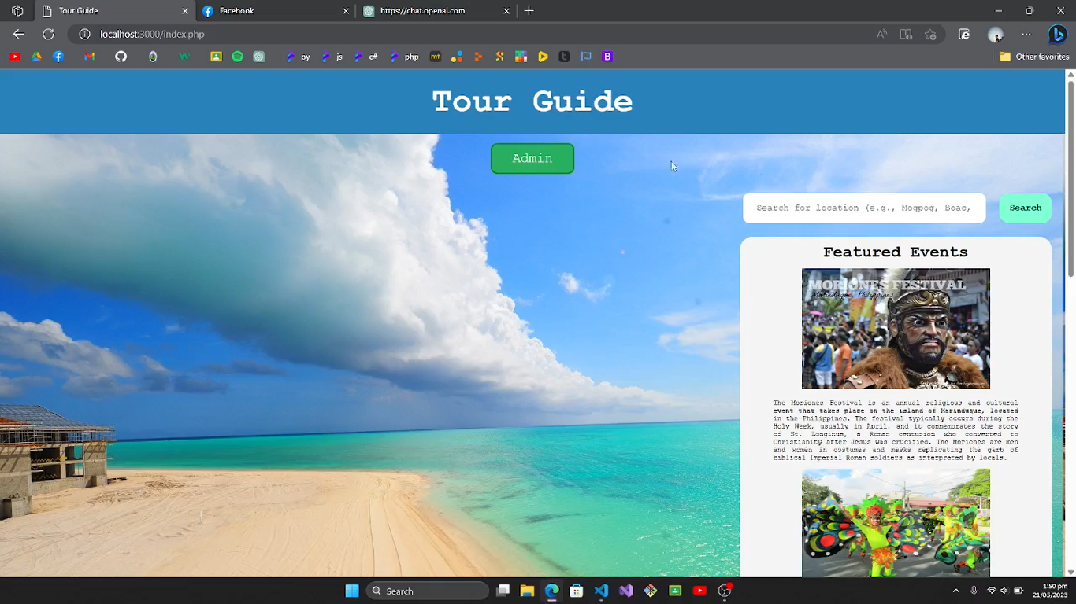
Figure 1. Homepage
The figure 1 is the main homepage of the website. This page have the search feature where the user have to enter the name of the place or municipality they want to visit and then the tourist spots and events will appear. Featured events are also present in home page.

Slide 23
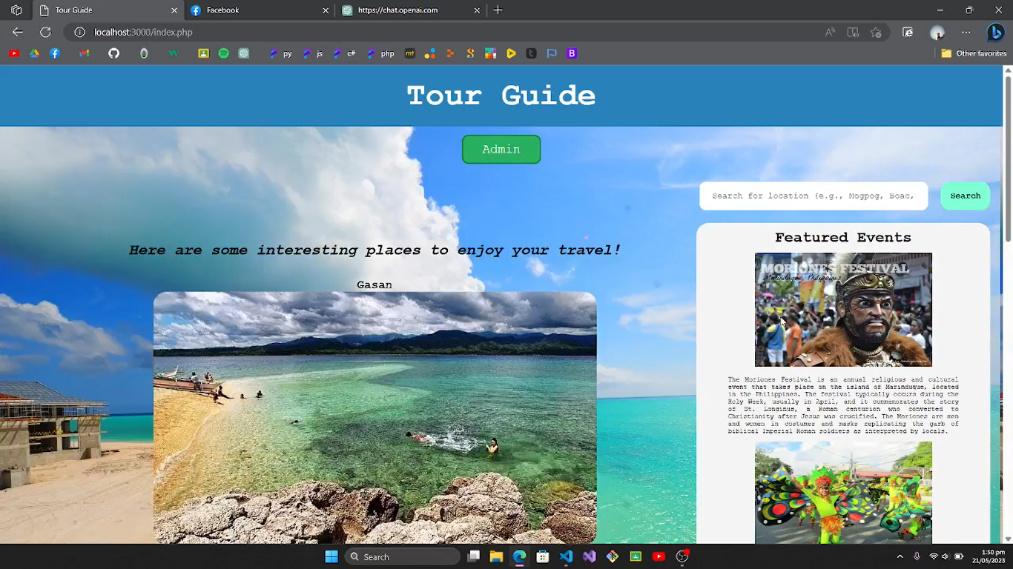
Figure 2. Search Page
On the figure 2, we can see the result of the searched place. The tourist spots and events will appear here once they are search.

Slide 24
Interface
Figure 1. Homepage
The figure 1 is the main homepage of the website. This page have the search feature where the user have to enter the name of the place they want to visit and then the tourist spots and events will appear.

Slide 25
Figure 2. Search Page
On the figure 2, we can see the result of the searched place. The tourist spots and events will appear here once they are search.

Slide 26
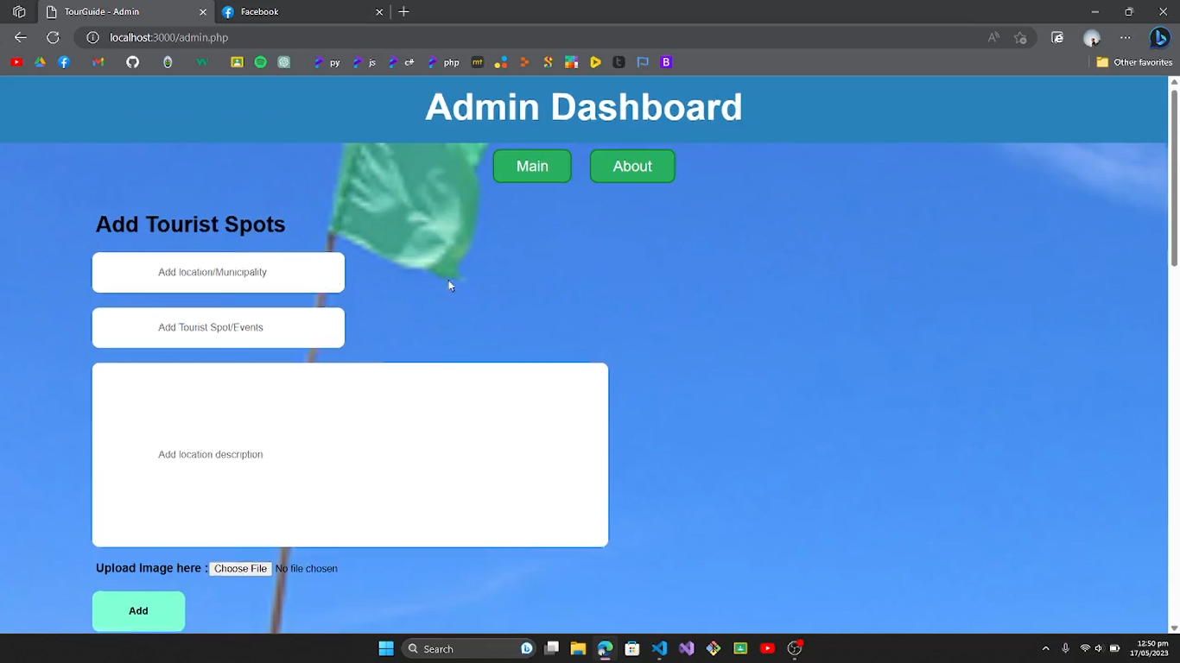
Figure 3. Admin Page
The figure 2 will be the page where the contents of the website will be placed. Here, we used xml to input the content to the website, the municipality, name of tourist spots or events and the description included.

Slide 27
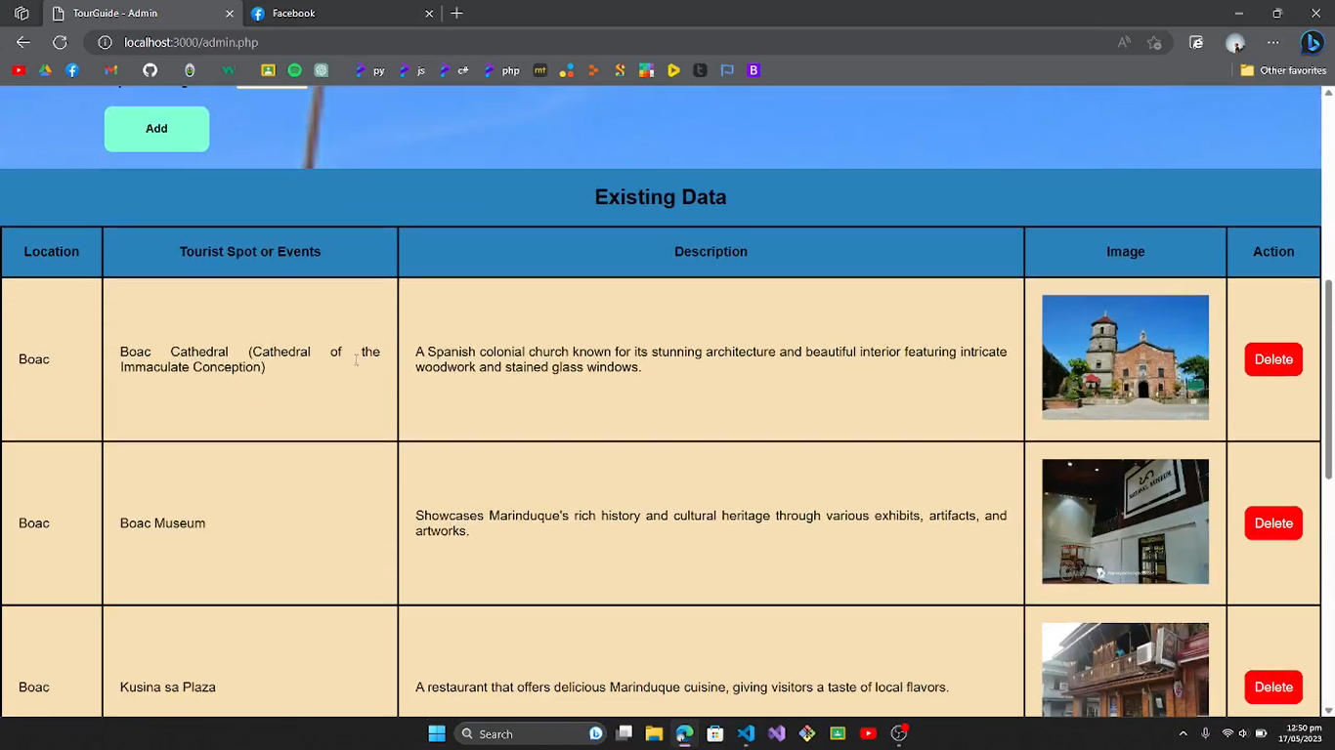
Figure 4. Stored Content
Figure 4 is the result of adding contents in admin. Now the contents are stored in this page. This table can be found below the admin page and input.

