Slide 1
Stemaway Presentation
Team 7

Slide 2
Team Members
Charles Im
Yumin Guo
Akansha

Slide 3
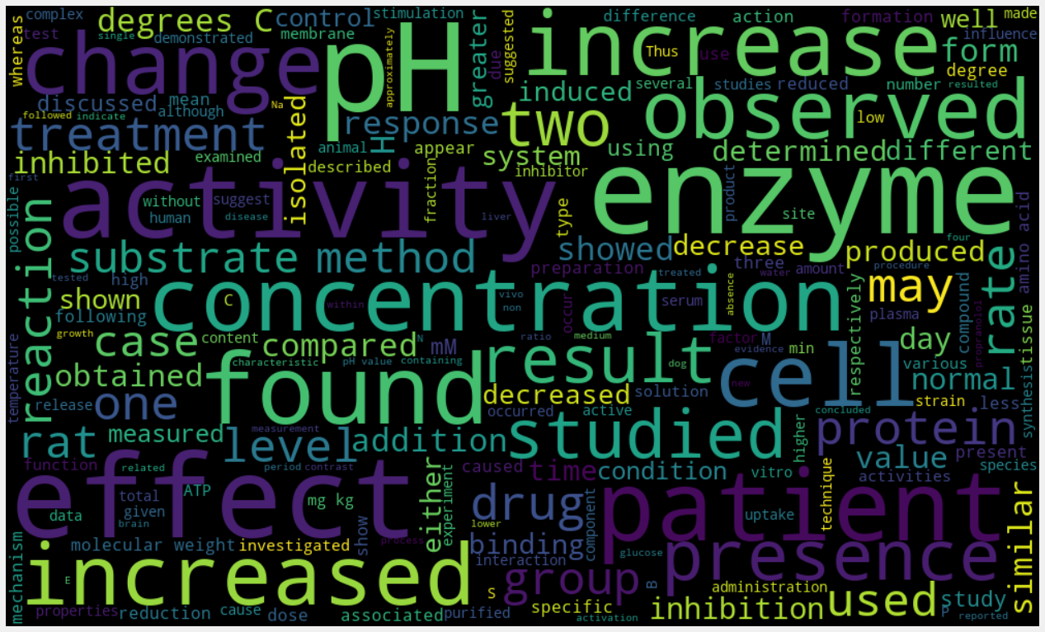
Data Gathering
Web scrape for Pubmed article archives
Extracted abstract into data frames
Use csv files for storage
Obtained drug list from Drug Bank Online
Obtained gene list from PharmGKB

Slide 4
Preprocessing
Removed a list of common words from the genes (e.g. “cat”, “was” …)
Removed the dots (periods) within sentences (used for abbreviation), without changing the performance of the sentences to be parsed.
Looked for sentences that contain exactly one drug name and one gene name; then parsed those sentences

Slide 5
Dependency Parser
E.G.
"Haloperidol (1 mg/kg) decreased the apparent Km of striatal TH for the pteridine cofactor."
'nsubj [nominal subject]
(decreased-6, Haloperidol-1)’,
'num [numeric modifier]
(mg/kg-4, 1-3)’,
'appos [appositional modifier]
(Haloperidol-1, mg/kg-4)’,
'root
(ROOT-0, decreased-6)’,
'det [determiner]
(Km-9, the-7)’,
…
What is it?
A dependency parser tries to figure out the grammatical structure of sentences.
It focuses on how words are dependent on each other (i.e. Which words are correlated and how?)
Tool used: Stanford Parser (Jython interface)

Slide 6
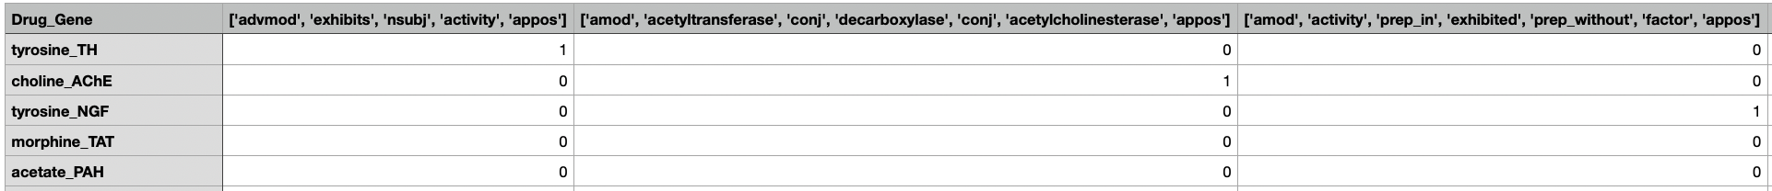
Stanford Parser
E.G.
"Haloperidol (1 mg/kg) decreased the apparent Km of striatal TH for the pteridine cofactor."
With the drug and gene of each sentence, find the shortest path connecting (from) the drug and (to) the gene.
Turn the results into a large dependency matrix, (drug-gene pairs as rows and relationships as columns), then pass to the EBC algorithm.
Drug: Haloperidol
Gene: TH
Relationship:
['nsubj', 'decreased', 'dobj', 'Km', 'prep_of']

Slide 7
Problems with the Current Parser
E.G.
"A comparative study of fluorescences parameters of HDC and its inhibitory complexes with methyl ester of histidine (MEH), hydroxylamine and p-chloromercuriumbensoate is carried out."
→ [“of”]
The parser sometimes connects words that don’t seem to be related.
Some drug-gene relationships are too short to be useful.
(we removed the relationship if the pair is connected by 0 or 1 word)
The parser itself might be making some mistakes consistently.
This version of parser treats every single word separately.

Slide 8
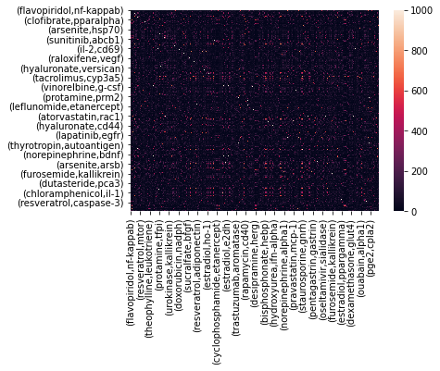
EBC (Unsupervised Portion)
Biclustered drug-pairs in the dependency matrix
1000 iterations used
Aggregate the interactions for co-occurrence matrix

Slide 9
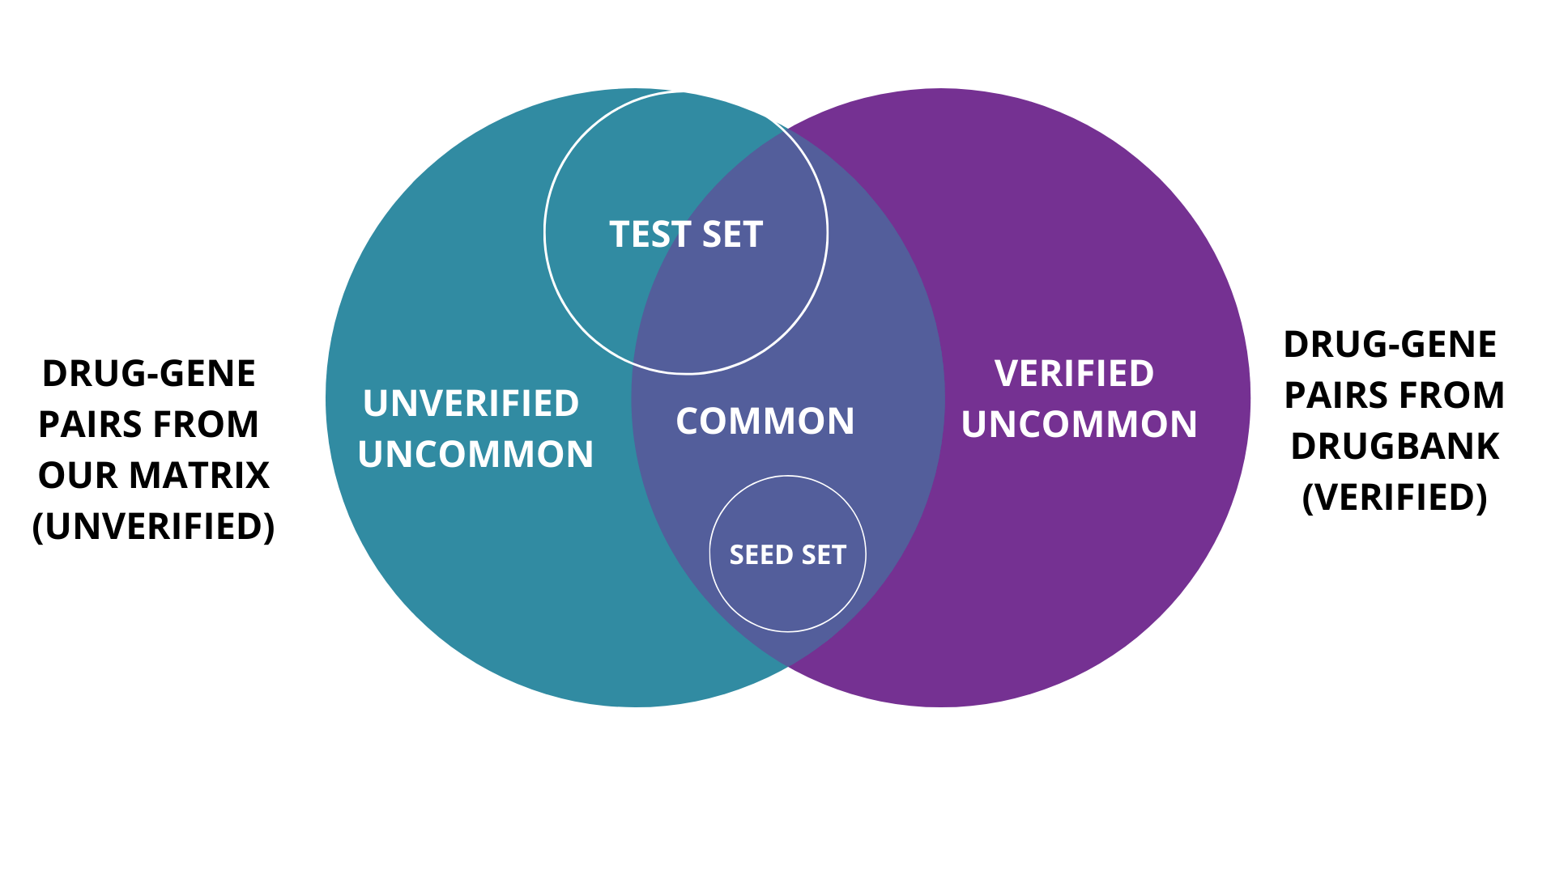
EBC (Supervised Portion)
Inputs:
TEST SET:
List of size 100
50 pairs from DrugBank (Verified)
50 pairs from our matrix(Unverified)
SEED SET:
List of size 1,2,3,4,5,10,100
All the pairs are verified DrugBank pairs

Slide 10
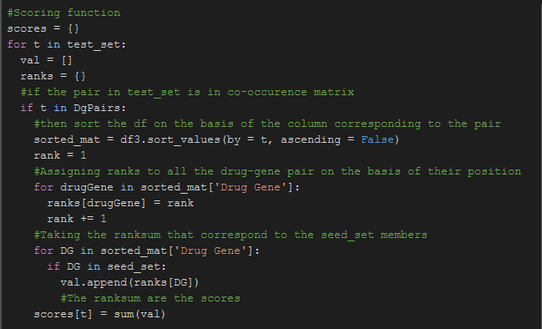
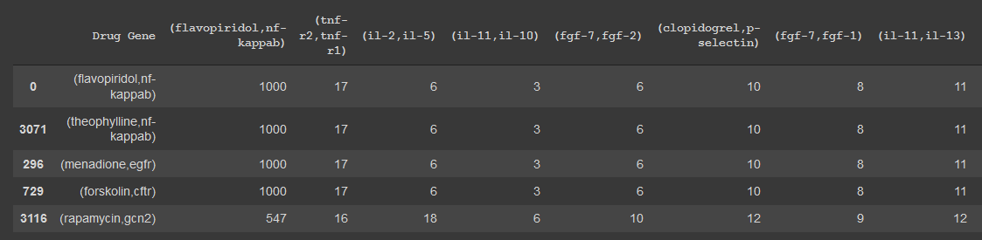
Scoring
Scoring Function
Sorted Matrix on the basis of flavopiridol,nf-kappab

Slide 11
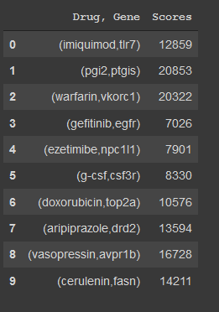
Scoring
Scoring Function
First 10 Scores/ Ranksum of Seed Set size 10

Slide 12
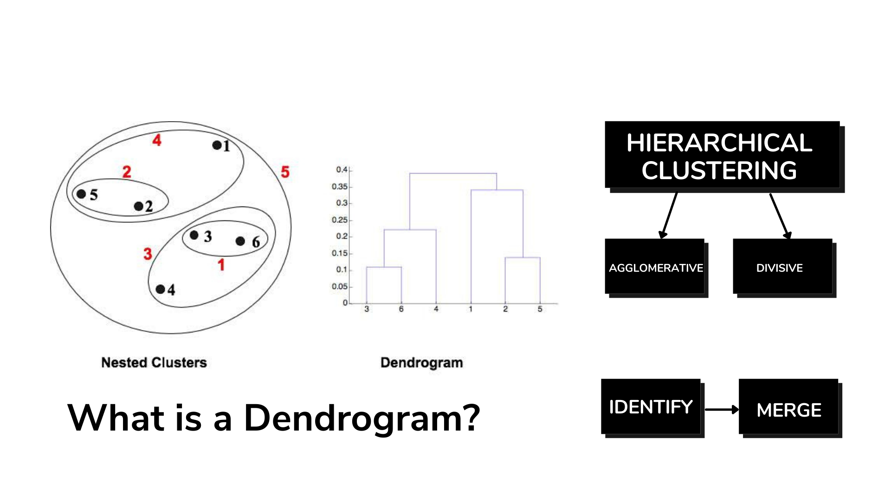
Dendrogram

Slide 13
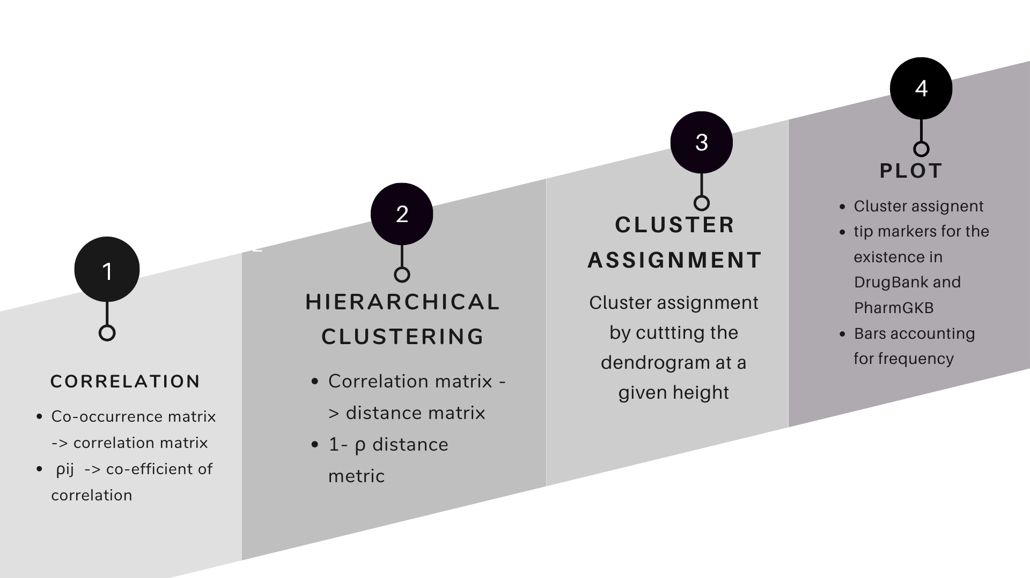
Implementation

Slide 14
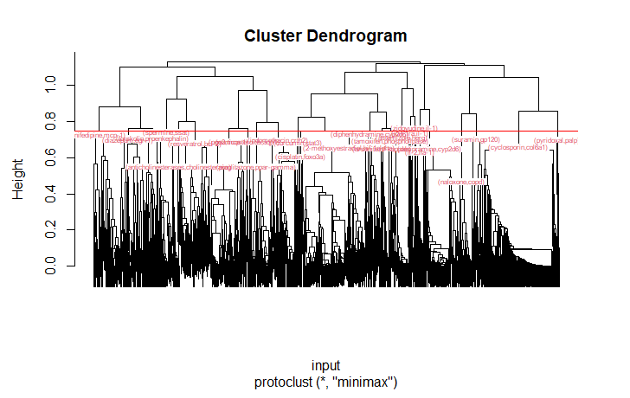
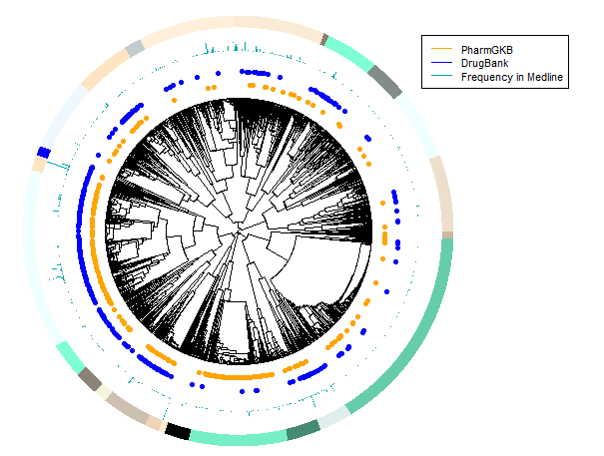
Dendrogram Plots

Slide 15
Final Thoughts
Charles
It was definitely a hard project but i believe that my team really held it together and pulled though
Yumin
Big thanks to all the resources and our great teammates!
Akansha
I am really thankful to the STEM- Away team for organising this and to my wonderful teammates for always being there when help was needed.

