Slide 1
Collective fish schooling
How does local proximity relate
to the organisation of a fish school?
Charles Scannavino and Jacques Chevolot
300
5,000
30
fish in the source school
observation frames
frames per second
2D positions and velocities. Valid detections vary by frame.
Oregon State University dataset.
01
Notes:
CHARLES
Target time 60 seconds
Good afternoon. We are Charles Scannavino and Jacques Chevolot. Our project investigates how graph analytics can describe the organisation of a fish school.
Our main question is how local proximity relates to the cohesion and internal structure of the group. Fish schooling is interesting because a large group can remain coordinated while each individual occupies a different local neighbourhood.
We use the Fish Schooling Data Subset from Oregon State University. It describes a school of three hundred fish over five thousand frames, recorded at thirty frames per second. Each observation provides a two-dimensional position and velocity.
The data initially consist of observations. We construct the connections ourselves. The number of valid observations varies between frames, so each graph contains the fish actually detected at that time.
Delivery cue
Introduce the research question, then explain what the observations contain.
Source
Project report, sections 1 and 2, pp. 4–5. Dataset attributed in the report to Oregon State University, Fish Schooling Data Subset, https://doi.org/10.7267/zk51vq07c.

Slide 2
Two graph representations
One node per observed fish, including isolated individuals
SPATIAL PROXIMITY
DIRECTIONAL VISIBILITY
Undirected edges: i — j
Directed arcs: i → j
j
j
i
i
k
k
distance(i, j) < R · symmetric
distance + orientation · asymmetric
R = 100 Position, velocity and ID on nodes
Distance stored on edges. Structural measures use no weights.
Reference radius in native coordinate units.
02
Notes:
CHARLES
Target time 85 seconds
Each node represents one observed fish. It retains the fish's position, velocity and tracking identifier. We then build two graph representations.
In the spatial model, two distinct fish share an edge when their Euclidean distance is smaller than a neighbourhood radius, R. We use one hundred native coordinate units as our reference. Because distance is symmetric, this graph is undirected. It is also simple, with no self-loops or repeated edges.
The visibility model adds orientation. We approximate the direction a fish faces using its velocity, and exclude a total rear blind sector of twenty-five degrees. An arc from fish i to fish j means that j satisfies both the distance and visibility conditions for i. This relationship can be asymmetric, which makes the graph directed.
Both models retain isolated fish. We store spatial distances as edge attributes, but calculate the reported structural measures without weights. Finally, the radius and blind angle are modelling assumptions. Their values require biological validation before they can describe actual perception or interaction.
Delivery cue
Point to the proximity rule, then explain why the visibility relationship becomes directed.
Source
Project report, sections 2.2 and 3.2–3.3, pp. 4–6. R is expressed in native dataset coordinate units. The 25-degree blind sector is a modeling assumption.

Slide 3
Analysis design
Method | Question or convention
Connectivity and distance | Largest connected / strongly connected component
Degree and betweenness | Direct neighbours / position on shortest paths
Louvain communities | Groups with relatively dense internal connections
Temporal and radius tests | 21 frames, approximately 167 seconds, 5 radii
Diameter = longest shortest path
Radius = smallest maximum distance from a node
21 sampled frames across the recording. Louvain: seed 42, resolution 1.0.
Radii: 60, 80, 100, 120, 140.
03
Notes:
CHARLES
Target time 80 seconds
We implement the analysis in Python with NetworkX. We first examine connectivity, meaning whether paths link the fish. For directed graphs, strong connectivity requires paths in both directions. Weak connectivity ignores the direction of the arcs.
We calculate distances on the largest connected component of the spatial graph and the largest strongly connected component of the visibility graph. A distance counts graph edges, or hops. The diameter is the longest shortest path. The radius is the smallest maximum distance from a node to the others.
Degree centrality measures direct neighbourhood size. Betweenness measures how often a fish lies on shortest paths between other fish. For communities, we use Louvain, which searches for groups with more internal connections than expected under a degree-based reference model.
We fix its random seed and resolution. We also repeat the analysis across twenty-one frames sampled throughout the recording and five neighbourhood radii, from sixty to one hundred and forty. This tests how the results change with time and modelling choices. Jacques will now present our findings.
Delivery cue
Explain the distance convention and the meaning of each method. Hand over to Jacques at the end.
Source
Project report, sections 3.1 and 3.4–3.10, pp. 5–9. NetworkX Louvain parameters are seed 42, resolution 1.0 and no edge weights. Sampling uses frames 1, 251, …, 4751 and 5000.

Slide 4
Most fish share one connected component
Measure | Spatial | Visibility
Observed fish | 253 | 253
Edges or arcs | 1,281 edges | 2,386 arcs
Components | 4 connected | 4 strongly connected
Largest component | 248 fish (98.02%) | 248 fish (98.02%)
Diameter in largest component | 23 hops | 24 hops
Radius in largest component | 12 hops | 12 hops
A large shared structure, with a few fish outside it
Frame 1, R = 100, rear blind angle 25°.
04
Notes:
JACQUES
Target time 55 seconds
Thank you, Charles. In the first frame, we observe two hundred and fifty-three fish. The spatial graph contains one thousand two hundred and eighty-one edges. It has four connected components, but the largest contains two hundred and forty-eight fish, or approximately ninety-eight percent.
The visibility graph contains two thousand three hundred and eighty-six directed arcs. Its largest strongly connected component also contains two hundred and forty-eight fish. Remember that a pair can contribute two directed arcs, so the raw edge counts use different conventions.
Within these largest components, the diameter is twenty-three hops for the spatial model and twenty-four for visibility. Both radii are twelve hops. The directional condition slightly lengthens the longest shortest path, while preserving a large mutually reachable group.
Delivery cue
Emphasise 248 out of 253. Read only the numbers that support the interpretation.
Source
Project report, section 4.1 and Table 1, pp. 9–10. Frame 1, R = 100, blind angle = 25 degrees. Distances refer to the largest connected component and largest strongly connected component respectively.

Slide 5
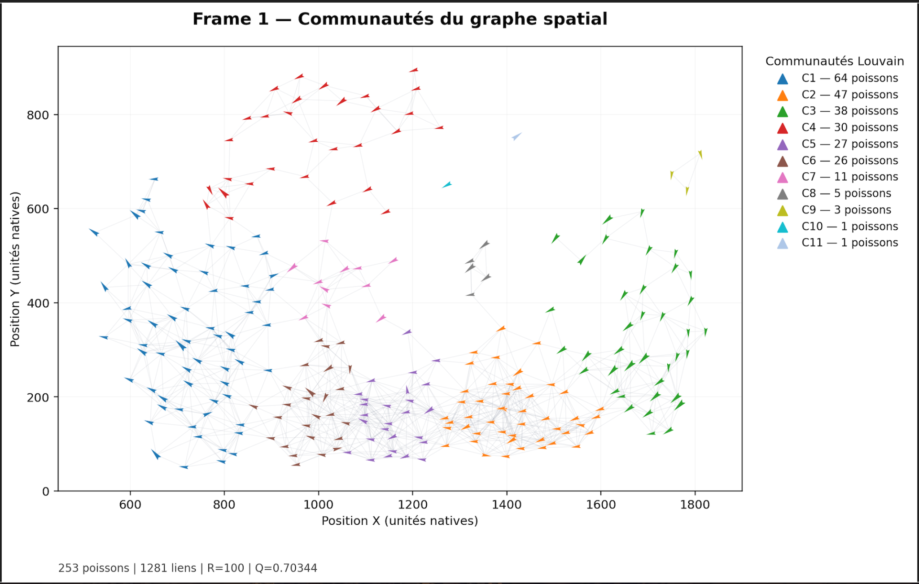
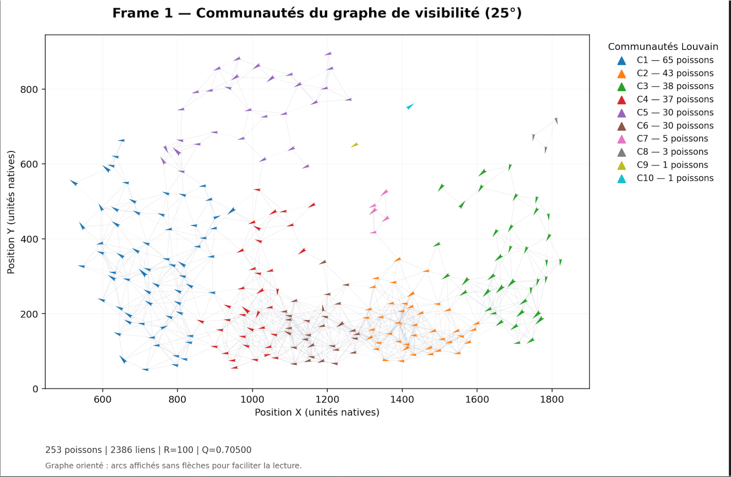
Centrality and community structure
Spatial: 11 communities, Q = 0.70344 | Visibility: 10 communities, Q = 0.70500
Frame 1 · 253 fish · R = 100 · 25° blind sector
05
Notes:
JACQUES
Target time 60 seconds
The centrality rankings show that different fish occupy different structural roles. Fish one hundred thousand two hundred and thirty has the highest degree centrality, approximately zero point zero nine nine. It has many immediate neighbours. A different fish, ninety-nine thousand four hundred and fifty-eight, has the highest betweenness, approximately zero point one six five. It lies on many shortest paths between other fish.
The spatial graph also contains eleven Louvain communities, shown by the colours in both panels, with modularity around zero point seven zero. The visibility graph produces ten communities.
A connected component describes reachability, while a community describes a relatively dense subgroup. These results therefore combine strong overall connectivity with local organisation. However, proximity can itself create communities, and a structurally central fish requires separate behavioural evidence before we can call it a leader.
Delivery cue
Contrast the meanings of the two centralities. Point to both community plots. Explain that the directed graph's arcs are rendered without arrowheads for readability.
Source
Project report, sections 4.2–4.3, pp. 10–11. Plot extracted from Figure 1(a), with the plot area displayed and English labels supplied on the slide. All fish positions in the plot are preserved. Centrality values use NetworkX normalization.

Slide 6
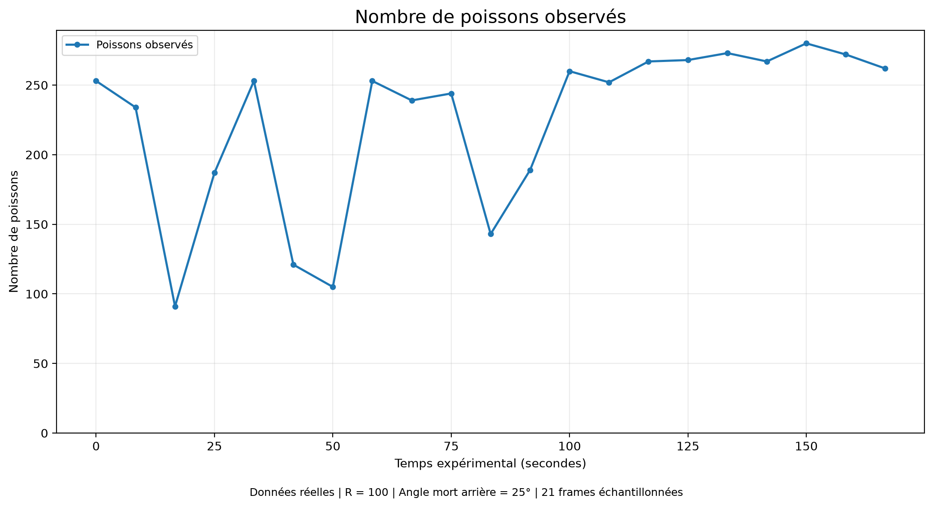
Connectivity depends on the radius
TEMPORAL CONTEXT
91–280 observed fish
across sampled frames
R = 100 is a modelling choice,
not a validated biological distance.
Each point is the mean over the same 21 frames.
06
Notes:
JACQUES
Target time 65 seconds
We then examine the stability of these observations. At the reference radius, the largest spatial component contains approximately ninety-eight to one hundred percent of observed fish across the sampled frames. However, the observed population ranges from ninety-one to two hundred and eighty, which also affects the network measures.
The radius has a much stronger effect on fragmentation. This chart shows the mean share of fish in the largest spatial component across the same twenty-one frames. It rises from about seventy-nine percent at R equals sixty to more than ninety-nine percent at R equals one hundred. Increasing the radius further produces only small gains in connectivity.
Meanwhile, density increases and the mean number of communities falls. At R equals one hundred, the graph is almost fully connected while preserving detectable community structure. This is a modelling choice, not a biologically validated interaction distance. Its biological interpretation remains an assumption, and the sampled frames provide only a partial view of temporal changes.
Delivery cue
Read the rising curve from R = 60 to R = 100. Distinguish the mean over frames from one frame.
Source
Project report, sections 4.4–4.6 and Table 2, pp. 11–15. Chart uses spatial LCC mean percentages 78.78, 95.14, 99.28, 99.63, 99.71 for radii 60, 80, 100, 120, 140, each averaged over the same 21 frames. Temporal ranges are approximate summaries reported in the text.

Slide 7
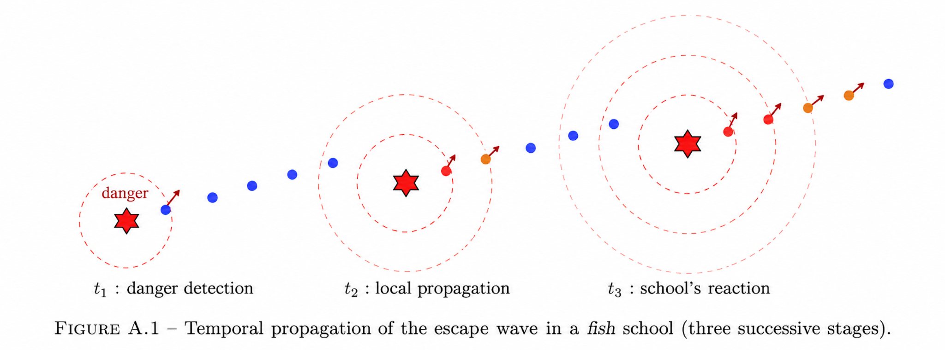
Bonus — From local signals to collective dynamics
t₁ · Detection
t₂ · Local response
t₃ · Group response
A fish reacts to a potential threat
Nearby fish change their heading
A collective escape pattern emerges
CONCEPTUAL MODEL · Circles illustrate propagation stages, not measured interaction radii or a detected event.
07
Notes:
Speaker 2 — approximately 35 seconds.
This diagram illustrates a possible escape-wave mechanism. A first fish detects a threat, nearby fish respond, and the change may spread through the school. The expanding circles are schematic, not measured distances. This is not an observed danger event in our dataset. It motivates two exploratory extensions: modelling local behavioural rules with Boids and testing temporal precedence using lagged turning correlations. Source: report Appendix A.

Slide 8
Bonus — Boids simulation and temporal leadership
01 BOIDS · PREDICTIVE SIMULATION
02 LEADERSHIP · TEMPORAL ANALYSIS
Separation • Alignment • Cohesion
Calibrated on frames 1–32
Lagged correlations of turning signals
Candidate followers identified by timing
H30 · mean across 2 holdout windows
150 frames · 5 phases of 30 frames
−4.4%
position error
3 / 5
leader phases
38.70 (inertia) → 37.00 (Boids)
Fish ID 105760 · persistence 0.60
Jaccard: 0.5122 → 0.5352
Cumulative influence score: 5.7558
Two validation windows only; results are exploratory, not statistical proof of generalisation.
Temporal precedence does not establish causality or permanent biological leadership.
Notes:
Speaker 2 — approximately 70 seconds.
First, the Boids simulation combines separation, alignment and cohesion. We calibrated on frames 1–32, then compared predictions with an inertia baseline on two holdout windows around frames 2000 and 4000. At horizon H30, the position-optimised model lowered mean position error from 38.70 to 37.00, a relative decrease of about 4.4 percent. Mean spatial-edge Jaccard rose from 0.5122 to 0.5352, about 4.5 percent. This is an exploratory comparison based on two windows, not statistical generalisation.
Second, our leadership heuristic uses time-lagged turning correlations to detect temporal precedence. For 150 frames starting at frame 2000, divided into five 30-frame phases, fish tracking ID 105760 met the potential-leader criterion in three phases: persistence 0.60, cumulative influence score approximately 5.7558. Temporal precedence is not causal influence. Report Appendices D–F.

Slide 9
A cohesive network with local structure
98.02%
11
78.78 → 99.28%
Largest component
Spatial communities
Connectivity by radius
248 / 253 fish · frame 1
Louvain · Q = 0.70344
Mean LCC share · R = 60 → 100
MAIN FINDING
A fish school can be globally connected while retaining distinct local communities.
LIMITS & NEXT STEPS · Graph structure depends on R; correlation ≠ causality. Validate biological assumptions and extend temporal holdouts.
Thank you · Questions?
09
Notes:
Speaker 2 — approximately 35 seconds.
Our main findings are threefold. In frame one, 248 of 253 observed fish, or 98.02 percent, belong to the largest connected component. The spatial graph still contains eleven Louvain communities with modularity 0.70344. And the mean largest-component share increases from 78.78 percent at radius 60 to 99.28 percent at radius 100, showing the importance of modelling assumptions. Overall, the school is globally connected but locally structured. Our methods are descriptive and exploratory; they do not demonstrate causal behavioural leadership. Future work should validate interaction radii and extend temporal validation. Thank you.

