Slide 1

ONLINE MOVIE BOOKING SYSTEM
An E-project presentation 2022

Slide 2

DESIGN DEVELOPED & MANAGED BY
CHARLES STEPHEN
(STUDENT1307539)
MOMNA KHAN
(STUDENT1307534)
MARYAM FATIMA
(STUDENT1320303)

Slide 3

CONTENTS
1. ACKNOWLEDGEMENT ……………….………...4
2 .PROBLEM STATEMENT ..……………...............5
3. PROBLEM SOLUTION ………….………………6
4. REQUIREMENT ANALYSIS …………………….7
5. FEATURES ……………………………………….8
5. DESIGN PHASE ………………………...……….9
6. ARCHITECTURE OF WEB ……..………....10-17
7. DATABASES …………………………………….18
8. ARCHITECTURE OF ADMIN PANEL .….…19-21
9. SOURCE CODE …………………………….22-32

Slide 4
ACKNOWLEDGEMENT
We would like to thank our teacher Sir Noman
for giving us a huge opportunity to prove
ourself on an amazing platform to
showcase our skills.
Thank you !
Regards team members

Slide 5

PROBLEM STATEMENT
Watching movies is one of the entertainment medium these days. People need to surf various website to watch trailers of the movies. They need to browse through different websites to get the movie review. Once they find a movie suited to their liking, they need
to go to theatres to book ticket. For this they need to stand in queues to buy tickets. To ease all these problems we have proposed a solution as
“Online Movie Ticket booking”

Slide 6
PROBLEM SOLUTION
Online movie booking system is a web portal where you can book tickets in advance, know your movie show timing, watch movie trailer and read reviews for the same.
User can know everything about a movie and its show rates and show time just sitting on your couch.
Just go to web portal for Online Movie Ticket Booking System and register yourself and gain access to all the movie and theaters and many more features.
Online Movie Ticketing System in PHP is a very user-friendly project and can be accessed from anywhere.
There is no need to go to the movie theaters and wait for your turn to book movie tickets.
User can now just track everything about a movie just by clicking on to it.
User can buy tickets just by selecting a movie and show timings. Also there is three classes for a movie theatre.
User can opt to Gold, Platinum or Box class to buy tickets. These are different seat categories inside the hall.

Slide 7
REQUIREMENT
Visitor or Registered user:
He/she needs to first register on this web portal.
He /she can enjoy watching trailer for movie.
He/she can book movie ticket by selecting show time and show date.
He/she can opt to our three classes and can select any one of the three classes.
We have special concessions for kids (aged between 3 to 12 years).
He/ she can read movie details and reviews along with their ratings at our web portal.
Admin
Admin is the main backbone for this portal.
Admin is responsible for adding and editing a movie theater.
Admin will add, edit and delete movies for each movie theaters.
Admin will be responsible for adding, editing and deleting show time for movies.
Admin can also view the number of users that are registered to the web portal.

Slide 8
ONLINE MOVIE BOOKING SYSTEM FEATURES
Login and Registration for users.
View show time just by selecting your preferred date.
Movie Reviews and ratings.
Movie trailers.
Payment Gateway needs to be added to this project.(Optional)
Admin dashboard.
Add, delete and edit movie theaters.
Add, delete and edit movies.
Add, delete and edit shows and their rates for each classes.

Slide 9
DESIGN PHASE
Design phase involves the preparation of our website which includes the following pages.
Home
Ticket Booking
Contact
Sign Up
Login

Slide 10
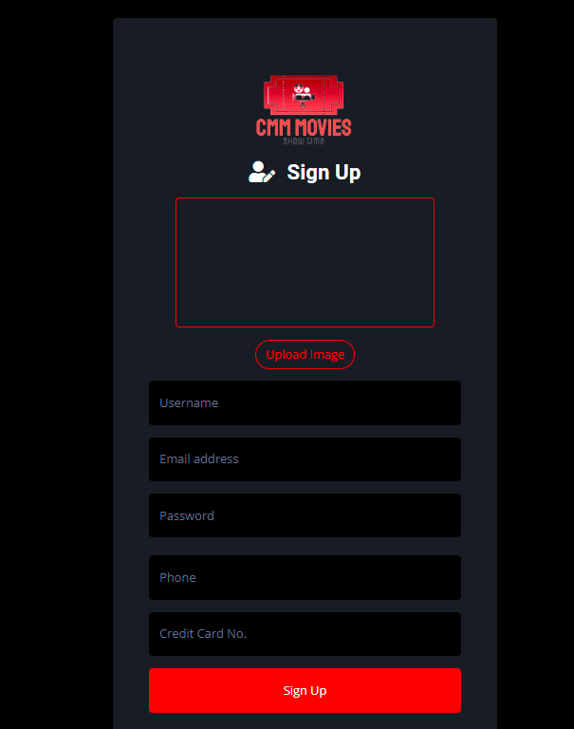
ARCHITECTURE OF WEB
SIGNUP

Slide 11
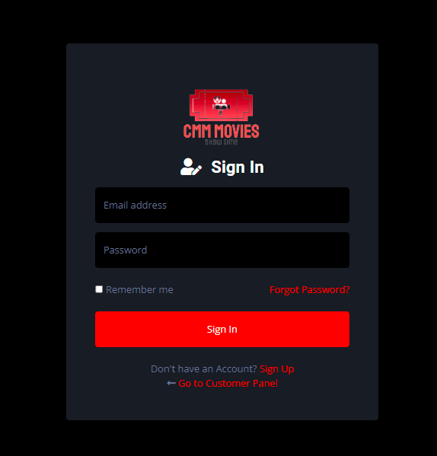
LOGIN

Slide 12
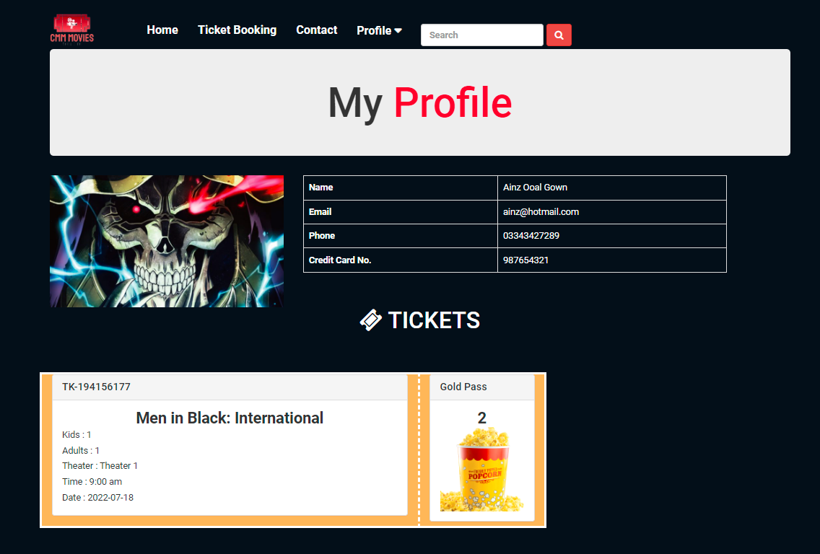
PROFILE

Slide 13

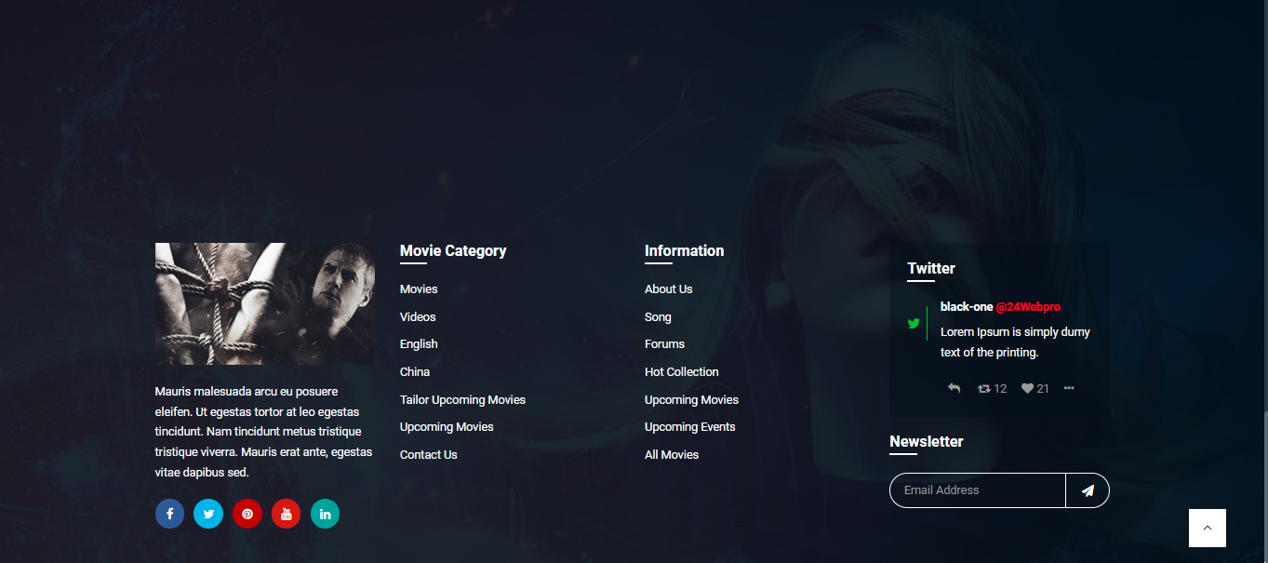
HEADER & FOOTER

Slide 14
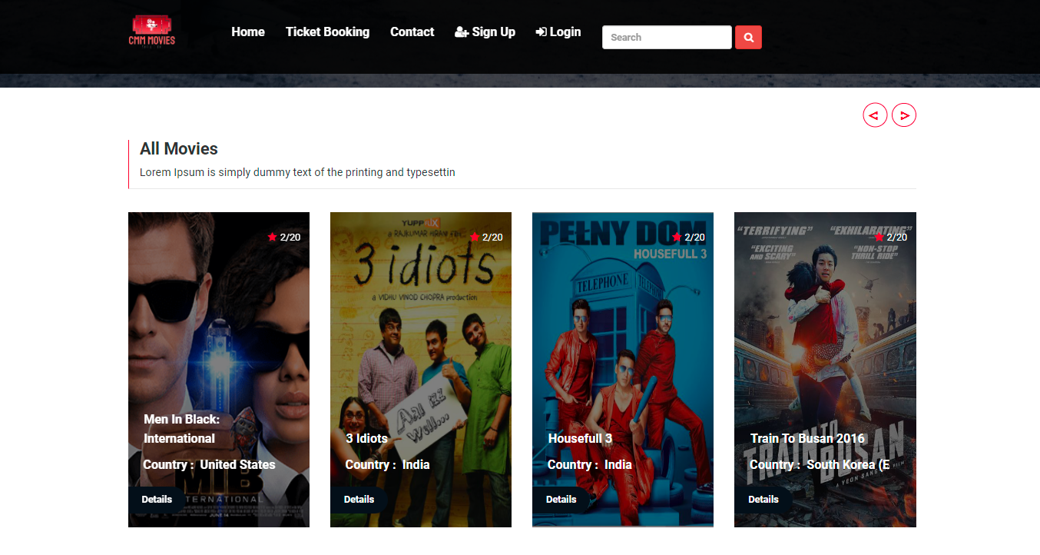
HOME PAGE

Slide 15
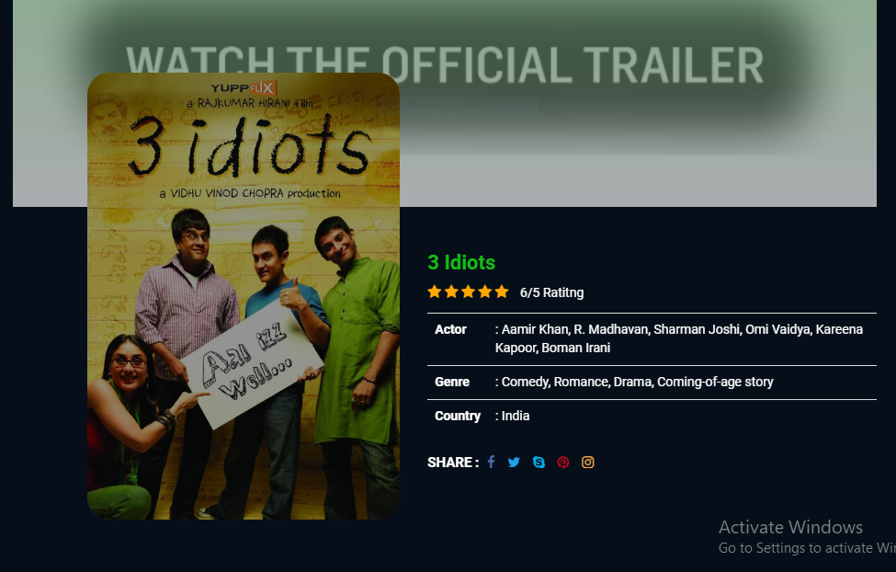
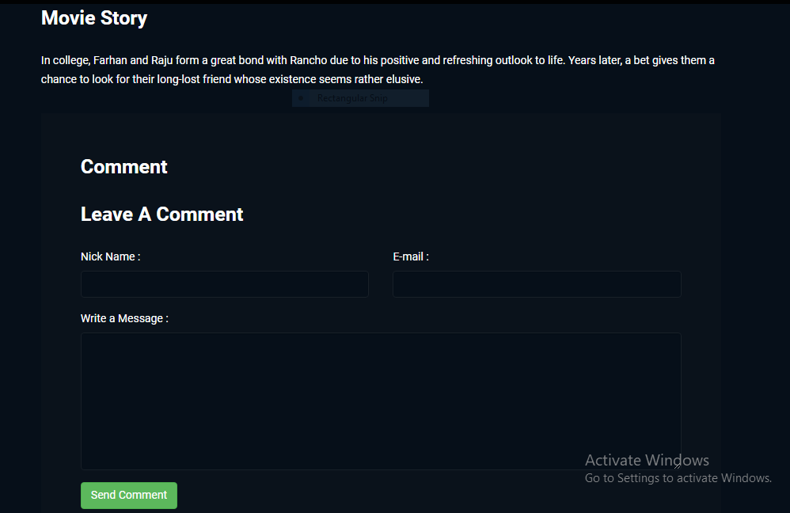
HOME PAGE

Slide 16
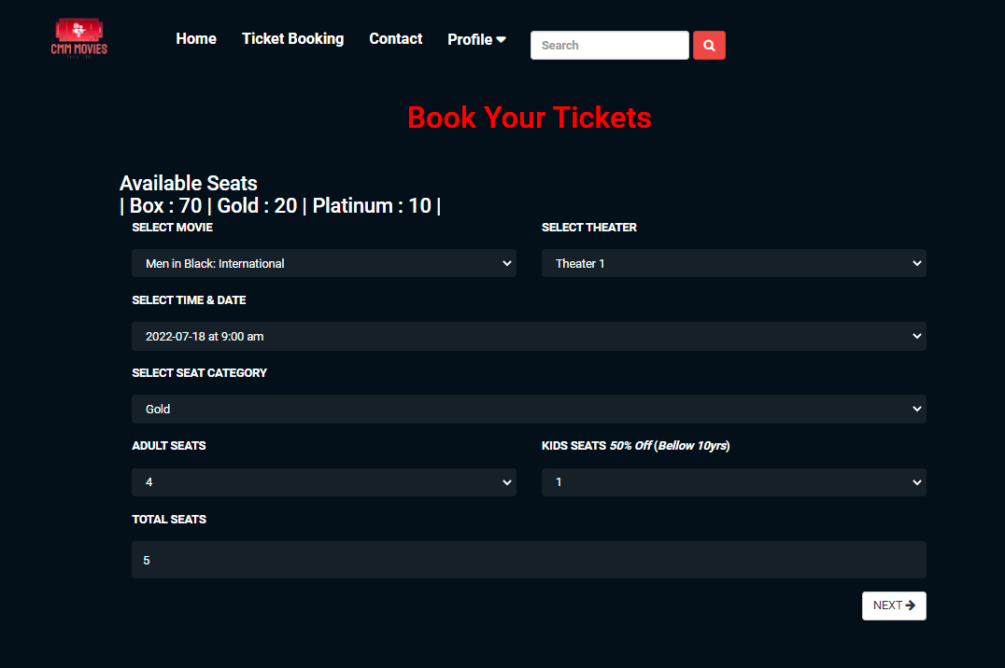
TICKET BOOKING

Slide 17
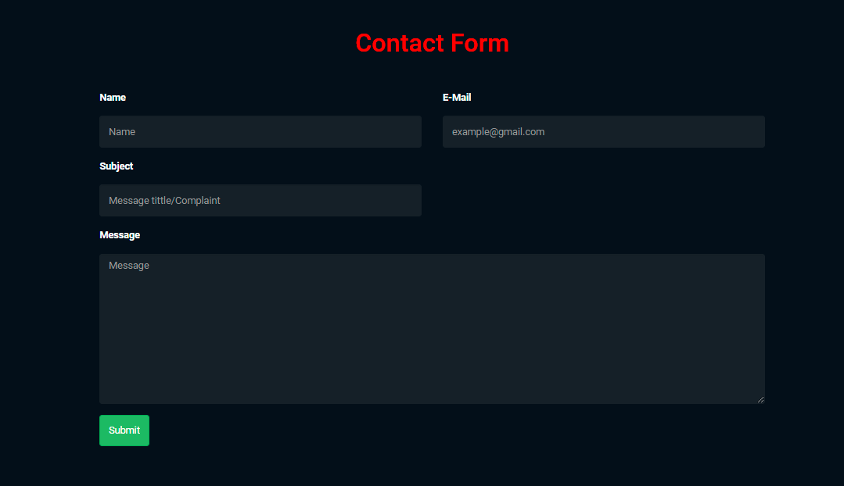
CONTACT

Slide 18
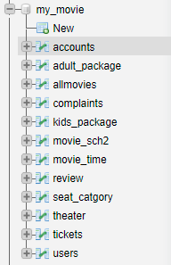
DATABASES

Slide 19
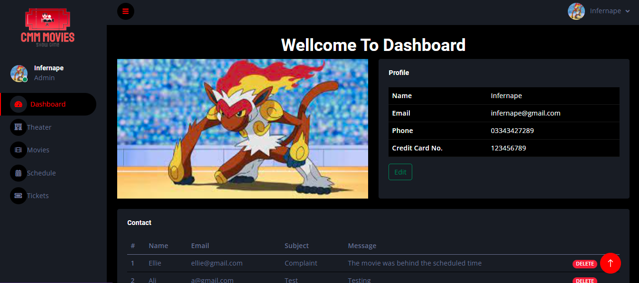
ADMIN PANEL INTERFACE
DASHBOARD

Slide 20
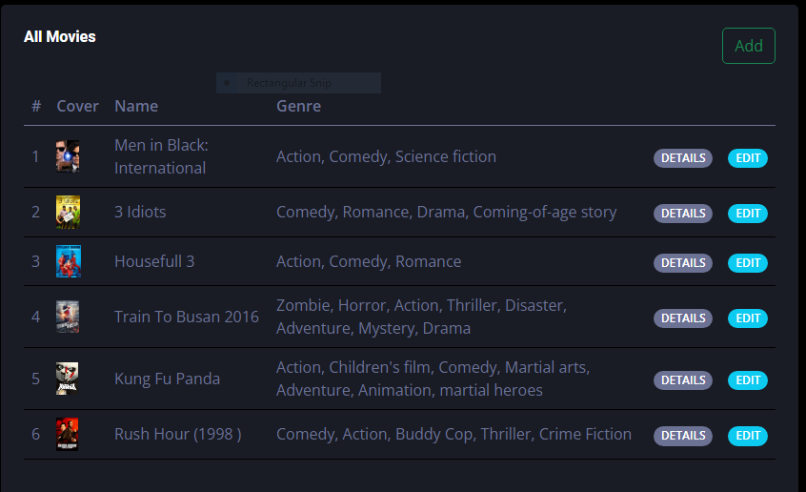
MOVIES

Slide 21
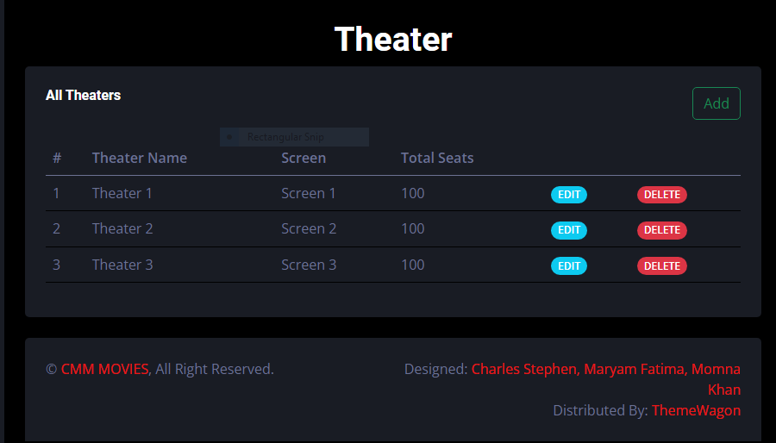
THEATER

Slide 22
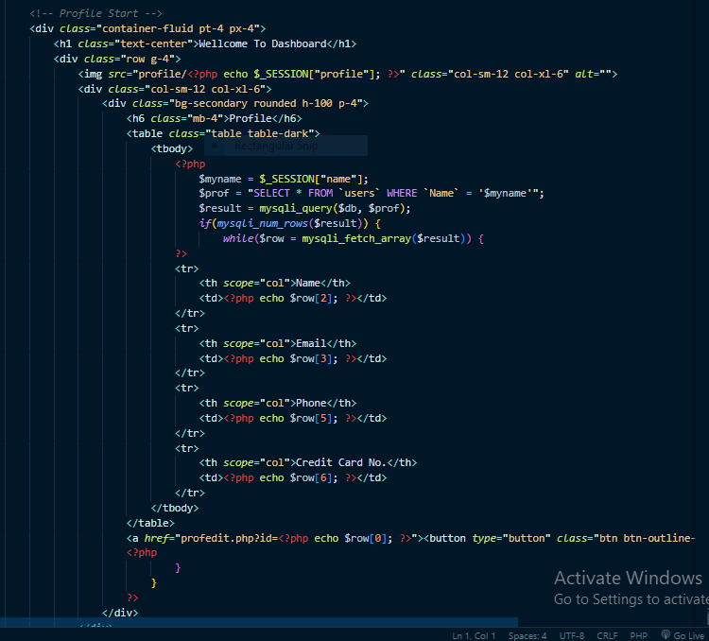
SOURCE CODE
DASHBOARD

Slide 23
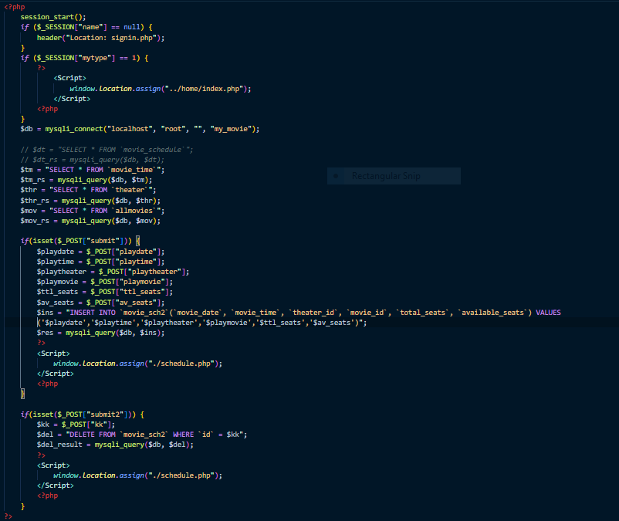
SCHEDULE (php)

Slide 24
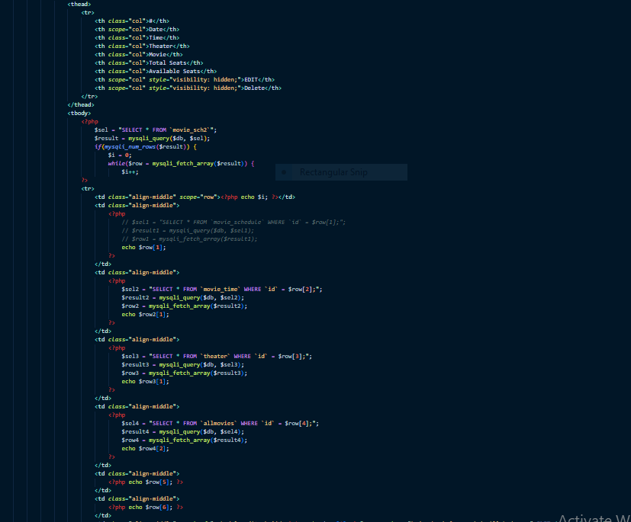
SCHEDULE (html)

Slide 25
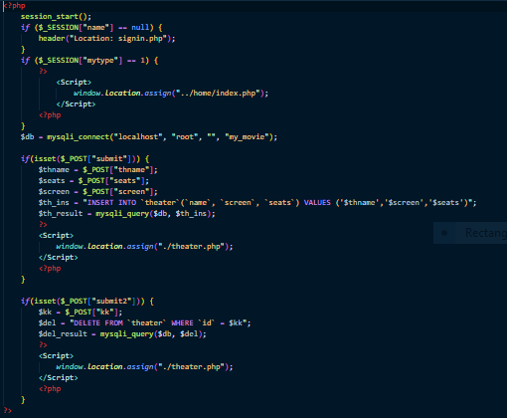
THEATER (php)

Slide 26
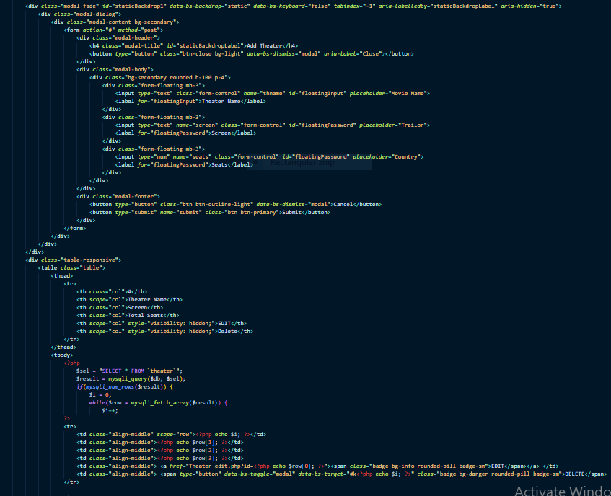
THEATER (html)

Slide 27
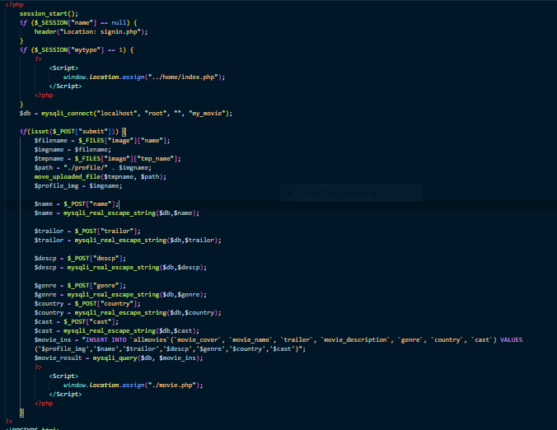
MOVIE (php)

Slide 28
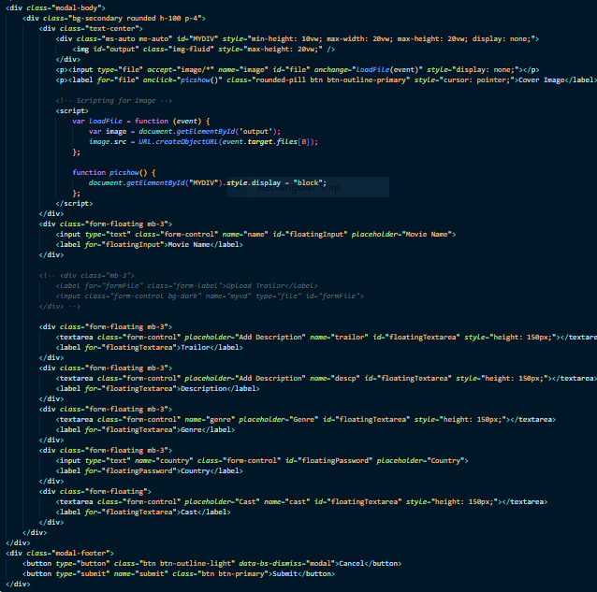
MOVIE (html)

Slide 29
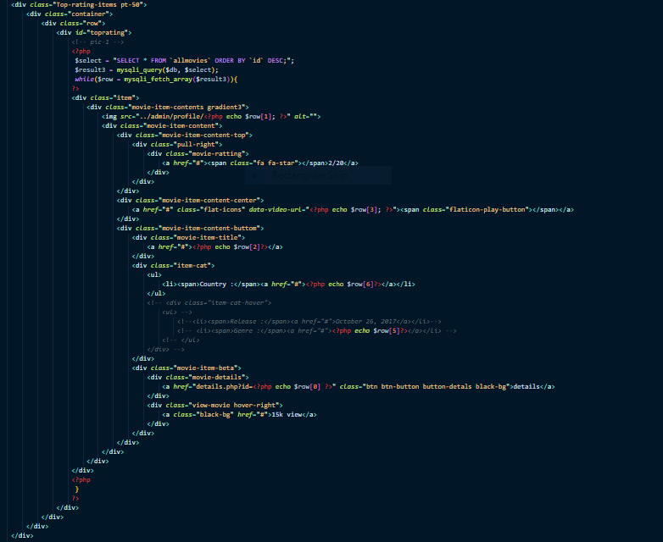
HOME

Slide 30
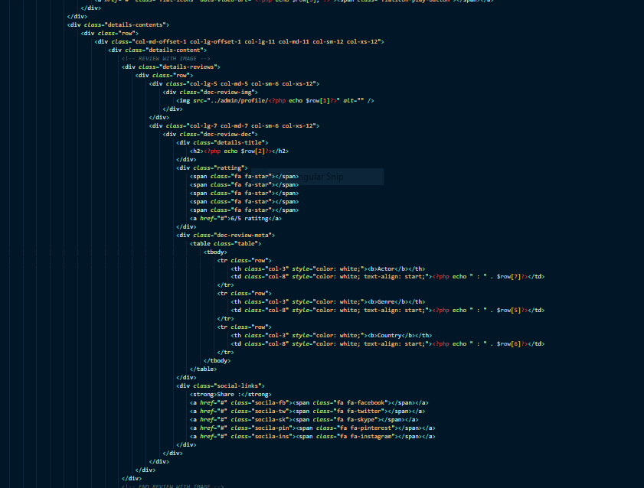
MOVIE

Slide 31
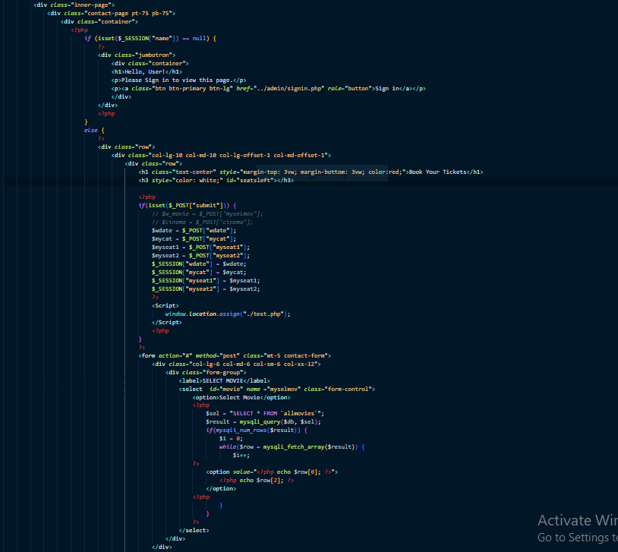
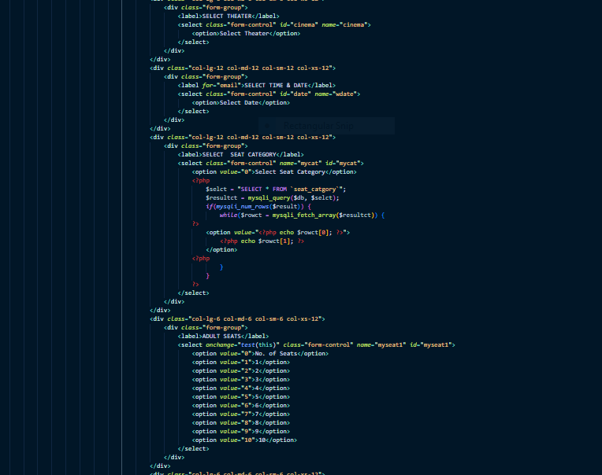
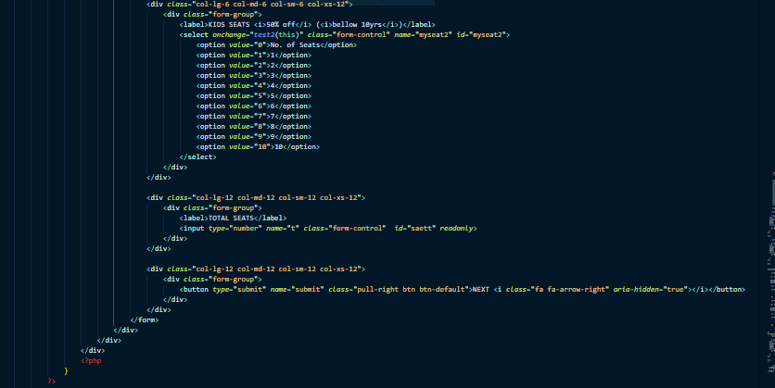
TICKET BOOKING

Slide 32
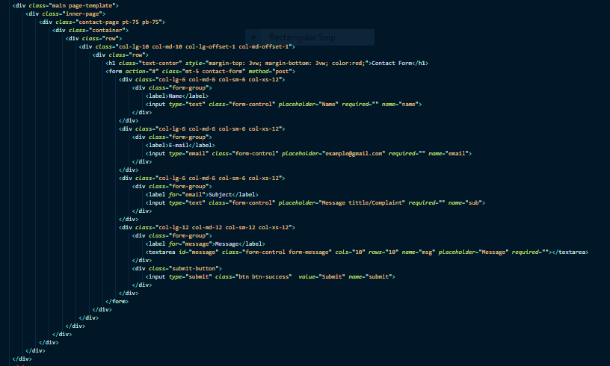
CONTACT

Slide 33

THANK YOU

