Slide 1



Credit Card Default Prediction
BA810- Team 05- Liyang Peng, Shengqi Wei, Xiaoyan Wang, Juncheng Zhu.

Slide 2

Problem statement
The primary target of this project is to predict whether the credit card holder will default on payment in the next month. The result to be predicted is either that the customer pays as expected or defaults on the payment. The issue of default prediction has historically been one of the main challenges in consumer finance.
By creating a predictive system that identifies consumers with higher default risk in advance, financial companies can make more informed estimates and adjust their tactics accordingly. The purpose of this project is to investigate the effectiveness of various supervised machine learning methods for addressing this problem.

Slide 3
Stakeholders
Why?
The key stakeholders in this project are banks issuing credit cards and consumer finance institutions.
Risk Management Teams that employ predictive modeling in monitoring and policy formation.
Data analysts are responsible for assessing the effectiveness and accuracy of models using risk metrics. And regulators, who are concerned about the overall stability of the consumer credit markets.

Slide 4
Data Overview
We use the Default of Credit Card Clients dataset from the
UCI Machine Learning Repository.
Link:
https://archive.ics.uci.edu/dataset/350/default+of+credit+card+clients
The dataset contains real anonymized records from a Taiwanese bank in 2005. This dataset provides information regarding demographics, payment history, bill amounts, repayment amounts, and default values for the next month. The dataset has 30,000 observations with 25 variables. The variables are numerical and do not contain any missing values.

Slide 5
Data Overview
⭐ Customer Profile 📌 Basic demographic information about each customer
SEX — gender (1 = male, 2 = female)
EDUCATION — graduate / university / high school / others
MARRIAGE — married / single / others
AGE — age in years
⭐ Credit Limit 📌 Overall credit capacity available to the customer
LIMIT_BAL — total credit limit (NTD)
⭐ Repayment Status (Past 6 Months) 📌 History of how timely customers made payments
Variables: PAY_0, PAY_2, PAY_3, PAY_4, PAY_5, PAY_6
Scale: -1 = paid in full
0 = paid minimum only
1–9 = months delayed
⭐ Bill Amounts (Past 6 Months) 📌 Monthly statement amounts issued by the bank
Variables: BILL_AMT1 – BILL_AMT6
⭐ Payment Amounts (Past 6 Months) 📌 Actual amounts repaid by the customer
Variables: PAY_AMT1 – PAY_AMT6

Slide 6
Exploratory Data Analytics

Slide 7
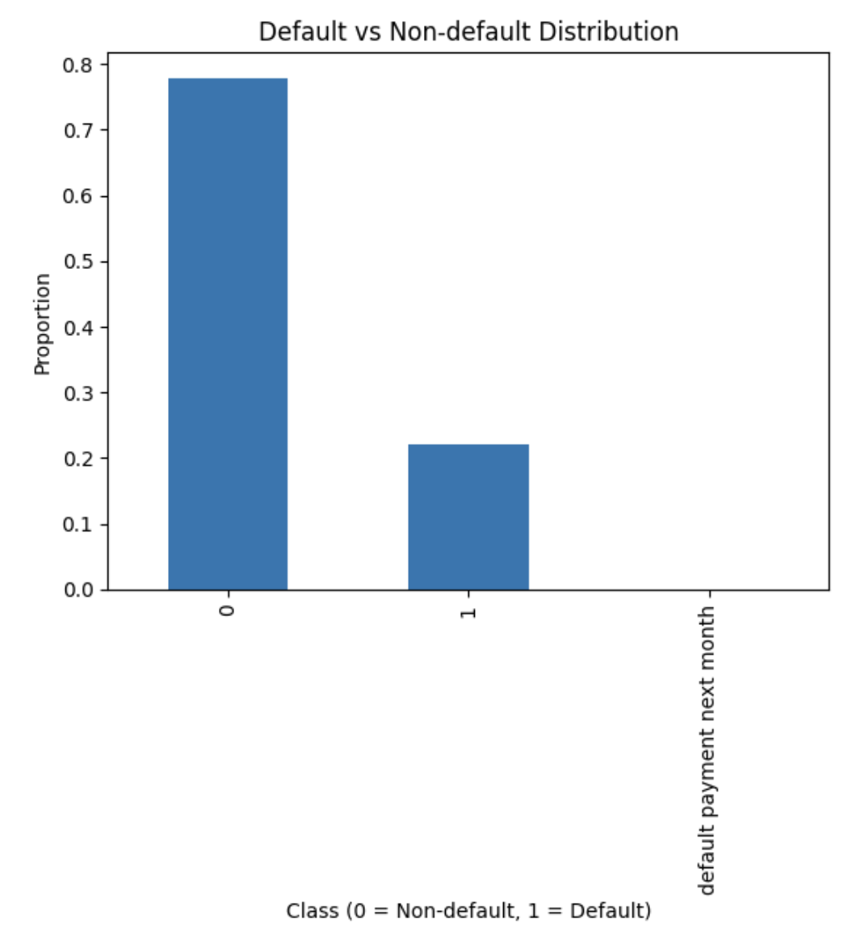
Target Variable Distribution:
The above graph depicts the distribution of the target variable Y in the dataset. For this data, 0 indicates that the customer did not default in the next month, and 1 indicates otherwise.
It’s clear that the majority of the data belongs to the non-default class. About four out of five data points are marked 0, while the rest are defaults, constituting just over 20% of the data. This indicates that there’s indeed class imbalance in this data but not substantial.
Most of the clients pay back in time, yet the default category remains sufficiently large to be taken into consideration.

Slide 8
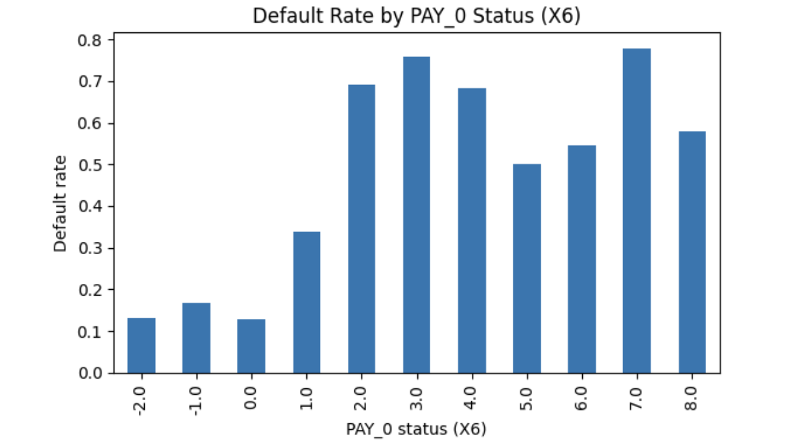
Default Rate by PAY_0 (Most Recent Payment)
This graph illustrates how the default rate varies with different PAY_0 values, where PAY_0 corresponds to the customer's repayment status in the most recent month. The negative values (-2, -1, 0) indicate that the customer paid either early or on time, and higher values indicate greater levels of delinquency.
Customer groups that were either on time or paid early have a default rate below 15%. After the PAY_0 variable reaches 1 or more, indicating the payment is at least one month late, the default rate jumps. The default rate in this case exceeds 70% when PAY_0 is 2 or 3.
This indicates that the current repayment pattern strongly predicts the probability of default in the next month. This means that if the individual has been late with the most recent payment, there is a significant likelihood of default in the next month.

Slide 9
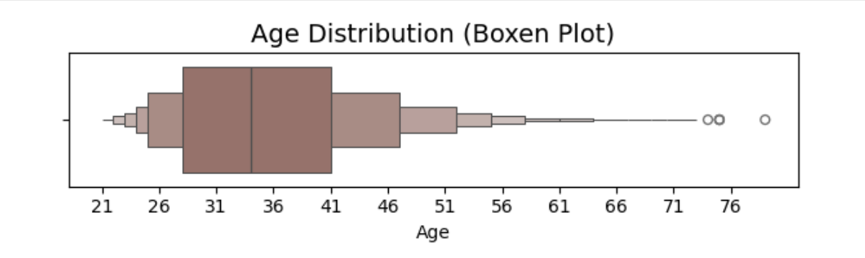
AGE Distribution
The box plot provides a clear perspective regarding the dispersal of age. The majority of individuals in the data are in their early 30s and 40s. Dispersal tends to thin out with age, and only a few are above 70. There are also a few data points that are outliers in the older category but do not appear to affect the prevailing trend.
The age distribution appears slightly right-skewed overall, with most in the working-age range. This would be valuable information when testing later, if age has any particular effect upon default behavior.

Slide 10
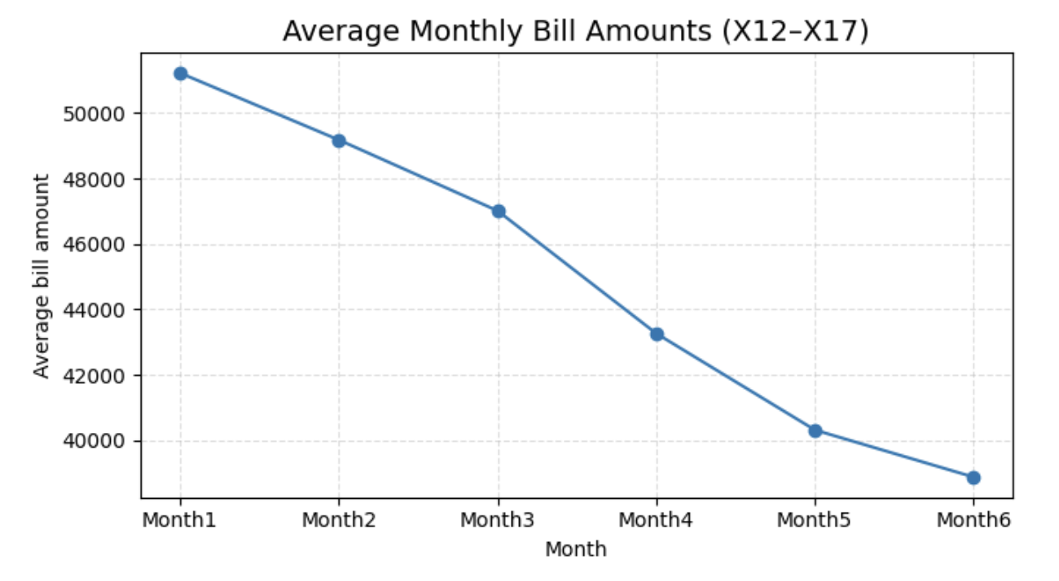
Monthly Bill Statement Amounts:
The graph illustrates the trend in the average amount of the bill over the six months recorded in the data. The most striking feature here is that the figures have been consistently decreasing month to month. The first month has the highest average bill amount.
This trend may be indicative of several things. It could be that many clients have repaid most of the money over time in installments and now have smaller bills each month. It may also indicate spending patterns, with some months seeing more spending than others.

Slide 11
Challenges & How We Addressed Them
The dataset is highly imbalanced, with far fewer defaulters than non-defaulters. This makes accuracy unreliable.
Solution: Use SMOTE to balance the training data and evaluate models with Recall, F1-score, and ROC-AUC instead of accuracy.
Challenge 1:
Imbalanced Data
Some features (EDUCATION, MARRIAGE, PAY_) contain unclear values (0, 5, 6). PAY_ also creates many dummy variables, increasing complexity.
Solution: Merge undefined categories, create meaningful features (Payment_Value, Dues), and apply one-hot encoding carefully to control dimensionality.
Challenge 2: Feature Engineering & Encoding

Slide 12
Challenges & How We Addressed Them
Challenge 3:
Hyperparameter Tuning
Models like SVC, Random Forest, and XGBoost require many parameters and may overfit without proper tuning.
Solution: Use GridSearchCV with cross-validation to systematically tune parameters and select the best models based on F1 and ROC-AUC.
Accuracy alone cannot measure performance on imbalanced data and may falsely indicate good results.
Solution: Select metrics aligned with credit-risk objectives—prioritizing Recall, F1-score, and ROC-AUC to better capture default prediction performance.
Challenge 4: Choosing Appropriate Evaluation Metrics

Slide 13
Supervied Machine Learning Models
Logistic Regression (AUC = 0.83)
Support Vector Classifier (AUC = 0.85)
Random Forest
(AUC = 0.91)
XGBoost
(AUC = 0.91+)

Slide 14
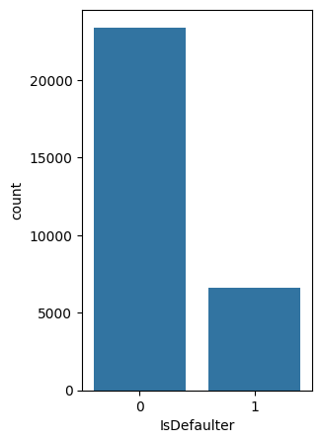
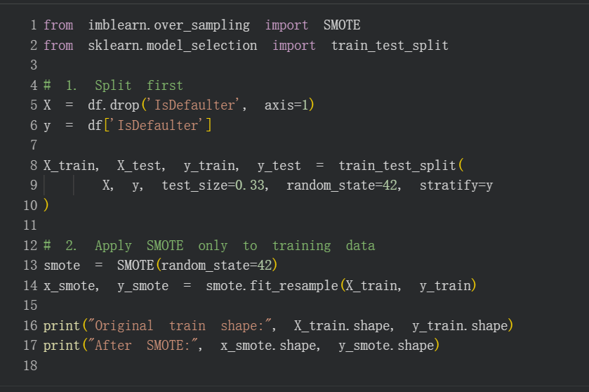
Pre Process - SMOTE Synthetic Minority Oversampling Tech
The defaulters were heavily underrepresented compare to another
we applied SMOTE to balance the training data. SMOTE generates synthetic minority samples increasing the training set from 20,100 to 31,308 while avoiding data leakage
This balanced distribution improves the model’s ability to detect true defaulters

Slide 15
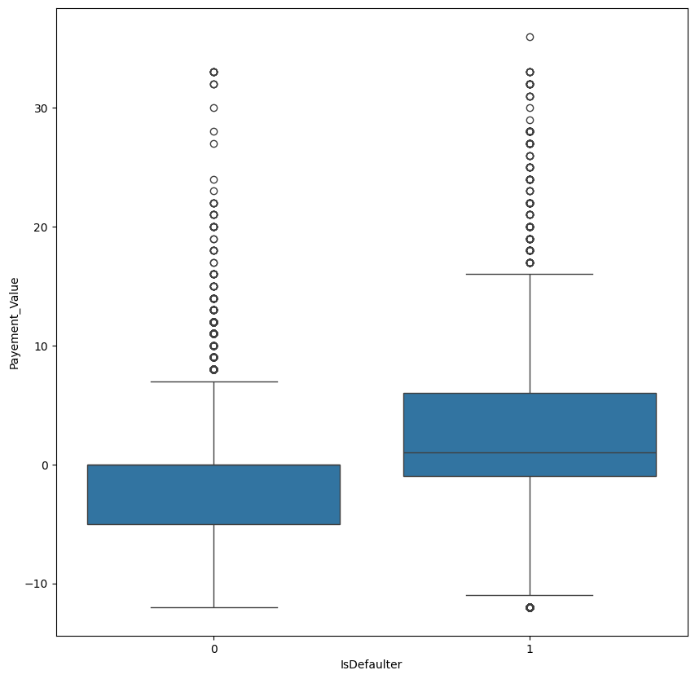
Pre Process - Feature Engineering
df_fr['Payement_Value'] =
df_fr['PAY_SEPT'] + df_fr['PAY_AUG'] + df_fr['PAY_JUL'] + df_fr['PAY_JUN'] + df_fr['PAY_MAY'] + df_fr['PAY_APR']
df_fr['Dues'] = (df_fr['BILL_AMT_APR']+df_fr['BILL_AMT_MAY']+df_fr['BILL_AMT_JUN']+df_fr['BILL_AMT_JUL']+df_fr['BILL_AMT_SEPT'])-(df_fr['PAY_AMT_APR']+df_fr['PAY_AMT_MAY']+df_fr['PAY_AMT_JUN']+df_fr['PAY_AMT_JUL']+df_fr['PAY_AMT_AUG']+df_fr['PAY_AMT_SEPT'])
We engineered new features to enhance predictive power: Payment_Value summarizes past payment behavior, while Dues captures outstanding unpaid balances—both showing clear differences between defaulters and non-defaulters.
We also cleaned categorical variables by merging rare categories and replacing numeric codes with meaningful labels for better interpretability.
Visual checks confirmed strong separation between classes, validating the usefulness of engineered features.

Slide 16
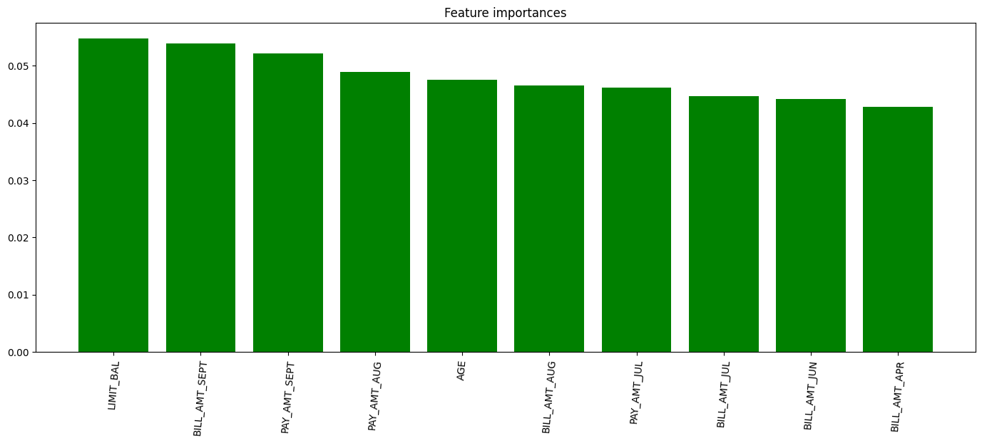
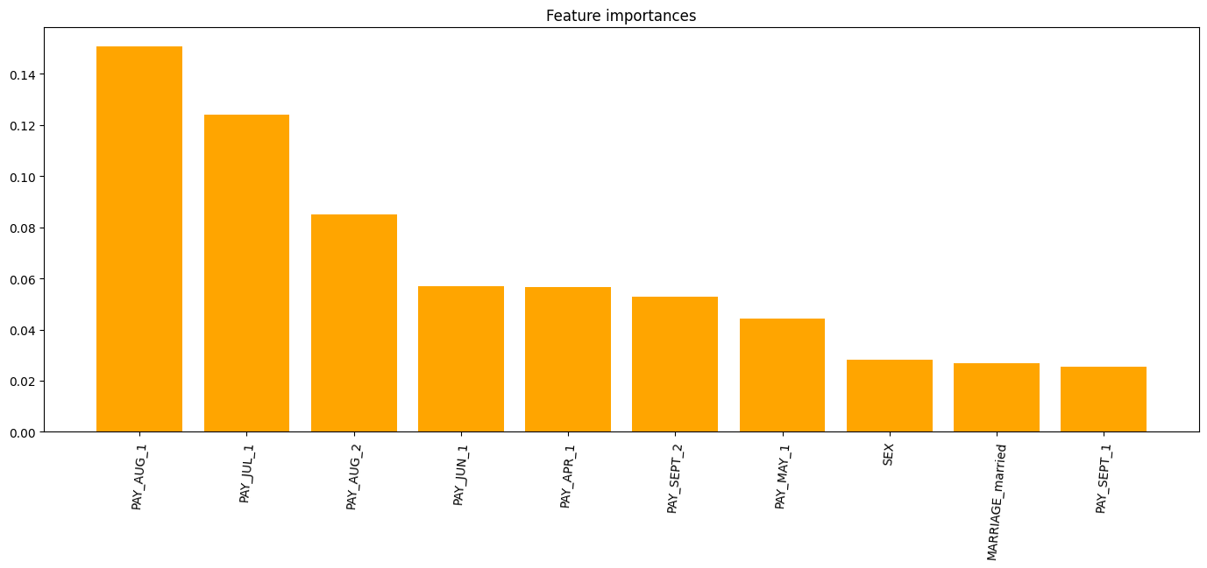
Feature Importance
Random Forest
XGbox
Random Forest focuses on financial amounts (bill and payment sizes).
XGBoost focuses on behavioral trends (payment delays and delinquency levels).
Combining both models gives a more comprehensive view of default risk, capturing both financial capacity and behavioral risk signals.

Slide 17
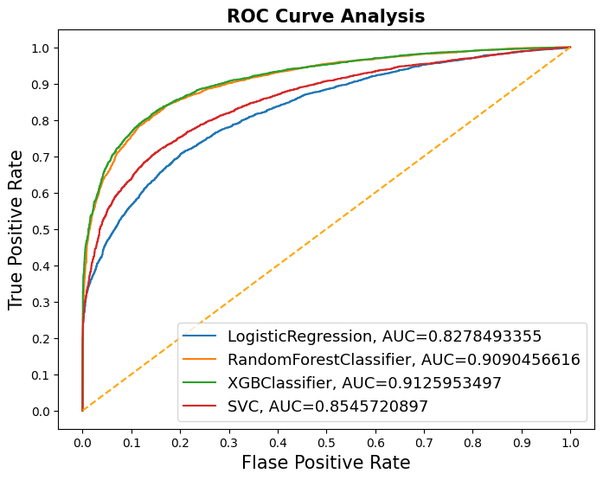
Model Results
Logistic Regression (AUC = 0.83)
Performs reasonably well but struggles with nonlinear relationships.
Support Vector Classifier (AUC = 0.85)
Better at capturing complex boundaries but still limited compared to tree-based models.
Random Forest (AUC = 0.91)
Strong performance due to its ability to model nonlinear patterns and interactions.
XGBoost (AUC = 0.91+)
Best-performing model; efficiently captures both linear and nonlinear relationships and handles imbalanced patterns well.

Slide 18
Business Execution Insights
Business Value of the Model
AUC ≈ 0.91 shows the model can reliably flag high-risk customers before default.
Behavioral signals (PAY_0, PAY history) outperform demographic factors → risk is mainly driven by recent payment behavior.
The model enables proactive intervention rather than reactive loss control.
Key Strategic Insights
1. Recent repayment behavior is the strongest predictor of default.
2. Bill amounts reflect ability to pay; delays reflect willingness to pay — both are necessary. 3. Feature engineering (e.g., Dues, Payment_Value) greatly improves real-world utility and interpretability.

Slide 19
Business Execution Insights
Deploying the Model
1. Assign customers into Low / Medium / High risk tiers. 2. Automate triggers for reminders, temporary limit reductions, or manual review for high-risk cases.
Model Monitoring & Governance
1. Track Recall, AUC, and monthly default rates.
2. Monitor input variable drift to ensure stability.
3. Retrain the model every 3–6 months or when performance drops.
Collaboration With Operations & Collections
1. Provide collections teams with high-risk segments for prioritized outreach.
2. Build a feedback loop to adjust credit policies and retrain models based on real outcomes.

Slide 20
Conclusion
Our analysis confirmed that default risk is influenced far more by recent repayment behavior than by demographics, and that combining behavioral signals with financial capacity measures delivers the most practical risk view.
From a business standpoint, the model provides clear value by enabling early identification of high-risk customers and supporting proactive interventions. A practical deployment strategy is to segment customers into Low/Medium/High risk tiers, automate reminder and limit-adjustment workflows for high-risk groups, and maintain governance through regular monitoring of Recall, AUC, and drift with periodic retraining.
Overall, our results suggest that a well-governed, behavior-focused ML system can meaningfully improve default prevention and strengthen credit risk decision-making.

