Slide 1

Predicting future customers
1
By Charles Verleyen
02/11/2017

Slide 2
Executive Summary
2
Dataset exploration
First insights
Data wrangling
Classifier Model selection
Results
Recommendations

Slide 3
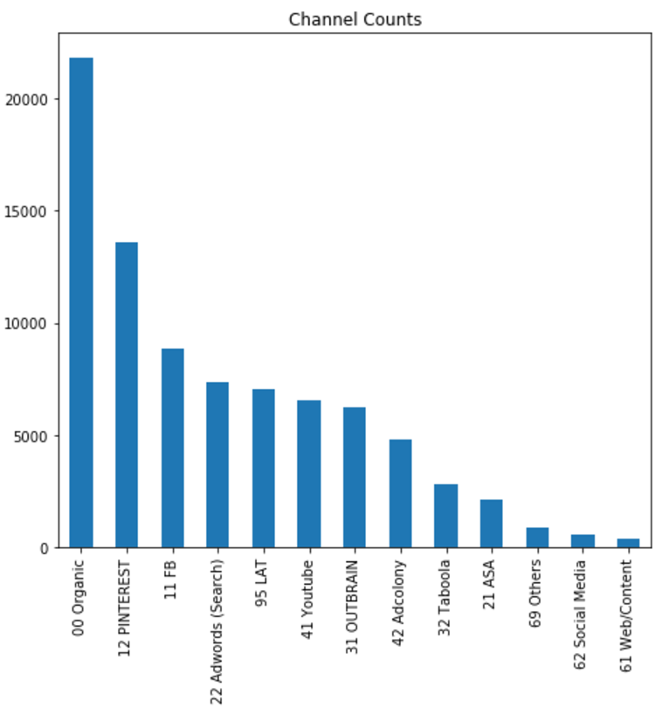
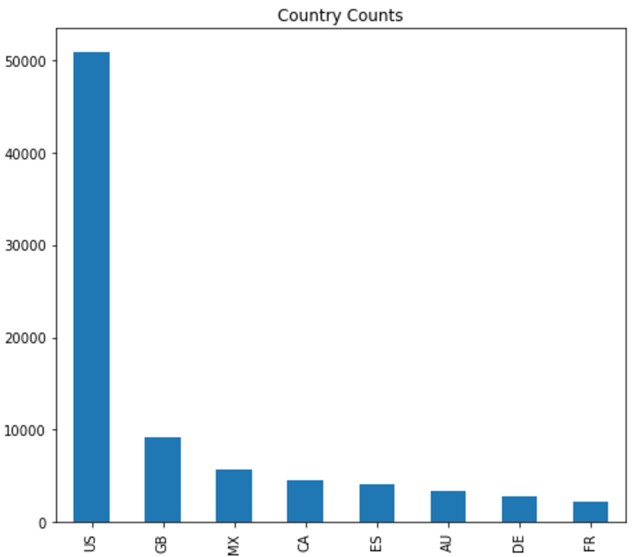
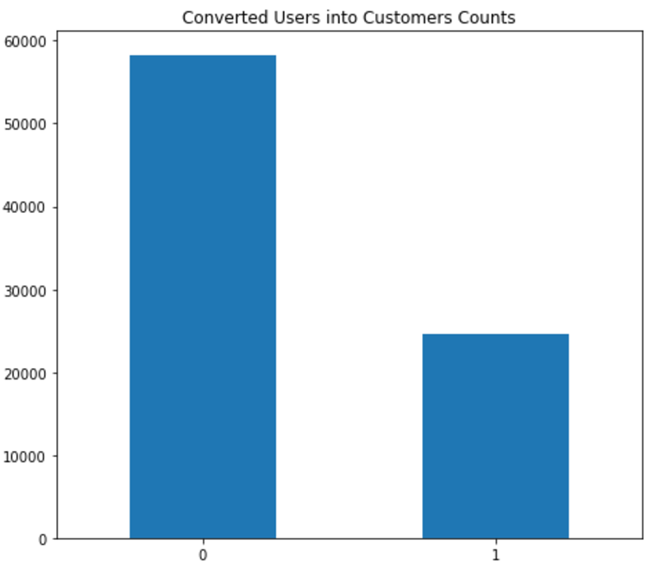
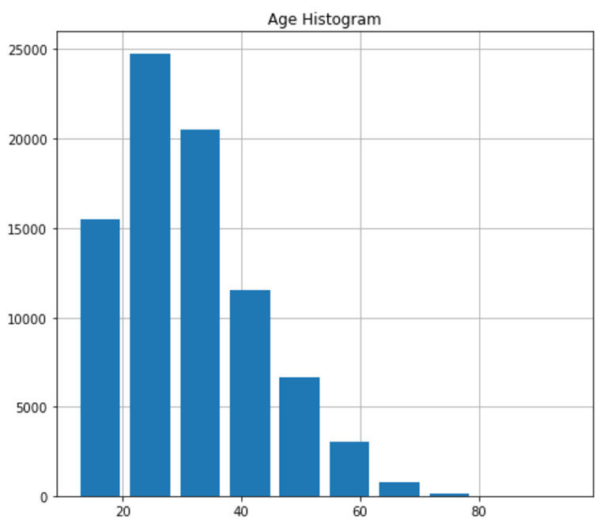
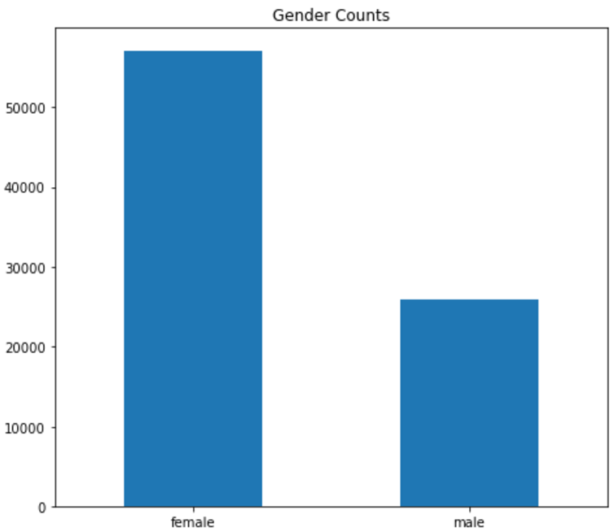
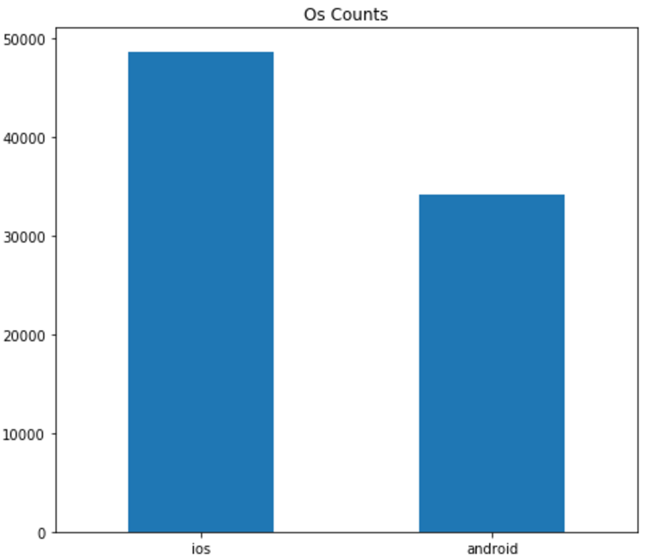
1. Dataset exploration
3
Half of the users in the following three channels: Organic, Pinterest and Facebook
Concentration of users between 15 and 50 years old.
More users using the app on Apple devices
Twice as much female users than male users
USA is by far the biggest market (60%). North America altogether (US, CA, MX) represents 80% of the total users.
70% of users turn into customers.

Slide 4
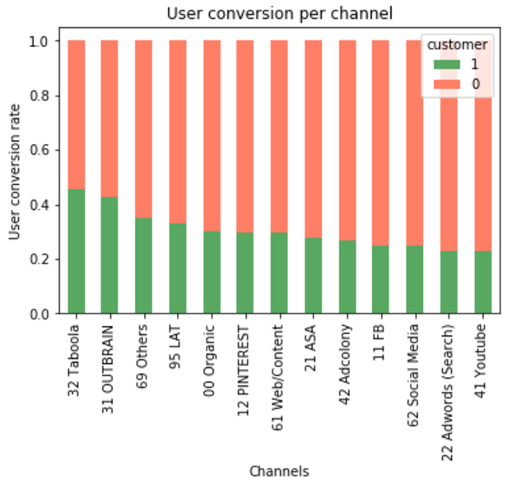
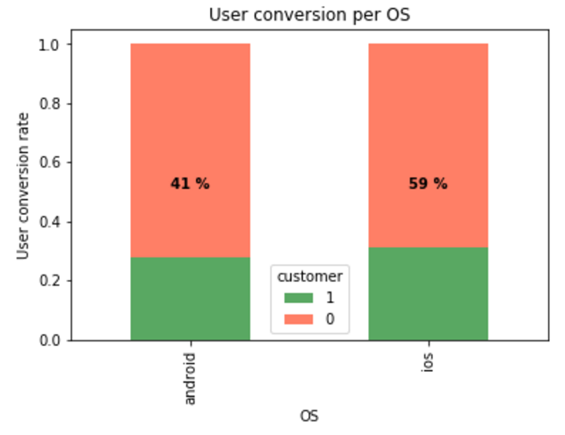
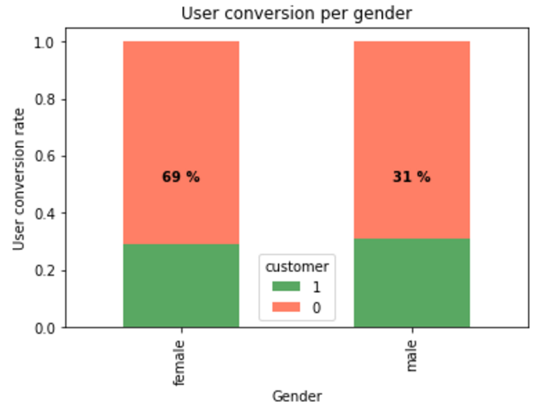
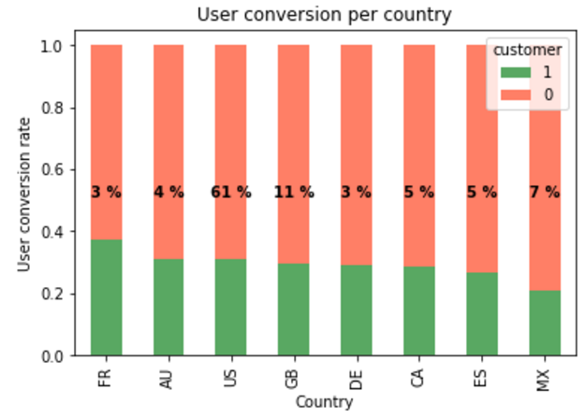
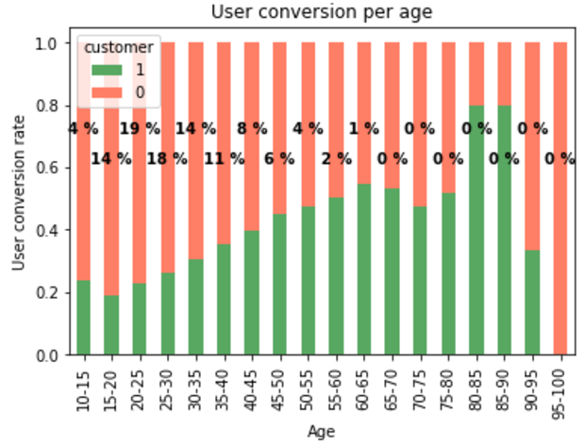
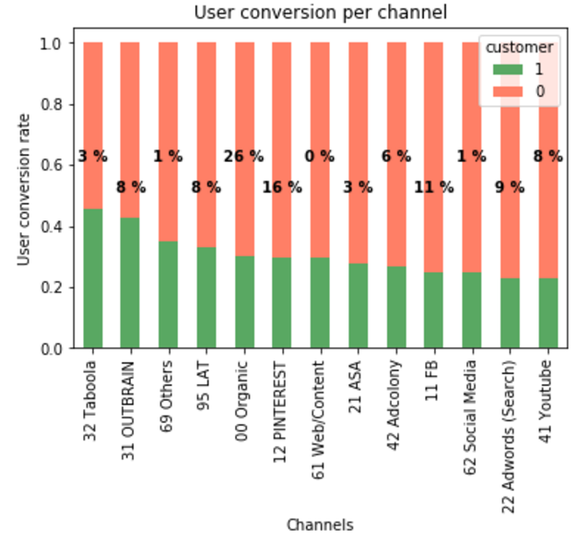
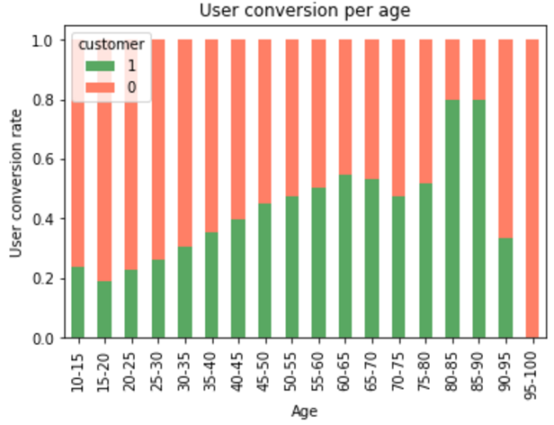
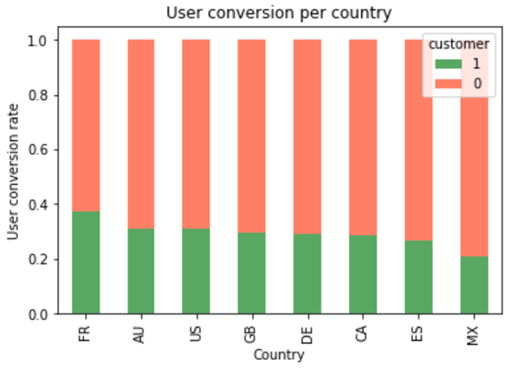
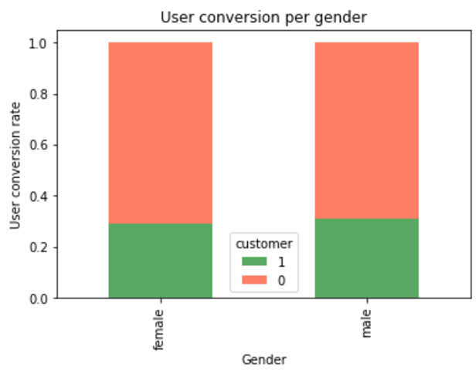
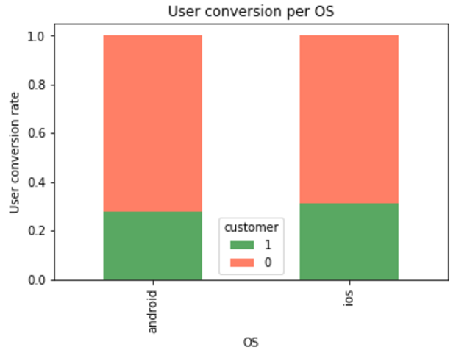
2. First insights
4
Users using the Taboola and Outbrain channels are more likely to convert.
Conversion increase with age. Peak is reached for customers above 60 years old (only 1.5% of total users).
France has the highest conversion rate and Mexico the lowest one but no real significant difference between the countries.
Gender and OS have the same conversion rate for both categories (M & F; IOS and Android) at around 25%.
No real discriminating features

Slide 5
3. Data wrangling
5
Data wrangling is the process of transforming and mapping data from one "raw" data form into another format.
Three pre-processing tools used:
One hot Encoder
Standard Scaler
Polynomial Features
End result is a dataset with only numerical values. Needed for machine learning.
Features: Channel, OS, Gender, Country
All Features
Only interactions between features

Slide 6
4. Classifier Model Selection
6
Dataset
Learning Problem
Learning Algorithm
Customer features
Will convert or not ?
(1 or 0)
Model
Task

Slide 7
4. Classifier Model Selection
7
g
- Target variable is categorical (0 or 1) --> classifier algorithm
- Logistic regression
- decision trees
- SVM
- Naïve Bayes
- Neural Networks
Learning Algorithm:
Similar results across the different algorithms.
Logistic regression chosen for its easier interpretation.
Optimization and selection

Slide 8
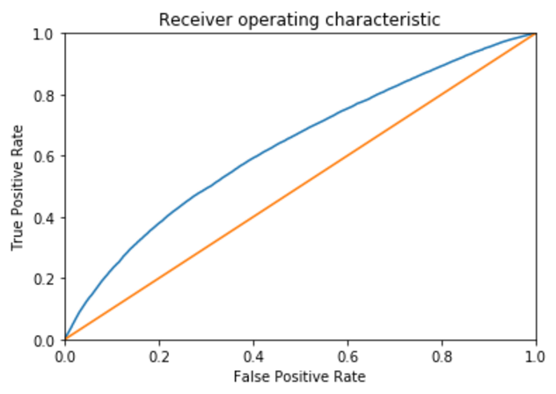
5. Results
8
Dataset divided into a training set and test set
Results:
--> ROC (area under the curve): 63%
Predictions (business decision):
Minimize False Positive Rate
OR
Minimize False Negative Rate
80%
20%
Notes:
True Positive Rate (Sensitivity, Recall) = TP/All Positives = TP/(TP + FN)
False Positive Rate = FP/All Negatives = FP/(TN + FP)
Misclassification rate is error rate for a single threshold. ROC visualizes all possible thresholds.
AUC representing the probability that a classifier will rank a randomly chosen positive observation higher than a randomly chosen negative observation.

Slide 9
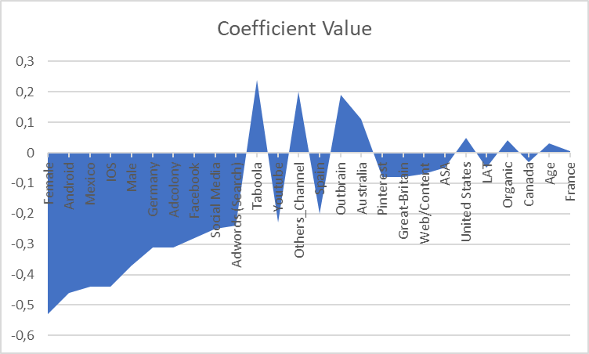
5. Results
9
Coefficient analysis :
Model is discriminating highly in favour of 0
(imbalanced dataset)
Down-sampling led to same results. Problem lies in lack of discriminating features
Notes:
Imbalanced dataset:
The reason we get 70% accuracy on an imbalanced data (with 70% of the instances in Class-0) is because our models look at the data and cleverly decide that the best thing to do is to always predict “Class-0”.
Solution:
- Resampling the dataset (randomly delete user that did not convert to get a balanced dataset)
- anomaly detection
- Choosing a classification threshold is a business decision: minimize False Positive Rate (users that are predicted to convert but do not) or maximize True Positive Rate (users that are predicted to not convert but do) .

Slide 10
6. Recommendations
10
1. Add new features to the model
- Average time spent per day
- Rating of the app
- Physical information (height, weight, etc.)
2. Feature engineering
- Process of creating new input features from existing features
3. Collect more data

Slide 11
Thank you
11

