Slide 1
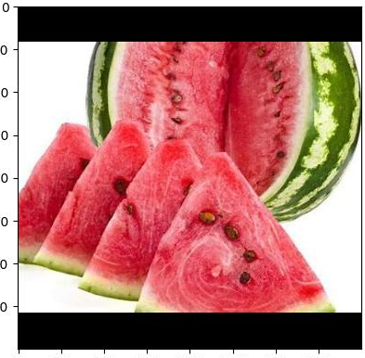
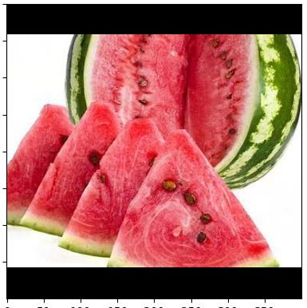
[{'score': 0.7917757, 'name': '西瓜'}, {'score': 0.20364602, 'name': '非果蔬食材'}, {'score': 0.00095761236, 'name': '草莓'}]
[{'score': 0.49676198, 'name': '非果蔬食材'},
{'score': 0.49638596, 'name': '西瓜'},
{'score': 0.0016645615, 'name': '草莓'}]

