Slide 1
Book
Hub
By:
Canedo, Jovian Charles
Catipay, Christian Jake

Slide 2
Description
BookHub is an online library system designed to enhance how students access and interact with educational resources. With a user-friendly interface, students can easily search for, borrow, and reserve books across various genres. The platform also allows users to rate and review books, fostering a sense of community and collaboration that helps guide reading choices.
For administrators, BookHub offers an efficient dashboard to manage book inventories, user accounts, and reservations. Built with a focus on security and accessibility, the platform ensures data protection while remaining accessible on various devices. Ultimately, BookHub aims to bridge the gap between students and literature, encouraging a love for reading and continuous learning.

Slide 3
Objectives
Develop a User-Friendly Platform: The core focus of BookHub is to provide an intuitive, easy-to-navigate interface for students. Whether they are searching for a specific book, browsing through categories, or checking their borrowing history, the platform ensures a seamless user experience.
Implement a Rating and Review System: Encouraging student engagement is vital. BookHub offers a community-driven feature where users can rate books based on their reading experience and leave reviews. This feature not only fosters a collaborative learning environment but also helps students discover new books based on peer recommendations.
Create a Comprehensive Admin Dashboard: The admin dashboard is a crucial component that empowers library staff to efficiently manage book inventories, reservations, and user accounts. Key features include adding, editing, or removing books from the system, generating reports on popular books, and tracking student activity.
Ensure Robust Security and Accessibility: To protect sensitive data, BookHub implements secure authentication and authorization protocols. In addition, the platform is designed to be responsive and accessible on various devices, ensuring that all students, regardless of their location or device, can access the platform.
Streamline Book Returns and Reservations: BookHub simplifies the process of reserving and returning books. Students can quickly reserve books online, and the platform sends reminders for due dates, making it easy to manage their borrowing without hassle.

Slide 4
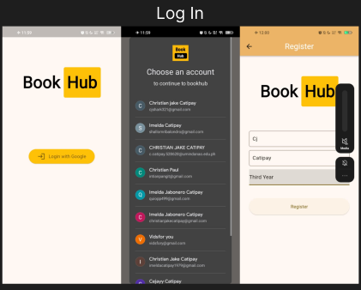
Outputs

Slide 5
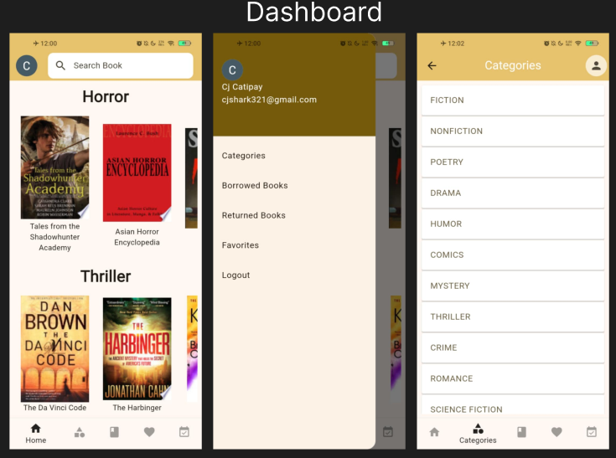
Outputs

Slide 6
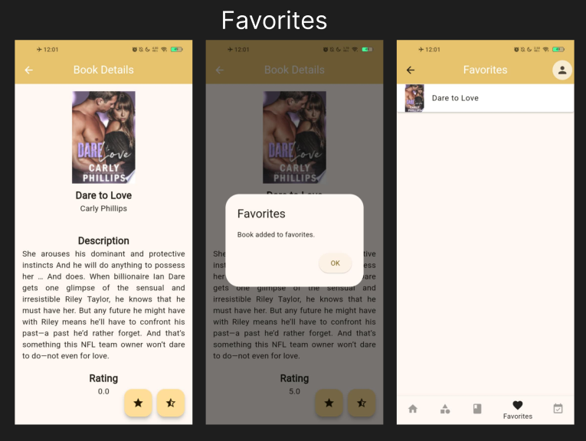
Outputs

Slide 7
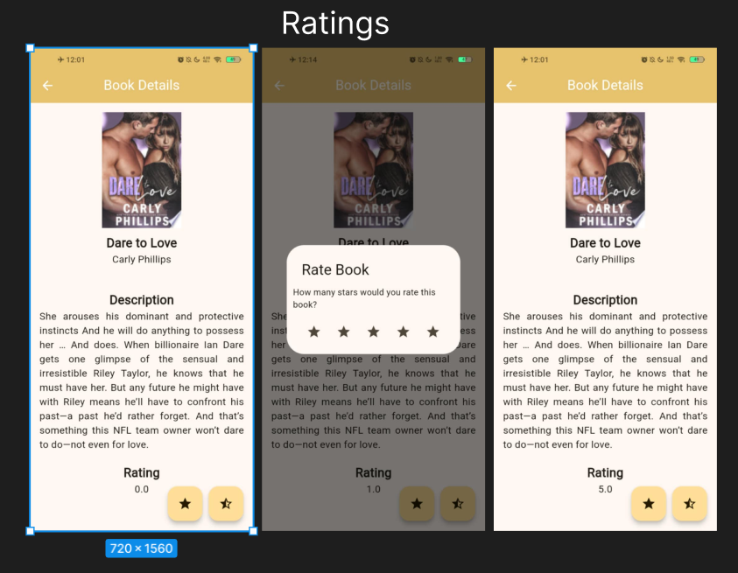
Outputs

Slide 8
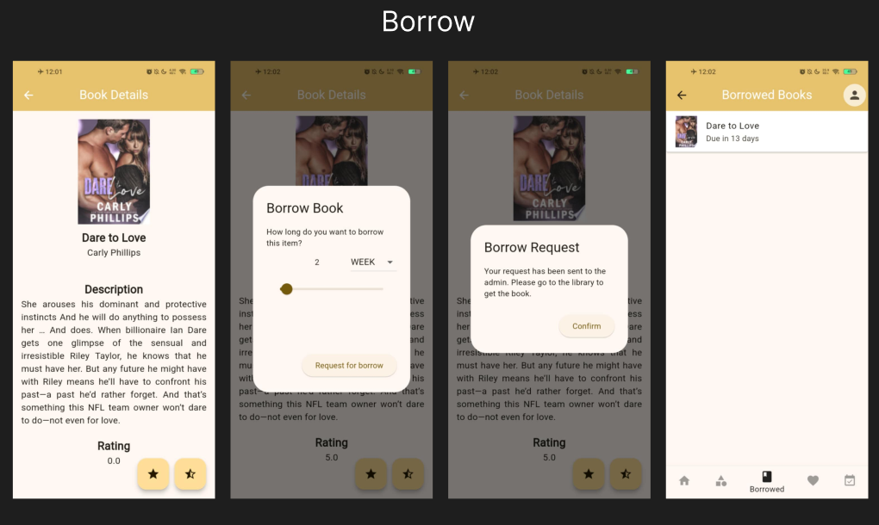
Outputs

Slide 9
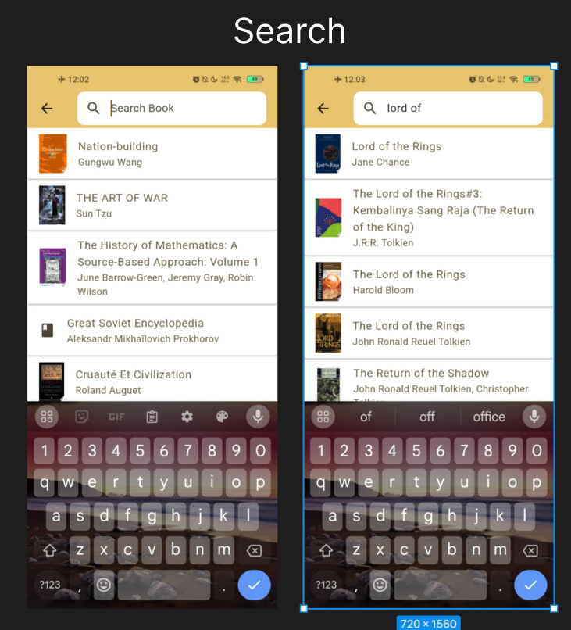
Outputs

