Slide 1
Natural Language Processing
NLTK (Natural Language Toolkit)

Slide 2
Techniques for Processing Text
Convert to lower case
Tokenize text (words, sentences)
Remove punctuation
Remove Stopwords

Slide 3
Convert to lowercase
Many NLP tools assume lowercase
Python has easy s.lower()
s = "ABCDEFG"
s2 = s.lower() # s2 is now "abcdefg"

Slide 4
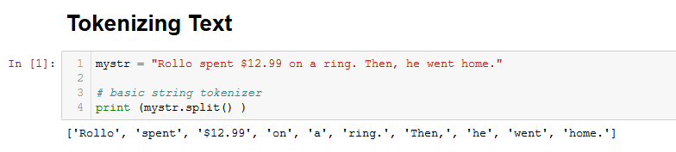
Tokenize with Python string split() function
Note that we get everything delimited by spaces.
We have no easy way of identifying sentences

Slide 5
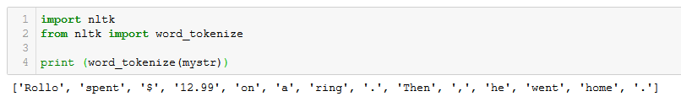
Tokenize with NLTK's word_tokenize
Note that we get more tokens. NLTK gives us punctuation and $ as a separate token – may want or not
But what about sentences??

Slide 6
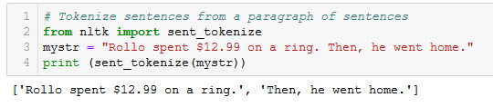
NLTK has a sentence tokenizer (sent_tokenizer)
List of strings – each string a sentence.
It will recognize '?' and '!' as sentence separators

Slide 7
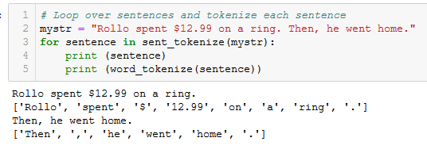
Put it all together
OK, we have sentences. How can we use this to begin to understand what is being said?

Slide 8

Remove Punctuation
Regular Expression (REGEX) Power!
When passing a string for regex to Python, preface string with 'r' – means here is a regex not a regular old string
Replace anything NOT a word character (\w) or NOT a space character (\s) with NOTHING.

Slide 9
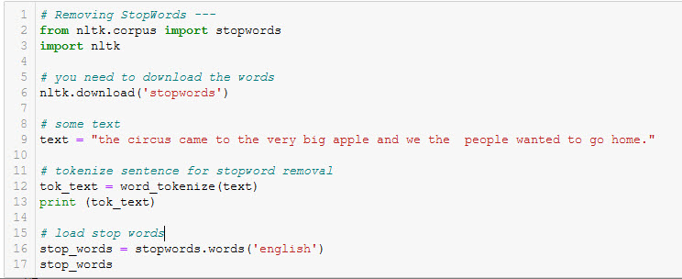
Remove 'stopwords'

Slide 10
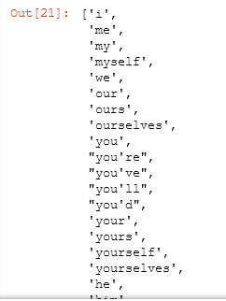
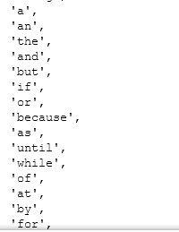
Stopwords from NLTK

Slide 11
Parts of Speech Tagging

Slide 12
Parts-of-Speech (POS) tagging
NLTK provides a pos-tagger that will parse a sentence and for each token in the sentence, attach a part of speech – noun, verb, adverb, pronoun, adjective....
The POS tagger encodes parts of speech as tuples using shortcut codes for the part of speech.
Example: ('Rollo', 'NNP')
rollo is a proper noun

Slide 13
Some common tags – there are more
JJ: adjective ‘big’
JJR adjective, comparative ‘bigger’
JJS adjective, superlative ‘biggest’
NN noun, singular ‘desk’
NNS noun plural ‘desks’
NNP proper noun, singular ‘Harrison’
NNPS proper noun, plural ‘Americans’
VB verb, base form take
VBD verb, past tense took
CD : cardinal digit
DT determiner
WP wh-pronoun who, what
WRB wh-abverb where, when

Slide 14
Help with parts of speech
School House Rock has fun videos to help explain English grammar
Pronouns: https://www.youtube.com/watch?v=cZaMXYAu9h0
Adverbs: https://www.youtube.com/watch?v=sZzG1jg4Ifo

Slide 15
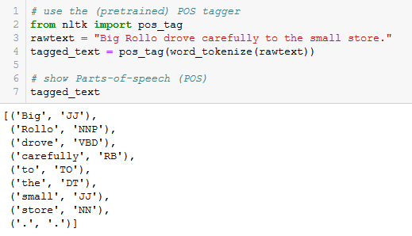
NLTK has pos_tag for tagging words with parts of speech
List of tuples

Slide 16
Think Data Flow

Slide 17
Data Flow Pipeline : data flows through a pipeline of functions, each of which performs a single data transformation task.
RAW TEXT
raw text
tokenize into sentences
parts of speech for each token
tokenize sentences into word tokens

Slide 18
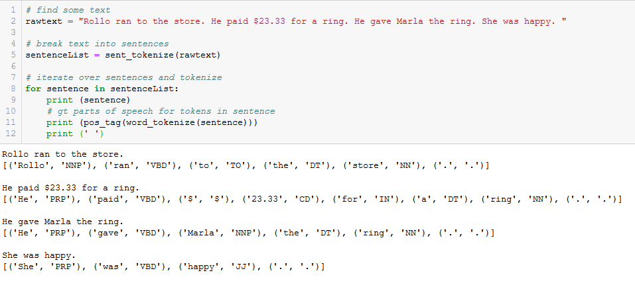
Data Flow..

Slide 19
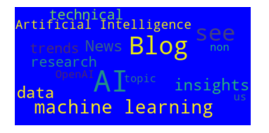
Creating a Word Cloud

Slide 20
Objective: For some given Corpus of Text
extract all the text
analyze the text to determine what the page is about
Create a Word Cloud that characterizes the text
Data Flow : data flows through a pipeline of functions, each of which performs a single data transformation task.

Slide 21
Data Flow Thinking is Functional Thinking
Word Cloud
Data Flow Pipeline : data flows through a pipeline of functions, each of which performs a single data transformation task.
text
List of the most frequent words in the document
convert to lower case
remove punctuation
remove 'stop' words ("the", "an", ...)
Get a count of the most frequent words. Focus on the top N words.

Slide 22

Data Flow Thinking is Functional Thinking
Word Cloud
Data Flow Pipeline : data flows through a pipeline of functions, each of which performs a single data transformation task.
remove from your own list of stopwords
text
List of the most frequent words in the document
convert to lower case
remove punctuation
remove 'stop' words ("the", "an", ...)
Get a count of the most frequent words appear. Focus on the top N words.

Slide 23


WordCloud – from a string of words
A string that contains all the text
OR... eliminate stopwords
list of stopwords

Slide 24
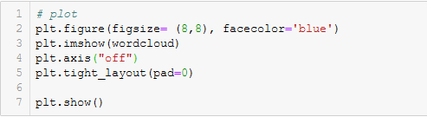
WordCloud – from a string of words

Slide 25
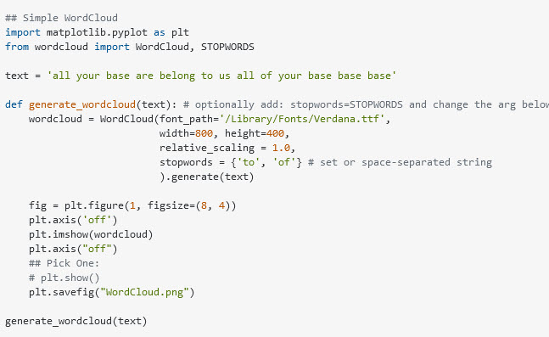

WordCloud 2

Slide 26
Named Entity Recognition

Slide 27
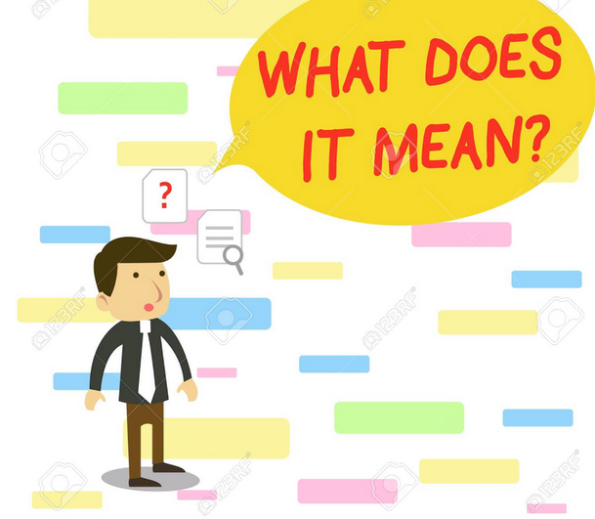
.. some text.....blah blah ..... blah.. blah

Slide 28
.. some text.....blah blah ..... blah.. blah
Person, Place or Thing?
Maybe if we knew what the sentences are referring to, we might have a chance?

Slide 29
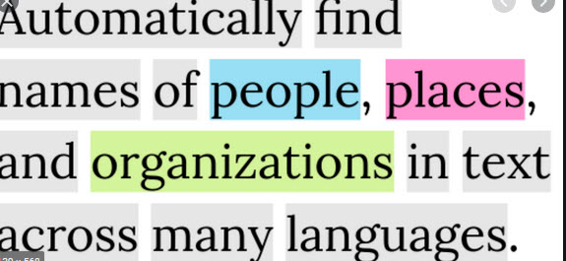
What is Named Entity Recognition

Slide 30
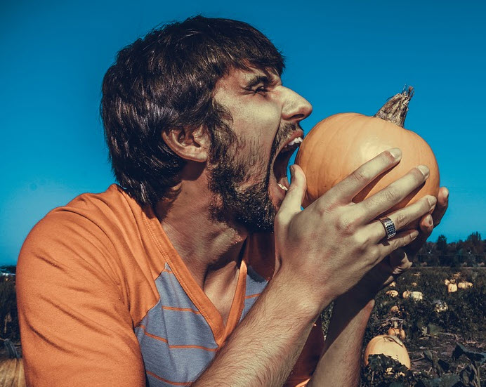

The Challenge: Entity Recognition (What are the things we talking about?)
mmmmm, CHUNKS!
NTLK to the rescue: It can find Persons, Organizations and Places within text.
The service is call ne_chunker :
ne = named entity

Slide 31
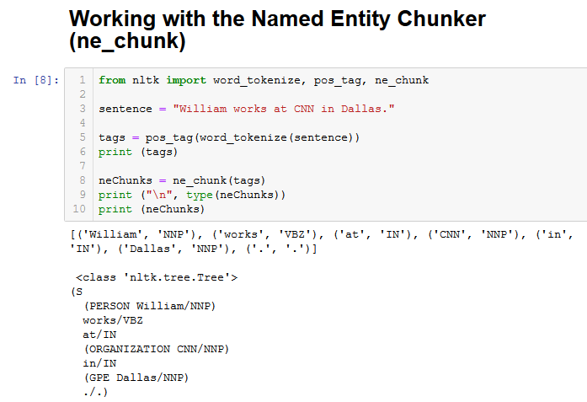
The NLTK ne_chunker finds Persons, Organizations and Locations
ne_chunk takes: a pos_tag list as input
ne_chunk returns an NLTK Tree with sub-trees and leaf nodes

Slide 32
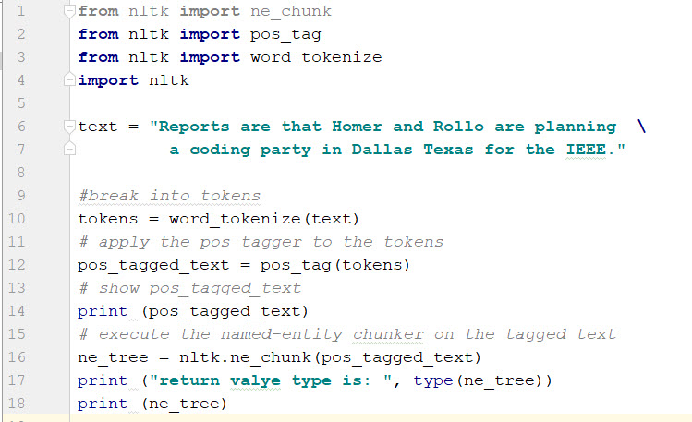
return value type is: <class 'nltk.tree.Tree'>
(S
Reports/NNS
are/VBP
that/IN
(PERSON Homer/NNP)
and/CC
(PERSON Rollo/NNP)
are/VBP
planning/VBG
a/DT
coding/VBG
party/NN
in/IN
(GPE Dallas/NNP Texas/NNP)
for/IN
the/DT
(ORGANIZATION IEEE/NNP)
./.)
[('Reports', 'NNS'), ('are', 'VBP'), ('that', 'IN'), ('Homer', 'NNP'), ('and', 'CC'), ('Rollo', 'NNP'), ('are', 'VBP'), ('planning', 'VBG'), ('a', 'DT'), ('coding', 'VBG'), ('party', 'NN'), ('in', 'IN'), ('Dallas', 'NNP'), ('Texas', 'NNP'), ('for', 'IN'), ('the', 'DT'), ('IEEE', 'NNP'), ('.', '.')]

Slide 33
Extracting Data from an NLTK.tree.Tree

Slide 34
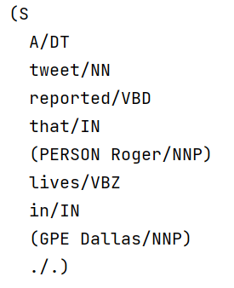
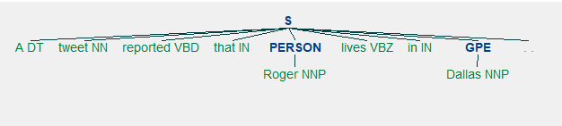
Extracting Data from a Tree
start with a sentence: A tweet reported that Roger lives in Dallas.
# process the sentence to create the tree with Entities
tagged_sentence = (pos_tag(word_tokenize(sentence)))
tree = nltk.ne_chunk(tagged_sentence)
tuples
trees

Slide 35
Extracting Data from a Tree -2
# the number_items in the tree = number of words in the sentence
number_items = len(sentence.split())
#each tree item is available using an index 0..number_items
for idx in range(number_items):
print (tree[idx], '\t', type(tree[idx]))
tree[0][0] is 'A'
('A', 'DT') <class 'tuple'>
('tweet', 'NN') <class 'tuple'>
('reported', 'VBD') <class 'tuple'>
('that', 'IN') <class 'tuple'>
(PERSON Roger/NNP) <class 'nltk.tree.Tree'>
('lives', 'VBZ') <class 'tuple'>
('in', 'IN') <class 'tuple'>
(GPE Dallas/NNP) <class 'nltk.tree.Tree'>
tree[2][0] is 'reported'
tree[4].label() is 'PERSON''
tree[4][0][0] is 'Roger'

Slide 36
Colocation and Sentiment Analysis

Slide 37
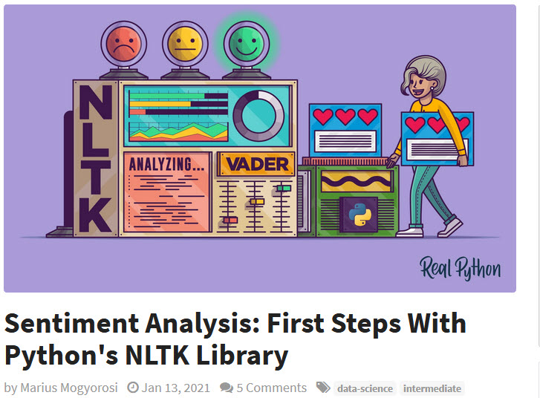
Great Article!
https://realpython.com/python-nltk-sentiment-analysis/

Slide 38

Collocations
Collocation – a series of words that appear together
Bigrams – frequent two-word combinations
Trigrams – frequent three-word combinations
Quadgrams – frequent four-word combinations

Slide 39

Sentiment Analysis
NLTK has VADER (Valence Aware Dictionary and sEntiment Reasoner)
VADER is BEST suited for language used in social media, like short sentences with some slang and abbreviations.
LESS accurate when rating longer, structured sentences, but a good launching point.
Adds to 1
Normalized value in range -1.0 (negative) to 1.0 (positive)

Slide 40
Summary

Slide 41
Summary
Techniques for cleaning text
remove punctuation
convert to lowercase
removing stopwords
Tokenizing Text
word tokenizer
sentence tokenizer
Word Cloud
Parts of Speech Tagging
Named Entity Recognition

