Slide 1
BA Customer Reviews Analysis
Sentiment Analysis & Key Insights Summary findings and recommendations.
This analysis covered 3853 customer reviews, with a specific focus on sentiment, key topics, and frequently mentioned terms.
The sentiment scores follow a near-normal distribution, indicating that most customer experiences fall within a moderate range, with fewer extreme positive or negative experiences. While the overall sentiment is favorable, there is still a noticeable portion of negative sentiment. This highlights areas where BA could focus on improving customer satisfaction and addressing pain points.
The topic modeling and word cloud indicate for example that "service, staff, crew" are frequently mentioned in both positive and negative contexts. It will be ideal to Invest in customer service training for staff, focusing on responsiveness, empathy, and problem-solving. And BA should consider implementing customer feedback loops to continuously improve service quality.

Slide 2
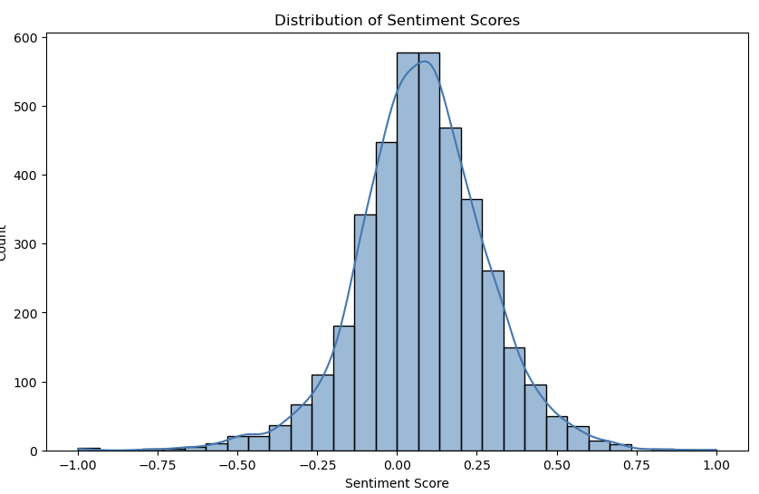
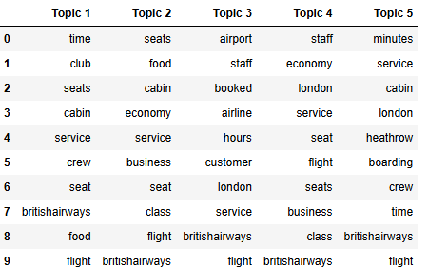
Overview & Key Findings
Key Metrics:
• Positive Reviews: 66.6% • Negative Reviews: 32.5% • Neutral Reviews: 0.9%
Recommendations:
• Improve customer service:
• Enhance seating comfort • Focus on punctuality and reliability • Optimize in-flight experience • Align pricing with customer expectations

