Slide 1
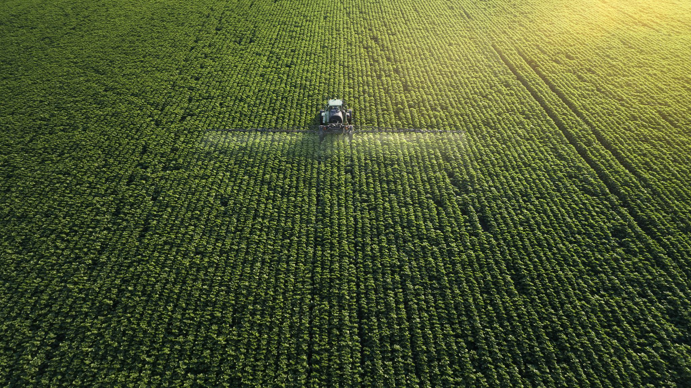
Harvesting Insights: The Economic Impact of Corn and Soybeans on Rural America
Analyzing 15 Years of Crop Trends to Forecast Rural Development and Economic Indicators

Slide 2
Exploratory Data Analysis

Slide 3
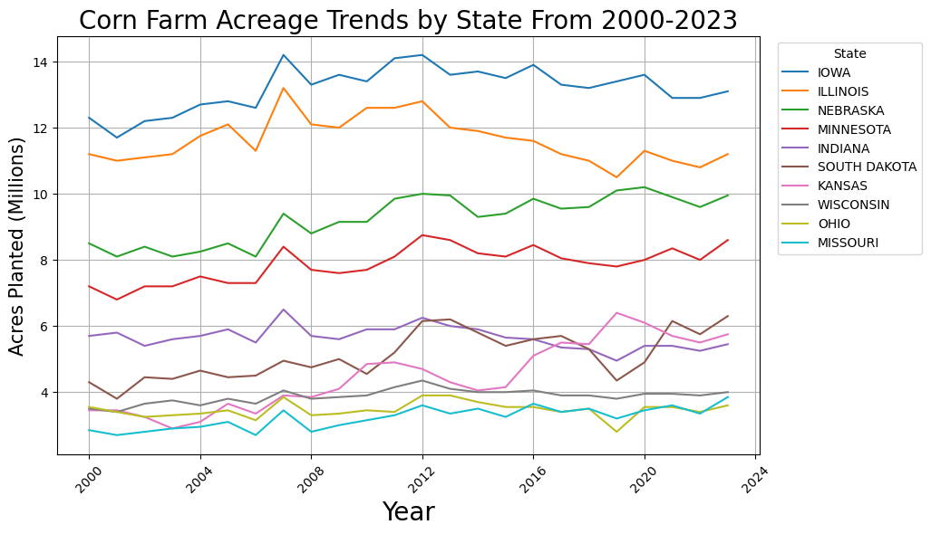
Notes:
This boom in farmland around the 2007 mark stands out as a particularly interesting phenomenon.
The housing market crash in 2007 is one possible explanation for this rapid growth in farmland. As the economy took a turn for the worse, farmland as an asset grew in popularity since it was considered a low-risk investment.
Additionally, following the collapse of the housing market and rising foreclosure rates, housing development suffered. The decreasing demand for land in which to develop houses upon likely contributed to the availability of land for agricultural purposes.

Slide 4
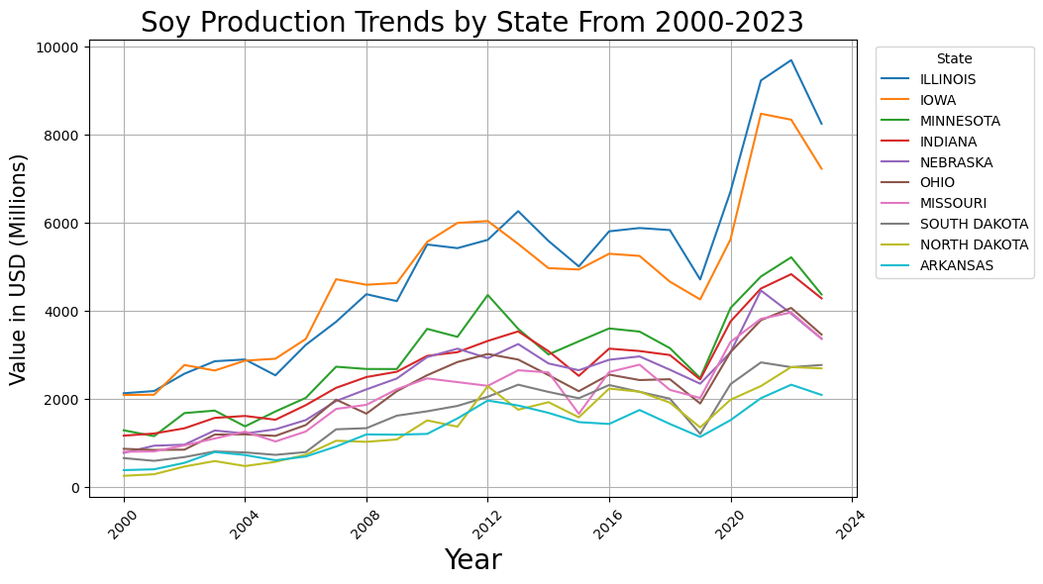
Notes:
Most states show a rather slow and steady decline in their corn and soy production after the year 2012 up until a final dip in 2019 (which can most likely attributed to COVID)
Many states were able to bounce back from COVID in a very impressive fashion, producing more corn and soy than ever before.
The rise in farm production post-COVID-19 is a complex issue influenced by multiple factors.\
Initially, the pandemic disrupted agricultural supply chains due to labor shortages, transportation restrictions, and logistical bottlenecks. \
However, agriculture showed resilience compared to other industries, particularly because it is essential for food security.
Globally, the COVID-19 pandemic emphasized the need for more robust and shorter food supply chains. Many governments began to invest in agriculture to ensure food security and resilience in the face of future crises. Technological advancements and sustainability efforts, such as improving farm efficiency and reducing environmental impact, are also driving the recovery and growth in the sector​

Slide 5
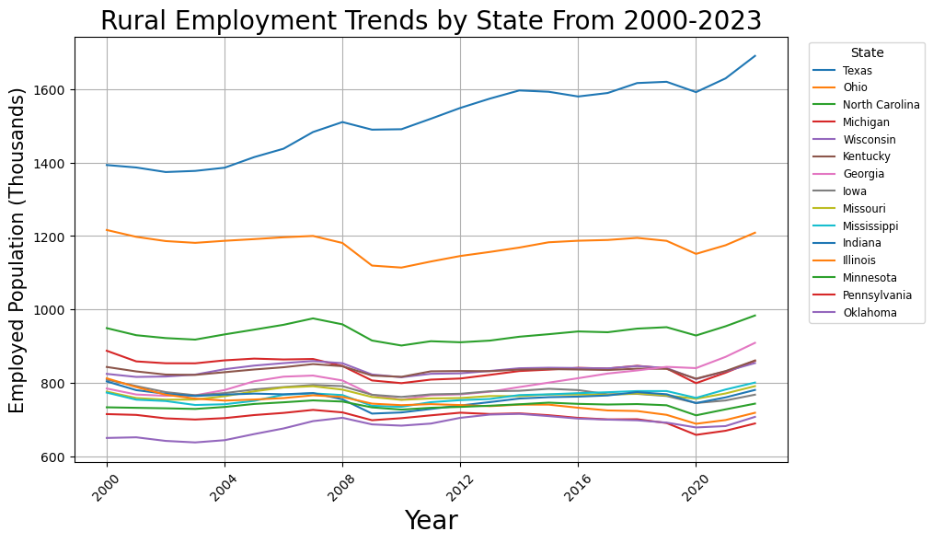
Notes:
The two biggest drops in employment being appropiately displayed by the housing market crash of 2007 and COVID pandemic of 2019.
Because of how essential the agricultural industry is to society as a whole. Employment rates in this market should not be expected to drop as much as employment in other industries such as hospitality.
During the COVID-19 pandemic, farmers and farmworkers were recognized as essential workers, playing a crucial role in maintaining the nation's food supply.
Despite the significant risks to their health, many continued working to ensure that food production and distribution remained uninterrupted.

Slide 6
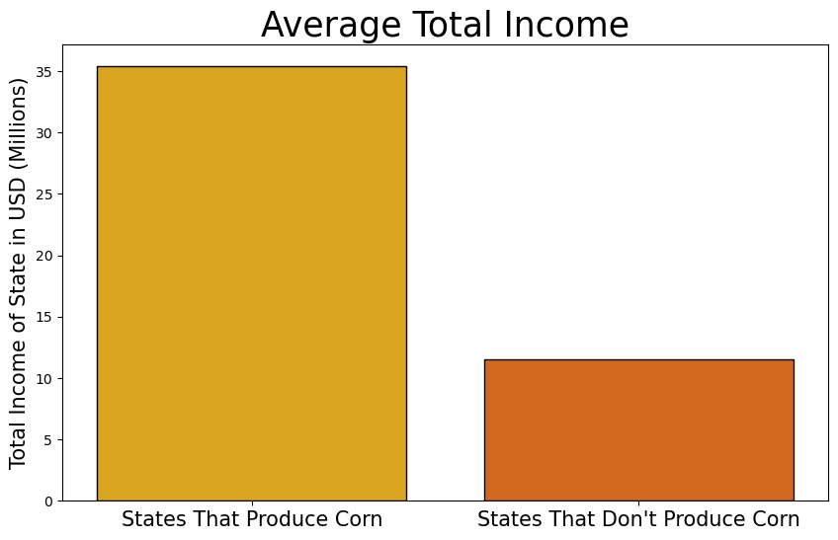
Notes:
Corn farming is a major driver of economic activity, particularly in rural states, with its impact extending beyond just agricultural output.

Slide 7
Corn Industry in 2023
GDP
Jobs
Economic Output
$62 billion contributed
600,000 nationwide
$151 billion
Notes:
In 2023 alone, U.S. corn farmers generated 151 billion dollars in economic output, contributing 62 billion dollars to the Gross Domestic Product (GDP) and supporting over 600,000 jobs nationwide.
The income generated by corn farming boosts not only the farmers themselves but also the broader economy, contributing to higher personal incomes in regions where corn farming is a central industry.
Therefore corn-producing states often see higher total personal incomes compared to states without significant corn production due to the industry's wide-reaching economic effects.

Slide 8
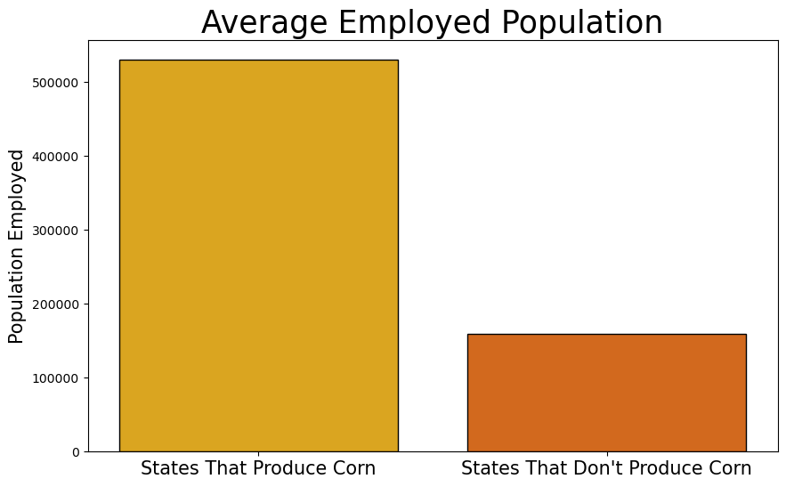
Notes:
Agriculture has a high demand for labor, many of which extend beyond traditional farming roles, including our work which we are doing now as Data Scientists.
With advancements in agricultural technologies and practices, new job opportunities are emerging in areas such as agribusiness, environmental management, and biotechnology.
For instance, roles such as biochemists, environmental engineers, and data scientists focused on crop production are in high demand.
There is also a growing need for jobs in fields like agricultural education, pest management, and ecosystem services, where professionals help implement and manage sustainable practices.
Overall, agriculture is expanding into areas that blend science, technology, and sustainability, offering career paths in both on-farm and off-farm sectors.

Slide 9
Positively Correlated Factors
Corn & Soy Farm Acreage, Production, & Value
0.26
Personal Rural Income
Corn & Soy Farm Acreage, Production, & Value
0.42
Rural Employment
Notes:
Rural Employment displays a high positive correlation with all corn/soy-related variables such as farmland, production volume, and commodity value.
This suggests that as rural employment increases, corn & soy metrics such as acres planted and yield also increase.
Personal Income similarly shows a positive correlation with the same variables. So we can interpret that higher personal income in rural areas correlates with greater corn productivity.

Slide 10
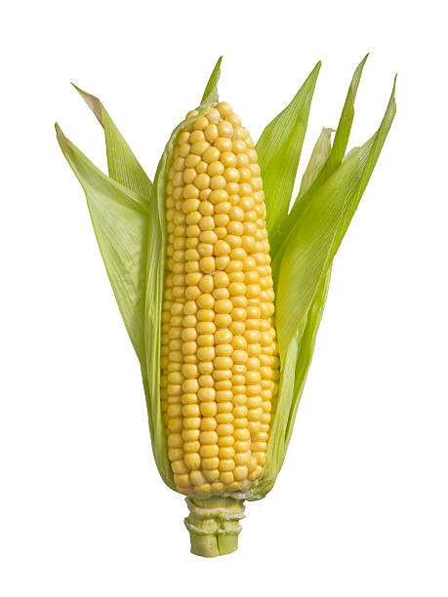
EDA Summary
Production:
Corn & soy production is trending upwards.
Employment:
Agriculture jobs are stabler than other industries.
Economic Impacts:
Intertwined nature of agricultural productivity, economic stability, and employment.
Notes:
Our Exploratory Data Analysis identified important relationships between corn and soybean production and rural economic factors.
We observed how agricultural production trends steadily upwards in the past 20 years, especially after the 2007 housing market crash, which redirected investment towards farmland, considered a safer asset at the time.
There were some substantial drops in employment which occurred during the 2007 housing crash and the 2019 COVID-19 pandemic.
However, agricultural jobs remained more stable than other industries because of their essential role in maintaining food supplies.
Corn and soy our the two leading drivers of the agriculture in the United States, and have been a significant contributor to the U.S. economy.
Its economic influence is felt beyond just farming communities,
the agriculture industry has expanded beyond traditional roles, with growing demand for positions in agribusiness, biotechnology, environmental management, and data science.
The need for professionals to address sustainability, improve efficiency, and manage ecosystem services is increasing, creating diverse career paths in the agricultural sector.
This analysis underscores the intertwined nature of agricultural productivity, economic stability, and employment in rural America.

Slide 11
Preprocessing Data

Slide 12
1. Merging Data
Getting Data Ready for Modeling
2. Handling Missing Values
3. Removing Duplicates
4. Renaming / Categorizing Columns
5. Scaling & Normalization
6. Feature Selection & Engineering
7. Dealing with Collinearity

Slide 13
Predictive Modeling

Slide 14
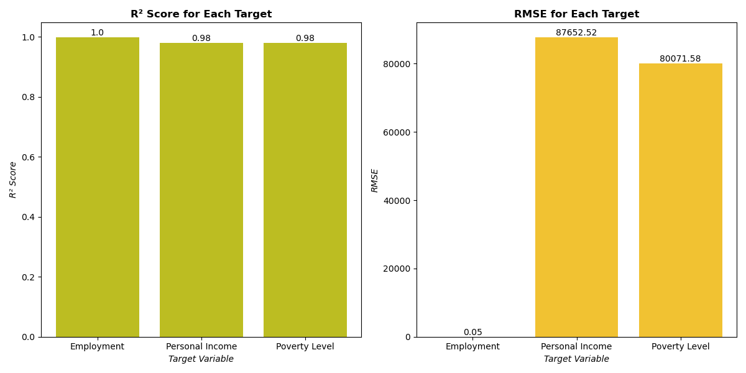
Linear Regression Model Results

Slide 15
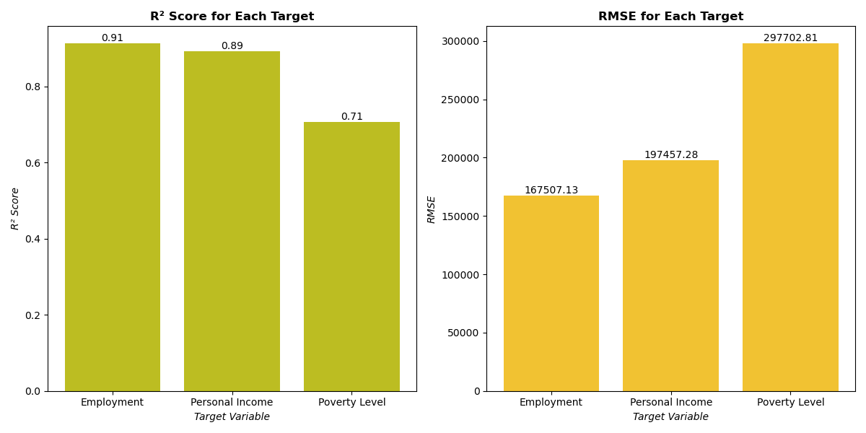
Decision Tree Model Results

Slide 16
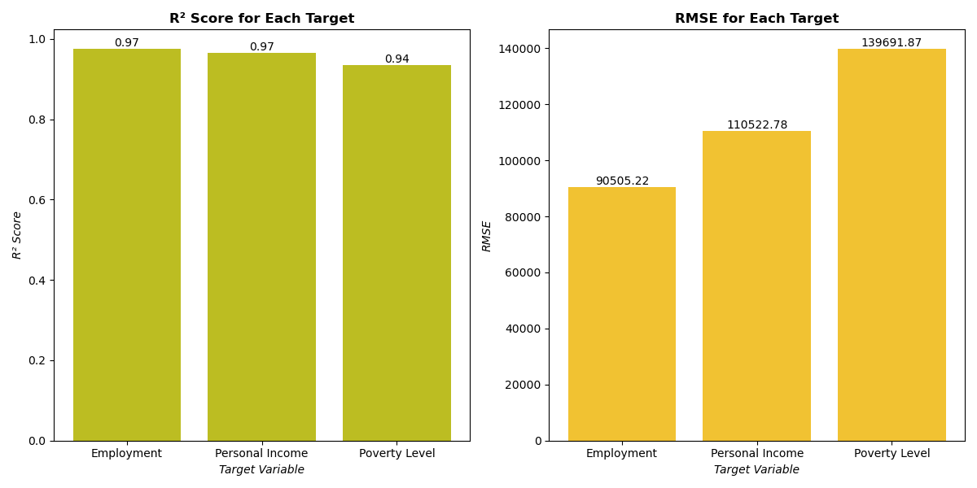
Random Forest Model Results

Slide 17
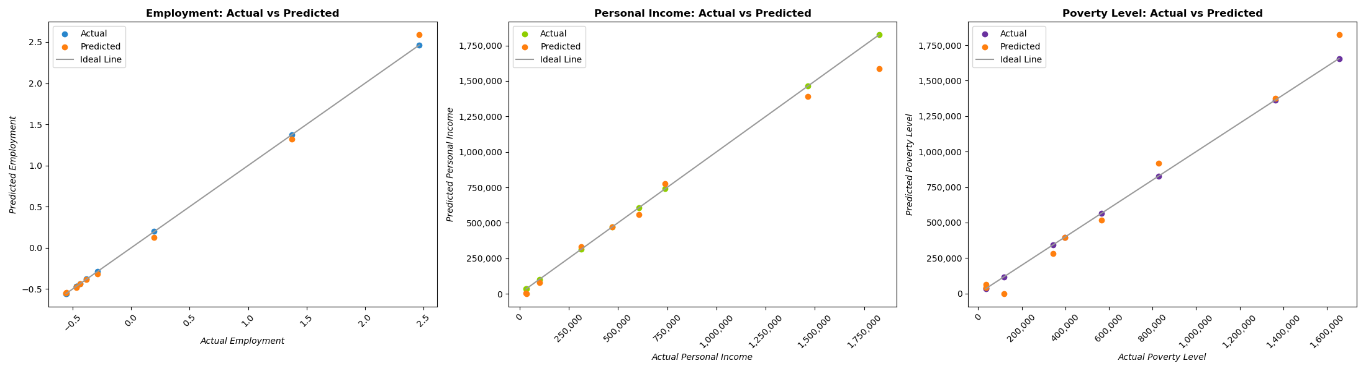
Best Model: Linear Regression

Slide 18
Conclusion

Slide 19
EDA
Modeling
Corn and soy farming are significant contributors to the U.S. economy, their economic influence is felt beyond just farming communities, raising incomes in corn-producing regions.
Following a recession, the corn and soy industries are resilient and dependable due to their necessities in maintaining a stable country.
Income and employment show positive correlations with corn and soybean production metrics.
Corn and soybean production data have strong predictive potential for employment and moderate potential for personal income in rural areas because they are likely closely tied to the agricultural sector, making crop production trends good indicators of rural employment and income.
Poverty levels, seem to be influenced by more complex factors beyond crop productivity like policy, local economic conditions, and demographic factors.
Future research could explore integrating other datasets like government assistance programs and local economic policies.

