Slide 1

Agile & SCRUM
Hack Your Future Belgium 2021

Slide 2


Agile mindset
A different way of looking at working together

Slide 3

What’s this “agile” all about?

Slide 4
Agile Manifesto
https://agilemanifesto.org/
Individuals and interactions over processes and tools Working software over comprehensive documentation Customer collaboration over contract negotiation Responding to change over following a plan
That is, while there is value in the items on the right, we value the items on the left more

Slide 5
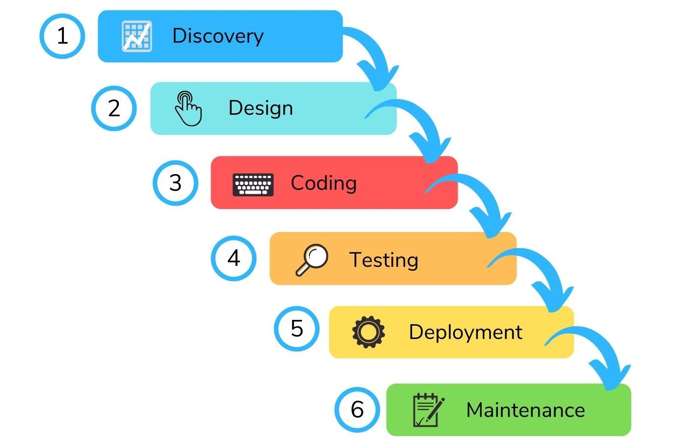
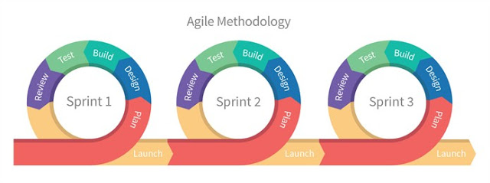
Classic waterfall versus agile
Waterfall
Agile
Break down that lengthy waterfall into a series
of short successive iterations, which all contain
the same basic activities. Show results per iteration.

Slide 6
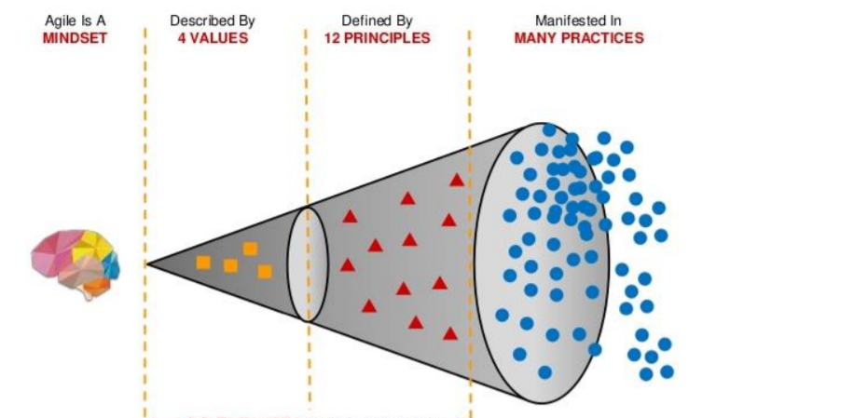

Slide 7

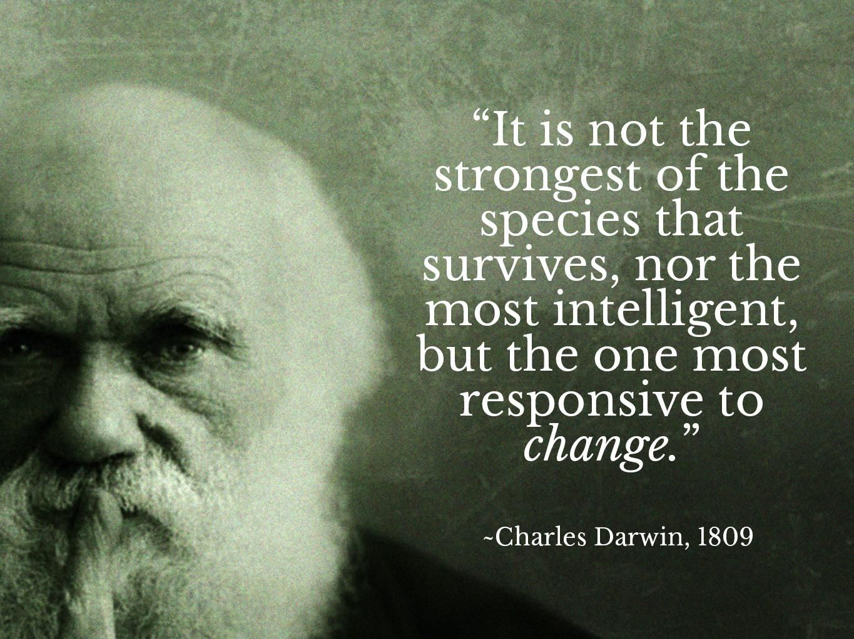
And remember ...
If things don’t
go as planned,
don’t panic,
but adapt !

Slide 8
SCRUM FRAMEWORK
A prescriptive set of rules and practices that help teams work in agile fashion

Slide 9
See next slide for a more conventional overview ☺

Slide 10
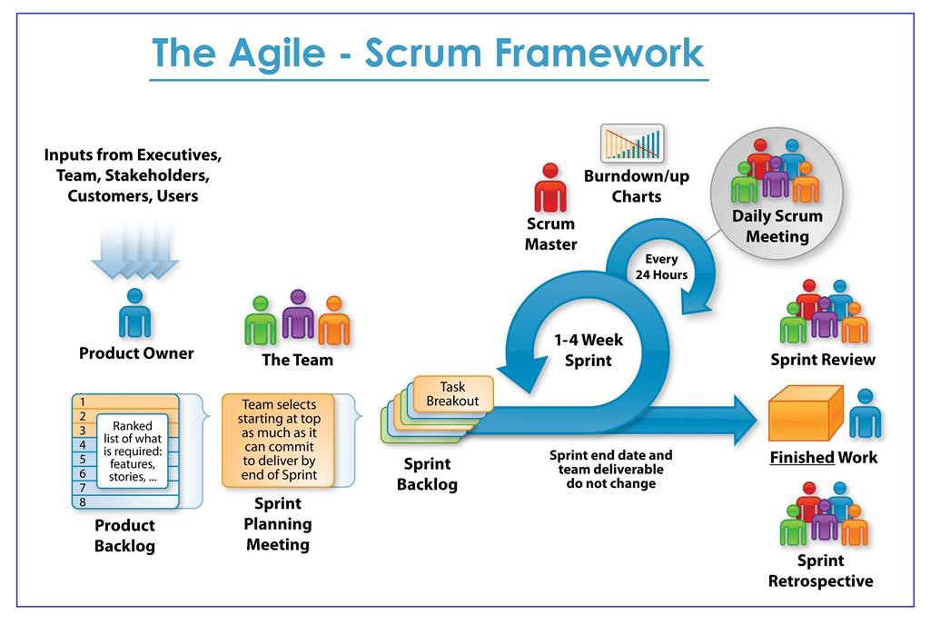

Slide 11

Your coaches are your
best friend, but you can
also reach me on the HYF Slack
https://hackyourfuturebe.slack.com/team/U01G7SKVB1U

